Slide 1
NACE Education Presents:
Corrosion Control for Emergency Backup Systems That Cannot Fail
Octane Systems Inc.

Slide 2
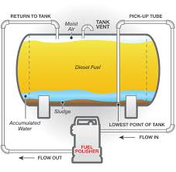
What We Will Cover
The installation of a special type of filtration system that
removes the vast majority of corrosion risk to
emergency generators caused by acidification of the fuel
SAE J1488

Slide 3
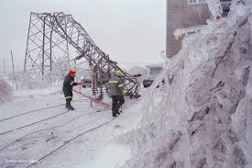
When Generators Do Fail
A failure during a crisis is at the worst possible time
Greatest risk to life and health
Business continuance risk
Operating 7/24, maximum stress on generators

Slide 4

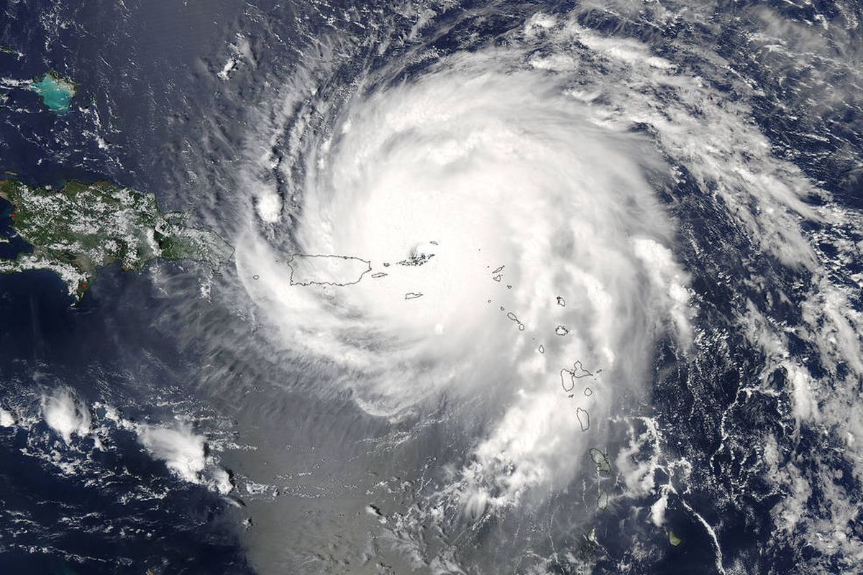
Risk to Life and Health
Irene 2011
Isaac 2012
Sandy 2012
Arthur 2014
Hermine 2016
Matthew 2016
Irma 2017
Nate 2017
Harvey 2017
Maria 2017
Florence 2018
Michael 2018
Hospitals: failures put life at risk
Water and waste water treatment plants: failures put health at risk

Slide 5
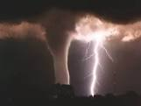

Costs and Liabilities
Financial institutions and business: Failures can have large liability cost
Cost of replacing generators, tanks
Tanks failing in 10 years, normal life 30+ years, before corrosion

Slide 6
Corrosion, Greatest Threat to Emergency Generators
Last line of defense, no single point of failure
Now, single point of failure, acidified fuel
35,000 psi, designs for 60,000 + psi
Acidified fuel corrodes injectors tips
Bonded/emulsified water pits injectors tips
Heat + water = steam explosion, pits injectors
Injector holes/needle tips micron size
Fuel must be dry, clean and non acidic !!

Slide 7
Timeline - Water in Diesel 1
1900 to 2006 – for over a century, fuel kept usable with regular removal of sludge and freestanding water from the tank bottom
2006 to Now – Ultra Low Sulfur Diesel (ULSD) introduced,
sulfur 500 ppm to 15 ppm
*KEY* Changed fuel chemistry!!!
Change One - lubrication removed, immediate catastrophic engine wear/failure, fixed with additives and fuel components

Slide 8
Timeline - Water in Diesel 2
Change Two - InterFacial Tension (IFT) dropped with additives and fuel components: IFT ability of two fluids to repeal each other
With IFT, emulsified water absorbed into the fuel column and bonds with the diesel, 2006 to now
*KEY* Bonded/emulsified water difficult to remove
*KEY* 2010 - SAE J1488 updated to reflect difficulty in removing bonded/emulsified water.
More on SAE J1488 later

Slide 9

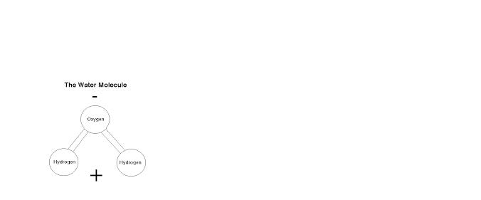
Why the Drop in IFT? Hydrogen Bonds
Hydrogen bonds between the oxygen atom in water and the hydrogen atom in biodiesel. Many attachment points.
Biodiesel Molecule

Slide 10
Why Corrosion Now?
*KEY* water has migrated into the fuel column as bonded/emulsified water. Microbes have followed:
growth volume/population, microbes produce acids
Main corrosion factors: location of the bonded/emulsified water in fuel column with microbial growth
Why the migration: polar bonds – additives, fuel components, and water molecules are all polar, difficult to remove

Slide 11
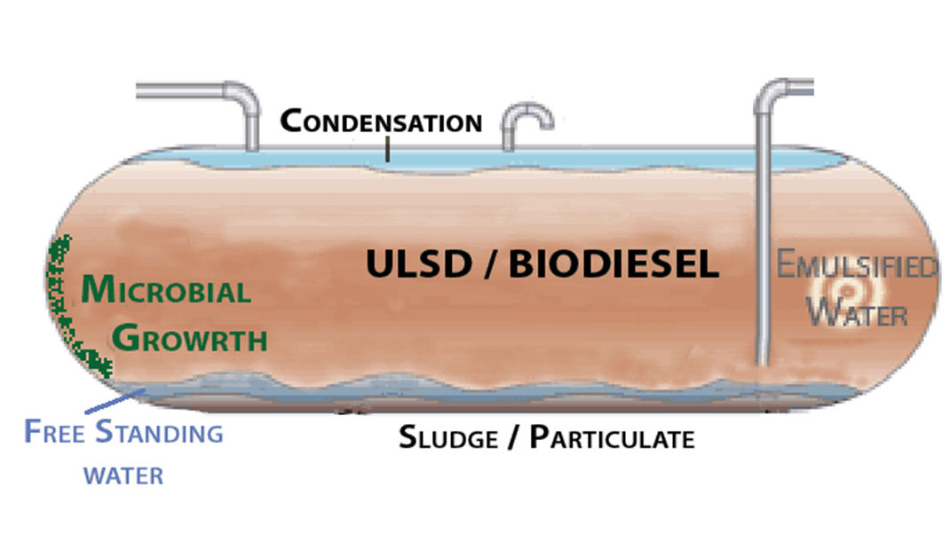
Summary: Acidification and Bonded/Emulsified Water in Diesel
Bonded/emulsified water absorbed into fuel from air and water bottoms
Great increase in microbial growth volume / population / acids
Risk of generator failure: injectors corroded, pitted by emulsified water
Reduces life cycle of gensets, tanks, metal fittings, piping
Shortens storage life of fuel

Slide 12
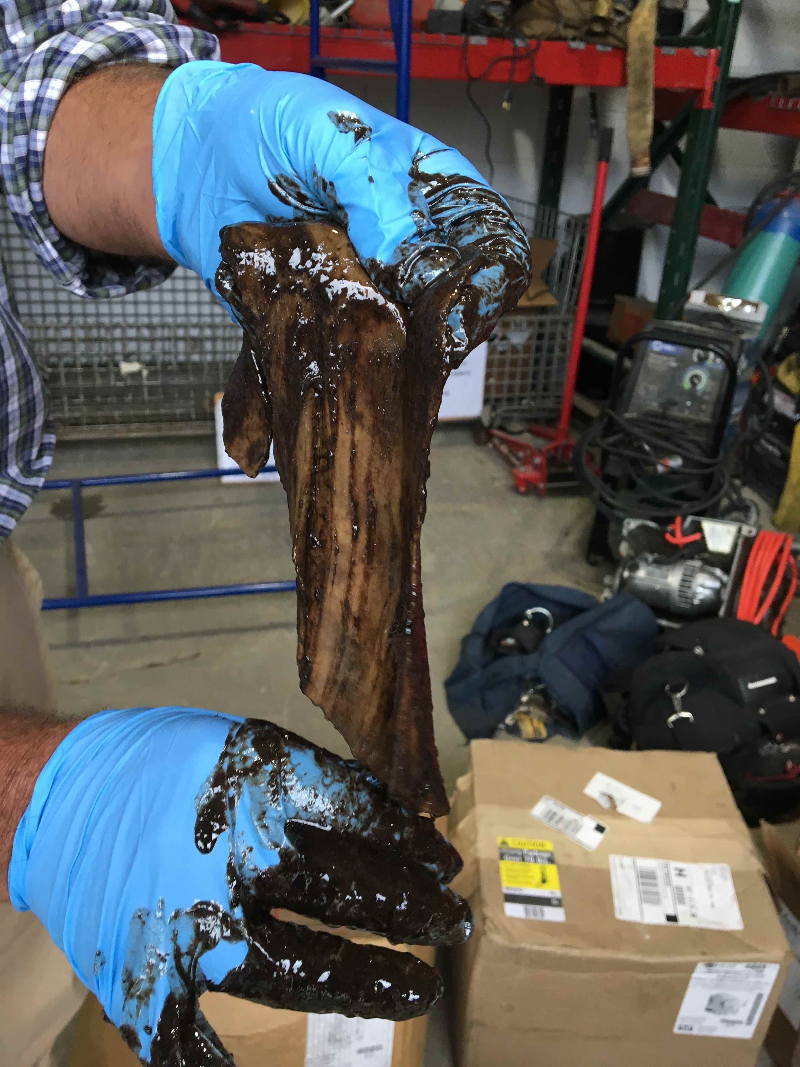
New - Biofilms
“WOW. Never saw anything like this, check out the last picture. This was the consistency of boiled pig skin. It was lining the bottom of the tank. Super bugs.”
Biofilm can cause generator failures by:
1 – corrosion of injectors and tanks components
2 – biofilm separates when fuel added, plug pipes
3 – biofilm disintegrates, plugs filters

Slide 13
Solution - SAE J1488 Filtration Corrosion Control
SAE J1488 Standard: “To determine the ability of a fuel/water separator to separate emulsified or finely dispersed water from fuels.”
Updated in 2010 to address difficulty in removing bonded/emulsified water in ULSD, SAE J1488_201010
*KEY* Removal of Bonded/Emulsified Water 200 ppm Controls Microbial Growth and Corrosion
  200 ppm is also the warranty standard for generator manufacturers

Slide 14
Solution - SAE J1488 Filtration Corrosion Control
*KEY* SAE J1488 is the industry standard for the filtration of bonded/emulsified water from diesel
Proper implementation will control corrosion, and can keep tanks clean permanently
Only the latest version can control corrosion in ULSD: SAE J1488_201010, older versions since 1985
Note, 100% efficiency in removing bonded/emulsified water from Jet-A

Slide 15
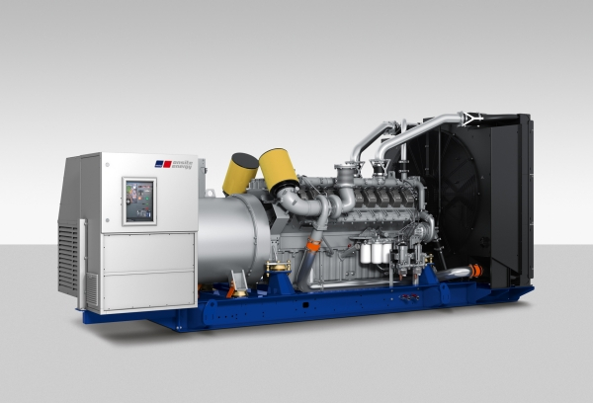
Solution – Install Permanent SAE J1488_201010 Filtration
A dedicated filtration system to remove particulate, sludge, and bonded/emulsified water, controls acidification
Keeps fuel clean and dry
Keeps emergency generators operating
Recommended by Uptime Institute: “Reconsider Your Diesel Fuel Supply”
https://journal.uptimeinstitute.com/reconsider-your-diesel-supply/
SAE J1488

Slide 16
Suggested Readings
EPA (2016) “Investigation Of Corrosion-Influencing Factors In Underground Storage Tanks With Diesel Service”
British Standards Institution BS 5410-3 (2016): use only SAE J1488_201010 Filtration for Critical Emergency Backup Generators
Emulsified Water/Fuel Separation Test Procedure www.sae.org/standards/content/j1488_201010/
Uptime Article (2017) “Reconsider Your Diesel Fuel Supply”
NFPA110 (2019) replace fuel regularly: yearly ?
Battelle Report (2012) Corrosion in Systems Storing and Dispensing Ultra Low Sulfur Diesel (ULSD)
Moisture Absorption In Biodiesel And Its PetroDiesel Blends

Slide 17
Octane Systems Inc.
Focus – Emergency Systems That Cannot Fail
1 – investigate levels of fuel acidification
2 – development of a corrosion control plan
3 – implementation of the corrosion control plan
Pat is a lecturer in BioFuelNet Canada’s Advanced Biofuels Course, hosted on McGill University’s myCourses platform. http://biofuelnet.ca/advanced-biofuels-course/
www.octanesystemsinc.com
patsmyth@octanesystemsinc.com
613-794-6090

Slide 18
Three Stages of Truth
All truth passes through three stages:
First, it is ridiculed
Second, it is violently opposed
Third, it is accepted as being self-evident

Slide 19
Corrosion Control for Emergency Backup
Systems That Cannot Fail
THANK YOU !!
Pat Smyth
www.octanesystemsinc.com
patsmyth@octanesystemsinc.com
613-794-6090

