Slide 1

Gardening with young children
STEAM ( Using Science, Technology, Engineering, Art, Math

Slide 2
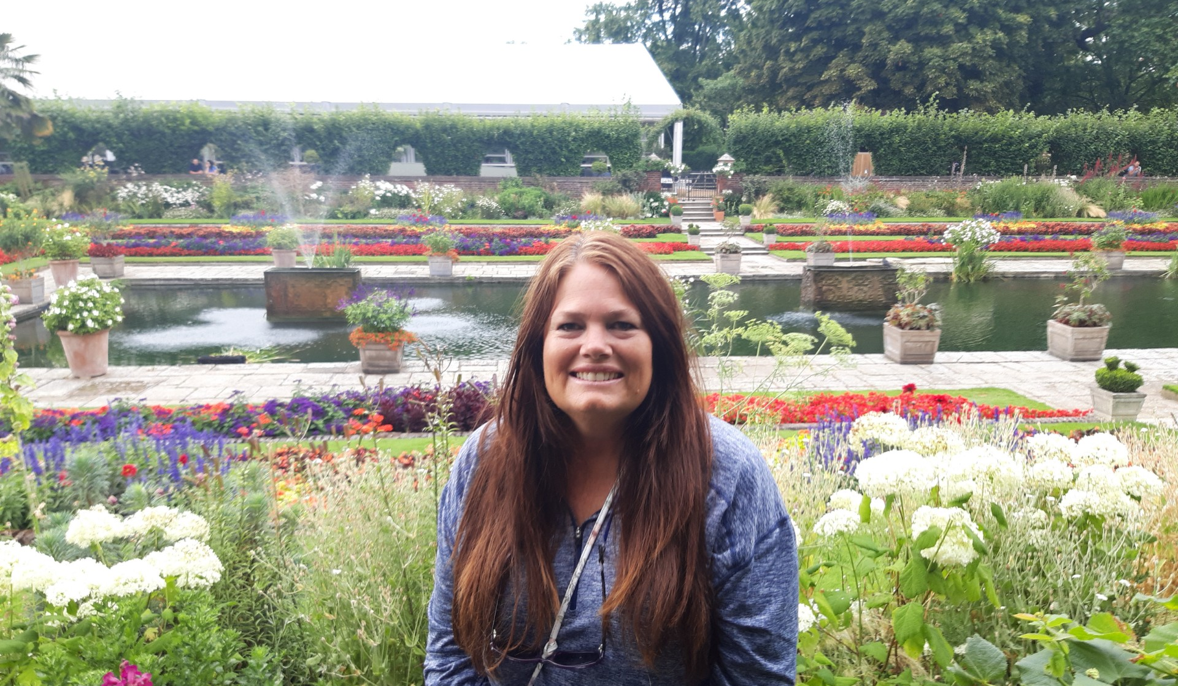
Hello, my name is Amy Perry, and I live in Bedford, Virginia. Since 2012, my family and I have enjoyed life on our 12-acre farm, where our house was built in 1810. I spend a lot of time gardening, growing vegetables, fruit trees, and herbs, and caring for three flower beds. My favorite part is working with herbs and produce, especially when I get to harvest, can, and make fermented foods. I also raise chickens and keep bees. Before moving here, I lived in Sarasota, Florida, for 19 years and homeschooled my two sons. My faith in the Lord, my love of homeschooling, and my passion for gardening inspired me to create these Agriculture Kits. I hope you enjoy using them as much as I enjoyed creating them.

Slide 3
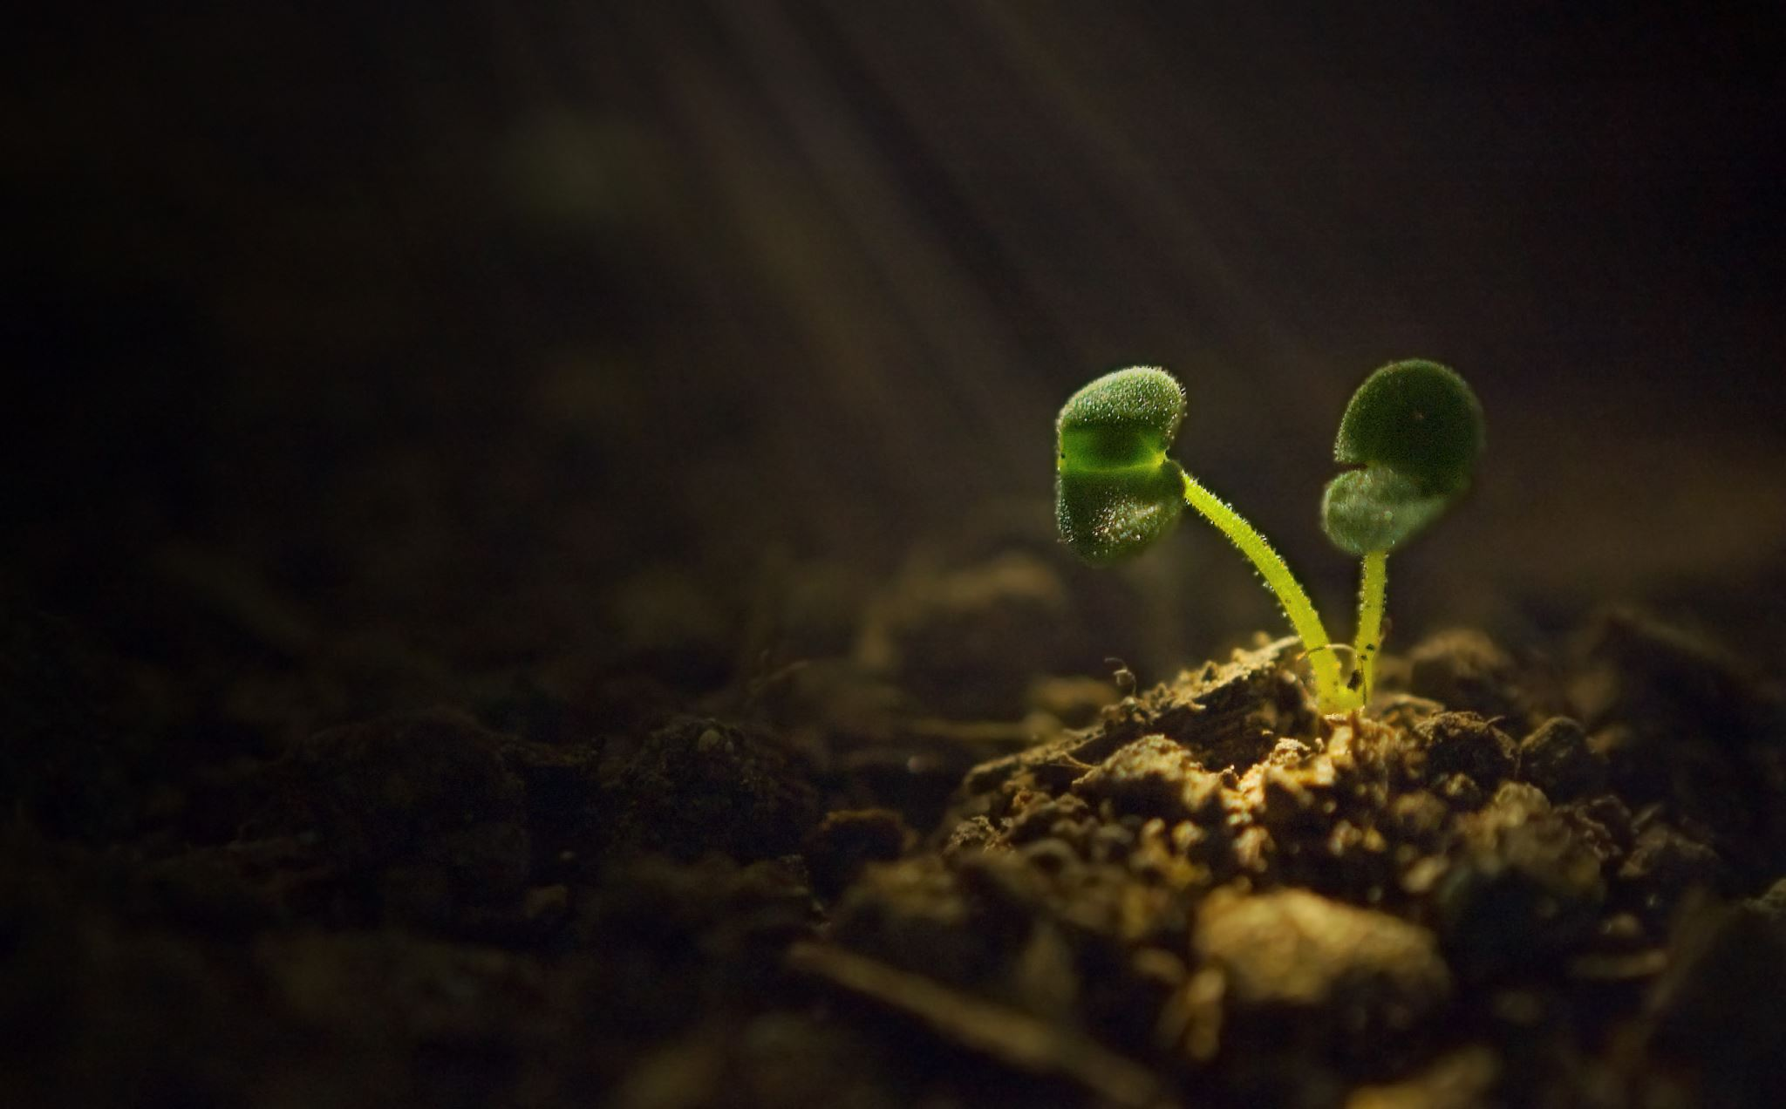
As technology increasingly influences society, acquiring foundational knowledge in science, technology, engineering, art and mathematics (STEAM) has become essential. Making these subjects accessible and engaging for children remains a challenge. One effective solution lies in the natural environment, such as gardens, where elements like soil, leaves, and bees provide opportunities for exploration. Engaging children in gardening offers a practical method to introduce STEAM concepts through experiential learning. Outdoor spaces become living laboratories, enabling children to learn through direct interaction rather than passive observation. This method fosters enduring curiosity and a passion for discovery.
Gardening is more than planting seeds and watching them grow. It is a comprehensive activity that supports multiple areas of children's development. STEM-focused garden projects offer hands-on, multi-sensory experiences that enhance physical, cognitive, and emotional growth.

Slide 4
Breaking down STEAM and Gardening activities

Slide 5

Questions to accompany this STEM gardening lesson:
Which seed(s) grew the tallest (most)?
Which seed(s) grew the least?
Which seed(s) took the longest to emerge?
Which seeds grew about the same?
Count how many seedlings emerged in the ten days.
Count how many days till the first seedling appeared.
Count how many days till the last seedling appeared.
If using a ruler is new to your child, go over how to read inches (you may have to help out with the quarter inches, and we rounded up to the nearest quarter inch).
Notes:
You can use these questions for any of the activities you like. This is an example of questions which would be good for growing the wildflowers or the beans in watch it grow.

Slide 6
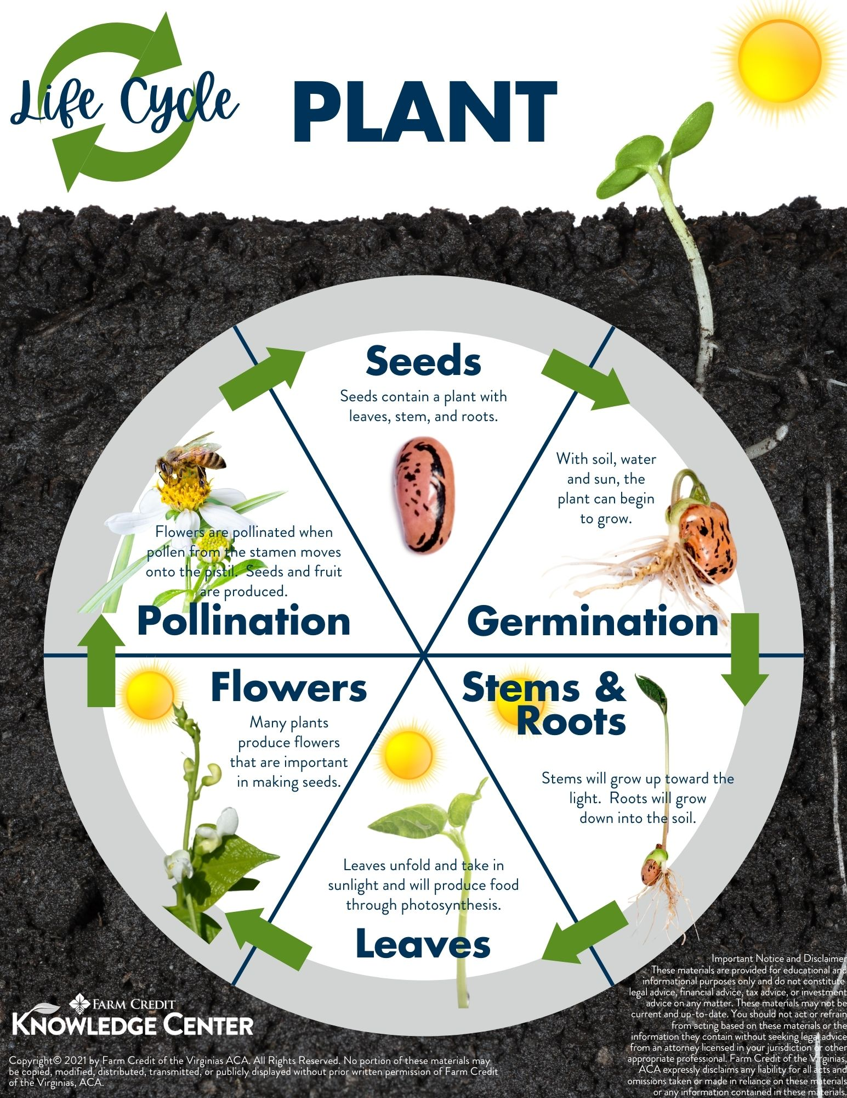
Life cycle of a plant
Cute videos on a plant's life cycle
https://www.youtube.com/watch?v=tkFPyue5X3Q
https://www.youtube.com/watch?v=2SBVz4MgeIE&t=21s
https://www.youtube.com/shorts/XA3BoRDBLQg
Plants start their lives as tiny seeds. Seeds contain a plant with leaves, stem and roots. The first step a seed takes on its path is germination. Germination is when the plant within the seed begins to grow with the help of water, soil and sun. As the process continues, the plant develops stems and roots. Stems push up toward the light. Roots grow down into the soil. Now, leaves begin to grow. Leaves unfold, take in sunlight and produce food through photosynthesis. The plant then begins to develop flowers. Many plants produce flowers that are important in making seeds. The flowers are then pollinated. Flowers are pollinated when pollen from the stamen moves onto the pistil. Seeds and fruit are produced.

Slide 7
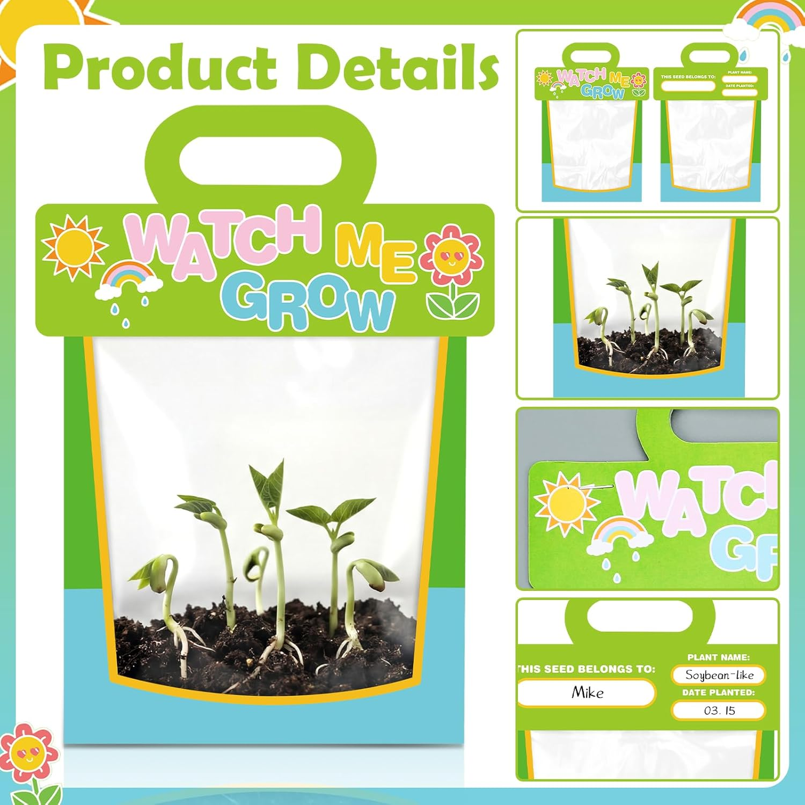
Plant Biology & Life Cycles: The Miracles of Growth
Planting bush beans is an easy and quick activity for kids. These beans sprout quickly, so children can see results without waiting too long.
Here’s how to get started:
Soak the seeds in water overnight to help them sprout faster.
Let your toddler fill the bag with dirt. They can poke a hole in the soil with their finger.
Ask your child to drop one or two beans into each hole.
Gently cover the beans with a little dirt.
Sprinkle a bit of water on top.
In about one week, you’ll see a small green shoot coming up from the dirt. Water a little each day to keep the soil moist. Staple the bag and cover the sides, leaving the top open. This allows ventilation and makes it easy to water the beans when the soil is dry.
Seeing a small seed grow into a healthy plant is amazing and makes a great introduction to plant biology.
Notes:
Teach the concepts mentioned before with s-science. Germination will be observed with the growth of the beans. To show photosynthesis take one of the beans out, Repot and put in dark . Discuss with child the importance of photosynthesis.
When growing the beans, you have 3 sources of light to use . If you have a place outside where the sun hits the beans but keeps it dry for rain, you can use that method. Or grow inside infront of window with direct light. Or under a lamp with a light mentioned in the website I linked,
https://www.thespruce.com/best-grow-lights

Slide 8
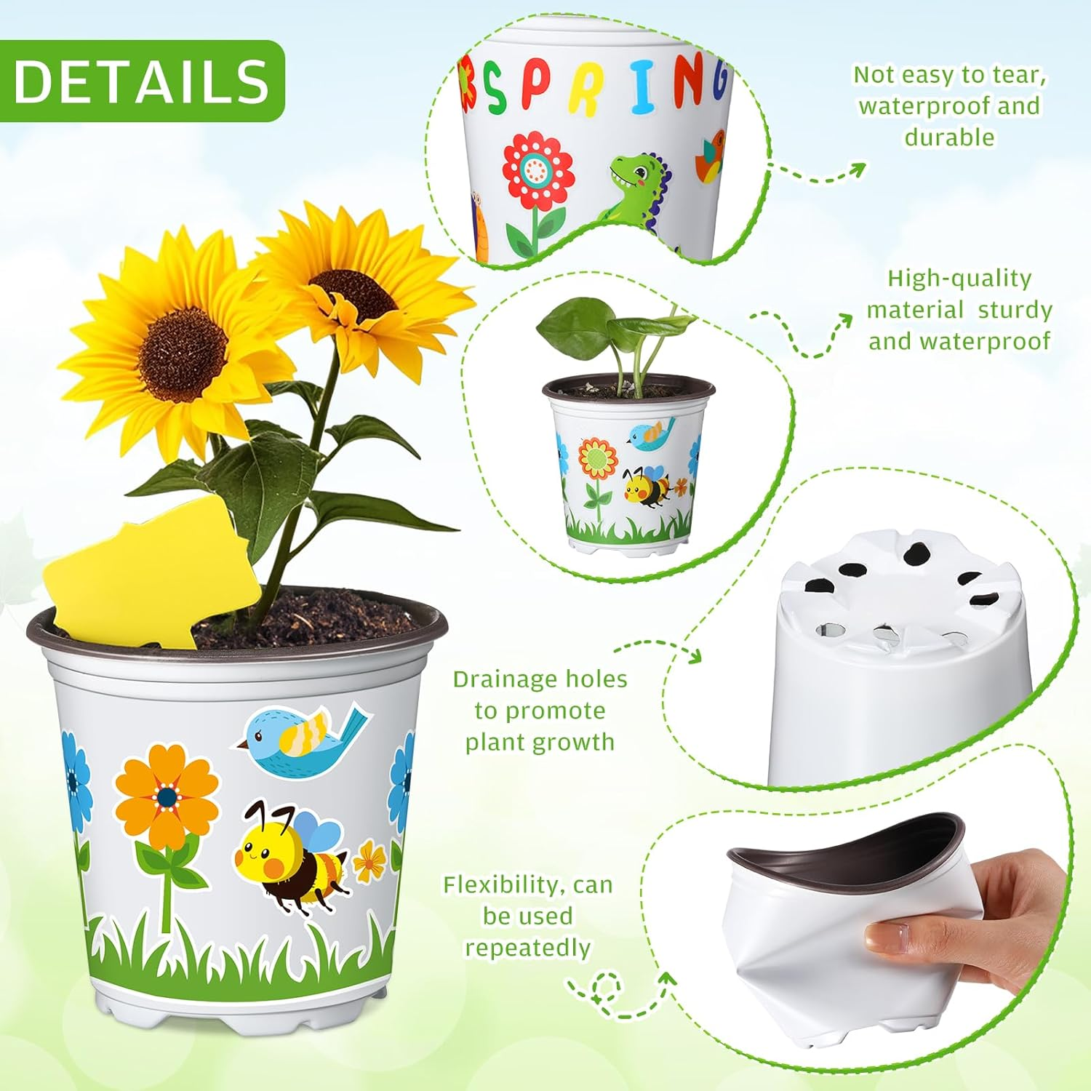
Planting pots
Inside, you will find two planting pots ready for your imagination, each with a set of stickers so you can decorate them however you like. The kit also includes a growing journal card, perfect for recording the progress of your tickle plant or any flowers you choose to grow. Use the card to capture every step of your gardening adventure.

Slide 9
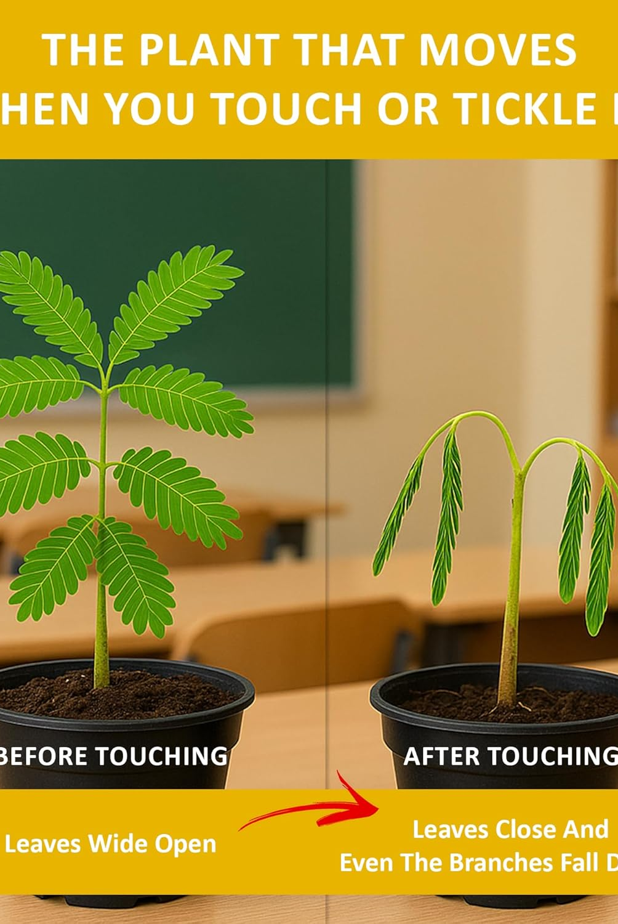
Growing a tickle me plant
Drop 4 or 5 tickle-me-plant seeds into a cup of steaming hot water just after it finishes boiling. Let them soak as the water cools for a full day or two before planting.
Scoop moist soil into your decorated flowerpot until it is about three-quarters full. When you plant the seeds, space them evenly across the soil surface.
Gently sprinkle just enough soil to barely cover the seeds. Place your pot in a cozy, warm spot, like a sunny windowsill or beneath a plant light.
Water regularly to keep the soil moist, but not soggy or bone dry. Watch closely—your plant may sprout in as little as 4 days or as long as 3 weeks.
The first leaves will not react to your touch, but they will fold up to sleep at night and greet the morning sun by opening again. Once the second set of leaves appears, those will close when tickled.
If your plant gets too big for its pot, gently move it to a larger home. As it matures, it may grow thorns, which you can carefully snip away with a nail clipper.
Notes:
Use on of your decorated pots to grow your tickle plant.

Slide 10
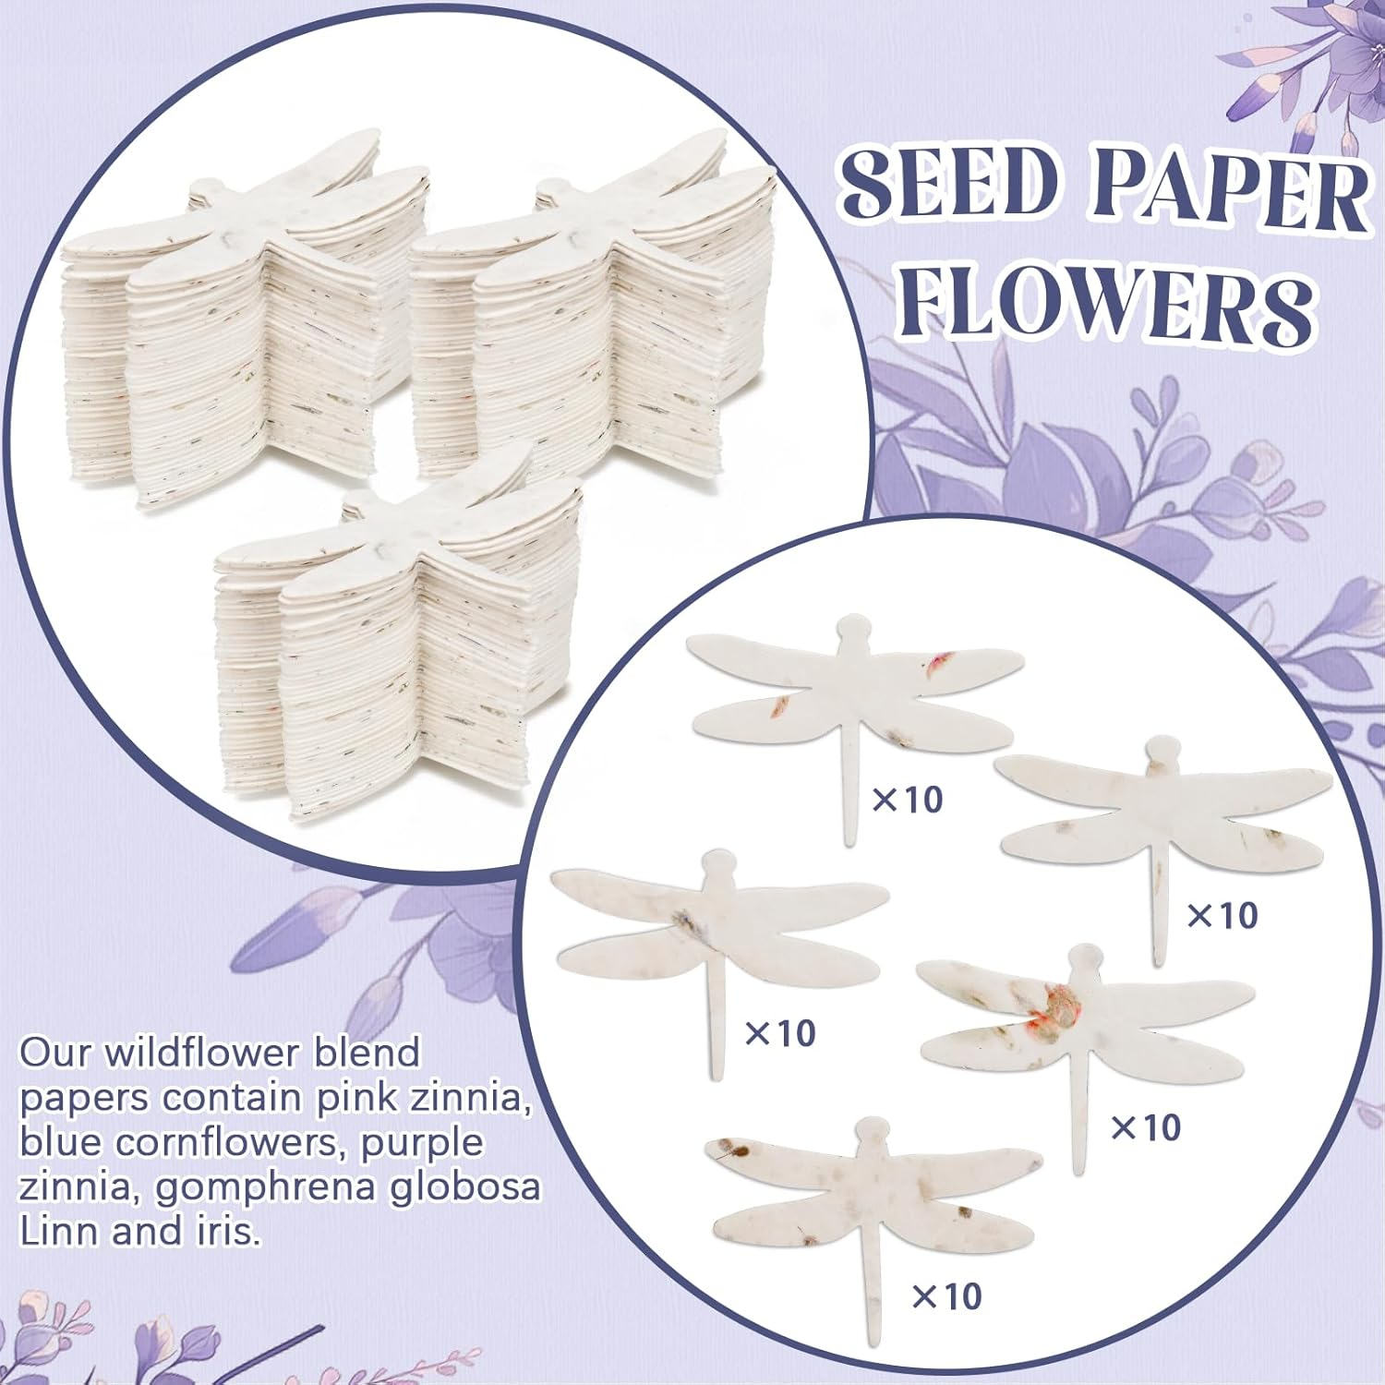
Notes:
Drop the whole dragonfly in the other pot you decorated. Water and grow along side of the tickle plant.

Slide 11
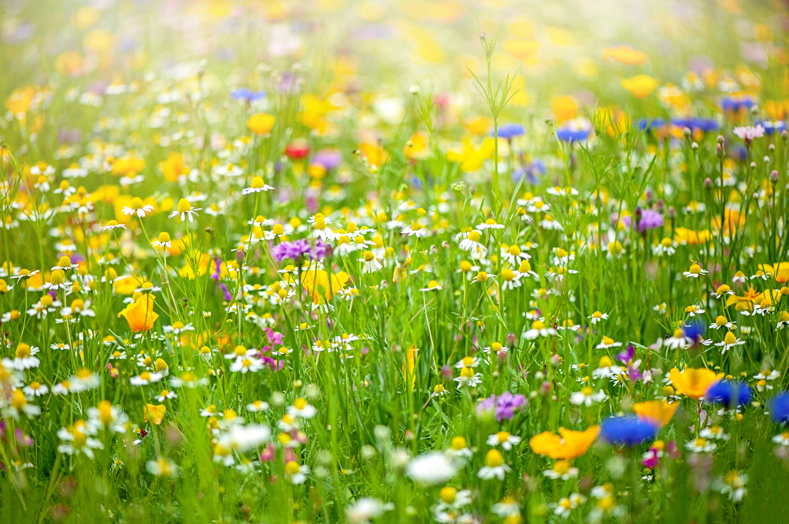
Planting wildflowers
Wildflowers
Symbolism of God's Provision: In a spiritual context, wildflowers were sometimes seen as a symbol of God's provision and a reminder not to worry about basic needs.
Activity: Growing for Pollinators
This activity is a great way to learn about why biodiversity and the connections between plants and animal's matter.
What you need:
Wildflower seeds or seeds for pollinator-The red envelope holds the seed, just find an area for wildflowers, plant the whole package and water.
How to do it:
Planting: Clear and area of grass and weeds. Lay down a layer of soil. Sprinkle the whole packet evenly. Take a raking tool and gently press down, Do not cover, Water so seeds hold. Best not to do on a windy day.
When the flowers start to bloom, ask your child to sit quietly and watch. Which insects come to visit? How many kinds of bees or butterflies can they spot?
Invite your child to draw the insects and flowers, paying attention to their colors, sizes, and what they do. Talk together about how insects help plants and how plants give food to insects. This helps kids see how important pollinators are for our food and the environment.
Notes:
https://www.thespruce.com/wildflower-gardening-1403564
Simple Steps for Kids:
Pick a Spot & Clear It: Choose a sunny spot (6+ hours of sun). Remove all weeds and grass to make a small patch of bare soil.
Mix & Scatter: Mix your seed packet with 4-5 times as much sand. This helps children see where they have sown and ensures even spreading.
Spread the Seeds: Walk across the area scattering the seed/sand mix, then do it again walking in the opposite direction (cross-hatching).
Press Down (Don't Bury): Do not cover seeds with soil, as many need light to grow. Have children walk, jump, or press on the area to press seeds into the soil.
Water & Wait: Gently water the area and keep it moist until seedlings appear.
American Meadows +4
Quick Tips:
Best Time: Plant in spring (last frost) or autumn.
Keep it Local: Buy native wildflower seeds to attract local bees and butterflies.
Make it Fun: Use a hand-drawn map to mark where you planted!

Slide 12
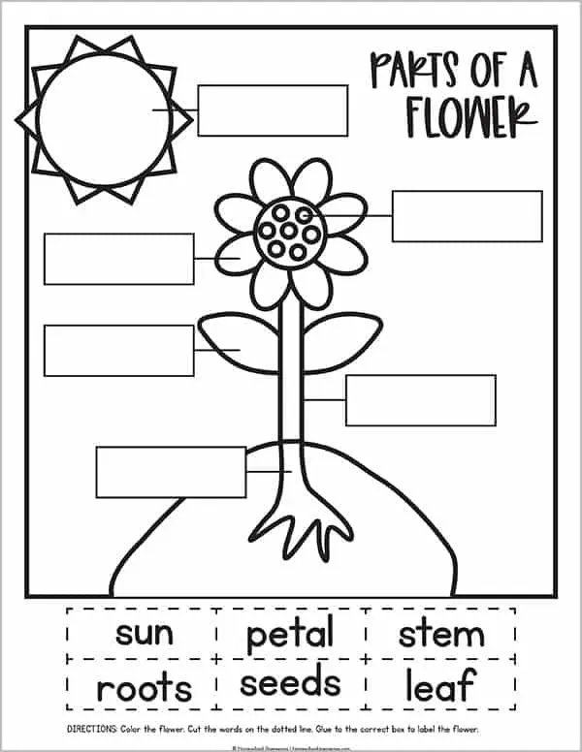
Parts of a Flower
Cute video on parts of a flower
https://www.youtube.com/watch?v=-402sEaV4u8&t=74s
https://www.youtube.com/watch?v=SiFaN2xQg5g
Petal: Brightly colored parts of the flower that attract pollinators such as the bee or butterfly
Stem: Supports the flower and transports water and nutrients.
Leaf: The part of the plant that uses sunlight to produce food through photosynthesis.
Bud: The early stage of the flower before it blooms.
Roots: Absorb water and nutrients from the soil, helping anchor the plant.
Soil: Provides the necessary nutrients and support for the plant’s growth

Slide 13
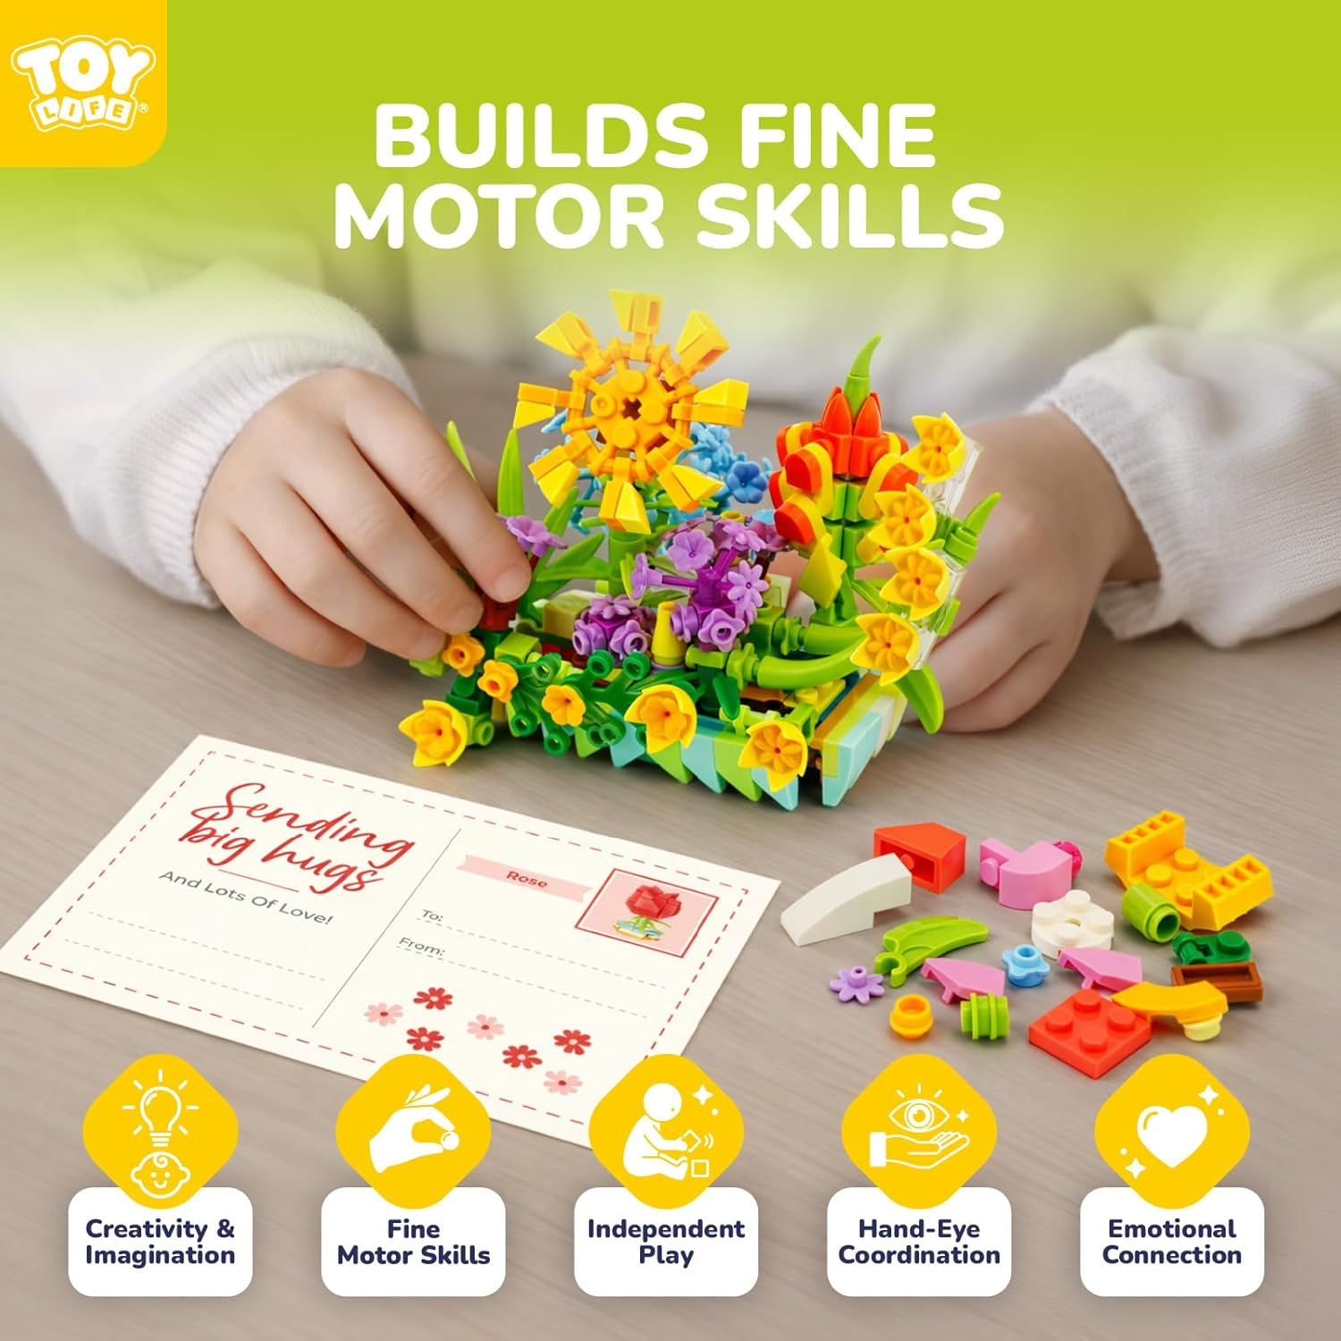
【Encourages Imagination & Creativity】 Our flower botanical succulents mini blocks building sets allow for endless possibilities, providing a fun and educational activity that inspires artistic expression and hands-on play, kids won't get bored with our hands-on building toy that inspires creativity, develops patience and independence. Designed with durability and safety in mind, making it perfect for kids to enjoy all year long.
By doing this, a simple nature activity becomes a project that shows how well natural systems work. It also helps students build creativity, problem-solving skills, and learn to think like designers.
Notes:
Here is how a flower model encourages engineering in STEM:
Reverse Engineering and Biomimicry: Students dissect flowers to understand their components, then act as "biomimicry designers" by analyzing how plant adaptations function. For example, learning how petals repel water can inspire them to engineer new waterproof materials.
Engineering Design Process (EDP): Students are challenged to use the EDP—identifying a problem, imagining, planning, creating, and improving—to build their own flower models using craft materials.
Structural Challenges: The "Free-Standing Flower Construction Challenge" requires students to design and build a flower that stands on its own, fostering engineering skills in stability, structural integrity, and material strength.
Engineering for Pollination: Activities often challenge students to design and build artificial flower models that can efficiently transfer "pollen" (simulated with materials), teaching them to engineer solutions that solve biological problems.
Connecting Nature to Technology: The model encourages children to build with blocks or other materials to emulate natural shapes and forces, bridging the gap between biological structures and man-made design

Slide 14

Bookmark and Journal is the art in STEAM
Included in your kit is a bookmark. This bookmark opens up. Included are many different stickers to add to your bookmark. Or cut out pictures and add or press leaves and flowers between, it is up to you and your turn to be creative.
There is a journal in your kit. Use some of the stickers included to decorate the journal. The journal can be used to write about your experiences, draw what you grew, or flowers and plants. Keep a record of your produce and planting schedule. Use your imagination and have fun!!!

Slide 15
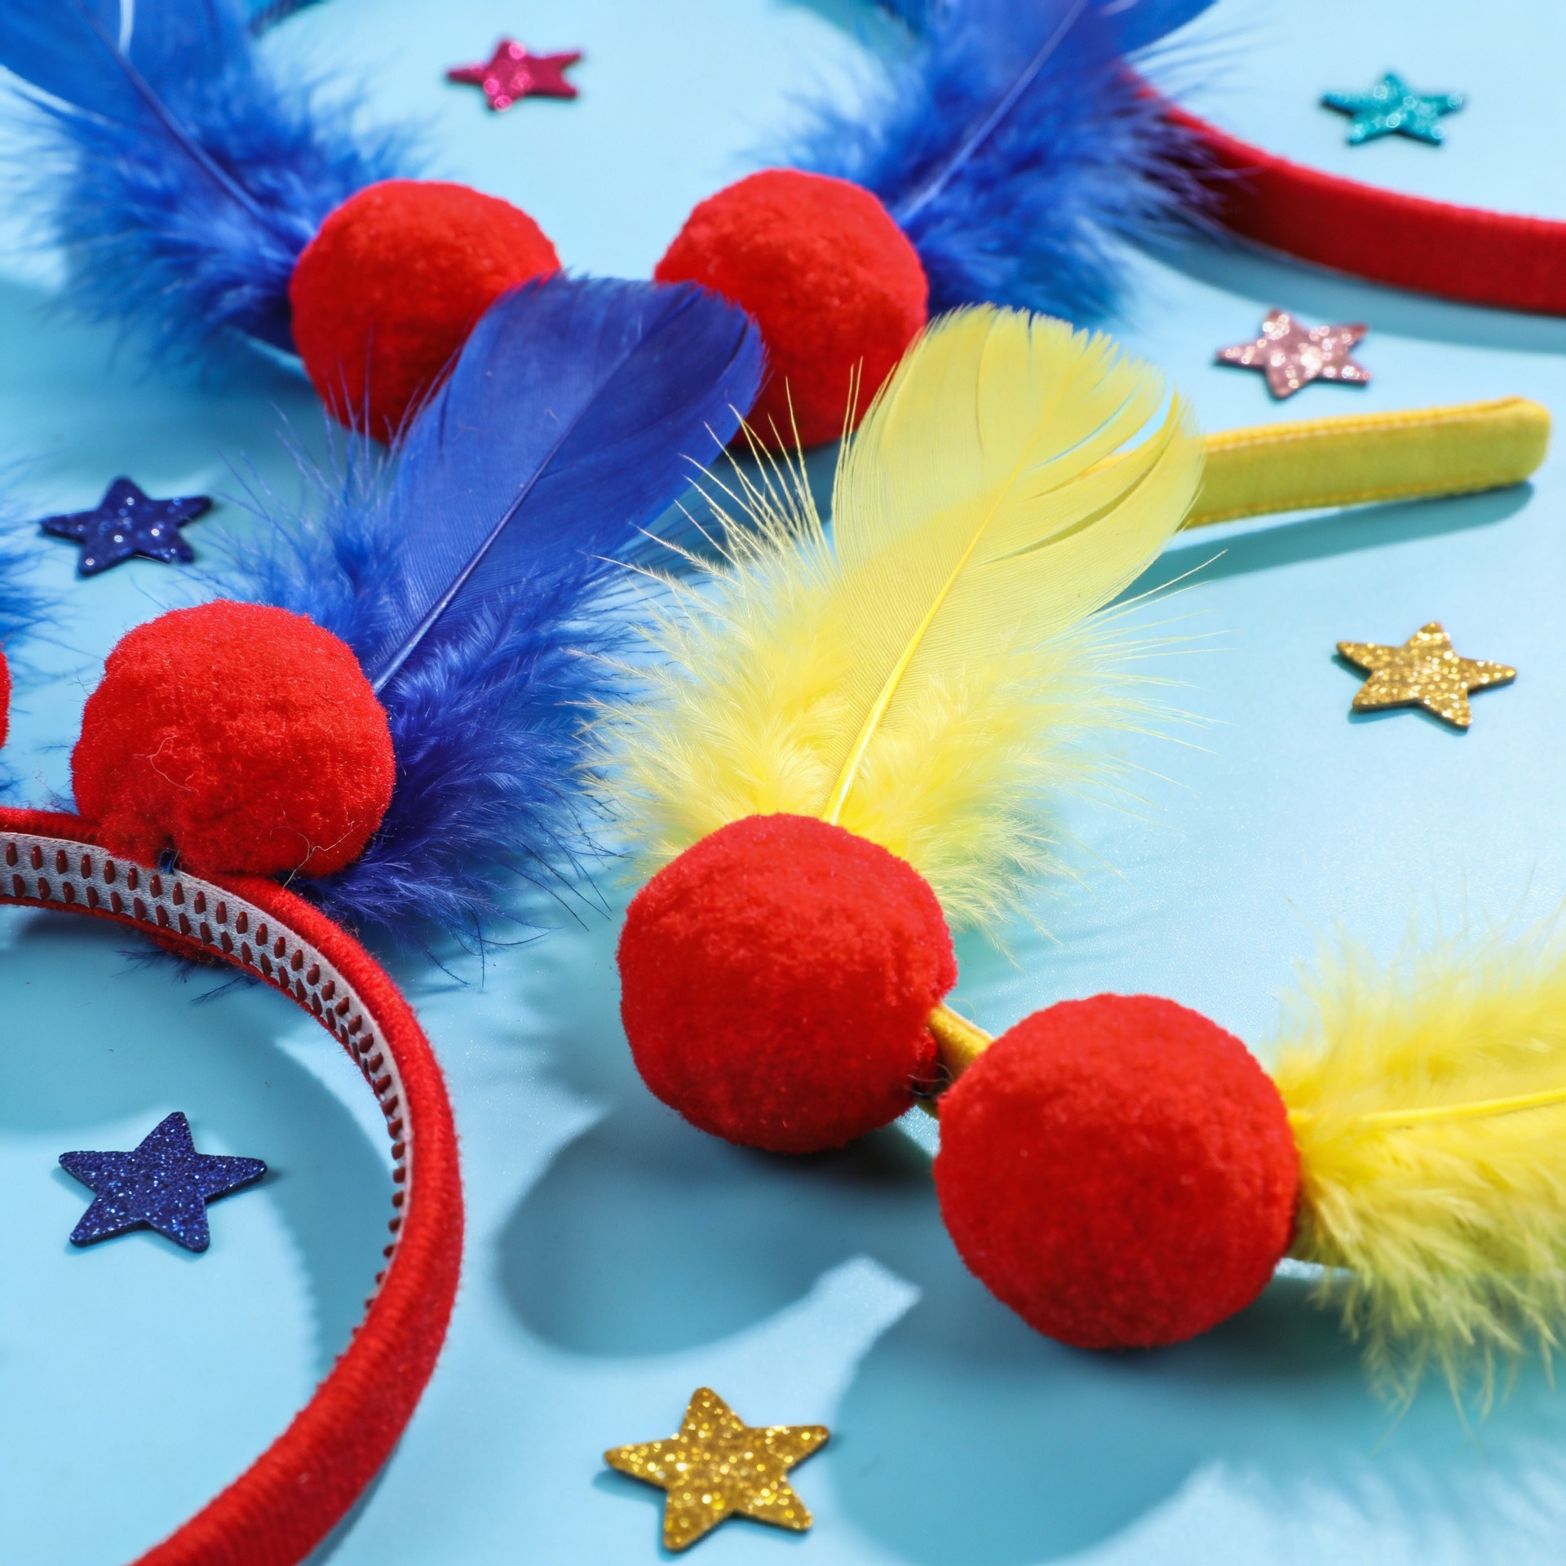
Create your own headband to wear at your tea party. Don’t be afraid to add your own creativity and spirit – have fun with it! There is no way to mess up. If you don’t like what you see, add another feather because you can never have too many!
Making a headband for children fits STEAM by integrating math (measuring head circumference), engineering (designing ), technology (using tools like glue guns), and art (color, texture, and design choices). This hands-on project promotes problem-solving through assembling fabric, selecting appropriate materials, and testing the final product for comfort and function
Notes:
\

Slide 16
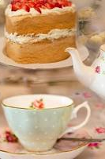
\
Teatime
This is a fun part of the kit. You learn about tea etiquette, and how to brew the tea. Now it is time to have a tea party. This is great etiquette whether you are a boy or girl, so encourage all your children to participate.
Along with the tea, a tea party always has foods.
The foods at a tea party, often called tea fare, afternoon tea foods, or tea party treats, generally fall into three categories: delicate finger sandwiches, warm scones with clotted cream and jam, and small sweets/pastries, served on a three-tiered stand in a traditional British Afternoon Tea.
Make your tea party headbands. Explore tea foods to make, make your tea and use your tea cups and plates and have a tea party, using the etiquette you learned.
TEA PARTY
tm

Slide 17
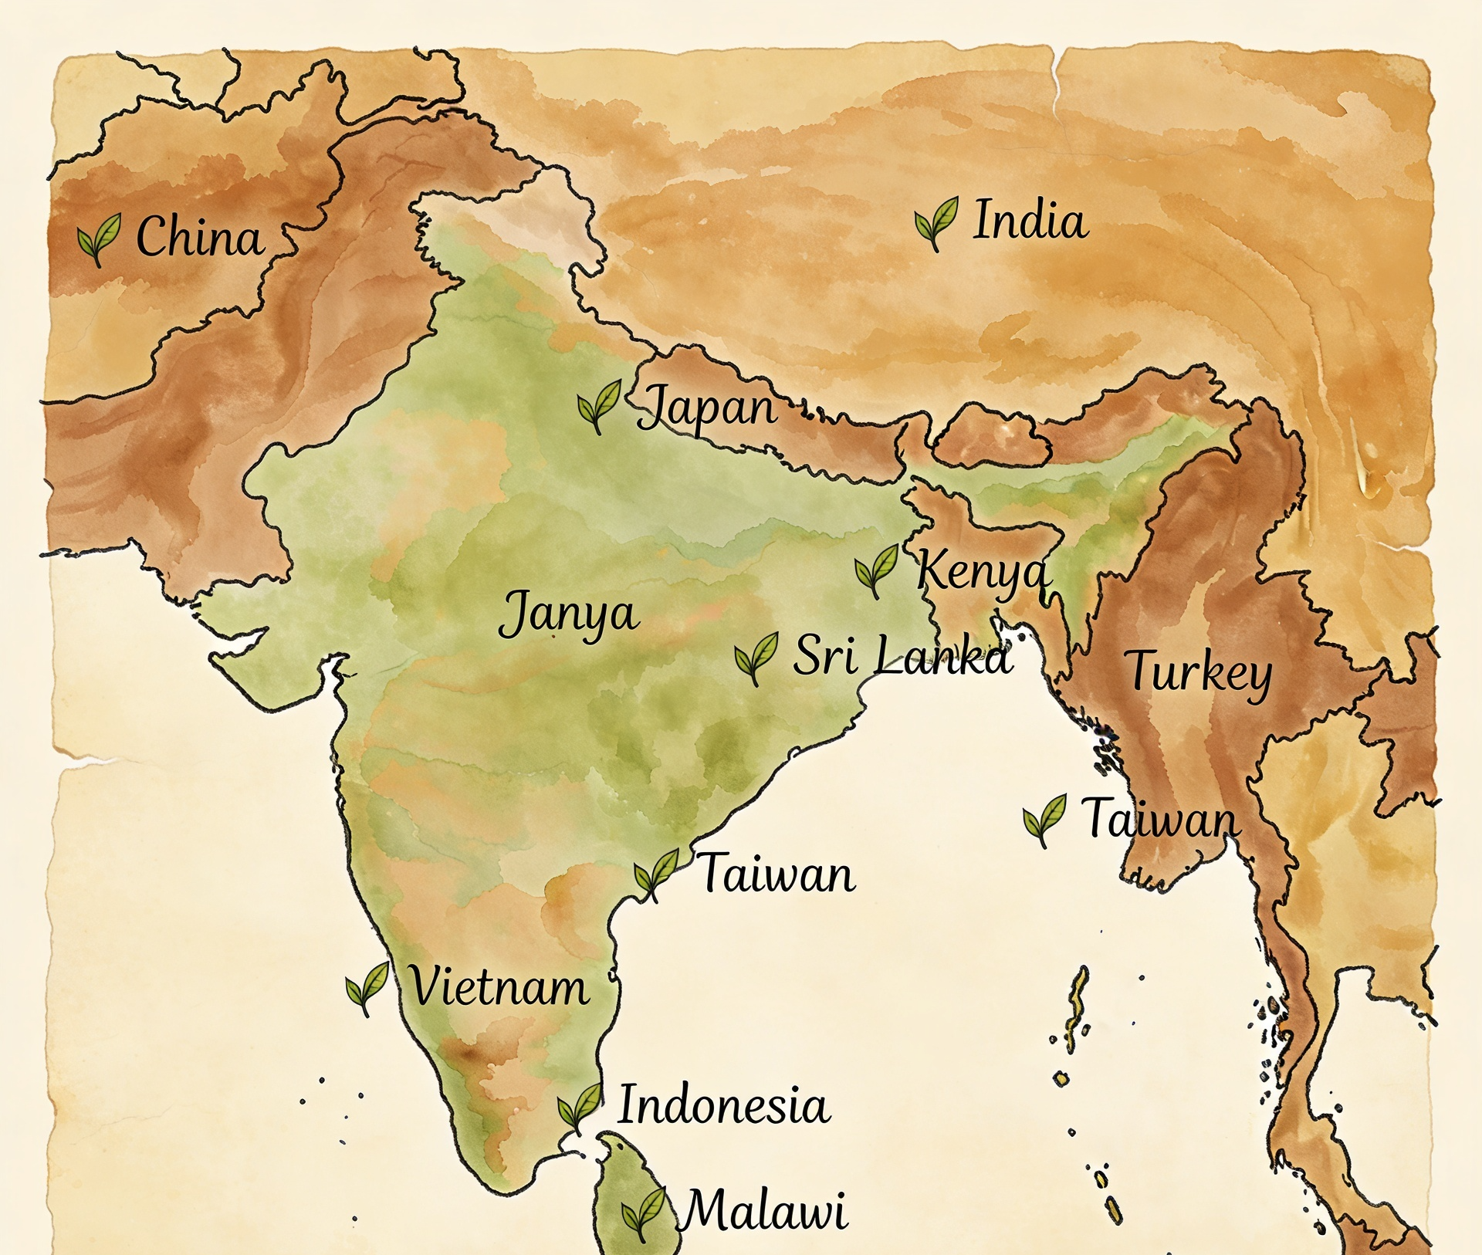
History of Tea
Here’s a fun story about how tea was discovered. In 2737 BC, the emperor of China, Shen Nung, was sitting under a wild tea tree. A breeze blew some leaves into his hot drink, and when he tasted it, he found it delicious. That’s how tea was discovered. People first enjoyed tea in China, and later it spread to Europe, England, the United States, and almost every country in the world.

Slide 18
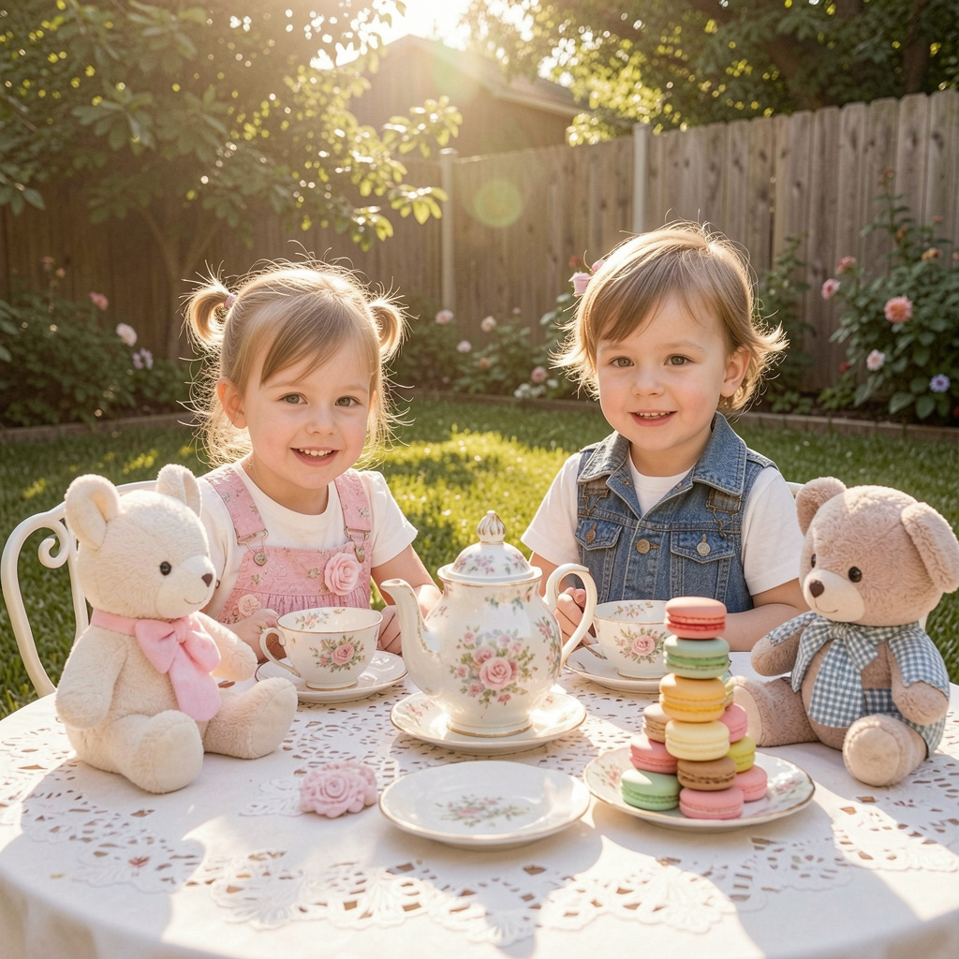
Tea Etiquette
Take small bites
Talk in a quiet voice
Put sugar, milk, or lemon in the cup after the tea has been poured and not before. Lemon should not be used with milk
Place the spoon on the saucer, not the table.
Sip the tea and don’t slurp
Wait for the host or older person to pick up their napkin first. Then you can. Place it in your lap with the crease towards your waist.
Don’t talk with food in your mouth.
Don’t put your elbow on the table.
Don’t push your plate away when you are finished
Write a thank you note to the person who invited you.

Slide 19
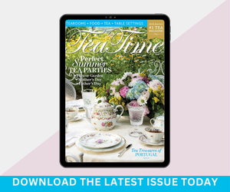
Tea etiquette for children
http://www.tea-happiness.com/2019/01/teaching-kids-through-tea-parties.html
https://www.eastangelharbor.com/blog/tea-hat-blog/little-girls-tea-party-ettiquette
https://youtu.be/nKup3embP0c?si=L3JNNwPrS96vTZMp
https://www.culturekidsmedia.com/videos/tea-time-rules-a-kids-guide-to-afternoon-tea-etiquette-not-high-tea-1/
Etiquette and Manners: Austen's novels are known for their exploration of social etiquette and manners. The rules and customs surrounding tea-drinking, such as how one should pour and serve the tea, were often used to illustrate a character's social standing and manners. Good manners were highly valued in Austen's society.
Manners and Etiquette: The rules of etiquette surrounding tea-drinking provided a microcosm for the broader social norms and expectations of Austen's time. The art of pouring tea, holding a teacup, and engaging in polite discourse were all reflective of one's upbringing and societal standing. In "Emma," for instance, Emma Woodhouse's guidance on tea service at her tea party demonstrates her authority and desire to control social situations
Notes:
Tea Time is a wonderful magazine to teach children tea etiquette, craft ideas, recipes, tea infusions, table settings, and even tea retreats.
Afternoon tea teaches children manners, planning, etiquette, appropriate dress, and handling precious things carefully.
https://teatimemagazine.com/what-afternoon-tea-teaches-our-children/

Slide 20

Making Herb Tea
How to Make Herb Tea-
Use any of the herbs from the Herb packet.
Garden fresh (mint, chamomile . Lemon balm) is easy to brew just like any other pot of tea. Leaves are soft, herbaceous, and contain a rich and potent supply the naturally derived menthol oil. How to brew Herbal Tea:
Using any type of tea infuser or tea bag, add about 3 tsp of freshly dried herb to every 8 oz of boiled water.
. Allow herb to steep for about 10-20 minutes.
Notes:
Included are 4 tea bags to make your own tea.

Slide 21
Final word and download options.
Thank you for welcoming me into your gardens and inviting me to be part of your homeschooling journey. I am cheering you on every step of the way and will keep creating more garden and nature resources, as well as keeping your families in my prayers. From my own experience, I know this path is both a tremendous blessing and a real challenge, filled with hard work and moments of exhaustion. May God watch over you and your loved ones. I also want to remind you to visit Knollwoodagriculture.com, where you can download this kit's PowerPoint, as well as the God and Nature, STEAM garden presentations and the Literature powerpoints if you wish. Feel free to explore and order any other kits that catch your eye.

