Slide 1
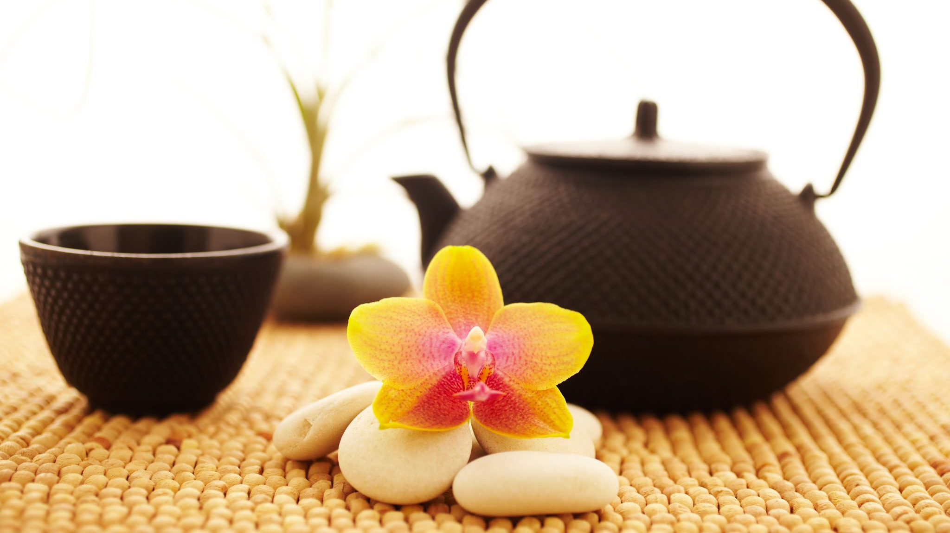
Jane Austen Flower and Tea kit
Flower section from the Regency Period

Slide 2
.
Flowers have their own language. Floriography, or the cryptological communication through flower use or arrangement, has been practiced for centuries. Flowers have been ascribed meanings for arguably thousands of years, and students of the Bible and of Shakespeare (think Hamlet) in the Regency would have been aware of this. Jane Austen used floriography in her writings, as did the Bronte sisters.
Daffodil – I regard you
Apple blossom – preference
Morning Glory – affection
Pansy – thoughtfulness
Thistle – defiance
Columbine – folly
Primrose – consistency
Violet – faithfulness
Zinnia – absent friends
Daisy – innocence
Lily – purit
Myrtle – love and marriage
Holly – foresight
Azalea – temperance
Rhododendron – danger
Iris – message
Ivy – fidelity
Tulip – fame
Basil – hatred
Lavender – distrust
Marigold – sorrow
Notes:
https://regrom.com/2016/06/08/regency-culture-and-society-the-language-of-flowers/

Slide 3
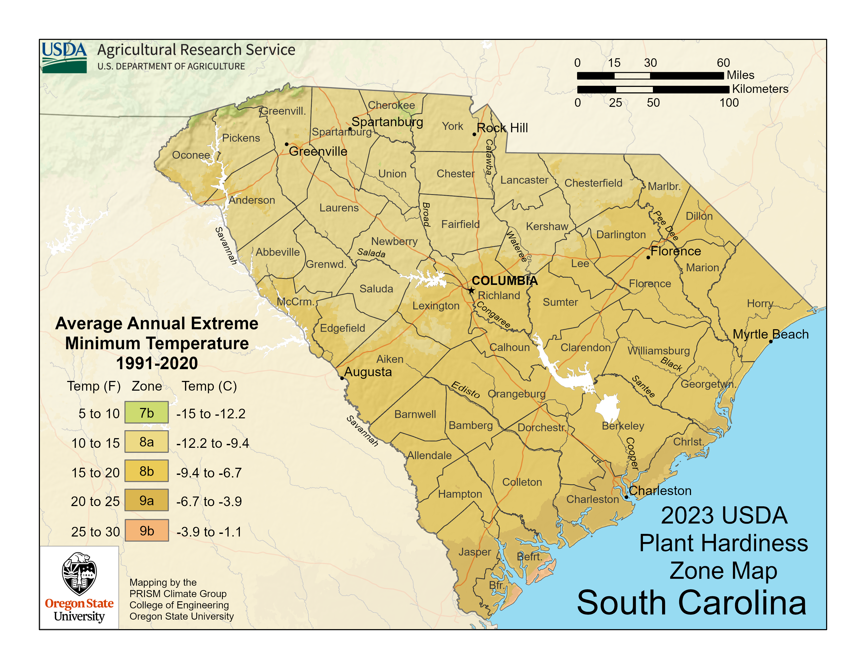
Websites are included. to read and learn best time to plant bulbs.
https://planthardiness.ars.usda.gov/ ( put your zip code in and it will give you your planting zone.
https://trueleafmarket.com/pages/usda-hardiness-zones
https://www.adrbulbs.com/page/Planting-Time#:~:text=The%20timing%20of%20bulb%20and,callas%2C%20cannas%2C%20begonias%2C%20caladiums
/
Notes:
This website provides zoning information by state and zip code. I have included details about each flower you will receive, plant, and grow, along with information to help you understand your region, state weather patterns, soil types, and planting seasons. I encourage you to review these resources thoroughly. To open the websites on my computer, I press the control key and then select the link when the hand icon appears. Some websites may require a verification code. I have verified all the websites to ensure they are safe to access. Please contact me if you have any questions.

Slide 4
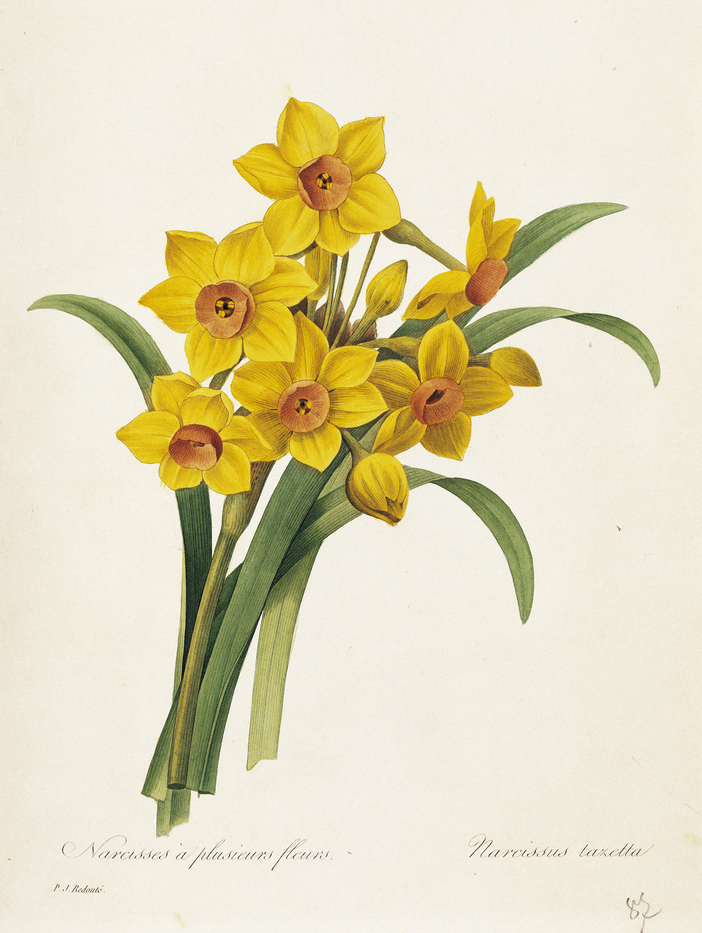
Daffodils flowers During the Regency era (1811–1820), daffodil bulbs were cherished as hardy, naturalizing spring flowers, often associated with the arrival of spring, rejuvenation, and, due to their toxic nature, were left undisturbed by pests. Website gives you the instructions on how to plant and grow Daffodils. A quintessential symbol of spring, providing cheerful yellow color and representing hope and new beginnings, often seen in gardens like Chawton House https://www.thespruce.com/planting-and-growing-daffodils-1402136 https://flowerbulbs.com/daffodils-plant-once-enjoy-them-for-years/
Notes:
For the daffodil it is planted in a clear planter- You can keep it there until you see the bulb sprouting and then transport it to the red pot I have included.
Steps for Success in March
potted daffodils in spring should be placed in full sun to partial shade, aiming for at least 6 hours of sunlight for best blooming, but protected from intense, direct, all-day scorching sun. warmer climate, dappled shade or morning sun with afternoon shade helps prevent the soil from drying too quickly and scorching the foliage.
Watering: Potted daffodils need consistent moisture while growing, but they must not sit in waterlogged soil. Water whenever the soil feels dry to touch.
Post-Bloom Care: Once they finish blooming, keep the pots in the sun to help the foliage soak up energy for next year, allowing it to turn yellow before removing it.
Do not cut the foliage after blooming; let it die naturally to allow the bulb to store energy for next year.
This perennial bulb is suitable for reuse. Once the foliage has died back, the bulb should be removed from the pot, dried, and cleaned of any soil. Store the bulb in a breathable bag in a cool, dark, and dry environment. Due to the region’s mild winters, refrigerate the bulb (not in the freezer) for 12 to 16 weeks prior to planting it in a pot in October or November. This cold treatment simulates winter conditions and promotes blooming.

Slide 5


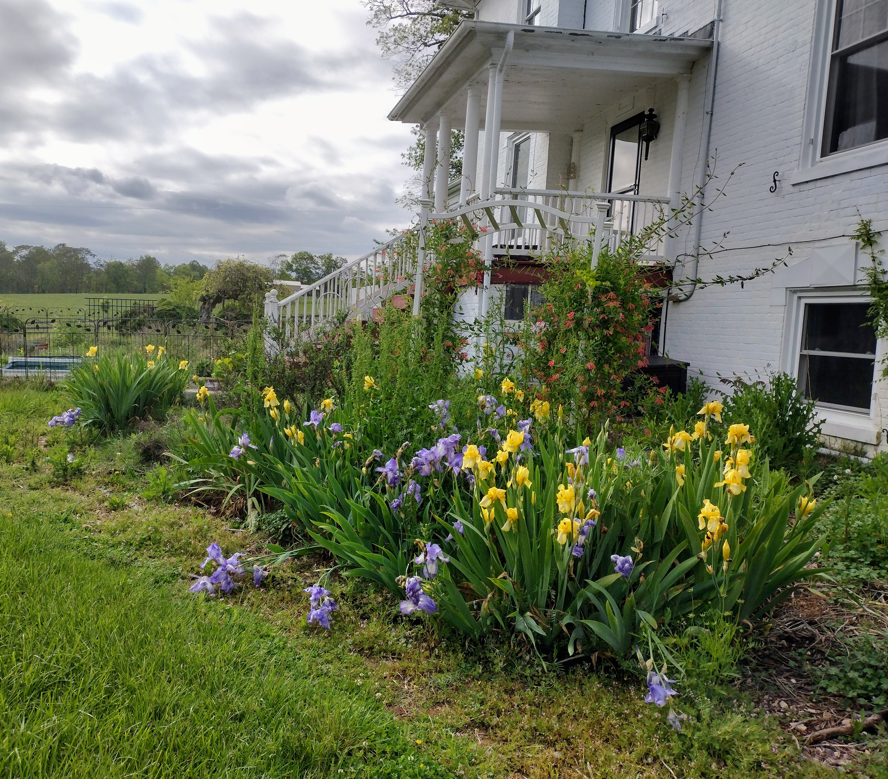



The iris flower commonly symbolizes faith, hope, wisdom, courage, and admiration. Derived from the Greek word for "rainbow" and named after the goddess of communication, it represents a bridge between heaven and earth. Irises are also associated with new beginnings, royalty, and, in some cultures, protection. Usage in Pot-Pourri: Orris powder, which is derived from the root of Iris x germanica var. florentina (the Florentine iris), was used by the Austen family for making pot-pourri, a mixture of dried flower petals used to scent rooms and linen. Literary Usage: While not a central symbol in her novels, the iris is often associated with the language of flowers, symbolizing messages, wisdom, and faith.
https://www.almanac.com/plant/irises
https://www.whiteflowerfarm.com/blog/2023/06/14/over-the-rainbow-the-wide-world-of-iris
https://www.thespruce.com/irises-for-flower-garden-1315808
https://www.gardeners.com/blogs/flower-encyclopedia/growing-irises-7131
Notes:
. Irises are summer bulbs that do best when planted in the ground, and they return each year. They need about six hours of sunlight daily. The best time to plant them is in the fall. Over winter, the bulbs stay dormant and store up energy. In early spring, they bloom. If you miss planting in the fall, you can keep the bulbs in the refrigerator, away from produce and food, and plant them in early spring. Make sure they spend at least six weeks in the refrigerator if you don't pot them outside during winter.

Slide 6
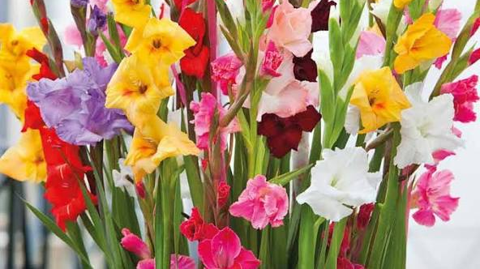
Gladiolus Flower n Victorian times, gifting gladiolus was seen as a symbol of love and infatuation. Beyond physical strength, the gladiolus also symbolizes integrity. In many cultures, it’s believed that giving someone gladioli is a way of honoring their honest and upright nature. During the Victorian era, the flower was used to convey the message: “You pierce my heart,” reflecting deep respect, emotional sincerity, and transparency. Wonderful website. Please take some time and read. https://www.southsideblooms.com/the-gladiolus-flower-a-symbol-of-strength-integrity-and-resilience https://www.avasflowers.net/blog/augusts-birthflower-the-glamorous-gladiolus https://www.boesen.com/knowledge/flower-dictionary/gladiolus/
Notes:
Planting Timing & Depth: Plant in spring once soil hits
(
). Set them 4-6 inches deep and 6 inches apart to prevent them from toppling.
Site Selection: Choose a location with 6-8 hours of direct sun.
Soil & Water: Soil should be well-drained; if you have heavy clay, amend with organic matter. Water weekly with at least 1 inch of water.
Overwintering: While they can be treated as annuals, they are often perennial in most places. In late fall, cut back foliage to ground level. Mulch with leaves or straw in late November for extra winter protection.
Pest Management: The main pest is thrips, which cause, silvery streaks on leaves/flowers. Control them by using insecticidal soap or Neem oil at the first sign of damage.
Staking: Because they can grow very tall, placing them near a wall or using stakes/cages can provide support.

Slide 7
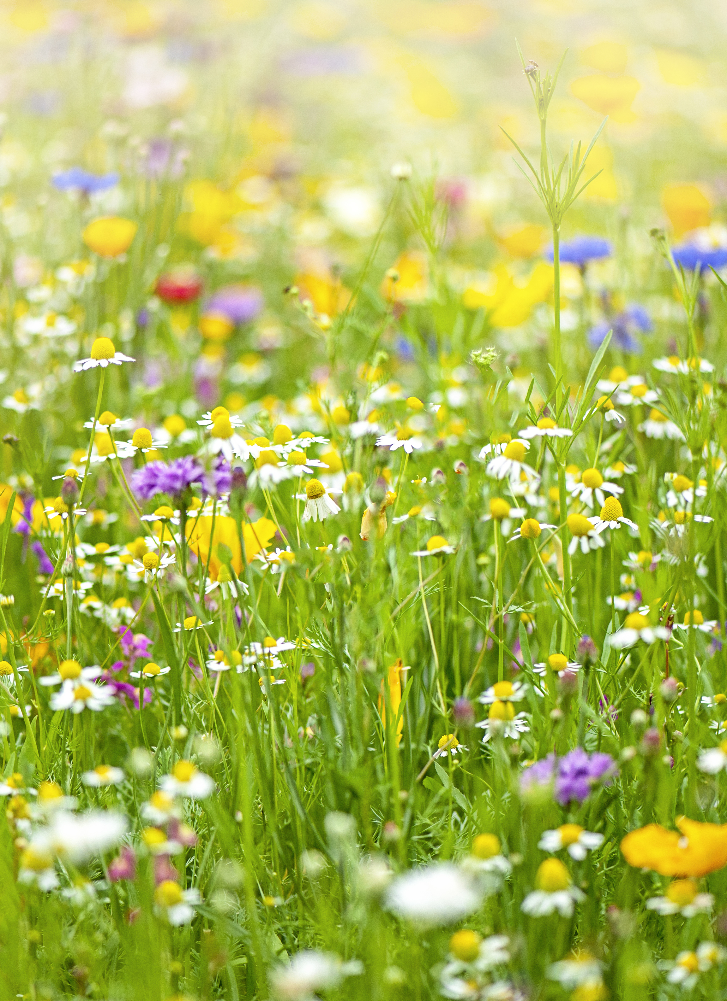
Wildflowers Symbolism of God's Provision: In a spiritual context, wildflowers were sometimes seen as a symbol of God's provision and a reminder not to worry about basic needs. Jane Austen-"Sense and Sensibility" Style: Regency bouquets often favored locally sourced, seasonal wildflowers and herbs, representing simplicity and freshness. https://www.youtube.com/watch?v=7FU5ZnwmqoE https://www.thespruce.com/wildflower-gardening-1403564
Notes:
Site Selection: Choose a location with at least 6 hours of full sun.
Soil Preparation: Wildflowers thrive in poor, well-drained soil. Avoid fertilizer, as it promotes weeds over wildflowers. Remove existing grass and weeds by tilling, sod cutting, or smothering.
When to Plant:. Early spring is also effective once the soil reaches
and the last frost has passed.
Sowing Method: Mix seeds with sand (8 parts sand to 1 part seed) for better distribution. Spread half the seeds walking north-to-south, then the other half east-to-west.
Seed-to-Soil Contact: Do not bury the seeds; they need light to germinate. Instead, press them into the soil using a roller or by walking on plywood placed over the seeded area.
Watering: Keep the soil moist for 4–6 weeks until seedlings are
inches tall, then water only during dry spells

Slide 8
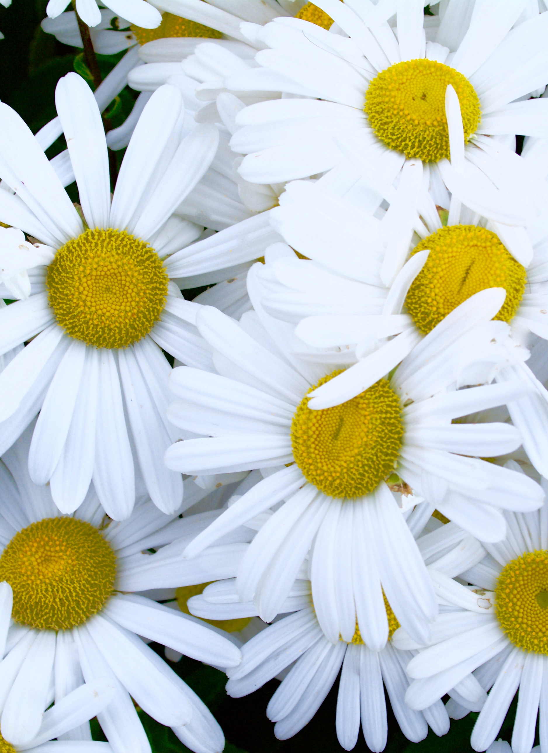
Daisy During the Regency period (1811–1820), daisies were cherished for representing innocence, loyalty, and new beginnings, frequently appearing in literature and poetry. Known as "day’s eyes," they symbolized purity and were believed to protect children. They were a popular choice for May Day crowns and, surprisingly, were used to represent the ability to keep secrets https://floralconceptshouston.com/blog/fascinating-facts-about-daisies-you-didn-t-know https://www.americanmeadows.com/blogs/wildflower-seeds/how-to-grow-daisies https://kellogggarden.com/blog/gardening/how-to-plant-grow-and-care-for-daisy-flowers/
Notes:
I have included a white potting containers. You will use one for the Daisies. If you love what you grow, you can put in the ground the next year. Here are some instructions:
Key Tips for Success:
Best Time: early spring (after danger of frost).
Containers: Use pots at least 12 inches deep with drainage holes. Avoid unglazed terra cotta as it dries out too fast.
Soil: Use a well-draining, all-purpose potting soil.
Light: Place in full sun (6-8 hours).
Water/Care: Water whenever the topsoil feels dry. Deadhead (remove faded flowers) regularly to promote more blooms.

Slide 9
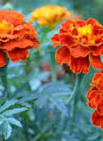
marigolds (specifically pot marigolds) were among the flowers grown in the cottage garden at Chawton, which Jane Austen knew and loved. They are part of the traditional, fragrant, and functional plants featured in her personal gardens, often mentioned alongside roses, lavender, and hollyhocks in accounts of her gardening. https://janeausten.co.uk/blogs/jane-austen-life/jane-austens-flower-garden
Notes:
Plant Type: Warm-season annual Height/Spread: 6 inches to 3 feet tall, varies by cultivar Sunlight Needs: Full sun (6 or more hours daily) Soil Type: Well-drained loamy soil, slightly acidic (pH 5.5 to 7.0) Bloom Time: Early summer to frost Water Needs: About 1 inch per week; let the soil dry between waterings Uses in Landscape: Borders, mass plantings, containers, cut flowers, cover crops Maintenance Tips: Remove spent blooms; stake tall African types if needed Deer Resistance: Yes – foliage is strongly scented and unappealing to deer
About Marigolds (Tagetes spp.)
Marigolds are easy to grow, economical, bloom reliably all summer, and have few insect and disease problems. .

Slide 10
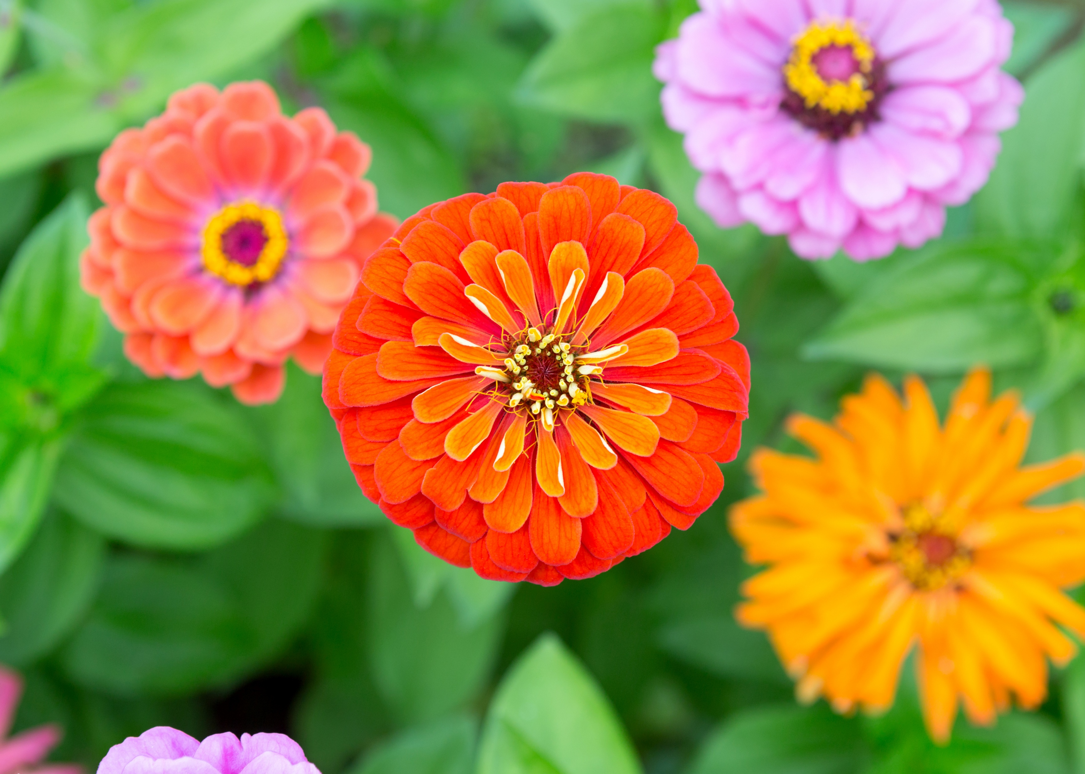
Zinnia Flower
Zinnias primarily symbolize enduring friendship, lasting affection, and remembrance. Due to their tough nature and vibrant, long-lasting blooms, they also represent endurance, goodness, and thoughts of absent friends. They are commonly associated with daily remembrance, positivity, and resilience.
Zinnias were well known in the Regency period. Not every garden had them, but well-to-do gardeners cultivated them. There is little doubt that polite English society was aware of zinnias – whether through botanical books, the gardens of friends, or the artwork of Mary Delany. In general, botany became popular in the 1780s and 1790s, especially among middle- and upper-class women.
Refer to the back of the zinnia packet on when to plant by the map, and how to plant under the instructions.
Great article on history of the Zinnia- https://regency-explorer.net/zinnia/

Slide 11
These are wonderful websites on Jane Austen interest in flowers and gardens, her life . Books and Regency era.
https://jasna.org/about/jasna-post/jane-austens-garden/
https://www.learningwithexperts.com/blogs/articles/the-garden-world-of-jane-austen-200-years-since-pride-and-prejudice
https://janeaustensworld.com/2010/03/13/the-flowers-in-jane-austens-garden/
https://janeausten.co.uk/
https://janeausten.co.uk/blogs/uncategorized/bandeau-hairbands-regency-style?

