Slide 1
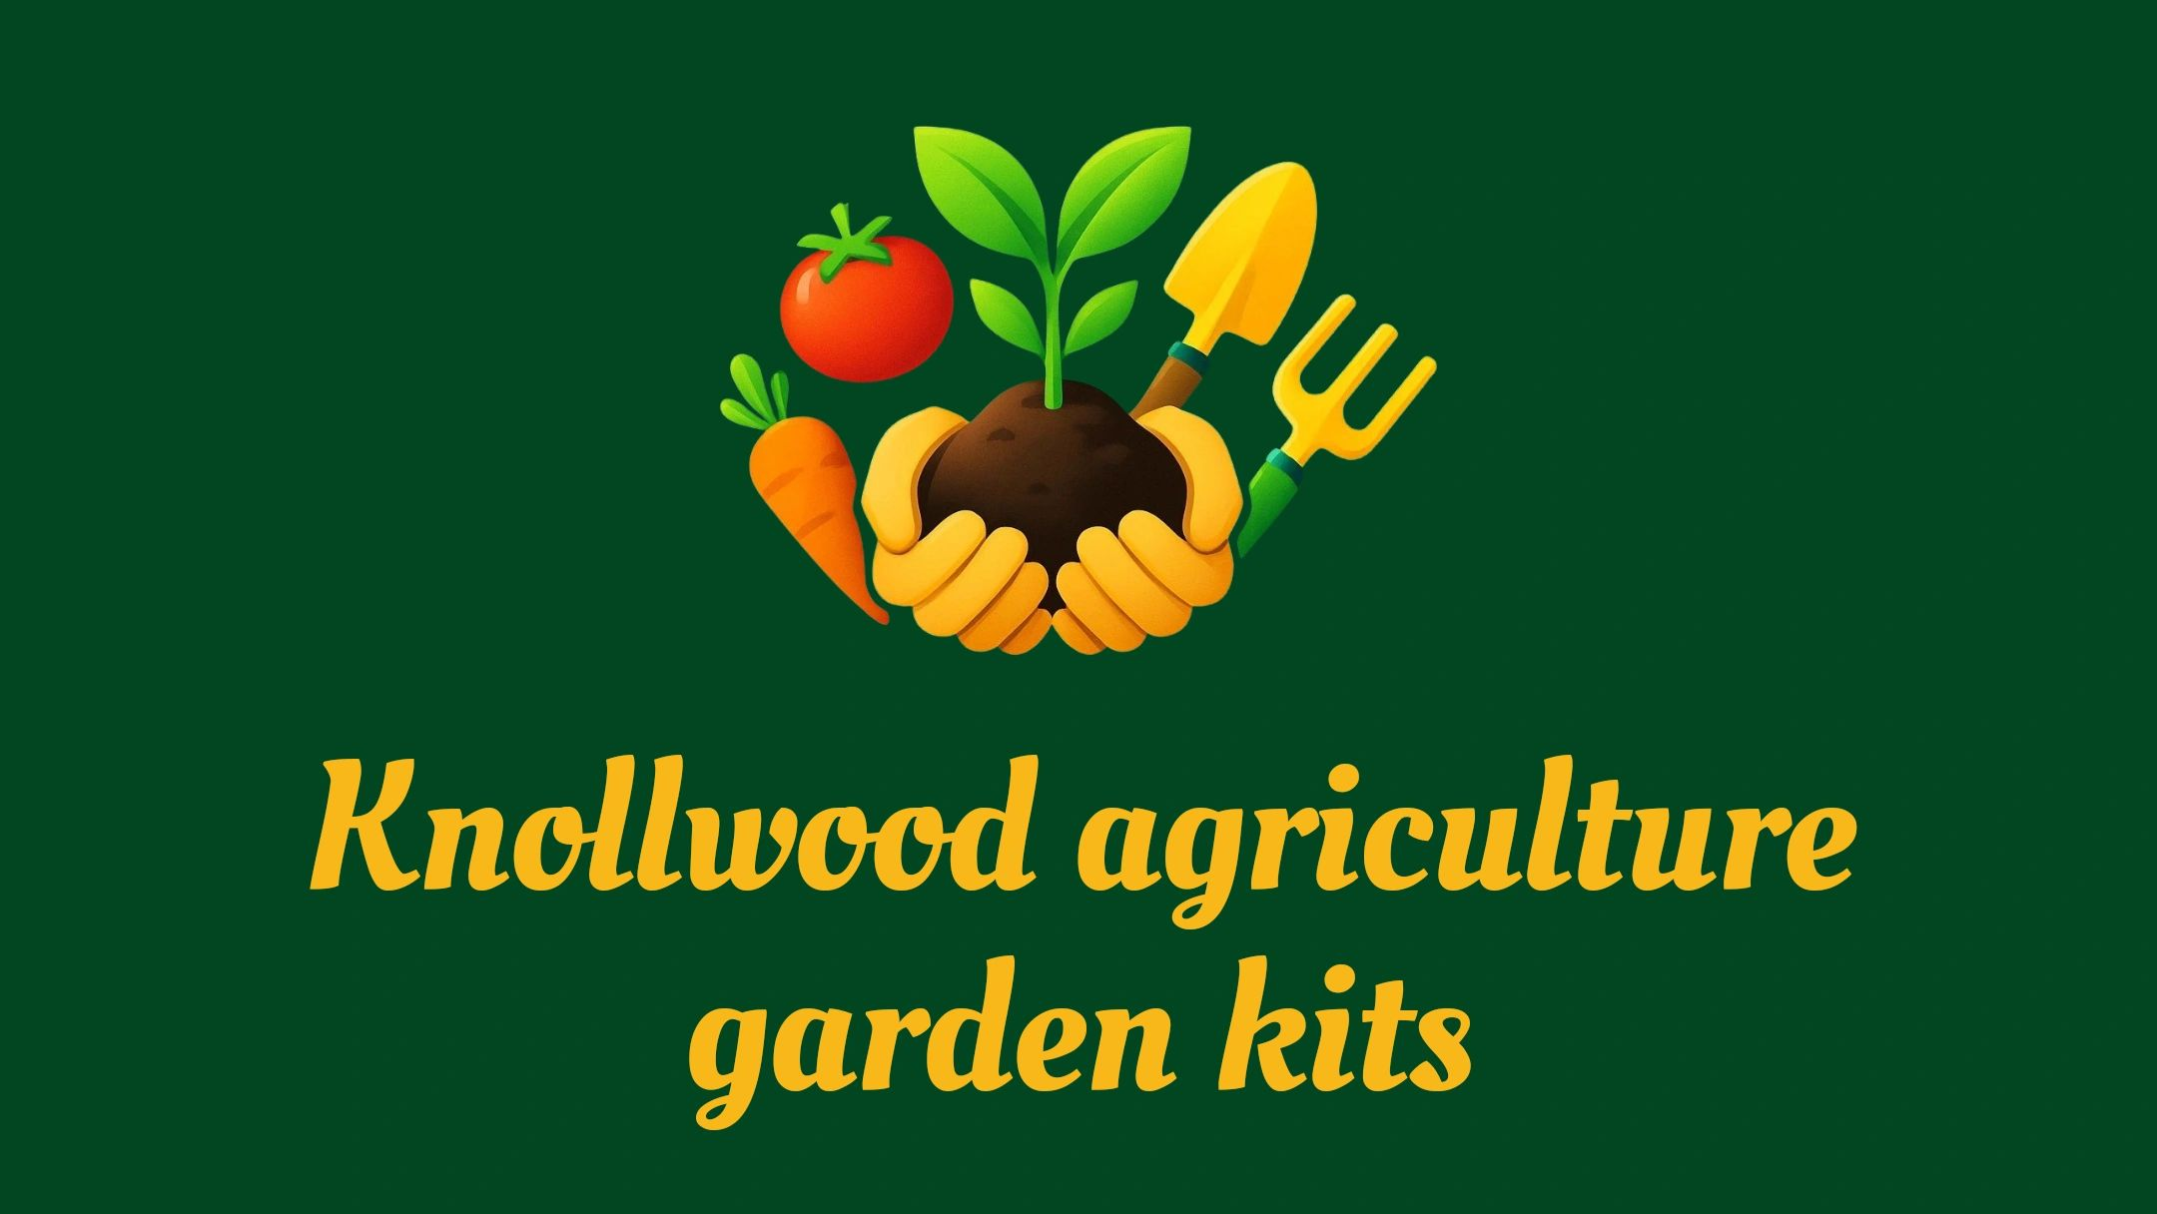
Bringing the farm to your Backyard.

Slide 2
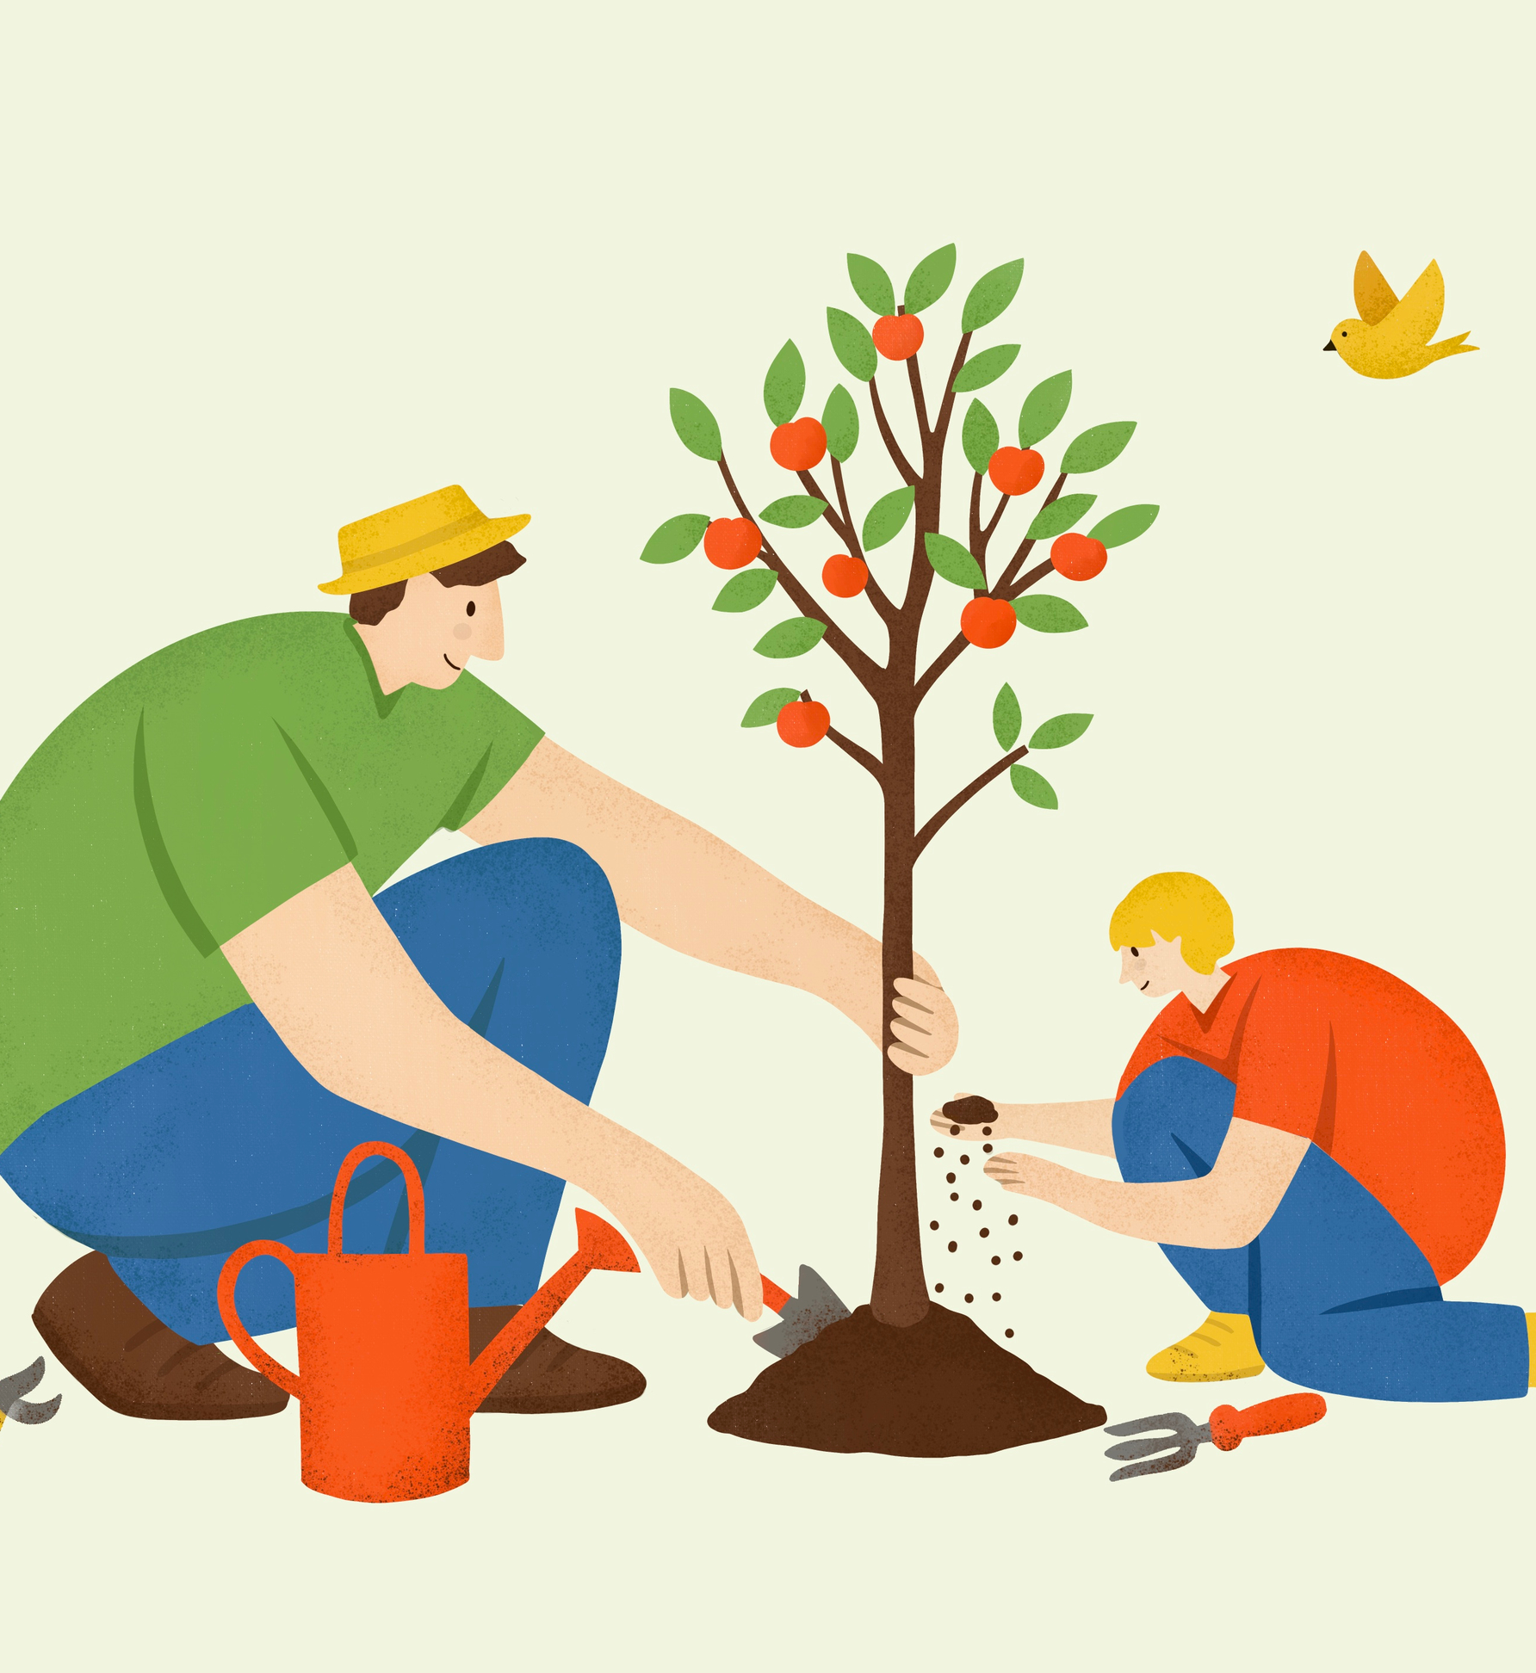
Gardening Kits for Kids
Imagine a vibrant garden where children become passionate learners, discovering firsthand how the environment and their food are deeply connected. Our gardening kits inspire kids to step outdoors, stay active, and develop essential life skills. With engaging, hands-on activities, each child transforms into a confident grower and proud harvester, nurturing plants from seed to table and experiencing the satisfaction of their own accomplishments.
=

Slide 3

Hello, my name is Amy Perry, and I live in Bedford, Virginia. Since 2012, my family and I have enjoyed life on our 12-acre farm, where our house was built in 1810. I spend a lot of time gardening, growing vegetables, fruit trees, and herbs, and caring for three flower beds. My favorite part is working with herbs and produce, especially when I get to harvest, can, and make fermented foods. I also raise chickens and keep bees. Before moving here, I lived in Sarasota, Florida, for 19 years and homeschooled my two sons. My faith in the Lord, my love of homeschooling, and my passion for gardening inspired me to create these Agriculture Kits. I hope you enjoy using them as much as I enjoyed creating them.
Website – knollwoodagriculture.com
Email-knollwoodagriculture@gmail.com
Phone- 540-526-6415

Slide 4
Table of Contents
If you have any questions or require assistance, please contact me using the information provided below. I am dedicated to supporting you in maximizing the benefits of these kits. Each slide contains links to websites with activities focused on planting, growing, and caring for the plant, as well as instructional videos designed to help children acquire and enhance relevant skills.
https://www.kidsgrowingcity.ca/blog/incorporating-stem-learning-into-garden-projects
This is an outstanding website to incorporate STEM ( science, technology, engineer and math)
Into your garden kit and growing projects. You will see many of the activities are part of the kit.
Garden zoning/soil
Ph of soil,
Amending soil
Pest control
Websites and videos
Hydroponic lettuce
Sprouting.
High school elective credit

Slide 5
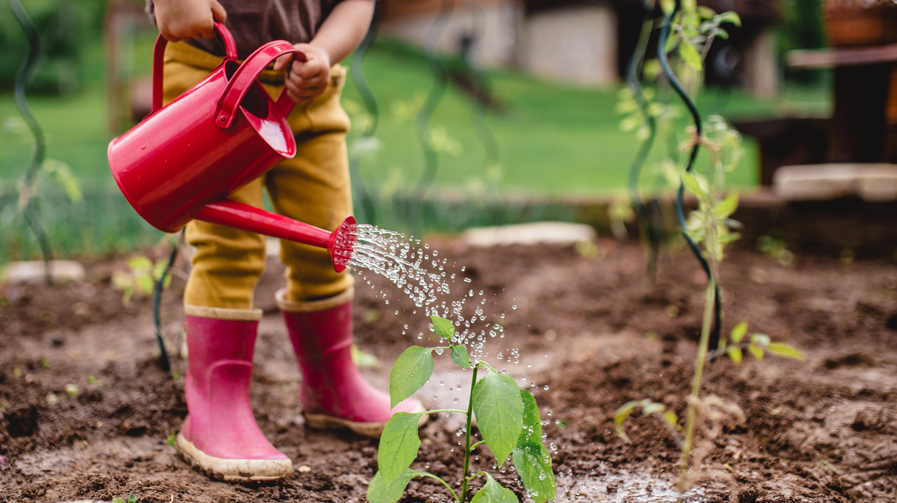
Soil and Gardening.
Soil health is crucial for providing plants with the necessary nutrients, water and physical support they need to grow and thrive. When the soil is healthy, plants are healthier, more productive and better equipped to resist pests, diseases and other stressors
Definition of soil and vocabulary words for soil and gardening.
Soil is the loose, biologically active layer of Earth's surface that supports plant life. It is a complex, living ecosystem and a three-state mixture of five key components:
Minerals: Sand, silt, and clay weathered from bedrock.
Organic Matter: Decaying plants, animals, and microorganisms.
Water: Moisture trapped in the pore spaces.
Air (Gases): Oxygen and carbon dioxide essential for roots and soil life.
Living Organisms: Bacteria, fungi, worms, and insects that cycle nutrients
The scientific study of soil as a natural resource is called pedology. While often used interchangeably with "dirt," soil is a dynamic, living medium, whereas dirt is technically soil that has lost its ability to support life
/
Notes:
Refer to websites for younger children learning about soil or a beginner gardener.
https://www.youtube.com/watch?v=5b9o7yM7YGE
https://kidsgardening.org/resources/gardening-basics-all-the-dirt-on-soil/
https://www.youtube.com/watch?v=-6BaL-VV1wA
https://www.youtube.com/watch?v=evlMlKCOKPM

Slide 6
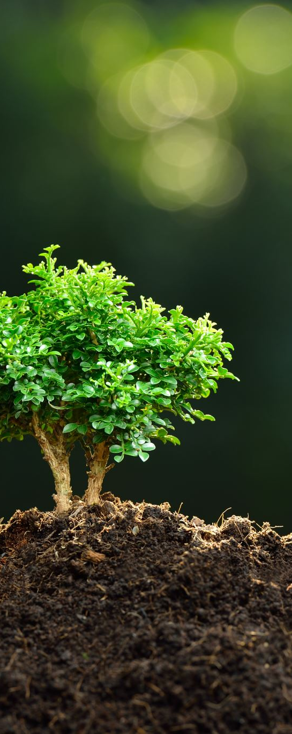
Understanding soil and more vocabulary
A gardener needs to understand soil texture (sand, silt, clay), pH levels, and organic matter content. These factors dictate how well soil drains, retains nutrients, and supports beneficial microbes. Knowing these basics allows a gardener to build a thriving foundation for plant roots.
Mastering your garden's soil foundation involves understanding a few core elements:
Soil Texture: Defines the size of your soil particles. It ranges from fast-draining sand to water-logging clay, with ideal loam sitting right in the middle.
Soil pH: Measures how acidic or alkaline your soil is. Most garden vegetables and flowers prefer a slightly acidic to neutral range (pH 6.0 to 7.0), which allows roots to properly absorb nutrients.
Organic Matter: The lifeblood of the soil. Decomposed plant and animal matter (compost, leaf mold) improves the structure of heavy clay and sandy soils while providing a steady food source for microbes.
The Soil Food Web: Healthy soil is a living ecosystem filled with billions of bacteria, fungi, and earthworms. These organisms break down organic matter and make nutrients bioavailable to plants.
Nutrient Levels: Knowing your macronutrients (Nitrogen, Phosphorus, Potassium) and
micronutrients helps you fertilize accurately without over-applying or wasting money.
Website for healthier soil- https://soilhealthinstitute.org/news-events/what-are-the-four-steps-to-healthier-soils

Slide 7
PH of soil
Taking the pH of soil is essential to determine its acidity or alkalinity, which directly controls nutrient availability to plants. If the pH is too high (alkaline) or too low (acidic), essential nutrients become locked in the soil, leading to nutrient deficiencies, poor growth, or plant death, regardless of how much fertilizer is applied.
How to change to pH of soil
The pH of soil is determined more by the nutrients available than the texture (clay, sand, silt) of the soil. For our plants, pH has a huge effect on root growth, and nutrient uptake. Different plants prefer different soil pH, but in general, most plants are happiest in a neutral pH of around 6.5-7.
In areas with high clay content, soil usually needs to be acidized. The fastest way to make soil more acidic is by applying lime. Lime is simply crushed and powdered limestone.
In regions where soils are excessively sandy, it may be necessary to neutralize the pH of the soil. The fastest way to create a more basic pH is by adding wood ash. Allow the wood ash to cool completely and make sure there is no toxic wood!
To learn more about the pyramid of soil or soil types refer to website:
https://barefootgardendesign.com/a-gardeners-guide-to-soil/
Notes:
10 things to know about soil-
https://www.provenwinners.com/learn/soil/10-things-know-about-your-garden-soil

Slide 8
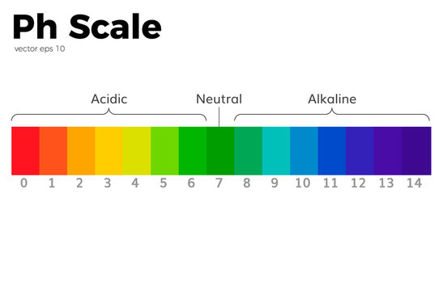
Testing Ph
I am asking you to test the pH to develop a general understanding of how it works. While detailed pH knowledge is not required to grow the produce, I have provided if you use high-quality organic soil, learning to test and interpret your local soil will be valuable if you pursue gardening.
In your seed box you will find 2 PH sticks for testing. Instructions include
To test soil pH with strips, create a 1:1 mixture of soil and distilled water (e.g., 4 tablespoons each) in a clean container, mix well, and let it sit for 20–60 minutes to settle. Dip the strip into the liquid for 2–30 seconds, shake off excess, and compare the color change to the chart within 1–2 minutes.
Notes:
Websites to learn more about PH soil. https://extension.psu.edu/understanding-soil-ph
Great website for finding all vegetables, fruits and flowers PH . https://soiltesting.cahnr.uconn.edu/plant-ph-preferences/

Slide 9

Amending your soil
You can do everything else right, but if you don’t invest in good soil, your garden won’t reach its full potential. The key to building good soil is using soil amendments that are readily available at most garden supply stores.
Compost, manure, worm castings, leaf mold, and biochar are a few examples of animal and plant-based soil amendments that enrich the soil with organic matter. Azomite, dolomitic limestone, greensand, and gypsum are several mineral-based soil amendments that add essential nutrients to the soil.
To read further on 12 soil amendments for your garden. Go to website:
https://seedsnsuch.com/blogs/gardeners-greenroom/12-miracle-soil-amendments-to-set-your-garden-up-for-success
Core Soil Mix Recipe
40% Topsoil: Provides the mineral base and heavy structure for plants to anchor their roots.
40% Compost: Delivers essential nutrients, introduces beneficial microbes, and improves moisture retention. You can use a mix of yard-waste compost, aged manure, or Mushroom Compost.
20% Perlite or Coarse Sand: Prevents soil compaction and ensures proper drainage and airflow to root zones.
Perlite can be expensive, so I reserve its use for potting or for planting species such as lavender and blueberries, as well as other plants susceptible to root rot in waterlogged soil. In raised beds, I place dead leaves or sticks at the bottom to facilitate natural decomposition, enriching both the plants and the soil with nutrients.

Slide 10
Soil Amendment
Targeting Your Existing Soil
Amending your existing ground soil requires tailoring to its specific texture:
For Clay Soil: Clay holds onto nutrients well but is dense and drains poorly. Mix in generous amounts of organic matter, like well-aged compost and shredded leaves. You can also add coarse (sharp) sand or gypsum to break up the dense clay platelets.
For Sandy Soil: Sandy soil drains very fast but leaches nutrients and water quickly. Add a heavy layer of water-retentive organic matter, such as compost, peat moss, or coconut coir.
Seasonal Amendments & Toppers
To refresh beds each season without deep tilling, simply top-dress the soil. Good seasonal amendments include:
Worm Castings: Add a handful around the base of plants or layer it into the top inch of soil.
Organic slow-release fertilizer: Granular organic fertilizers can be mixed into the top 1–2 inches of soil during planting.
Mulch: Always cover your amended soil with a 2-inch layer of straw, shredded leaves, or untreated wood chips to prevent evaporation and regulate temperature

Slide 11
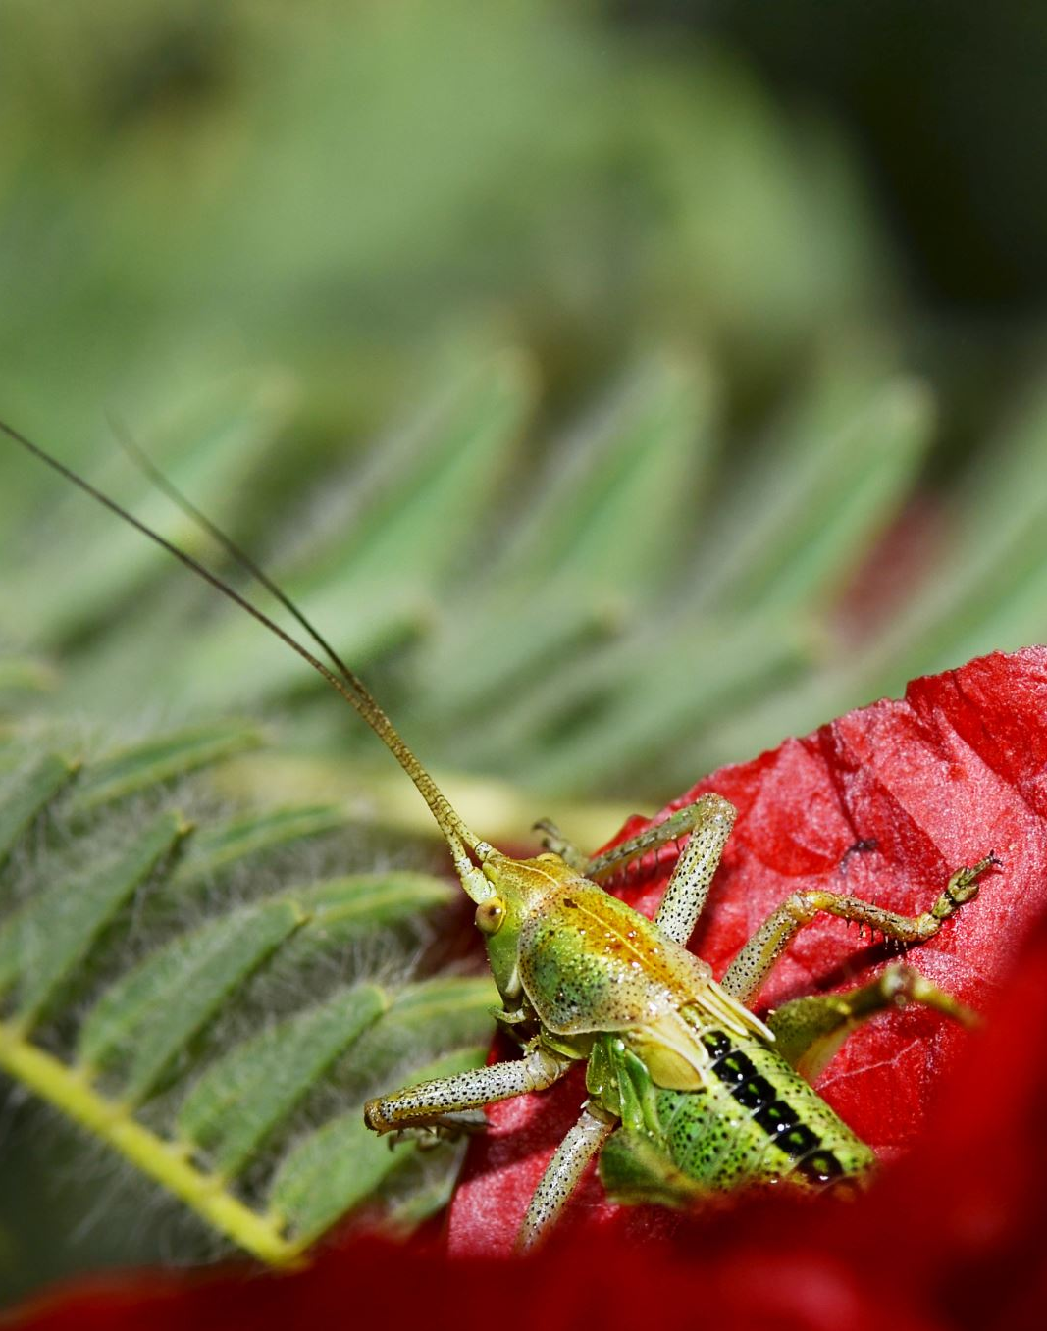
Pest control
The best pest control relies on a combination of organic treatments, beneficial insects, and physical barriers rather than harsh chemicals. For specific pests, use natural solutions like Bacillus thuringiensis (BT) for caterpillars, Neem oil for aphids, and Diatomaceous earth for beetles and slugs.
The most effective targeted strategies include:
Bacillus thuringiensis (BT): A naturally occurring bacterium that is the gold standard for controlling worms and caterpillars (like tomato hornworms) without harming bees or other beneficials.
Neem Oil: An organic extract ideal for soft-bodied insects like aphids, spider mites, and whiteflies by disrupting their life cycles.
Diatomaceous Earth (DE): A fine powder that damages the exoskeletons of crawling insects like ants, beetles, and slugs, causing them to dehydrate. Apply as a dry dust to the soil base.
Insecticidal Soap: Breaks down the outer protective coating of pests like thrips, aphids, and mites on contact.
To learn more about controlling pest and how to apply refer to website:
https://www.thespruce.com/natural-pesticide-for-vegetable-garden-11761238
Notes:
Further websites if you want to learn more about vegetables and pest .
https://extension.entm.purdue.edu/publications/E-21/E-21.html

Slide 12
Controlling Pest through beneficial ways
Three ways I like to control pest
1. Planting herbs and flowers with my garden vegetables. Bring in beneficial insects. Specific herbs and flowers (like marigolds or basil) release natural chemicals or scents that repel unwanted insects. Densely planted companions also shade the soil, physically suppressing weed growth
2. Companion planting -Companion planting is the practice of growing different crops together to mutually benefit one another, naturally improving garden health. Key advantages include deterring harmful pests, boosting pollination, maximizing garden space, suppressing weeds, and enriching the soil with vital nutrients.
3. An organic spray I make with Neem oil and Peppermint essential oil. I have included a sample for you in kit.
For further study refer to website:
https://www.fws.gov/story/5-pollinator-friendly-ways-you-can-manage-garden-pests
Further study on vegetable companions refer to website:
https://www.webmd.com/a-to-z-guides/benefits-of-companion-planting

Slide 13
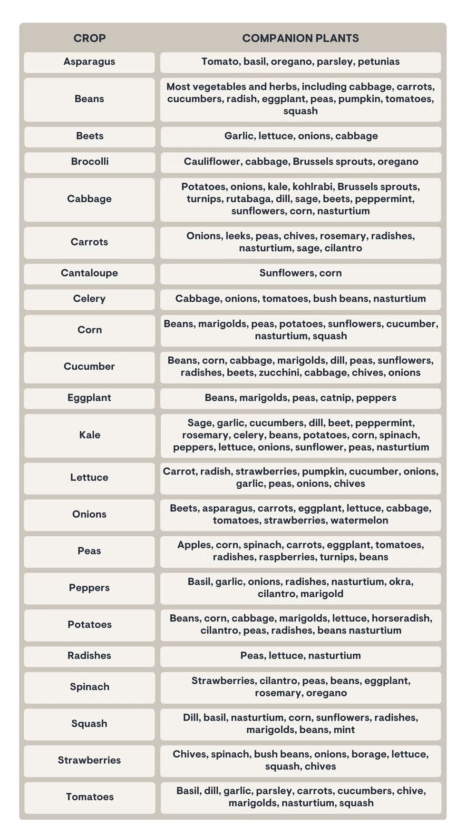
Beneficial planting
For this chart and a list of herbs and flowers that bring beneficial insects and healthy soil refer to these websites.
https://www.housebeautiful.com/lifestyle/gardening/a64945991/companion-planting-chart-guide
https://seedtherapy.com/blogs/news/shop-talk-companion-planting-what-works-and-why?gad_source
https://urbanfarmfoods.co/f/companion-plants---quick-reference
https://morningchores.com/companion-planting/

Slide 14
If you want to learn more about pollination . Check out these websites!!
https://www.appalachianforestnha.org/kids
(Excellent website for kids' activities and worksheets)
https://kidsgardening.org/resources/planting-for-pollinators/
(Excellent website for learning about pollination for kids)
https://www.climatekids.org/pollinators
https://www.canr.msu.edu/resources/smart-gardening-pollination-in-vegetable-gardens-and-backyard-fruit
https://www.pollinator.org/pollinators

Slide 15
5 Things Kids Can Do to Help Pollinators
Be kind to your pollinator friends. Pollinators like bugs and birds are small and fragile. It’s easy for people to hurt them. Be gentle and quiet when they are near!
2. Look, but don’t touch! When you see a butterfly, bee, beetle, or hummingbird outside, look, but don’t touch! Pollinators won’t hurt you if you leave them alone and are nice to them.
3. Don’t use poison sprays. Bug your family to stop using poison sprays in your house and garden. This poison kills bad bugs, but it hurts pollinators too. Bug your family to buy ORGANIC fruit and vegetables. These are grown without poison sprays, so they keep pollinators safe and happy.
4. Keep pollinators’ homes safe. And help make habitat for pollinators. Take care of a garden. Plant some flowers. When you find a bug in your house, gently take it outside to its natural habitat.
5. Bug someone! Bugs and pollinators are fun and interesting. Teach your family and friends about these important animals. Teach them to say “Thanks Bugs!” You can “bee” an expert!

Slide 16
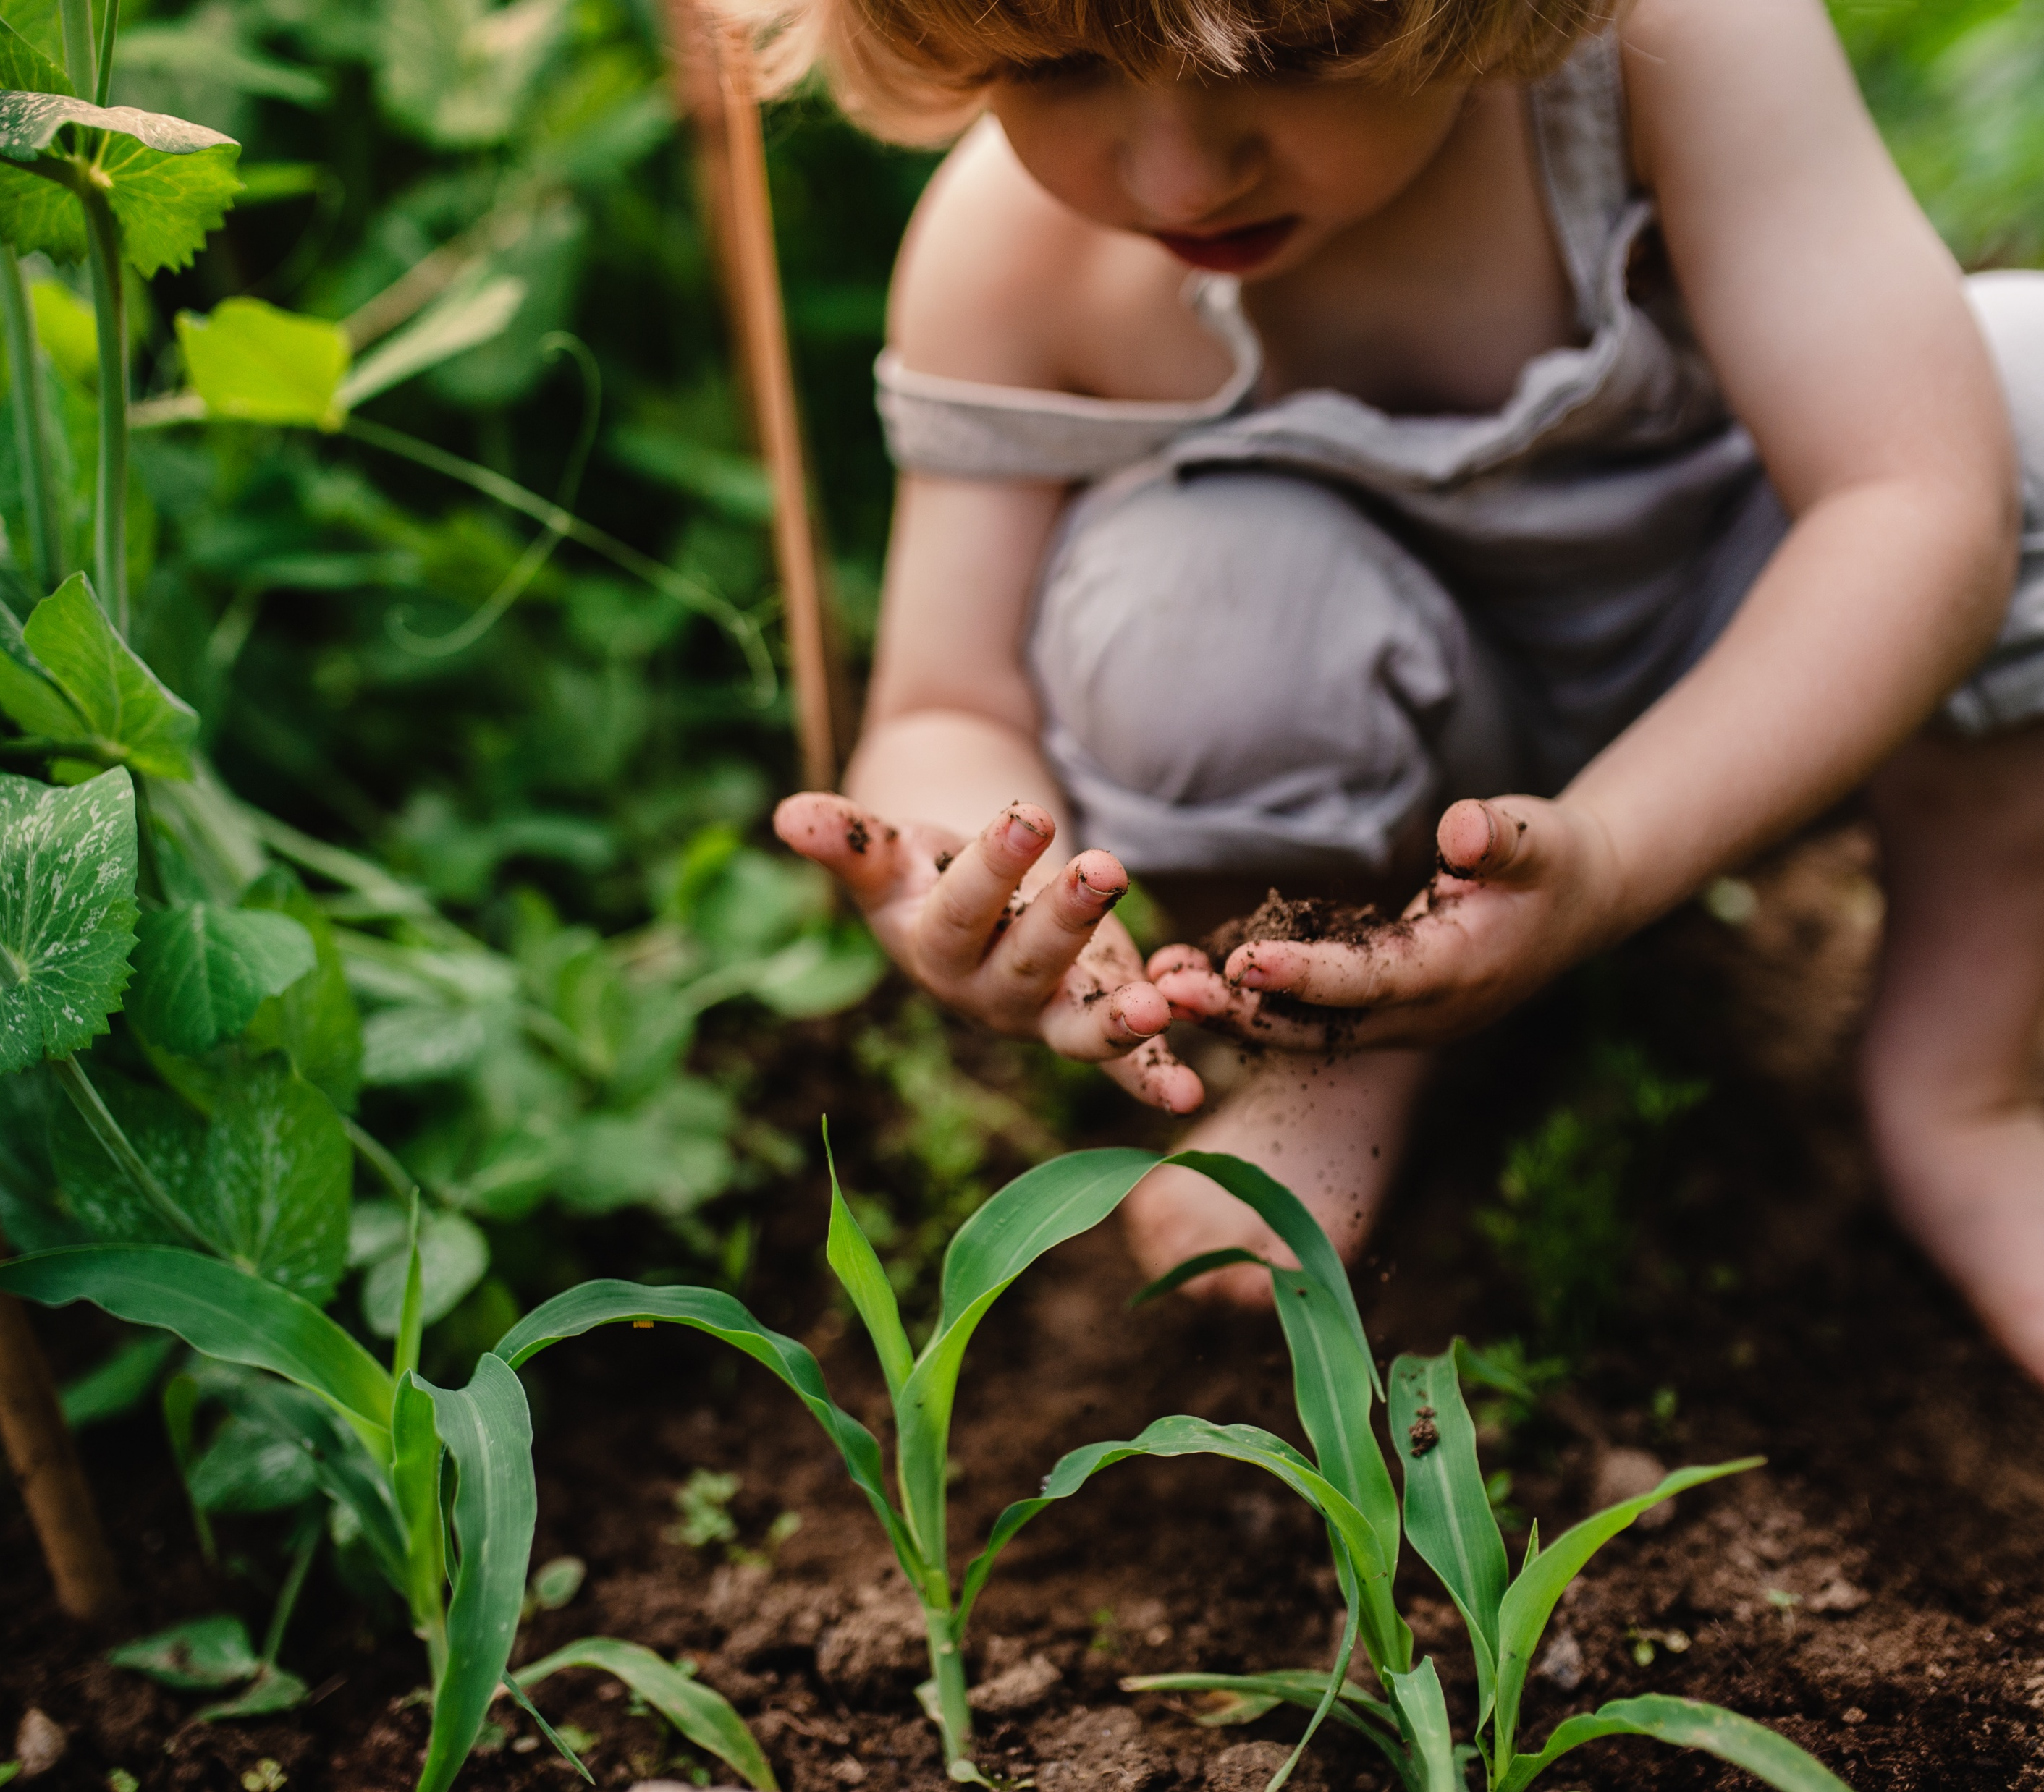
Chia pet, Hydroponic lettuce,
Growing sprouts.
Fermented ideas

Slide 17
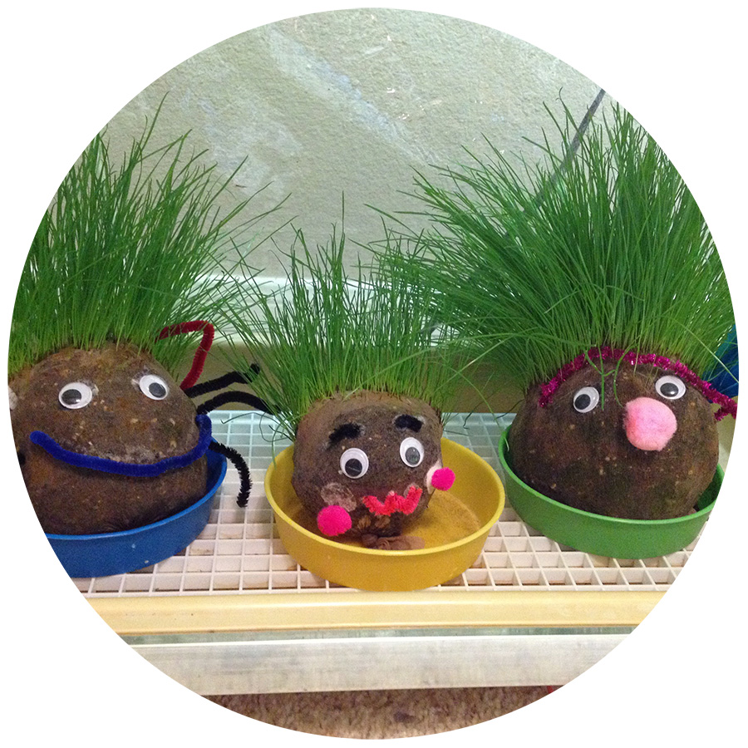
Homemade Chia pet. Make your own grass person. Website has material and instructions.
https://kidsgardening.org/resources/garden-activities-plant-people/
Notes:
You will need to provide your own soil.

Slide 18
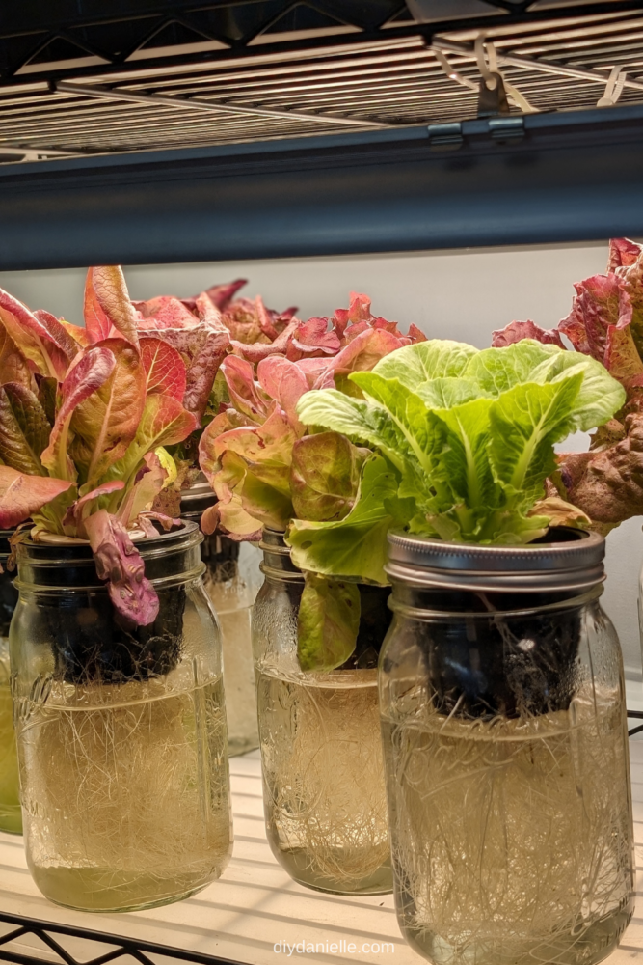
Hydroponic Lettuce
In this activity you will grow lettuce not with soil or in the ground. But with water and in a jar. It is a great way to grow lettuce year -round.
Step 1: Fill your wide mouth mason jar with water. It should just touch the bottom of the basket when placed in the lip of the mason jar.
Step 2: Insert the larger net/pot/basket into the mason jar. It should be big enough to sit right on top.
Step 3 Add your seed Rockwool pod and seeds. Use the clay pebbles to raise the Rockwool pod of the bottom of the basket and keep it centered.
Step 4 : Add more water until the water level just touches the bottom of the Rockwool. Make sure to get the seed block wet, too! ‘
Step 5: Place the hydroponic mason jar somewhere warm until the plant sprouts.
Step 6: Once the plants have sprouted, add fertilizer that’s made specifically for hydroponics. This is super important for giving your plants nutrients they will usually get from the ground!
Step 7: You will need to block light from entering the mason jar in order to prevent algae growth. Use kitchen towel, black paper or felt.
Important: You should check your water regularly, you will have to add water as it evaporates, If you see mold or algae, preplace the water.
Notes:
You will need to provide your own wide mouth mason jar.

Slide 19
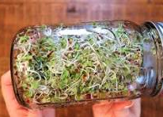
How to Grow Sprouts in a Mason Jar http://cultivatorkitchen.com/how-to-g row-sprouts/
Growing sprouts in a mason jar takes 4-6 days using just seeds, water, and a jar. Soak 1-2 tablespoons of seeds overnight, then rinse and drain them twice daily, keeping the jar upside down at an angle in a shaded spot. They are ready to harvest when they fill the jar, are 1–2 inches long,and have developed small leaves.
Notes:
You will only need to provide a wide mouth mason jar. Mason Jar: A 32 oz wide-mouth jar is ideal.
Sprouting Seeds: (e.g., Alfalfa, Broccoli, Radish, or Clover).
Lid: A mesh sprouting screen or cheesecloth secured with a rubber band.
YouTube +4
Step-by-Step Instructions
Soak: Add 1-2 tablespoons of seeds into the clean jar. Fill with water, cover with the mesh lid, and let them soak for 4-8 hours (or overnight).
Drain & Rinse: Drain out all the soaking water. Rinse the seeds with fresh water, swishing gently, and drain thoroughly again.
Store: Place the jar upside down at an angle (45°) in a bowl or on a drying rack, away from direct sunlight, to allow air circulation and ensure no standing water remains.
Rinse & Drain Twice Daily: Twice a day (morning and night), fill the jar with water, rinse the seeds, and drain thoroughly, returning the jar to the angled position.
Harvest: In 4–6 days, when the jar is full, rinse well, drain, and allow them to dry for a few hours. Store in a covered container in the fridge for up to 3 days

Slide 20
Fermenting vegetables at home is a simple, economical way to preserve produce using salt and water. The process produces a tangy flavor and promotes the growth of beneficial probiotics.
Required materials include 3 to 4 cups of dense vegetables such as carrots, cauliflower, radishes, green beans, or cabbage; 1 tablespoon of unrefined sea salt, kosher salt, or canning salt (iodized salt should be avoided, as it may inhibit beneficial bacteria); 1 quart of filtered, spring, or distilled water (if using tap water, allow it to stand overnight to permit chlorine evaporation); optional spices such as garlic, peppercorns, dill, or bay leaves; and a standard 1-quart mason jar with a plastic lid.
Step-by-Step Instructions
Prep the Veggies: Wash and chop your vegetables into sticks, chunks, or thin slices.
Pack the Jar: Place your spices at the bottom of the jar, then pack the chopped vegetables in tightly, leaving about 1 inch of space at the top.
Make the Brine: Dissolve 1 tablespoon of salt into 1 quart of water. Pour this saltwater solution over the vegetables until they are completely submerged.
Weigh It Down: To prevent vegetables from coming into contact with air (which can cause mold), place a small, clean glass weight or a folded cabbage leaf on top to keep the veggies submerged in the liquid.
Ferment: Secure the jar tightly with a lid and leave it at room temperature (around 68-75°F) out of direct sunlight. Open (or "burp") the jar once a day to release carbon dioxide gases.

Slide 21
Further learning for all ages https://www.creationillustrated.com/gardening-with-children/
Many garden activities/crafts/art.
https://ngb.org/kids-gardening-activities/
10 Screen-Free Garden Activities for Kids This Summer
https://www.gardenary.com/blog/10-screen-free-garden-activities-for-kids-this-summer
Grow a worm farm for your garden
https://pdf.lowes.com/productdocuments/59dac708-4a2e-4352-9722-ee0064ba5d92/47521184.pdf
Free resources to download for gardening ideas.
https://plantheroes.org/educator-resources/
Great courses for upper-level students to expand their gardening knowledge
https://ngb.org/garden-courses/
https://gardentutor.com/learn-how-to-garden/
https://www.smilinggardener.com/organic-gardening/
https://commonsensehome.com/start-a-garden/

Slide 22
Disclaimer And Liability Clause
All seeds are sourced from reputable seed companies that claim their products are organic and have high germination rates. However, these seeds are not approved by the FDA. Knollwood Agriculture does not grow the seeds included in this packet.
This kit is intended for educational use only. Please follow the instructions provided. Knollwood Agriculture is not responsible for misuse or individual choices.
Parents and guardians are responsible for addressing any family concerns about allergies, medical reactions, or pre-existing medical conditions.
"This product is provided 'as is' and 'as available' for informational and educational purposes only. Knollwood Agriculture makes no warranties, express or implied, regarding its safety, reliability, or performance. By using this product, you acknowledge and agree to assume full responsibility for any risks, injuries, or damages, and agree that Knollwood Agriculture shall not be liable for any direct, indirect, or consequential losses arising from its use or reliance on any information provided. Use is at your own risk
"These statements have not been evaluated by the FDA. This product is not intended to diagnose, treat, cure, or prevent any disease. Always consult a qualified healthcare professional before using this product, especially if you have pre-existing medical conditions or are pregnant/nursing. Use at your own risk. [Your Company Name] accepts no liability for any adverse effects or damages resulting from the use or misuse of this product

Slide 23
High school Gardening Elective
Transcript Titles: Options include :
Horticulture, Botany, Environmental Science,
Sustainable Agriculture,
Home Economics
Or Life Skills

Slide 24
High school elective credit
Gardening is a versatile high school elective that can be tailored to fulfill requirements for science, vocational skills, or life skills.
1. Assigning High School Credit
To award credit on a transcript, students must typically log a specific number of hours:
0.5 Credit (one semester): 60 to 90 hours of instruction, research, and hands-on work.
1.0 Credit (full year): 120 to 180 hours.
Transcript Titles: Options include Horticulture, Botany, Environmental Science, Sustainable Agriculture, or Home Economics
Gardening Journal: Require students to maintain a detailed log of planting dates, weather observations, and pest control efforts as part of their coursework.

Slide 25
Ideas for expanding study or elective hours.
research on topics like plant pathology, soil pH, hydroponics, and urban farming
Documentation: Maintain a detailed garden journal, take photos of progress, and require written reports on experiments, such as tracking plant growth or analyzing the results of different fertilizer types.
Structure: Utilize a structured approach by requiring students to plan a garden layout, manage a budget, calculate yield (mathematics), and track costs for a potential farmer's market project
Botany & Science: Study plant anatomy, photosynthesis, photosynthesis, and genetics
Sustainability: Explore composting, companion planting, and natural pest control methods.
Project-Based Learning: Focus on specific projects, such as building raised beds, starting seeds indoors, creating a herb garden, or developing a sustainable greenhouse
Field Studies: Visit local botanical gardens, nurseries, or community gardens, and connect with local

Slide 26
Horticulture Elective Class Syllabus Template

Slide 27
How to turn Knollwood agriculture garden kit into a high school elective credit
How to turn Knollwood agriculture kit into full year credit . 120 hours
First semester follow semester track using the kit.
Second semester focus on interest, skill, resume building.
Teach younger siblings the kit
Supplement field trips or volunteer work in a green house, garden store, community gardening, Nursing home, schools garden planting.
Focus on a topic and build a project or science lab experiment]:
Soil ph., soil blending, soil composition and improving
Plant anatomy, plant care, harvesting, plant companions.
Grow utilizing all resources, garden beds, boxes, hoop houses, greenhouse, container , hydroponics.
Environmental resources, pesticides concern, organic treatments.
Focus on produce in the kitchen with cooking, making teas, harvesting, canning, fermenting.
Add one of the other Knollwood agriculture kits: Herbs and Wellness or Jane Austen flowers.
Semester credit – Total 60 hours
Hands on activities- 20 hours
Research and learn power point topic websites.- 25 hours
Journal activities and take notes on website material. Add worksheets, test- 15 hours

