Slide 1
Jane Austen’s Garden/ Flower kit

Slide 2
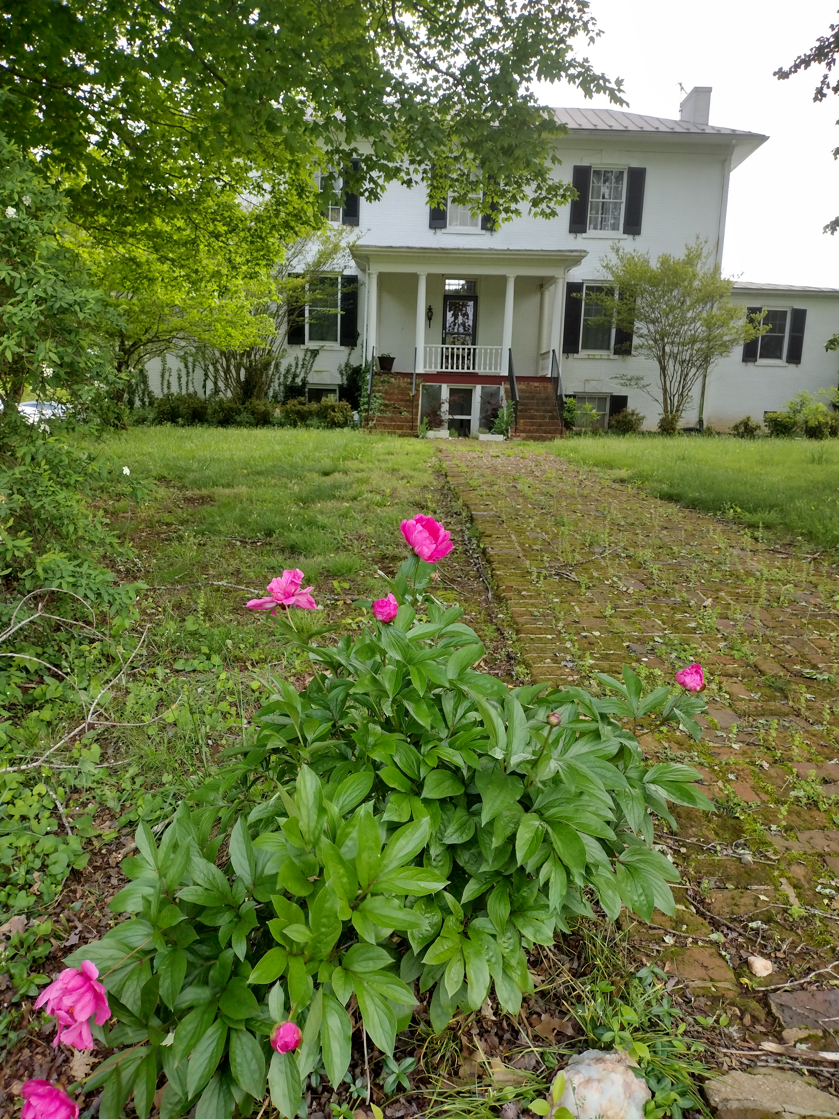
My farm built in 1810, with one of Jane Austen’s favorite flowers the Peony.. Jane Austen was 34 or 35 years old in 1810, as she was born on December 16, 1775, making her 34 for most of that year and turning 35 in December, right around the time her sister Cassandra painted her famous portrait
Notes:
I have provided several websites on Jane Austen, an influential writer who effectively represents the Regency period. I encourage you to explore her life, her literary works, and her appreciation for gardens and flowers.

Slide 3
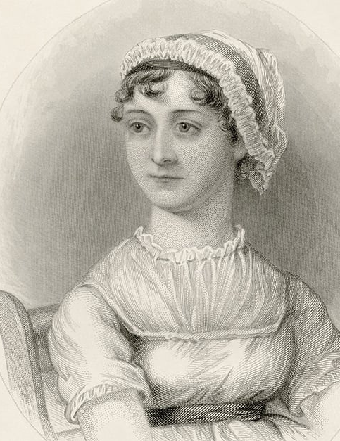
A woman of letters and plants. While Jane Austen is renowned for her novels, she was also a keen gardener.
Jane Austen, English novelist (1775–1817)
Notes:
https://janeaustens.house/jane-austen/jane-austen-a-life/ This is a great website to read on Jane’s life. There is just too much on her to include in a power point. So, this gives you more research on her.

Slide 4
The Life of Jane Austen
What did Jane Austen look like.
2. Jane Austen's life
3. The end of Jane Austen life
https://www.youtube.com/watch?v=h_xOCobYYtQ
This is a wonderful video. I highly recommend watching it. The author gives you a view of what she felt Jane looked like based on the information on her. It is a touching and well thought out picture;
https://www.youtube.com/watch?v=g8-zx056ek0&list=PL7ZS1Ml0SItRGbJfMQoNn4JLirhayU1eb&index=2
https://www.youtube.com/watch?v=_ds1KdX-5Kg&list=PL7ZS1Ml0SItRGbJfMQoNn4JLirhayU1eb&index=4
Notes:
https://janeausten.co.uk/blogs/jane-austen-life/jane-austens-flower-garden. This website gives you more information about janes home in London and Bath, England. Also, gives information on the festivals every year for Jane Austen.

Slide 5
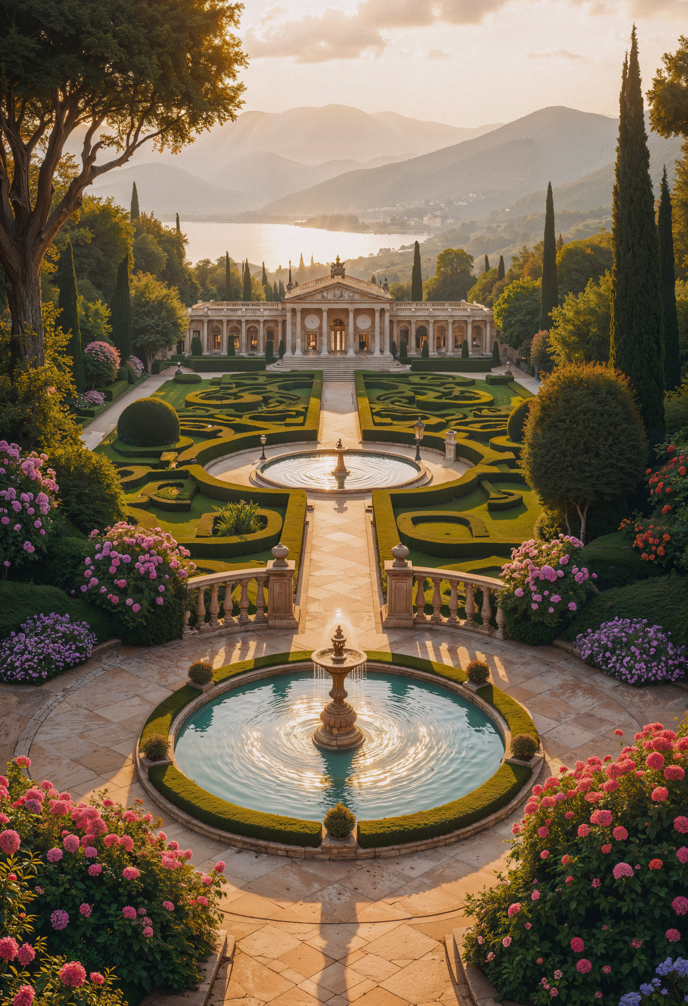
The Regency Period officially spanned 1811 to 1820, when George, Prince of Wales, acted as Prince Regent while King George III was ill. It ended when George III died and the Prince Regent became King George IV. More generally, people use "Regency" to describe the years from around 1795 to 1837, a time of major artistic and cultural change that bridged the late Georgian and early Victorian eras.
During the Regency period, social customs changed along with culture. Walking became an important part of daily life, especially for the upper class. People went out for strolls not just for fun, but also to be seen in public. Instead of walking to get somewhere, which was usually done by carriage, the upper class walked for recreation and to show off. Women often joined these outings to meet other fashionable people and display the latest styles. Special promenade dresses had unique designs and followed fast-changing trends in color and fabric.
Social life in the Regency era also included showing personal taste and status through nature. Flowers became an important way to express social standing. On wealthy estates, flower gardens showed off the owner's wealth, taste, and culture. People chose flowers like roses, tulips, dahlias, and hyacinths for their beauty and their meanings.
Notes:
]https://chawtonhouse.org/2022/11/gardens-in-the-regency-era/
https://www.woodlandsphila.org/blog/promenades-and-english-gardens

Slide 6
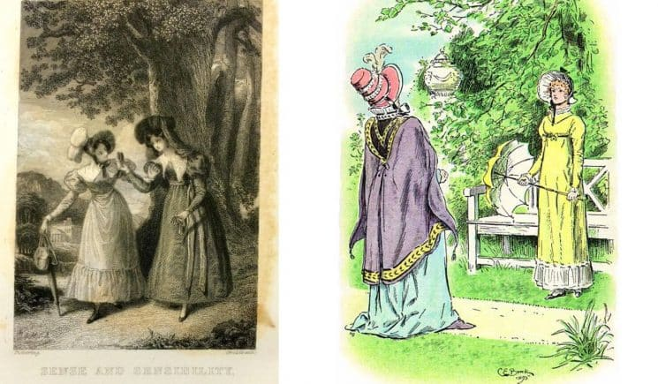
The garden was also one of the only spaces in Regency England where private conversations could be held. Social etiquette dictated that whilst indoors everyone was often confined to the same room, whereas in the garden people could break apart and hold their own private conversations or even break away from the rest of their party to wander in reflective solitude. It is perhaps due to this that some of Austen’s most dramatic scenes play out in the gardens. It is a private walk through the gardens at Barton Park that Eleanor learns from Lucy Steele that she is secretly engaged to her own love Edward Ferrars. Lady Catherine takes Elizabeth Bennet for a walk through the gardens at Long bourn, and it is there that she attacks Elizabeth over the rumors regarding her engagement to Darcy. Thus, through Austen, we are given a clear insight into how gardens were utilized to engage in intimate conversation.
Left: Frontispiece to the Bentley 1833 edition of Sense and Sensibility, showing Lucy and Elinor walking together as Lucy confirms that she is indeed engaged to Edward Ferrars. Right: C. E. Brock’s illustration for the 1895 edition of Pride and Prejudice, in which Lady Catherine de Bourgh attempts to make Elizabeth promise not to marry Mr. Darcy.

Slide 7
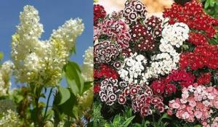
The Flowers in Jane Austen’s garden
.Jane wrote to Cassandra: ( Her sister) Some of the Flower seeds are coming up very well–but your Mignioette makes a wretched appearance. Our young Peony at the foot of the Fir tree has just blown & looks very handsome & the whole of the Shrubbery Border will soon be very gay with Pinks & Sweet Williams, in addition to the Columbines already in bloom. The Syringas too are coming out — We are likely to have a great crop of Orleans plumbs–but not many greengages–on the standard scarcely any–three or four dozen perhaps against the wall. – Christian Encounters: Jane Austen, Leithart, p75- 76.
Besides the peonies, dianthus and columbines Austen mentioned in her letter to her sister, the garden contained mallows, hollyhocks, phlox, lilacs, mock orange, cornflowers ,dahlias. daisies and sweetbriar roses. Berry bushes included raspberries, currants and gooseberries.
The excellent article, Jane Austens Flower Garden, describes additional variety of flowers, fruits, trees and shrubs and the kitchen garden. “I remember the garden well,” writes Miss Lefroy. “A very high thick hedge divided it from the (Winchester) road, and round it was a pleasant shrubbery walk, with a rough bench or two where no doubt Mrs. Austen and Cassandra and Jane spent many a summer afternoon.”
Syringa, Sweet William are flowers in the pictures.
Notes:
https://janeaustensworld.com/2010/03/13/the-flowers-in-jane-austens-garden/
https://www.woodlandsphila.org/blog/promenades-and-english-gardens Festival information

Slide 8
Importance of Flowers in Jane’s novels.
Jane Austen's novels are rich in symbolism and thematic depth, with flowers serving as a significant motif throughout her works. Each flower often reflects character traits, social status, and emotional landscapes. Below is an exploration of the presence and significance of flowers in Austen's novels.
Here's how gardens and flowers appear in her major novels:
Pride and Prejudice: Gardens at Netherfield, Longbourn, and Pemberley are crucial. Darcy's gift of violets to Elizabeth symbolizes purity, contrasting with the coarse Lady Catherine's dismissal of Longbourn's "little wilderness" (an unfashionable garden style) against Pemberley's grand waterlilies, signaling wealth and taste.
Sense and Sensibility: Gardens provide settings for walks and private talks, with plants like roses and sweetbriar appearing, mirroring the characters' inner lives and blossoming relationships within rustic, natural settings.
Mansfield Park: The grand gardens and wilderness at Mansfield Park contrast with Fanny Price's humble origins, with plants like roses and lilies used to highlight the family's status and Fanny's quiet dignity amidst them.
Emma: Gardens at Hartfield and Donwell Abbey are key locations for social interaction, like the famous strawberry picking scene, using flowers and fruits to signify romance, domesticity, and societal roles.
Northanger Abbey: Features rustic gardens and shrubberies, often associated with the wild, Gothic imagination of Catherine Morland, contrasting with more manicured estates.
Persuasion: The seaside setting influences plants, but traditional cottage garden flowers and shrubberies still feature in gardens at Kellynch and Uppercross, symbolizing enduring affection and the natural world
Notes:
https://www.petalandpoem.com/floral-thoughts/a-guide-to-flowers-as-a-theme-in-jane-austen-novels#:

Slide 9
.
Flowers have their own language. Floriography, or the cryptological communication through flower use or arrangement, has been practiced for centuries. Flowers have been ascribed meanings for arguably thousands of years, and students of the Bible and of Shakespeare (think Hamlet) in the Regency would have been aware of this. Jane Austen used floriography in her writings, as did the Bronte sisters.
Daffodil – I regard you
Apple blossom – preference
Morning Glory – affection
Pansy – thoughtfulness
Thistle – defiance
Columbine – folly
Primrose – consistency
Violet – faithfulness
Zinnia – absent friends
Daisy – innocence
Lily – purit
Myrtle – love and marriage
Holly – foresight
Azalea – temperance
Rhododendron – danger
Iris – message
Ivy – fidelity
Tulip – fame
Basil – hatred
Lavender – distrust
Marigold – sorrow
Notes:
https://regrom.com/2016/06/08/regency-culture-and-society-the-language-of-flowers/

Slide 10
These are wonderful websites on Jane Austen interest in flowers and gardens, her life . Books and Regency era.
https://jasna.org/about/jasna-post/jane-austens-garden/
https://www.learningwithexperts.com/blogs/articles/the-garden-world-of-jane-austen-200-years-since-pride-and-prejudice
https://janeaustensworld.com/2010/03/13/the-flowers-in-jane-austens-garden/
https://janeausten.co.uk/
https://janeausten.co.uk/blogs/uncategorized/bandeau-hairbands-regency-style?

Slide 11
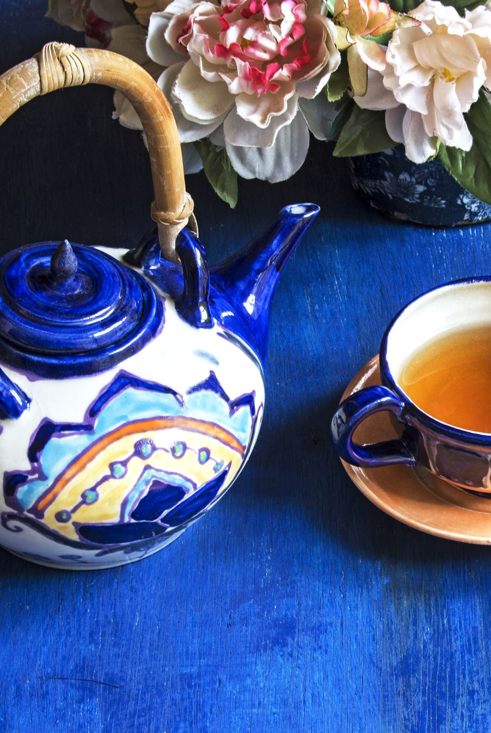
Tea Section
Jane loved Roses and Lavender. History shows she talked about these two flowers often. This is a great section to introduce flowered teas ( Mint, Lemongrass, Hibiscus, Chamomile flowers) and using Lavender to make cookies for the tea party.
In This Section you will learn all about tea.
The history of tea
Tea etiquette
How to Make flowered tea
How to make lavender cookies
And to finish it off. You will have a tea party.

Slide 12
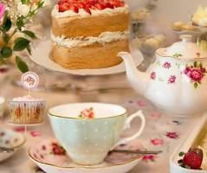
\
This is a fun part of the kit. You learn about tea history, tea etiquette, and how to brew the tea. Now it is time to have a tea party. This is great etiquette whether you are a boy or girl, so encourage all your children to participate.
Along with the tea, a tea party always has foods.
The foods at a tea party, often called tea fare, afternoon tea foods, or tea party treats, generally fall into three categories: delicate finger sandwiches, warm scones with clotted cream and jam, and small sweets/pastries, served on a three-tiered stand in a traditional British Afternoon Tea.
Included is culinary lavender to make cookies for the tea party. Recipe last slide .
TEA PARTY
tm

Slide 13
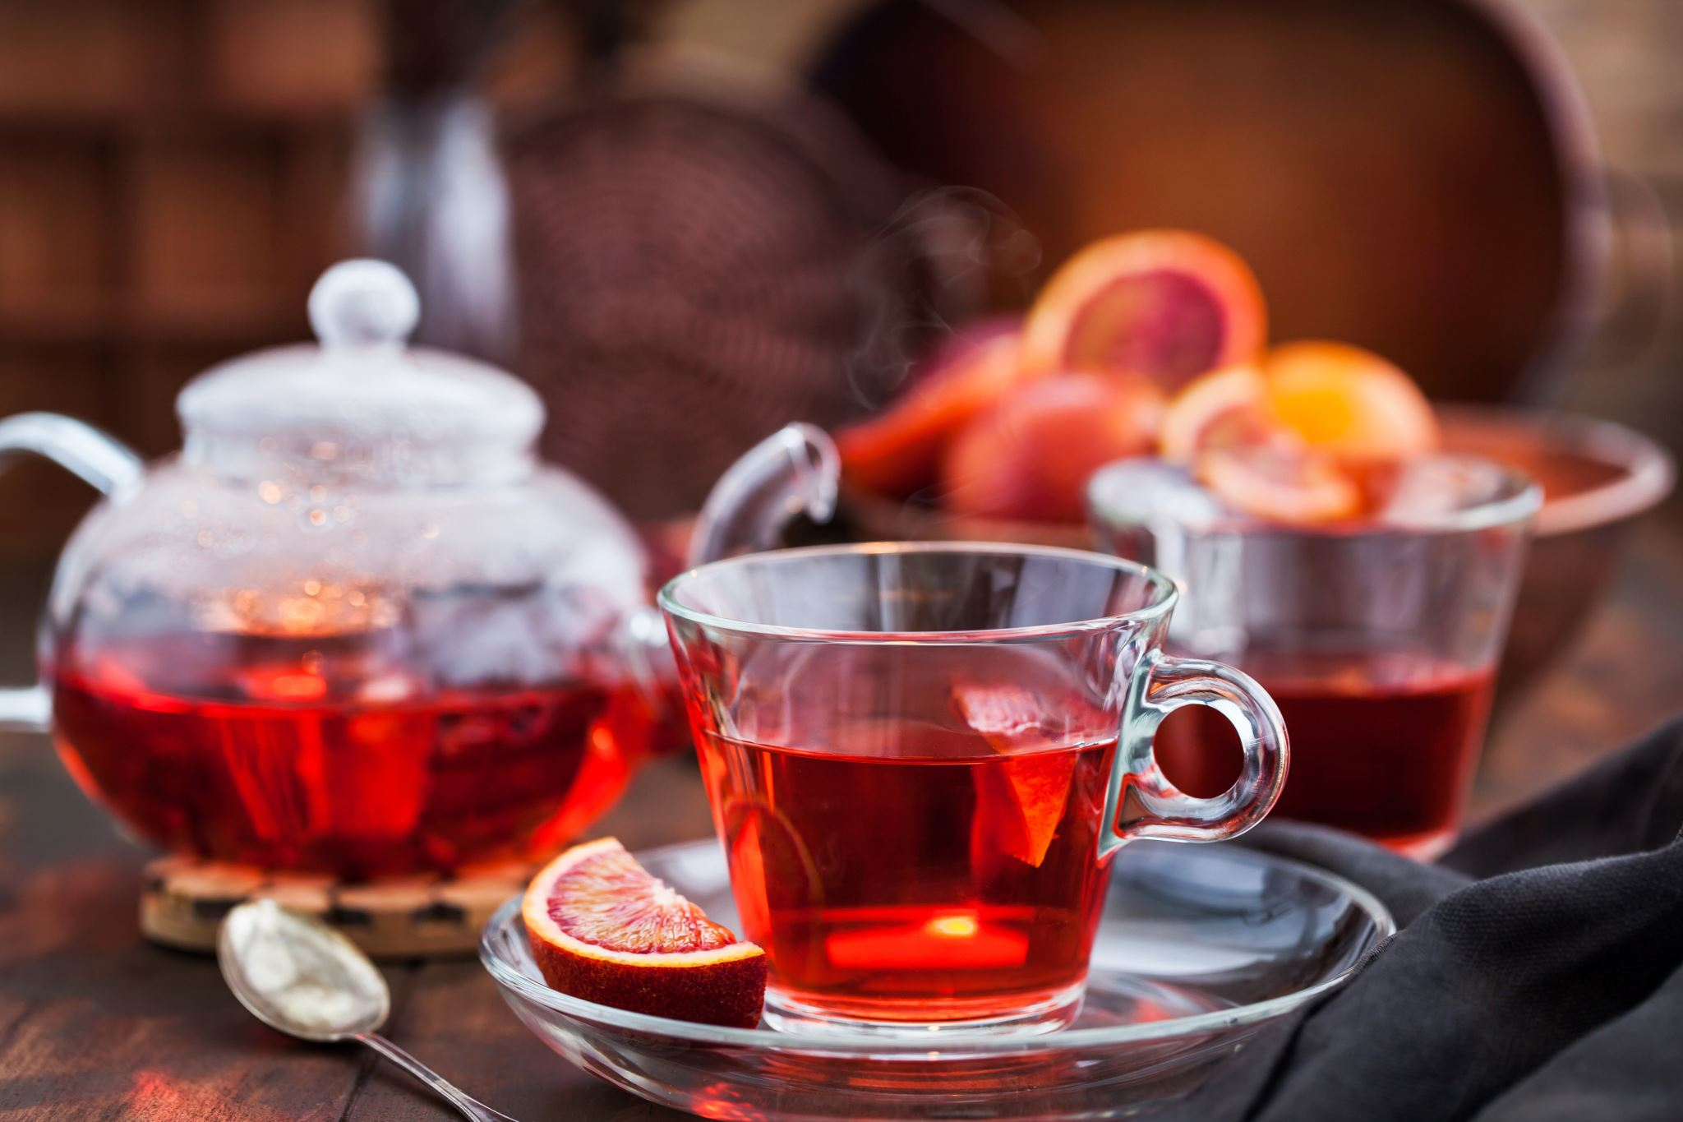
This website will teach you all the History of Tea in the Regency Period. Please take the time to learn. https://www.beachhouseteacompany.com/blogs/loose-leaf-tea-1/jane-austen-and-tea?srsltid
Jane Austen, the famous English novelist, is often associated with tea in the context of her literary works and the social customs of her time. Tea was a central part of British culture during the 18th and 19th centuries, which is the period in which Jane Austen lived and wrote. Here are a few ways in which tea is connected to Jane Austen:

Slide 14
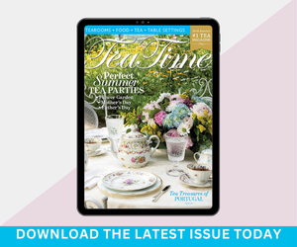
Tea etiquette for children
http://www.tea-happiness.com/2019/01/teaching-kids-through-tea-parties.html
https://www.eastangelharbor.com/blog/tea-hat-blog/little-girls-tea-party-ettiquette
https://youtu.be/nKup3embP0c?si=L3JNNwPrS96vTZMp
https://www.culturekidsmedia.com/videos/tea-time-rules-a-kids-guide-to-afternoon-tea-etiquette-not-high-tea-1/
Etiquette and Manners: Austen's novels are known for their exploration of social etiquette and manners. The rules and customs surrounding tea-drinking, such as how one should pour and serve the tea, were often used to illustrate a character's social standing and manners. Good manners were highly valued in Austen's society.
Manners and Etiquette: The rules of etiquette surrounding tea-drinking provided a microcosm for the broader social norms and expectations of Austen's time. The art of pouring tea, holding a teacup, and engaging in polite discourse were all reflective of one's upbringing and societal standing. In "Emma," for instance, Emma Woodhouse's guidance on tea service at her tea party demonstrates her authority and desire to control social situations
Notes:
Tea Time is a wonderful magazine to teach children tea etiquette, craft ideas, recipes, tea infusions, table settings, and even tea retreats.
Afternoon tea teaches children manners, planning, etiquette, appropriate dress, and handling precious things carefully.
https://teatimemagazine.com/what-afternoon-tea-teaches-our-children/

Slide 15
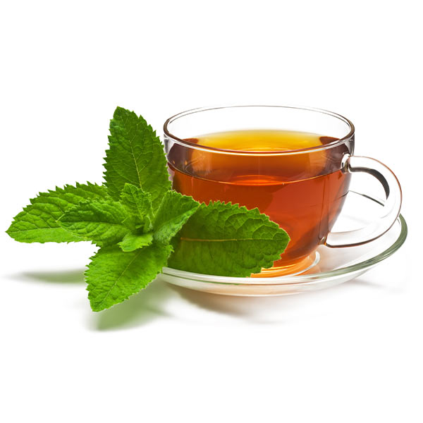
Making Herb Tea
How to Make Herb Tea-
Use any of the herbs from the Herb packet. Enough for tea and use of all medicinal/wellness activities.
Garden fresh (mint, chamomile . Lemon balm) is easy to brew and takes no longer than
10 minutes just like any other pot of tea. leaves are soft, herbaceous, and contain a rich and potent supply the naturally derived menthol oil. How to brew Herbal Tea:
1. Using any type of tea infuser or tea bag, add about 3 tsp of freshly dried herb to every 8 oz of boiled water.
2. Allow herb to steep for about 10-20 minutes.
Notes:
Included are 4 tea bags to make your own tea.

Slide 16
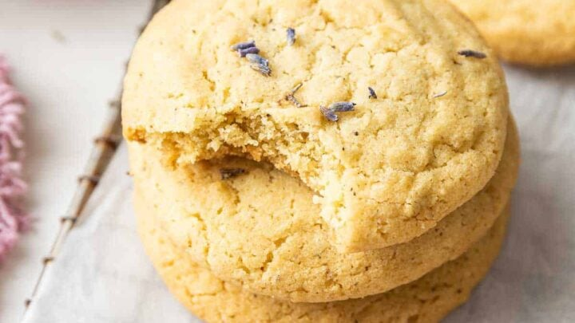
Lavender Cookies
Preheat the oven to 350, and line a small baking sheet with parchment paper (or use a silicone mat).
Place the butter in a microwave-safe bowl, and melt it in the microwave in 25 second intervals until fully melted. Keep an eye on it because if it gets too hot, it will splatter.
In a small food processor, combine the sugar and lavender buds and pulse a few times to break the buds into small pieces. Cover the food processor while you pulse so the sugar doesn’t fly out.
Stir together the melted butter, lavender sugar, egg yolk, and vanilla extract. Stir very well to combine.
Next, sprinkle the flour, baking soda and salt evenly over the dough, and stir just to combine.
Press the dough flat and evenly in the bowl, and then divide it in half by eye. You should get 3 cookies from each half.
Evenly space the cookies on the prepared baking sheet. Bake for 10 minutes, until they spread, start to crackle and appear dry on top.
Let the cookies rest on the baking sheet for 2 minutes before moving them to a wire rack to cool completely.
4 tablespoons (2 ounces) unsalted butter, melted
1/3 cup (67 grams) granulated sugar
1/2 teaspoon culinary grade lavender buds
1 large egg yolk (no white)
1/2 teaspoon vanilla extract
3/4 cup (96 grams) all-purpose flour
1/4 teaspoon baking soda
1/8 teaspoon fine salt
For complete recipe go to website-https://www.dessertfortwo.com/lavender-cookies/

Slide 17
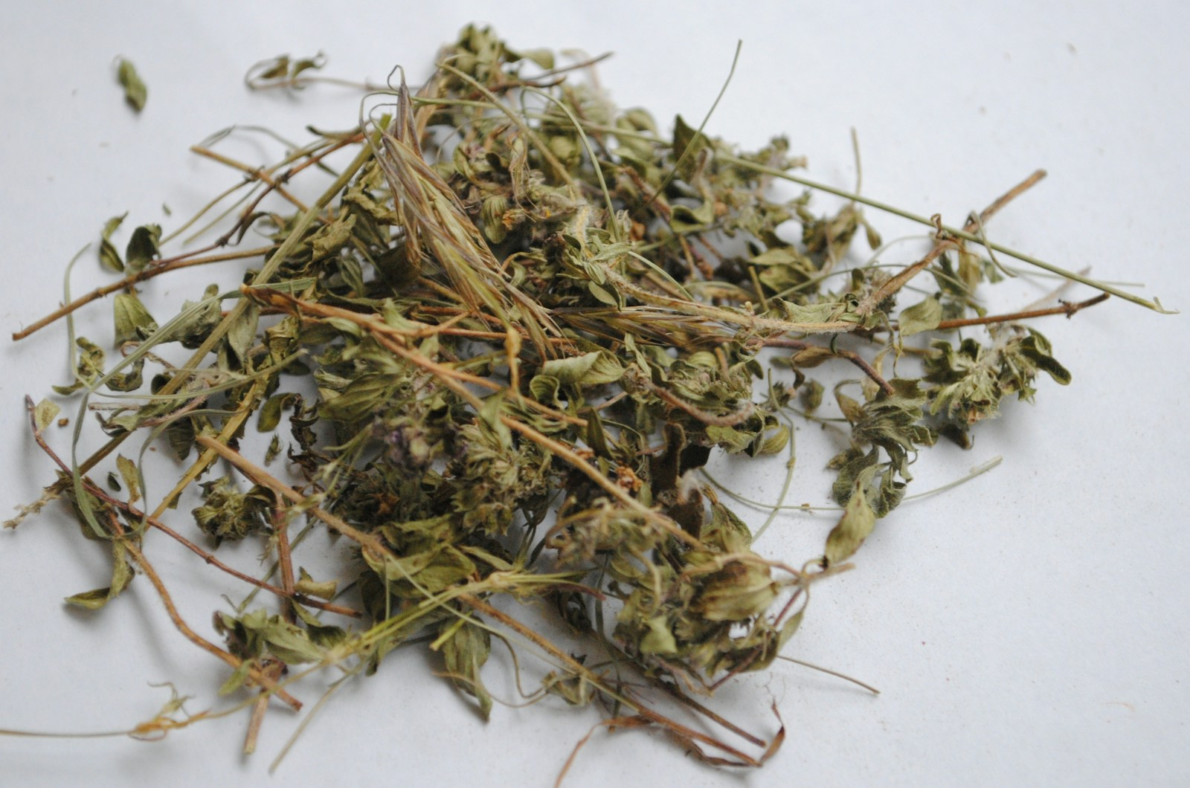
https://kidsgardening.org/resources/garden-activities-exploring-herbs
https://www.facebook.com/pallensmith/videos/herbal-dryer-sachets/10155105634359573/
herbal sachets (often called 'posies' or 'sweet bags') were very popular in the Regency Era, used for both pleasant scents and perceived health benefits, with ladies like Jane Austen's characters likely using them to combat unpleasant smells, uplift spirits, or as simple remedies, though specific mentions by Austen herself are scarce, the cultural practice was widespread. These sachets contained fragrant herbs like lavender, rose, chamomile, or rosemary, providing aromatherapy and freshness, notes Always Austen and Jane Austen's World, which detail Regency remedies and scents

Slide 18
Bookmark and Journal
Included in your kit is a bookmark. This bookmark opens up. Included are many different stickers to add to your bookmark. Or cut out pictures and add or press leaves and flowers between, it is up to you and your turn to be creative.
There is a journal in your kit. Use some of the stickers included to decorate the journal. The journal can be used to write about your experiences, draw what you grew, or flowers and plants. Keep a record of your produce and planting schedule. Use your imagination and have fun!!!

Slide 19
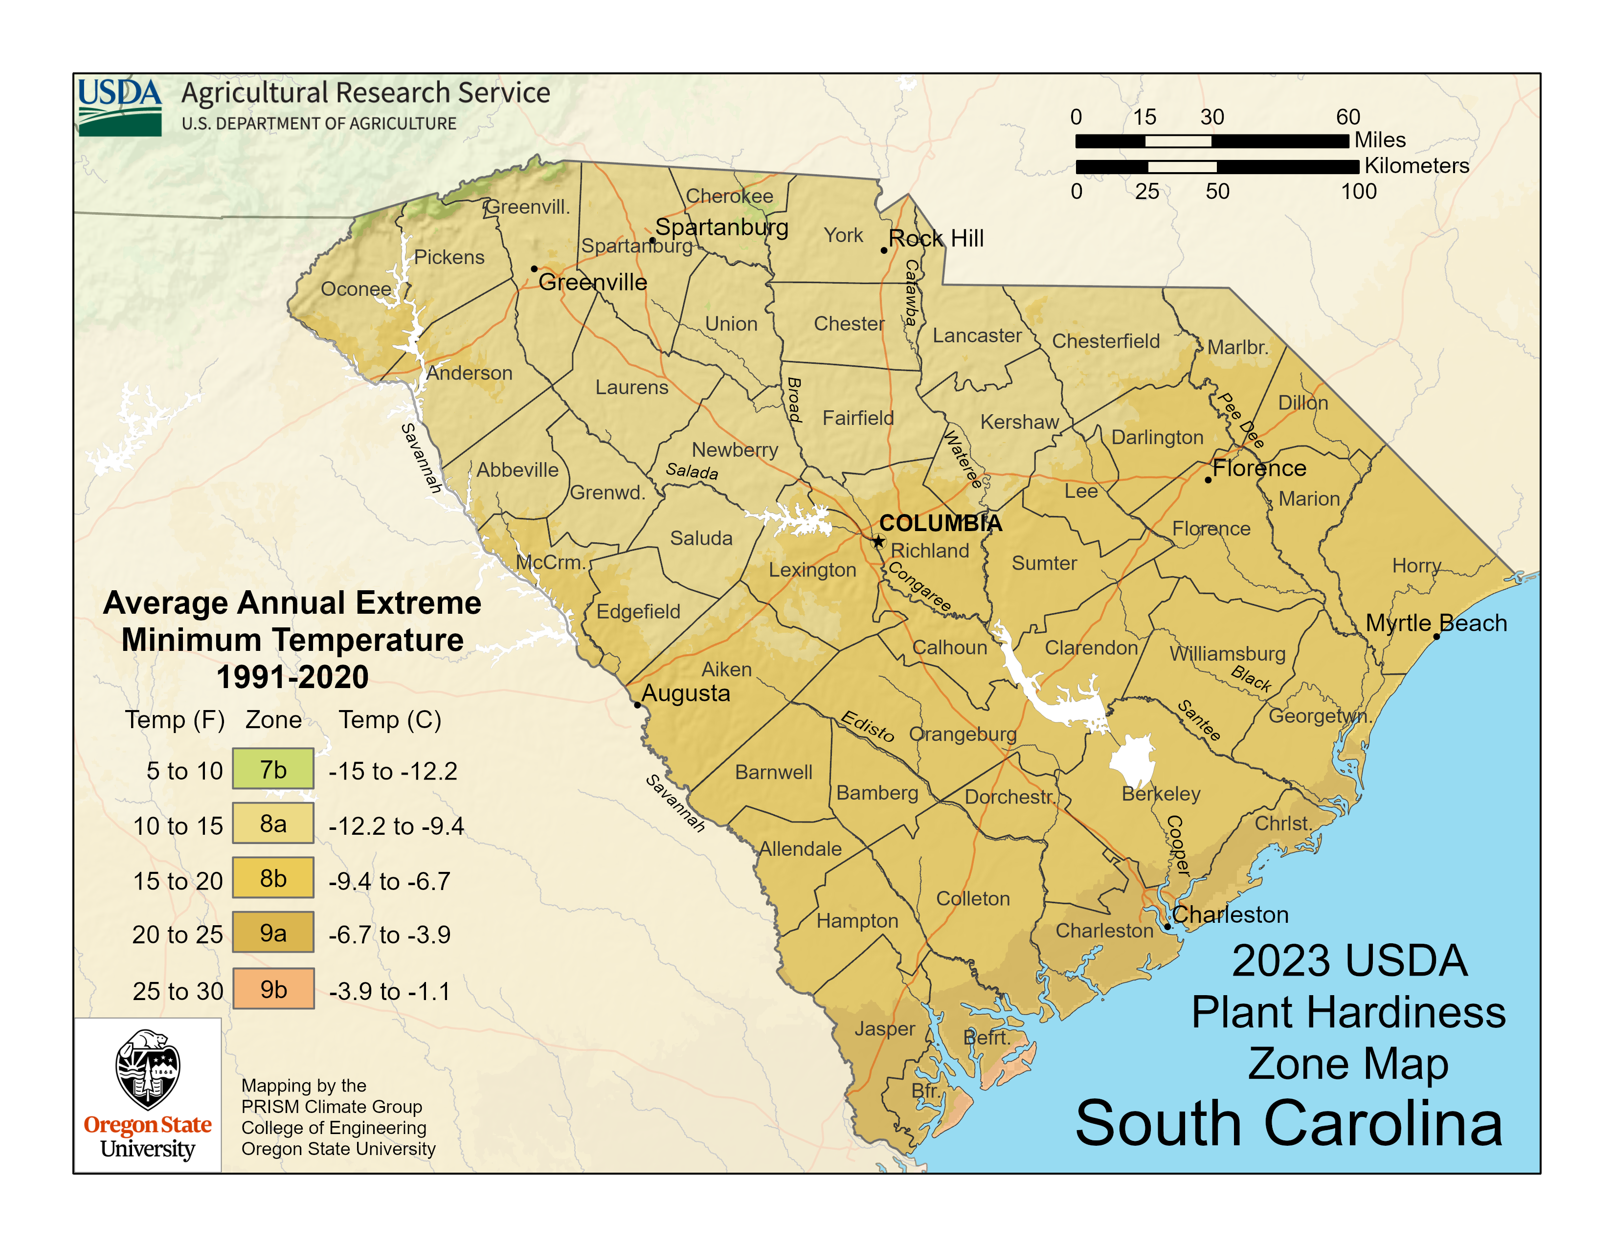
Websites are included. to read and learn best time to plant bulbs.
https://planthardiness.ars.usda.gov/ ( put your zip code in and it will give you your planting zone.
https://trueleafmarket.com/pages/usda-hardiness-zones
https://www.adrbulbs.com/page/Planting-Time#:~:text=The%20timing%20of%20bulb%20and,callas%2C%20cannas%2C%20begonias%2C%20caladiums
/
Notes:
This website provides zoning information by state and zip code. I have included details about each flower you will receive, plant, and grow, along with information to help you understand your region, state weather patterns, soil types, and planting seasons. I encourage you to review these resources thoroughly. To open the websites on my computer, I press the control key and then select the link when the hand icon appears. Some websites may require a verification code. I have verified all the websites to ensure they are safe to access. Please contact me if you have any questions.

Slide 20
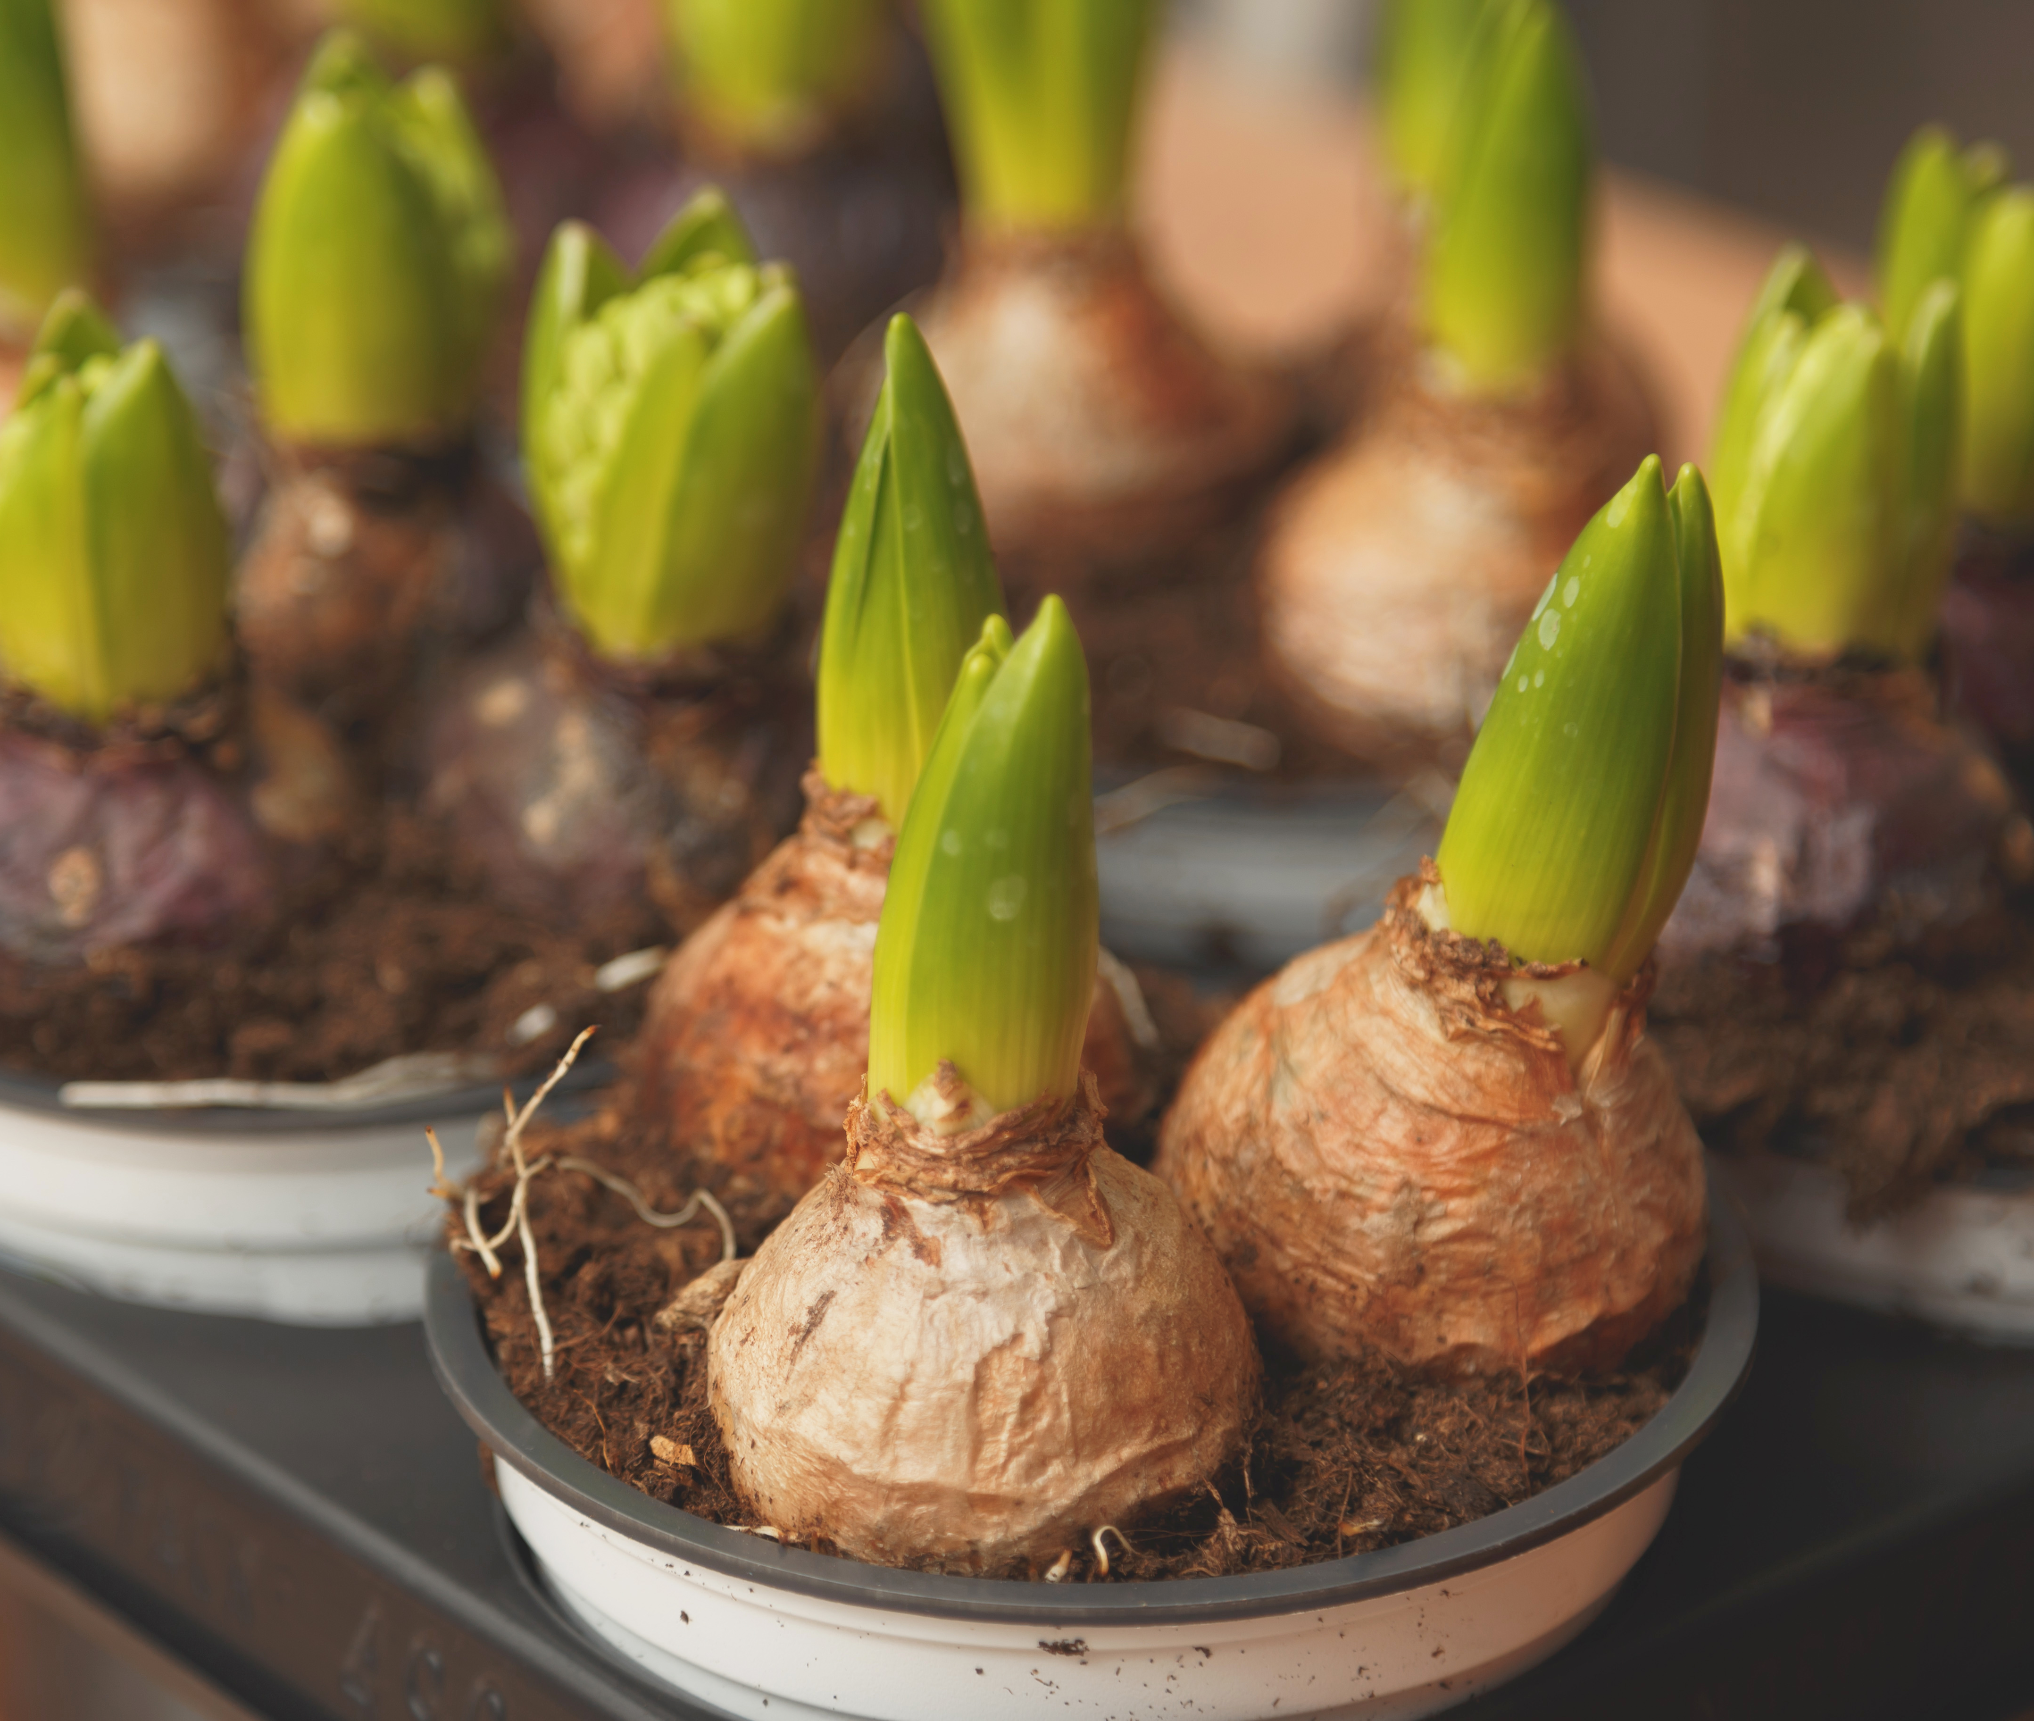
Perennial Bulbs Definition: Lasting throughout the year or for many years. The story "Cinderella" is a perennial favorite.
"This is a plant's super-snack!": Explain that the bulb has all the food it needs inside to grow, like a superhero's energy bar.
"It's a sleeping baby flower!": The bulb holds a tiny, folded-up flower, leaves, and stem, waiting for spring to wake up.
"Pointy up, flat down!": The pointy part is where the flower will peek out, and the flat, rooty part goes down to drink water from the soil.
"Winter is its magic nap!": Spring bulbs need a cold winter sleep (chilling period) to get ready to bloom.
"We're tucking it in!": Gently cover the bulb with soil, like giving it a cozy blanket
https://growinghealthykids.co.uk/help-your-kids-grow-seeds-and-bulbs-and-fire-their-imagination/
https://kidsgardening.org/resources/lesson-plans-bulb-botany

Slide 21
Disclaimer And Liability Clause
All seeds are sourced from reputable seed companies that claim their products are organic and have high germination rates. However, these seeds are not approved by the FDA. Knollwood Agriculture does not grow the seeds included in this packet.
This kit is intended for educational use only. Please follow the instructions provided. Knollwood Agriculture is not responsible for misuse or individual choices.
Parents and guardians are responsible for addressing any family concerns about allergies, medical reactions, or pre-existing medical conditions.
"This product is provided 'as is' and 'as available' for informational and educational purposes only. Knollwood Agriculture makes no warranties, express or implied, regarding its safety, reliability, or performance. By using this product, you acknowledge and agree to assume full responsibility for any risks, injuries, or damages, and agree that Knollwood Agriculture shall not be liable for any direct, indirect, or consequential losses arising from its use or reliance on any information provided. Use is at your own risk
"These statements have not been evaluated by the FDA. This product is not intended to diagnose, treat, cure, or prevent any disease. Always consult a qualified healthcare professional before using this product, especially if you have pre-existing medical conditions or are pregnant/nursing. Use at your own risk. [Your Company Name] accepts no liability for any adverse effects or damages resulting from the use or misuse of this product

