Slide 1
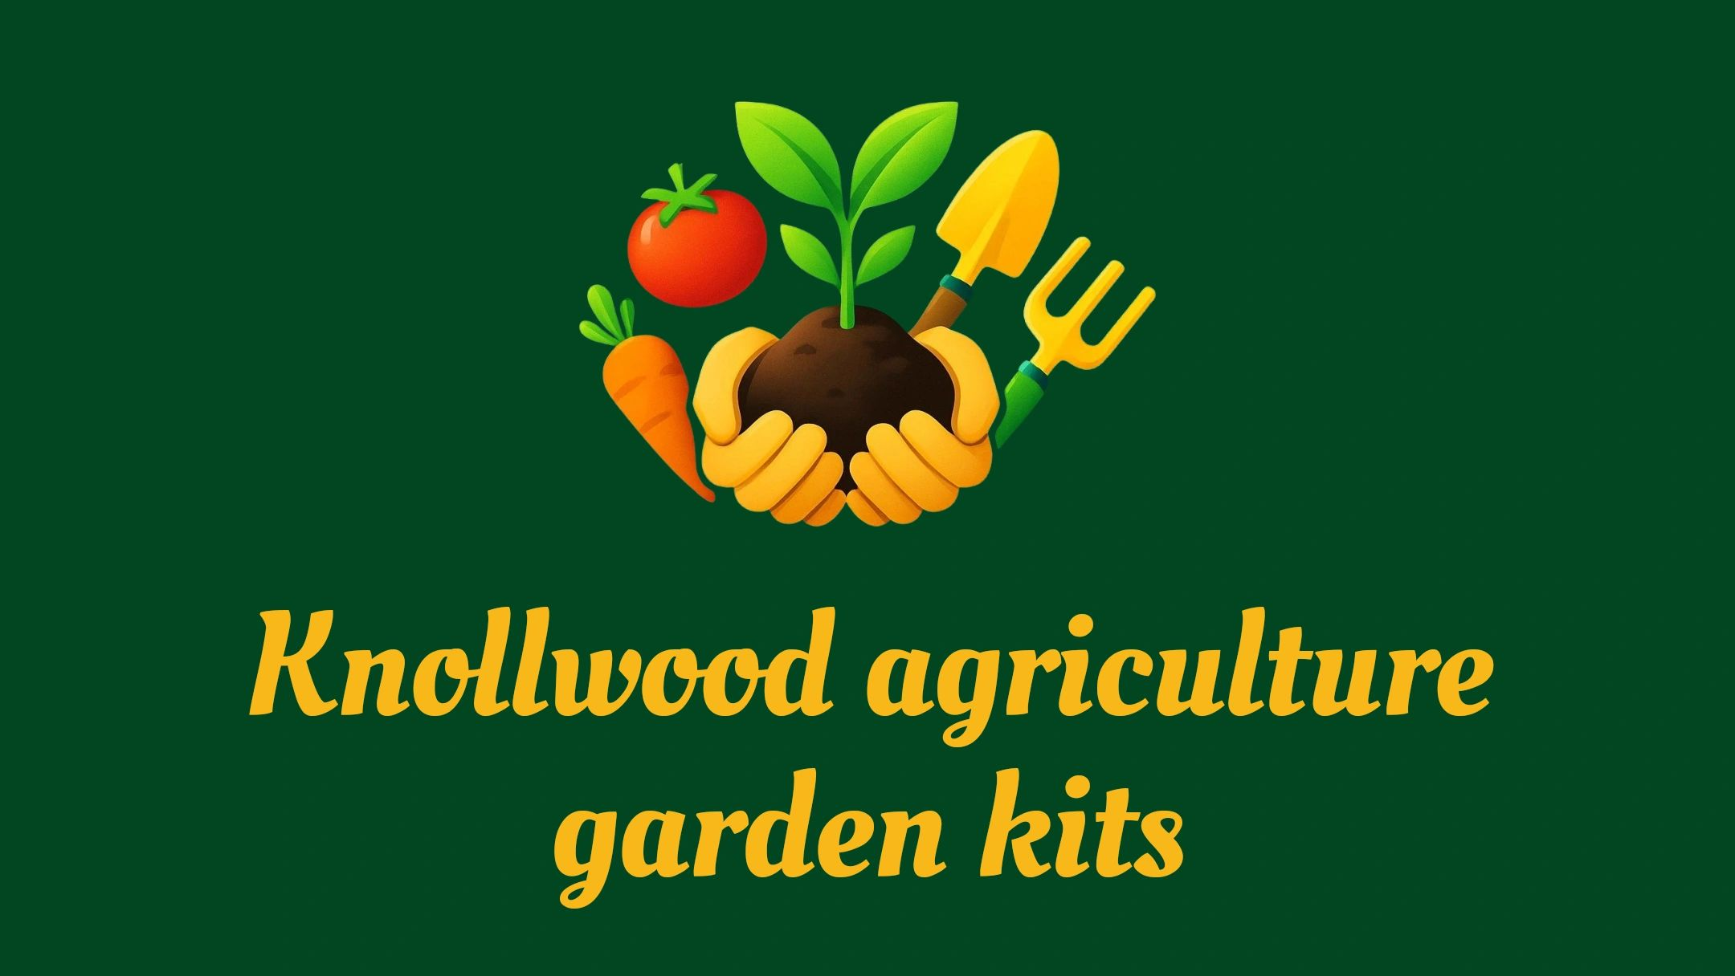
Bringing the farm to your Backyard.

Slide 2
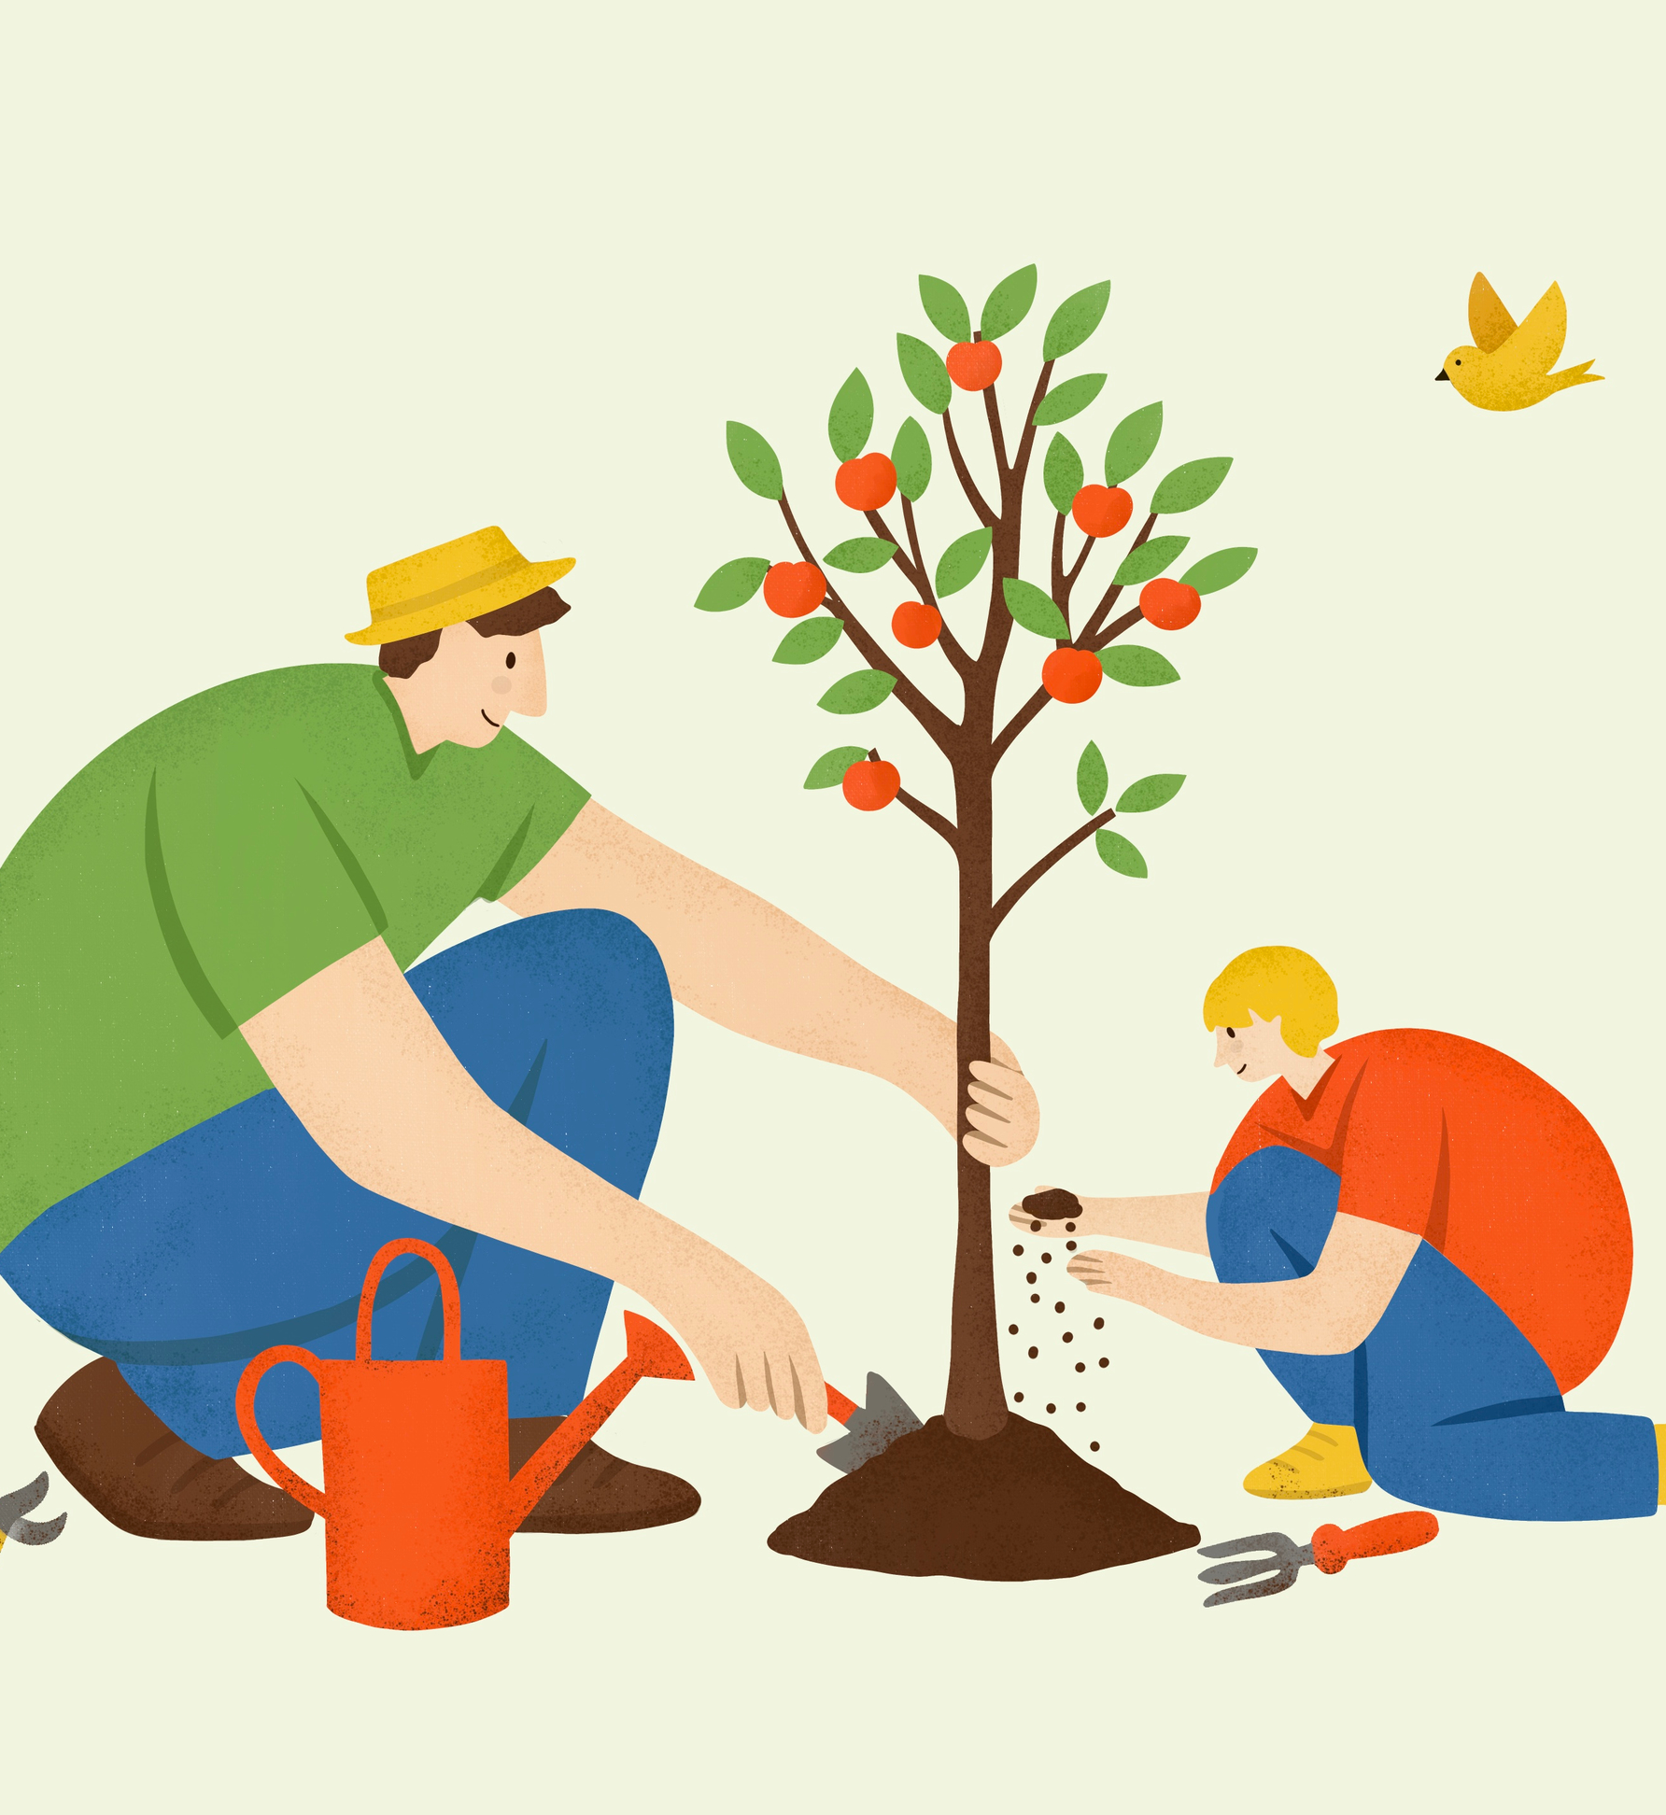
Gardening Kits for Kids Imagine a vibrant garden where children become passionate learners, discovering firsthand how the environment and their food are deeply connected. Our gardening kits inspire kids to step outdoors, stay active, and develop essential life skills. With engaging, hands-on activities, each child transforms into a confident grower and proud harvester, nurturing plants from seed to table and experiencing the satisfaction of their own accomplishments. =

Slide 3
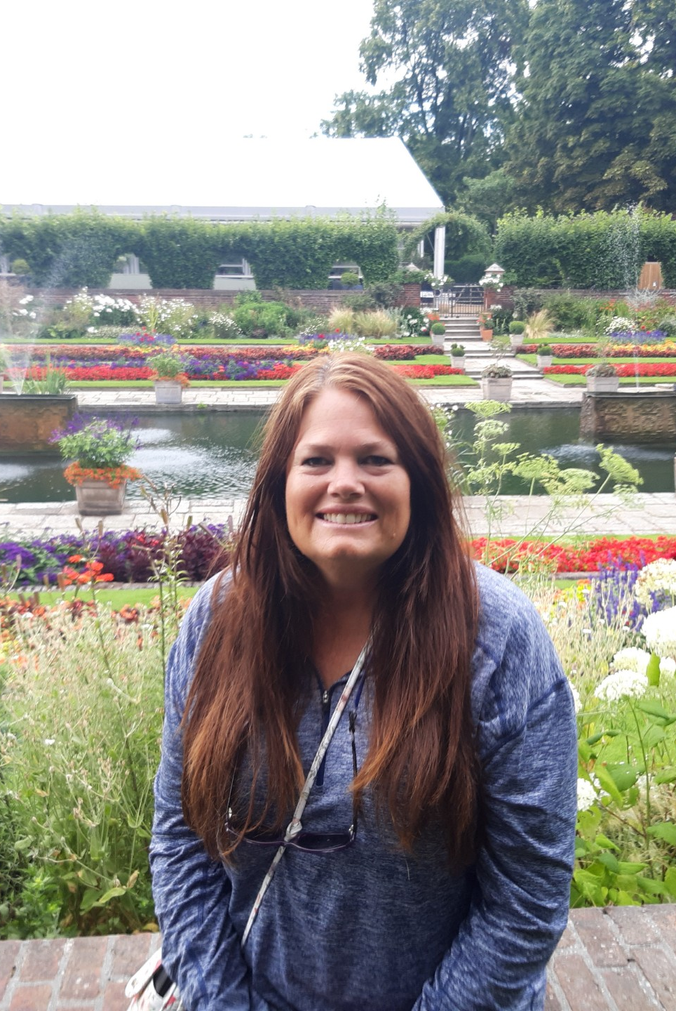
Hello, my name is Amy Perry, and I live in Bedford, Virginia. Since 2012, my family and I have enjoyed life on our 12-acre farm, where our house was built in 1810. I spend a lot of time gardening, growing vegetables, fruit trees, and herbs, and caring for three flower beds. My favorite part is working with herbs and produce, especially when I get to harvest, can, and make fermented foods. I also raise chickens and keep bees. Before moving here, I lived in Sarasota, Florida, for 19 years and homeschooled my two sons. My faith in the Lord, my love of homeschooling, and my passion for gardening inspired me to create these Agriculture Kits. I hope you enjoy using them as much as I enjoyed creating them.

Slide 4
Table of Contents
If you have any questions or require assistance, please contact me using the information provided below. I am dedicated to supporting you in maximizing the benefits of these kits. Each slide contains links to websites with activities focused on planting, growing, and caring for the plant, as well as instructional videos designed to help children acquire and enhance relevant skills.
Website – knollwoodagriculture.com
Email-knollwoodagriculture@gmail.com
Phone- 540-526-6415
Purchase Kits through cash app- https://cash.app/$knollwoodagriculture.
Garden zoning/soil
Planting fruits and vegetables
Recipes/activities with vegetables grown in garden
Hydroponic lettuce/container growing
Garden
Activities

Slide 5
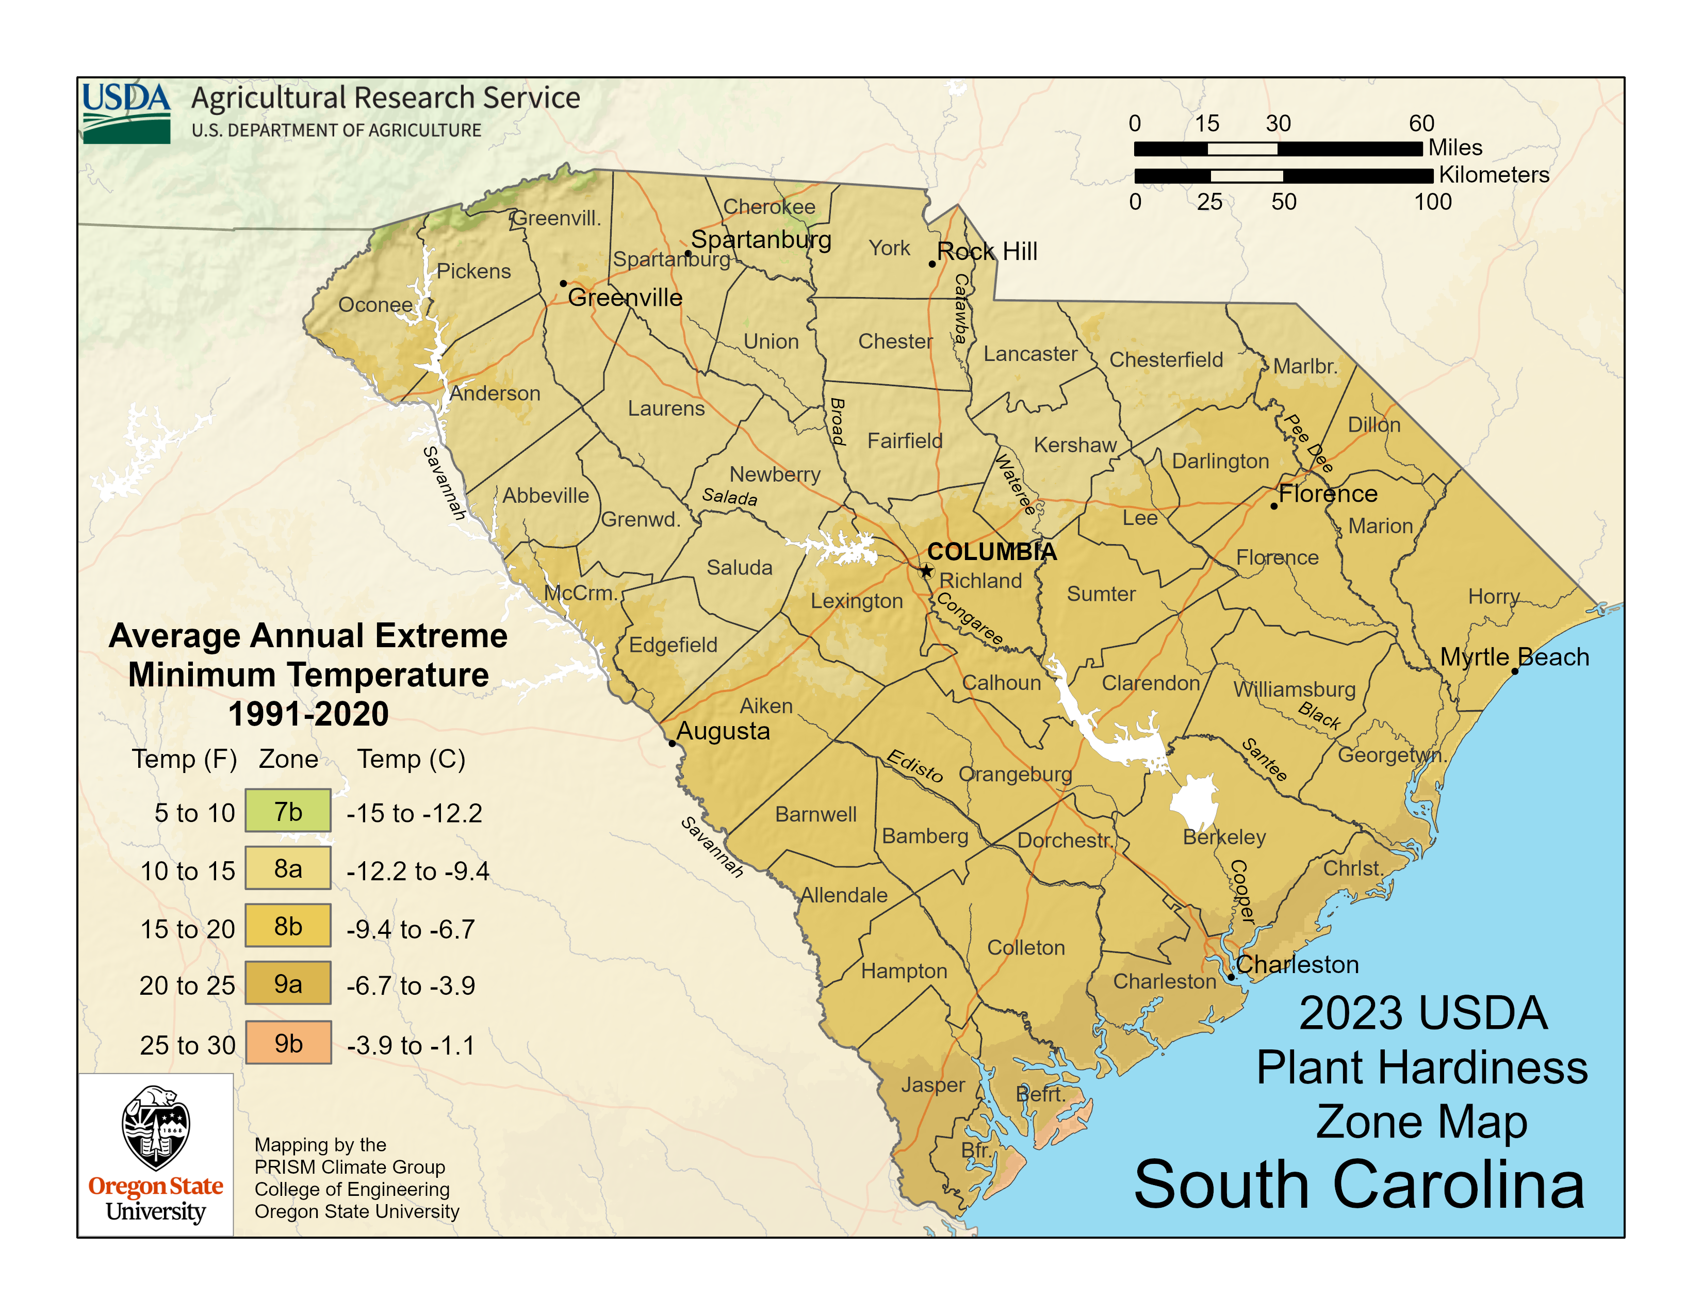
Refer to the websites below for facts and finding your planting zone according to your state and zip code. https://trueleafmarket.com/pages/usda-hardiness-zones https://planthardiness.ars.usda.gov/ ( enter zip code to find zone) https://planthardiness.ars.usda.gov/pages/how-to-use-the-maps
Zoning for planting
South Carolina’s plant hardiness zones range from 7b to 9b.

Slide 6
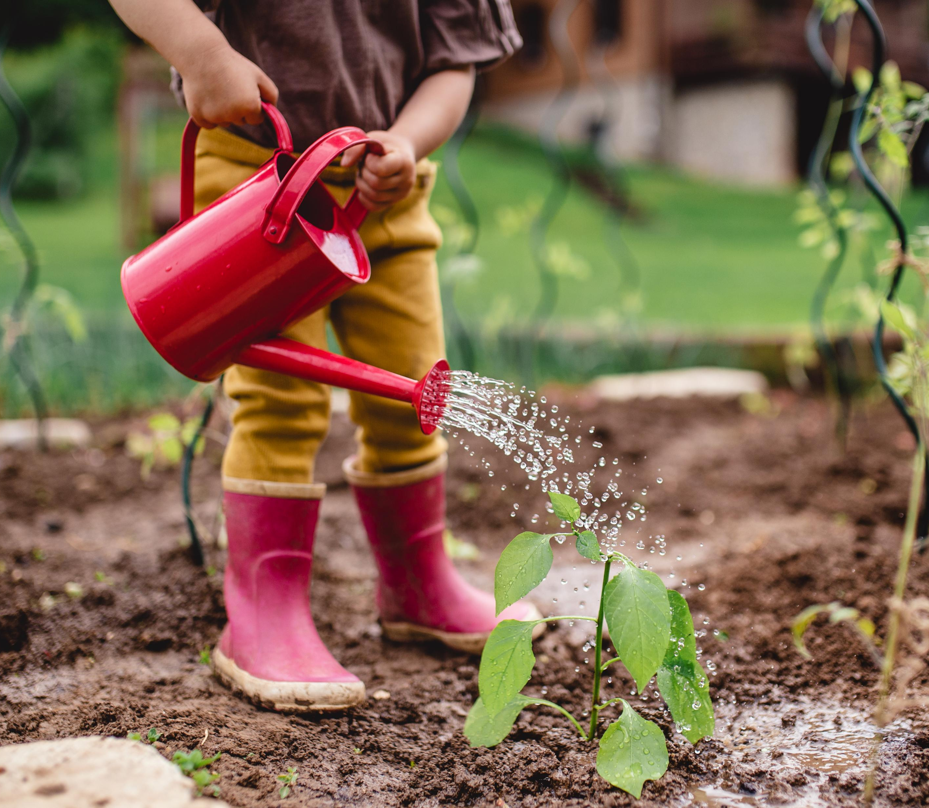
Soil and Gardening Refer to websites below to learn about soil and using for gardens.
https://www.soils4kids.org/home\
https://www.scdrainagereport.com/otherdrainageinfo/common-soil-types-in-coastal-south-carolina-amp-how-they-affect-drainage
https://www.youtube.com/watch?v=5b9o7yM7YGE
https://kidsgardening.org/resources/gardening-basics-all-the-dirt-on-soil/

Slide 7
PH of soil
South Carolina soil is typically characterized by high acidity, low organic matter, and, in many areas, low fertility, often requiring nutrient amendments for gardening. The state features a transition from sandy soils in the Coastal Plain to heavy red clay in the Piedmont region, with many soils having iron-rich, dense subsoils (fragipans or plinthite) that restrict root growth
Taking the pH of soil is essential to determine its acidity or alkalinity, which directly controls nutrient availability to plants. If the pH is too high (alkaline) or too low (acidic), essential nutrients become locked in the soil, leading to nutrient deficiencies, poor growth, or plant death, regardless of how much fertilizer is applied

Slide 8
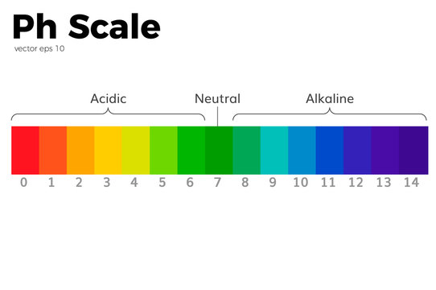
Testing Ph
I am asking you to test the pH to develop a general understanding of how it works. While detailed pH knowledge is not required to grow the produce, I have provided if you use high-quality organic soil, learning to test and interpret your local soil will be valuable if you pursue gardening.
In your seed box you will find 2 PH sticks for testing. Instructions include
To test soil pH with strips, create a 1:1 mixture of soil and distilled water (e.g., 4 tablespoons each) in a clean container, mix well, and let it sit for 20–60 minutes to settle. Dip the strip into the liquid for 2–30 seconds, shake off excess, and compare the color change to the chart within 1–2 minutes.

Slide 9

Zone 1 | Early August |  | Zone 1 | Early June
Zone 2 | Late August |  | Zone 2 | Late May to Early June
Zone 3 | Early to Late September |  | Zone 3 | Mid to Late May
Zone 4 | Late September to Early October |  | Zone 4 | Early to Mid May
Zone 5 | Early to Late October |  | Zone 5 | Late April to Early May
Zone 6 | Late October to Early November |  | Zone 6 | Mid to Late April
Zone 7 | Early to Late November |  | Zone 7 | Early to Mid April

Slide 10
Average Last Frost
Average First Frost dates
Zone 8 | Late March to Early April
Zone 9 | Late February to Late March
Zone 10 | No Frost
Zone 8 | Late November to Early December
Zone 9 | Early to Late December
Zone 10 | Late December
Notes:
When you find your zoning, you will be able to judge when your first and last Frost occur. Also, good to use the help of the Farmers Alamac for that year.

Slide 11
Garden Planning – Vegetables ALF- After last frost BLF- Before last frost
Tomatoes | Full sun | 6-8 weeks BLF | Transplant | 1/4 inch | 18-36 inches | 60-85 days
Pumpkins | Full sun | weeks ALF | Direct | 1 inch | 36-48 inches | 90-120 days
Potatoes | Full sun | weeks BLF | Direct | 3-4 inches | 12-15 inches | 70-120 days | Cabbage, corn, horseradish, beans
Corn | Full sun | weeks ALF | Direct | 1-2 inches | 12-24 inches | 60-100 days | Cucumbers, melons, potatoes, squash
Cucumbers | Full sun | weeks BLF | Direct | 1/2 inch | 36-60 inches | 50-70 days | Beans, corn, radishes, sunflowers

Slide 12
Garden Planning – Vegetables ALF- After last frost BLF- Before last frost
Watermelon | Full sun | 6-8 weeks BLF | Direct | 1/4 inch | 18-24 inches | 70-100 days | Beets, carrots, dill, mint
Green Beans | Full sun | weeks ALF | Direct | 1 inch | 6-8 inches | 50-60 days | Cabbage, carrots, cucumbers, potatoes
Spinach | Partial shade | 4-6 weeks BLF | Direct | 1/2 inch | 6-12 inches | 40-50 days | Strawberries, cauliflower, carrots
https://www.almanac.com/gardening/growing-guides. One of the best websites on how to grow all vegetable seed according to where you live.

Slide 13

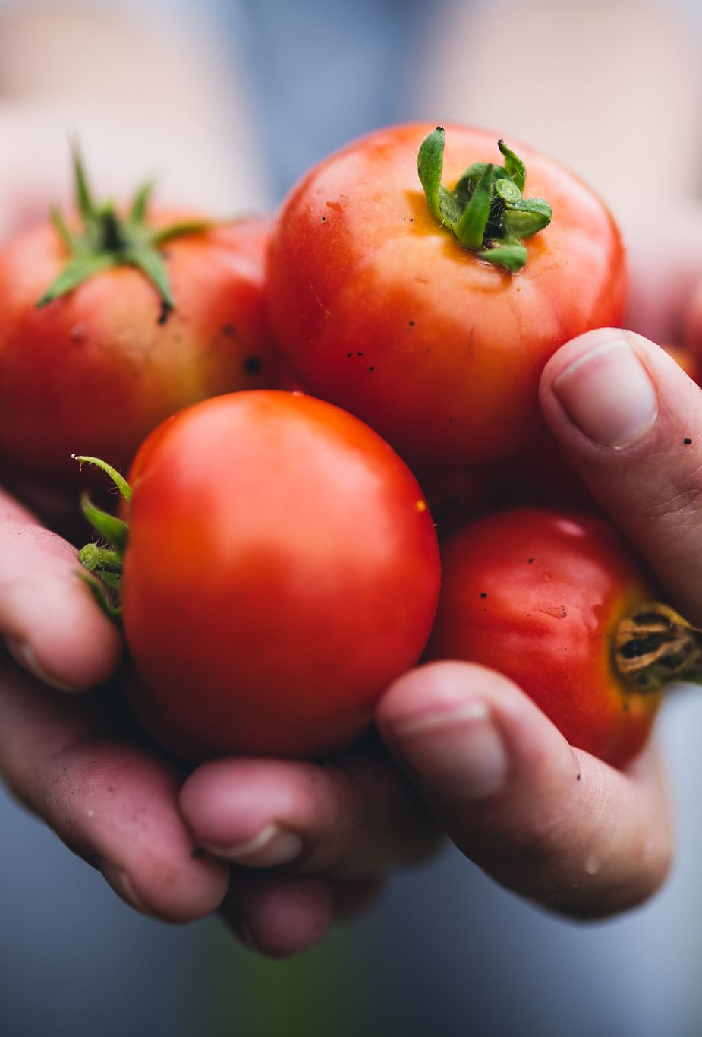
Growing Cherry Tomatoes Tomatoes are fruits that originated in Peru and have more than 10,000 varieties in colors like yellow, purple, and black. They were once feared as poisonous but are now celebrated, with a massive annual tomato-throwing festival in Spain and Ohio's official state drink being tomato juice. Tomatoes have even been grown in space, and the heaviest one on record weighed over 7 pounds
http://www.gardening.cornell.edu/homegardening/sceneea10.html
https://www.gardenary.com/blog/truth-about-tomatoes
https://www.canr.msu.edu/news/tomatoes_and_the_science_behind_them
Notes:
The best time to plant cherry tomatoes in South Carolina is typically from late March through April, once all danger of frost has passed and soil temperatures reach at least
. Coastal areas can plant as early as March 1, while the Piedmont region is safer planting from late March to early Ap

Slide 14
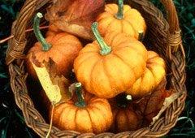
Planting a pumpkin
Pumpkins are fruits, not vegetables, and are technically a type of berry from the gourd family. They are about 90% water and are grown on every continent except Antarctica. Each pumpkin contains around 500 seeds, and every part of the pumpkin—including the skin, seeds, flesh, and flowers—is edible.
Refer to the websites below for instructions on how to plant, grow and harvest pumpkins.
http://www.gardening.cornell.edu/homegardening/scene61ea.html
https://www.thespruce.com/how-to-grow-pumpkins-1403469
Notes:
The best time to plant pumpkins in South Carolina for a fall harvest is mid-June to early July. This timing ensures they mature just in time for late September or October, allowing 90–120 days for growth while avoiding extreme heat stress during early development.
Home & Garden Information Center +3
Key Planting Considerations for SC:
Coastal Regions: Plant between July 1–15 for Halloween harvest.
Central/Midlands: Plant between June 15–30.
Soil Temp: Ensure soil is above
before sowing.
Variety Matters: Check your seed packet for "days to maturity," as some varieties take longer to mature than others (70-120 days).
Conditions: Choose a spot with full sun and consistent watering to withstand summer hea

Slide 15
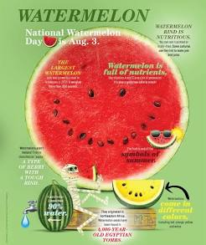
Watermelon
Planting
Watermelons (Citrullus lanatus) are warm-season crops that grow best at average air temperatures between 70 and 85 °F. Melon seeds do not germinate well in cold soil. The soil temperature at the 4-inch depth should be 60 to 65 °F before this crop is planted. In the spring, do not plant this crop until after the last chance of frost.
https://hgic.clemson.edu/factsheet/watermelons/
Watermelons are 92% water, belong to the cucumber and squash family, and originated in Africa 5,000 years ago. Over 1,200 varieties exist, ranging from red to yellow-fleshed, and they are botanically classified as a berry called a pepo. Both the rind and seeds are edible, and they are highly nutritious, containing high levels of lycopene
Notes:
Key Planting Tips for SC:
Soil Temp: Ensure the soil is warm enough (
to
is ideal).
Timing:
Plant after the last frost to avoid cold damage.
Spacing: Space plants 36–48 inches apart in well-draining soil .Succession Planting: For a continuous harvest, plant seeds every 2–3 weeks.Temperature: Watermelons thrive in air temperatures between
and
.
Clemson News +3
Regional Recommendations:
Coastal SC: April 1 – April 30.
Piedmont SC: April 15 – June 15.

Slide 16
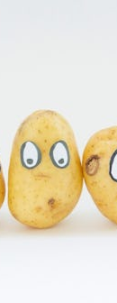
Potatoes What do you call a baby potato? Small fry
Potatoes are the first vegetable grown in space, originated from the Andes region of South America, and come in thousands of varieties. They are about 80% water and have been used as folk medicine, such as for toothaches. The first "french fries" were served at a White House dinner, and Mr. Potato Head was the first toy with its own television commercial.
Refer to website below to learn how to grow, harvest and cook with potatoes.
http://www.gardening.cornell.edu/homegardening/scenec6be.html
https://www.thespruce.com/growing-potatoes-in-the-home-garden-1403476
Notes:
It is not too late to plant potatoes in South Carolina at the end of March. While early-to-mid March is optimal, you can still plant in late March to early April, as potatoes thrive in the cool, early spring soil. They need about 3 to 4 months to reach harvest.
YouTube +2
Key Tips for Late March Planting in SC:
Timeframe: Potatoes can be planted through April, though late planting means they might grow during warmer weather.
Method: Plant certified seed potatoes 8–10 inches deep in well-drained soil or raised beds.
Protection: In late March, the danger of frost is passing, but you can cover early shoots with soil if a late frost threatens

Slide 17
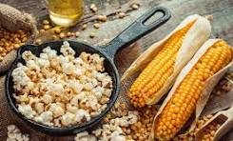
What kind of amphibian lived in a Corn field? A Corned Toad.
A fun fact about popcorn is that a kernel can pop with a force that launches it up to three feet in the air. This happens because the water inside the kernel turns to steam, building up pressure until the hull bursts, causing the starchy interior to explosively expand and the kernel to jump.
Refer to the websites below for instructions on how to plant, grow and harvest corn.
http://www.gardening.cornell.edu/homegardening/scene05f6.html
https://gardenerspath.com/plants/vegetables/grow-popcorn/
https://www.popcorn.org/All-About-Popcorn/Corny-Facts
Notes:
Key Planting Considerations for SC:
Soil Temp: Ensure the soil is consistently warm; cold, wet soil causes seed rot.
Optimal Timing: Mid-March is suitable for some, but many gardeners wait until after mid-April to avoid late, unexpected frosts.
Maturation: Popcorn needs 90–120 days to mature, so planting early in spring allows it to develop over the summer and dry in late summer/fall.
Location: Plant in full sun in a block of at least three rows for proper pollination, not in a single long line.
YouTube +4
Planting Tips:
Sow seeds about
deep, with
spacing, or in "hills" of 3-4 seeds, according to Jung Seed's tips.
Ensure consistent moisture, particularly around mid-summer for pollination

Slide 18
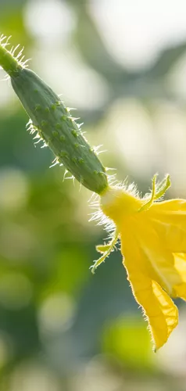
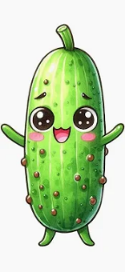
Growing a Cucumber
What is the cutest vegetable? A cute cumber
Fun Facts: Ancient Romans loved them so much it's said they created moveable greenhouses just to grow cucumbers year-round so they'd never have a time without this delicious vegetable. In addition to eating cucumbers, they used them as remedies to treat bad eyesight, scorpion stings, and infertility. Emperor Tiberius ate a cucumber a day.
Refer to the websites below for instructions on how to plant, grow and harvest cucumbers.
https://www.thespruce.com/cucumber-plant-growing-stages-7368730
http://www.gardening.cornell.edu/homegardening/scenef65b.html
https://www.gardenary.com/blog/things-you-didnt-know-about-cucumbers
Notes:
In South Carolina, plant cucumbers in the spring from mid-March to mid-May (coastal areas) or early April to early June (Piedmont), and for fall, from August 1 to August 30. Direct seeding is recommended around mid-April, with soil temperatures around
. To avoid diseases, earlier spring planting (mid-March) is often preferred.
scgrower.com +2
Key Planting Dates for South Carolina
Coastal Region Spring: March 15 – May 15
Piedmont Region Spring: April 15 – June 5
Fall Planting (All Areas): August 1 – August 30
Clemson News
Tips for Success
Soil Temp: Ensure soil has warmed to at least
, though seeds can germinate at
.

Slide 19
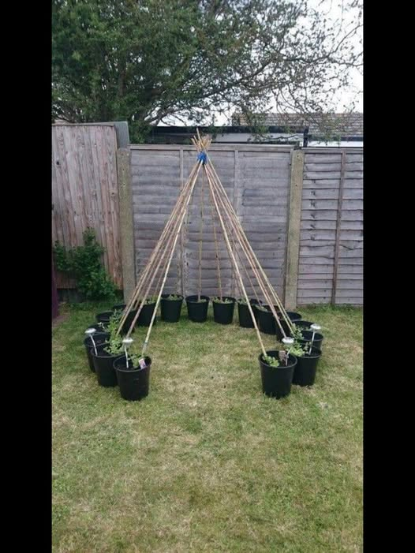
Green Beans
New World Crop: They come from the Americas, domesticated thousands of years ago, and were introduced to the Old World by Christopher Columbus in 1493.
String Beans: Their original nickname comes from the fibrous "string" on the seam of the pod, which botanists bred out to create modern "stringless" varieties.
Snap Beans: The sound they make when snapped clean is why they're also called snap beans
Websites to research how to grow and take care of Green beans.
https://www.thespruce.com/how-to-grow-green-beans-1403459
https://happyhealthy.extension.msstate.edu/fact-sheets/happyhealthy-green-beans-fact-sheet
The picture is a great example of growing green beans with a trellis
Notes:
In South Carolina, plant green beans in the spring after the last frost (April 1–15) through early June, and for a fall crop, plant from late July to early September. Piedmont areas should plant in spring from April 15 to July 1, while Coastal areas should plant from April 1 to June 1.
Key Planting Times for South Carolina
Spring Planting (Piedmont): April 15 – July 1.
Spring Planting (Coastal): April 1 – June 1.
Fall Planting (Piedmont): July 20 – August 1.
Fall Planting (Coastal): August 1 – September 1.
Growing Tips
Soil Temperature: Soil should be at least 60°F for optimal germination.
Spacing & Depth: Plant seeds 1 inch deep, with bush beans 2-4 inches apart and pole beans 4-6 inches apart

Slide 20
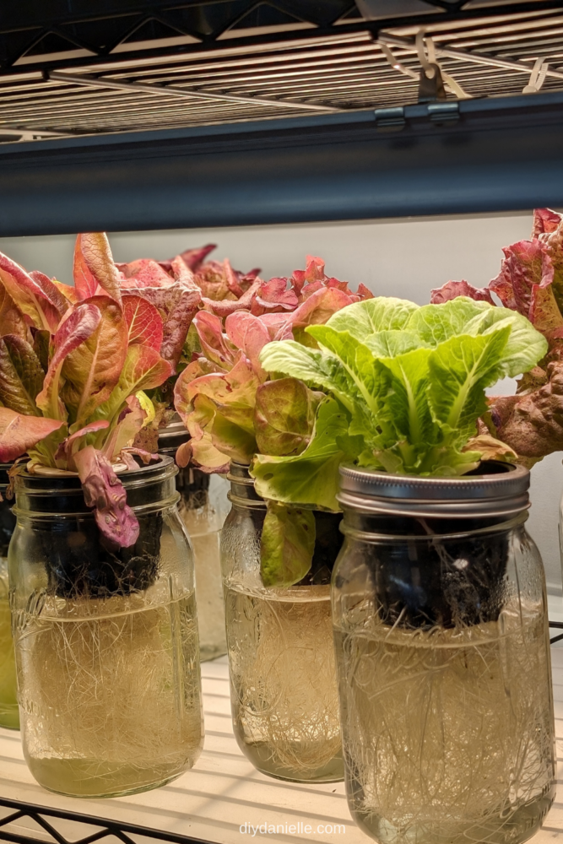
Hydroponic Lettuce
In this activity you will grow lettuce not with soil or in the ground. But with water and in a jar. It is a great way to grow lettuce year -round.
Step 1: Fill your wide mouth mason jar with water. It should just touch the bottom of the basket when placed in the lip of the mason jar.
Step 2: Insert the larger net/pot/basket into the mason jar. It should be big enough to sit right on top.
Step 3 Add your seed Rockwool pod and seeds. Use the clay pebbles to raise the Rockwool pod of the bottom of the basket and keep it centered.
Step 4 : Add more water until the water level just touches the bottom of the Rockwool. Make sure to get the seed block wet, too! ‘
Step 5: Place the hydroponic mason jar somewhere warm until the plant sprouts.
Step 6: Once the plants have sprouted, add fertilizer that’s made specifically for hydroponics. This is super important for giving your plants nutrients they will usually get from the ground!
Step 7: You will need to block light from entering the mason jar in order to prevent algae growth. Use kitchen towel, black paper or felt.
Important: You should check your water regularly, you will have to add water as it evaporates, If you see mold or algae, preplace the water.
Notes:
You will need to provide your own wide mouth mason jar.

Slide 21
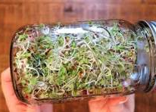
How to Grow Sprouts in a Mason Jar http://cultivatorkitchen.com/how-to-g row-sprouts/
Growing sprouts in a mason jar takes 4-6 days using just seeds, water, and a jar. Soak 1-2 tablespoons of seeds overnight, then rinse and drain them twice daily, keeping the jar upside down at an angle in a shaded spot. They are ready to harvest when they fill the jar, are 1–2 inches long,and have developed small leaves.
Notes:
You will only need to provide a wide mouth mason jar. Mason Jar: A 32 oz wide-mouth jar is ideal.
Sprouting Seeds: (e.g., Alfalfa, Broccoli, Radish, or Clover).
Lid: A mesh sprouting screen or cheesecloth secured with a rubber band.
YouTube +4
Step-by-Step Instructions
Soak: Add 1-2 tablespoons of seeds into the clean jar. Fill with water, cover with the mesh lid, and let them soak for 4-8 hours (or overnight).
Drain & Rinse: Drain out all the soaking water. Rinse the seeds with fresh water, swishing gently, and drain thoroughly again.
Store: Place the jar upside down at an angle (45°) in a bowl or on a drying rack, away from direct sunlight, to allow air circulation and ensure no standing water remains.
Rinse & Drain Twice Daily: Twice a day (morning and night), fill the jar with water, rinse the seeds, and drain thoroughly, returning the jar to the angled position.
Harvest: In 4–6 days, when the jar is full, rinse well, drain, and allow them to dry for a few hours. Store in a covered container in the fridge for up to 3 days

Slide 22
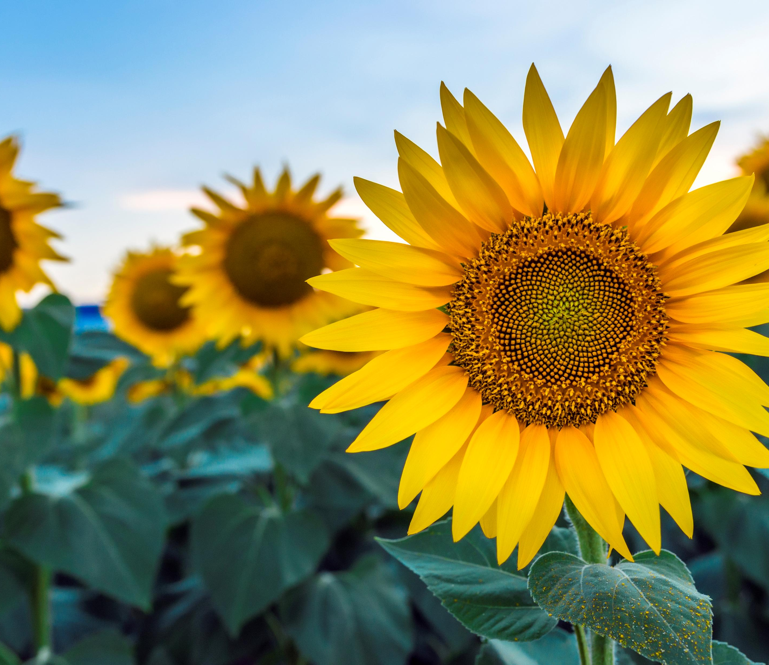
Growing Sunflowers
https://www.youtube.com/watch?v=sz-eYYfTQ20
Excellent and up close of how a sunflower attracts bees and in return the bees pollinate your garden.
Garden Protection: Sunflowers act as a host plant for caterpillars like the Painted Lady, and they attract bees and other pollinators to boost vegetable garden yields.
Hardy Gardeners: Sunflowers are drought-tolerant and can grow in various soil types as long as they are not waterlogged.
Natural "Sunscreen" and Oil: Sunflower oil is rich in Vitamin E, and they are used to make both food products and biofuel.
Colors Beyond Yellow: Sunflowers can come in stunning shades of red, maroon, and orange, not just yellow
Notes:
Growing sunflowers in South Carolina is ideal due to the long, hot summers. Plant seeds directly in the ground after the last spring frost (typically March-May) when soil temperatures exceed 50-55°F. Choose a site with 6–8+ hours of direct sun and well-drained soil. Successive planting every 2-3 weeks ensures continuous blooms.
Home & Garden Information Center +4
Key Growing Steps for South Carolina:
Soil Preparation: Sunflowers prefer a soil pH of 6.0-7.5. Amend soil with compost or organic matter for better, larger blooms, though they are generally not picky.
Planting: Sow seeds 1 to 2 inches deep.
Spacing: Space seeds 6 inches apart for small blooms, up to 1-2 feet apart for large branching varieties.
Watering: Water consistently to keep soil moist during germination. Once established, water deeply about once a week, ensuring the root zone gets moisture

Slide 23
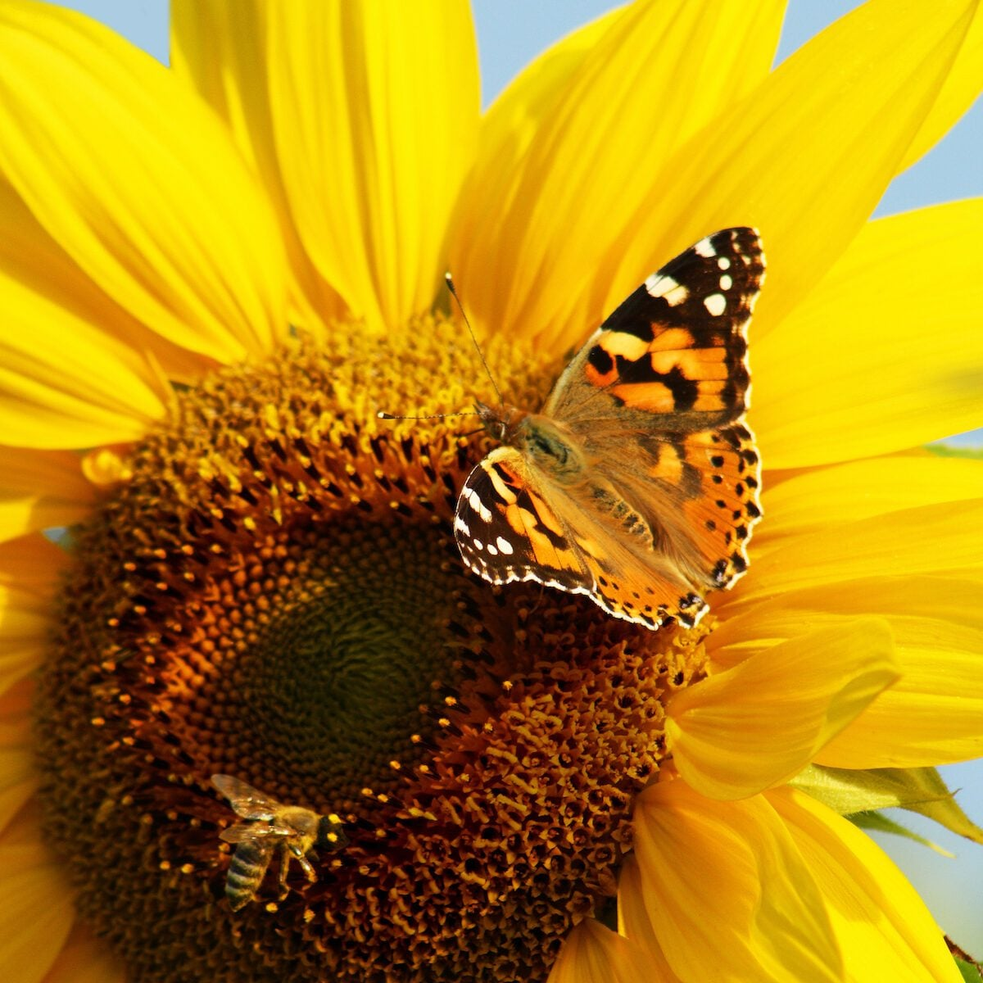
Sunflower
Fun Sunflower & Garden Facts
The Sun-Tracking Dance: Young sunflowers track the sun from east to west, a behavior called heliotropism. At night, they turn back to face east in anticipation of the morning sun.
Not One Flower, But Hundreds: What looks like one flower is actually a composite of hundreds or thousands of tiny flowers (florets).
"Jack and the Beanstalk" Realness: The tallest sunflower on record was over 30 feet tall, grown in Germany in 2014.
Environmental Clean-up Crew: Sunflowers can absorb toxic materials and radiation from the soil, a process used at Chernobyl and Fukushima.
Edible Everything: Every part of the sunflower is edible, including the roots, leaves, stalks, and seeds.
Notes:
Sunflowers are one of the easiest plants to grow. Pop a sunflower seed in the ground, give it a good drink of water, and you should see a green sprout in about 14 days!

Slide 24
If you want to learn more about pollination . Check out these websites!!
https://www.appalachianforestnha.org/kids
(Excellent website for kids' activities and worksheets)
https://kidsgardening.org/resources/planting-for-pollinators/
(Excellent website for learning about pollination for kids)
https://www.climatekids.org/pollinators
https://www.canr.msu.edu/resources/smart-gardening-pollination-in-vegetable-gardens-and-backyard-fruit
https://www.pollinator.org/pollinators

Slide 25
5 Things Kids Can Do to Help Pollinators
Be kind to your pollinator friends. Pollinators like bugs and birds are small and fragile. It’s easy for people to hurt them. Be gentle and quiet when they are near!
2. Look, but don’t touch! When you see a butterfly, bee, beetle, or hummingbird outside, look, but don’t touch! Pollinators won’t hurt you if you leave them alone and are nice to them.
3. Don’t use poison sprays. Bug your family to stop using poison sprays in your house and garden. This poison kills bad bugs, but it hurts pollinators too. Bug your family to buy ORGANIC fruit and vegetables. These are grown without poison sprays, so they keep pollinators safe and happy.
4. Keep pollinators’ homes safe. And help make habitat for pollinators. Take care of a garden. Plant some flowers. When you find a bug in your house, gently take it outside to its natural habitat.
5. Bug someone! Bugs and pollinators are fun and interesting. Teach your family and friends about these important animals. Teach them to say “Thanks Bugs!” You can “bee” an expert!

Slide 26
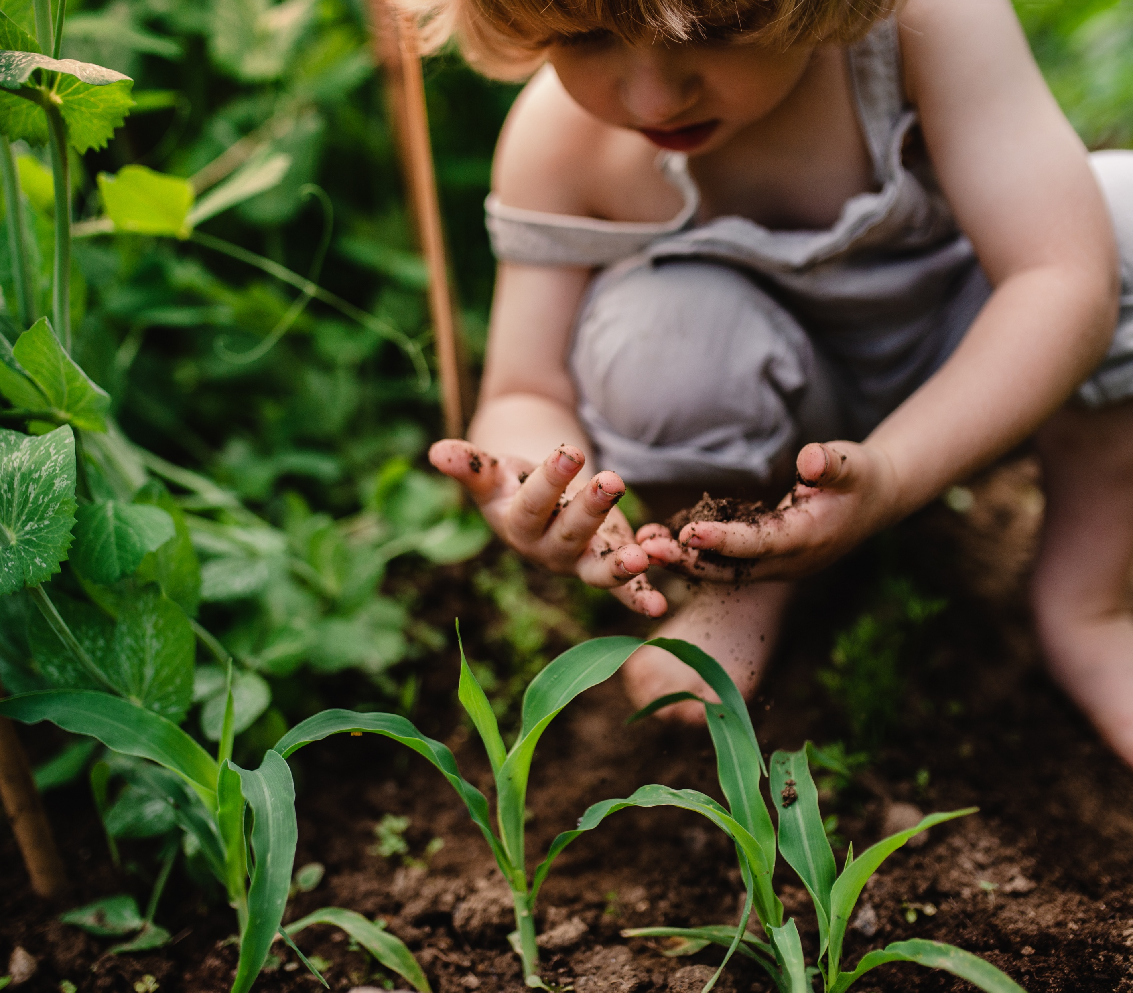
Bookmark, Journaling, Chia pet, Garden vegetable activities in the kitchen

Slide 27
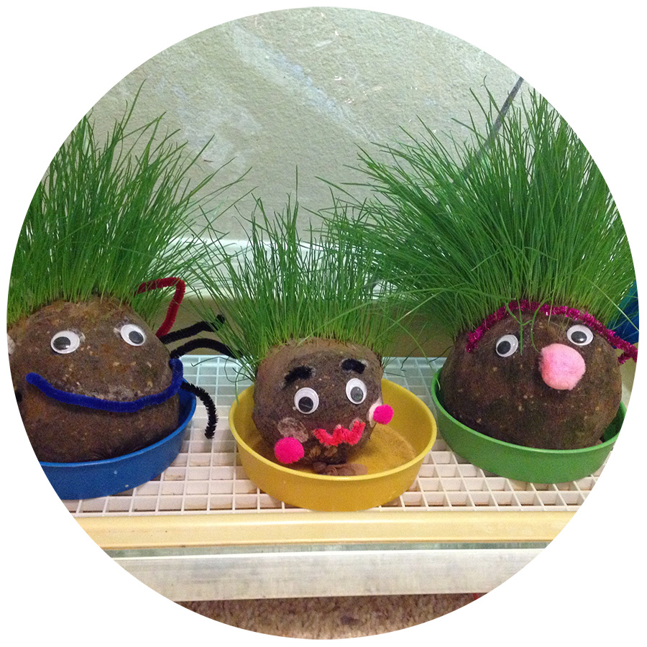
Homemade Chia pet. Make your own grass person. Website has material and instructions.
https://kidsgardening.org/resources/garden-activities-plant-people/
Notes:
You will need to provide your own soil.

Slide 28
Bookmark and Journal
Included in your kit is a bookmark. This bookmark opens up. Included are many different stickers to add to your bookmark. Or cut out pictures and add or press leaves and flowers between, it is up to you and your turn to be creative.
There is a journal in your kit. Use some of the stickers included to decorate the journal. The journal can be used to write about your experiences, draw what you grew, or flowers and plants. Keep a record of your produce and planting schedule. Use your imagination and have fun!!!

Slide 29
Popcorn Activities -- Included in your kit is a corn on the cob in a popcorn bag. Leave the cob in the provided bag. Add to the bag what you want, such as butter, herbs, salt. Place the bag in your microwave and use the popcorn setting for 2 minutes. Smell, listen, and watch the corn pop. If you want to pop the whole cob, take out what popped and continue.
. Old Fashion Popcorn Balls –
7.0 cup popped popcorn unsalted 1.0 cup granulated sugar 0.33 cup water
0.33 cup light corn syrup or molasses for molasses popcorn balls
1.0 teaspoon salt If you use salted popcorn omit the salt 0.5 stick butter unsalted 1.0 teaspoon pure vanilla extract
Sift through the popped corn and remove any un popped kernels. Transfer popcorn to a large bowl and set aside.
Add the sugar, water, corn syrup, salt, and butter to a medium saucepan and mix over medium heat until the butter has melted and all ingredients are combined.
Cook to 250 degrees on a candy thermometer or when mixture forms a hard ball when dropped in cold water. Click the following link to see how to test candy in cold water, https://mycountrytable.com/test-candy-cold-water/
Add the vanilla and mix to blend it in.
Drizzle the hot syrup in a thin stream over the popcorn while mixing at the same time. Mix until all of the popcorn is covered with the syrup.
Using buttered hands shape popcorn into balls and place on parchment paper. Allow popcorn balls to sit on the parchment paper for 15 minutes and place each one in a sandwich bag.

Slide 30
Tomatoes
Fun Activity: Tomato Science Exploration
Turn snack time into a learning experience by becoming "tomato scientists".
Materials:
Different colored cherry tomatoes (red, yellow, orange)
Cutting board and knife (for adult use)
Magnifying glasses
Paper and crayons/markers
Instructions:
Observe: Ask children to sort the different colored tomatoes by color or size. Encourage them to describe how the outside of the tomatoes looks and feels (smooth, round, shiny).
Investigate: An adult should cut the tomatoes in half. Give the children magnifying glasses to look closely at the inside.
Discuss findings: Ask the children what they see. Can they spot the seeds? Can they see the water inside? Discuss that tomatoes are actually a fruit because they have seeds.
Taste Test and Draw: Have a taste test of the different varieties. Ask them to describe the taste and texture. Then, have them draw their observations in a "garden journal"
Fun Recipe: Edible Cherry Tomato Caterpillars
Cherry tomatoes
Small mozzarella balls (bocconcini)
Fresh basil or spinach leaves
Balsamic glaze or reduction
Toothpicks or small skewers
Arrange the body: On a small plate, lay out a few basil or spinach leaves to look like a bed of grass.
Assemble the caterpillar: Alternate threading a cherry tomato and a mozzarella ball onto a skewer, starting and ending with a tomato to form the body of the caterpillar.
Add details:
Use a toothpick to poke two small holes in the "head" tomato. Insert two thin basil or spinach stems into the holes for antennae.
Dip a clean toothpick into the balsamic glaze and draw eyes and a smile on the tomato head.
Serve: Arrange the caterpillar on the leaf bed. Serve with extra balsamic glaze or ranch dressing for dipping.

Slide 31
Potatoes
Recipe Idea: "Kitchen Fry Lab" Shoestring Fries
Ingredients:
Waxy potatoes (like Yukon Gold or Maris Piper), about 1 per person
1 tablespoon olive oil per 3 potatoes
Salt for seasoning
Instructions:
Wash & Cut (Adult Task, or Older Kid with Mandoline/Spiralizer Supervision): Wash and thoroughly dry the potatoes. For shoestring fries, consistency is key. A mandoline slicer with a julienne blade or a spiralizer set to a thin noodle setting works wonderfully. If cutting by hand, aim for thin, uniform strips.
Dry Thoroughly (Kid Task: All ages): Lay the raw potato "fries" on clean kitchen paper or a towel and dry them as much as possible. This step is crucial for crispiness – less water means more crunch! Kids can gently pat them dry.
Toss with Oil (Kid Task: All ages): Add the dried fries to a bowl and drizzle with olive oil. Gently toss them with clean hands to ensure they are fully covered with a thin layer of oil.
Bake & Crisp (Adult Task): Heat your oven to its maximum temperature (e.g., 425-450°F / 220-230°C). Line a baking sheet with foil or parchment paper and spread the fries out in a single layer, ensuring they aren’t touching too much. This is important for crispiness! Bake for 15-25 minutes, flipping halfway through, until golden brown and crispy.
Season & Serve (Kid Task: All ages): Immediately sprinkle with salt as soon as they come out of the oven. Serve with favorite dips
FOR HEALTHY VERSION COOK IN AIR FRYER!!!!

Slide 32
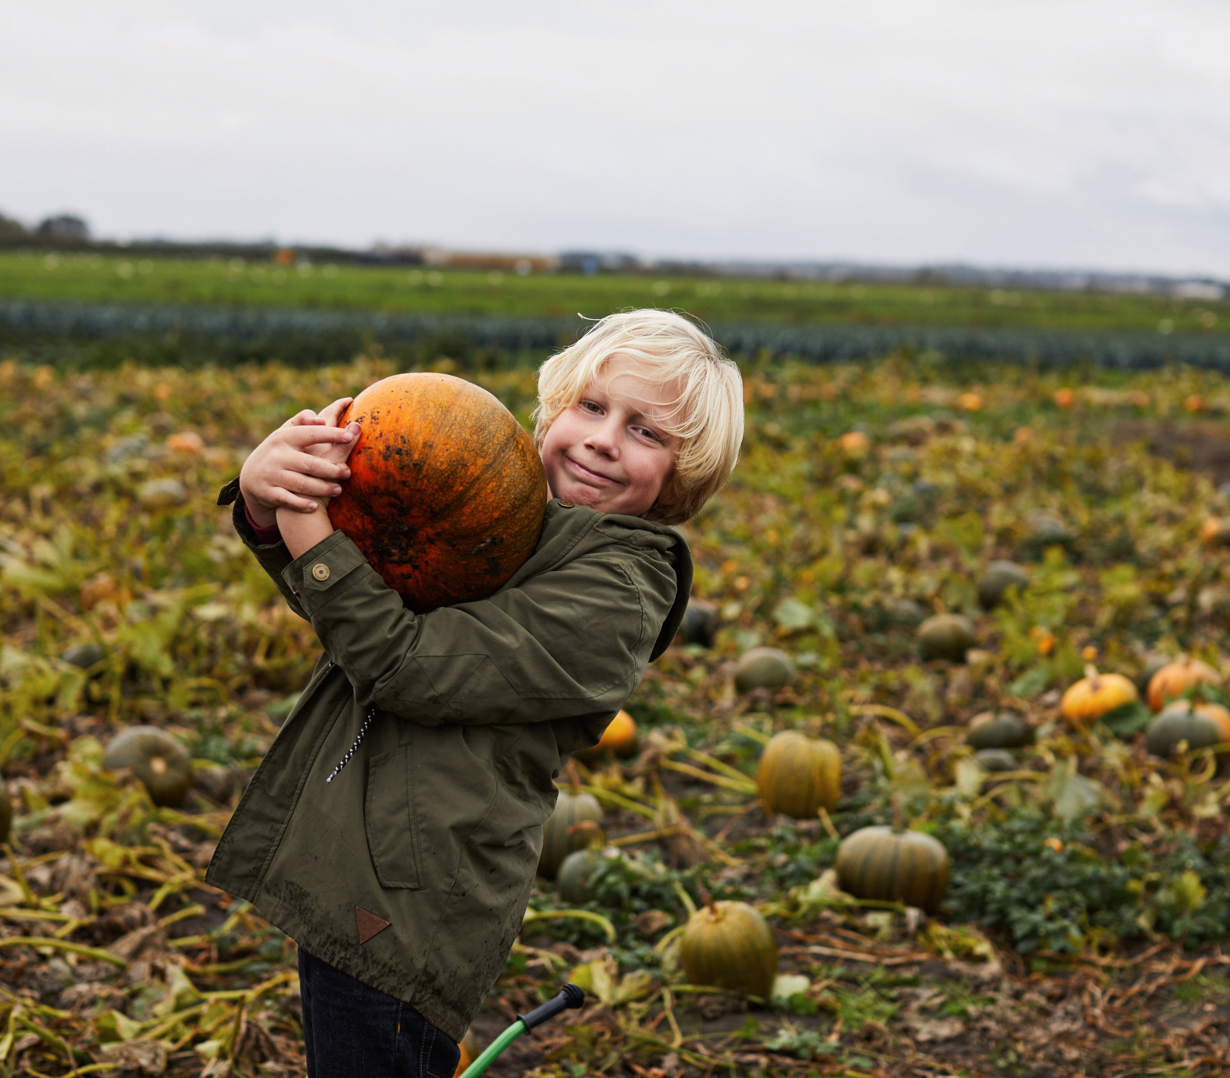
Pumpkin
Great site for cleaning your pumpkin, recipes and cooking with Pumpkin Puree
https://www.dimitrasdishes.com/homemade-pumkin-puree/
Great site if you don’t want to cook with pumpkin, here are many ideas for activities using the pumpkins you grow.
https://playteachrepeat.com/15-ways-learn-play-real-pumpkins/
For older kids, have them dissect a pumpkin, learn about the parts and observe under a microscope.
https://thehomeschoolscientist.com/30-pumpkin-stem-activities/

Slide 33
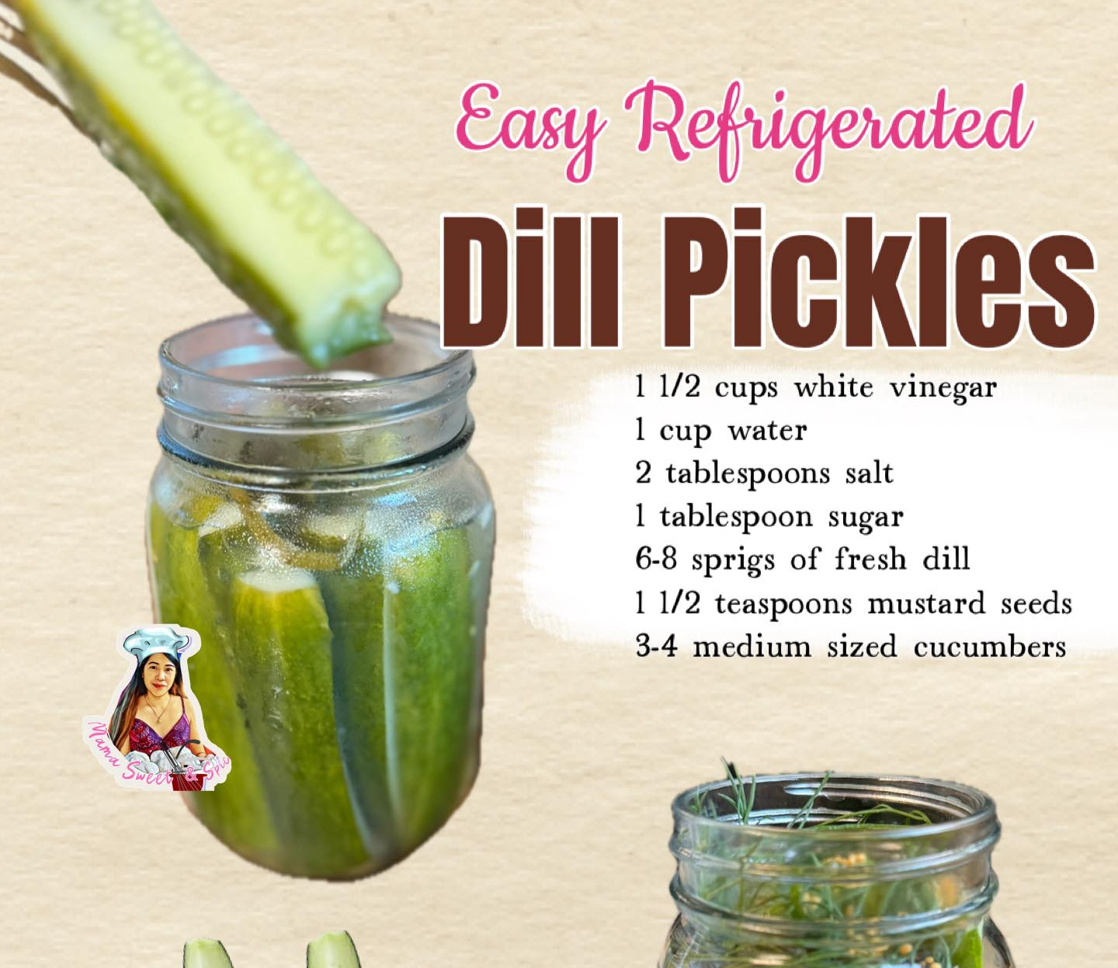
Steps:
Sliced cucumbers in spears or cubes
Fill in into the cleaned pint jars. Divide it till it covers 3 jars. Add 2-3 sprigs of fresh dill in each jar. Add 1/2 teaspoon mustard seeds in each jar.
In a pan, add vinegar, water, salt and sugar. Mix well till the sugar dissolves and the mixture reaches boiling point. Remove from heat. Pour it directly into the jars filled with cucumbers. Cover the jar and let it cool. Store in refrigerator up to 1 month. Ready to ear the next day. Enjoy!

Slide 34
Further learning for all ages https://www.creationillustrated.com/gardening-with-children/
Many garden activities/crafts/art.
https://ngb.org/kids-gardening-activities/
10 Screen-Free Garden Activities for Kids This Summer
https://www.gardenary.com/blog/10-screen-free-garden-activities-for-kids-this-summer
Grow a worm farm for your garden
https://pdf.lowes.com/productdocuments/59dac708-4a2e-4352-9722-ee0064ba5d92/47521184.pdf
Free resources to download for gardening ideas.
https://plantheroes.org/educator-resources/
Great courses for upper-level students to expand their gardening knowledge
https://ngb.org/garden-courses/
https://gardentutor.com/learn-how-to-garden/
https://www.smilinggardener.com/organic-gardening/
https://commonsensehome.com/start-a-garden/

Slide 35
Disclaimer And Liability Clause
All seeds are sourced from reputable seed companies that claim their products are organic and have high germination rates. However, these seeds are not approved by the FDA. Knollwood Agriculture does not grow the seeds included in this packet.
This kit is intended for educational use only. Please follow the instructions provided. Knollwood Agriculture is not responsible for misuse or individual choices.
Parents and guardians are responsible for addressing any family concerns about allergies, medical reactions, or pre-existing medical conditions.
"This product is provided 'as is' and 'as available' for informational and educational purposes only. Knollwood Agriculture makes no warranties, express or implied, regarding its safety, reliability, or performance. By using this product, you acknowledge and agree to assume full responsibility for any risks, injuries, or damages, and agree that Knollwood Agriculture shall not be liable for any direct, indirect, or consequential losses arising from its use or reliance on any information provided. Use is at your own risk
"These statements have not been evaluated by the FDA. This product is not intended to diagnose, treat, cure, or prevent any disease. Always consult a qualified healthcare professional before using this product, especially if you have pre-existing medical conditions or are pregnant/nursing. Use at your own risk. [Your Company Name] accepts no liability for any adverse effects or damages resulting from the use or misuse of this product

Slide 36
High school Gardening Elective
Transcript Titles: Options include :
Horticulture, Botany, Environmental Science,
Sustainable Agriculture,
Home Economics
Or Life Skills

Slide 37
High school elective credit
Gardening is a versatile high school elective that can be tailored to fulfill requirements for science, vocational skills, or life skills.
1. Assigning High School Credit
To award credit on a transcript, students must typically log a specific number of hours:
0.5 Credit (one semester): 60 to 90 hours of instruction, research, and hands-on work.
1.0 Credit (full year): 120 to 180 hours.
Transcript Titles: Options include Horticulture, Botany, Environmental Science, Sustainable Agriculture, or Home Economics
Gardening Journal: Require students to maintain a detailed log of planting dates, weather observations, and pest control efforts as part of their coursework.

Slide 38
Ideas for expanding study or elective hours.
research on topics like plant pathology, soil pH, hydroponics, and urban farming
Documentation: Maintain a detailed garden journal, take photos of progress, and require written reports on experiments, such as tracking plant growth or analyzing the results of different fertilizer types.
Structure: Utilize a structured approach by requiring students to plan a garden layout, manage a budget, calculate yield (mathematics), and track costs for a potential farmer's market project
Botany & Science: Study plant anatomy, photosynthesis, photosynthesis, and genetics
Sustainability: Explore composting, companion planting, and natural pest control methods.
Project-Based Learning: Focus on specific projects, such as building raised beds, starting seeds indoors, creating a herb garden, or developing a sustainable greenhouse
Field Studies: Visit local botanical gardens, nurseries, or community gardens, and connect with local

Slide 39
Horticulture Elective Class Syllabus Template

Slide 40
How to turn Knollwood agriculture garden kit into a high school elective credit
How to turn Knollwood agriculture kit into full year credit . 120 hours
First semester follow semester track using the kit.
Second semester focus on interest, skill, resume building.
Teach younger siblings the kit
Supplement field trips or volunteer work in a green house, garden store, community gardening, Nursing home, schools garden planting.
Focus on a topic and build a project or science lab experiment]:
Soil ph., soil blending, soil composition and improving
Plant anatomy, plant care, harvesting, plant companions.
Grow utilizing all resources, garden beds, boxes, hoop houses, greenhouse, container , hydroponics.
Environmental resources, pesticides concern, organic treatments.
Focus on produce in the kitchen with cooking, making teas, harvesting, canning, fermenting.
Add one of the other Knollwood agriculture kits: Herbs and Wellness or Jane Austen flowers.
Semester credit – Total 60 hours
Hands on activities- 20 hours
Research and learn power point topic websites.- 25 hours
Journal activities and take notes on website material. Add worksheets, test- 15 hours

