Slide 1
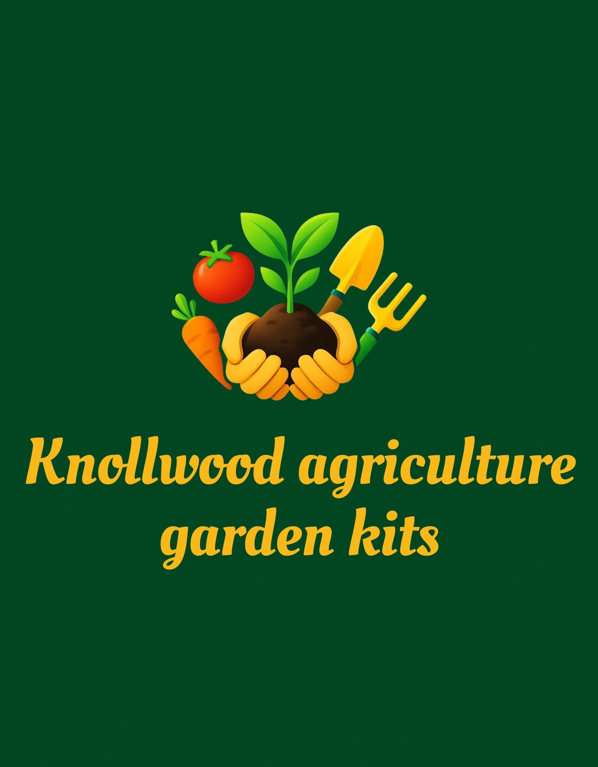
Bringing the farm to your Backyard.
Herbal and Wellness Kit
Inspired by the bible and God’s truth

Slide 2
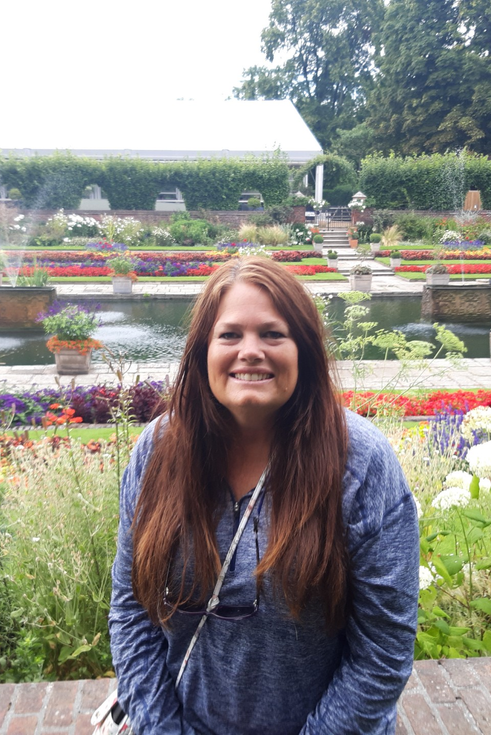
Hello, my name is Amy Perry, and I live in Bedford, Virginia. Since 2012, my family and I have enjoyed life on our 12-acre farm, where our house was built in 1810. I spend a lot of time gardening, growing vegetables, fruit trees, and herbs, and caring for three flower beds. My favorite part is working with herbs and produce, especially when I get to harvest, can, and make fermented foods. I also raise chickens and keep bees. Before moving here, I lived in Sarasota, Florida, for 19 years and homeschooled my two sons. My faith and adoration in the Lord, my passion for homeschooling, and my love for gardening inspired me to create these Agriculture Kits. I hope you enjoy using them as much as I enjoyed creating them.
Notes:
I am here to support you. If you have any questions or run into any problems with the kit, please email me and I will get back to you. As a fellow homeschool veteran, I am proud of your commitment to your children and your dedication to preparing them for adulthood. We all know this journey is not easy, but with support from our community and faith in our loving Lord, we can accomplish so much. I pray this kit inspires you to try other kits or helps you build skills, knowledge, and confidence in using herbs. Our education and medical systems both have challenges, but God created herbs and gave us the Bible to help us understand their health benefits, whether we use them in food, drinks, or cosmetics. Becoming self-sufficient and making healthy choices for your family is so important. I hope this kit sparks a new adventure and interest for you. God bless your family!

Slide 3
Table of Contents
If you have any questions or require assistance, please contact me using the information provided below. I am dedicated to supporting you in maximizing the benefits of these kits. Each slide contains links to websites with activities focused on planting, growing, and caring for the plant, as well as instructional videos designed to help children acquire and enhance relevant skills.
Website – knollwoodagriculture.com
Email-knollwoodagriculture@gmail.com
Phone- 540-526-6415
Purchase Kits through cash app- https://cash.app/$knollwoodagriculture.
Bible and Herbs
Understanding Herbs and use
Making the products
Benefits of Herb oils and products
Herbal Activities
Notes:
This table of contents breaks down the PowerPoint. Please take some time to look into the websites provided. There is a lot of useful information and advanced knowledge in the material. Mom, this is mainly for you to learn and then teach your children. If you have a middle or high school student, they can also learn the material, help teach younger siblings, and count the hours toward their high school elective credit. At the end, I have included information about high school credit. Please go through the entire PowerPoint and use the notes to get ready for this kit. Some instructions may require you to prepare ahead of time for future activities.

Slide 4
Herbs Relating to God’s Creation .When we see herbs, we remember God’s amazing creation. They show us the beauty and strength of nature, which belongs to God’s kingdom. Each herb is different, showing how creative God is. The beauty of nature invites us to think about God’s love and care for all he has made. These verses remind us to care for nature and be thankful for all it gives us.
As the rain and the snow come down from heaven, and do not return to it without watering the earth and making it bud and flourish, so that it yields seed for the sower and bread for the eater.” – Isaiah 55:10-11
Notes:
Slides 5-10 are biblical references to herbs. Please take your time and see the importance God has put in place with herbs. Feel free to do further research in herbs and the Bible.

Slide 5
As we look at the meaning of herbs in the Bible, we see how they relate to our healing, nourishment, and spiritual health. These verses show God’s care and presence in our lives through creation. We are encouraged to value what we have, from the herbs we eat to the community we share. By learning from these scriptures, we grow in gratitude and see how nature shapes our spiritual path. I hope these thoughts encourage us to grow in faith and appreciate God’s creation more. Let’s value our time together, show love to one another, and care for our bodies as temples of the Holy Spirit. By doing this, we can build a grateful and connected community that lifts everyone up.
Herbs as symbols of Healing
Herbs of Nourishment
Herbs in Daily Life
Herbs of Offering
Herbs and Spiritual growth
Herbs related to Gods creation
Herbs for Prayer and Worship
Herbs for Community and Connection

Slide 6
And the Lord God made all kinds of trees grow out of the ground—trees that were pleasing to the eye and good for food. In the middle of the garden were the tree of life and the tree of the knowledge of good and evil.” – Genesis 2:9
And why do you worry about clothes? See how the flowers of the field grow. They do not labor or spin.” – Matthew 6:28
He covers the sky with clouds; he supplies the earth with rain and makes grass grow on the hills.” – Psalm 147:8
“As the rain and the snow come down from heaven, and do not return to it without watering the earth and making it bud and flourish, so that it yields seed for the sower and bread for the eater.” – Isaiah 55:10-11
“To satisfy a desolate wasteland and make it sprout with grass?” – Job 38:27
Herbs in Daily Life
Herbs emphasize the daily sustenance we receive from God. Our everyday lives can be enriched by recognizing the gifts of nature, including herbs. When we include such elements in our lives, we embrace the blessings of God’s creation. Learning from scripture, we can find purpose in even the smallest details of our lives. Herbs remind us to appreciate every little thing God has provided, connecting us actively to nature and to Him.

Slide 7
Herbs for Healing
Faith often highlights the importance of healing, and herbs have long been part of that story. The Bible shows that God uses natural things to restore and heal us. When we see how herbs are used in scripture, we find they can help our bodies and spirits. By appreciating the healing gifts found in creation, we draw closer to God, who wants us to be whole. We are thankful for the simple and meaningful gift of herbs that help us heal.
“Fruit trees of all kinds will grow on both banks of the river. Their leaves will not wither, nor will their fruit fail. Every month they will bear fruit, because the water from the sanctuary flows to them. Their fruit will serve for food and their leaves for healing.” – Ezekiel 47:12
“Down the middle of the great street of the city, on each side of the river stood the tree of life, bearing twelve crops of fruit, yielding its fruit every month. And the leaves of the tree are for the healing of the nations.” – Revelation 22:2
“A cheerful heart is good medicine, but a crushed spirit dries up the bones.” – Proverbs 17:22
“Is there no balm in Gilead? Is there no physician there? Why then is there no healing for the wound of my people?” – Jeremiah 8:22
“Is anyone among you sick? Let them call the elders of the church to pray over them and anoint them with oil in the name of the Lord.” – James 5:14

Slide 8

In the Bible, herbs are often seen as symbols of healing and renewal. People have long looked to green plants for help with both physical and spiritual needs. The scriptures use herbs to show that God cares for us and brings healing. This gentle image appears throughout the Bible, offering hope and reminding us that healing is possible. When we read these passages, we can find encouragement in God’s promise to restore us, whether we need healing in our bodies, our relationships, or our faith.
Symbolism of Herbs in the Bible
As we grow in faith, we encounter many symbols in scripture, including herbs. Herbs symbolize purity, growth, and God’s promises. Reflecting on their meaning deepens our understanding of faith and highlights God’s presence in all aspects of life. Studying these symbols can strengthen our relationship with the Lord and help us recognize God’s guidance each day.
Notes:
Exodus 15:26
“He said, “If you listen carefully to the Lord your God and do what is right in his eyes, if you pay attention to his commands and keep all his decrees, I will not bring on you any of the diseases I brought on the Egyptians, for I am the Lord, who heals you.” – Exodus 15:26
Proverbs 17:22
“A cheerful heart is good medicine, but a crushed spirit dries up the bones.” – Proverbs 17:22
Jeremiah 30:17
“But I will restore you to health and heal your wounds,’ declares the Lord, ‘because you are called an outcast, Zion for whom no one cares.” – Jeremiah 30:17
Isaiah 53:5
“But he was pierced for our transgressions, he was crushed for our iniquities; the punishment that brought us peace was on him, and by his wounds, we are healed.” – Isaiah 53:5

Slide 9
Herbs for Nourishment
As we consider the Bible verses about herbs, we remember that they bring nourishment to our bodies. Nourishing our bodies is essential in our walk of faith, showing gratitude for the bounty that God provides. The scriptures remind us that we should sustain not just our physical needs, but also our spiritual well-being. By reflecting on how herbs are used in our diets and lives, we recognize that God cares about every aspect of us, including how we nourish ourselves. It’s a beautiful illustration of His provision and love!
Genesis 1:29
“Then God said, “I give you every seed-bearing plant on the face of the whole earth and every tree that has fruit with seed in it. They will be yours for food.” – Genesis 1:29
Psalms 104:14
“He makes grass grow for the cattle, and plants for people to cultivate—bringing forth food from the earth.” – Psalms 104:14
Matthew 13:32
“Though it is the smallest of all seeds, yet when it grows, it is the largest of garden plants and becomes a tree, so that the birds come and perch in its branches.” – Matthew 13:32
John 6:51
“I am the living bread that came down from heaven. Whoever eats this bread will live forever. This bread is my flesh, which I will give for the life of the world.” – John 6:51

Slide 10
3 Ways to Use Herbs
Culinary Use
Medicinal/Wellness Uses
Household and Craft use
Infusions & Butters: Steep fresh herbs (rosemary, thyme) in warm oil for drizzling or mix chopped herbs into softened butter for toast, meats, or veggies.
Teas & Drinks: Brew dried or fresh herbs like mint, chamomile, or lemon balm into soothing teas, or freeze them in ice cubes for flavored water.
Flavor Boosters: Add to marinades, sauces (pesto, vinaigrettes), rubs for roasts, or mix directly into doughs for breads and pasta
Herbal Teas & Tinctures: Use chamomile for skin, oregano for colds, or ginger for nausea, steeped in hot water or preserved in alcohol/vinegar.
Topical Remedies: Create salves with chamomile for chapped lips or use lavender for soothing aromatherapy.
Natural Cleaners: Thyme's essential oils act as a natural disinfectant.
Aromatherapy & Decor: Dried lavender or mint can be placed in sachets for pleasant smells in drawers or hung as decorative bundles.
Gifts & Crafts: Press herbs for cards, create designs on solar paper, or make scented gifts.
Pest Deterrents: Grow rosemary near your porch to keep mosquitoes away, and mint to deter mice
Notes:
You will be exploring all the 3 ways in using herbs through out the rest of the power point.

Slide 11
Descriptions of oil choices
Selection Guide by Use
Product Type Recommended Oils Key Considerations
General Skincare/Body Salves Sweet Almond, Sunflower, Jojoba, Olive, Apricot Kernel Consider skin type (oily vs. dry), absorption rate, and budget. Jojoba is great for the face; olive oil is better for the body.
Culinary Products Olive, Avocado, Coconut Choose high-quality, food-grade oils that complement the herb's flavor. Note that high smoke points are important for cooking.
High-End/Specialty Argan, Rosehip Seed, Baobab, Macadamia Nut These offer specific benefits (anti-aging, hair care) but come at a higher price point.
https://formulabotanica.com/8-best-oils-botanical-oil-infusions/
Great website for learning more about oils for herbal use.
Notes:
This slide shows the different oils you can use and how to use them. Feel free to swap out the oils I provided for any you already have or prefer. I included almond and coconut oil in the kits because they are kid-friendly, easy to find, and less expensive than some other options. If you use culinary oils, make sure they are safe to eat. For skin care oils, check that your child is not allergic or sensitive to the oil you choose. Aromatherapy oils are just for smelling. Enjoy!

Slide 12
Culinary Herbs
All Herbs edible and for used for infused oils too!

Slide 13
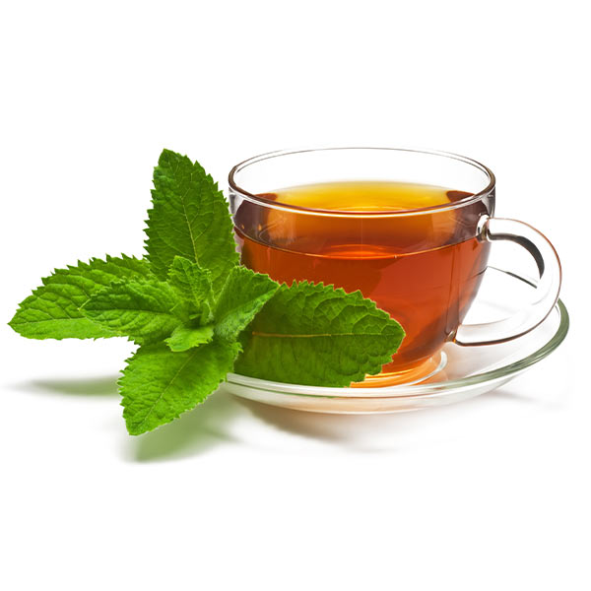
Ma Making Herb Tea
.
How to Make Herb Tea-
Use any of the herbs from the Herb packet. Enough for tea and use of all medicinal/wellness activities.
Garden fresh (mint, hibiscus, chamomile . Lemon balm and peppermint) is easy to brew and takes no longer than 10 minutes just like any other pot of tea. leaves are soft, herbaceous, and contain a rich and potent supply the naturally derived menthol oil. How to brew Herbal Tea:
1. Using any type of tea infuser or tea bag, add about 3 tsp of freshly dried herb to every 8 oz of boiled water.
2. Allow herb to steep for about 10-20 minutes.
Notes:
Included are 4 tea bags to make your own tea.

Slide 14
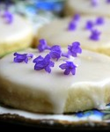
Easy Lavender Shortbread Cookies
Subtly-scented tea time treats.
Cuisine: English
Keyword: cookies, easy, lavender
Servings: 24
Ingredients
1/2 cup sugar
4 teaspoons fresh lavender buds, or 2 teaspoons dried
8 ounces unsalted butter, softened to room-temperature
2 cups all-purpose flour, scooped and leveled
Glaze: 1 cup confectioners sugar blended with just enough water to achieve a spreadable consistency
Optional for decoration: fresh lavender petals
Instructions
Use a food processor or a mortar and pestle to grind the sugar and lavender petals together.
Put the sugar mixture and butter in the work bowl of a standing mixer that is outfitted with the paddle attachment. Beat at low speed until smooth -- about 2 minutes. Add the flour and beat until combined. Mixing is complete when there are no visible lumps of butter in the dough. Form the dough into a rough disk, wrap it in plastic, and chill for 30 minutes in the refrigerator.
Roll the dough into a 1/4-inch thick circle. Cut out cookie shapes with a round, 2-inch diameter cutter. Use a flat spatula to transfer the rounds to a parchment-lined baking sheet. Chill for 30 minutes. Meanwhile, preheat the oven to 300°F.
Bake on the middle rack of the preheated oven just until the sides of the cookies begin to color — 25-30 minutes. Let cool completely on the baking sheet.
Top the cookies with the glaze mixture. If desired, sprinkle fresh lavender petals over the cookies.
Notes:
I have personally made these cookies, I think they are yummy!!! Great for a tea party.

Slide 15

Chamomile
https://www.vannh.com/blogs/flowers-herbs/chamomile-tea-for-kids-safe-and-soothing-uses#
Chamomile chocolate moon milk
https://raiasrecipes.com/2020/06/chocolate-chamomile-moon-milk.html
Notes:
This is a very fun and tasty drink for children

Slide 16
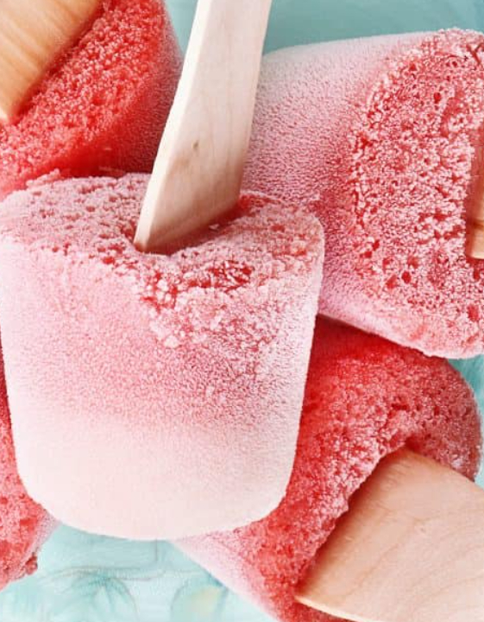
Hibiscus and Chamomile popsicles
https://stickyfingerscooking.com/recipes/iced-hibiscus-tea-splash
History and recipes for Hibiscus
https://www.learningherbs.com/blog/homemade-popsicles#gsc.tab=0
Recipe for popsicles
Notes:
Hello! I’m Hibiscus Tea.
"I have a deep red color and a sweet, floral taste with a hint of tartness, much like cranberry juice. You can enjoy me as a hot tea or a cold, fruity punch!"
Hibiscus tea is made by infusing the calyces of the hibiscus, or roselle, flower. The calyx is the part that protects and supports the flower bud. You can use either fresh or dried hibiscus to make this herbal tea.
The hibiscus used for tea likely originated in Africa, where the drink is very popular. In Sudan, people use hibiscus tea in folk medicine to help with various health conditions.
Roselle juice, made from hibiscus, is a dark red-purple drink. In Senegal, it’s called "bissap," and in Ghana, it’s known as "sobolo." In Jamaica and other Caribbean countries, both the juice and the flower are called "sorrel." In Southeast Asia, hibiscus tea is often served cold and sweetened.
Hibiscus tea can help lower blood pressure in people with high blood pressure. It may also help reduce cholesterol and fight inflammation.

Slide 17
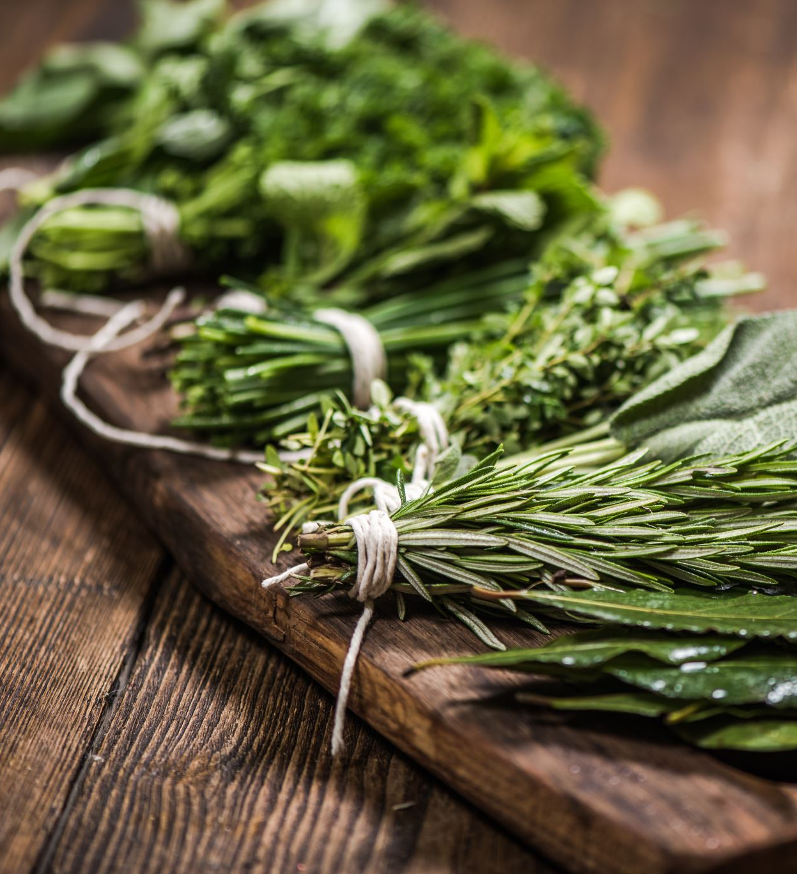
Rosemary
Rosemary & Thyme Water Crackers {With the Kids}
http://www.easypeasyorganic.com/2012/08/rosemary-thyme-water-crackers-with-kids.html
Cooking with Kids: Butter and Rosemary
https://tinkerlab.com/cooking-with-kids-butter-and-rosemary/

Slide 18
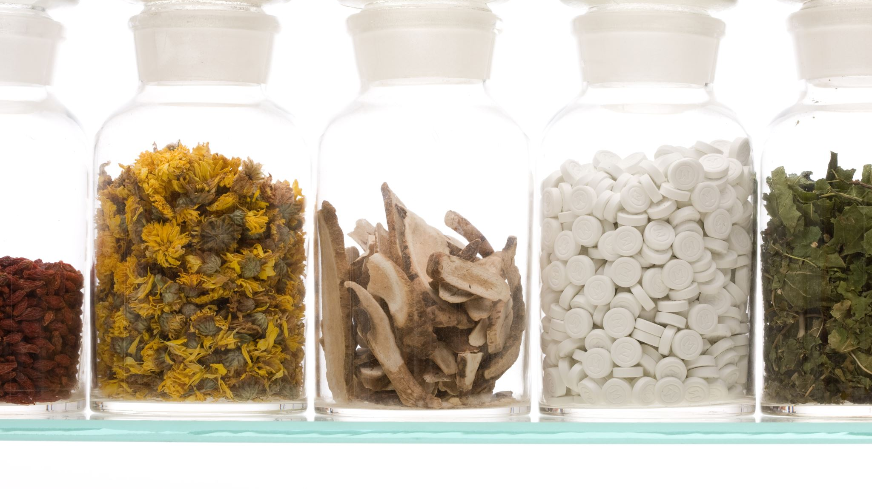
Medicinal and Wellness Use
Information and Activities

Slide 19
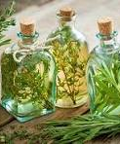
Infused almond oil with herbs
How to make a herbal infused oil
There are three main ways in which an oil can be infused: the cold infusion method, sun infusion method and heat infusion method. Here’s each method in more detail:
The cold infusion method
1) Clean and sterilize a glass jar and ensure it is completely dry.
2) Pack full of your dried herb (here we are using calendula).
3) Using a carrier oil of your choice such as cold-pressed sunflower or sweet almond, pour oil over the petals ensuring they are completely covered. Fill the jar almost to the brim with oil as any air gaps will promote oxidation and will spoil the oil.
4) Gently push a spoon handle or chopstick around the edge of the jar to release any air bubbles.
5) Put the lid on and leave to infuse for six weeks away from strong sunlight. You can pop the jar in a warm place such as an airing cupboard.
6) After six weeks strain the contents of a jar through a muslin cloth, squeezing to remove all the oil. Leave the oil to settle before using.
Notes:
See notes on second slide number 22. Two secrets are longer infused, stronger scent, do not use fresh herbs but the ones I gave you, or your own dried herbs.

Slide 20
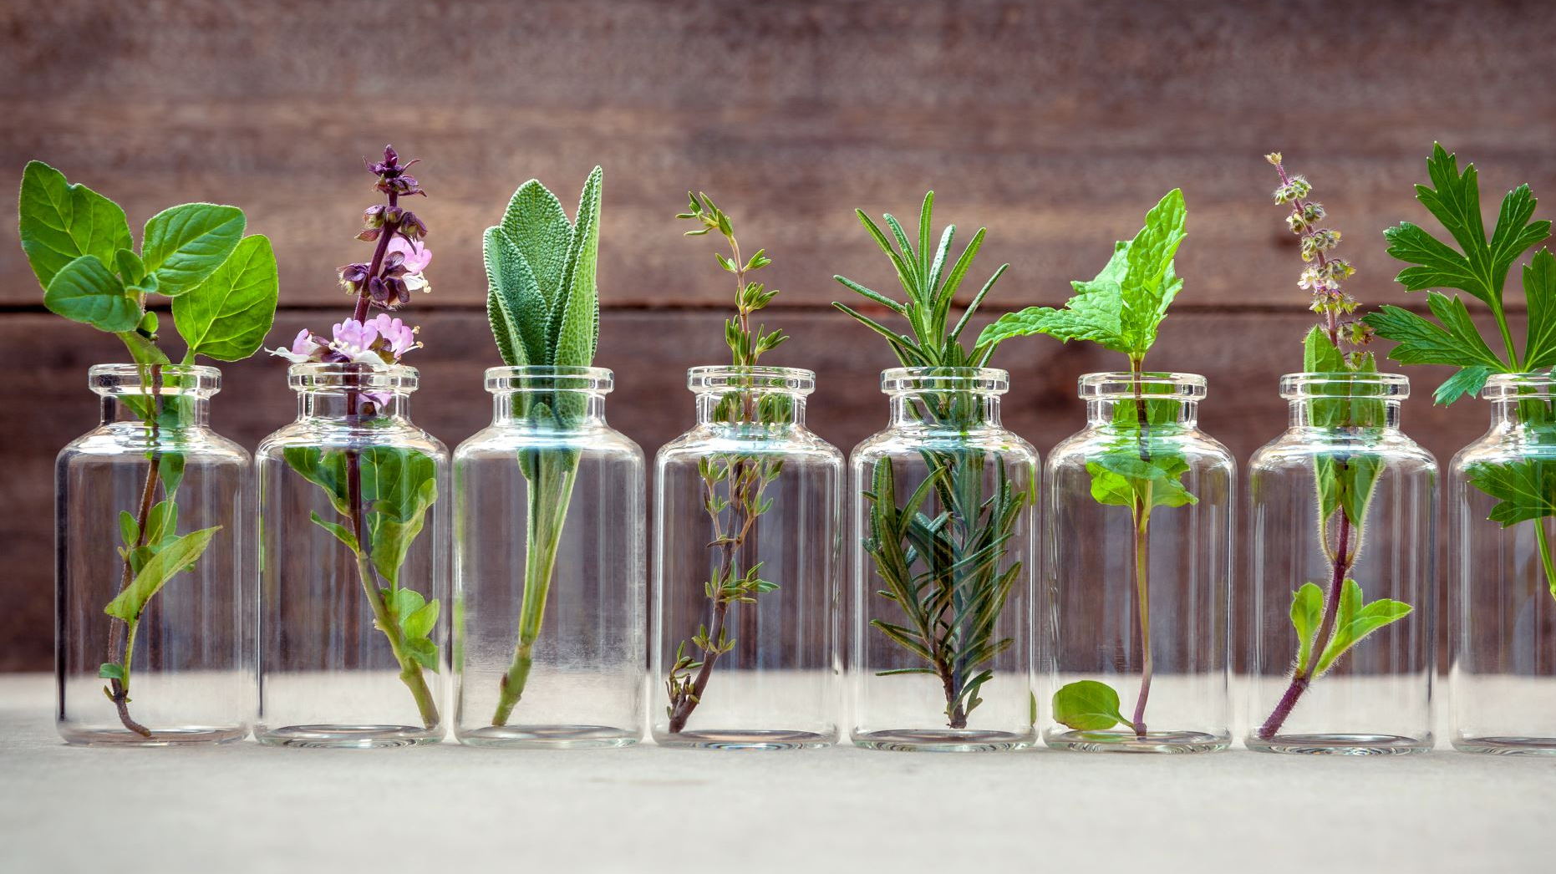
Continue Infused herbs
.Heat infusion method
This is a much quicker way to infuse oils – good for the impatient!
The most important point to remember when creating herbal oils this way is to keep the heat as low as possible, because you don’t want to ‘cook’ the herbs. All you need to do is to place the herbs in a double boiler, slow cooker or bain-marie, cover with the oil of your choice and gently heat the herbs over a low heat for 2-6 hours. Turn off the heat and allow to cool. Strain the herbs through a muslin cloth and the oil is ready for use.
Once the oils are infused they will probably take on a new color and smell. Herbal oils will keep for approximately a year if stored properly in a dark and cool place. Some oils are more vulnerable to rancidity than others. Vitamin E oil may also be added to prolong the shelf life.
https://www.schoolofnaturalskincare.com/how-to-make-herbal-infused-oils/
https://www.beckyocole.com/how-to-make-an-infused-herbal-oil-quick-and-fast-methods/
Notes:
If you search online for infused herbs, you will find many websites with instructions, workshops, and classes about wellness products. How far you want to go is up to you. In this class, I am teaching you how to make infused oils to use in your products. This method is gentler than using essential oils, which can have strong scents and reactions. I chose not to introduce or sell essential oils because choosing them is a personal decision. There are thousands of essential oils, and their prices vary widely. Please use any of the herbs I have provided and choose one to make your own infused oil for your wellness products.

Slide 21
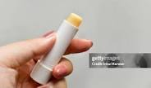
Herbal Lip Balm
Prep time: 5 mins | Melt time: 1-1.5 minutes |
Set time: 1-2 hours . If you don’t have a ½ Yields 2 tubes
Tbsp, Use 1 & ½ teaspoon
Ingredients:
1/2 or 1Tbsp Beeswax pellets (or grated beeswax) This is a thickener
1/2 Tbsp Coconut oil . This is the thinner.
1/2 Tbsp Sweet almond oil. ( Can use your infused almond oil)
Optional: 5-10 drops skin-safe essential oil (peppermint, lavender
Instructions
Combine bee wax and oils in microwave or use double boiler
Set 30 seconds and stir. Up to 1 minute until melted and clear.
Add-ins: Remove from heat. Stir in essential oils or colorants (like lipstick bits).
Pour: Carefully pour the hot liquid into your containers.
Cool: Let sit undisturbed for at least an hour to fully harden. Cap and label
Notes:
These are fun to make! I’ve given you two lip balms, but if you want to make more, you can use any small container with a lid and apply the balm with your finger. The ones I included twist up. I also added some blank stickers so you can make your own labels for the tubes. You can use any oil you like, but I’ve included infused sweet almond oil, coconut oil, and the secret ingredient—beeswax. I gave you more than you’ll need, and the recipe makes at least three, even though you only have two tubes. So have an extra container ready if you don’t want to throw away the extra balm.

Slide 22
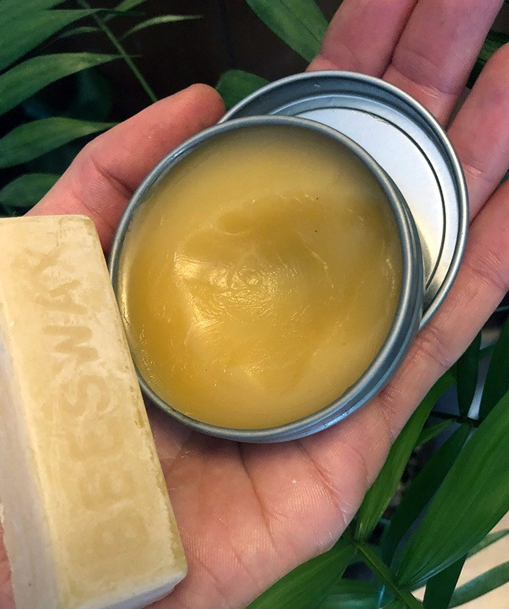
Ingredient
½ to 1 tbsp bee wax .
½ tbsp of shea Butter
Drops of essential oil or infused oil
Instructions
Add butter and beeswax to the warming system and put on low heat until the beeswax melts into the oil. Or microwave in increments of 30 sec until melted.
Add your essential oils of choice. ( or drops of your infused oil)
From here you can pour the finished product into your salve containers - make sure it is still liquid but not too hot.
Once it cools, the beeswax re-hardens with the oil to form the consistency of salve.
That’s it! Let's get into a little detail.
The goal is to keep the oil and beeswax from burning. A common tool is a classic double boiler. You can make your own double boiler by placing a pot of water on the stove and putting a smaller pot inside. Then put the ingredient inside the second, smaller pot. If you have one, a small crockpot is a great choice that is safe, especially if working with kids.
https://blog.mountainroseherbs.com/diy-herbal-salves
https://thehealthhutt.com/guide-tomake-salve-at-home
https://www.healthline.com/health/diy-herbal-salves#rash-cream-recipe
https://www.youtube.com/watch?v=vW9XBU6TIkU
Notes:
Very explanatory.

Slide 23

Making sugar scrub
Safety and Usage Tips for Children
Adult Supervision: Always have an adult present when the child is using the scrub, especially in the bath or shower, as the oil can make surfaces slippery.
External Use Only: Emphasize that the scrub is for external use on hands, arms, and legs, and not for the face or consumption.
Gentle Exfoliation: Instruct children to apply the scrub gently in a circular motion on wet skin and then rinse off.
Storage and Shelf Life: Store the scrub in an airtight container to keep water out, which can cause bacterial growth. For best results, use within a few months, or sooner if using fresh ingredients like citrus zest
Great websites for recipes for sugar scrubs.
https://myculturedpalate.com/homemade-sugar-scrubs/
https://simpleinthecountry.com/simple-sugar-scrub-recipes/
Ingredients
Refer to the websites given for recipes.
Sugar included
Use any fresh produce rinds
Food coloring, essential oils or the infused oil made in kit.
Instructions- Use the product labeled. It is a 2:1 ratio with sugar and oil.
Mix the Ingredients: In a small bowl, combine the sugar and the carrier oil.
Add Scent/Color (Optional): If using, add 1-2 drops of a child-safe essential oil or a very small amount of food coloring. Stir until the mixture is well blended and reaches a consistency similar to wet sand. Also, can use a little of infused oil.
Transfer to Container: Carefully spoon the mixture into the 1-ounce container and seal it tightly with the lid

Slide 24
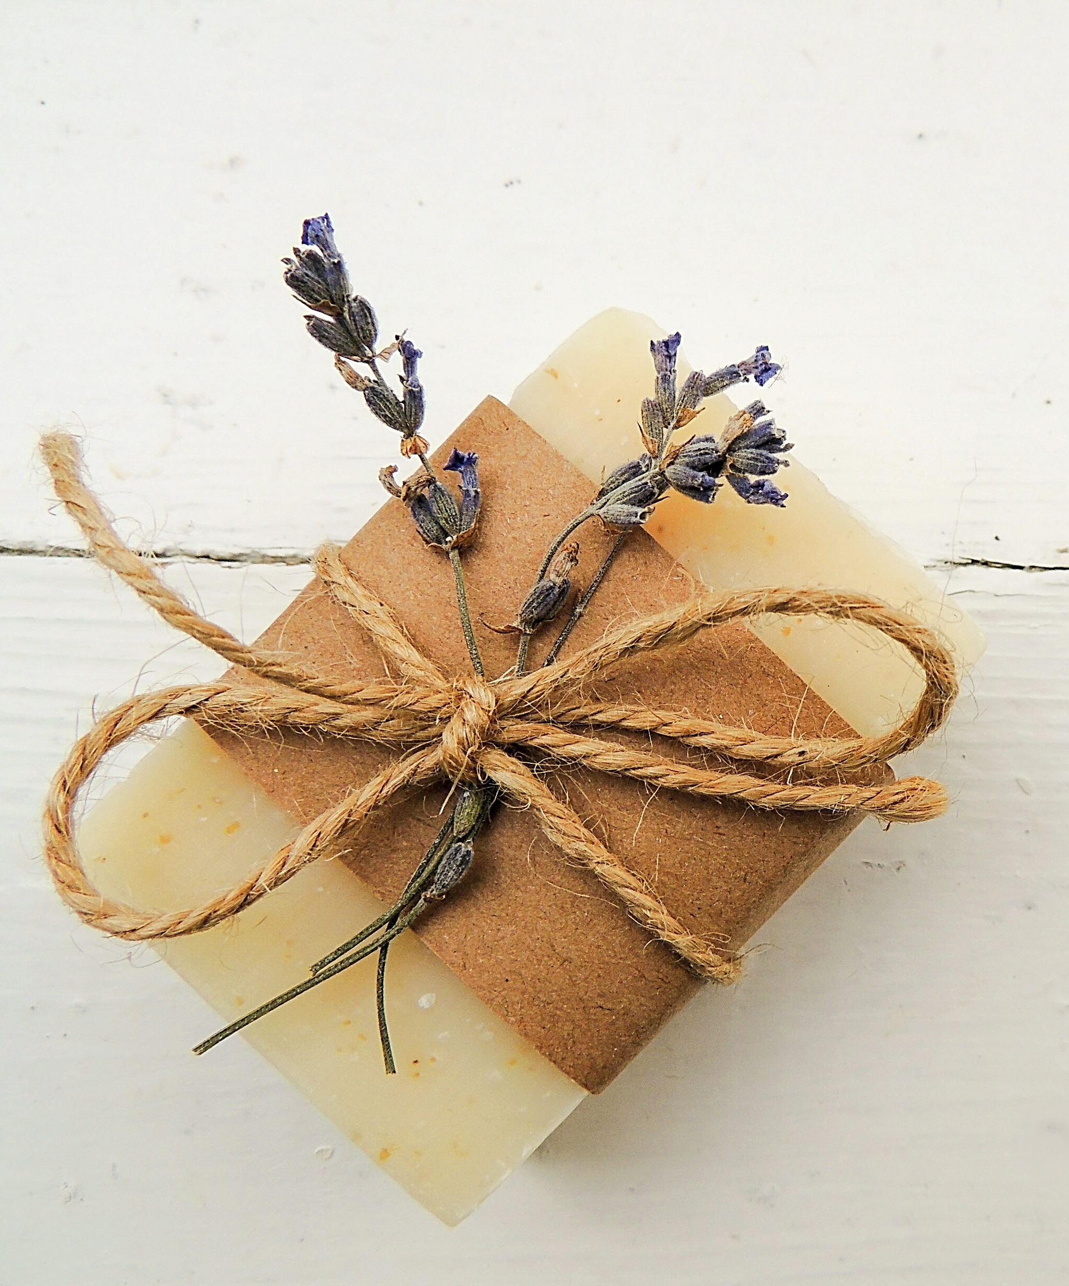
Making soap
Melt the soap base in the Microwave ( in 20 seconds burst) or in a double boiler.
Stir in the infused oil of your choice..
Cool to 125F
Stir in the dried petals or herb leaves of your choice
Pour soap mixture into mold and set overnight.
Remove from Mold and ready to use.
Any of the herbs included in your kit can be used to make the soap. The infused oil and herb do not have to be the same. Make according to the smell and texture you want.
.
Notes:
I’ve given you a soap base to use. Making soap from scratch usually needs lye, which isn’t safe for kids, so this base keeps things simple. There are lots of ways to make soap, and you can get creative with ingredients like fruit rinds. I’ve already added oatmeal powder to the base to help make the soap smoother. When you pour the base into a pot or microwave-safe dish, stir in a little coconut oil or infused almond oil along with the oatmeal. Once it’s fully melted, stir quickly to mix everything together, since it dries fast. I like to put herbs or dried flowers at the bottom of the mold. Pour in some of the liquid, add more herbs, then pour in the rest. The soap will need up to 24 hours to set and become solid. Feel free to experiment with different herbs, textures, and oils to suit your taste. Remind your children to use it only as soap—don’t eat it or get it in their eyes.

Slide 25
Aromatherapy & Decor
https://missjaimeot.com/aromatherapy-101-for-children/
https://focusandbalance.org/aroma-therapy-for-kids/

Slide 26
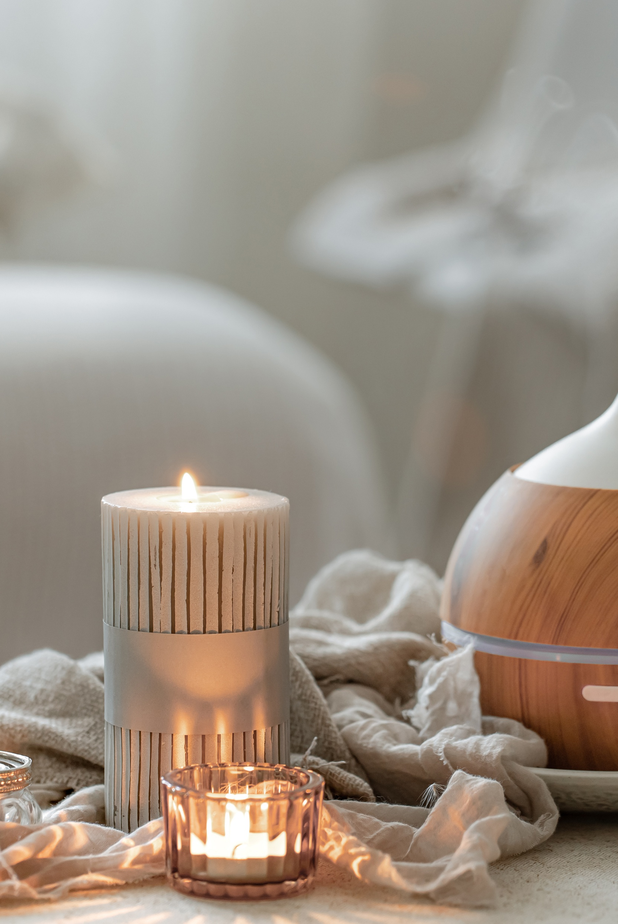
Aromatherapy Decor
Aromatherapy and decor can be simply explained to a child as using plant smells and fun decorations to make a room feel happy, calm, or focused
Included is a diffuser to burn, smell and teach about Aromatherapy.
Scented Diffusers & Vessels:
Ultrasonic Diffusers: Sleek, modern devices that disperse essential oils into a fine mist, often doubling as decorative pieces.
Reed Diffusers: Glass bottles with reeds soaking in scented oil, offering continuous fragrance without heat or electricity.
Decorative Bowls: Fill bowls with dried botanicals like lavender or pinecones and add drops of essential oil for natural potpourri.
Shower Steamers/Bursts: Aromatic tablets placed in the shower that release scents as they dissolve.
Scented Candles & Incense:
Soy/Beeswax Candles: Infused with essential oils like vanilla (comfort), jasmine (uplifting), or sandalwood (relaxation).
Notes:
I have given you a cone diffuser, to light and burn with your parent. Enjoy the aroma and the calming effect it can have.

Slide 27
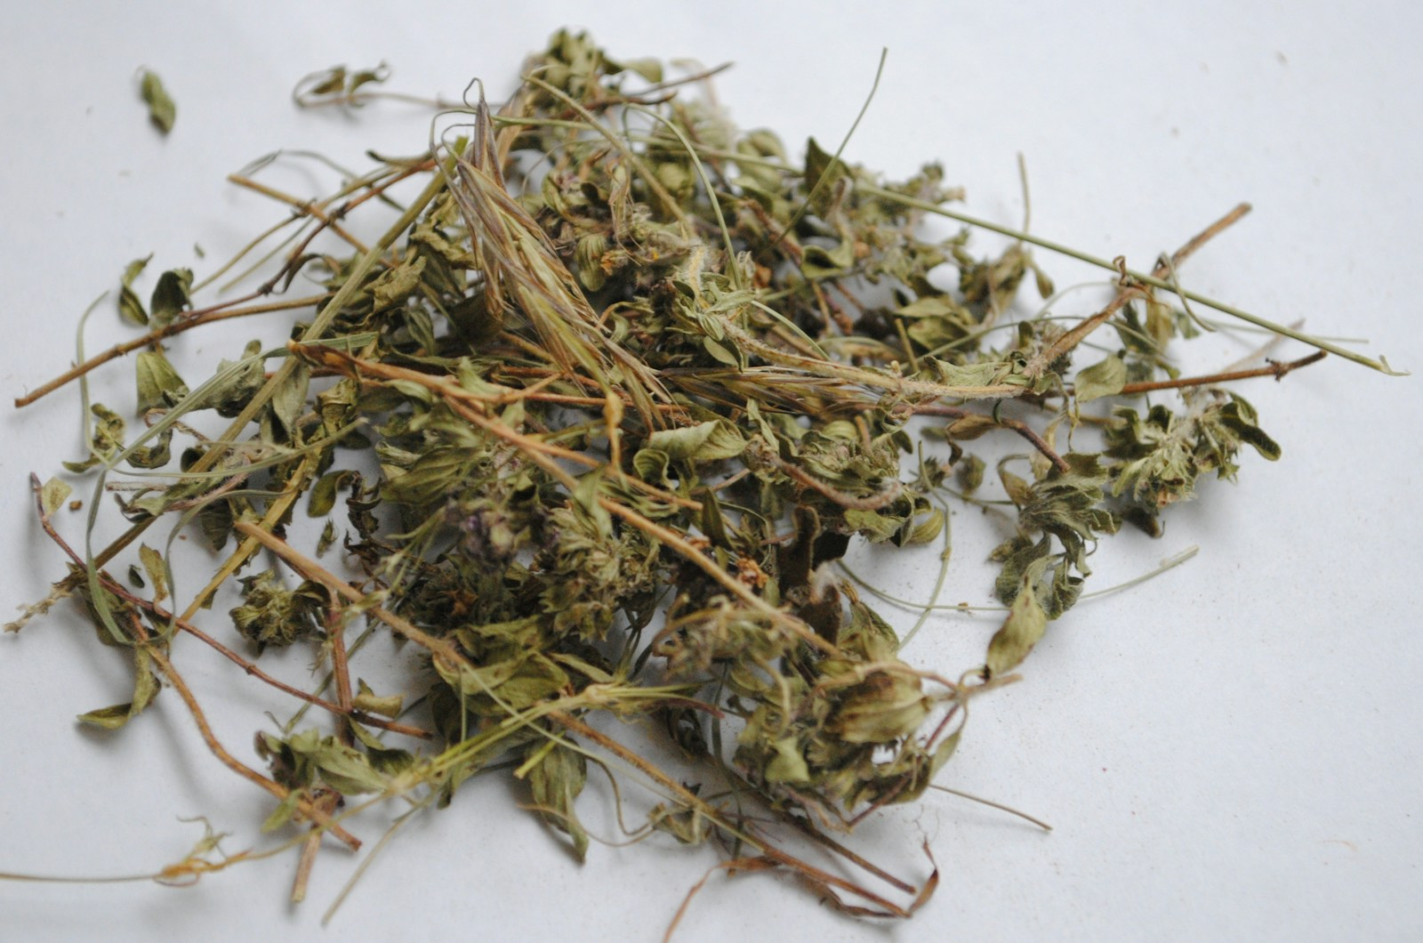
https://kidsgardening.org/resources/garden-activities-exploring-herbs
https://www.facebook.com/pallensmith/videos/herbal-dryer-sachets/10155105634359573/
Making an herbal sachet for a drawer is a simple DIY project that can keep your clothes smelling fresh.
Materials Needed:
Fabric: I have included a sachet for you.
Herbs and Fillers: A blend of dried herbs, flowers, and potentially a filler.
Popular herbs: Lavender (calming, moth-repellent), cedar chips (moth-repellent), dried rose petals, mint, rosemary, and thyme.
Fillers: You can use cotton batting, rice, or dried beans to add volume and longevity [1].
Optional intensifiers: Essential oils for a stronger scent, or orris root powder to help the scent last longer.

Slide 28
Herb-Inspired Art & Poetry
Foraging- (sustainably gathering wild plants)
Activities with Herbs

Slide 29
Bookmark and Journal
Art About Herbs: Botanical Art, Botanical Illustration, or sometimes referred to within broader themes like "Herbarium" in a gallery context.
Our kit comes with a bookmark that opens up. You’ll find lots of stickers to decorate it. You can also cut out pictures or press leaves and flowers inside. It’s your turn to get creative.
You’ll also find a journal in your kit. Use the stickers to decorate it however you like. You can write about your experiences, draw what you grow, or sketch flowers and plants. Keep track of your produce and planting schedule. Most of all, use your imagination and have fun!
Notes:
This is introduced first so you can set up your journal in the way you want to use it.

Slide 30
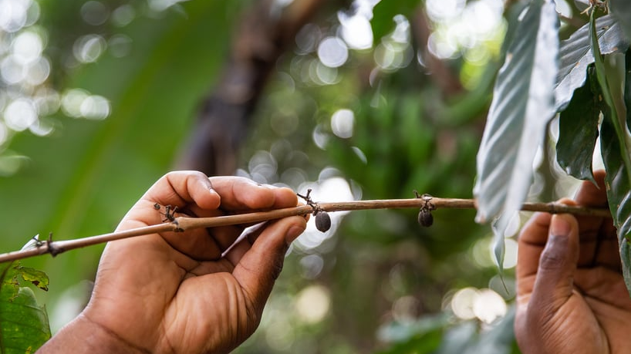
Poems About Herbs: Often called Botanica Poetica (herbs in verse) or poetry within the broader field of Herbology or Herbalism.
The Herbs That Followed Us
Our people didn’t just carry stories.
We carried seeds.
Even when we weren’t allowed to own land, we still knew what to plant.
Even when they took the drums, our hands still knew the rhythm of the soil.
Hibiscus, called zobo in Nigeria, karkadé in Sudan, and bissap in Senegal, was boiled down into red elixirs long before it became trendy in Western tea aisles. It was how we welcomed guests, how we cooled the heat, how we held on to joy when joy felt far away.
And then there’s mint.
The plant that spread like gospel across gardens and kitchens.
From North African markets to Southern porches, you’ll find it in tea glasses, tucked behind ears, rubbed on temples, steeped into strong pots when the body felt heavy.
It’s familiar.
Faithful.
It followed us well.
And then there are the ones we left behind.
African Wormwood—once a staple in southern Africa—rarely crosses the ocean now. But it lived in the bundles tied at the hip of grandmothers who walked barefoot to collect what they needed. Sharp. Bitter. It stayed strong in poor soil, just like the women who made do with what they had.

Slide 31
Foraging Herbs
For a child, foraging means going on a real-life treasure hunt in nature to find yummy things like berries, nuts, or cool plants to eat (with a grown-up's help!), or just exploring to find interesting natural treasures, like shiny rocks or cool bugs, making it a fun way to learn about the outdoors and discover food. It's like being an explorer or a survival hero, searching for anything interesting in the woods or fields

Slide 32
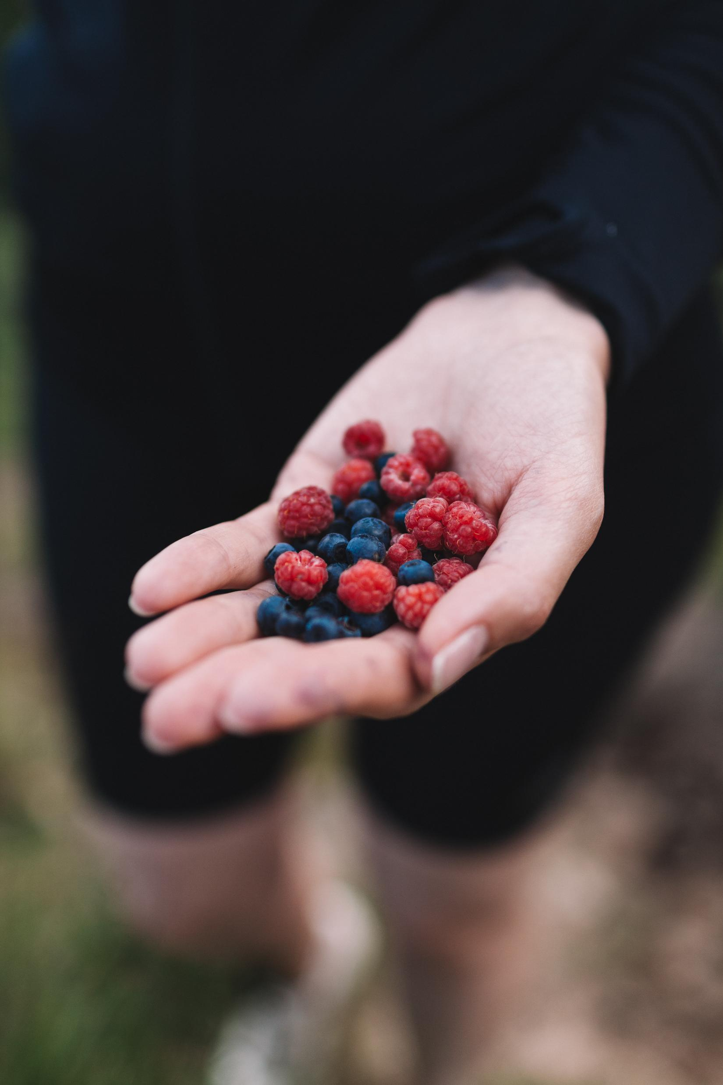
Foraging safely with children
Take your children foraging in the grocery store in the flower department, introduce edible flowers vs toxic flowers. Go to produce section and talk about all the culinary herbs and their use.
Take your children to your back yard and introduce edible weeds, flowers and plants.
Take your children to the woods and look for wild raspberry or blackberry plants that are edible.
Or pick wildflowers, unique leaves and sticks to take home and make a flower arrangement or put in a pot or press for your journal.
Take plants, flowers home and research to learn more about them.
Research Heirloom plants in your region and see if you can find them growing naturally.
On the next slide are is a list of Non- toxic plants. .
Safety first
100% ID: Only eat what you are absolutely certain of, use a reliable guide.
Avoid Pollution: Don't pick near roads, sprayed lawns, or industrial areas.
Taste Test: Introduce new plants slowly, just a small amount first.
Know Your Area: Check local regulations; some plants might be protected.
Supervise Closely: Always with an adult for positive identification and preparation

Slide 33
Edible plants
Flowers & Greens (Easy to Spot)
Dandelion (Flowers & Leaves): Yellow flowers and jagged leaves are great in salads, teas, or cooked like spinach.
Clover (Flowers): Pink/white flowers can be eaten fresh or dried for tea.
Violets (Flowers & Leaves): Sweet flowers and leaves, good in salads.
Wood Sorrel (Oxalis): Lemon-flavored leaves and flowers (use sparingly).
Chickweed: Small, delicate plant, good raw in salads.
Plantain (Common): Not the banana, but a broad-leafed weed; young leaves are edible cooked.
Nasturtium (Often cultivated but can escape): Peppery flowers and leaves.
Wild Garlic/Ramps: All parts have garlic flavor (requires positive ID).
Berries & Fruits (Sweet Treats)
Blackberries/Raspberries: Classic sweet forage (ensure correct identification of berry type).
Wild Strawberries: Small but flavorful, found in grassy areas.
Elderberry (Flowers & Berries): Flowers make great fritters; berries cooked into syrup (ensure proper cooking)

Slide 34
High school Herb elective

Slide 35
Herb/Wellness kit into a high school elective credit
First semester follow semester track using the kit.
Second semester focus on interest, skill, resume building.
Teach younger siblings the kit
Supplement field trips or volunteer work in a green house, garden store, community gardening, Nursing home, schools garden planting herbs.
Focus on a topic and build a project or science lab experiment]:
Herb growing and harvesting ( drying)
Using the herbs in Kitchen ( culinary)
Using the herbs for wellness products, focusing on all product or specializing just in soaps, or balms. Etc.
Add one of the other Knollwood agriculture kits: Garden or Jane Austen flowers.
Semester credit – Total 60 hours
Hands on activities- 20 hours
Research and learn power point topic websites.- 25 hours
Journal activities and take notes on website material. Add worksheets, test- 15 hours

Slide 36
Steps to Create an Herbal Elective
• Define the Course Scope: Focus on areas like medicinal herbs, culinary herbology, or botany. Topics can include plant-based medicine, phyto-nutrients, gut health, and creating remedies.
• Structure the Curriculum: Use a mix of textbooks, online courses, and hands-on projects to ensure academic rigor. Document study hours, as 120-180 hours generally equal 1 credit, and 60-90 hours equal 0.5 credit.
• Integrate Practical Skills: Include hands-on activities such as drying herbs, making salves, tinctures, or teas.
• Identify for Credit: Classify this course under Electives, specifically as Home Economics (Life Skills), Horticulture, or Botany/Science.
• Record Keeping: Maintain a detailed course description, syllabus, log of hours, and a portfolio of projects (photos of remedies, research papers) for the high school transcript.
Sample Course Topics
• Botany & Identification: Learning to identify local herbs and understanding plant families.
• Herbal Pharmacology: Studying the chemical components of herbs and how they affect the body.
• Safety & Medicine Making: Proper foraging techniques, drying, and creating safe,, home-based remedies.
• History of Herbology: Exploring traditional plant medicine uses.
Potential Course Titles
• Introduction to Herbalism
• Principles of Medicinal Botany
• Home Economics: Herbal Homesteading
• Applied Horticulture: Culinary and Medicinal Herbs
This elective can be documented on a transcript as "Elective: Herbal Studies" or similar, demonstrating 21st-century skill development in wellness and agriculture
Teaching a high school herb elective for credit involves
structuring a curriculum around botany, pharmacology, and practical application, typically earning 0.5 to 1.0 elective credit (equivalent to 60–120+ hours of study). Key components include studying plant identification, medicinal properties, foraging, drying techniques, and creating herbal remedies, often within a "Natural Medicine" or "Applied Botany" framework.

Slide 37
• 2. Core Topics for an Herbal Elective
To ensure the course is high-school level, include a mix of science, history, and practical skills:
• Botany & Plant Science: Plant identification, parts of a plant, and life cycles.
• Materia Medica: Detailed study of specific herbs, their properties, and traditional uses.
• Herbal Pharmacy: Hands-on creation of teas, tinctures, salves, and infusions.
• Safety & Ethics: Sustainability, proper dosage, and understanding interactions.
• History & Lore: The historical use of herbs in different cultures, such as Native American or Appalachian traditions.
3. Teaching Resources
• Curricula: Utilize specialized programs like the Earthschooling Herbalist Course: High School Edition or unit studies from Campfire Curriculums.
• Practical Activities: Use gardening basics from resources like Garden Tutor to teach soil composition and growing zones.
• Field Work: Incorporate plant scavenger hunts, nature walks, and foraging practice.
4. Grading and Record Keeping
• Logs: Track daily hours spent on reading, research, and hands-on preparation.
• Assignments: Assign research papers on specific herbs, maintain a "Main Lesson Book" (portfolio) with sketches and observations, or require a final project like creating a family first-aid kit.
• Course Description: Write a clear description for the transcript that includes the course title (e.g., "Herbal Sciences" or "Botany & Herbalism"), materials used, and your grading method

Slide 38
Disclaimer And Liability Clause
All seeds are sourced from reputable seed companies that claim their products are organic and have high germination rates. However, these seeds are not approved by the FDA. Knollwood Agriculture does not grow the seeds included in this packet.
This kit is intended for educational use only. Please follow the instructions provided. Knollwood Agriculture is not responsible for misuse or individual choices.
Parents and guardians are responsible for addressing any family concerns about allergies, medical reactions, or pre-existing medical conditions.
"This product is provided 'as is' and 'as available' for informational and educational purposes only. Knollwood Agriculture makes no warranties, express or implied, regarding its safety, reliability, or performance. By using this product, you acknowledge and agree to assume full responsibility for any risks, injuries, or damages, and agree that Knollwood Agriculture shall not be liable for any direct, indirect, or consequential losses arising from its use or reliance on any information provided. Use is at your own risk
"These statements have not been evaluated by the FDA. This product is not intended to diagnose, treat, cure, or prevent any disease. Always consult a qualified healthcare professional before using this product, especially if you have pre-existing medical conditions or are pregnant/nursing. Use at your own risk. [Your Company Name] accepts no liability for any adverse effects or damages resulting from the use or misuse of this product

