Slide 1

Knollwood Agriculture
C O-OP KITS

Slide 2
Teachers and Co-op Leaders
Teachers and cooperative leaders interested in the kits are encouraged to respond by email or phone.
Email- Knollwoodagriculture@gmail.com Phone 540-526-6415
Each kit contains an inventory list specifying the materials provided to each student, regardless of class size.
A teacher packet is available for purchase, which includes the PowerPoint presentation, class outline, semester lesson plan, and instructional ideas.
Pricing and contact info on last power point please read through.

Slide 3
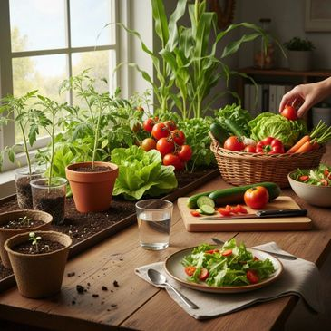
STEM Garden Kit
The Fall/Spring STEM Garden kit invites students to dig into hands-on learning, Designed for co-op meetings during the school year, it features vegetables perfect for fall or spring planting. The journey starts with exploring soil science, testing pH, and discovering how to enrich soil for thriving gardens. The kit sparks curiosity by weaving STEM concepts into every lesson. Students will sprout seeds, follow the plant life cycle, investigate pollination, experiment with companion planting, tackle pests and diseases, master watering and fertilizing, and finally harvest their crops to create delicious recipes from seed to table. Creative projects like growing a chia pet and building a mason jar hydroponic system add extra excitement. Co-ops simply need to provide a garden space, pots, or raised beds to get started.
Will also include extra power point on High school Gardening elective.

Slide 4

Example of Lesson: What is soil
What is in the soil below our feet, our plants, our roads, and our buildings?
Students will explore what soil is composed of, as well as the textures of soil. They will act out how water moves through various types of soil.
Student Objectives 1. Recognize that soil is made up of specific components, including mineral matter (sand, silt and clay), water, air and organic matter
. 2. Recognize that soil is made up of different-sized particles that define its texture.
3. Relate the effect of the different-sized particles on the properties of soil.
4. Explain why different soil particles form layers.
5. Use appropriate increments to measure soil layer thickness
Vocabulary • clay - smallest of the three soil particles; when wet, feels sticky or greasy; when dry, hard, and brick-like. •
organic matter - partially decomposed plant and animal matter. •
sand - very tiny rock fragments; largest and heaviest of soil particles; feels gritty. •
silt - medium-sized soil particles; feels like flour. •
soil - the outer portion of the earth’s surface. Soil is the foundation of every living thing. • soil texture - the way a soil feels.

Slide 5

Jane Austen
Regency Period Tea and Flower Kit
The Jane Austen kit opens up a world of possibilities, inviting you to chart your own course through literature, history, and hands-on exploration. Imagine crafting a rich British literature class that not only delves into Austen's beloved novels but also brings to life the vibrant world of the Regency era, tracing its influence across Europe and America. Or let the kit whisk you away on a journey through the art of tea, where you can discover its fascinating history, master the etiquette, and experiment with brewing techniques and herbal blends. For those drawn to the beauty of nature, the kit can also inspire a deep dive into flower cultivation, from the mysteries of pollination to the joy of harvesting and creating with blooms.
Tea could be done in Fall; Flowers would have to be in Spring.
Will also include an extra power point on how to turn into High school credit in British Literature.

Slide 6
British Afternoon Tea - Sample lesson
Simulation Lesson for Ladies (30-45 minutes)
Objective: To introduce students to British Afternoon Tea traditions,
including its history, food, and etiquette.
1. Introduction to Afternoon Tea (5 min)
Originated in 19th century Britain as a light meal between lunch and dinner.
Created by Anna, Duchess of Bedford, who wanted a small meal to stave off hunger before the late evening meal.
Often served between 3:30 pm - 5:00 pm.
2. Elements of Afternoon Tea (5 min)
Food: Delicate finger sandwiches, scones with clotted cream and jam, and pastries.
o Drink: Fine loose-leaf teas, served with milk and sugar.
o Etiquette: Traditionally enjoyed with soft conversation in a relaxed setting.
3. Tea Etiquette (5 min)
o Tea pouring: Host pours tea, ensuring everyone is served.
o Milk in tea: Pour tea first, then add milk. Avoid stirring too vigorously.
o Eating: Finger sandwiches and scones are eaten with hands, but pastries with a fork.
Conversation: Keep topics light and polite; avoid controversial topics.

Slide 7
Jane Austen continue
The Jane Austen kit offers comprehensive content with multiple instructional pathways. It can be adapted for either a semester- or year-long course, enabling flexible curriculum design.
A unit can be dedicated to an in-depth study of Jane Austen's life and works, fulfilling requirements for British literature credit.
Additional emphasis on the Regency period may serve as a supplement to history coursework.
The curriculum may also include the history of tea, tea preparation, etiquette, and period-appropriate social gatherings such as tea parties and dances.
A focus on flowers can fulfill gardening elective credit, encompassing topics such as seeding, cultivation, pruning, pest management, harvesting, and related crafts and activities.
Ultimately, the curriculum can be tailored to individual interests and the desired duration of study.

Slide 8
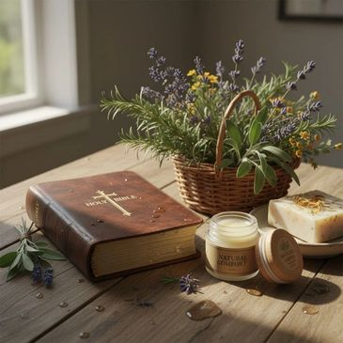
Herbal and Wellness product Kit
This immersive herbalism course integrates scriptural wisdom, encouraging participants to recognize God’s nurturing presence throughout each lesson.
Students engage with the diverse world of herbs through hands-on activities that highlight herbal benefits and applications.
Sensory experiences include working with aromatic incense, crafting herbal sachets, and foraging for wild herbs outdoors.
The course concludes with a creative workshop where participants develop personalized wellness products, such as lip balm, sugar scrubs, and goat’s milk soaps. All materials are provided, including complimentary product containers and supplies for experimenting with cosmetic and wellness formulations.

Slide 9
Student and Teacher Kit supplies
Each student will receive a supply list based on the selected course.
All student supplies will be shipped to a single address, either the teacher's or the co-op leaders' address.
Knollwood will establish a uniform price for all inventory per student, regardless of class size.
Communication from Knollwood will be directed exclusively to co-op leaders, not to individual parents or students. The pricing set by Knollwood is independent of any fees that individual co-ops may charge families for classes or group participation.
Teachers receive complimentary access to PowerPoint materials for the Kits and free supplies for themselves when their class size exceeds 12 students.
Teachers may also access a teacher package designed to streamline instruction. Alternatively, a teacher packet is available for purchase, which includes the PowerPoint presentation, class curriculum, semester lesson plan, and instructional resources.
Teachers and cooperative leaders are responsible for all communications regarding their purchase. They will collect payments from their class and remit a single payment to Knollwood Agriculture.
Knollwood will not give grades or transcripts to students or Co-op groups.

Slide 10
Pricing
Student Kit Pricing
Garden Kit: $20.00 per student per semester (includes all necessary supplies).
Jane Austen Kit: $25.00 per student per semester (includes all necessary supplies).
Wellness Kit: $35.00 per student per semester (includes all wellness containers and cosmetic ingredients)
Teacher Kit Package: $50.00. For classes with fewer than 12 students, an additional $10.00 will be charged for teacher activity supplies, which are the same as those provided to students.
PowerPoint materials are provided to teachers at no additional cost, regardless of class size.

