Slide 1

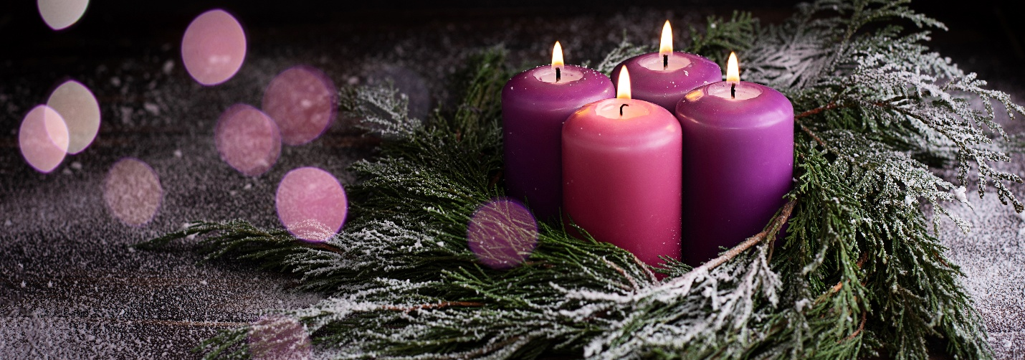
Knollwood Agriculture
Using nature to learn about Advent during the Christmas season

Slide 2
Meaning of Advent
The word 'Advent' comes from Latin and means "coming." Advent is a time to look forward to Christ coming to Earth—a season of waiting and hope. It marks the start of something new and better. This is what Christmas is really about, isn’t it? We celebrate the arrival of a new era, when God entered our world.
As Christmas approaches, Christians enter a period of spiritual reflection and preparation. Many people light candles, enjoy traditions, and sing carols that celebrate the birth of Jesus in Bethlehem. This season is called Advent, a word that suggests something special is on the way.

Slide 3
But what exactly is Advent, and why does it matter so much to millions of Christians around the world?
The Advent season is a four-week period before Christmas that celebrates the anticipation and coming of Jesus Christ, the Messiah. The origin of "advent" is from the Latin word adventus, which simply translates as "coming" or "arrival." Not only is the Christian meaning for preparing and celebrating the coming of Jesus Christ, his birth at Christmas, but also to celebrate the new life when someone accepts Jesus Christ as their Savior, and lastly, the anticipation of Jesus returning again.

Slide 4
Prayer helps us draw close to God and ask Him to prepare our hearts
just as He prepared history for the gift of His Son. During Advent, ask God to clear away distractions and fill your life with warmth and openness. We’ve gathered these Advent prayers to help you make sure there’s "room at the inn" of your heart this year.
Advent is a brief yet meaningful season, and sometimes all you need is short and simply heartfelt prayers to invite God’s calming presence into our lives amid the busyness of November and December. Let these simple prayers ground us in the peace, hope, and love that Christ brings as we prepare our hearts for His coming

Slide 5
Prayers for the whole family
Lord Jesus, as we enter this Advent season, help us cling to the hope You bring. In a world that feels heavy with need, remind us of Your promise to come again and make all things new. Let our hearts be filled with the light of Your presence, leading us closer to You each day. Amen.
Prince of Peace, settle our hearts in this season of waiting. Where there is tension or fear, bring Your calming presence. May Your peace fill our lives, our homes, and our relationships, drawing us together in unity and love. Amen.
God of joy, let us rediscover the wonder of Your love this Advent. Help us to rejoice not just in the gifts we receive, but in the gift of Your Son. May our hearts overflow with gratitude and joy as we look forward to celebrating Your birth. Amen.

Slide 6
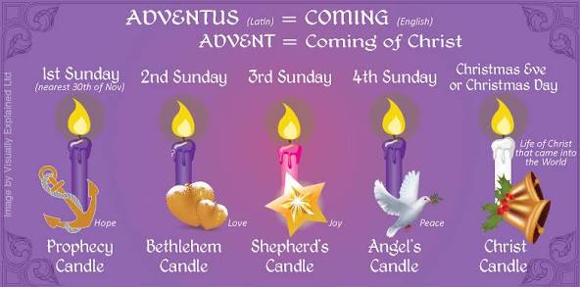
There are beautiful and rich traditions behind the celebration of Advent. Let's take a deeper look at the focus and themes of each week of Advent, and some of the traditions celebrated worldwide during the Advent season. May you find time to slow down this Christmas season, say "no" to the things that distract you from Jesus, and say "yes" to the gift that God wants you to experience

Slide 7
Interesting meaning about Advent
A new candle is lit on each of the four Sundays before Christmas. Each candle has its own meaning, though traditions can differ. Often, the first, second, and fourth candles are purple, and the third is rose-colored. In some places, all the candles are red, blue, or white. Sometimes, a fifth white candle is placed in the center and lit on Christmas Day to celebrate Jesus’ birth.
Each Advent candle matches the theme for its week. Families and churches start by lighting one candle on the fourth Sunday before Christmas, then light another candle each Sunday after that.
Advent candles shine in the darkness, reminding us that Jesus came as Light into our world. The candles are usually placed in a circular Advent wreath. In Scandinavia, Lutheran churches light one candle each day in December, so by Christmas, twenty-four candles are burning. Another tradition uses a single candle with twenty-four marks on the side. Each day, the candle is lit and allowed to melt down to the next mark.

Slide 8
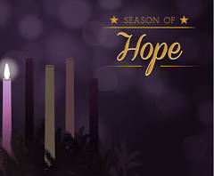
First Candle
* The first candle stands for hope and is called the "Prophet’s Candle." Old Testament prophets, especially Isaiah, waited in hope for the Messiah to come.
First Sunday of Advent: The Prophecy Candle (Hope)
Meaning: The first candle of Advent symbolizes hope. It reminds us of the promises God made through the prophets about the coming of a Savior, filling us with expectant hope in Christ’s arrival.
Prayer: "Lord, today we light this candle of hope. We remember the prophets who foretold a Savior, and we hold on to the promises You’ve given us. As we enter this Advent season, may Your hope fill our hearts and keep our eyes fixed on You. Thank You for the hope that sustains us in every season. Help us to share this hope with those around us, shining Your light into the world. Amen."

Slide 9
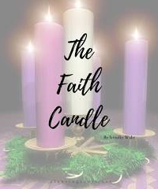
Second candle
* The second candle stands for faith and is called "Bethlehem’s Candle." The prophet Micah said the Messiah would be born in Bethlehem, which is also where King David was born.
Second Sunday of Advent: The Bethlehem Candle (Faith)
Meaning: The second candle represents faith, calling us to remember Mary and Joseph’s journey of faith to Bethlehem, trusting in God’s plan and His promise.
Prayer: "Father, as we light this candle of faith, we think of Mary and Joseph’s journey and their trust in You. Just as they followed Your guidance to Bethlehem, help us to walk in faith and trust Your plans for our lives. Strengthen our faith, Lord, so we may rely on Your promises even when we don’t see the way ahead. Thank You for guiding us and being our faithful provider. Amen.

Slide 10
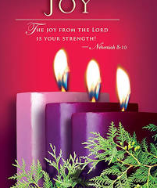
Third candle
The third candle stands for joy and is called the "Shepherd’s Candle." The angels brought joyful news to the shepherds, showing that Jesus came for humble people like them. In church services, the color rose means joy.
Third Sunday of Advent: The Shepherd’s Candle (Joy)
Meaning: This candle represents joy, recalling the shepherds’ joyful response to the angel’s announcement of Jesus’ birth—a joy that we, too, can carry in our hearts.
Prayer: "Dear Lord, today we light this candle of joy. We remember the excitement of the shepherds and their wonder at the birth of the Savior. Fill our hearts with that same joy, a joy that comes from knowing You and from the good news of Jesus. Let this joy shine brightly, lifting our spirits and pointing others to Your love. May our joy be a testimony of Your grace in our lives. Amen."

Slide 11
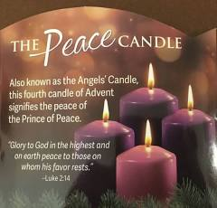
Fourth candle
* The fourth candle represents peace and is called the "Angel’s Candle." The angels announced that Jesus came to bring peace — He came to bring people close to God and to each other again.
Fourth Sunday of Advent: The Angel’s Candle (Peace)
Meaning: The fourth candle represents peace, echoing the angel’s message of “peace on earth” and reminding us that Jesus is the Prince of Peace who brings calm to our hearts and our world.
Prayer: “God of peace, as we light this candle, we thank You for the peace You offer through Jesus. In a world filled with turmoil, you are our calm and our comfort. Help us to carry this peace within us and to share it with others. May our homes, our hearts, and our relationships be touched by Your peace as we prepare for Jesus’ coming. Thank You for being the Prince of Peace and our constant refuge. Amen."

Slide 12
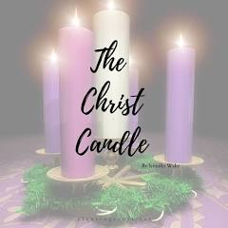
Fifth candle
* The optional fifth candle stands for light and purity and is called "Christ’s candle." It is located in the center and lit on Christmas Day.
Meaning: The fifth candle, the Christ candle, represents the light of Christ entering the world. It reminds us that Jesus, the Light of the World, dispels darkness and brings life and hope to all.
Prayer: “Lord Jesus, on this holy night, we light the Christ candle, celebrating the arrival of Your light in the world. Thank You for stepping into our darkness to bring us hope, peace, joy, and love. May Your light shine brightly in our hearts, guiding us closer to You and inspiring us to reflect Your love to others. Help us to carry this light beyond Christmas, sharing Your grace and truth with everyone we meet. Thank You for the gift of Your presence with us, now and forever. Amen."

Slide 13

Advent Activities
Nature activities to celebrate Advent and christmas

Slide 14
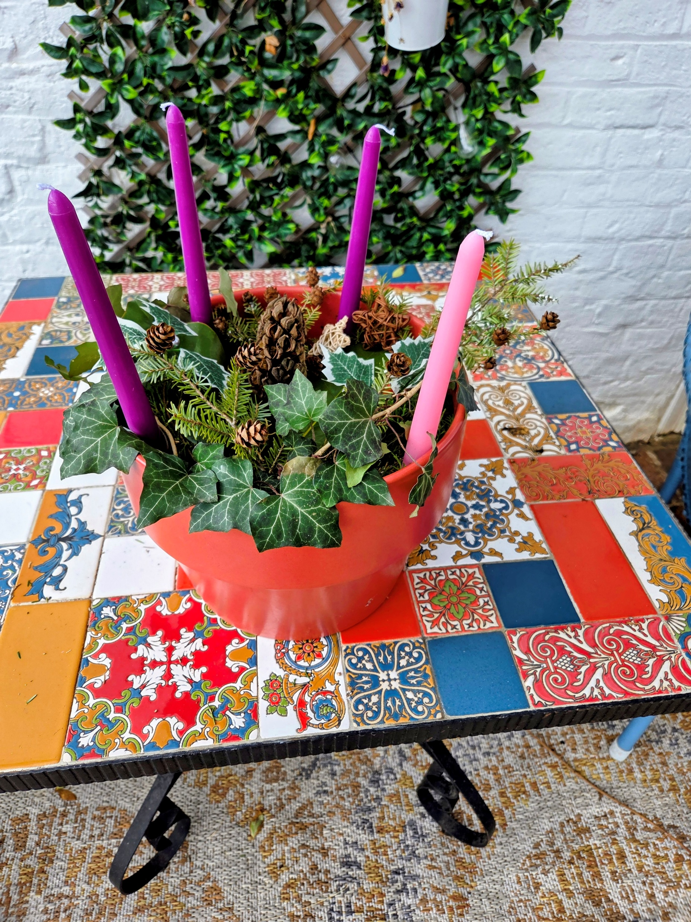
Creating an Advent candle potted plant with children is a simple and meaningful way to mark the weeks leading up to Christmas. This activity involves preparing a container with soil and greenery, then adding one, four, or five candles to be lit each week.

Slide 15
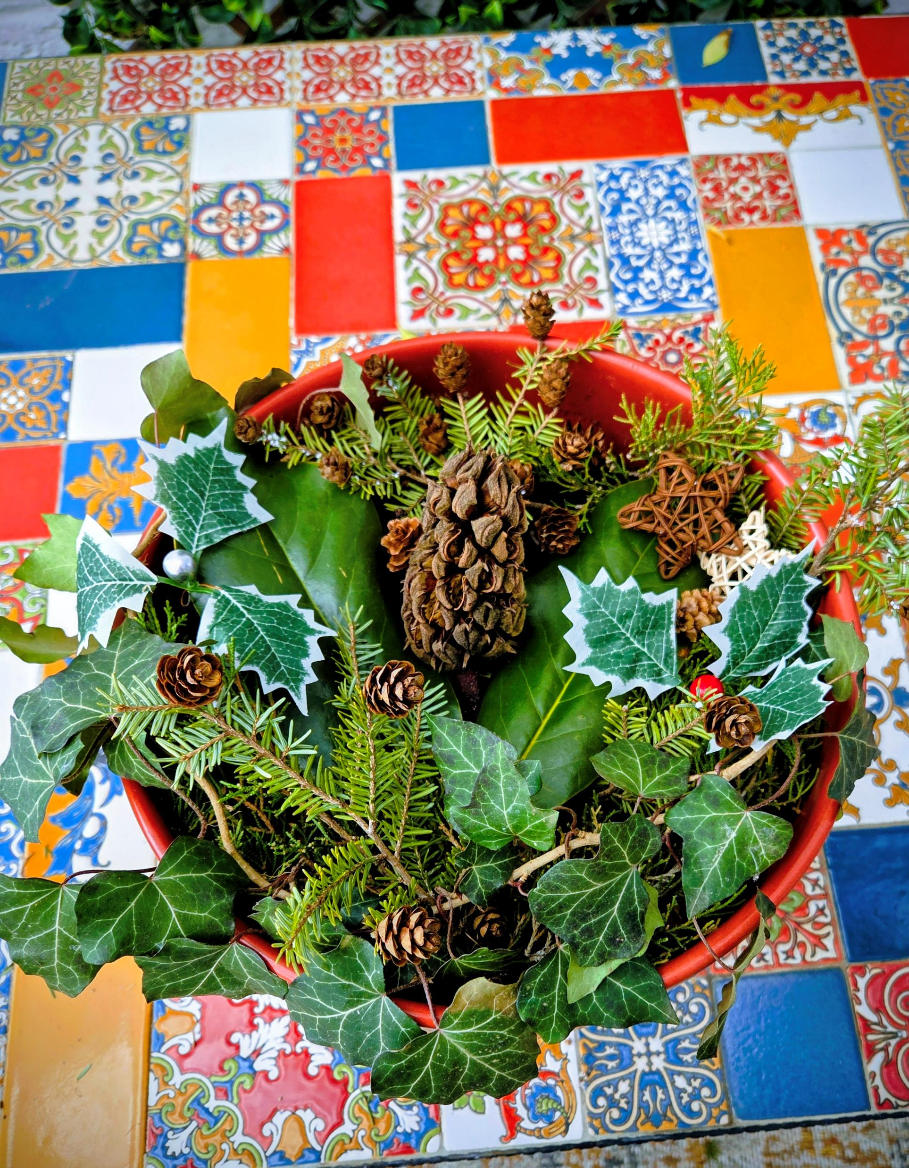
Preparing the Advent Pot
Begin by obtaining a terracotta pot and filling it with soil. Note that these materials are not provided in the kit.
Next, accompany your family outdoors to gather winter plants such as pine branches, rocks, or moss. Use these natural materials to decorate the pot and create a festive, Christmas appearance.
Exercise creativity during foraging. For those residing in neighborhoods, consider visiting local parks, fields, or nearby countryside. As Advent begins in December, seek pine trees or any winter shrubs with green foliage. If live plants are unavailable. Be creative with some of the wintery decorations I gave you in the purple envelop. Buy moss from Walmart or local home store.

Slide 16
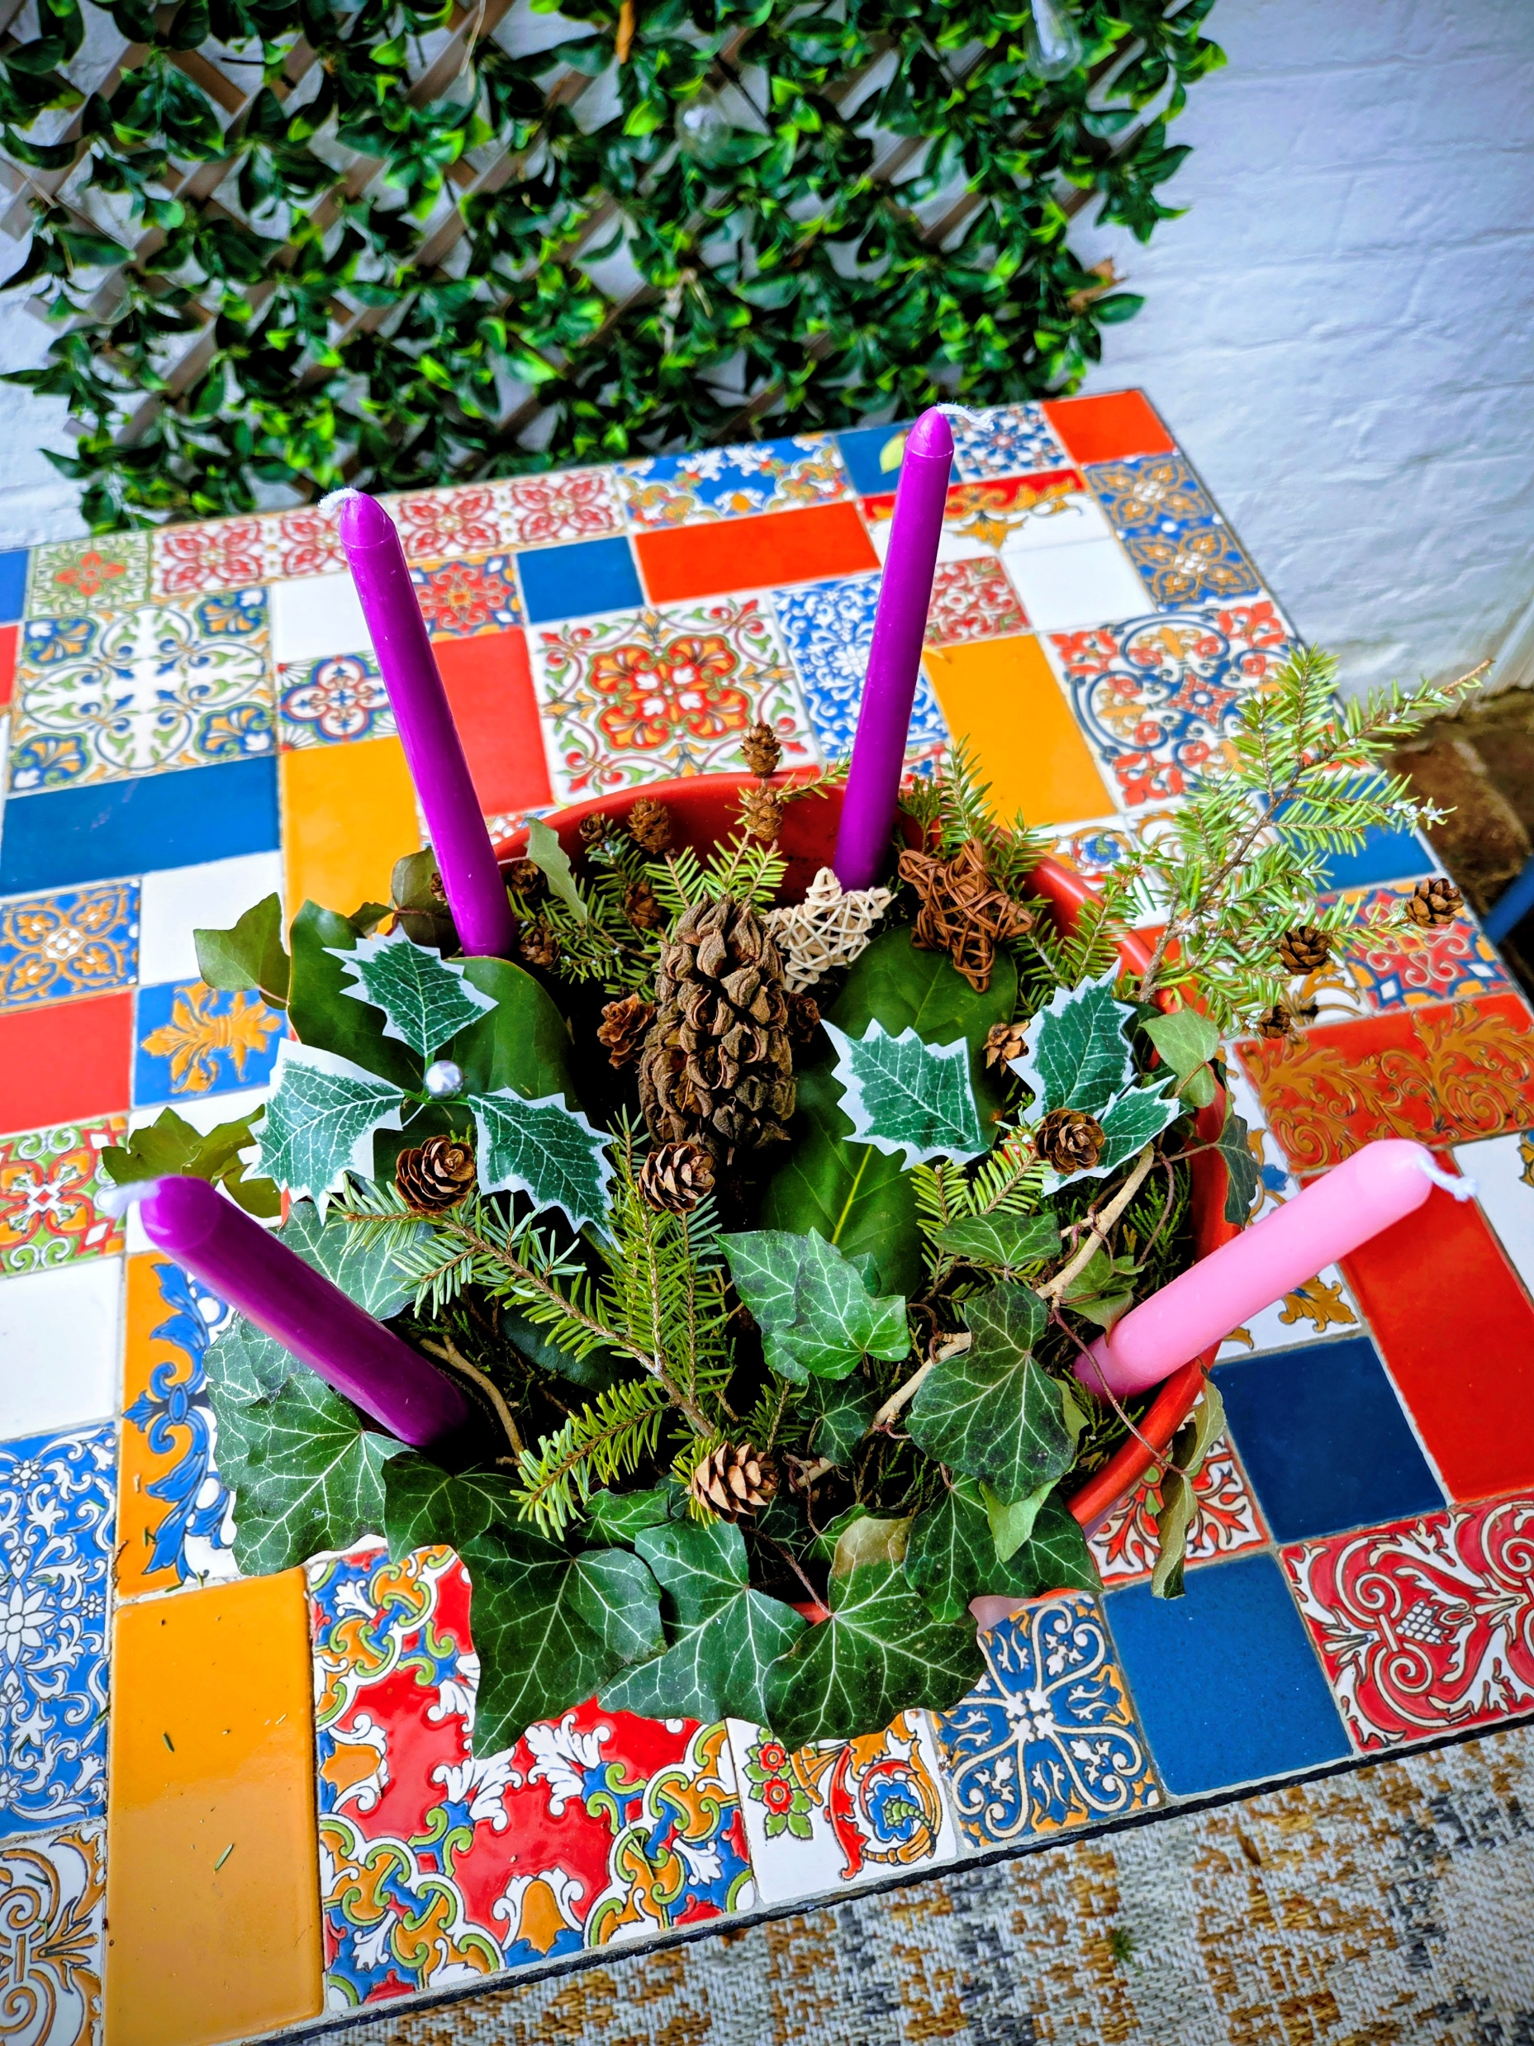
Once you have decorated your pot, use the provided materials to assemble your Advent pot each week.
Each week, add a candle and participate in the scripture reading, prayer, and song as outlined.
You are encouraged to celebrate each week in a way that is meaningful to you. For information on the significance of each week, please see slides 8 through 11 in the PowerPoint presentation.
A candle is not included for the fifth week. Instead, as shown in the following slides, you may use the figure of Jesus in the manger from your Nativity set, which can be more engaging for children.

Slide 17
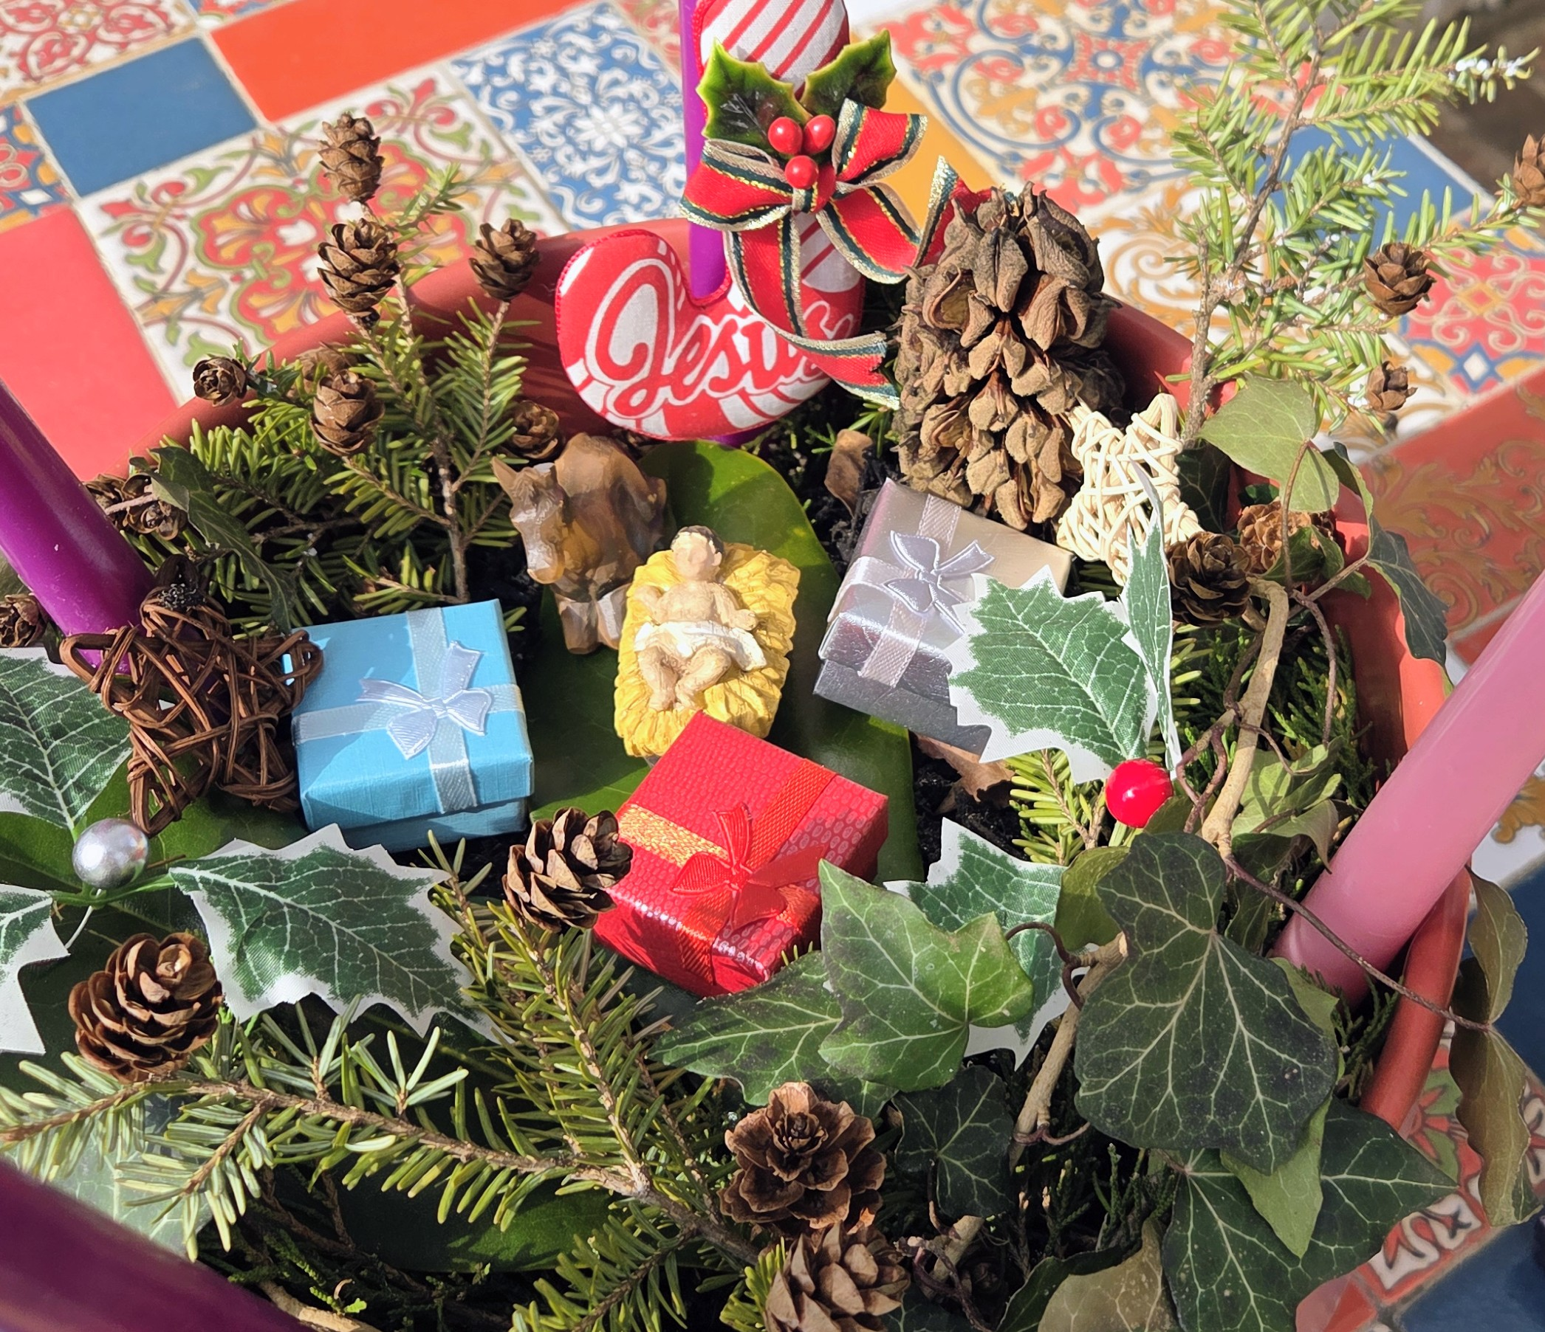
Bearing gifts for Jesus
The packet includes three small gift boxes symbolizing the gifts presented to Jesus by the wise men. When arranging the Advent pot, position it at the center of the four candles. The manger and Jesus figure are not provided. If a Nativity set is available, use the Jesus figure from that set. Individual manger pieces are also available for purchase during the Christmas season at various retailers, such as Walmart.

Slide 18
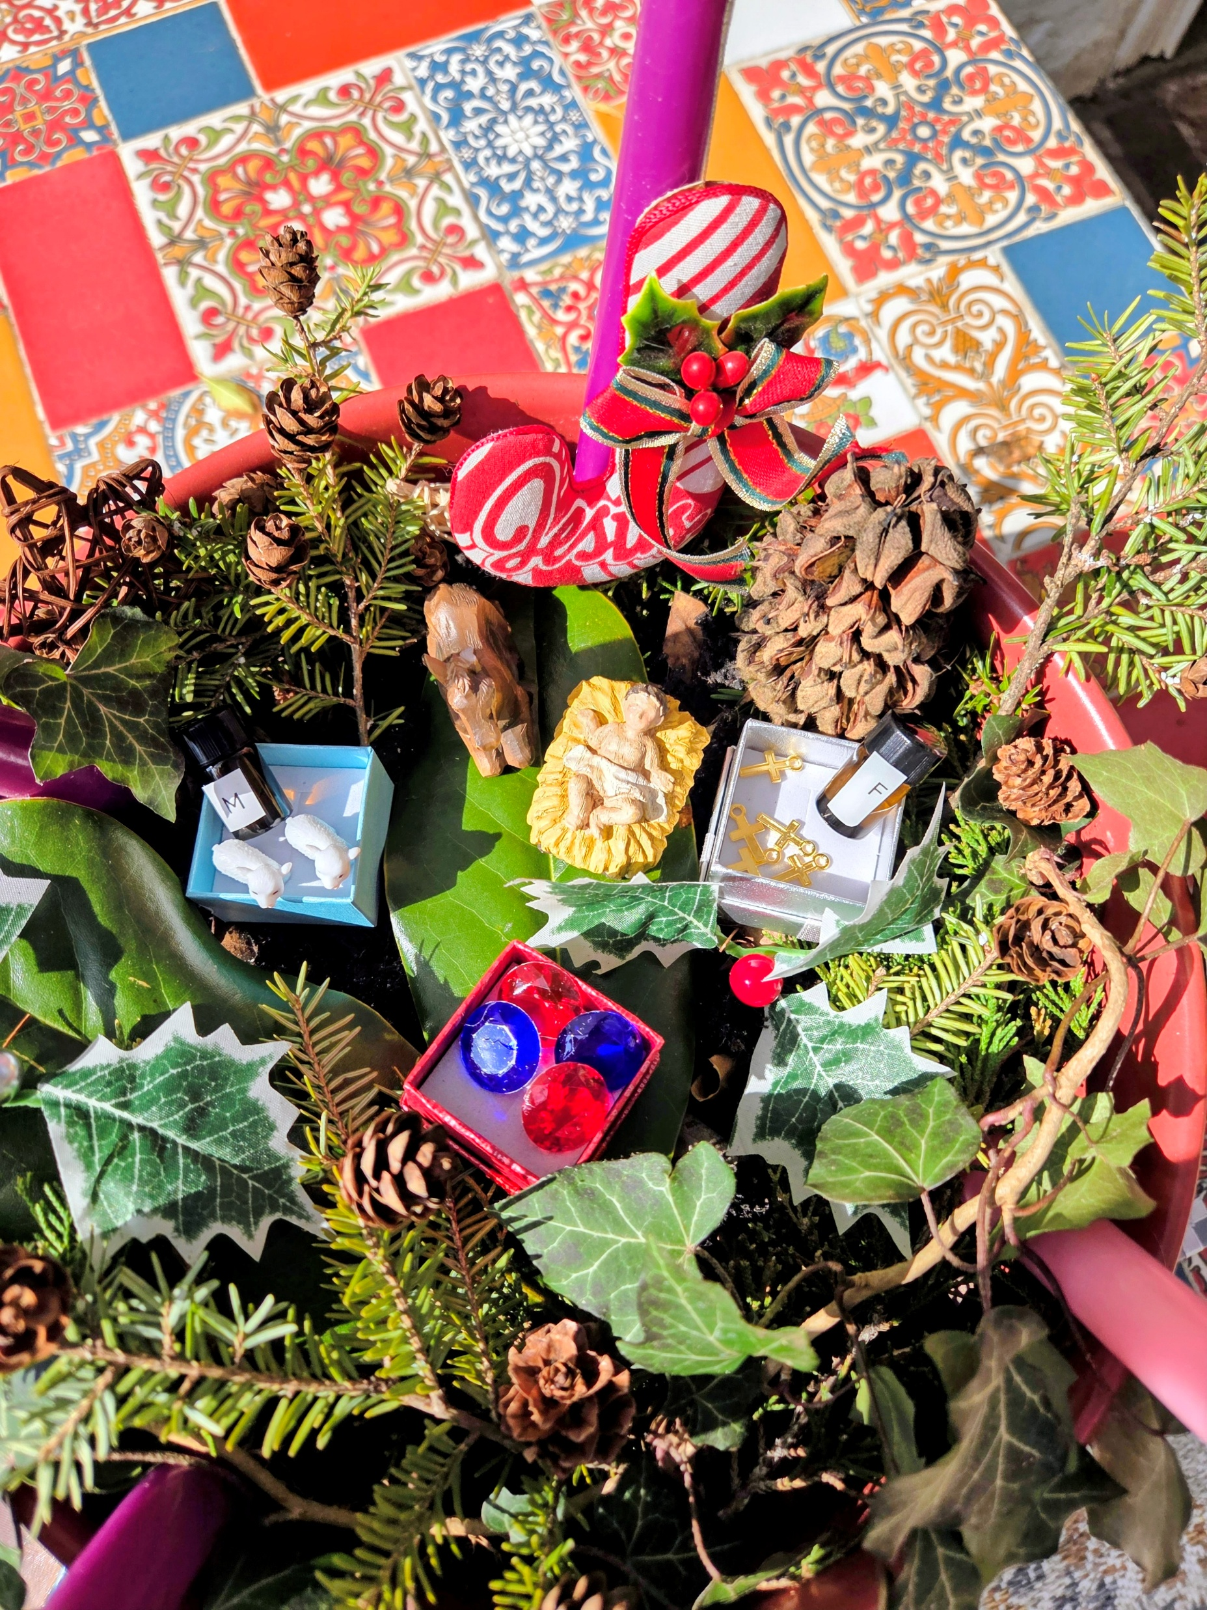
The Three Kings (or Wise Men) brought gifts to baby Jesus to honor him as a special king, not a regular baby. They brought gold to symbolize his kingship frankincense to show he was a divine priest, and myrrh to represent his role as a savior.
Gold (The Gift for a King): Since Jesus was the "King of Kings" the wise men brought him the most precious metal, similar to how a king would be honored.
Frankincense (The Gift for God): This was a special incense used in worship. It symbolized that Jesus was holy and brought people closer to God.
Myrrh (The Gift for a Savior): This was a special oil used for healing or preparing someone for burial. It represented that Jesus came to save the world, showing his role as a loving savior.

Slide 19
Frankincense and Myrrh
Frankincense and myrrh are aromatic tree resins, harvested by cutting tree bark, prized since antiquity for their fragrance in incense, perfumes, and medicine, with frankincense from Boswellia trees and myrrh from Commiphora trees, both used spiritually for purification and historically in rituals like embalming, famously gifted to baby Jesus in the Bible. They symbolize divinity and mortality, respectively, and continue to be used in aromatherapy and traditional medicines for anti-inflammatory and antiseptic properties
The kit comes with two bottles of myrrh and frankincense oils. You can introduce these oils to children in a few ways. For example, pour the oils into the Christmas boxes on the inserts as a symbolic gift to Jesus, just like the three kings did. You can also add the oils to Advent greenery and decorations or use them in a diffuser. This helps children learn about the oils and enjoy their unique scents.

Slide 20
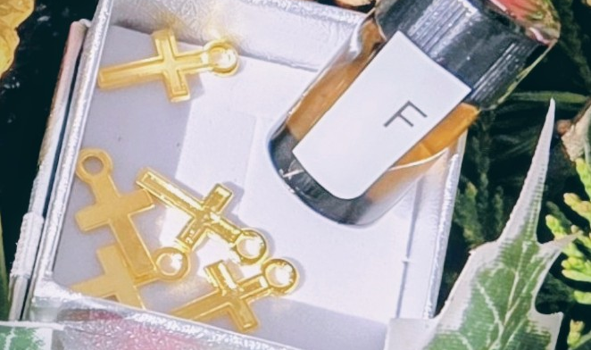
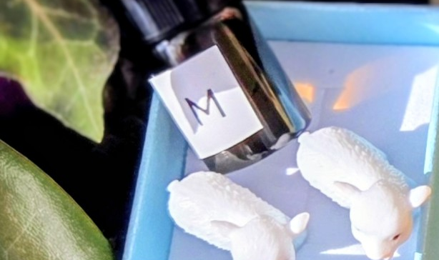
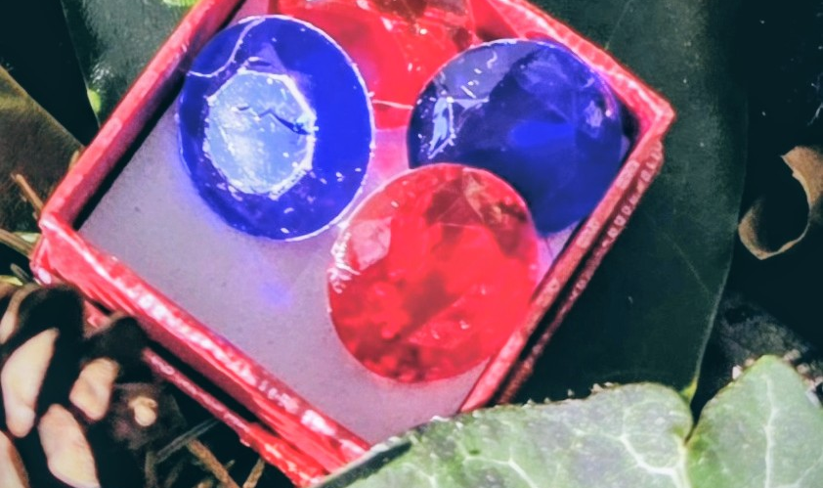
The kit also has jewels, gold crosses, and sheep
Gold crosses
Sheep
Jewels
The cross is one of the most recognized symbols in the world, representing faith, hope, and sacrifice
We will talk about in Next slide
The jewels go in the Christmas present boxes. Even though the kings did not give Jesus real jewels, these stand for royalty.

Slide 21
The representation of sheep during Advent and Christmas—often found in nativity scenes—is a powerful tool to teach children about their relationship with Jesus. Sheep in the biblical narrative symbolize innocence, vulnerability, and the need for guidance, which parallels the Christian belief that followers of Jesus need Him as their protector and leader
2. Jesus the Lamb of God
1. The good Shephard and his Flock.
3. The Shepherds’ message
The Concept: Jesus calls Himself the "Good Shepherd" (John 10:11). Just as a real shepherd knows each of his sheep by name and cares for them, Jesus knows and loves every child personally.
The Lesson: Sheep are not very smart and tend to wander away or get lost. They need a shepherd to keep them safe from danger, guide them to food, and protect them. Similarly, children can learn that they need Jesus to guide them in making good choices, keep them safe, and lead them in love.
Safety: The imagery of the Good Shepherd helps children feel secure, knowing that Jesus is always watching over them
The Concept: In the Bible, John the Baptist calls Jesus "the Lamb of God, who takes away the sin of the world" (John 1:29).
The Lesson: Lambs are gentle, pure, and innocent. During the Christmas story, Jesus is depicted as this perfect, innocent lamb born in a humble manger.
Sacrifice: This teaches that Jesus came to be the ultimate sacrifice who loves us so much that He laid down His life to save us
The Story: In the Christmas story, angels appeared first to shepherds in the fields, not to kings or rich people (Luke 2:8-20).
The Lesson: This shows that Jesus came for everyone, especially the humble and ordinary. Sheep and shepherds are a sign of God’s love for all people

Slide 22
Legend of Manger Herb Plants
(Herb plants of the manger, or Nativity, are not often written about or talked about, even though there was vegetation all around the Bethlehem area, including in Jesus’ birth stable.
My favorite legends tell of lady’s bedstraw, pennyroyal , horehound, thyme , rosemary and lavender as the herbs of the manger.
Legend tells us that while Mary rested, Joseph gathered herbs and grass to line the manger. Among his gatherings was bedstraw, a common stable plant easily found in fields and along roadsides. Farmers fed it to their milk cows to sweeten the milk. It was also used to stuff mattresses and pillows.
Legend points out that it was nothing more than a common weed with white flowers that had no fragrance. However, when the baby Jesus’ head touched the lowly weed it was forever changed. The flowers turned to a golden yellow color, and instantly the foliage had a sweet fresh scent.
Pennyroyal is another plant that Joseph is thought to have gathered for the manger bed. It was considered a weed that was low-growing and did not bloom.
According to legend, Joseph picked it to line the manger because of its minty smell. The little herb burst into bloom at the moment of Jesus’ birth and since then, has bloomed a bright purple flower—the color of royalty. It’s believed that the scents of these flowering herbs were pleasing to Mary, Joseph and Jesus.
Among the herbs Joseph gathered was horehound, with its soft and velvety leaves. It was believed to have healing powers, but also meant sorrows were to come. It was one of the bitter herbs placed on the Passover tables to commemorate the Jewish exodus from Egypt. Horehound is thought to have symbolized Jesus’ roots and foreshadowed a future betrayal.
It’s said that Mary wept when she found the horehound among the manger plants. Supposedly, she tried to remove the herbs, but it was too tightly woven among the other plants and her efforts were unsuccessful. As she picked through the plants, she also found thyme, a symbol of courage and endurance.

Slide 23
Two other herbs of the manger that were to later have a role in this story were lavender and rosemary. When Mary, Joseph, and the baby Jesus fled Bethlehem to escape King Herod’s orders, they ran through a thick field with rosemary to escape the murderous soldiers.
As they made their way through the dense vegetation, legend says that other shrubs crackled and whispered as the family ran through them and tangled their feet. But rosemary shrubs silently parted, then closed the path behind them, preventing soldiers from seeing them.
Being a grateful mother, Mary offered a blessing and spread her cloak over a rosemary shrub. Instantly, the pale flowers were turned into a heavenly blue color.
Once the family was safely beyond Herod’s reach, Joseph and Mary stopped to rest beside a stream. While the baby Jesus slept, Mary rinsed her cloak and Jesus’ clothing in the stream. She then laid the laundry on two shrubs to dry. Both shrubs, lavender and rosemary, were so honored to serve the family that they both stood tall and gave off a fragrance that penetrated and remained in the fabrics the family wore. Again, Mary blessed them, and to this day the plants have a sweet fragrance.
Even today, rosemary is used indoors to freshen the air and to add a holiday scent to rooms. Some families add it to their Advent wreathes as it is still thought to bring good luck throughout the year.
(by Laurie Garretson, a Victoria, Texas, gardener and nursery owner)

Slide 24
Herbs from the Manger story
The kit contains three herbs referenced in the Manger story: rosemary, lavender, and mint. You may use them in any way you prefer. The following suggestions may serve as inspiration:
One option is to place a selected herb in the velvet sachet and store it in a drawer.
Consider constructing a small manger for your Advent pot using sticks, then arrange the herbs as bedding within it.
The herbs may be used to bake rosemary- bread following the provided recipe, and to prepare tea using mint and lavender. Tea bags are included for your convenience.
Alternatively, you may prepare lavender cookies and mint or rosemary tea to commemorate Jesus’ birthday or the final day of Advent.

Slide 25
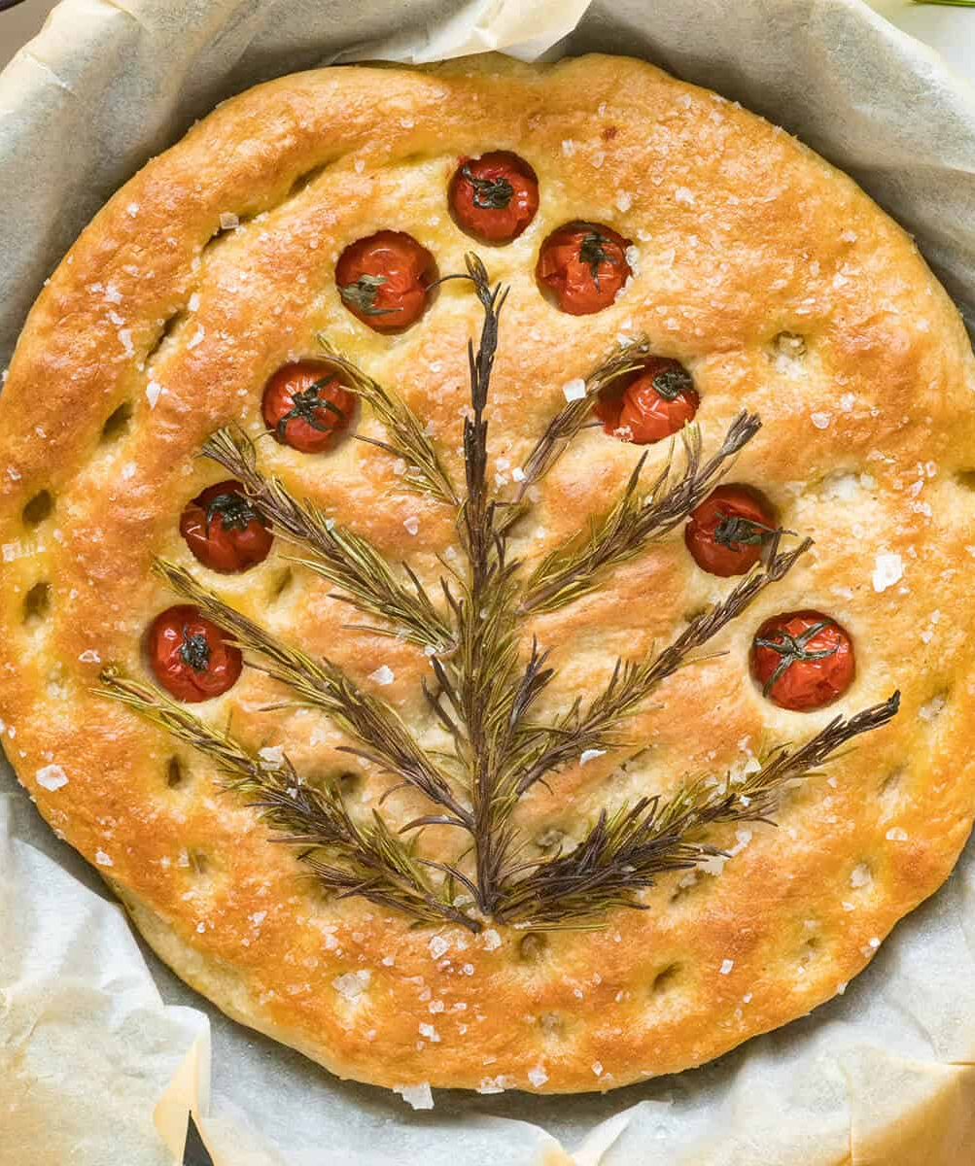
A perfect, festive, and thematic recipe for Advent is a Rosemary Christmas Tree Focaccia, which uses fresh rosemary sprigs to create an edible holiday centerpiece. The bread is savory, fragrant, and visually appealing, offering a cozy, homemade touch to the holiday season
Dough: Prepare a simple dough with 500g flour, 10g instant yeast, 10g salt, 325ml warm water, 3 tbsp olive oil, and 1 tsp honey.
Shape & Assemble: After the dough rises, shape it into a large Christmas tree on a parchment-lined baking sheet.
Decorate: Dimple the surface with fingers, drizzle with olive oil, and decorate with fresh rosemary sprigs to look like tree branches. Add halved cherry tomatoes and olives for "ornaments".
Bake: Sprinkle with flaky sea salt and bake at 425°F
for 25–30 minutes until golden brown
For more detail instructions open website for complete recipe
https://www.lanascooking.com/rosemary-christmas-focaccia/

Slide 26
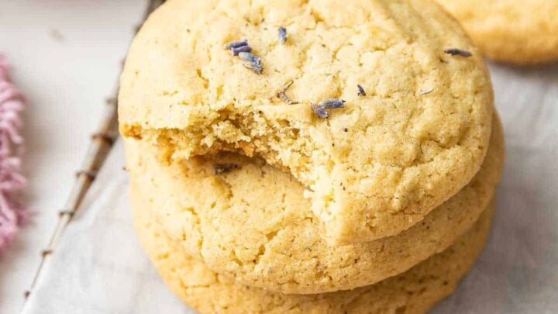
Lavender Cookies
Preheat the oven to 350, and line a small baking sheet with parchment paper (or use a silicone mat).
Place the butter in a microwave-safe bowl and melt it in the microwave in 25 second intervals until fully melted. Keep an eye on it because if it gets too hot, it will splatter.
In a small food processor, combine the sugar and lavender buds and pulse a few times to break the buds into small pieces. Cover the food processor while you pulse so the sugar doesn’t fly out.
Stir together the melted butter, lavender sugar, egg yolk, and vanilla extract. Stir very well to combine.
Next, sprinkle the flour, baking soda and salt evenly over the dough, and stir just to combine.
Press the dough flat and evenly in the bowl and then divide it in half by eye. You should get 3 cookies from each half.
Evenly space the cookies on the prepared baking sheet.
Bake for 10 minutes, until they spread, start to crackle and appear dry on top.
Let the cookies rest on the baking sheet for 2 minutes before moving them to a wire rack to cool completely.
4 tablespoons (2 ounces) unsalted butter, melted
1/3 cup (67 grams) granulated sugar
1/2 teaspoon culinary grade lavender buds
1 large egg yolk (no white)
1/2 teaspoon vanilla extract
3/4 cup (96 grams) all-purpose flour
1/4 teaspoon baking soda
1/8 teaspoon fine salt
For complete recipe go to website-https://www.dessertfortwo.com/lavender-cookies/

Slide 27
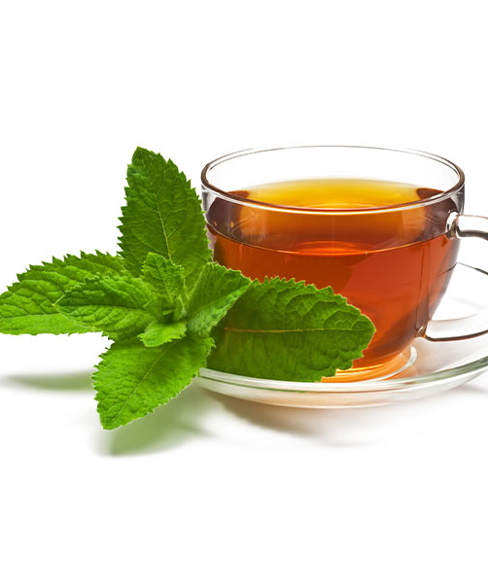
Making Herb Tea
How to Make Herb Tea-
Use any of the herbs from the Herb packet. Enough for tea and other recipes.
Garden fresh (mint, ) is easy to brew and takes no longer than
10 minutes just like any other pot of tea. leaves are soft, herbaceous, and contain a rich and potent supply the naturally derived menthol oil. How to brew Herbal Tea:
1. Using any type of tea infuser or tea bag, add about 3 tsp of freshly dried herb to every 8 oz of boiled water.
2. Allow herb to steep for about 10-20 minutes.
Notes:
Included are 4 tea bags to make your own tea.

Slide 28
https://www.ibelieve.com/holidays/family-prayers-to-pray-each-day-of-advent.html#google_vignette https://www.agoodandjoyfulthing.org/adventwreath https://www.catechist.com/the-lights-of-advent-for-your-students-and-their-families/
Advent Prayer
This Christmas, Lord, come to the manger of my heart.
Fill me with Your presence from the very start.
As I prepare for the holidays and gifts to be given,
Remind me of the gift You gave when You sent Your Son from Heaven.
The first Christmas gift, it was the greatest gift ever.
You came as a baby born in a manger.
Wrapped like the gifts I find under my tree,
Waiting to be opened, to reveal Your love to me.
Restore to me the wonder that came with Jesus' birth,
when He left the riches of Heaven and wrapped Himself in rags of earth.
Immanuel, God with us, Your presence came that night.
And angels announced, "Into your darkness, God brings His Light."
"Do not be afraid," they said, to shepherds in the field.
Speak to my heart today, Lord, and help me to yield.
Make me like those shepherd boys, obedient to Your call.
Setting distractions and worries aside, to You I surrender them all.
Surround me with Your presence, Lord, I long to hear Your voice.

