Slide 1
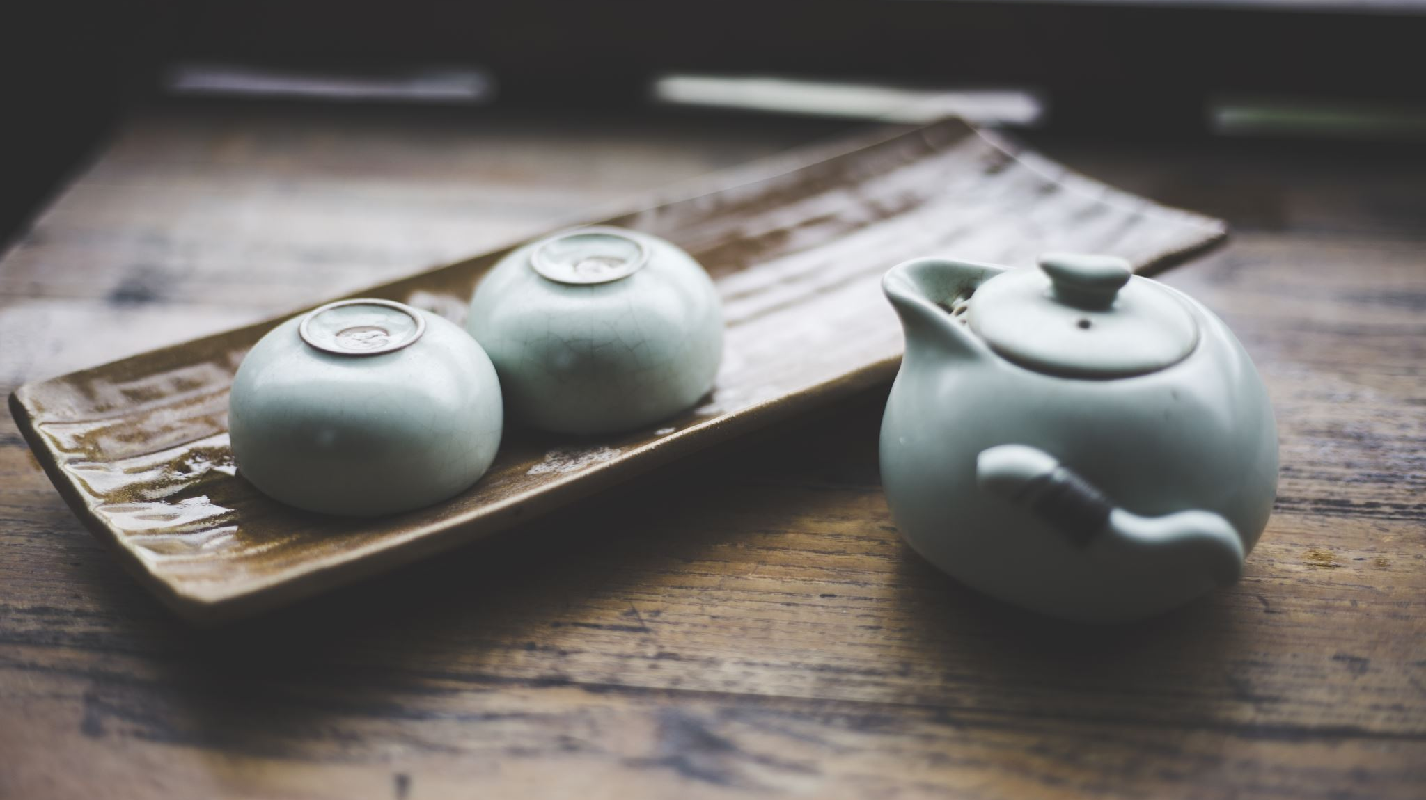
Jane Austen and Tea
Learn about teas during the regency period

Slide 2
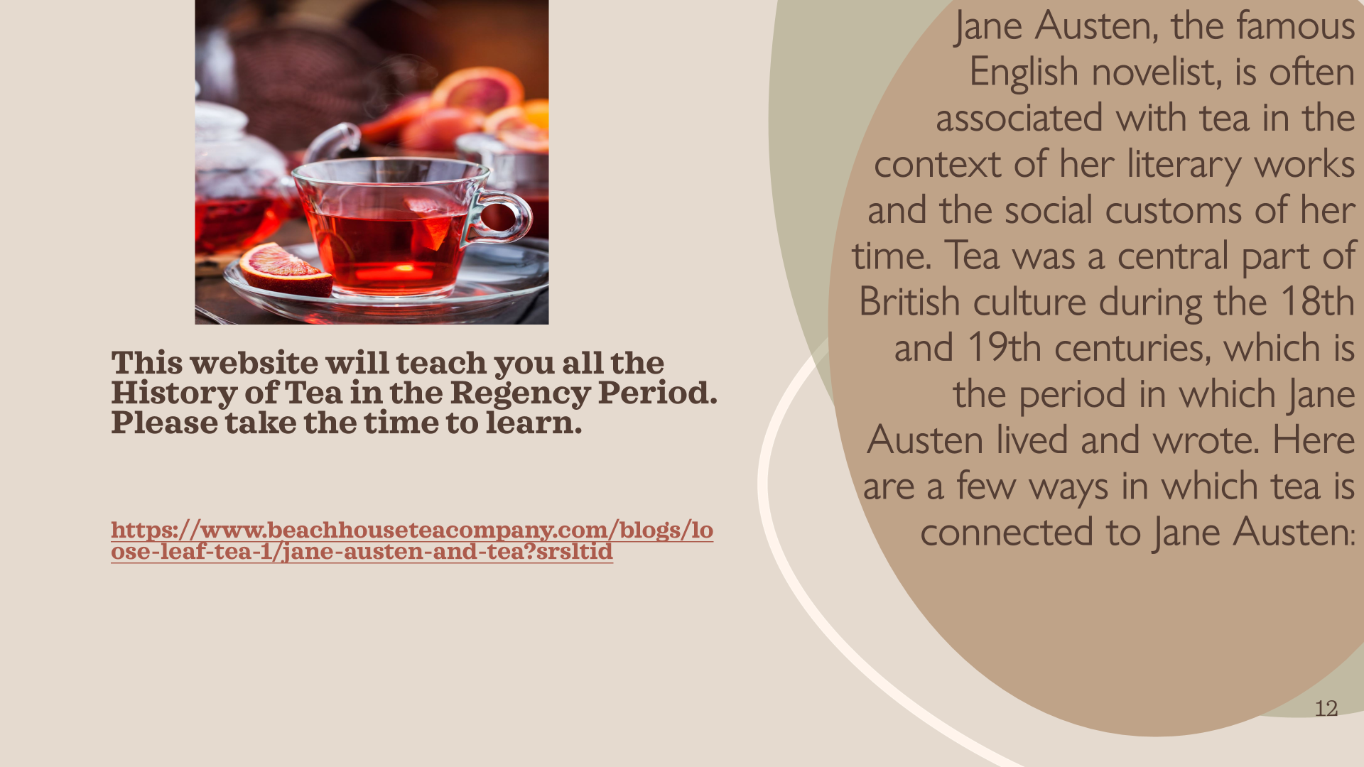

Slide 3

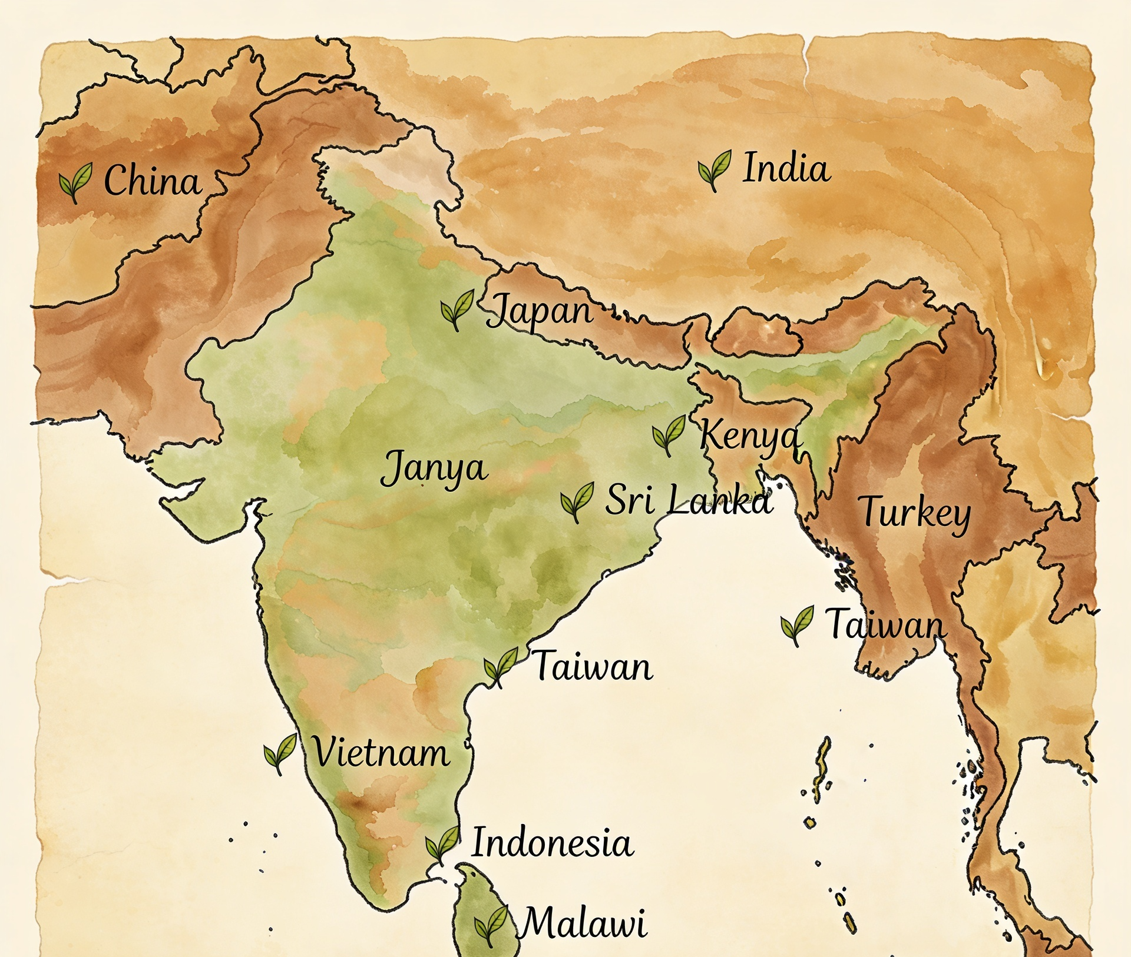
History of Tea
Here’s a fun story about how tea was discovered. In 2737 BC, the emperor of China, Shen Nung, was sitting under a wild tea tree. A breeze blew some leaves into his hot drink, and when he tasted it, he found it delicious. That’s how tea was discovered. People first enjoyed tea in China, and later it spread to Europe, England, the United States, and almost every country in the world.

Slide 4
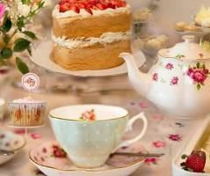
\
This is a fun part of the kit. You learn about tea history, tea etiquette, and how to brew the tea. Now it is time to have a tea party. This is great etiquette whether you are a boy or girl, so encourage all your children to participate.
Along with the tea, a tea party always has foods.
The foods at a tea party, often called tea fare, afternoon tea foods, or tea party treats, generally fall into three categories: delicate finger sandwiches, warm scones with clotted cream and jam, and small sweets/pastries, served on a three-tiered stand in a traditional British Afternoon Tea.
Included is culinary lavender to make cookies for the tea party. Recipe last slide .
TEA TIME
tm

Slide 5
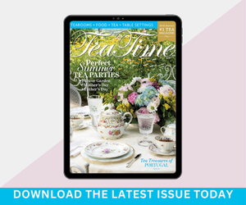
Tea etiquette for children
Great websites for tea etiquette
http://www.tea-happiness.com/2019/01/teaching-kids-through-tea-parties.html
https://www.eastangelharbor.com/blog/tea-hat-blog/little-girls-tea-party-ettiquette
https://youtu.be/nKup3embP0c?si=L3JNNwPrS96vTZMp
https://www.culturekidsmedia.com/videos/tea-time-rules-a-kids-guide-to-afternoon-tea-etiquette-not-high-tea-1/
Etiquette and Manners: Austen's novels are known for their exploration of social etiquette and manners. The rules and customs surrounding tea-drinking, such as how one should pour and serve the tea, were often used to illustrate a character's social standing and manners. Good manners were highly valued in Austen's society.
Manners and Etiquette: The rules of etiquette surrounding tea-drinking provided a microcosm for the broader social norms and expectations of Austen's time. The art of pouring tea, holding a teacup, and engaging in polite discourse were all reflective of one's upbringing and societal standing. In "Emma," for instance, Emma Woodhouse's guidance on tea service at her tea party demonstrates her authority and desire to control social situations
Notes:
Tea Time is a wonderful magazine to teach children tea etiquette, craft ideas, recipes, tea infusions, table settings, and even tea retreats.
Afternoon tea teaches children manners, planning, etiquette, appropriate dress, and handling precious things carefully.
https://teatimemagazine.com/what-afternoon-tea-teaches-our-children/

Slide 6
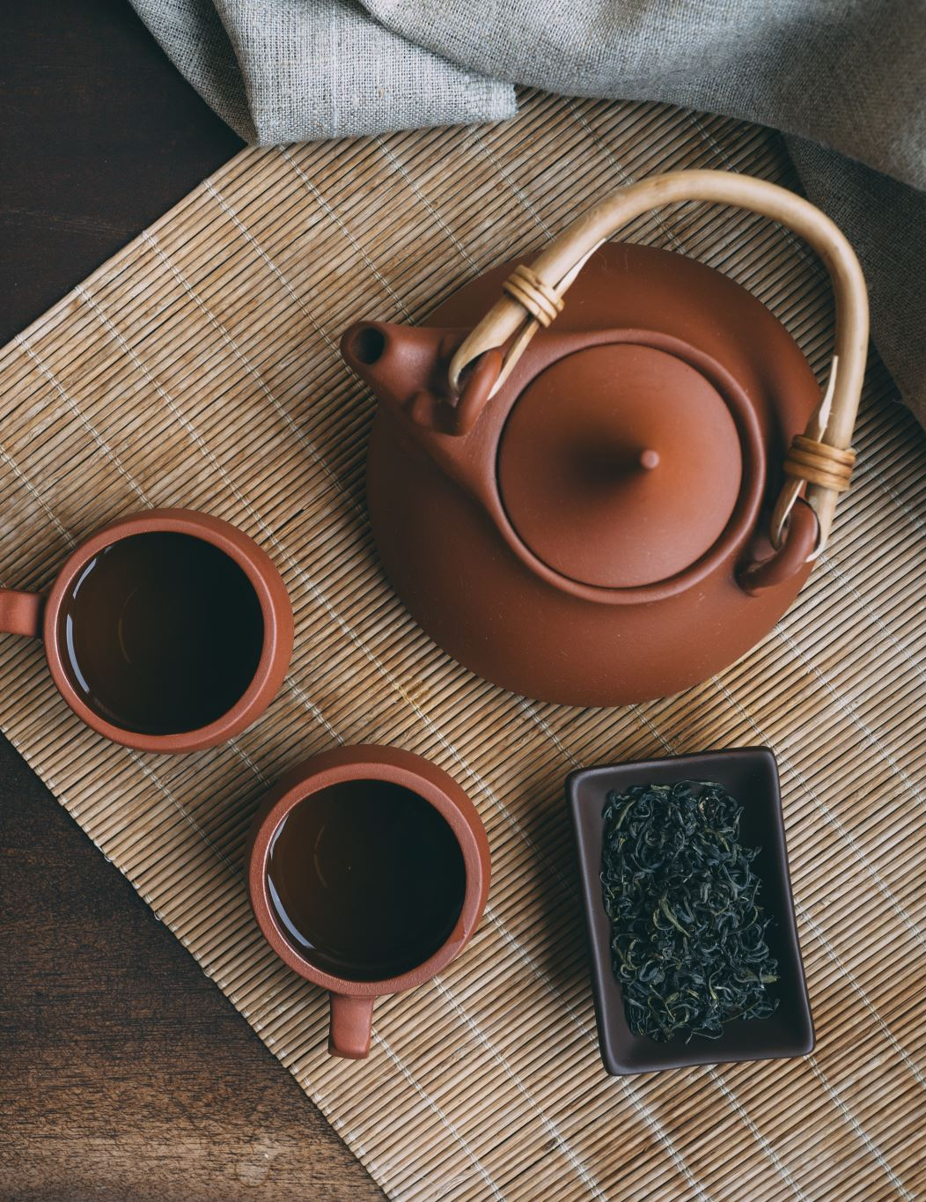
Tea Etiquette
Take small bites
Talk in a quiet voice
Put sugar, milk, or lemon in the cup after the tea has been poured and not before. Lemon should not be used with milk
Place the spoon on the saucer, not the table.
Sip the tea and don’t slurp
Wait for the host or older person to pick up their napkin first. Then you can. Place it in your lap with the crease towards your waist.
Don’t talk with food in your mouth.
Don’t put your elbow on the table.
Don’t push your plate away when you are finished
Write a thank you note to the person who invited you.

Slide 7
Tea Etiquette with the table.
Etiquette in Society, in Business, in Politics and at Home, published in 1922, specifies that a properly arranged tea tray should include a kettle already boiling with a lamp underneath, an empty teapot, a caddy of tea, a tea strainer, a slop bowl, a cream pitcher, a sugar bowl, and lemon slices on a glass dish. Additionally, a stack of matching cups and saucers, small tea plates, and a folded napkin on each plate are required. For food, one dish should contain hot bread, another sandwiches, and a third cake. The use of a tea table or a stand with three small shelves is recommended, with the top plate covered.

Slide 8
Preparing the Tea
Fill a kettle with fresh cold water and bring it to a boil. Add one teaspoon of tea leaves per person, plus one additional teaspoon for the pot, to the warmed teapot.
1
Once the water reaches a rolling boil, pour it over the tea leaves in the teapot.
2
Allow the tea to steep for 2 to 5 minutes, depending on the desired strength and the type of tea. Place a pitcher of hot water on the tea tray so guests who prefer a milder cup can dilute their serving.
3

Slide 9
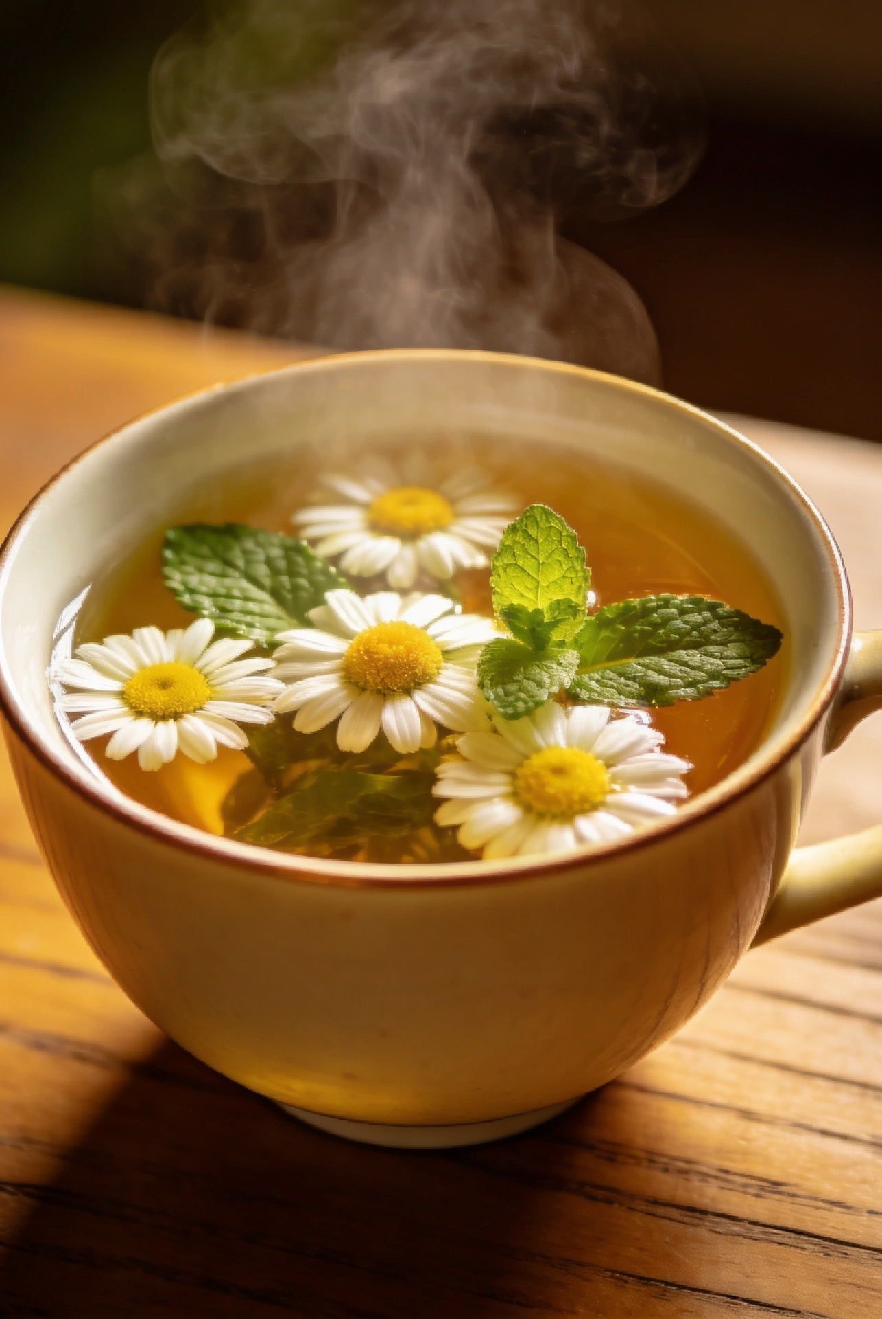
Making Herb Tea
How to Make Herb Tea-
Use any of the herbs from the Herb packet.
Garden fresh (mint, chamomile . Lemon balm) is easy to brew just like any other pot of tea. Leaves are soft, herbaceous, and contain a rich and potent supply the naturally derived menthol oil. How to brew Herbal Tea:
Using any type of tea infuser or tea bag, add about 3 tsp of freshly dried herb to every 8 oz of boiled water.
. Allow herb to steep for about 10-20 minutes.
Notes:
Included are 4 tea bags to make your own tea.

Slide 10
Serving the Tea
Traditionally, the hostess both prepares and serves the tea.
Each cup is poured through a tea strainer to capture loose leaves and is handed to a guest before the next cup is poured.
Guests may then add milk or a lemon slice to their cup. Milk is typically added to black tea, while lemon is preferred with green tea.
Sugar is added last, and the tea is then stirred. Once the sugar has dissolved, the spoon is placed back on the saucer. The saucer should always remain on the table when the cup is lifted to drink.
The cup is held with the thumb and index finger meeting in the handle, with the handle resting on the middle finger.
The little finger should never be held upright, as this is considered impolite.
Finally, tea is sipped rather than gulped, and the cup is returned to the saucer between sips.

Slide 11
British and Herbal teas

Slide 12
British Teas
Traditional caffeinated teas are produced from only two varieties of the tea plant. The diversity of tea types results from differences in leaf processing and blending methods.

Slide 13
Tea characteristics
Green tea originated in China and subsequently spread to various countries across Asia. Its production requires minimal processing, typically involving drying or steaming the leaves followed by rolling. ( Included in tea kit)
White tea is the most delicately flavored among the five primary types of tea. It is produced from immature leaves and young buds covered with fine white hairs, which are hand-harvested before fully opening and then minimally processed by rapid drying.
Black tea, in contrast, is generally the most flavorful. Its production involves four stages: the leaves are heavily withered, slightly rolled, fully oxidized under controlled temperature, and finally dried to halt the oxidation process. ( Included in tea Kit)
Oolong tea leaves are partially oxidized and fermented under controlled temperatures. After this process, the leaves are curled and twisted to achieve their distinctive shape.

Slide 14
Herbal Teas
Herbal teas—also known as tisanes or herbal infusions—are beverages made by steeping dried or fresh herbs, flowers, fruits, barks, or roots in hot water

Slide 15
Herbal teas in Kit
Chamomile
Peppermint
Hibiscus
popular, caffeine-free herbal remedy known for promoting relaxation and sleep. Beyond sleep support, its natural antioxidants and anti-inflammatory properties provide relief from digestive and can help stabilize blood sugar.
Digestive Relief: The menthol in peppermint relaxes the muscles in the gastrointestinal tract, which can ease bloating, gas, indigestion, and stomach cramps. Sinus & Congestion: Its natural menthol acts as an effective decongestant, helping to clear airways and soothe a scratchy throat when you are sick or dealing with allergies.
Pain & Cramping: a natural muscle relaxer, sipping the tea can help reduce the intensity of tension headaches
A vibrant, tart, and naturally caffeine-free herbal brew loaded with antioxidants. It is highly regarded for its potential to lower blood pressure, reduce inflammation, support heart health, and promote overall metabolic wellness

Slide 16
Tea with Jane Austen
Recipes inspired by her Novels and letters

Slide 17
Buttered Apple Tart
The Buttered Apple Tart popularized by Jane Austen fans comes from the novel Emma, where health-conscious Mr. Woodhouse urges Miss Bates to try a slice. The modernized recipe, often featured in culinary books like Dinner with Jane Austen or Tea with Jane Austen, relies on stiffly beaten egg whites for its light, fluffy, and egg-set custard filling.
For tips on how to properly beat and fold the egg whites and achieve the right consistency for this Regency-era dessert:
Recipe- https://coolfooddude.com/2024/02/18/buttered-apple-tart/
Video- https://www.youtube.com/watch?v=Sy3Vx1VMt_w

Slide 18
Ingredients
1 cup unsalted butter (softened to room temperature)
½ cup powdered icing sugar
¼ cup cornstarch
1 ½ cups all-purpose flour
Instructions
Cream the butter: In a stand mixer fitted with the paddle attachment or using a hand mixer, whip the softened butter until it is completely smooth and creamy.
Add dry ingredients: Sift in the powdered icing sugar and cornstarch. Mix on low until fully incorporated.
Add the flour: Slowly add the all-purpose flour until the dough just comes together into a soft, velvety texture. Be careful not to overmix at this stage.
Shape: This dough does not require chilling. Use a small cookie scoop to drop rounded dough balls onto a parchment-lined baking sheet.
Decorate: Gently press each cookie down with a fork lightly dusted in flour to create a textured pattern. You can also top each with half of a glazed cherry or a chocolate drizzle.
Bake: Preheat your oven to \(375^{\circ}\text{F}\) and bake for 12 to 15 minutes. Take them out right around 12 minutes to ensure the bottoms don't overbake and the cookies stay pale.
Cool: Let them cool on the baking sheet for a few minutes before transferring to a wire rack
This classic, melt-in-your-mouth whipped shortbread recipe only requires four simple pantry ingredients. It yields a light, tender cookie with a delicate, silky texture that melts on the tongue.

Slide 19
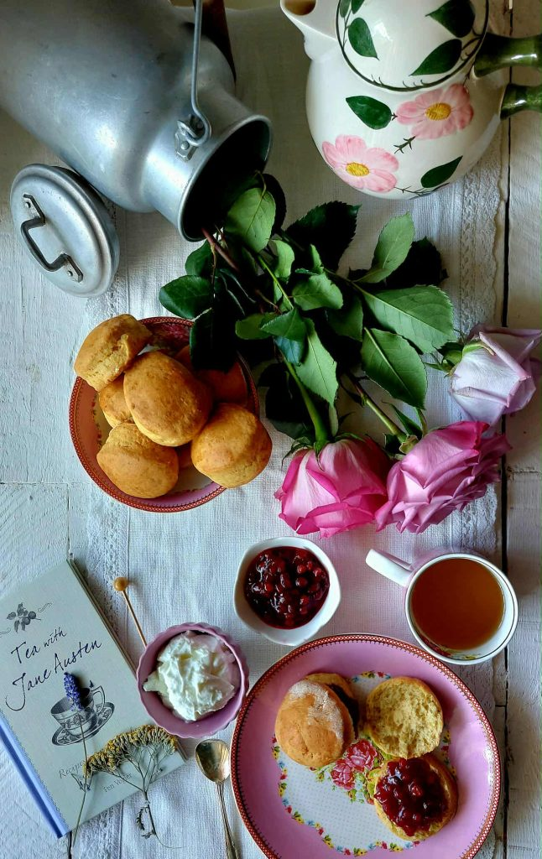
Clotted Cream Scones
Very popular during Regency period and still today on every British Tea Party
https://www.momlovesbaking.com/clotted-cream-scones-downton-abbey-style/
https://www.bbcgoodfood.com/recipes/classic-scones-jam-clotted-cream
https://toriavey.com/clotted-cream-scones/

Slide 20
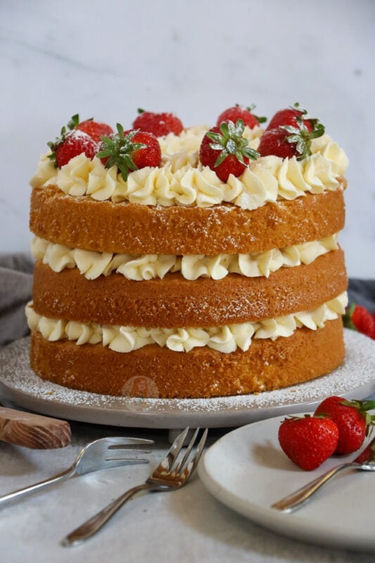
Victoria Sponge Cake
A coronation Victoria sponge with freshly whipped cream, strawberry jam and a dusting of icing sugar – perfect for King Charles Coronation!
There are endless versions… buttercream and jam, buttercream and fruit, cream and fruit, just jam, and cream and jam
https://www.janespatisserie.com/2023/04/21/coronation-victoria-sponge/
https://www.janespatisserie.com/2015/04/13/victoria-sponge-celebration-cake/

Slide 21
Disclaimer And Liability Clause
"This product is provided 'as is' and 'as available' for informational and educational purposes only. Knollwood Agriculture makes no warranties, express or implied, regarding its safety, reliability, or performance. By using this product, you acknowledge and agree to assume full responsibility for any risks, injuries, or damages, and agree that Knollwood Agriculture shall not be liable for any direct, indirect, or consequential losses arising from its use or reliance on any information provided. Use is at your own risk
"These statements have not been evaluated by the FDA. This product is not intended to diagnose, treat, cure, or prevent any disease. Always consult a qualified healthcare professional before using this product, especially if you have pre-existing medical conditions or are pregnant/nursing. Use at your own risk. [Your Company Name] accepts no liability for any adverse effects or damages resulting from the use or misuse of this product
All herbal teas are sourced from reputable companies that claim their products are organic and tea liners are nontoxic, no microplastics or GMO . Knollwood Agriculture does not grow the herbal teas included in this packet.
This kit is intended for educational use only. Please follow the instructions provided. Knollwood Agriculture is not responsible for misuse or individual choices.
Parents and guardians are responsible for addressing any family concerns about allergies, medical reactions, or pre-existing medical conditions.

