Slide 1

Knollwood Pollinator Garden
For every child, best from 3-9 years old

Slide 2
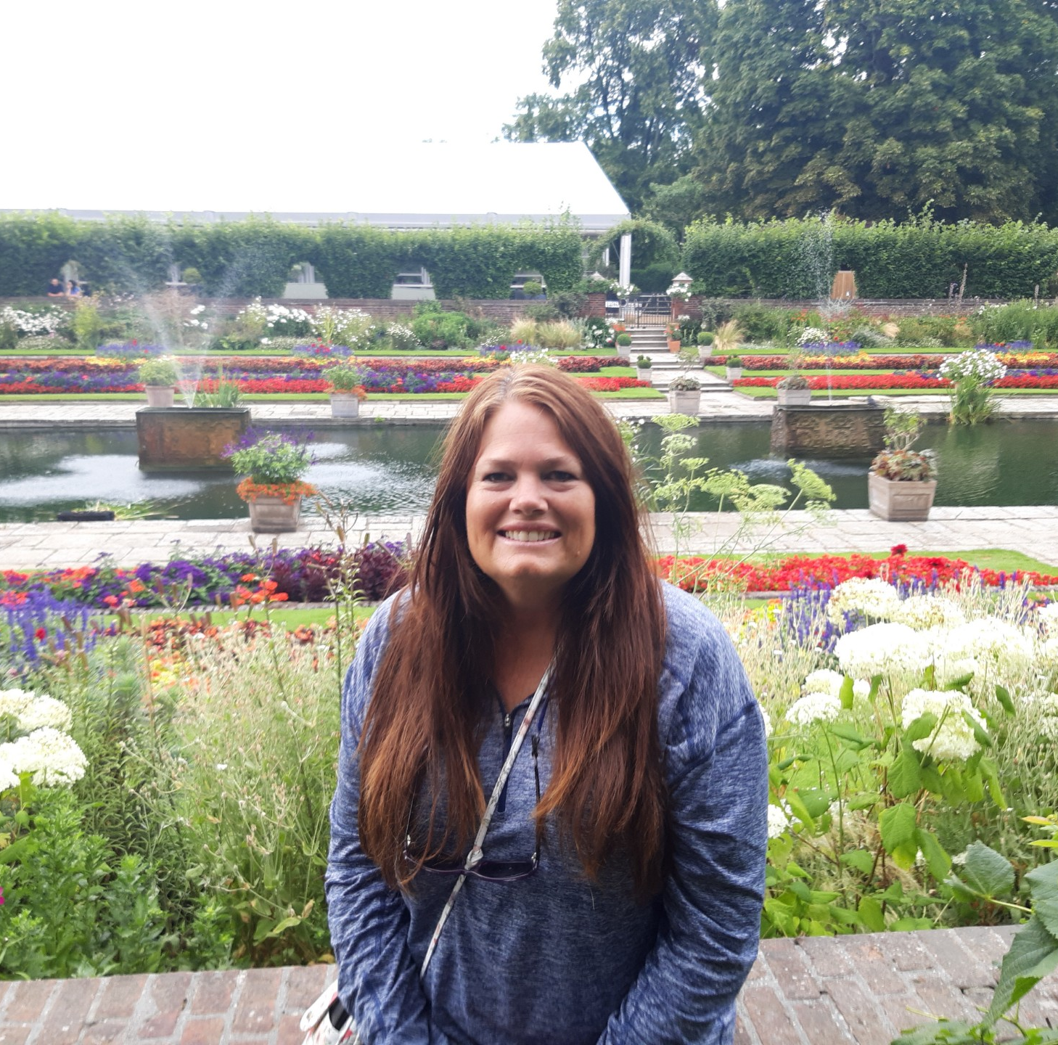
Hello, my name is Amy Perry, and I live in Bedford, Virginia. Since 2012, my family and I have enjoyed life on our 12-acre farm, where our house was built in 1810. I spend a lot of time gardening, growing vegetables, fruit trees, and herbs, and caring for three flower beds. My favorite part is working with herbs and produce, especially when I get to harvest, can, and make fermented foods. I also raise chickens and keep bees. Before moving here, I lived in Sarasota, Florida, for 19 years and homeschooled my two sons. My faith in the Lord, my love of homeschooling, and my passion for gardening inspired me to create these Agriculture Kits. I hope you enjoy using them as much as I enjoyed creating them.

Slide 3

Learning about pollinators and what they need to survive
Diverse food source
Water sources
Shelter and nesting

Slide 4
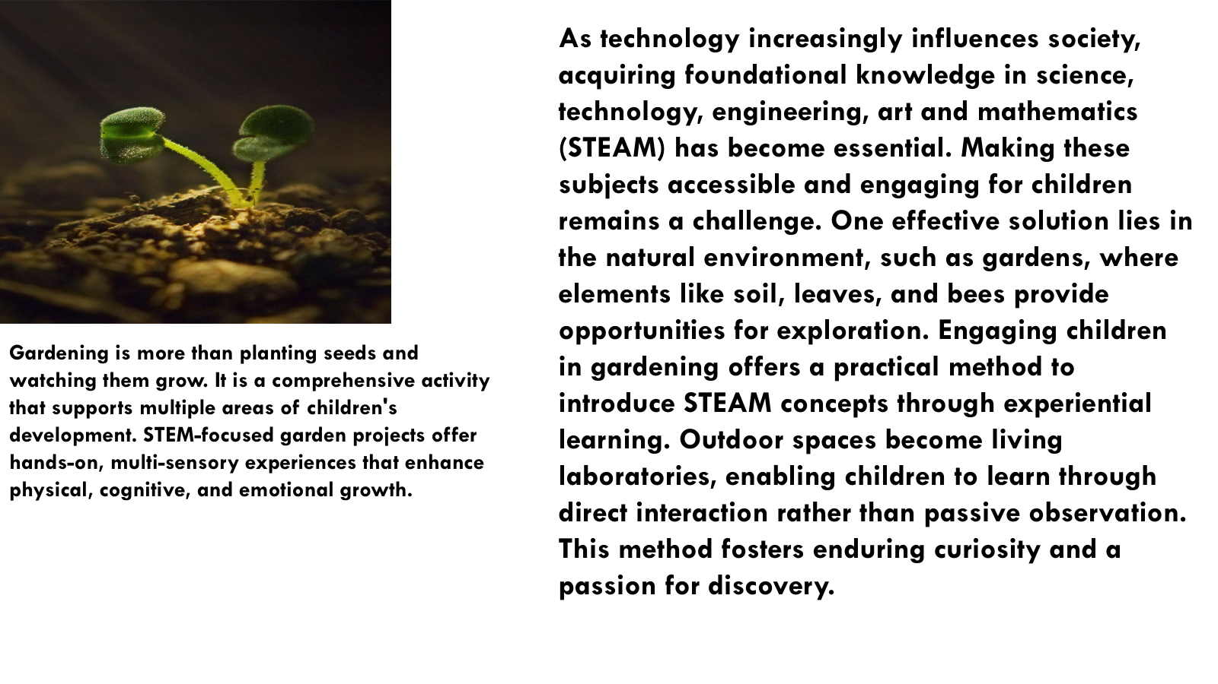

Slide 5
What are pollinators and Why do we need them?
Honeybees, butterflies, birds, bats, and other animals play a crucial role in nature by pollinating many of the foods we enjoy, such as apples, bananas, blueberries, strawberries, melons, peaches, potatoes, vanilla, almonds, coffee, and chocolate.
Did you know bats help make chocolate? Imagine that the next time you bite into a chocolate bar!
Pollinators are organisms that transfer pollen from the male structures of flowers (anthers) to the female structures (stigmas), facilitating plant reproduction. This makes them vital to the health of our ecosystems.
As pollinators search for food like nectar and pollen, they visit flowers and often transfer pollen from one flower to another without realizing it. This process helps plants produce fruits and seeds.
That means one out of every three bites of food you eat depends on them. More than 3,500 native bee species help boost crop yields.

Slide 6
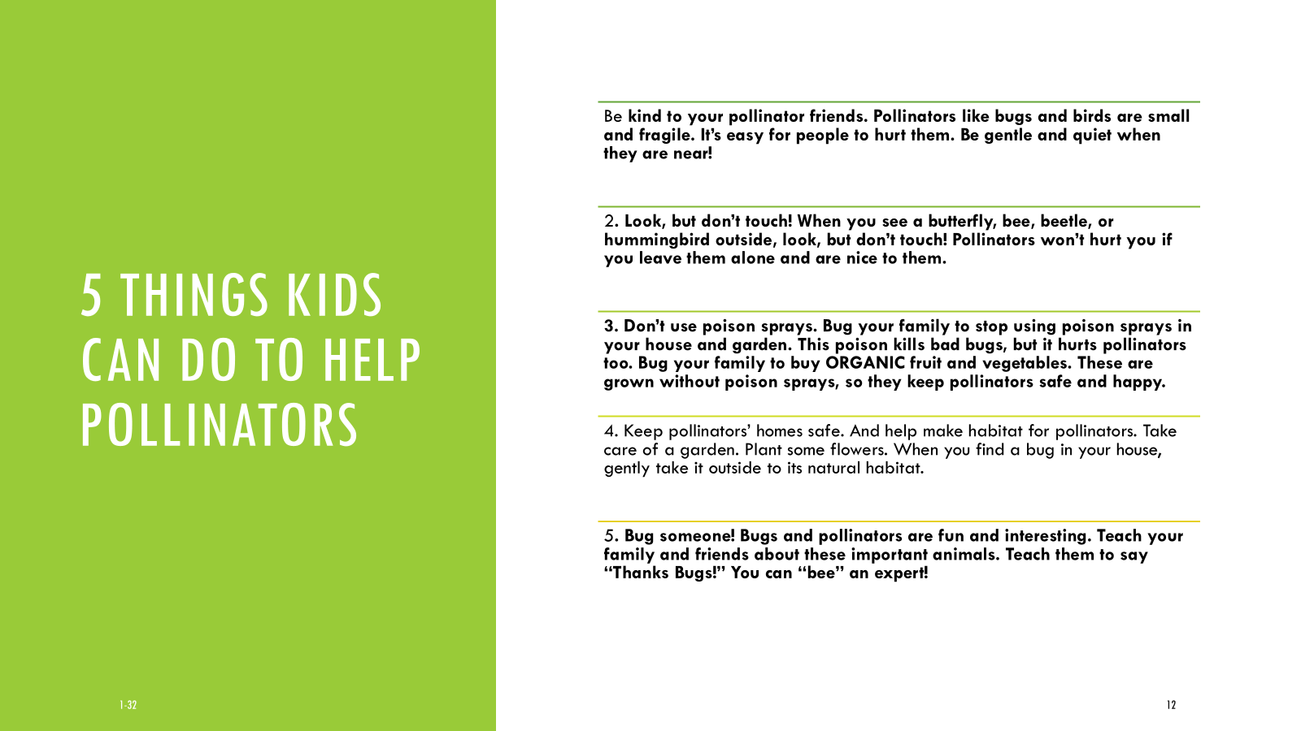

Slide 7
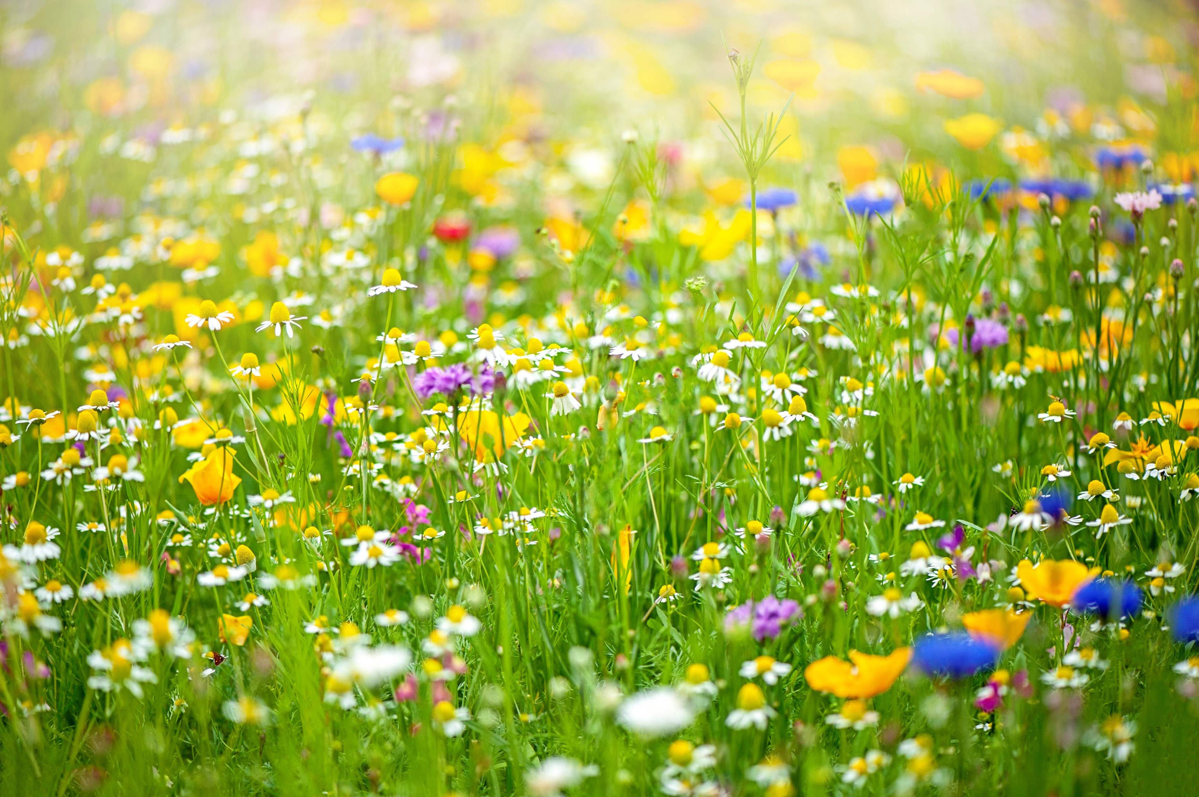
Planting wildflowers
Wildflowers
Symbolism of God's Provision: In a spiritual context, wildflowers were sometimes seen as a symbol of God's provision and a reminder not to worry about basic needs.
Activity: Growing for Pollinators
This activity is a great way to learn about why biodiversity and the connections between plants and animal's matter.
What you need:
Wildflower seeds or seeds for pollinator-The red envelope holds the seed, just find an area for wildflowers, plant the whole package and water.
How to do it:
Planting: Clear and area of grass and weeds. Lay down a layer of soil. Sprinkle the whole packet evenly. Take a raking tool and gently press down, Do not cover, Water so seeds hold. Best not to do on a windy day.
When the flowers start to bloom, ask your child to sit quietly and watch. Which insects come to visit? How many kinds of bees or butterflies can they spot?
Invite your child to draw the insects and flowers, paying attention to their colors, sizes, and what they do. Talk together about how insects help plants and how plants give food to insects. This helps kids see how important pollinators are for our food and the environment.
Notes:
https://www.thespruce.com/wildflower-gardening-1403564
Simple Steps for Kids:
Pick a Spot & Clear It: Choose a sunny spot (6+ hours of sun). Remove all weeds and grass to make a small patch of bare soil.
Mix & Scatter: Mix your seed packet with 4-5 times as much sand. This helps children see where they have sown and ensures even spreading.
Spread the Seeds: Walk across the area scattering the seed/sand mix, then do it again walking in the opposite direction (cross-hatching).
Press Down (Don't Bury): Do not cover seeds with soil, as many need light to grow. Have children walk, jump, or press on the area to press seeds into the soil.
Water & Wait: Gently water the area and keep it moist until seedlings appear.
American Meadows +4
Quick Tips:
Best Time: Plant in spring (last frost) or autumn.
Keep it Local: Buy native wildflower seeds to attract local bees and butterflies.
Make it Fun: Use a hand-drawn map to mark where you planted!

Slide 8
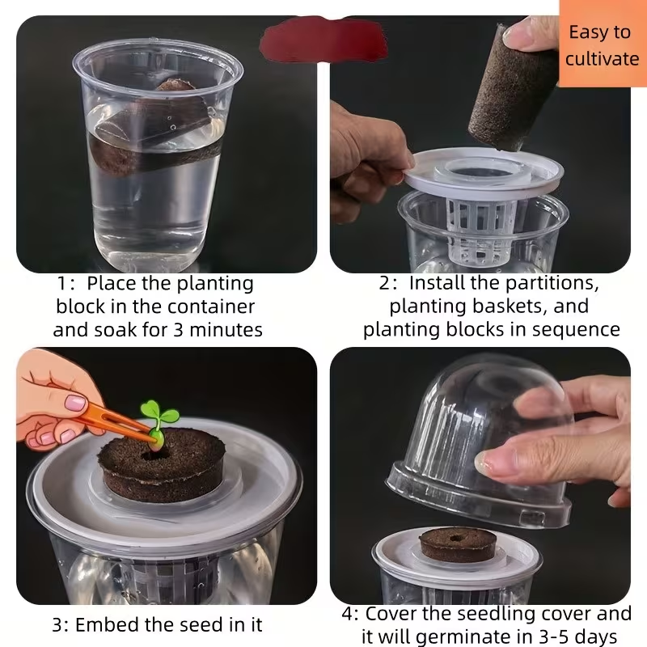
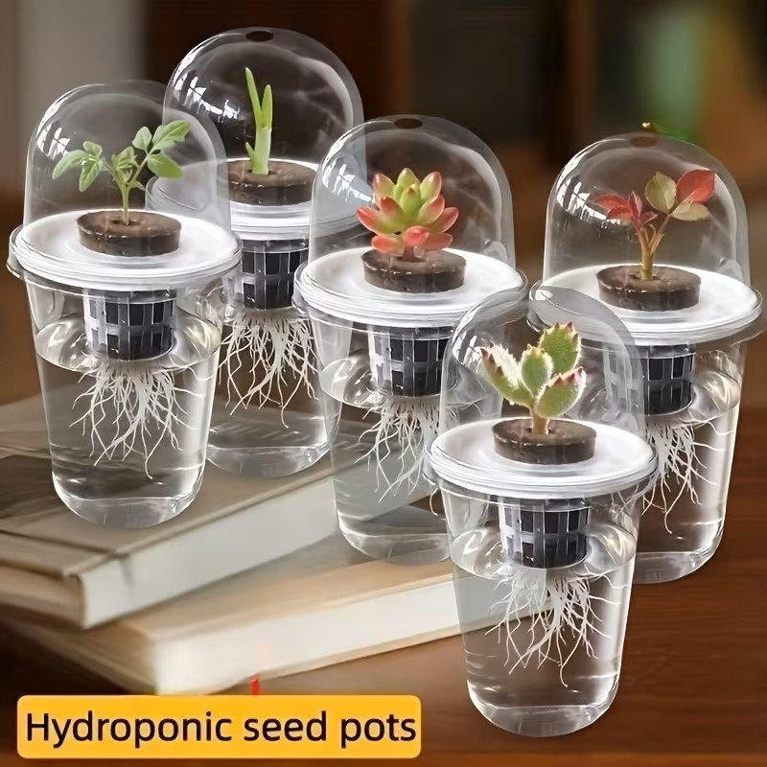
Growing hydroponic lettuce is a Growing hydroponic System
Growing hydroponic lettuce is an excellent, fast-paced STEM activity for children, allowing them to see roots grow in water and harvest fresh leaves in about 4–7 weeks. Using simple setups like nutrient-filled jars or small Kratky systems, children can learn about plant biology, food sustainability, and nutrition.
Benefits for Children:
Faster Growth: Lettuce grows quicker hydroponically than in soil.
Education: Teaches sustainability, plant biology, and promotes healthy eating.
Cleanliness: No soil makes for a cleaner indoor activity.

Slide 9
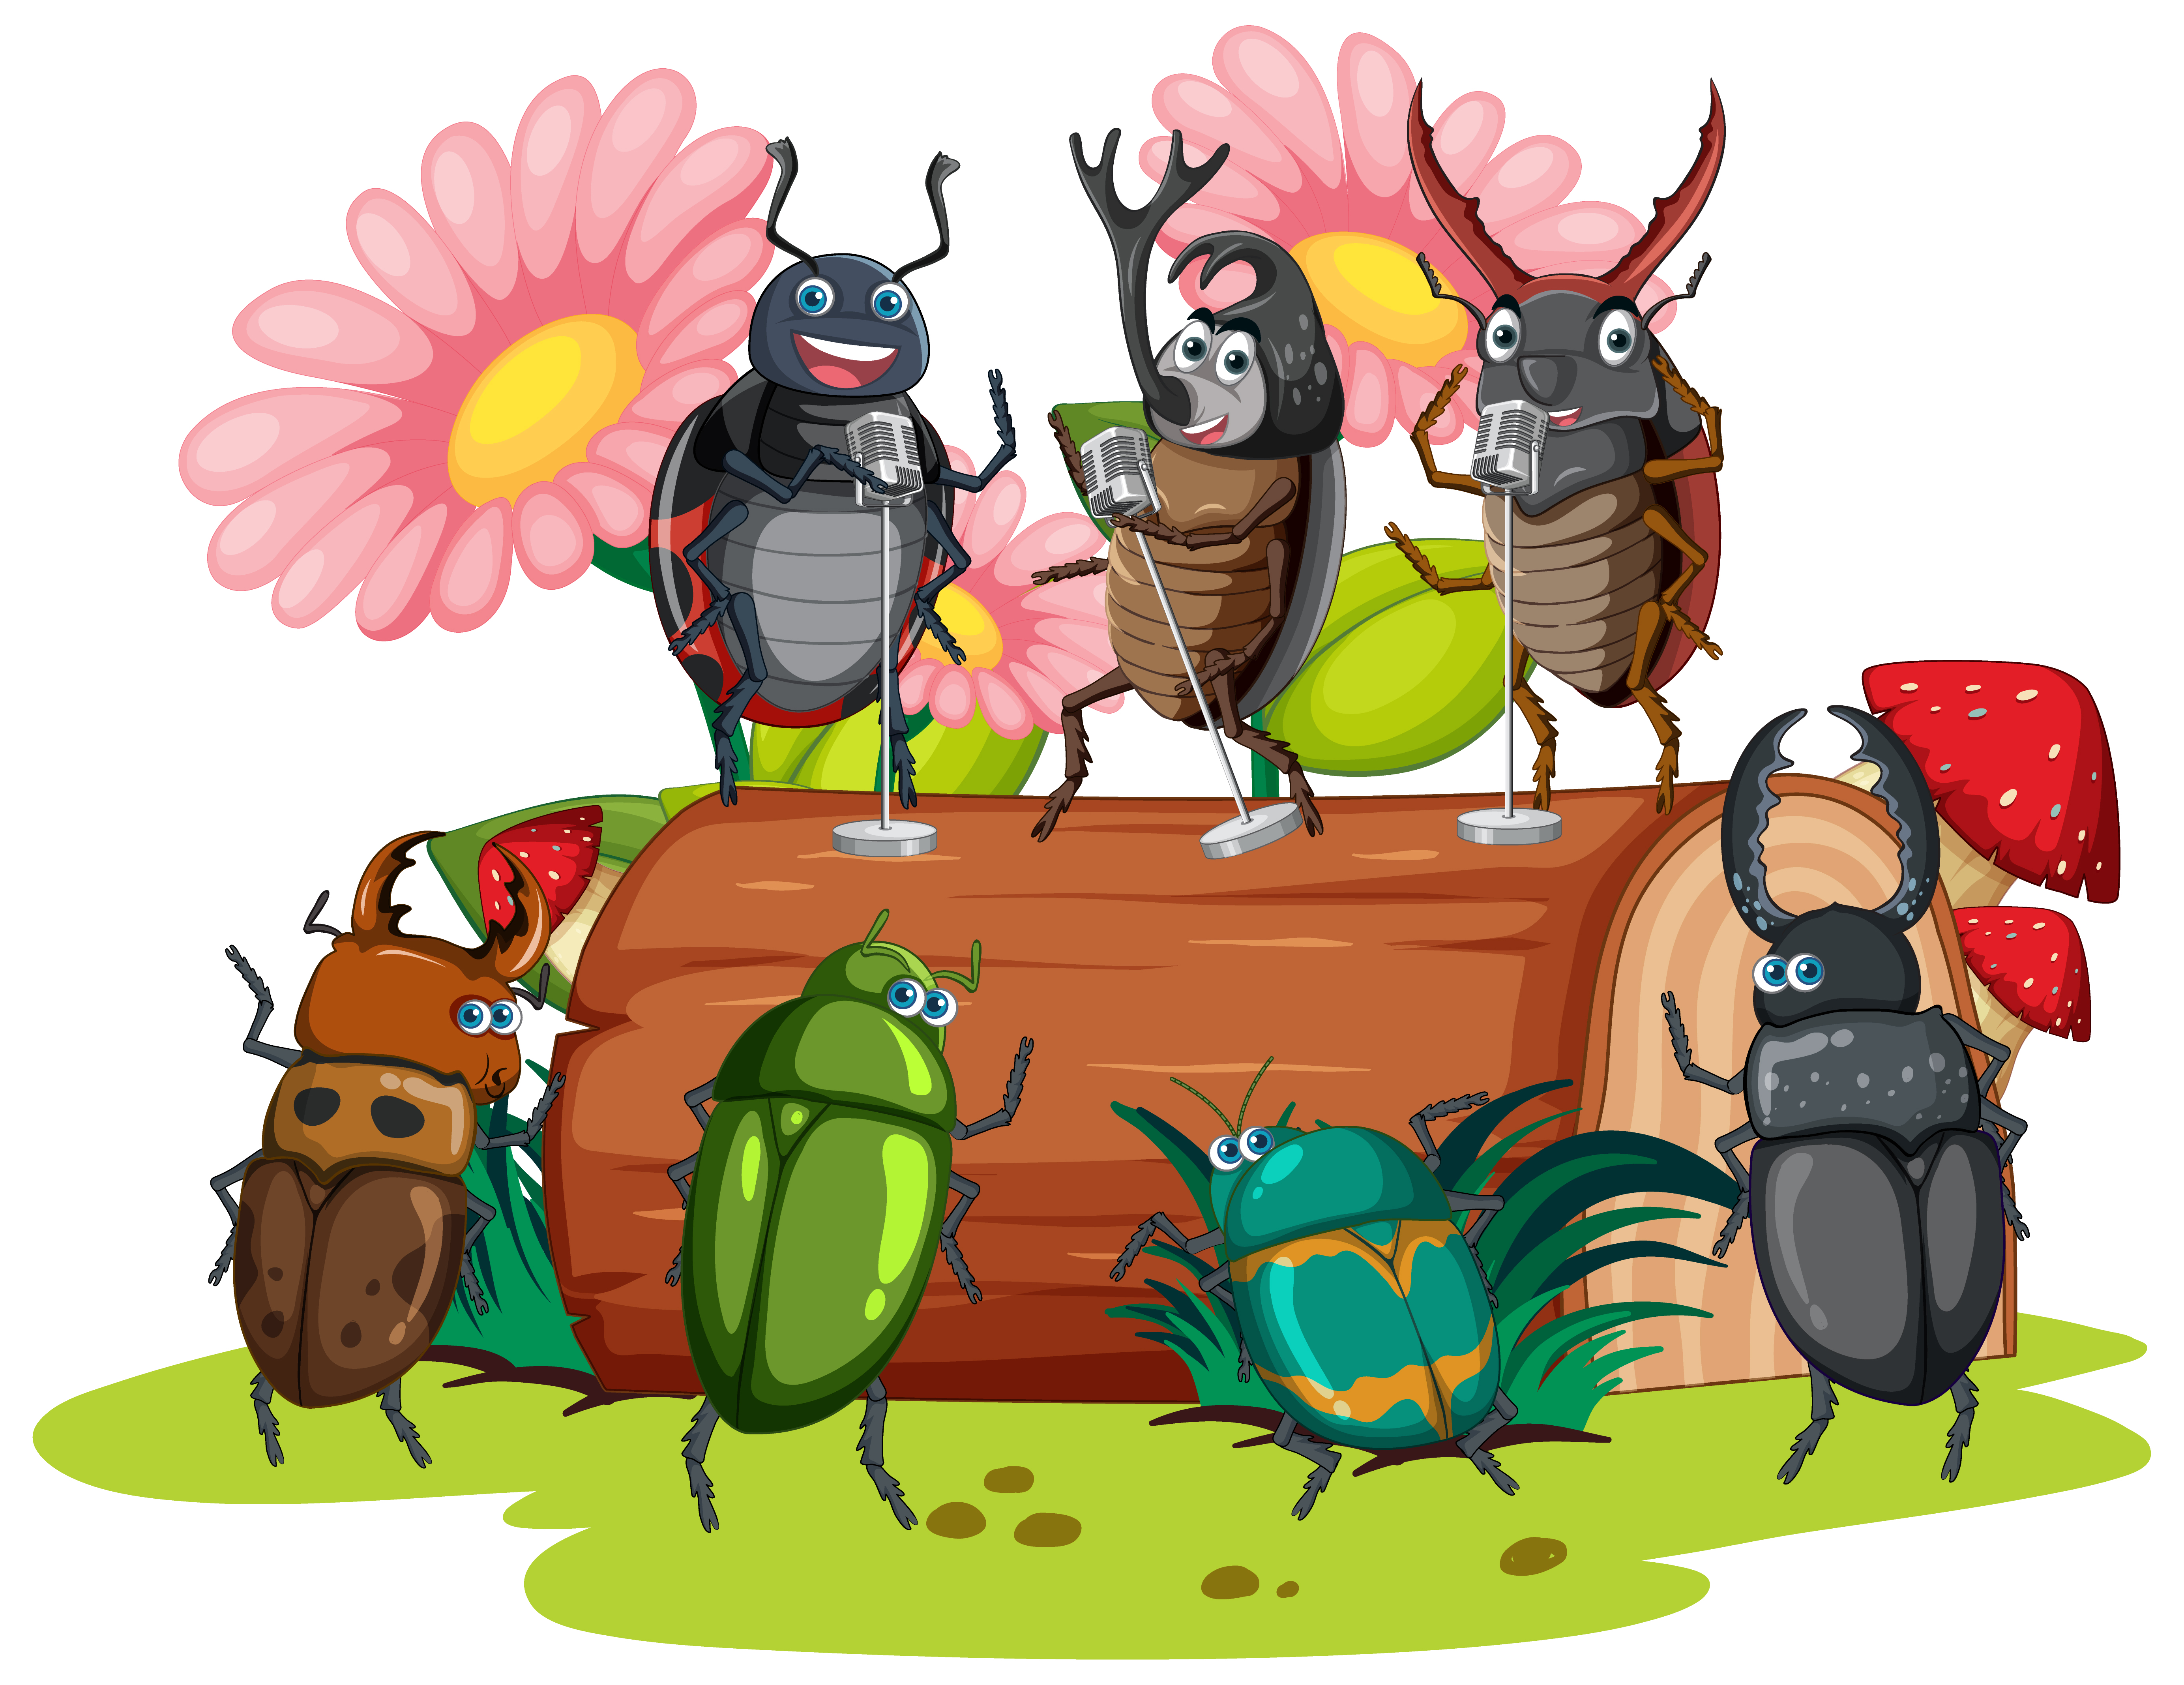
incidental pollinators. While primarily known as predators that eat pests, they also consume pollen and nectar, transferring pollen between flowers as they move. .
Included in the kit is a bug container . This is a great activity to catch a pollinator and study it up-close and learn more about the insect.
Great field guide when you catch your insects and study them.
https://lsa.umich.edu/content/dam/ummnh-assets/ummnh-docs/UMMNH_BugFieldGuide_2021.pdf

Slide 10
Introducing a few pollinators
Honeybees and Mason bees, Butterflies, Hummingbirds, Birds
And the 3 things they need to survive
Diverse food source. Water source and shelter

Slide 11
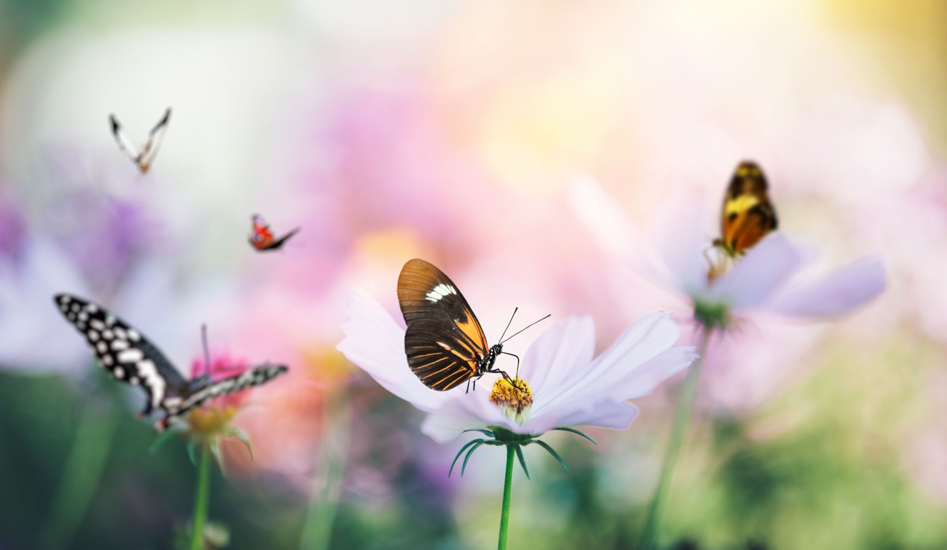
https://www.fws.gov/story/top-plants-your-pollinator-garden#southeast
Please go to the website to learn what are the best pollinator plants for your region.
Wonderful website for a lot more children pollinator activities
https://www.appalachianforestnha.org/kids
Again, a wonderful website you can download or print up activities for your child to learn about gardening, pollinators or nature.
https://www.fs.usda.gov/managing-land/wildflowers/kids/activities

Slide 12
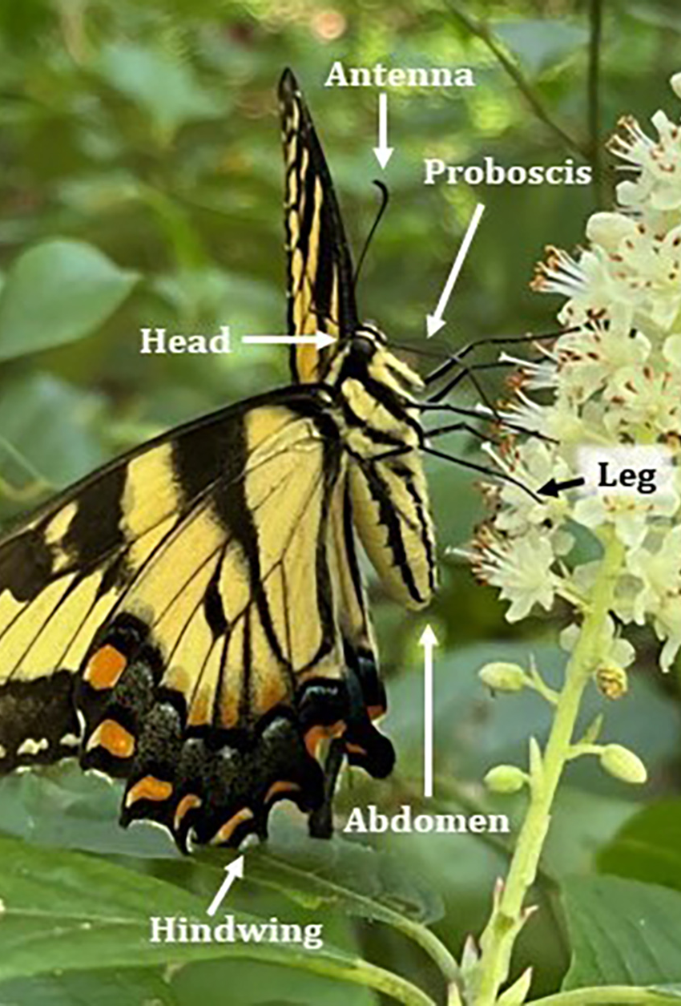
Butterflies as pollinators
Butterflies are enjoyable to watch and help with pollination. They are drawn to bright flowers like Butterfly Milkweed and move pollen from one flower to another as they feed.*
Adult butterflies use their long, tube-shaped mouthparts, called a proboscis, to drink nectar. Nectar gives them the energy they need to fly and reproduce.
As caterpillars, they eat the leaves of certain plants to get the nutrients they need to grow and become adult butterflies.*
Butterflies cannot hover when they feed, so they look for flowers that give them a steady place to land. Big, flat flowers or groups of small blossoms make it easy for butterflies to rest while drinking nectar.

Slide 13
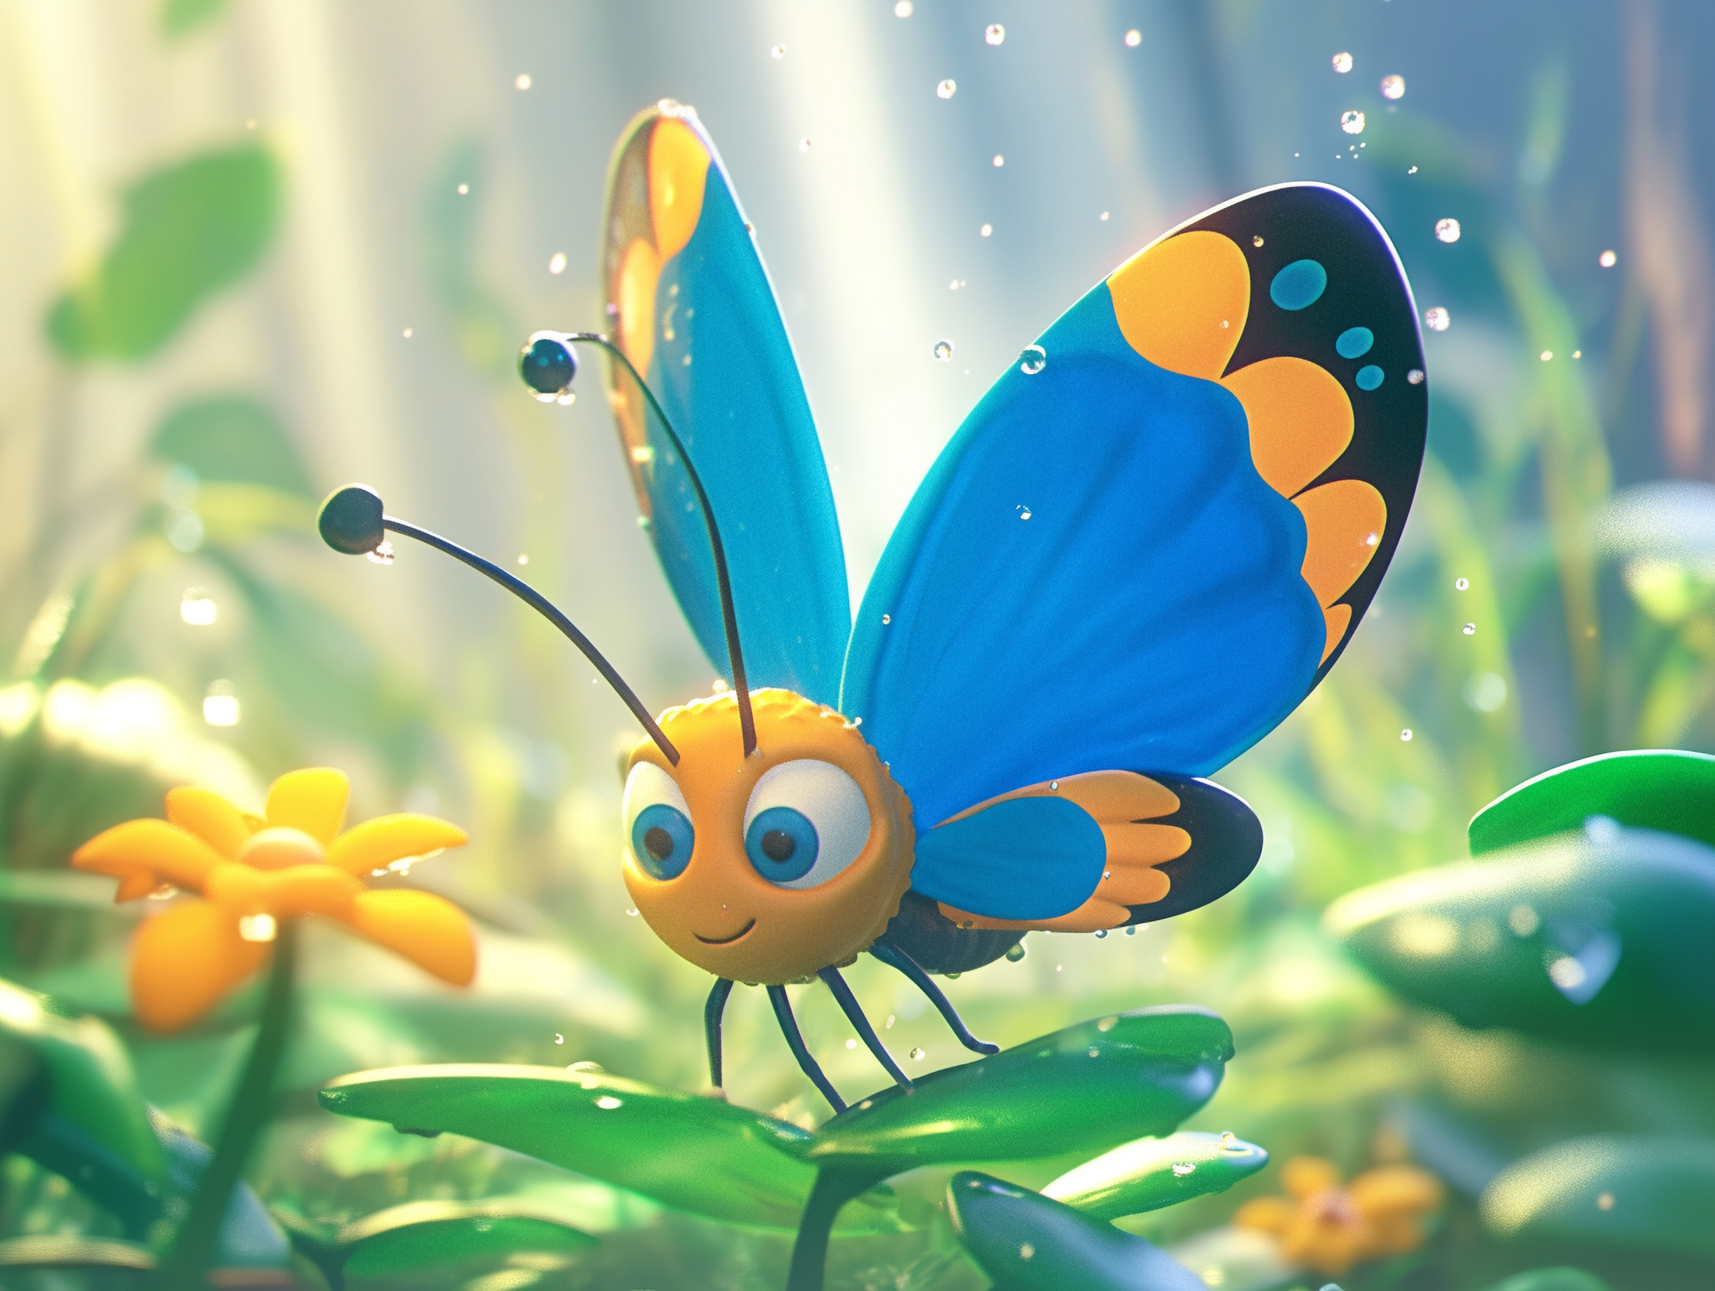
Butterfly water and housing
Butterflies get water and important nutrients such as salts and amino acids mainly by 'puddling,' which means drinking from damp sand, mud, compost, and manure. They also drink morning dew and sap.
Great website if you want to make a puddler.
https://www.homesandgardens.com/gardens/butterfly-puddlers#section-how-to-make-a-butterfly-puddler
Butterflies live in open areas like meadows, forests, and gardens. When the weather is bad or at night, they hide in tall grass, trees, or among rocks.
Great website for making butterfly shelter
https://dwr.virginia.gov/blog/sustaining-butterflies-with-habitats-at-home/

Slide 14
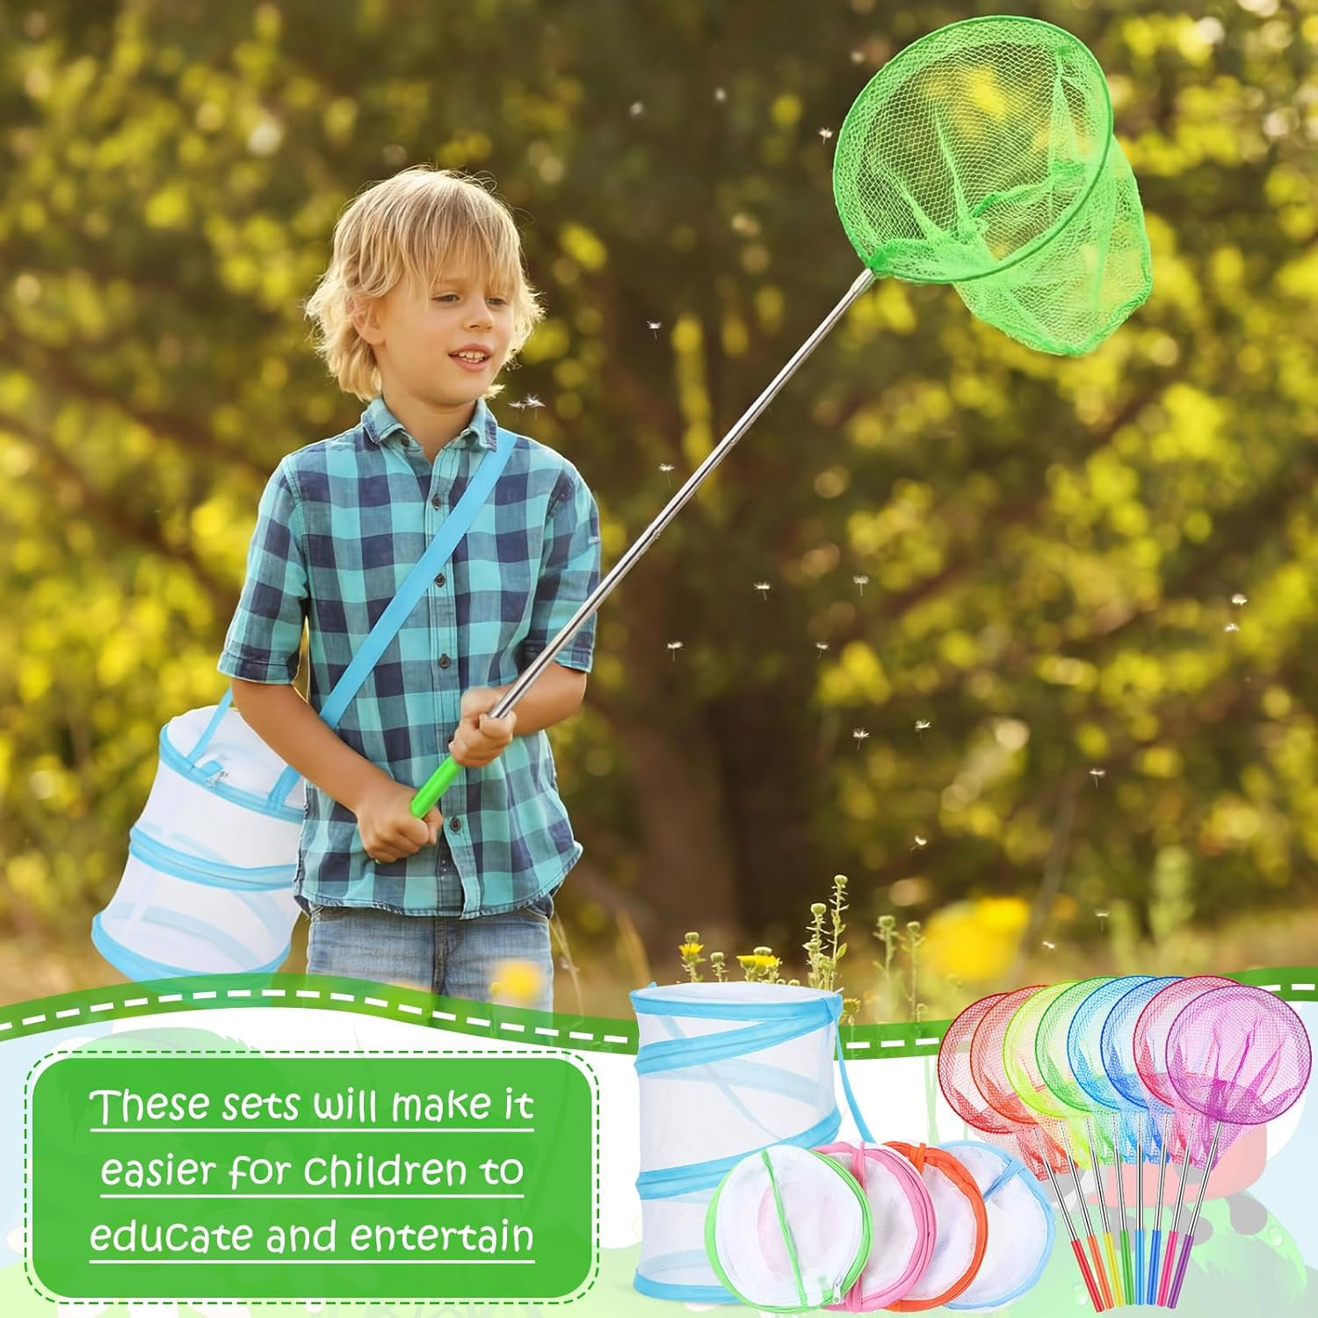
Butterfly activity
Inside your kit, you will find a butterfly net and a special housing. How you use them is entirely up to your imagination. You might catch a butterfly and observe its delicate beauty up close, using the websites I shared to learn more. Or, you could transform the housing into a cozy sanctuary, inviting a butterfly to lay its eggs. Then, you can witness the magical transformation from egg to caterpillar to cocoon, and finally, watch a new butterfly emerge right before your eyes.
Steps to Prepare the Hatching Home:
Cleanliness: Ensure the enclosure is clean.
Interior Setup: Add leafy, fresh host plants for caterpillars to eat.
Vertical Space: Place sticks or mesh inside so caterpillars can hang upside down to form their chrysalis, and later, for emerging butterflies to hang and dry their wings.
Feeding/Maintenance: Regularly remove frass (caterpillar droppings) to prevent sickness.
Humidity: Lightly mist the enclosure daily to maintain humidity.
Butterfly Care: Once butterflies emerge, provide food sources like nectar plants or a sugar-water solution.
Ensure the mesh is fine enough that caterpillars cannot escape, and place the habitat out of direct sunlight to prevent overheating
Website on cycle of a butterfly
https://dwr.virginia.gov/blog/an-introduction-to-virginias-butterflies/
Websites on how to house caterpillars into butterflies.
https://runwildmychild.com/raising-butterflies/
https://runwildmychild.com/raising-butterflies/#:
https://www.thefarmatoxford.com/blog-1/raisingbutterflies
Notes:
If you spot a butterfly sipping nectar from a plant, keep an eye out for tiny eggs she may have tucked beneath the leaves. Gently remove the leaf and place it in your butterfly netting, creating a cozy home for the egg. Soon, you can watch as it hatches into a caterpillar, spins a cocoon, and finally emerges as a butterfly. This was one of my favorite hands-on activities to do with my boys during our homeschooling days.

Slide 15
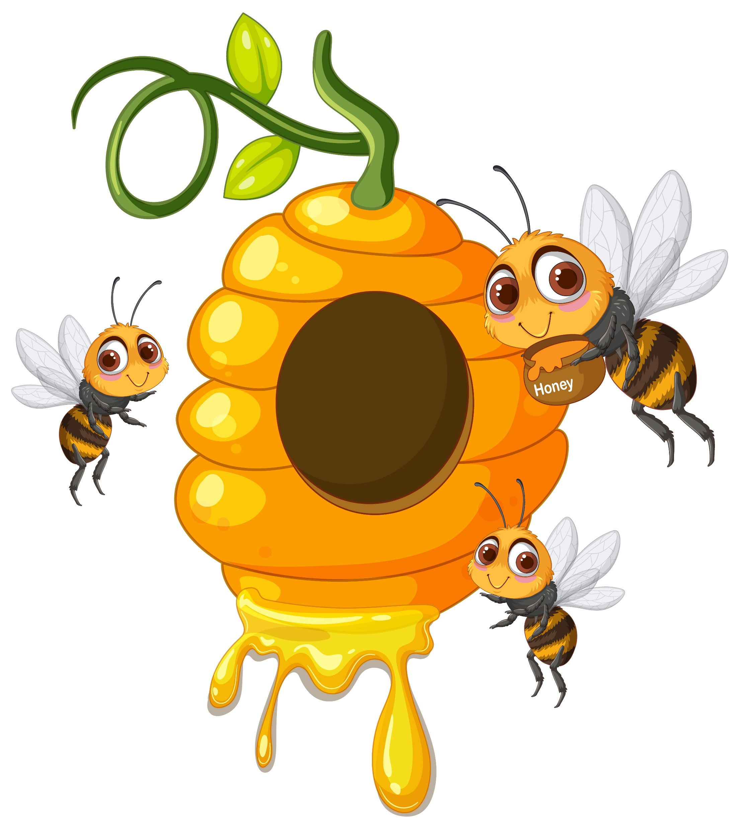
Bees
Nectar is a primary source of carbohydrates for bees, so plants that produce abundant nectar are particularly attractive to them. They also consume pollen as a source of protein and lipids, which is particularly important for developing bee larvae.
Most of the honey in the stores are from wildflowers, for a bee will travel 10 miles for different flowers from spring through fall.
They communicate through a "waggle dance" to share food locations, possess a sense of smell 50 times more powerful than a dog, and can even recognize human faces.
Incredible Bee Facts for children, look up website below
https://www.wwf.org.uk/learn/fascinating-facts/bees#:~:text=6.,create%20a%20new%20queen%20bee.
So how are we going to feed them? In your kit you will grow wildflowers, which they love.
Water source- It is good to have some type of water available, otherwise they will go to other peoples home looking for water, even swimming pools! Don’t want them getting chlorine from the pool.
For shelter- You are making a home for Mason bees, keep in mind that honeybees have different needs. Unless you are a beekeeper with special boxes, honeybees will look for dry, enclosed, and elevated spaces like hollow trees or gaps in buildings to build their nests. Inside, they make wax combs to store honey and raise their young. Honeybees live together in large groups and need a big, dark space to stay safe, control the temperature, and hibernate together during winter.

Slide 16
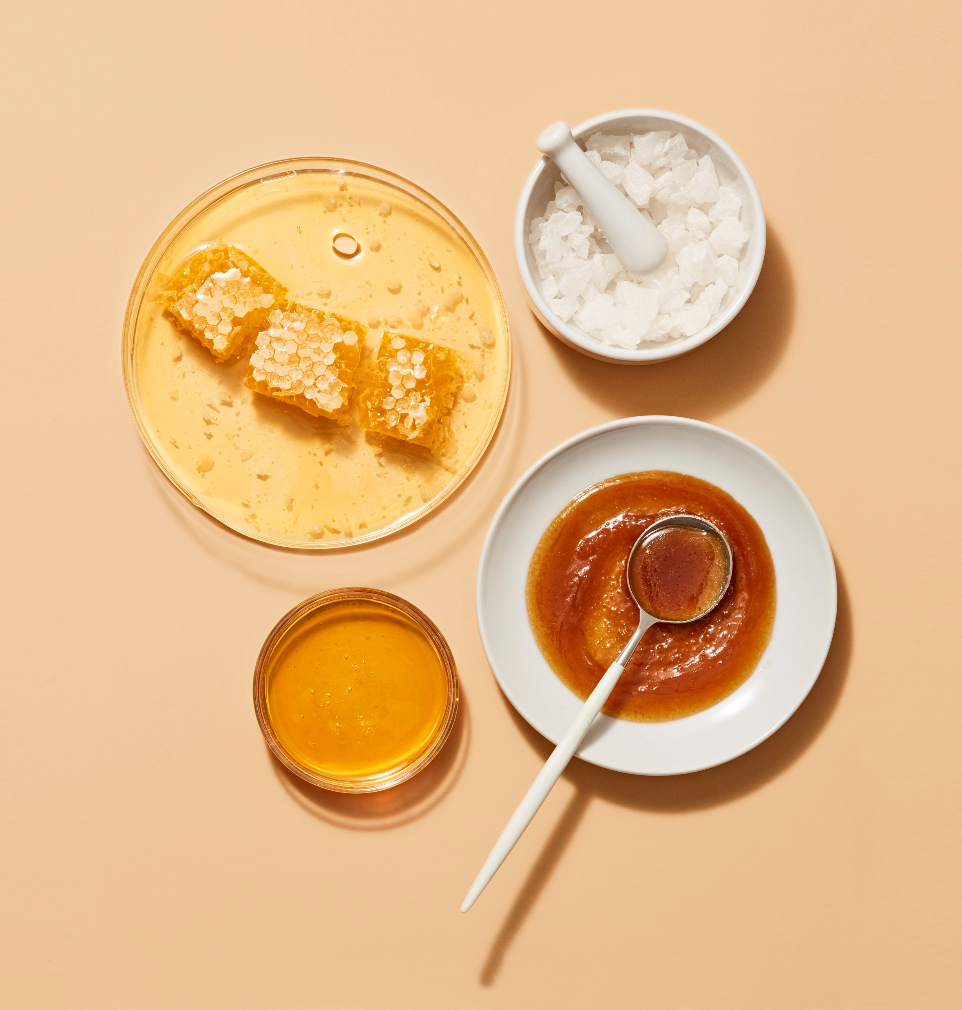
Varieties of Honey
https://www.smileyhoney.com/blogs/honey-school/clover-honey-vs-wildflower-honey-how-are-they-different?srsltid
Did you know a honeybee will make the honey based on what it eats.
If you want light and sweet honey, grow wildflowers for them
If you want a little darker and stronger taste, grow clover
If you want dark and strong, grow buckwheat clover

Slide 17
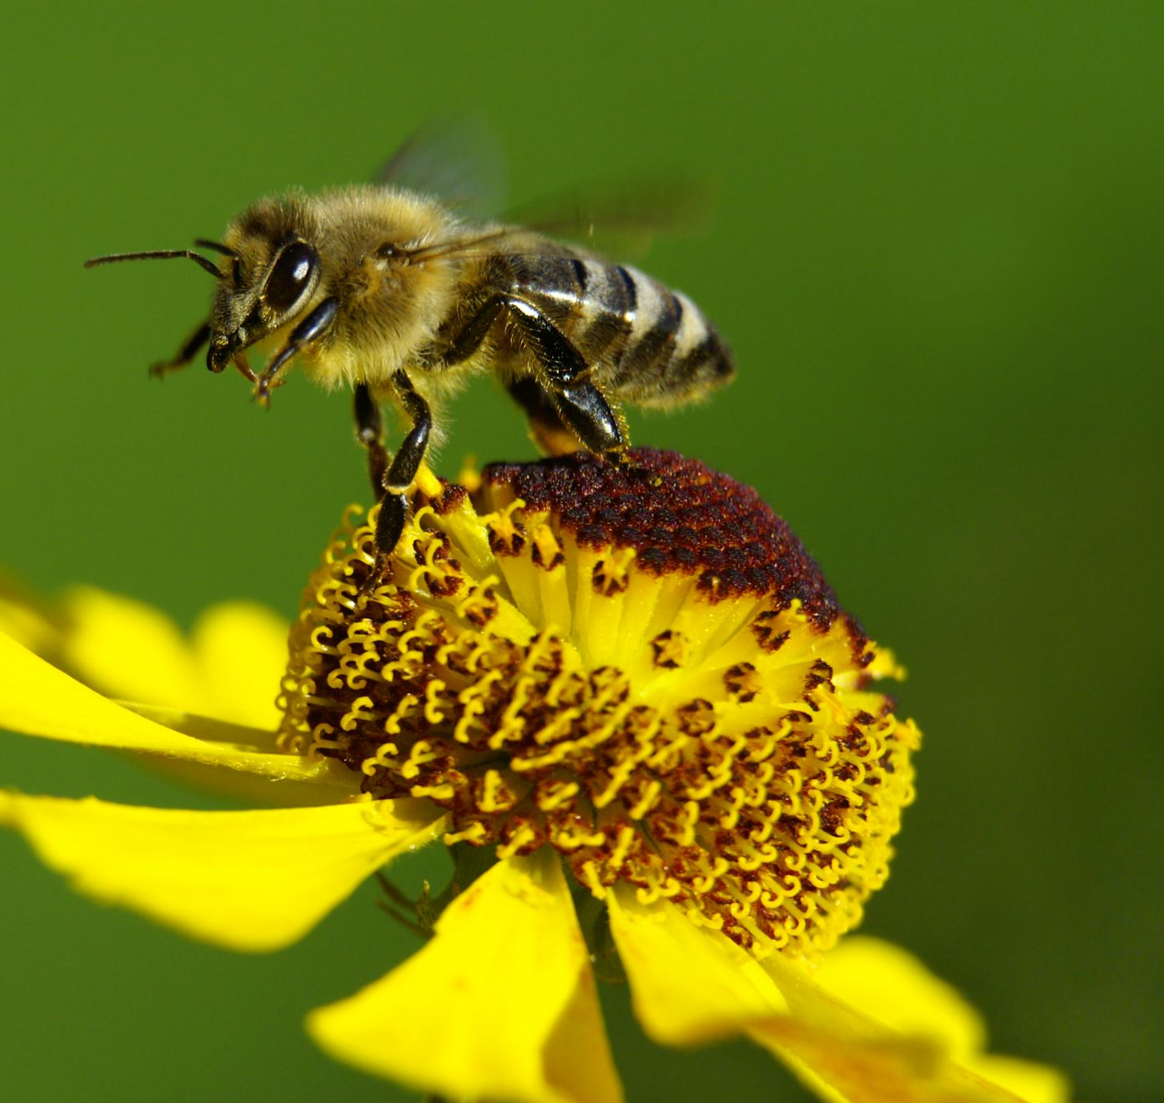
Videos just on Bees
https://www.youtube.com/watch?v=xD5tdykIJBI
https://www.youtube.com/watch?v=-Jsm7_Z-0Qo https://www.youtube.com/watch?v=eDxZojp9yNg https://www.youtube.com/watch?v=xQpolPycuxQ
https://www.youtube.com/watch?v=metiK21AMn0
https://www.youtube.com/watch?v=9WAvsrjrSWA

Slide 18
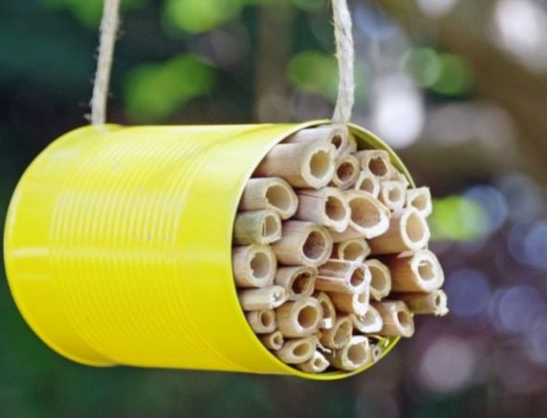
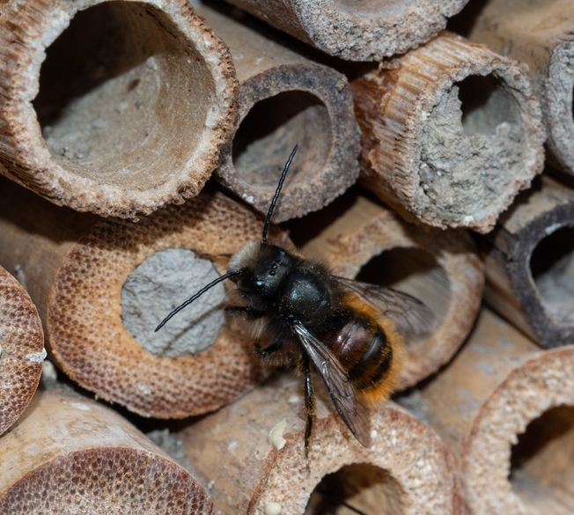
How to make your mason bee home
MASON BEES ARE SMALL. They don’t look like what we think a bee should look like and in fact more closely resemble a fly, although some are an attractive metallic greenish-blue.
Independent, adaptable and resilient, Mason bees emerge from their cocoons at the first hint of warmth in spring and fly in wet and windy weather, conditions that keep other bees grounded. I
3 things they need are flowers , sun and mud. The picture above is the example of a home you will make them
Use any tin can you have, painting it is optional, but will keep it from rusting. Included are the bamboo pipes which you will cut up to fit the can and layer.
Mason bees will use mud to cover up the holes after they lay their egg. So, if you can make a mud pile for them by their home, they will appreciate it.
If you can hang your home from a tree, close to your garden or flowers and with the mud pile close.
If you’re looking to add a nesting box to your landscape, choose a sunny location, preferably south-facing, that receives morning light to encourage the bees to emerge early in the day.
https://www.seattletimes.com/pacific-nw-magazine/3-things-mason-bees-need-to-flourish-and-to-give-a-boost-to-your-garden/

Slide 19
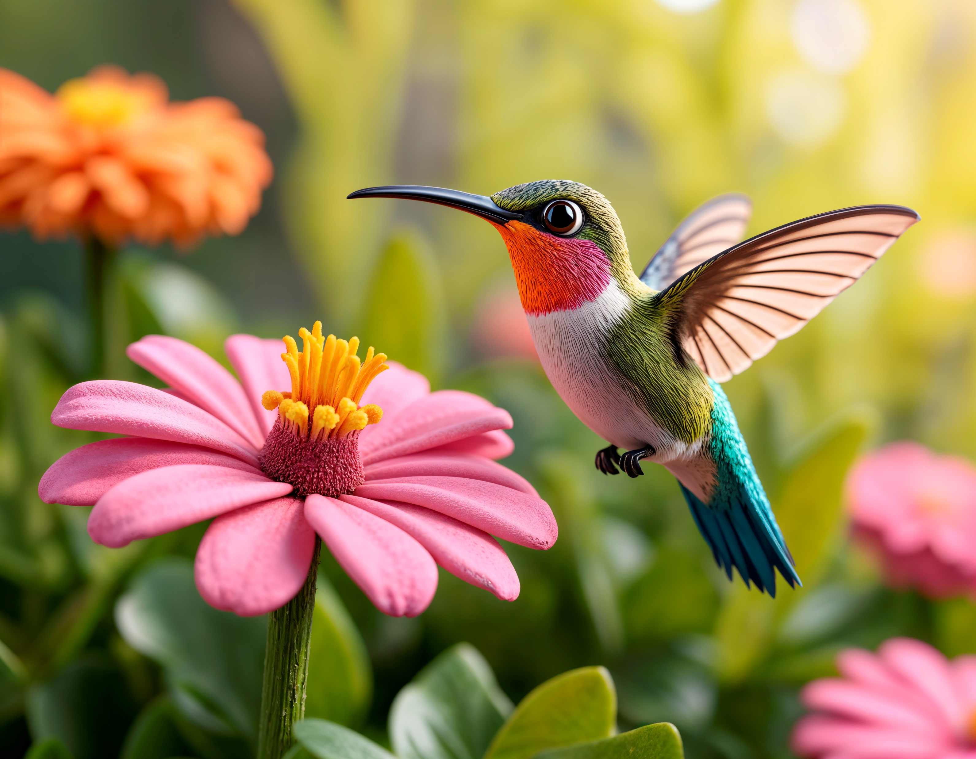
Hummingbird as a pollinator
As specialized nectar feeders, hummingbirds play a crucial role as pollinators. From fledgling to adulthood, hummingbirds rely heavily on flowers for their nutritional needs.
Nectar is the primary source of carbohydrates for hummingbirds, fueling their incredibly high metabolism and energetic flight patterns. In addition to nectar, they consume small insects and spiders to obtain essential proteins and other nutrients.
Hummingbirds eat various small insects and arthropods, including gnats, fruit flies, aphids, mosquitoes, and tiny spiders. Incorporating leaf litter, water sources, and dense foliage can create a welcoming habitat for insects and provide a natural food supply for hummingbirds.
Homemade hummingbird nectar is highly beneficial because it mimics natural flower nectar, providing a safe, cheap, and easily digestible energy source (1 part white sugar to 4 parts water) without harmful dyes or preservatives.

Slide 20
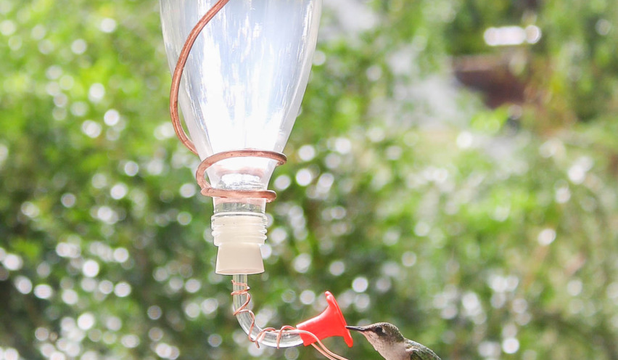
Homemade Hummingbird feeder
Use a Sparkling Water Bottles, Glass Soda Bottle, or Antique Glass Bottles) that you have. Make sure you wash and remove any labels.
2. Use a thick gauge copper wire to hang the glass bottle. First, bend a small curve at the bottom and feed it around the neck of the bottle. You can use a clamp to help get a tighter fit against the bottle’s neck.
3. Work your way up and around the sides of the bottle, twisting the glass bottle as you bend the wire. End at the base of the bottle.
4. Form a big curve and a curly Q at the bottom of the bottle (which will now be the top of the feeder) to act as a hanger.
5.Use the hummingbird feeder spout included.
6. Add homemade syrup or buy at store. Recipe below
Create a sugar water mixture by using 4 parts water to 1 part sugar. Bring the water and sugar to a boil. Let it simmer for 5 minutes, then remove to cool. You can store the mixture for up to five days in the fridge. To draw birds, They love the color red. IF YOU FIND A RED BOTTLE THAT WILL BE BETTER.

Slide 21
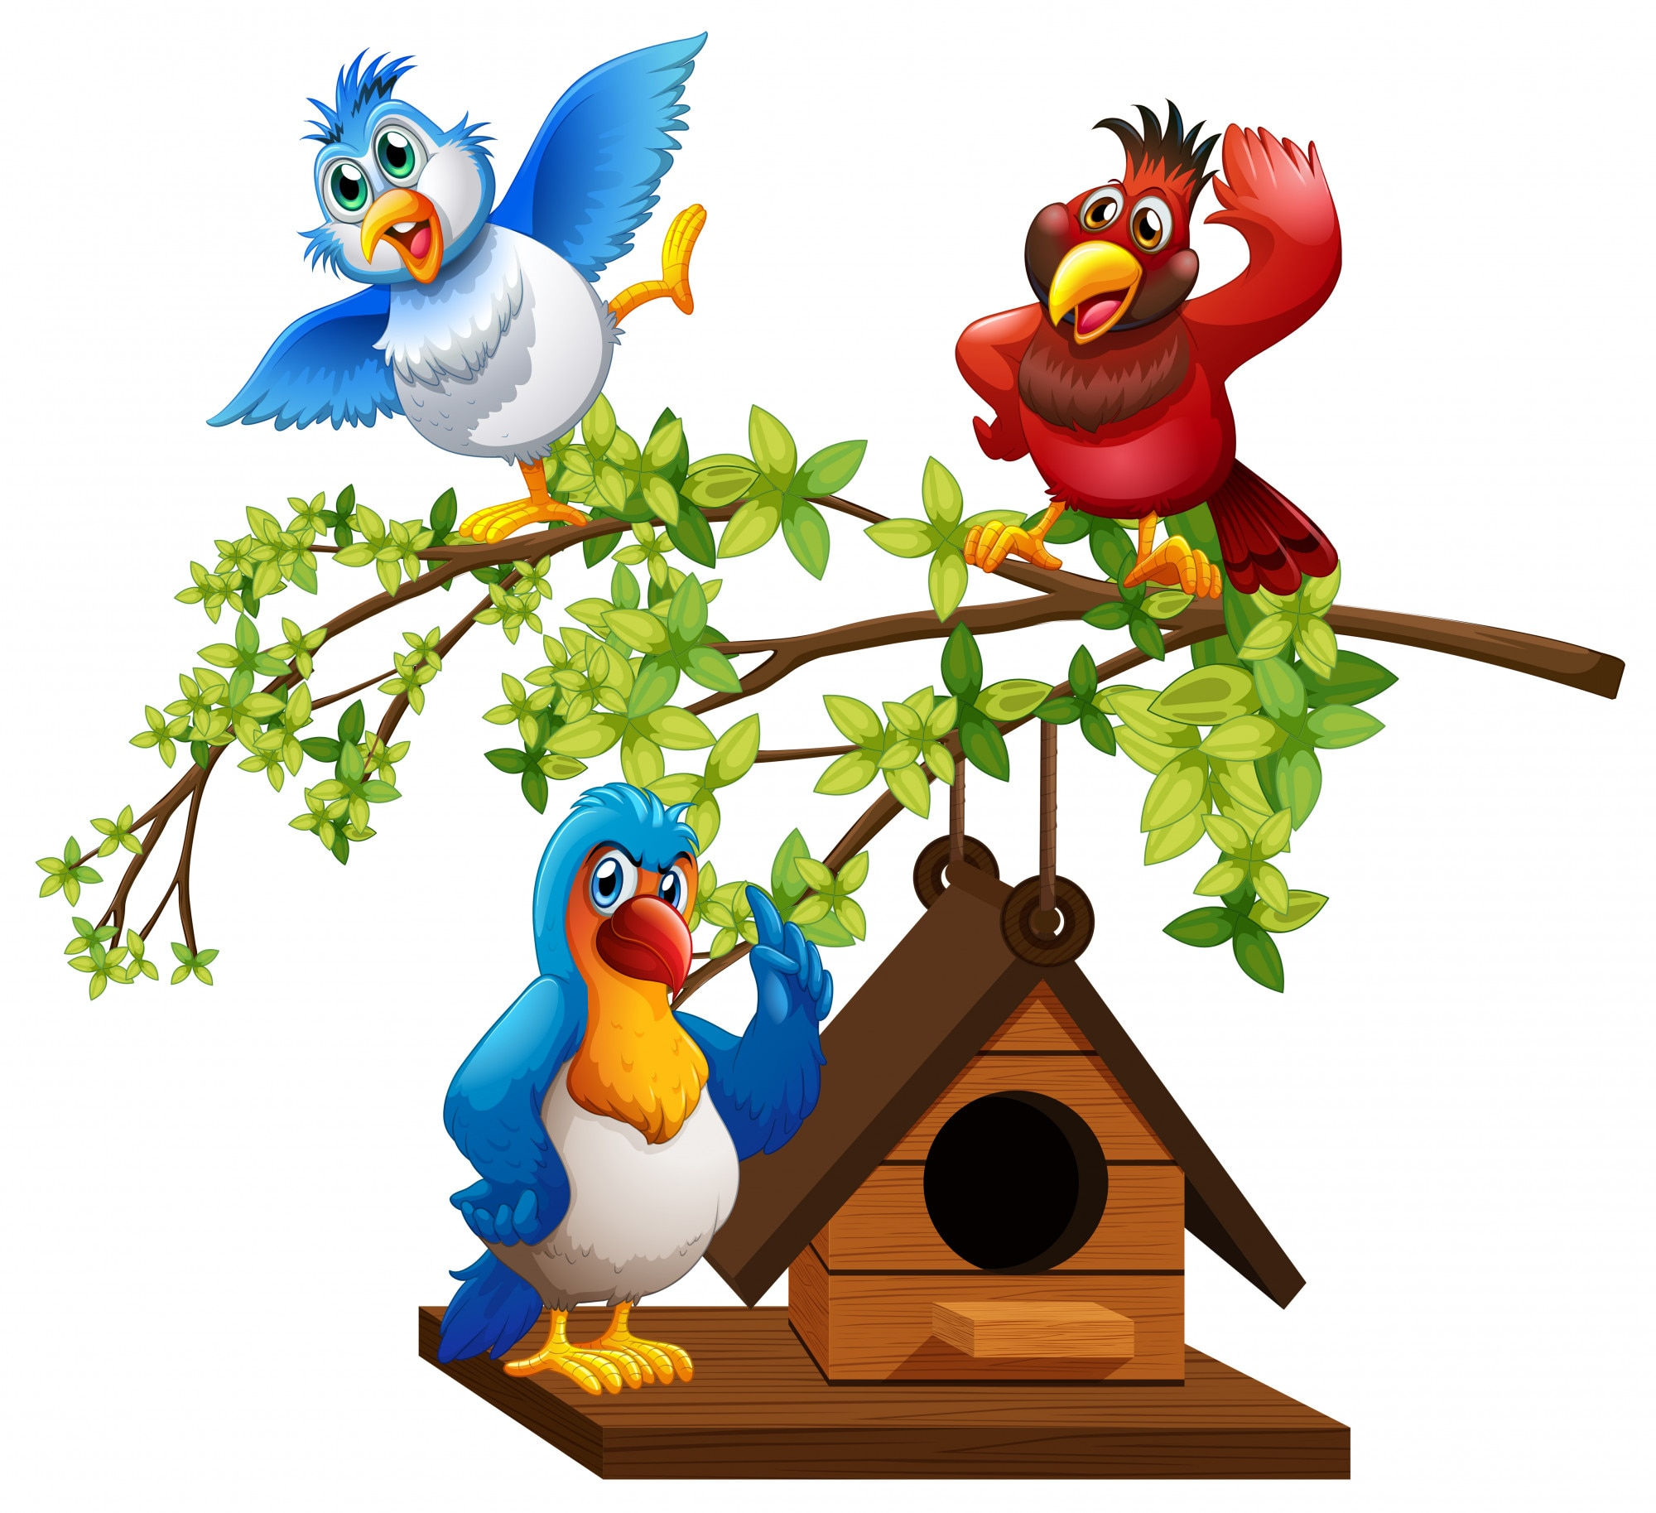
Birds are pollinators
Birds are effective pollinators because they transfer pollen on their feathers, beaks, and heads while feeding on nectar from tubular, brightly colored flowers. Over 2,000 bird species, including hummingbirds and sunbirds, facilitate plant reproduction by traveling long distances between plants, offering a major ecological service.
  Why Birds Are Efficient Pollinators:
Sticky Pollen Transfer: As birds insert their beaks into flowers for nectar, sticky pollen adheres to their feathers, heads, and breasts.
Foraging Behavior: Birds often fly faster and longer distances than insects, allowing them to cross-pollinate plants over larger areas.
Specialized Adaptations: Many bird-pollinated plants have evolved specifically to attract birds. These plants usually have sturdy, tubular structures and produce large amounts of nectar.
Targeted Colors: Birds are highly attracted to bright, warm colors, particularly red, orange, and yellow, which helps them identify food sources

Slide 22
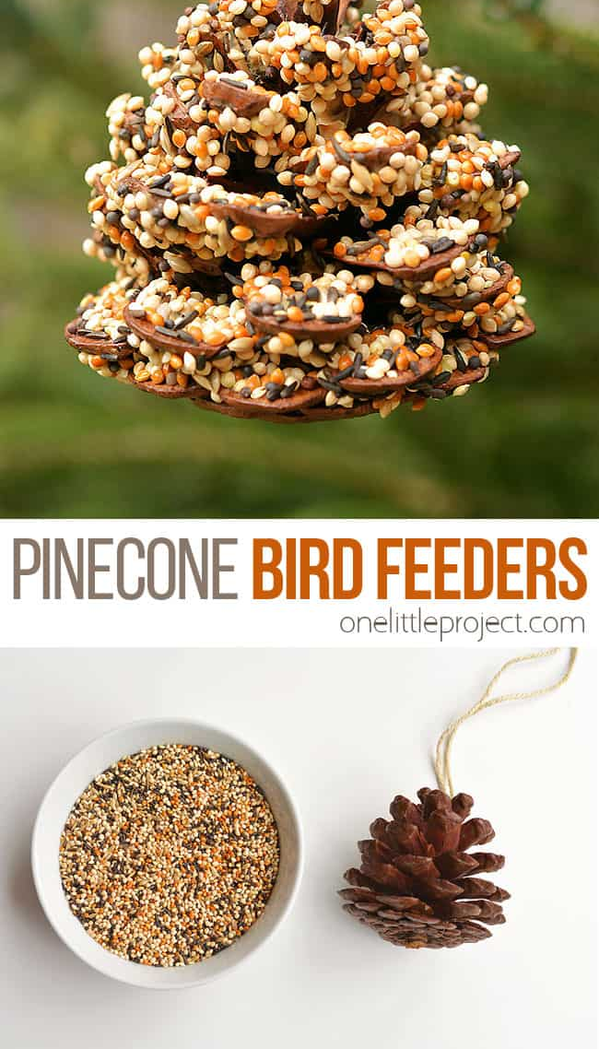
Here is a fun extra activity if you want to draw more birds to your garden.
First tie a string, twine or even yarn around the top of the cone., so, you can hang it on a branch or your bird feeder.
Using a spatula, coat the cone in peanut butter or Crisco or lard, if anyone is allergic to peanuts in your home.
Place birdseed in mixing bowl.
Roll the pinecone in the bird seed, smushing it into the crevices of the pinecone…but with a gentle hand.
Then hang outside on a branch or place that you’ll be able to gaze at the birds eating.
Great website for pinecone feeder- https://www.finchandfolly.com/pinecone-bird-feeder

Slide 23
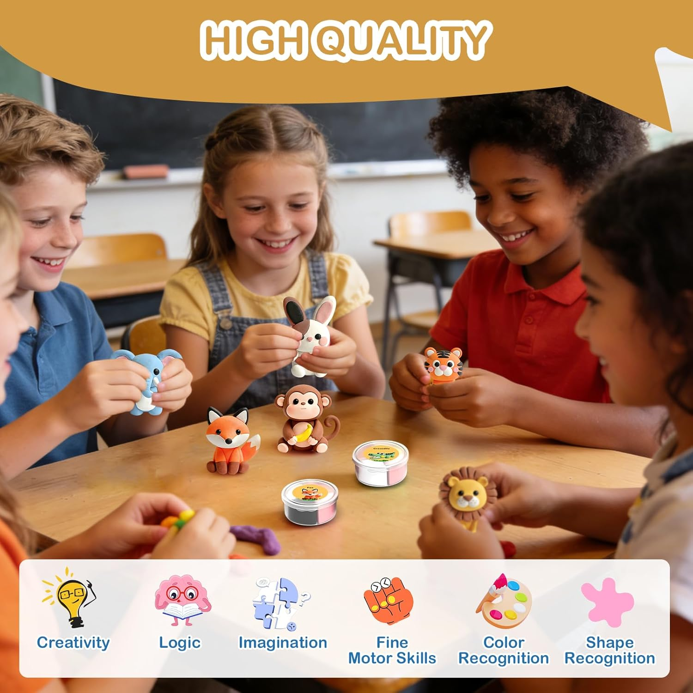

Slide 24
Bookmark and Journal
Included in your kit is a bookmark. This bookmark opens up. Included are many different stickers to add to your bookmark. Or cut out pictures and add or press leaves and flowers between, it is up to you and your turn to be creative.
There is a journal in your kit. Use some of the stickers included to decorate the journal. The journal can be used to write about your experiences, draw what you grew, or flowers and plants. Keep a record of your produce and planting schedule. Use your imagination and have fun!!!

Slide 25
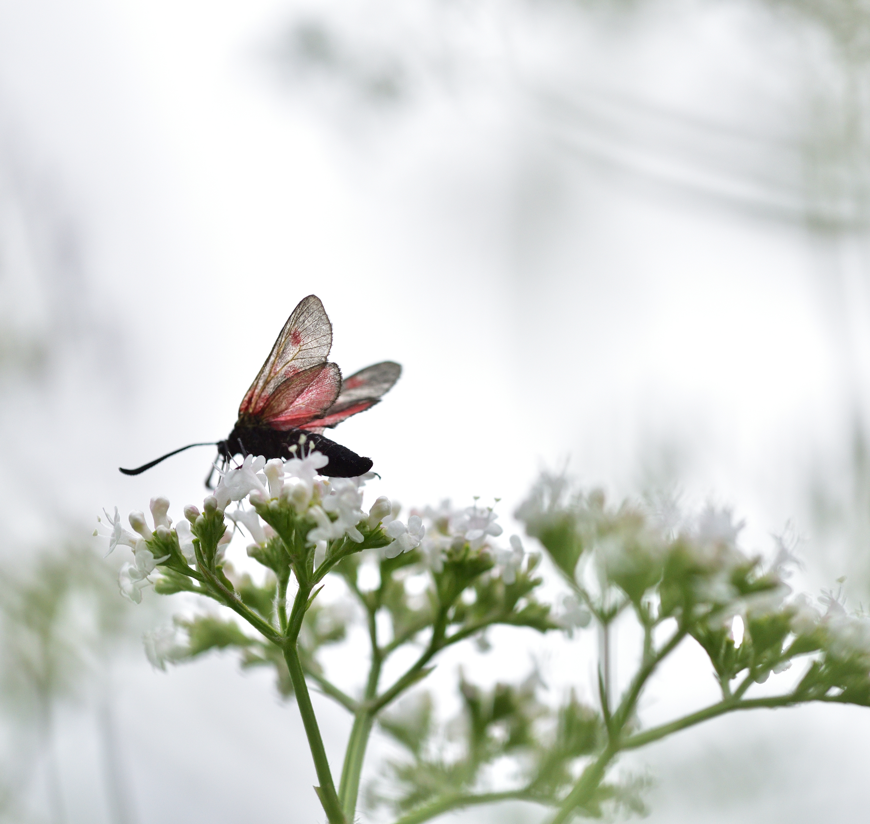
Our beautiful pollinator videos
https://www.youtube.com/watch?v=gR3E2tGx2vc
https://www.youtube.com/watch?v=9nD55iGgv1M
https://www.youtube.com/watch?v=Z5FxJl6-QaM
https://www.youtube.com/watch?v=GGQupaZLnbM
https://www.youtube.com/watch?v=THD6nzasM_8
https://www.youtube.com/watch?v=HB-lMAMpDQA
Notes:
Mom, please watch videos first and make sure this is what you want your kids to see.

Slide 26
Websites for great pollinator projects
https://letgrow.org/backyard-wildlife-habitats/ ( great projects for young children)
https://www.stephensplace.org/blog/how-to-make-a-bug-hotel?gad_source=1&gad_campaignid
https://www.kidsgrowingcity.ca/blog/incorporating-stem-learning-into-garden-projects
https://www.plt.org/educator-tips/pollinator-activities-preschool#:~:text=Bats%20are%20pollinators%2C%20too!,flowers%20native%20to%20your%20area.

Slide 27
Final word and download options.
Thank you for welcoming me into your gardens and inviting me to be part of your homeschooling journey. I am cheering you on every step of the way and will keep creating more garden and nature resources, as well as keeping your families in my prayers. From my own experience, I know this path is both a tremendous blessing and a real challenge, filled with hard work and moments of exhaustion. May God watch over you and your loved ones. I also want to remind you to visit Knollwoodagriculture.com, where you can download this kit's PowerPoint, as well as the God and Nature and STEAM garden presentations if you wish. Feel free to explore and order any other kits that catch your eye.

