Slide 1
Breaking down STEAM and Gardening activities for any of the kits

Slide 2
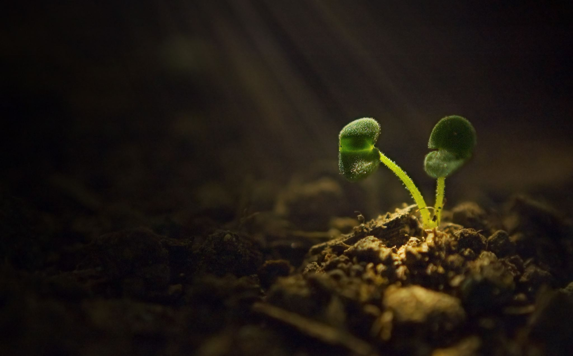
As technology increasingly influences society, acquiring foundational knowledge in science, technology, engineering, art and mathematics (STEAM) has become essential. Making these subjects accessible and engaging for children remains a challenge. One effective solution lies in the natural environment, such as gardens, where elements like soil, leaves, and bees provide opportunities for exploration. Engaging children in gardening offers a practical method to introduce STEAM concepts through experiential learning. Outdoor spaces become living laboratories, enabling children to learn through direct interaction rather than passive observation. This method fosters enduring curiosity and a passion for discovery.
Gardening is more than planting seeds and watching them grow. It is a comprehensive activity that supports multiple areas of children's development. STEM-focused garden projects offer hands-on, multi-sensory experiences that enhance physical, cognitive, and emotional growth.

Slide 3
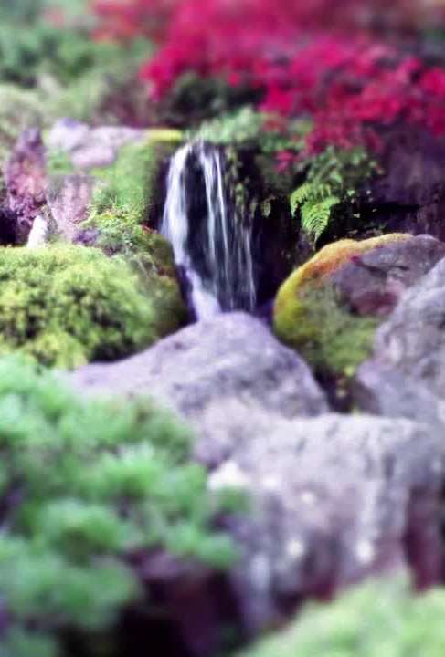
Impact on Environmental Awareness
When gardening is combined with STEAM lessons, students start to care more about the environment. They learn why it matters to save resources such as water and soil nutrients. This understanding leads them to act responsibly at school and at home.
Students also discover why biodiversity is important for keeping nature in balance. Watching how plants and pollinators interact or learning about composting helps them see how these practices support a healthier planet.

Slide 4
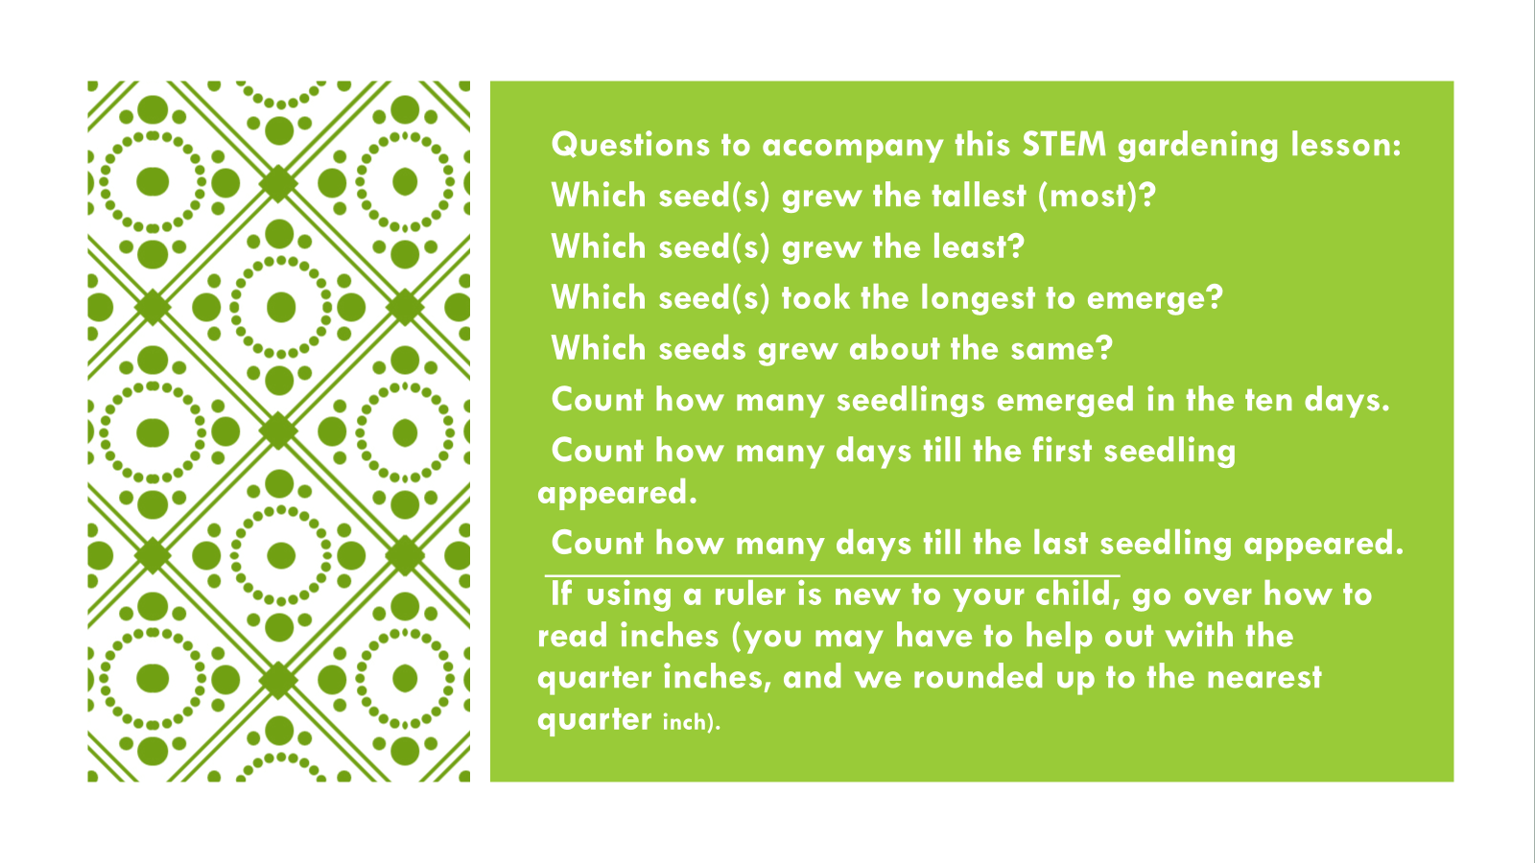

Slide 5
Science in Steam framework of Gardening
Within the STEAM framework, educators offer students experiential learning opportunities that enhance their comprehension of scientific principles. For instance, planting seeds enables students to study plant biology, photosynthesis, and ecosystems. Students may monitor growth patterns, observe plant life cycles, and examine the influence of environmental factors on plant health.
Science comes alive in the garden, turning it into a real-world lab for exploring biology, ecology, and environmental science

Slide 6
Science terminology
1. Germination-is when a seed wakes up and begins to grow. With enough water, warmth, and oxygen, the seed opens, sending a small root into the soil and a shoot up toward the sun
2. Photosynthesis- Is how plants make their own food. In their green leaves, plants use sunlight, water, and carbon dioxide to make sugar for energy. As they do this, plants release oxygen into the air, which people and animals need to breathe
3. Plant Cycle
The plant cycle is the path a plant follows from seed to adult and then repeats. The main stages are:
Seed: The resting stage.
Germination: The seed sprouts.
Seedling: A young plant grows leaves.
Adult Plant: The plant produces flowers and fruits.
Seed Dispersal: The plant spreads seeds to start over.

Slide 7
Science terminology
4. Plant Anatomy
Plant anatomy is the study of the different parts of a plant and their functions.
Roots hold the plant in the soil and take in water and nutrients.
The stem supports the plant and moves water to the leaves.
Leaves collect sunlight to help the plant make food through photosynthesis.
Flowers are a part of the plant that produces seeds.
5. Soil Ecosystem
A soil ecosystem is a world beneath our feet where living and non-living things interact. It includes soil, water, air, nutrients, and creatures such as earthworms, insects, and bacteria that help plants grow by breaking down dead material.
6. Pollinators
Pollinators are animals—like bees, butterflies, birds, and bats—that visit flowers to drink nectar. As they move from flower to flower, they carry yellow dust called pollen, which helps flowers produce fruit and seeds. In an ecosystem, highlighting who eats whom. It usually starts with the sun, then plants (which make food via photosynthesis), and then animals that eat plants or other animals. It is a "web" because most animals eat more than one thing.

Slide 8

T-Technology is not just about screens and gadgets. It also means using tools and new ideas to solve problems and work more efficiently. In gardening, this could be as simple as using recycled materials or trying out new systems. These hands-on experiences help children learn how technology works in real life. When children learn about modern gardening tools and methods, they can become interested in how new ideas help solve real problems, like saving resources and making the most of space.
When planting your wildflowers, introduce different garden tools and layouts for the garden.
Notes:
You will do a hydroponic system. But if you want to incorporate more technology in gardening. You can make a water system or use toilet paper roll or egg carton for making plant pots.
Have fun with making different tools for your garden.

Slide 9
Technology in Steam framework of gardening
Moreover, incorporating technology like sensors and automated watering systems introduces students to coding and robotics. These technologies can help monitor soil moisture levels or automate irrigation, providing practical applications of technological skills in real-world scenarios.

Slide 10
Engineering in STEAM framework of Gardening
Engineering significantly contributes to the advancement of gardening projects. Students may design and construct structures such as trellises or raised beds by applying principles from physics and mathematics. This process fosters problem-solving and critical thinking as students evaluate optimal materials and structural designs for their projects.
Through engineering projects, students develop problem-solving and creative thinking skills while understanding the relationship between form and function. They follow key steps such as identifying needs, generating ideas, designing, building, testing, and refining, which form the core of the engineering design process.

Slide 11
Integrating art into STEAM (Science, Technology, Engineering, Arts, Mathematics) gardening transforms, planting into a creative, hands-on experience, fostering deeper engagement, environmental stewardship, and critical thinking. It merges aesthetic design with scientific observation, improving skills in documentation, patience, and spatial awareness while boosting creativity
ART IN STEAM

Slide 12
Art in the steam framework for gardening
Bringing art into gardening gives students a chance to express their creativity. When they design garden layouts, they learn about color, space, and what looks good together. Students can try out artistic ideas by making mosaic paths or painting plant markers.
Besides visual arts, students can write poems inspired by their time in the garden or keep journals about what they see and feel. These activities help them connect more with nature and think about their own experiences.

Slide 13
Math in the steam framework of gardening
You can connect activities to math by having students calculate area and volume and manage resources. Ask them to look at the data from their projects to help them decide how to improve the garden.
. Some important math skills children can learn in the garden are:
Counting and Sorting: Children can count seeds, bugs, or leaves, and sort seeds by size, type, or color.
Measurement: Kids can use rulers to check plant height or the space between seeds, measure water for the plants, and use calendars to keep track of how long plants take to grow.
Geometry and Spatial Awareness: Children notice shapes in garden beds, arrange plants in rows or grids, and learn ideas like full, empty, tall, and wide.
Data Handling: Kids can make graphs to show how plants grow, compare the sizes of different vegetables, and weigh what they harvest.
Operations: Children practice adding new plants, taking away dead ones, and figuring out how many plants are in each row.
https://www.youtube.com/watch?v=wrTm8a3HMKY
.

Slide 14

Games to learn about children gardening and STEM
https://seedsurvivor.com/agrium-games/Feeding%20the%20Future/
https://seedsurvivor.com/just-for-kids/games/
https://www.soils4kids.org/games
https://www.soils4kids.org/about

Slide 15
Important for gardening with stem and learning outside
https://www.imthecheftoo.com/blogs/stem-for-kids/garden-stem-activities-sprouting-curiosity-and-learning#section4
https://childsplayabc.wordpress.com/recipes/( great website for cooking and activities)
https://kidsgardening.org/resource-activities/
https://preschoolsteam.com/garden-steam-activities-preschoolers/
https://www.runningbugfarm.com/blog/gardening-for-kids-learn-grow-and-get-messy-with-fun-steam-projects#/
https://www.natgeokids.com/uk/discover/science/nature/the-life-cycle-of-flowering-plants/
https://www.calaes.com/blog/5-benefits-outdoor-learning-has-for-young-children
https://wigardenexpo.com/virtual-kids/
Notes:
Questions to accompany this STEM gardening lesson:
Which seed(s) grew the tallest (most)?
Which seed(s) grew the least?
Which seed(s) took the longest to emerge?
Which seeds grew about the same?
Count how many seedlings emerged in the ten days.
Count how many days till the first seedling appeared.
Count how many days till the last seedling appeared.
If using a ruler is new to your child, go over how to read inches (you may have to help out with the quarter inches, and we rounded up to the nearest quarter inch).
Instructions in notes

