Slide 1
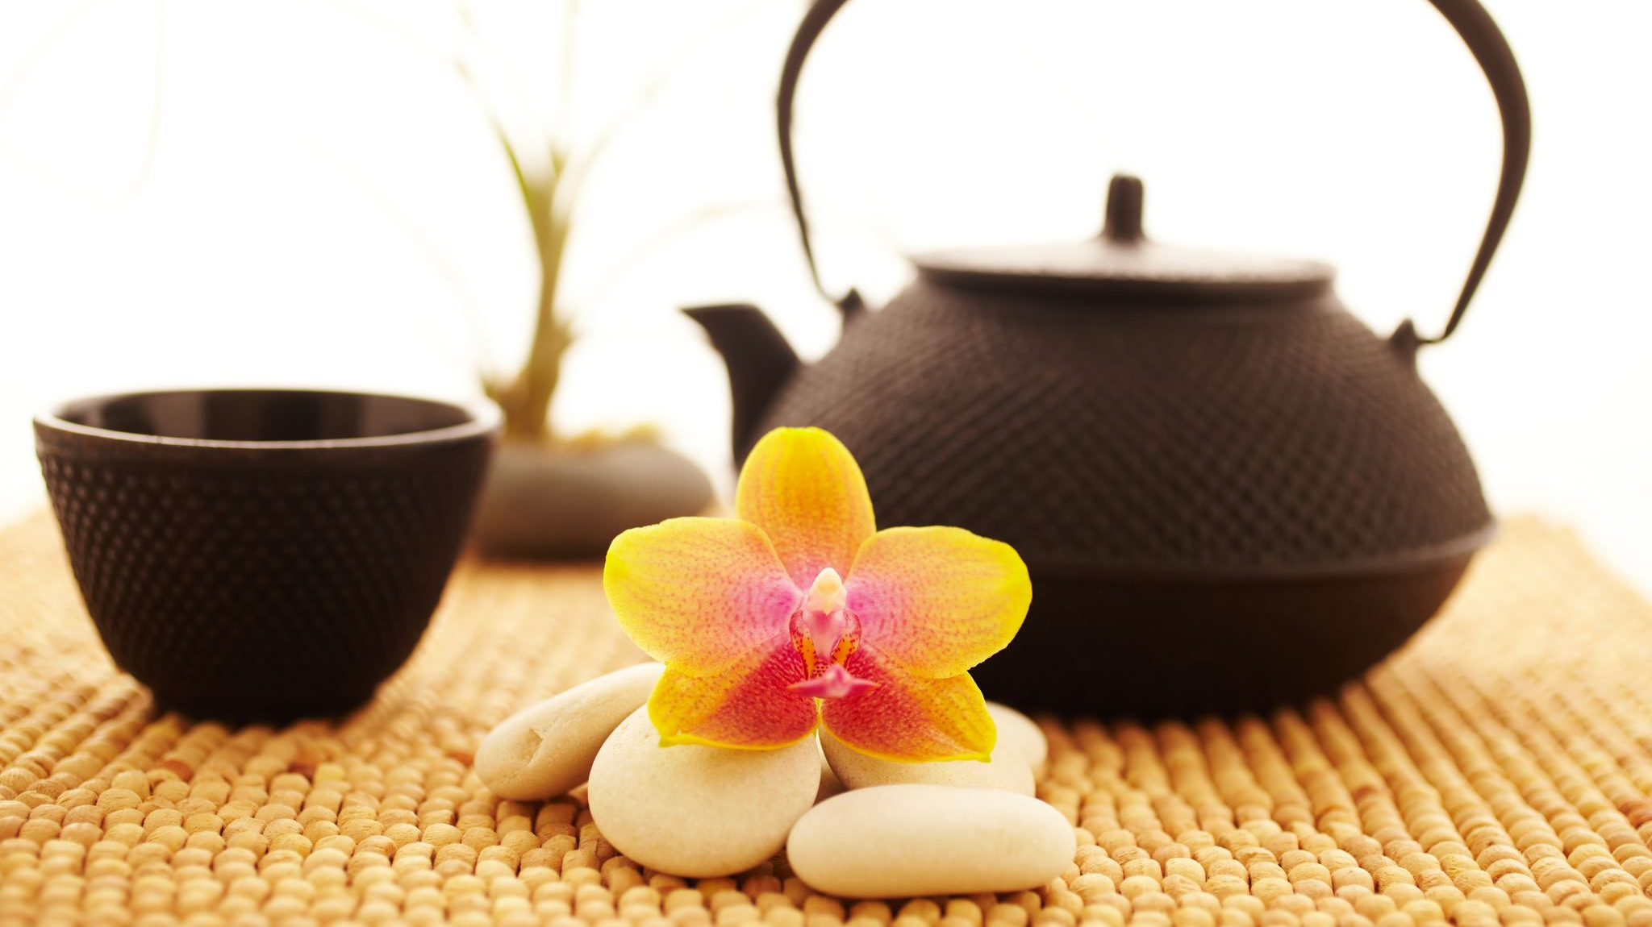
Jane Austen Flower and Tea kit
Flower section from the Regency Period

Slide 2
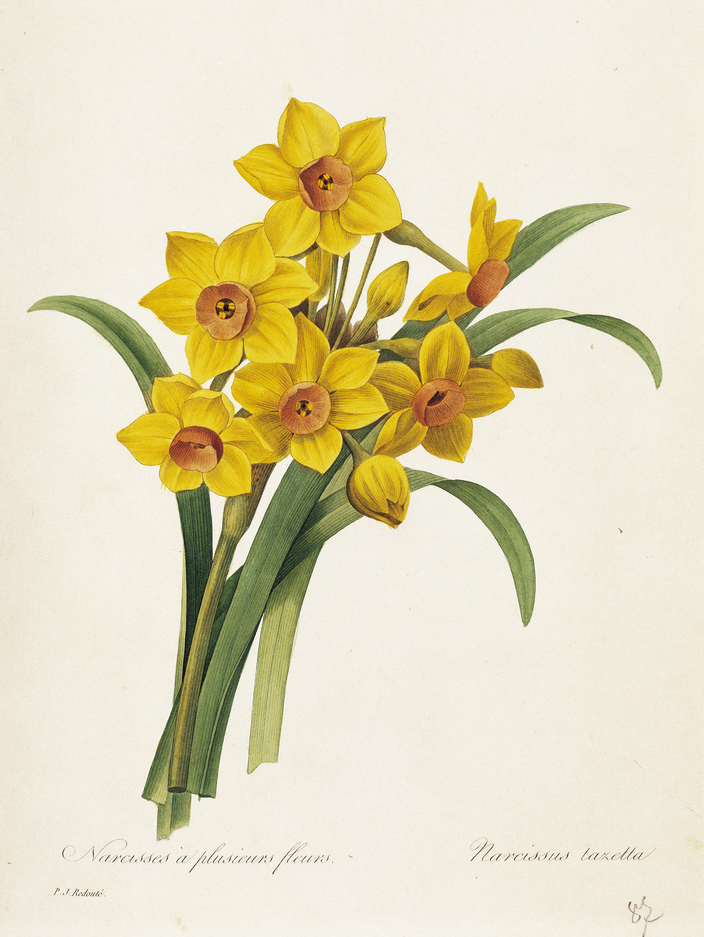
Daffodils flowers
During the Regency era (1811–1820), daffodil bulbs were cherished as hardy, naturalizing spring flowers, often associated with the arrival of spring, rejuvenation, and, due to their toxic nature, were left undisturbed by pests.
Website gives you the instructions on how to plant and grow Daffodils. A quintessential symbol of spring, providing cheerful yellow color and representing hope and new beginnings, often seen in gardens like Chawton House https://www.thespruce.com/planting-and-growing-daffodils-1402136 https://flowerbulbs.com/daffodils-plant-once-enjoy-them-for-years/
Notes:
For the daffodil it is planted in a clear planter- You can keep it there until you see the bulb sprouting and then transport it to the red pot I have included.
Steps for Success in March
In South Carolina, potted daffodils in spring should be placed in full sun to partial shade, aiming for at least 6 hours of sunlight for best blooming, but protected from intense, direct, all-day scorching sun. In SC's warmer climate, dappled shade or morning sun with afternoon shade helps prevent the soil from drying too quickly and scorching the foliage.
Location Strategy: In SC, you can place them under deciduous trees or on a covered patio that gets bright, indirect light to protect them from intense heat.
Watering: Potted daffodils need consistent moisture while growing, but they must not sit in waterlogged soil. Water whenever the soil feels dry to touch.
Post-Bloom Care: Once they finish blooming, keep the pots in the sun to help the foliage soak up energy for next year, allowing it to turn yellow before removing it.
Do not cut the foliage after blooming; let it die naturally to allow the bulb to store energy for next year.
This perennial bulb is suitable for reuse in South Carolina’s climate. Once the foliage has died back, the bulb should be removed from the pot, dried, and cleaned of any soil. Store the bulb in a breathable bag in a cool, dark, and dry environment. Due to the region’s mild winters, refrigerate the bulb (not in the freezer) for 12 to 16 weeks prior to planting it in a pot in October or November. This cold treatment simulates winter conditions and promotes blooming.
In Zone 8a and 8b, plant daffodil bulbs in November or early December. While they can be planted in October, waiting until the soil cools below 60°F is ideal for southern zones, often allowing planting into late autumn or early winter before the ground freezes.
Key Planting Tips for Zone 8:
Timing: November is optimal for Zone 8, with late October to mid-December being acceptable.
Preparation: No pre-chilling is required for daffodils in Zone 8.
Depth: Plant bulbs 6 inches deep (or three times their height) to avoid premature sprouting.
Location: Choose full sun to part shade with well-draining soil.
Placement: Plant with the pointed end up and spaced 4–6 inches apart.
Because Zone 8 has warmer, milder autumns, earlier planting (like September) can lead to premature growth, making late fall or early winter better to ensure the bulbs experience enough cold to bloom properly

Slide 3
Cheat sheet for Lavender Cheat sheet for Daffodil
In USDA zones 8a and 8b, the best time to pot or plant lavender is during the early fall (September to October), as the soil is still warm and roots can establish before winter. Early spring (March to April) is also a good alternative, allowing roots to settle before summer heat.
Key Tips for Potting Lavender in Zones 8a/b:
Best Time: Early fall is generally considered best for warmer zones to establish roots during the cool, moist winter.
Alternative Time: Early spring, just after the last hard frost, is suitable for new growth.
Container Care: Use well-draining, sandy soil, as lavender hates "wet feet".
Maintenance: Position in full sun and reduce watering in the winter.
Using containers allows for more flexibility than planting in the ground, but these times ensure the best growth for those regions
In Zone 8a and 8b, plant daffodil bulbs in November or early December. While they can be planted in October, waiting until the soil cools below 60°F is ideal for southern zones, often allowing planting into late autumn or early winter before the ground freezes.
Key Planting Tips for Zone 8:
Timing: November is optimal for Zone 8, with late October to mid-December being acceptable.
Preparation: No pre-chilling is required for daffodils in Zone 8.
Depth: Plant bulbs 6 inches deep (or three times their height) to avoid premature sprouting.
Location: Choose full sun to part shade with well-draining soil.
Placement: Plant with the pointed end up and spaced 4–6 inches apart.
Because Zone 8 has warmer, milder autumns, earlier planting (like September) can lead to premature growth, making late fall or early winter better to ensure the bulbs experience enough cold to bloom properly

Slide 4


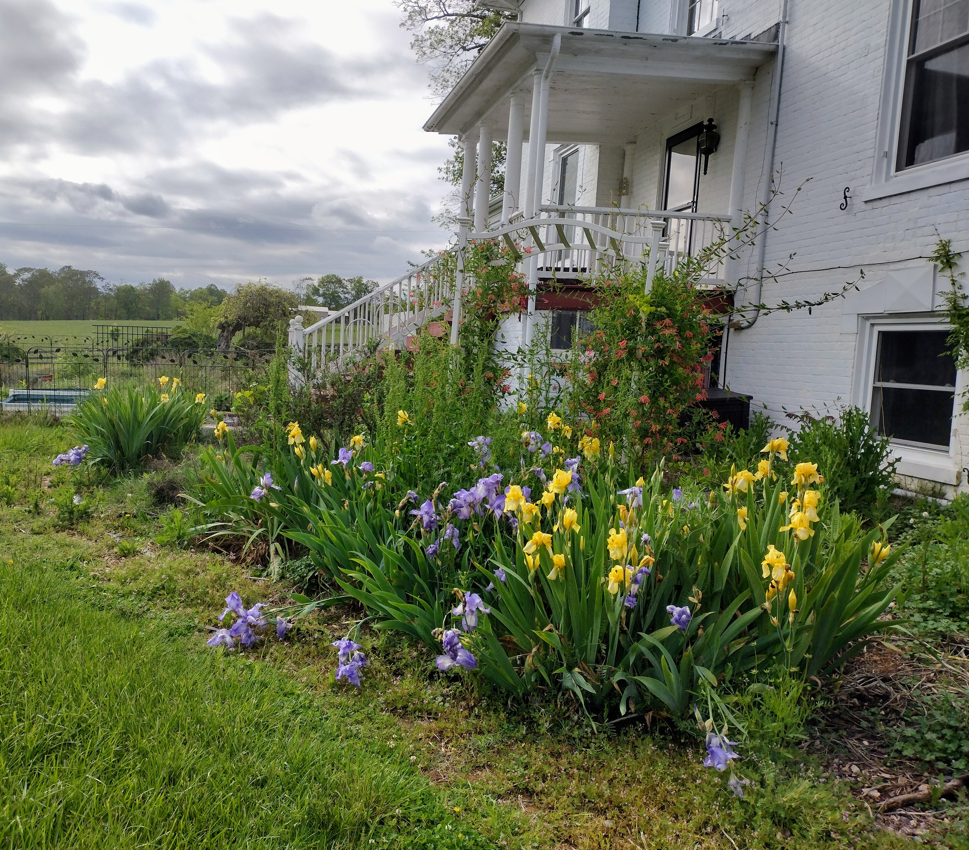



The iris flower commonly symbolizes faith, hope, wisdom, courage, and admiration. Derived from the Greek word for "rainbow" and named after the goddess of communication, it represents a bridge between heaven and earth. Irises are also associated with new beginnings, royalty, and, in some cultures, protection. Usage in Pot-Pourri: Orris powder, which is derived from the root of Iris x germanica var. florentina (the Florentine iris), was used by the Austen family for making pot-pourri, a mixture of dried flower petals used to scent rooms and linen.
Literary Usage: While not a central symbol in her novels, the iris is often associated with the language of flowers, symbolizing messages, wisdom, and faith.
https://www.almanac.com/plant/irises
https://www.whiteflowerfarm.com/blog/2023/06/14/over-the-rainbow-the-wide-world-of-iris
https://www.thespruce.com/irises-for-flower-garden-1315808
https://www.gardeners.com/blogs/flower-encyclopedia/growing-irises-7131
Notes:
I have provided an iris in a white cloth planter with soil, allowing you to plant it immediately upon returning home. In South Carolina, container-grown or potted irises are best planted in March to allow establishment before the onset of summer heat. When planting in spring, select a location with full sun and well-draining soil, ensuring the rhizome's top remains slightly exposed. Irises planted in pots typically bloom the same summer, whereas those planted directly in the ground may not bloom until the following spring. Detailed Post-Bloom Care for SC Potted Irises: Remove Spent Blooms: As soon as the flowers wither, cut the stalk down to the base to prevent the plant from wasting energy on seeds. Manage Foliage: Leave green, healthy leaves intact to continue photosynthesis, which stores energy in the rhizome for next year's bloom. Cut back, trim, or remove any browning or diseased foliage to tidy the pot. Summer Maintenance: Keep the pot in full sun (at least 6 hours). Water only when the top 1-2 inches of soil are dry; overwatering in hot SC summers can cause rot. Fall Care: In late summer or early fall, you can cut the leaf fans back to about 6 inches to keep them tidy. Overwintering: Potted irises can stay outside in SC, but place them in a sheltered spot against the house to protect them from extreme wind.

Slide 5
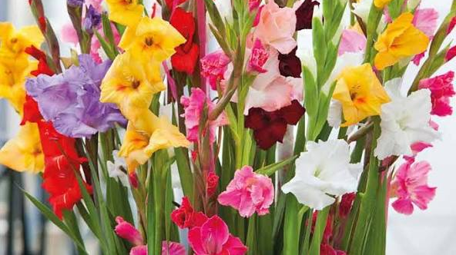
Gladiolus Flower n Victorian times, gifting gladiolus was seen as a symbol of love and infatuation.
Beyond physical strength, the gladiolus also symbolizes integrity. In many cultures, it’s believed that giving someone gladioli is a way of honoring their honest and upright nature. During the Victorian era, the flower was used to convey the message: “You pierce my heart,” reflecting deep respect, emotional sincerity, and transparency.
Wonderful website. Please take some time and read. https://www.southsideblooms.com/the-gladiolus-flower-a-symbol-of-strength-integrity-and-resilience https://www.avasflowers.net/blog/augusts-birthflower-the-glamorous-gladiolus https://www.boesen.com/knowledge/flower-dictionary/gladiolus/
Notes:
Key Tips for Success in SC Zone 8:
Planting Timing & Depth: Plant in spring once soil hits
(
). Set them 4-6 inches deep and 6 inches apart to prevent them from toppling.
Site Selection: Choose a location with 6-8 hours of direct sun.
Soil & Water: Soil should be well-drained; if you have heavy clay, amend with organic matter. Water weekly with at least 1 inch of water.
Overwintering: While they can be treated as annuals, they are often perennial in Zone 8. In late fall, cut back foliage to ground level. Mulch with leaves or straw in late November for extra winter protection.
Pest Management: The main pest is thrips, which cause, silvery streaks on leaves/flowers. Control them by using insecticidal soap or Neem oil at the first sign of damage.
Staking: Because they can grow very tall, placing them near a wall or using stakes/cages can provide support.

Slide 6
Cheat sheet for Iris Cheat sheet for Gladiolus
In USDA Zones 8a and 8b, the best time to direct sow or plant bearded iris rhizomes is late summer to early fall (July, August, or September), though they can be planted as late as October. Planting during this dormant period allows the roots to establish before winter and ensures a better, more established bloom in the spring.
American Iris Society
American Iris Society
+2
Key Planting Tips for Zones 8a/8b:
Optimal Months: July – September, aiming for 6–8 weeks before the first hard frost.
Method: Plant with the top of the rhizome partially exposed (not deep under the soil) to prevent rot.
Conditions: Plant in full sun and well-drained, slightly raised beds to manage moisture during hot, humid summers.
Spacing: Space rhizomes 12–24 inches apart
In USDA Zones 8a and 8b, direct sow gladiolus bulbs (corms) from late March through April, once the threat of last frost has passed and soil temperatures reach
For consistent summer blooms, plant new corms every two weeks until mid-June or early July.
Key Tips for Success in Zone 8:
Last Frost: Typically mid-March to early April in Zone 8, making April a safe starting point.
Spacing & Depth: Plant corms 4-6 inches deep and 3-6 inches apart, with the pointy side up.
Soil: They need well-drained soil in full sun, avoiding, soggy areas to prevent rot.
Support: As they grow up to
tall, plan for staking to keep them upright.

Slide 7
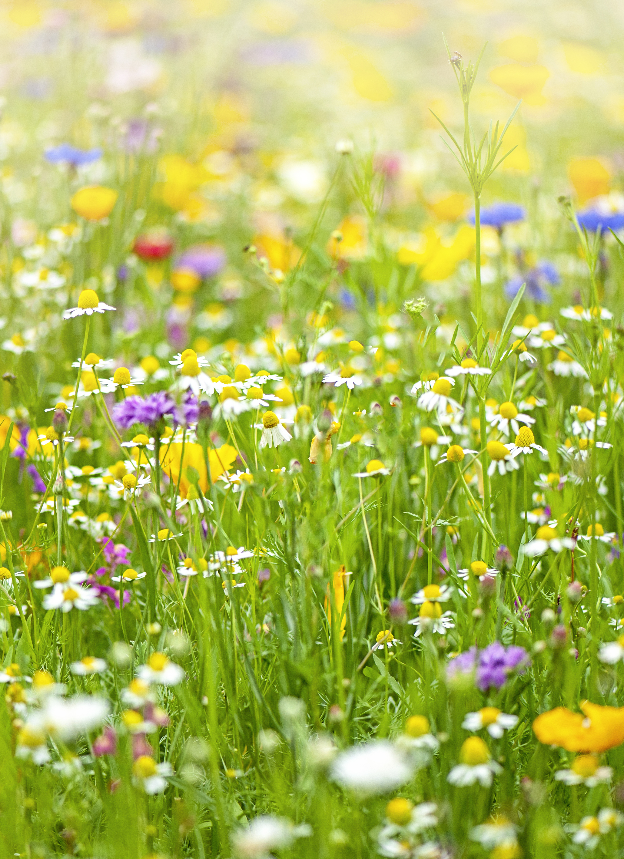
Wildflowers
Symbolism of God's Provision: In a spiritual context, wildflowers were sometimes seen as a symbol of God's provision and a reminder not to worry about basic needs.
Jane Austen-"Sense and Sensibility" Style: Regency bouquets often favored locally sourced, seasonal wildflowers and herbs, representing simplicity and freshness. https://www.youtube.com/watch?v=7FU5ZnwmqoE https://www.thespruce.com/wildflower-gardening-1403564
Notes:
Key Tips for Success in Zone 8 SC: these need to be grown in the ground.
Site Selection: Choose a location with at least 6 hours of full sun.
Soil Preparation: Wildflowers thrive in poor, well-drained soil. Avoid fertilizer, as it promotes weeds over wildflowers. Remove existing grass and weeds by tilling, sod cutting, or smothering.
When to Plant: Fall is ideal for sowing in SC (8 weeks before the first hard frost) to allow seeds to cold-stratify over winter. Early spring is also effective once the soil reaches
and the last frost has passed.
Sowing Method: Mix seeds with sand (8 parts sand to 1 part seed) for better distribution. Spread half the seeds walking north-to-south, then the other half east-to-west.
Seed-to-Soil Contact: Do not bury the seeds; they need light to germinate. Instead, press them into the soil using a roller or by walking on plywood placed over the seeded area.
Watering: Keep the soil moist for 4–6 weeks until seedlings are
inches tall, then water only during dry spells

Slide 8
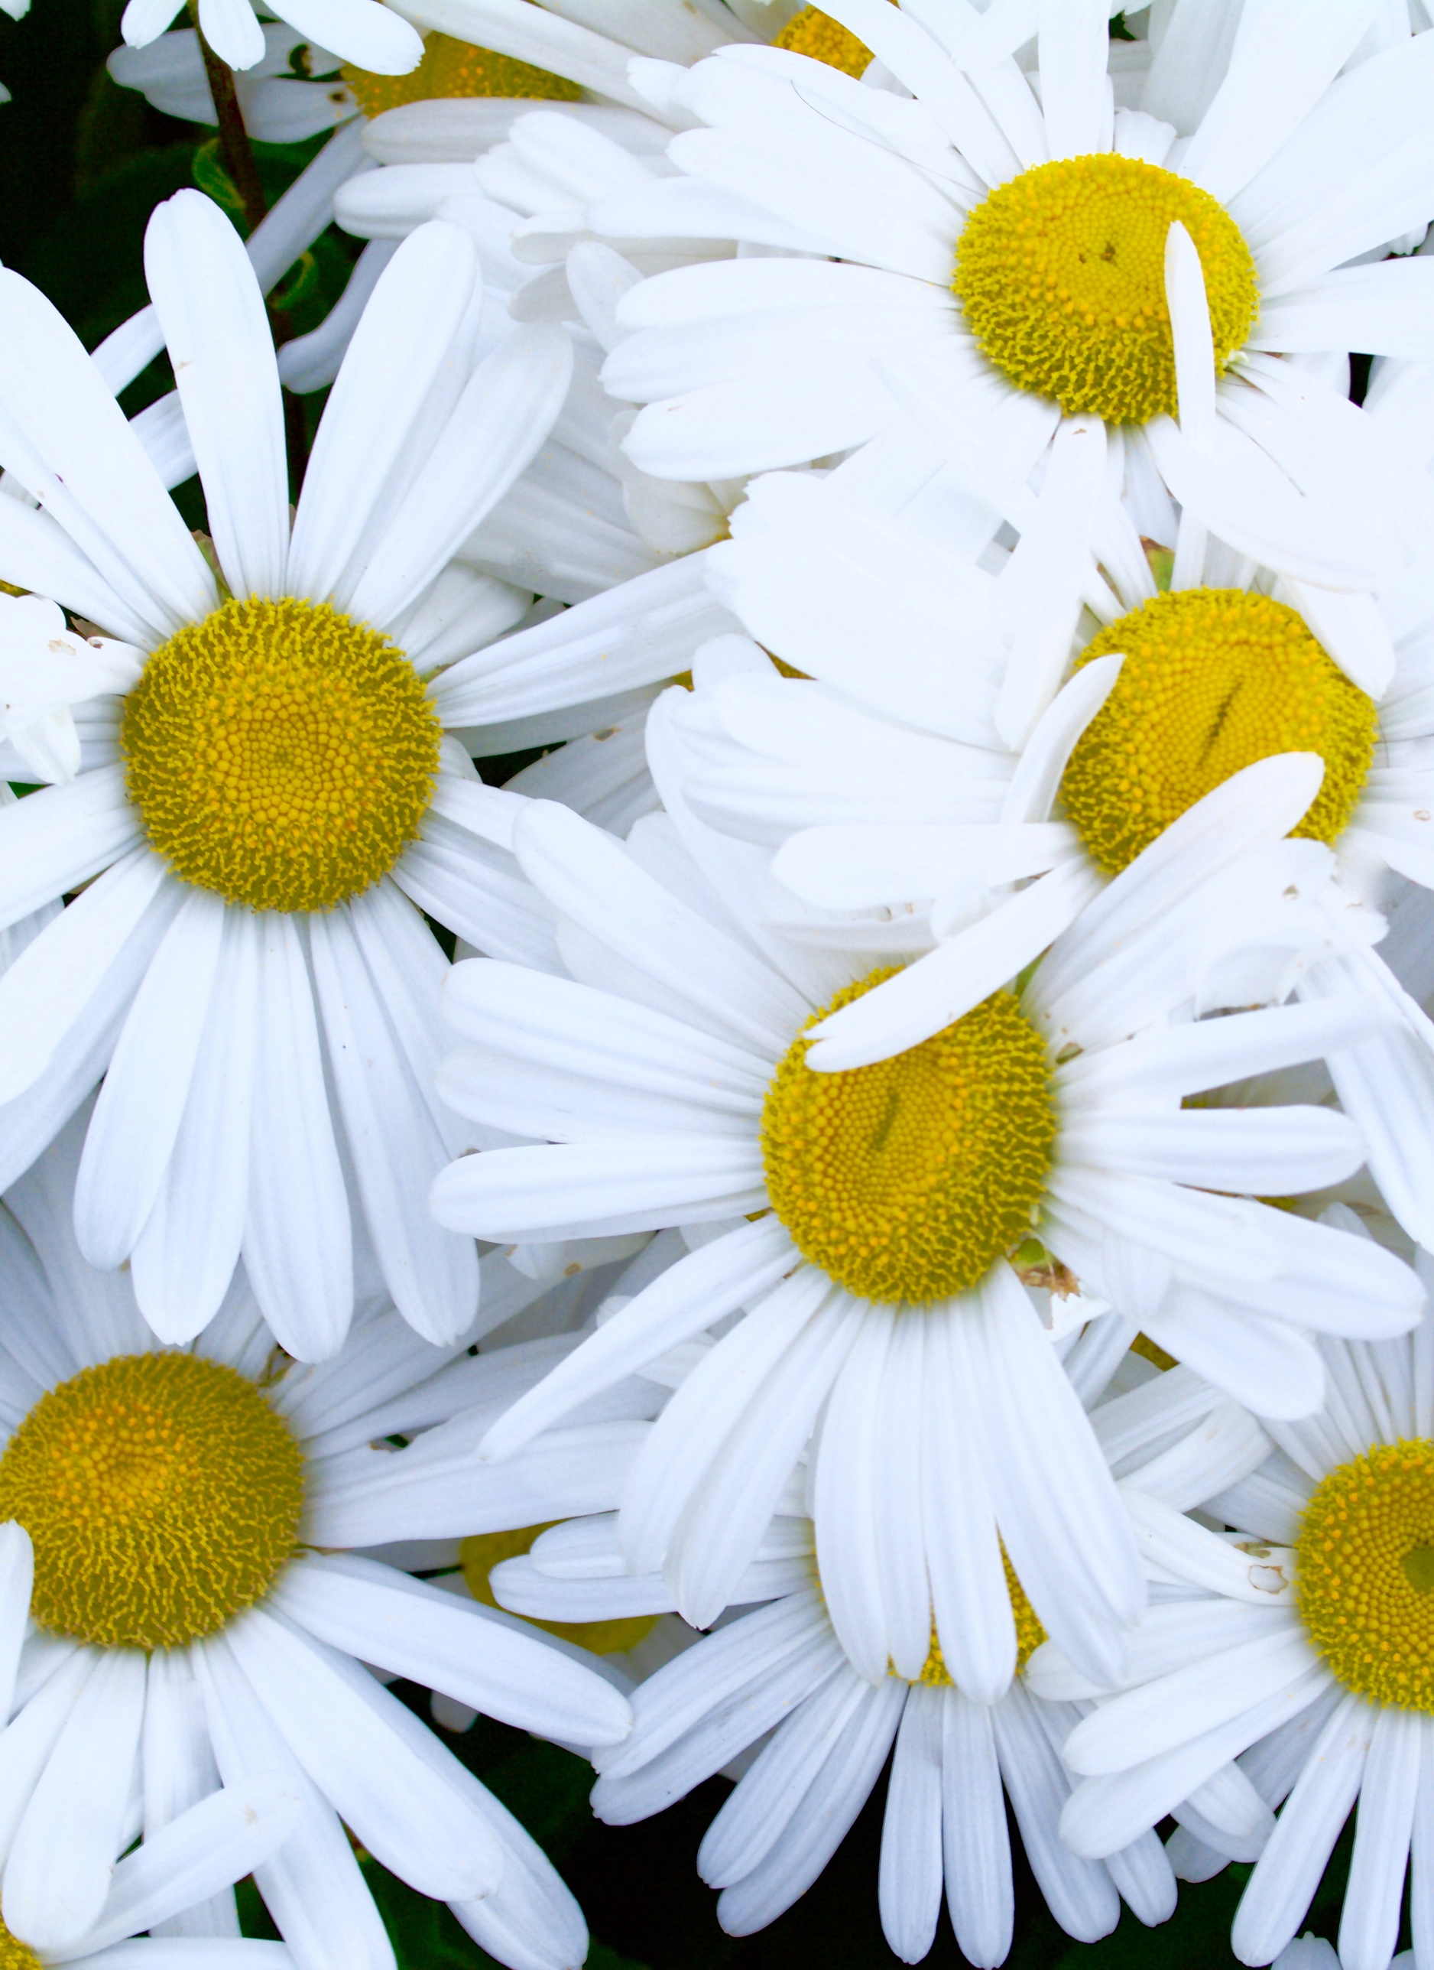
Daisy
During the Regency period (1811–1820), daisies were cherished for representing innocence, loyalty, and new beginnings, frequently appearing in literature and poetry. Known as "day’s eyes," they symbolized purity and were believed to protect children. They were a popular choice for May Day crowns and, surprisingly, were used to represent the ability to keep secrets https://floralconceptshouston.com/blog/fascinating-facts-about-daisies-you-didn-t-know https://www.americanmeadows.com/blogs/wildflower-seeds/how-to-grow-daisies https://kellogggarden.com/blog/gardening/how-to-plant-grow-and-care-for-daisy-flowers/
Notes:
I have included a white potting containers. You will use one for the Daisies. If you love what you grow, you can put in the ground the next year. Here are some instructions:
Key Tips for Success:
Best Time: Fall (preferred) or early spring (after danger of frost).
Containers: Use pots at least 12 inches deep with drainage holes. Avoid unglazed terra cotta as it dries out too fast.
Soil: Use a well-draining, all-purpose potting soil.
Light: Place in full sun (6-8 hours).
Water/Care: Water whenever the topsoil feels dry. Deadhead (remove faded flowers) regularly to promote more blooms.
Zone 8 Considerations: In humid SC summers, ensure good airflow to prevent disease. For winter, move pots to a sheltered, warmer spot to protect them

Slide 9
Cheat sheet for wildflowers Cheat sheet for Daisies
In USDA Zones 8a and 8b, plant daisy seeds outdoors in early spring (March to April) once the soil warms, or in fall for blooms the following year , Key Planting Tips for Zone 8:
Direct Sowing: Sow directly outdoors in early spring (March/April) when soil temperatures are around
.
Site: Plant in full sun with well-draining soil, note American Meadows.
Method: Simply press seeds into the soil rather than covering them, as they need light to germinate
\In USDA Zones 8a and 8b, the best time to plant wildflowers is in the fall, specifically from September to December, with October and early November being ideal. Planting in fall allows seeds to establish root systems and undergo winter stratification before blooming in spring. Alternatively, seeds can be sown in early spring (late February to early April), after the last frost.
Key Tips for Zone 8a/8b:
Fall Sowing: Planting just before the rainy season starts helps with germination.
Spring Sowing: If waiting for spring, ensure it is after the last hard freeze to avoid killing new sprouts.
Method: Clear the area of weeds, sow seeds on top of the soil, and press them into the ground without covering them deeply
Prep: Many natives thrive when seeded before winter, allowing them to benefit from freezing temperatures

Slide 10
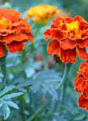
marigolds (specifically pot marigolds) were among the flowers grown in the cottage garden at Chawton, which Jane Austen knew and loved. They are part of the traditional, fragrant, and functional plants featured in her personal gardens, often mentioned alongside roses, lavender, and hollyhocks in accounts of her gardening. https://janeausten.co.uk/blogs/jane-austen-life/jane-austens-flower-garden
Notes:
Quick Guide to Growing Marigolds in South Carolina
Plant Type: Warm-season annual
Height/Spread: 6 inches to 3 feet tall, varies by cultivar
Sunlight Needs: Full sun (6 or more hours daily)
Soil Type: Well-drained loamy soil, slightly acidic (pH 5.5 to 7.0)
Bloom Time: Early summer to frost
Water Needs: About 1 inch per week; let the soil dry between waterings
Uses in Landscape: Borders, mass plantings, containers, cut flowers, cover crops
Maintenance Tips: Remove spent blooms; stake tall African types if needed
Deer Resistance: Yes – foliage is strongly scented and unappealing to deer
About Marigolds (Tagetes spp.)
Marigolds are easy to grow, economical, bloom reliably all summer, and have few insect and disease problems. These bright, cheerful flowers thrive in South Carolina’s warm climate and are suitable for both beginner and experienced gardeners.

Slide 11
Cheat sheet for Marigolds Cheat sheet for Mint
In USDA Zones 8a and 8b, plant marigold seeds indoors in early March (6–8 weeks before the last frost). Direct sow seeds outdoors or transplant seedlings in mid-March to April, once all danger of frost has passed.
Planting Timeline for Zones 8a/8b
Start Indoors: Early March.
Direct Sow/Transplant: March 15 to April 1 (after the last frost).
Tips for Success:
Last Frost: Zone 8a typically has its last frost around April 1-15, while 8b is often March 15-April 1.
Conditions: Marigolds need warm soil and full sun to thrive.
In Zone 8a and 8b, plant mint seeds directly outdoors in March, once the danger of the last frost has passed. For earlier growth, start seeds indoors 8 to 10 weeks before the last frost date, which typically falls between March 15 and April 15 in these zones.
Key Planting Details for Zones 8a/8b:
Direct Sowing: March is the recommended time for planting seeds directly into the garden.
Conditions: Plant in moist, well-draining soil once it has warmed.
.
Pro Tip: Because mint is highly invasive, plant seeds in pots or containers to prevent them from taking over the garden

