Slide 1

SLA Timeline Comparison: Old Timeline Process vs. New Process (Archer)
Stage / Activity | Previous Timelines (FND) | New Timelines (Archer) | Reduction
Initial Review Cycle (Validator + QC Only) | 37 Days (30 Validator + 7 QC) | 30 Days (23 Validator + 7 QC) | 19%
Draft Submission | 30 Days | 15 Days | 50%
Resubmission Window | 30 Days | 10 Days | 67%
QC Review (Resub) | 7 Days | 4 Days | 43%
Validator Review (Resub) | 30 Days | 6 Days | 80%
Total Resubmission Cycle | 67 Days (30 Resub + 30 Valid + 7 QC) | 20 Days (10 Resub + 6 Valid + 4 QC) | 70%

Slide 2

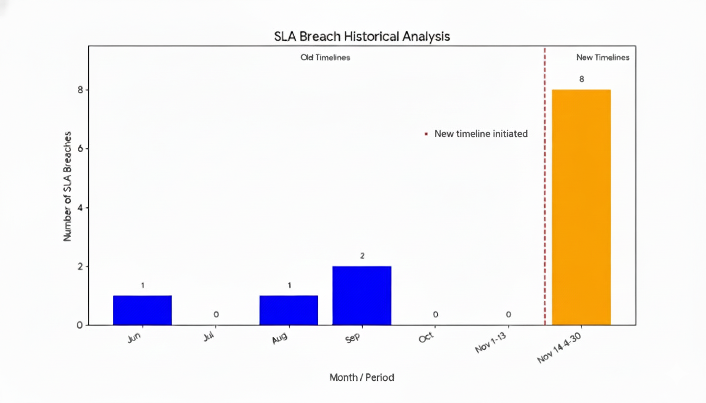

SLA Breach Impact: Timelines vs. Volume
The introduction of the 10-day resubmission window corresponds with the sudden rise in SLA breaches, as the limited timeframe is leading records into SLA.
In Old Timeline (Jun–Oct), SLA breach volume remained low at 0–2 per month​
In New Timeline (Nov-15) SLA breaches have increased due to the shortened timelines.
In the first month of the new timelines, breaches are higher than the total from the previous five months in the old timelines.

