Slide 1

SLA Timeline Comparison: FND vs. Archer
Stage / Activity | Previous (FND) | New (Archer) | Reduction
Initial Review Cycle (Validator + QC Only) | 37 Days (30 Validator + 7 QC) | 30 Days (23 Validator + 7 QC) | 19%
Draft Submission | 30 Days | 15 Days | 50%
Resubmission Window | 30 Days | 10 Days | 67%
QC Review (Resub) | 7 Days | 4 Days | 43%
Validator Review (Resub) | 30 Days | 6 Days | 80%
Total Resubmission Cycle | 67 Days (30 Resub + 30 Valid + 7 QC) | 20 Days (10 Resub + 6 Valid + 4 QC) | 70%

Slide 2

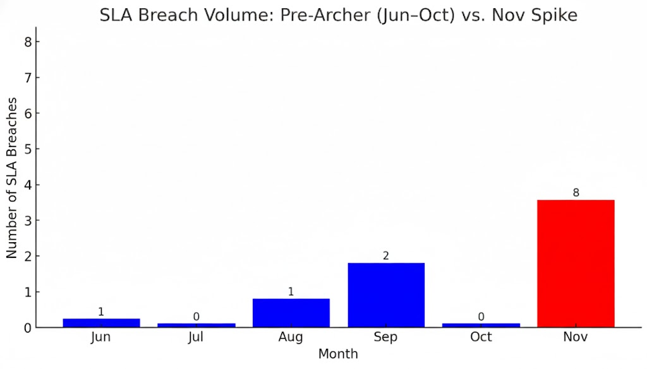


SLA Breach Impact: Timelines vs. Volume
The introduction of the 10-day resubmission window corresponds with the sudden rise in SLA breaches, as the limited timeframe is leading records into SLA.
In FND (Jun–Oct), breach volume remained low at 0–2 per month
In Archer (Nov), breaches increased to 8 due to the shortened timelines.
Conclusion: In the first month of Archer, breach volume is higher than the cumulative total of the prior five months.
Breach Volume Spike Post-Archer Migration

Slide 3
SLA Breach Impact: Timelines vs. Volume
*Estimated
Number
The introduction of the 10-day resubmission window corresponds with the sudden rise in SLA breaches, as the limited timeframe is leading records into SLA.
In FND (Jun–Oct), breach volume remained low at 0–2 per month
In Archer (Nov), breaches increased to 8 due to the shortened timelines.
Conclusion: In the first month of Archer, breach volume is higher than the cumulative total of the prior five months.
Estimated number based on SLA breaches since process timeline change (3rd November 2025)
Breach Volume Spike Post-Process Timeline Change

