Slide 1
Corrections to 2020 NEC Changes

Slide 2
Correction:
110.26(A)(3)- the following slide has the correct 6.5ft. dimension on the graphic. The original slide may have incorrectly shown 6ft. as the dimension.

Slide 3
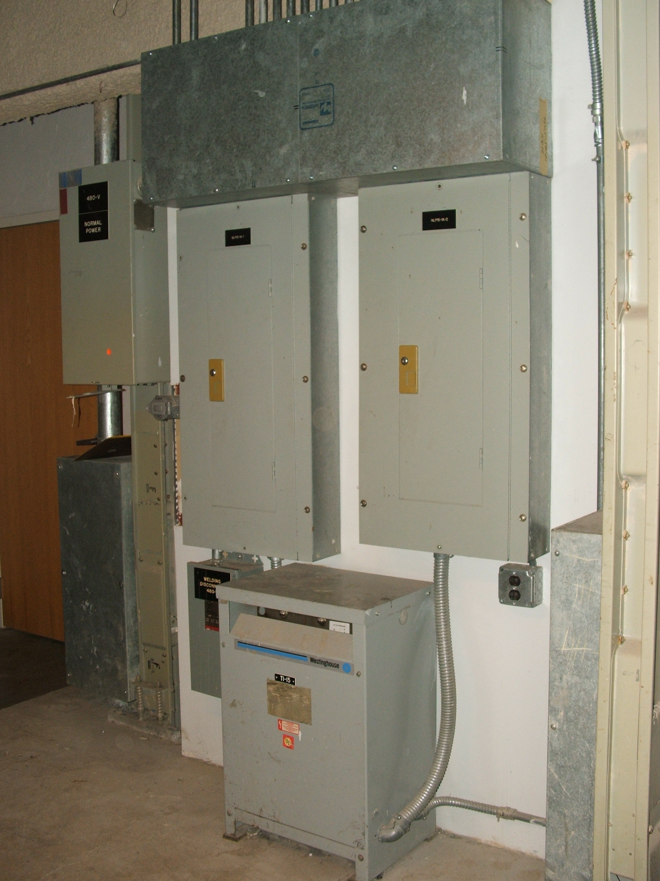
Working Space in front of these panelboards must be clear from the floor to a height of at least 6 ½ ft. or the height of the equipment!
6.5ft. Min.

Slide 4
Corrections:
310.12- The following slides have the correct reference to 310.15(B)(1). The original slides may have incorrectly stated 310.15(B)(2)(a)

Slide 5
310.12 NEC Examples
Breaker Wire Amps T310.16
100A X 83% = 83-amp wire min. = #4 CU. THW (85 amps)
But…if adjusted for an ambient temperature
of 90 degrees F……310.15(B)(1)
#4 CU. THW=
85 amps X .94 = 79.9amps
TOO SMALL !

Slide 6
310.12 Examples
Breaker Wire Amps T310.16
100A X 83% = 83-amp wire min. = #4 CU. THW-2 (95 amps)
However, if THW-2 is used instead of THW…
#4 CU. THW-2 =
95 amps X .96 = 91.2 amps
OK!

Slide 7
310.12 Examples
Breaker Wire Amps T310.16
200A X 83% = 166-amp wire min. = 4/0 AL. THW (180 amps)
However…if adjusted for an ambient temperature
of 96 degrees F…… 310.15(B)(1)
4/0 AL. THW=
180 amps X .88 = 158.4-amp wire……..TOO SMALL!
250Kcmil (205amps) X .88 = 180.4-amp wire…OK!

Slide 8
Correction
Following slide has the correct revised wording. The original slide for 404.14(F) mistakenly stated “cord-and-pug connected”. Pretty funny but obviously incorrcect.

Slide 9
404.14(F) Cord-and-Plug Connected Loads
Where a snap switch or other control device controls cord-and-plug connected loads on a general-purpose branch circuit, the snap switch or control device shall have a rating not less than the rating of the branch circuit overcurrent device.
This rule was added to minimize the possibility of overloading a switch.
For example, 15-amp switches could not be used on a 20-amp circuit.

Slide 10
Correction:
517.31(E)- The following slide has the correct revised wording. The original slide incorrectly stated “The covers must be a distinctive color!”

Slide 11
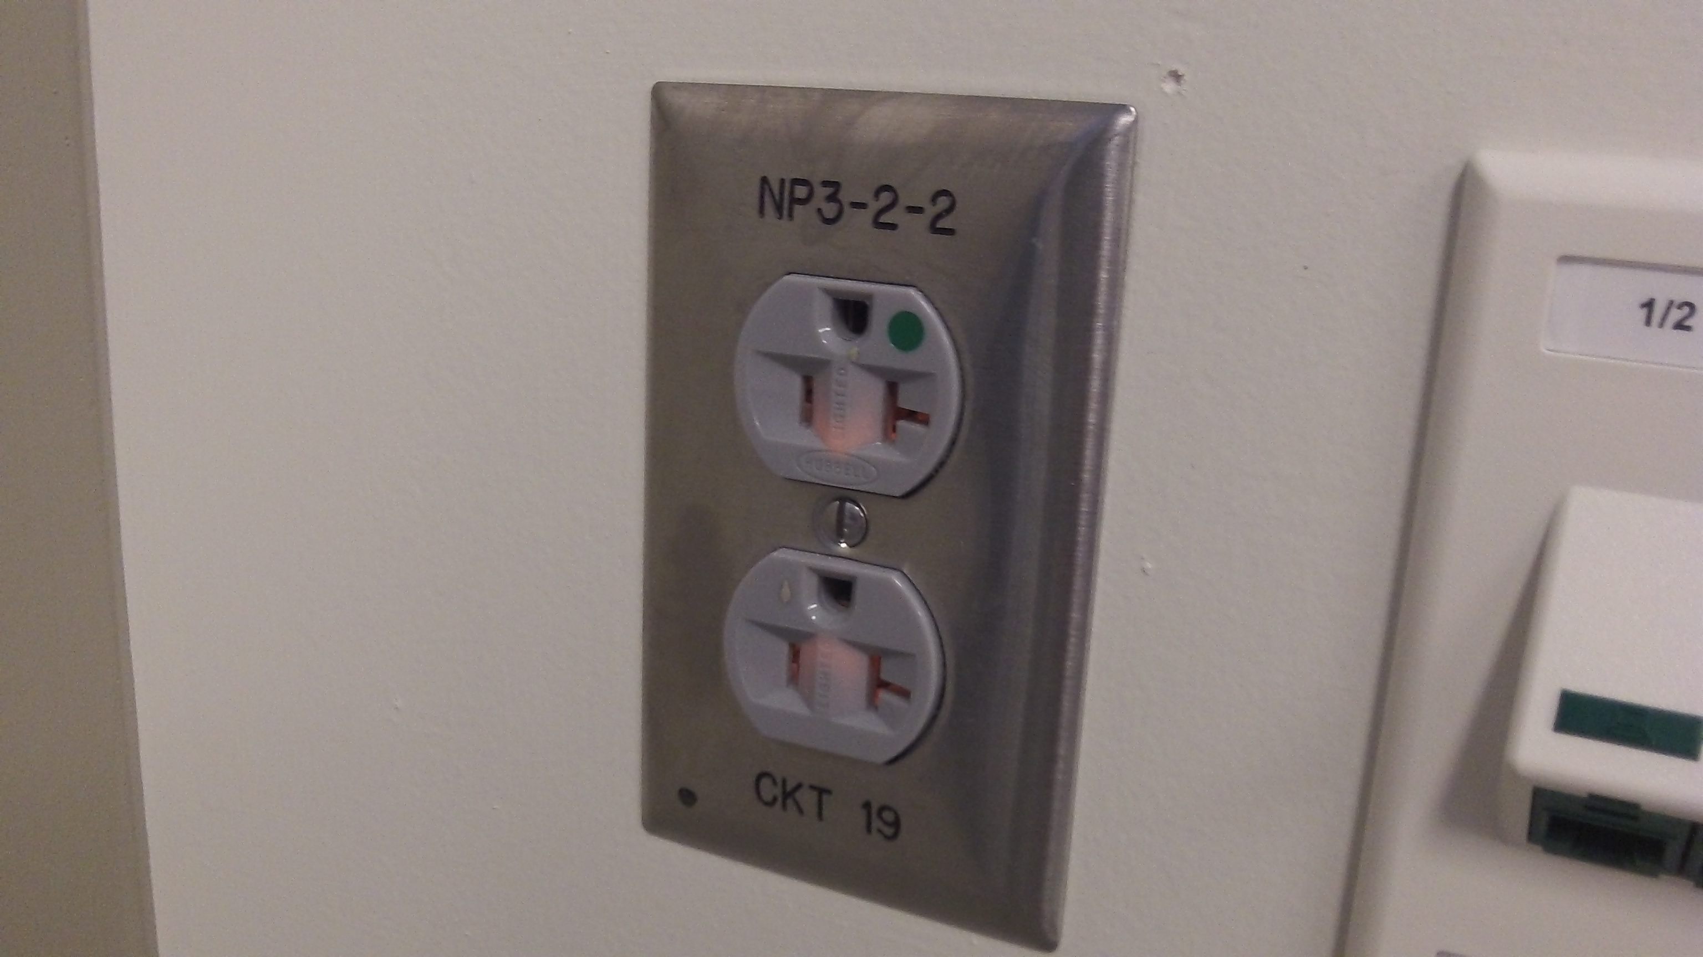
517.31(E)- Normal power receptacles or plates are not required to be a distinctive color!

Slide 12
Correction
625.6- The following slide has been revised. It incorrectly stated 625.6 instead of 625.54.

Slide 13
625.54 GFCI Protection for Personnel
In addition to the requirements in 210.8, all receptacles installed for the connection of electric vehicle charging shall have GFCI protection for personnel.
This new rule makes it clear that all receptacles installed for charging electric vehicles must have GFCI protection regardless of voltage, amperage, configuration, or location!

Slide 14
Thank you for your patience!
Please contact us directly at russ@russleblanc.net if you notice any other corrections that may be needed.

