Slide 1
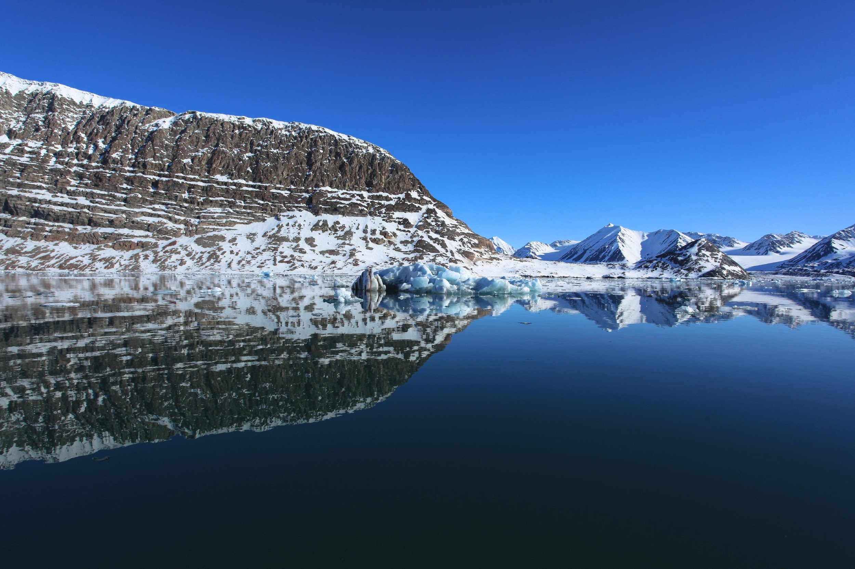


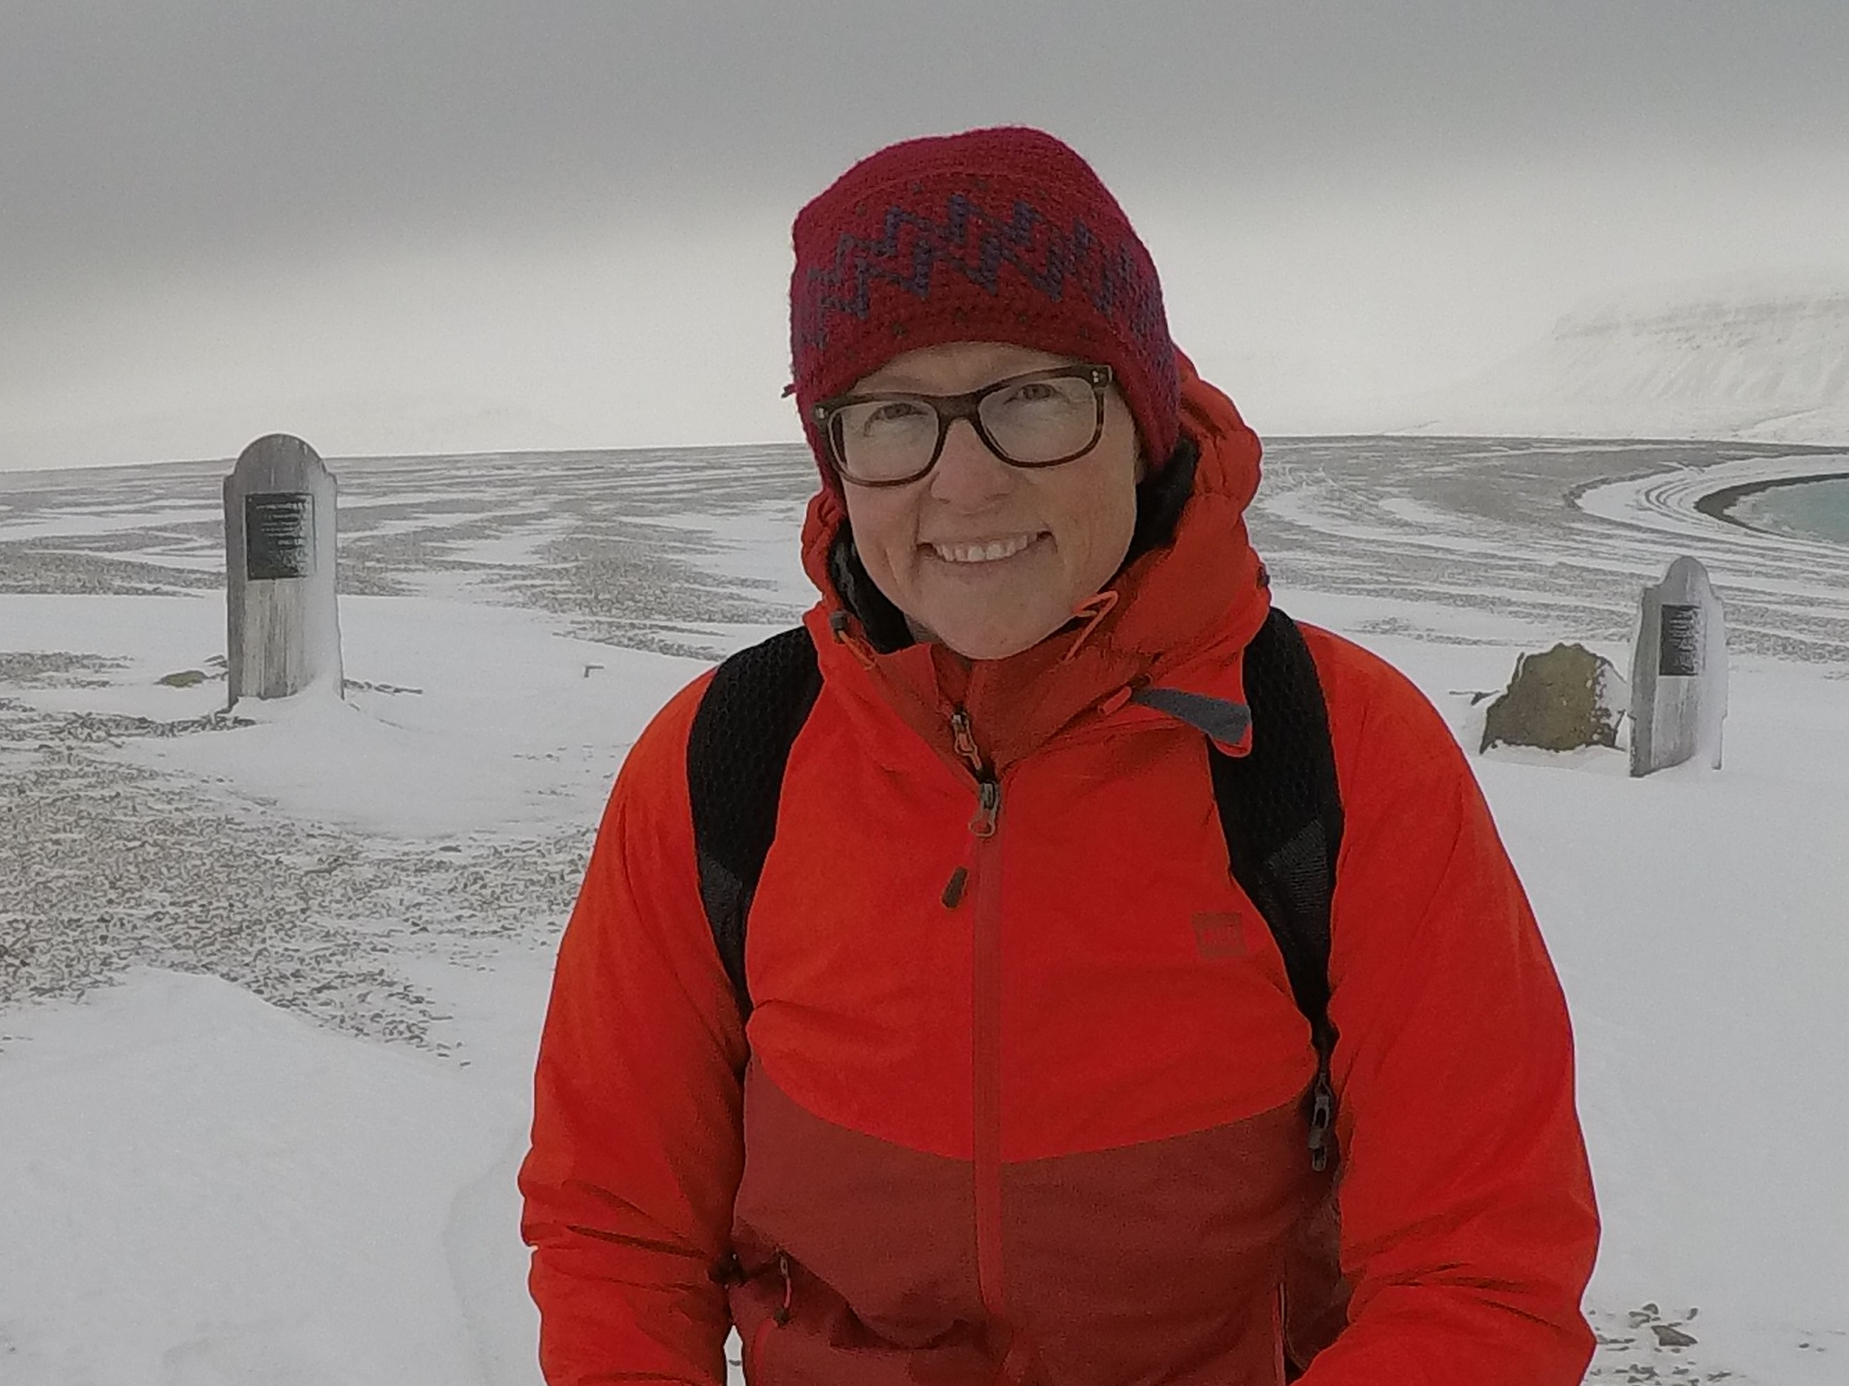







Supporting the International Decade on Indigenous Languages and Oceans Decade
13th International Forum of NGOs: “Mobilizing NGOs for the International Decade of Indigenous Languages and Ocean Decade”.
Dr. Jackie Dawson
Scientific Director

Slide 2

Since 2004, ArcticNet has been the national hub for Arctic research excellence. Bringing together scientists, engineers, and managers in the natural, human health and social sciences with their partners from Inuit organizations, northern communities, federal and provincial agencies and the private sector, ArcticNet leverages research, community building and knowledge translation.
ArcticNet contributes to the development and dissemination of knowledge needed to formulate adaptation strategies and national policies to help Canadians face the impacts and opportunities of climate and socio-economic change in the Arctic.
Notes:
Network of Centres of Excellence of Canada

Slide 3
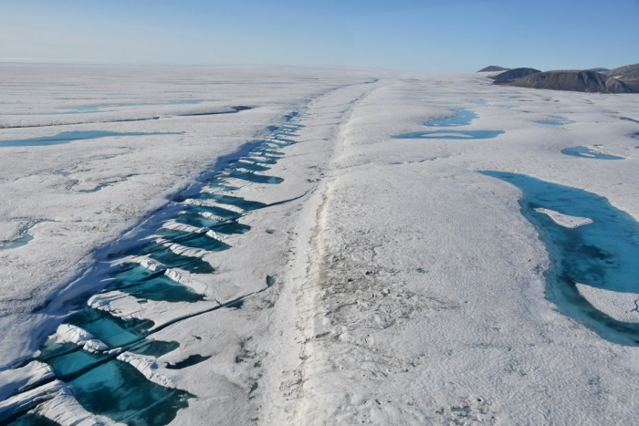
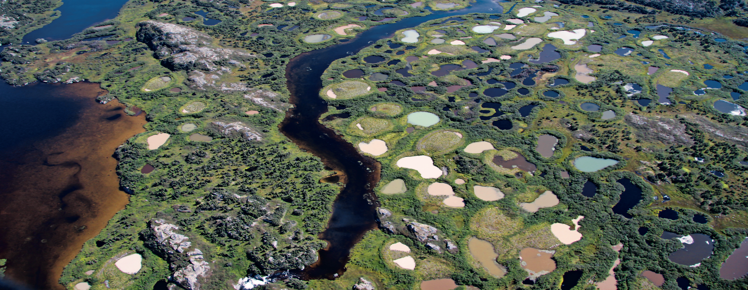
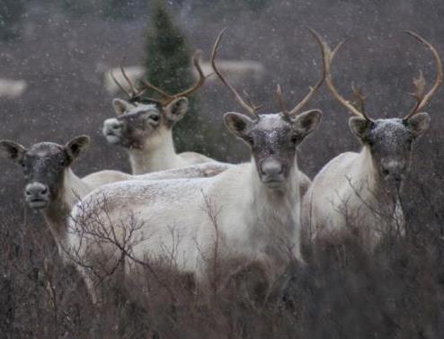
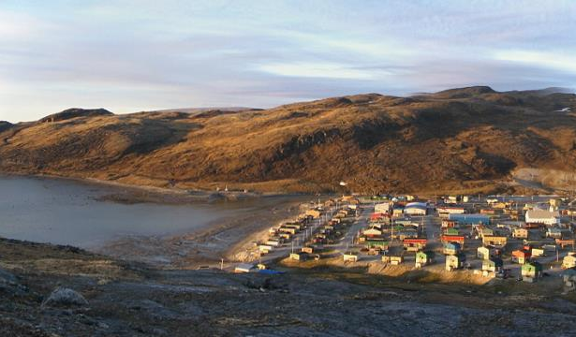
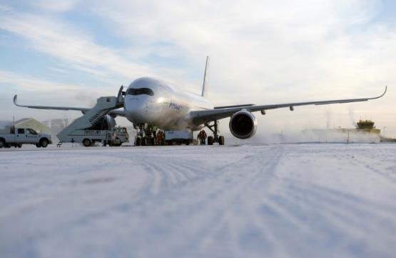
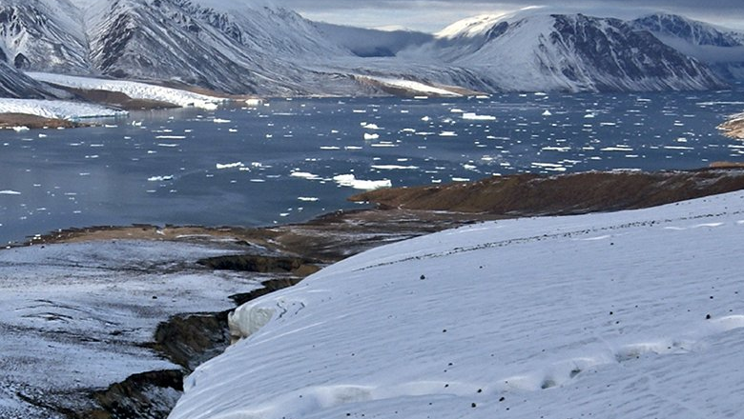
Impacts of Climate Change & Threats to Arctic Sovereignty
Rapid changes in the North are cascading from biophysical to social to economic and cultural realms with more serious consequences to the environment, northern communities and our Arctic sovereignty
Milne Ice shelf collapse (Nunavut)
“Canada’s last intact ice shelf breaks up ”
The Economist August 2020
Landscape changes (Nunavik)
Impacts on ecosystems
“I feel the whole town should move”
(Nunatsiaq News 2011)
“Thawing permafrost a growing problem for Iqaluit airport”
(CBC North)
Loss of sea ice leading to opening of the Northwest Passage

Slide 4
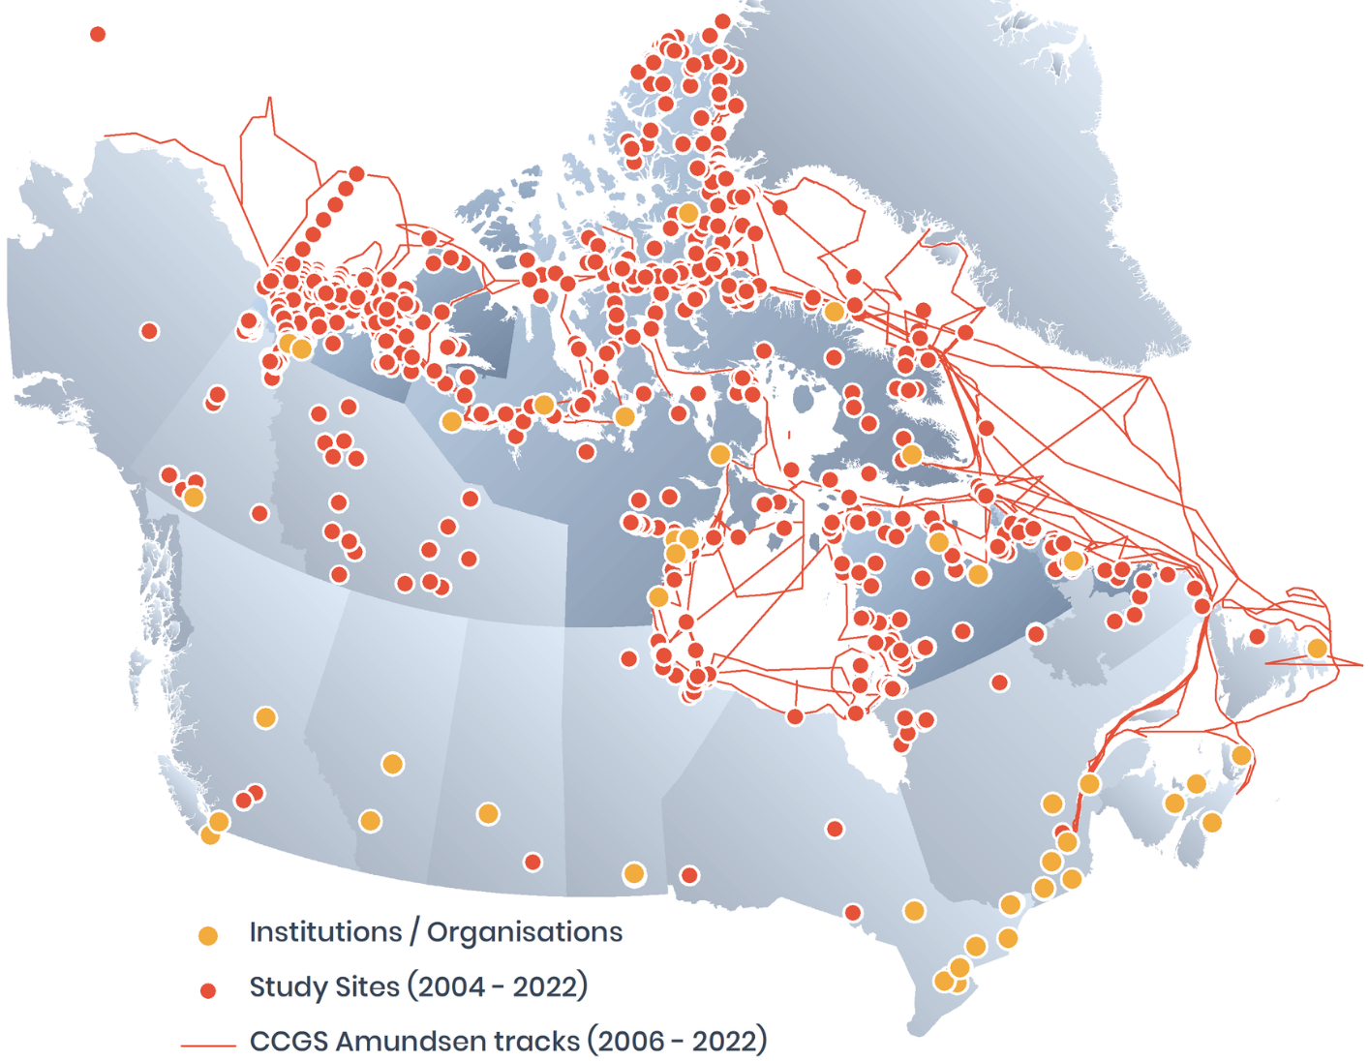
Research
Footprint
2004-2024

Slide 5
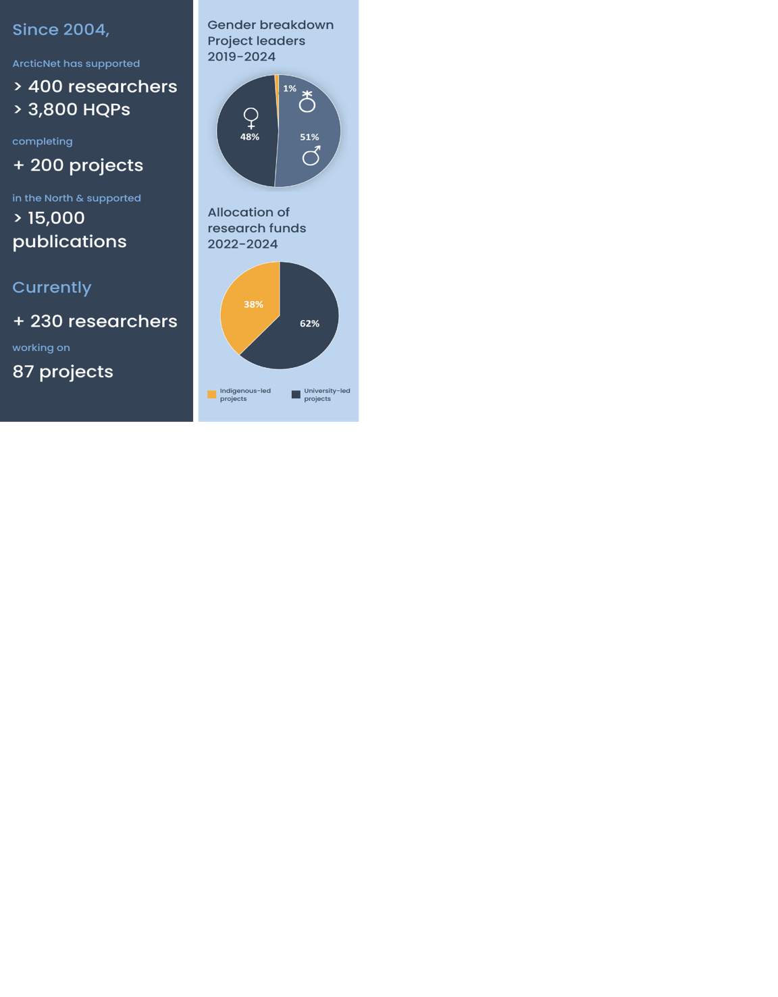





ArcticNet - at a Glance
ArcticNet is actively engaging with:
60 Indigenous partners
48 communities in all provinces & territories
+40 universities & northern colleges
8 federal & 11 provincial government agencies
international research collaborations, including: United Kingdom Denmark, Finland, France, Greenland, Japan, Norway, Poland, Spain, Sweden, Portugal, and United States
Notes:
Canada’s largest investment to date in northern research: $146.2 million for 2003-2025

Slide 6
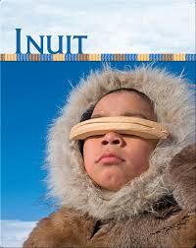
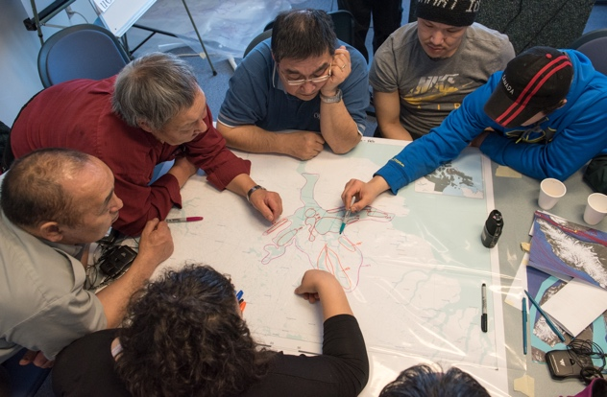
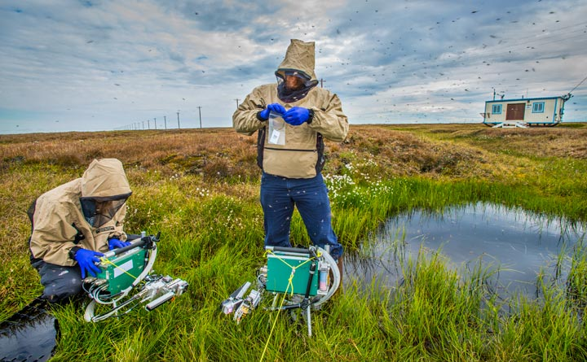
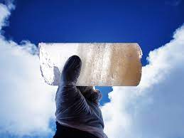
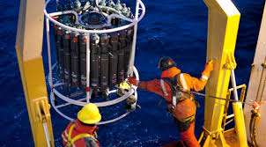
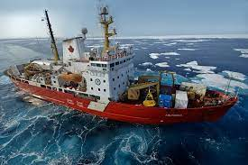
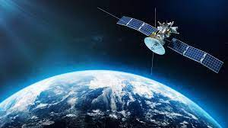
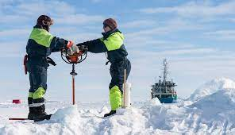
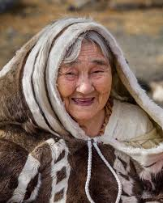
How we do research
How we do research

Slide 7
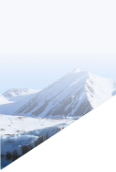
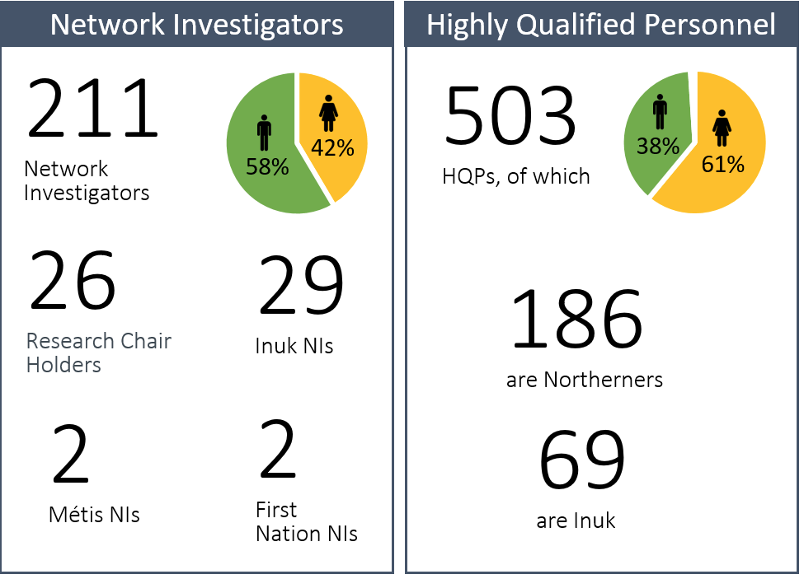
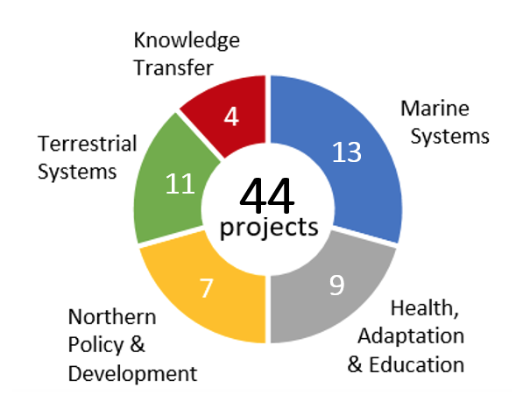


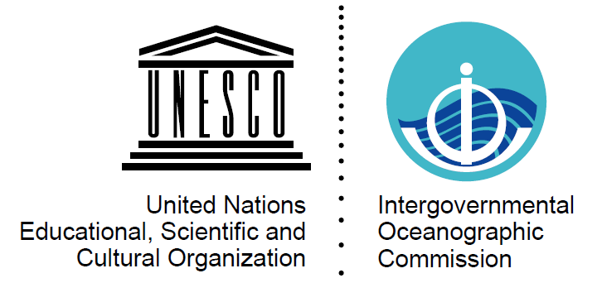

Academic Program (2022-2024)
Joint Postdoctoral Fellowships
• 5-9 projects ($200K)
High Impact Publications Program
• 10 projects ($848K)
UN Decade Endorsed Projects
• 4 projects ($1.2M)
Notes:
An overview of our science program = multidisciplinary research with projects in knowledge transfer, terrestrial, marine, northern policy and development, and health-education-adaptation
Over 211 researchers in this new funding phase at 34 Canadian universities, and over 15 post-secondary institutions, northern colleges and Inuit organizations.
An extremely important component is our Highly Qualified Personnel (students, research assistants), over 500 of which 186 are Northern HQP (including 69 Inuit).
As you can see, and study sites cover all geographic regions of Canada's North with a multitude of offshore, coastal & deep sea sites that do not appear on the map.
Terrestrial – vegetation, wildlife (caribou, Arctic char, salmon, muskox), biodiversity, freshwater systems including wetlands, rivers & lakes, geomorphology, glaciers
Marine – FISHERIES, deep sea to intertidal zones, sea ice levels, ocean bathymetry & currents, ocean productivity & biodiversity
Inuit health – from emerging diseases, zoo-noses, mental health, education systems adapted to northern realities, and adaption tools
Policy – management and policy-related work for fisheries, development of conservation areas
Knowledge exchange – communicating science in the North and connecting Indigenous knowledge systems with western science
The new CFP is in partnership with UNESCO's Intergovernmental Oceanographic Commission (IOC) and Mitacs, partially funded by Fisheries and Oceans Canada (DFO) at $500K over 2 years and ArcticNet will fund up to $1.5-2M. The deadline to apply was Feb 18th and we received 23 eligible applications, with a total ask of $6,4M. 11 were funded under new call for a total of $2,5M.
Currently funded projects under the Core Research Program (2019-2023) could request a one-year extension as part of their annual progress reporting. ArcticNet had budgeted approximately $750K and the total ask is over $2M. To be eligible, currently funded projects must demonstrate: outstanding quality of research achieved, relevance of the objectives, continued support for HQP training, far-reaching outcomes for northern communities, and the project’s global impact. Of our 31 projects, 25 have requested an extension. These new Core Program applications, project renewals, and extension requests will be evaluated at the 15-16 March RMC meeting.
From 2004 to 2020, all of our funded researchers were university researchers. During our last renewal in 2019, we created with our inuit & northern partners, the North-by-North program so that we can directly fund northern researchers who are not university based. This new program is a huge success....

Slide 8
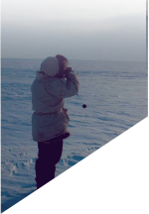
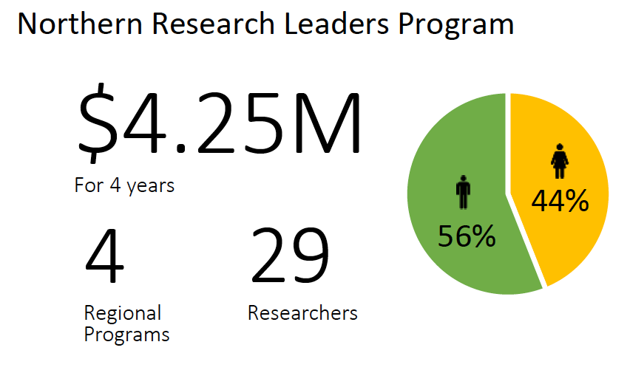
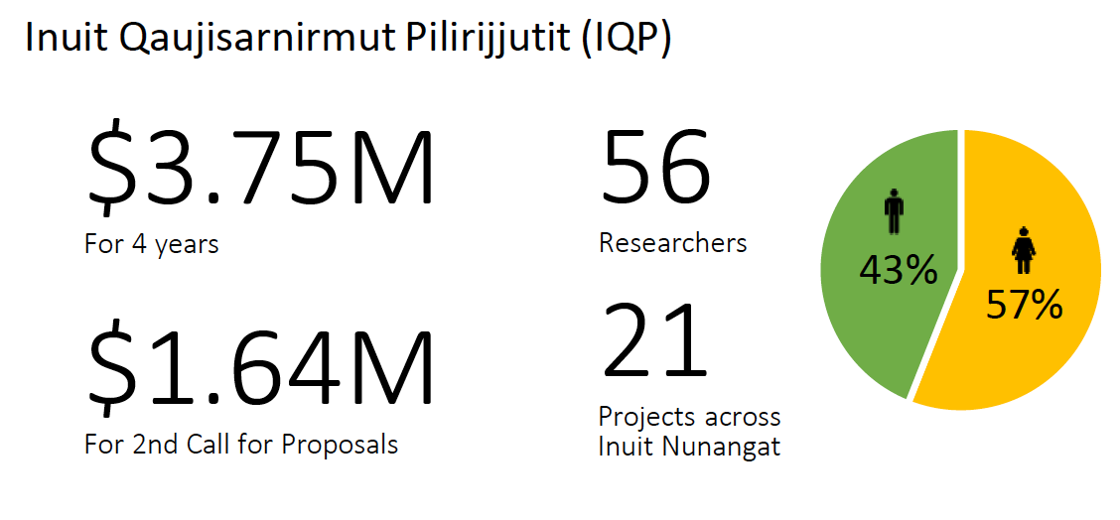










North-by-North Program (2022-2024)
Notes:
The North-by-North program was co-created by partners across Canada’s North and is a leader in advancing self-determination in research, supporting Northerners to design and lead research, and building capacity for research and training activities that respond to northerners’ needs.

Slide 9
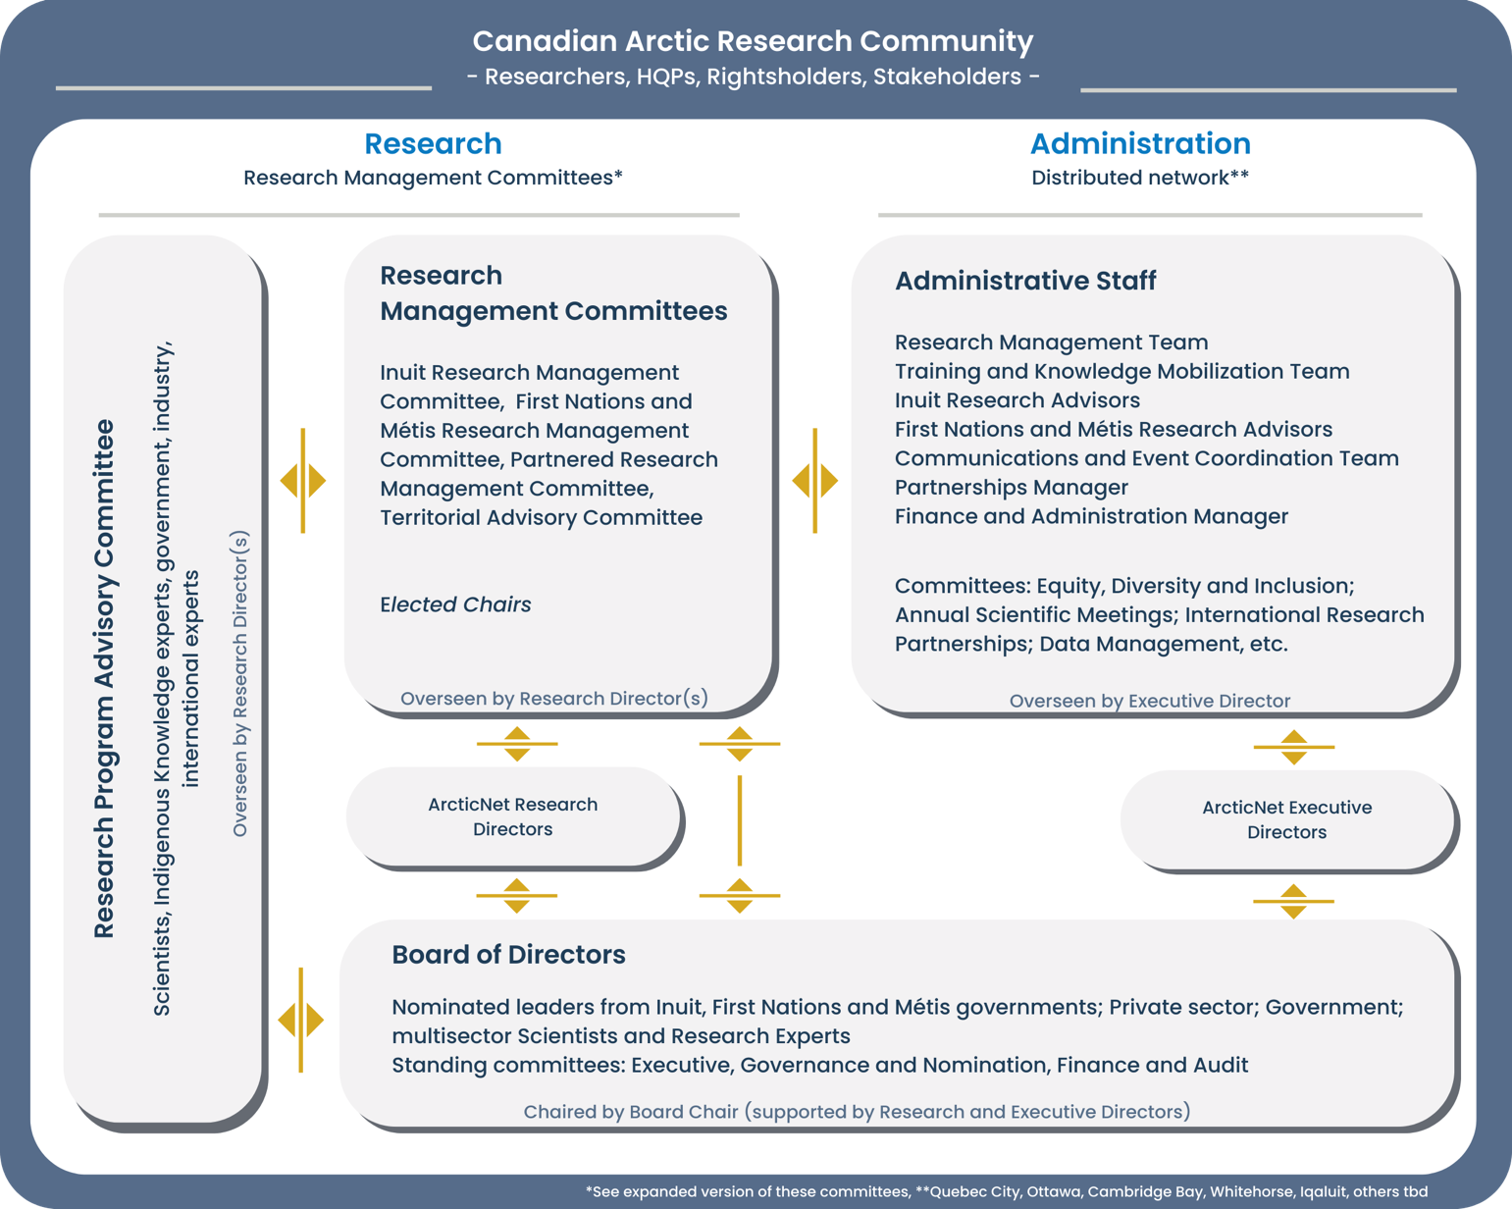
Network Management

Slide 10
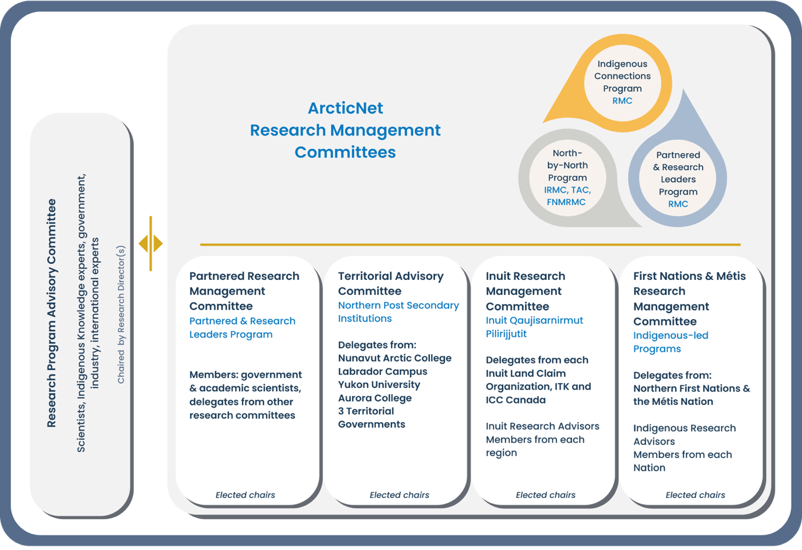
P204 - Fortune, Sarah
An ecosystem approach to quantifying behavioural and energetic impacts of anthropogenic disturbance to Arctic whales
Total cost: $150,000
External cash and in-kind: $2,285,715
P206 - Limoges, Audrey & Ardyna, Mathieu
Rapidly changing ecosystem dynamics in the Arctic Ocean’s Last Ice Area (RED-AO)
Total cost: $350,000
External cash and in-kind: $1,712,024
P221 - Mueller, Derek
Weather and aajurait (lead) monitoring for sea ice safety during the break-up season
Total cost: $194,680
External cash and in-kind: $307,000
P209 - Sharma, Sapna
Future Arctic Mobilities: Informing transportation adaptation through climate observations and model projections of changing snow and ice
Total cost: $256,500
External cash and in-kind: $99,000
Governance
Research Management

Slide 11
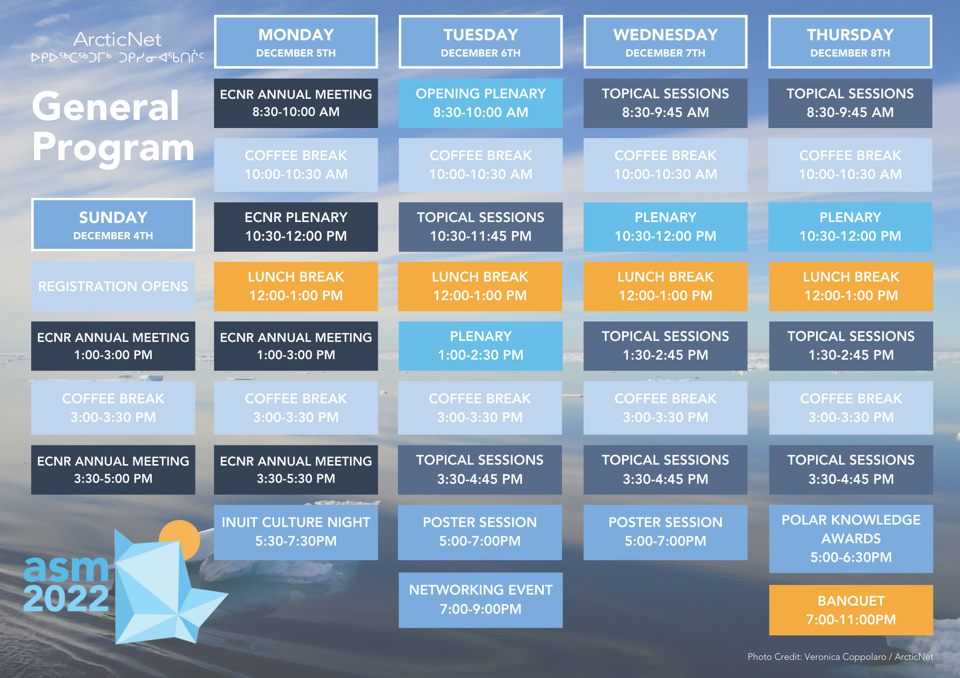
4-8 Dec.
Toronto, ON.
Network Initiatives (2021-2022)
Plenary:
Ocean Decade Initiatives for a Changing Arctic

Slide 12
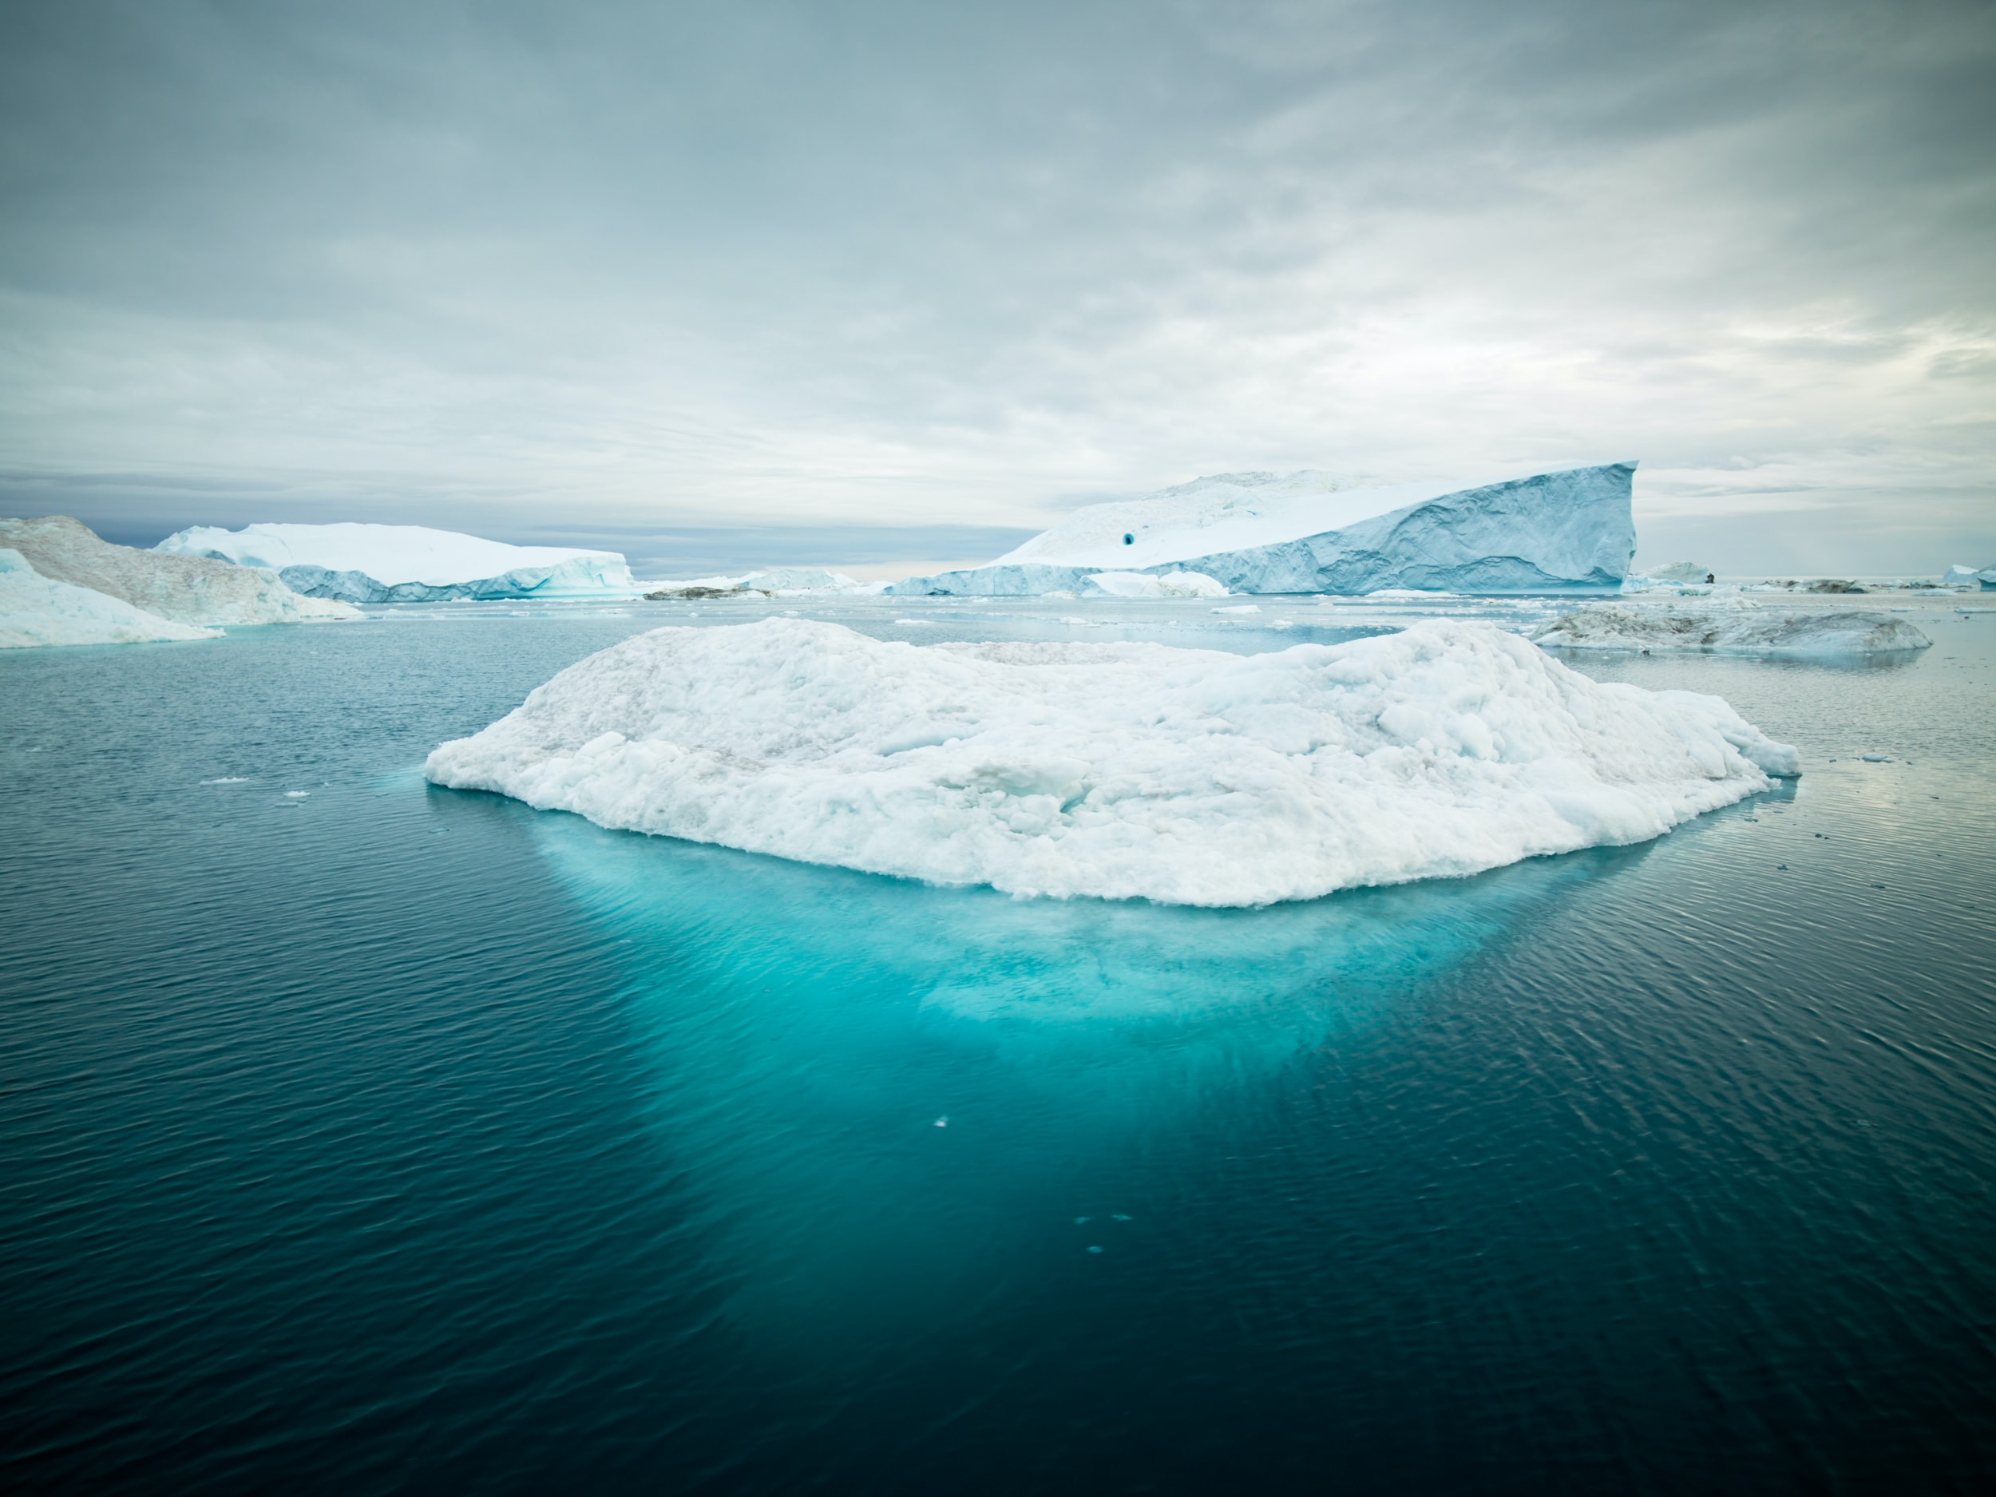

Dr. Jackie Dawson
Scientific Director, ArcticNet
Canada Research Chair (Tier 1) in Human & Policy Dimensions of Climate Change
Professor, University of Ottawa
jackie.dawson@uottawa.ca
Phone number: 613-505-0303

