Slide 1
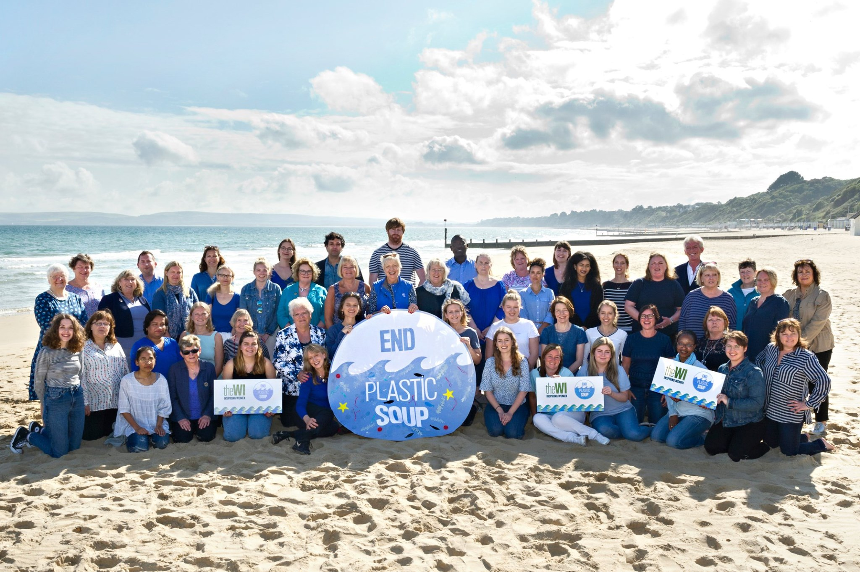
National Federation of Women’s Institutes
End Plastic Soup campaign

Slide 2
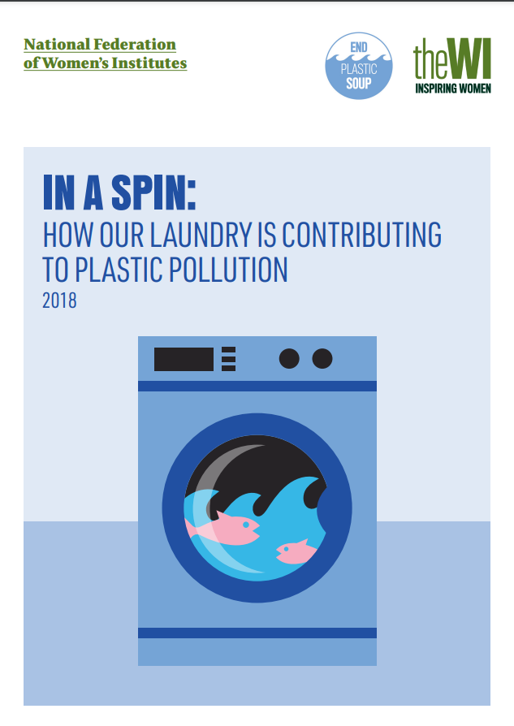
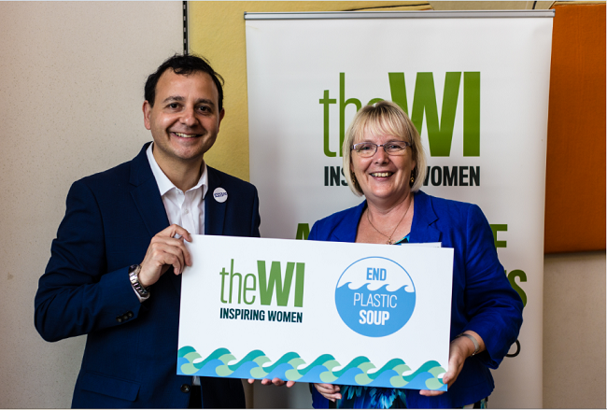
Raising awareness of microplastic pollution

Slide 3
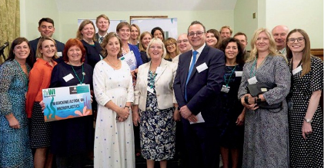
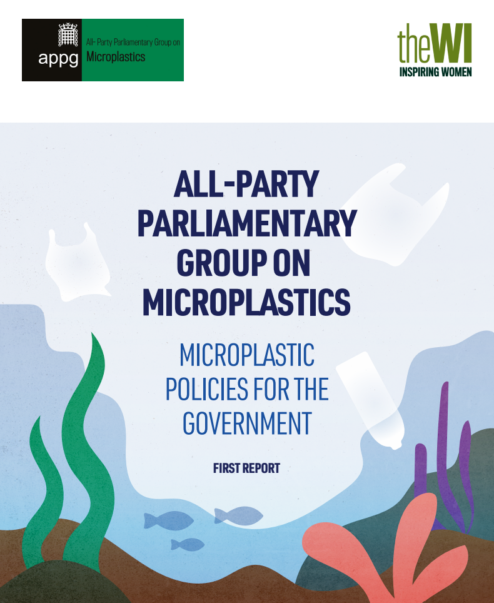
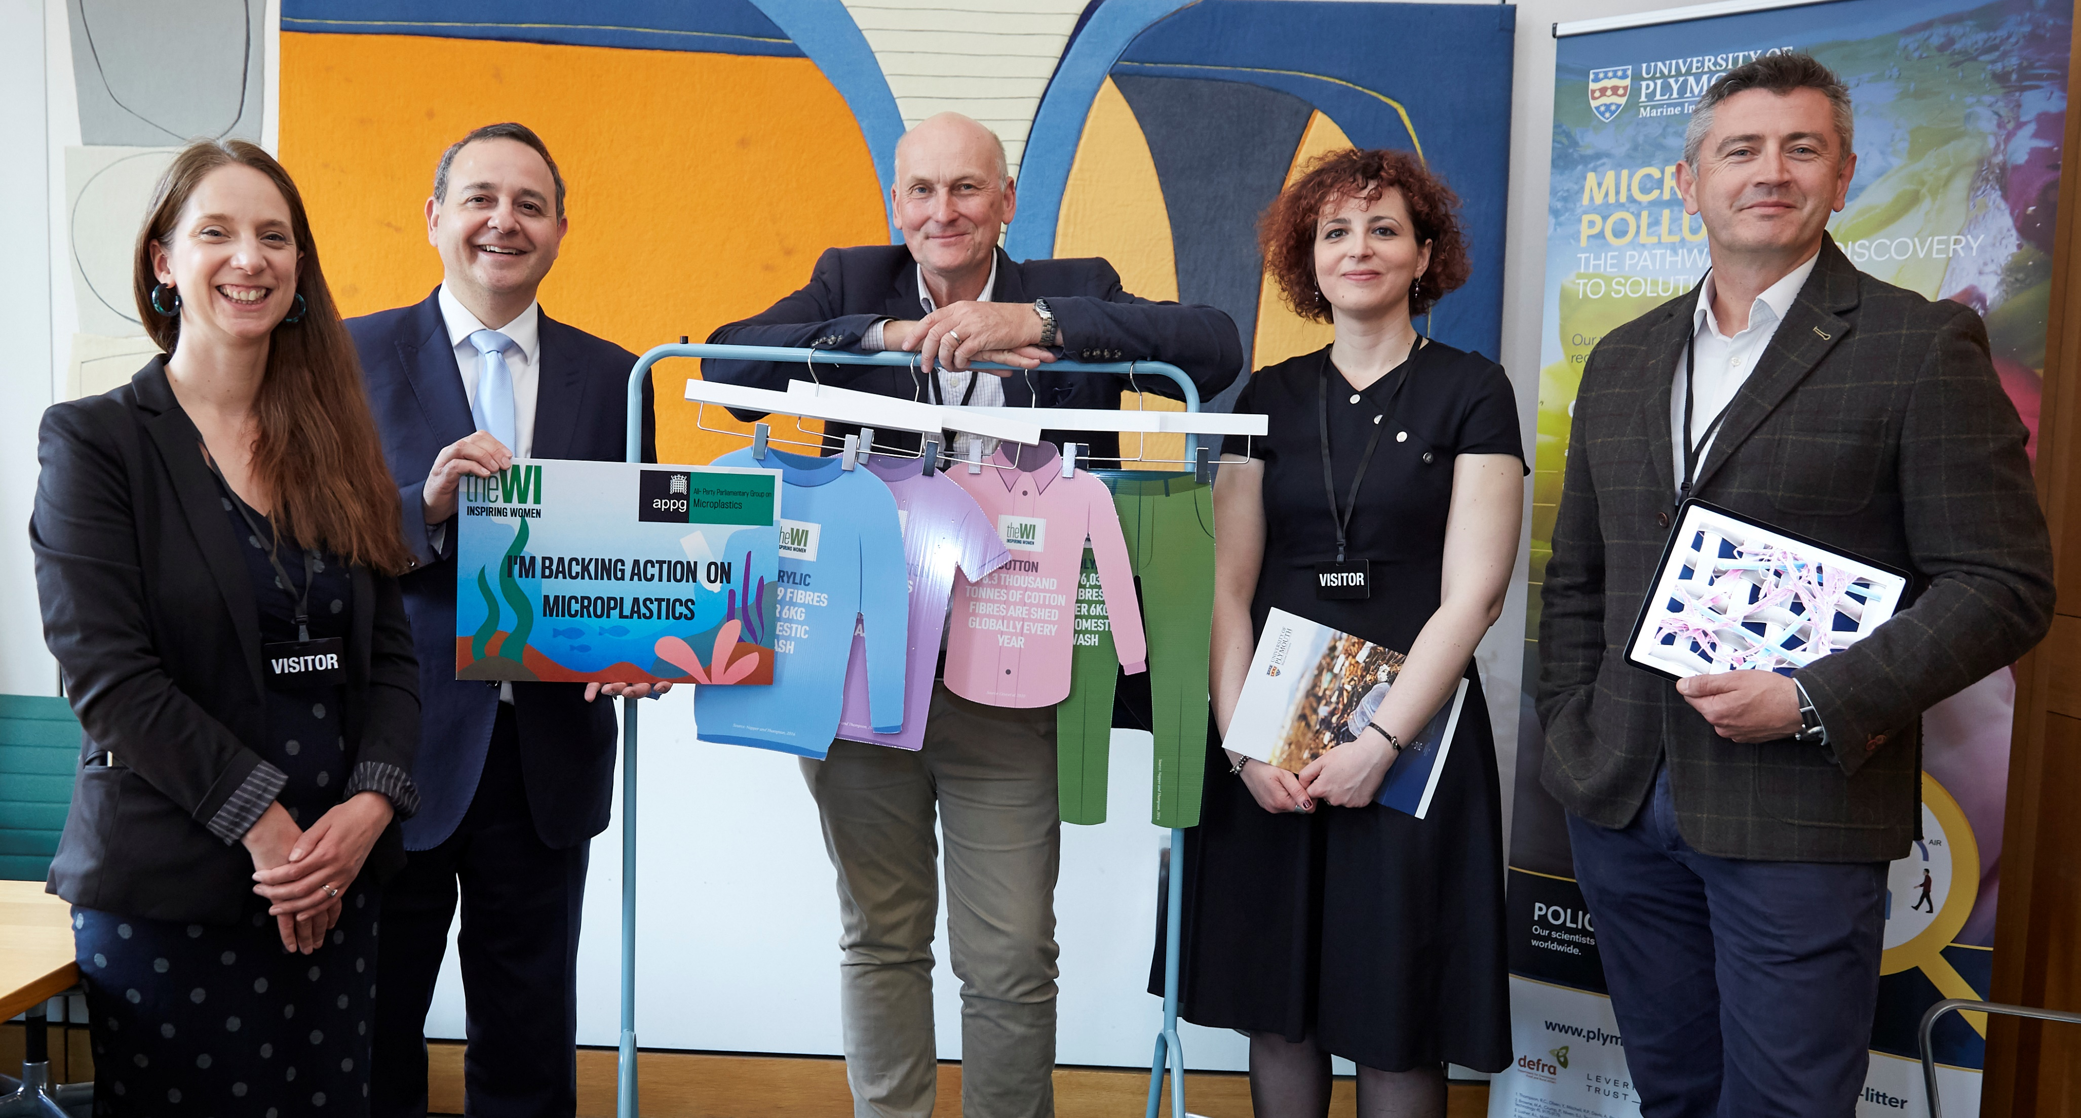
The APPG on Microplastics

Slide 4
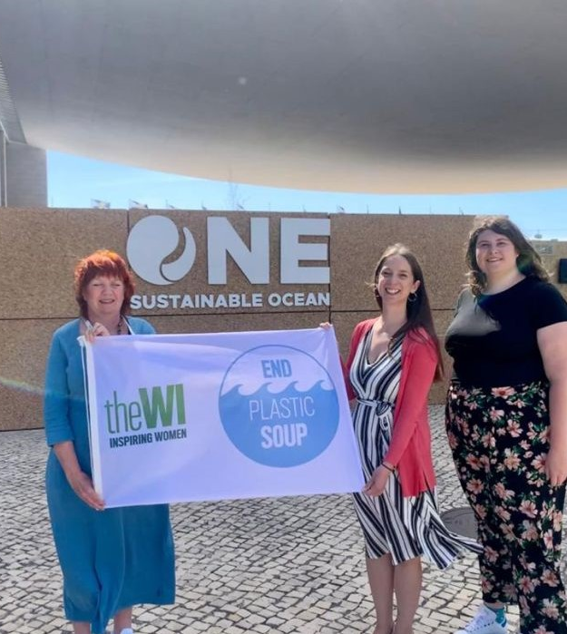
Campaign outcomes
62% of WI members indicated that they had made some sort of behaviour change as a result of the End Plastic Soup campaign
Secured £200,000 of government research funding to the University of Plymouth to assess the impact of microplastic fibre pollution on the environment and shedding rates
Enhanced relationships with global stakeholders working on microplastic fibres
Boosted awareness of microplastic fibre pollution in Parliament
Kickstarted DEFRA policy discussions on microplastic fibre filters
Addressed UN Oceans Conference, Lisbon, about the work of the APPG on Microplastics

Slide 5
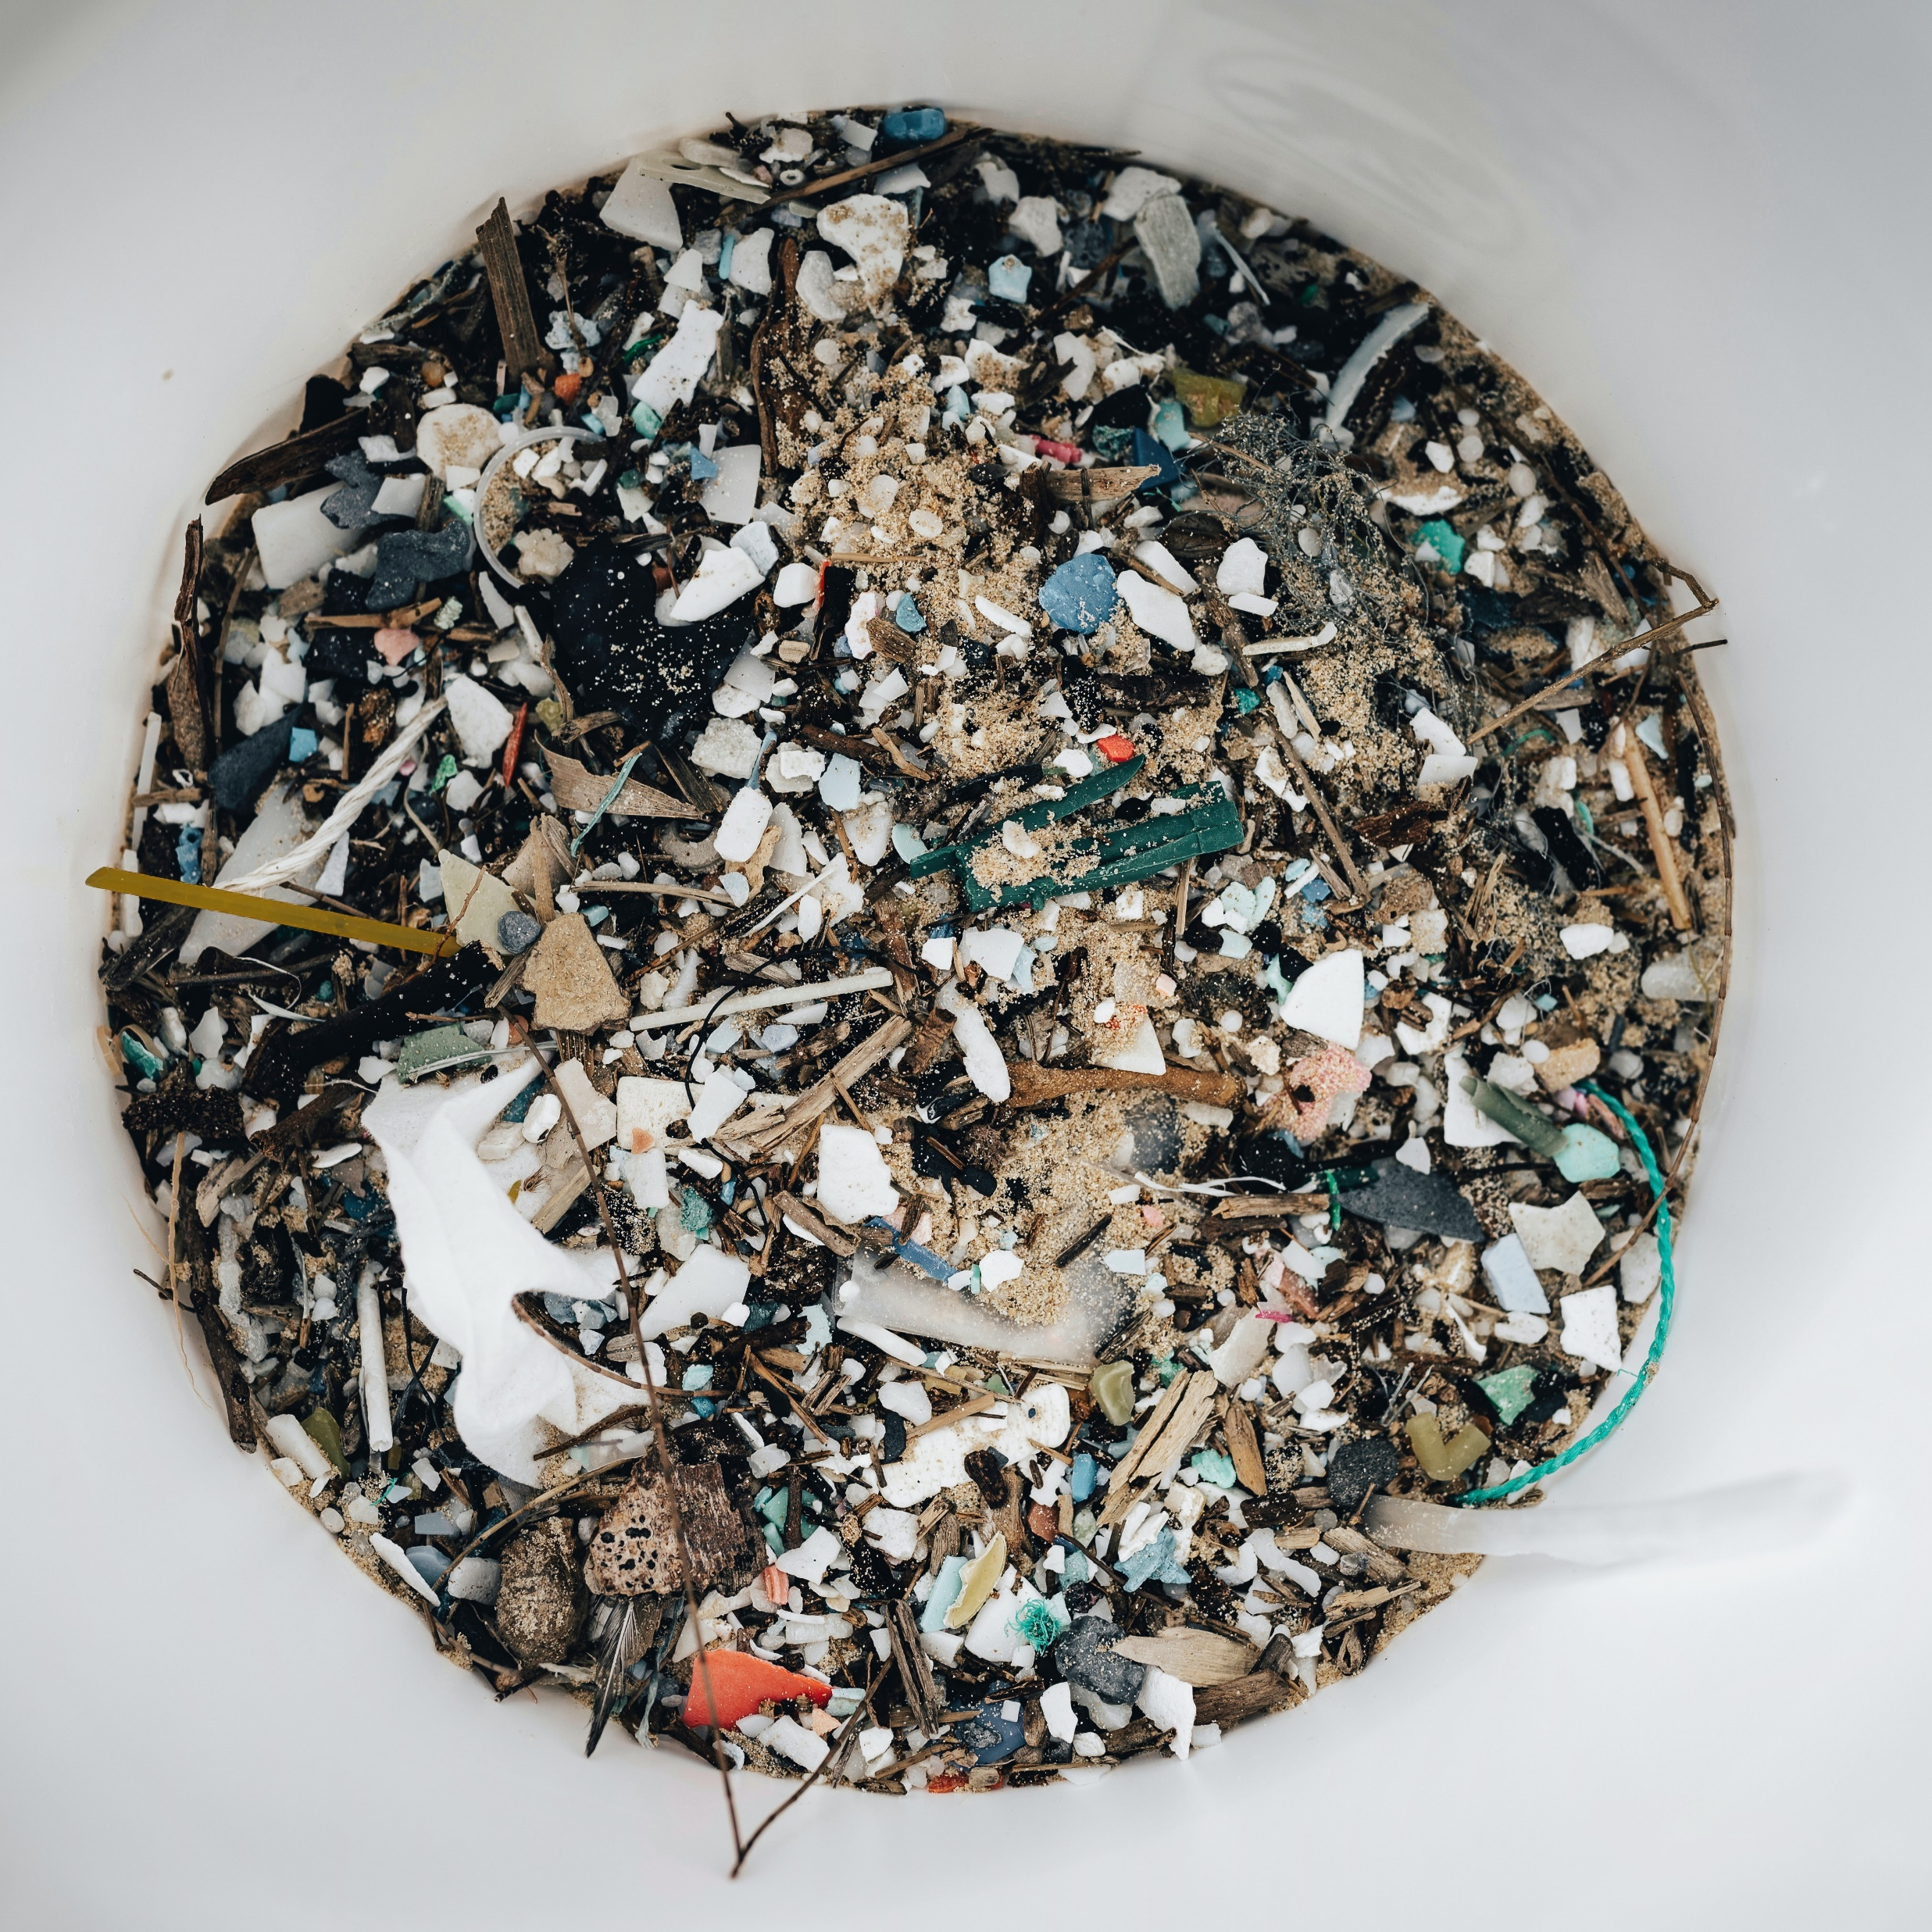
Next steps for 2023
Stay up to date with our campaign
www.thewi.org.uk
Email pa@nfwi.org.uk

