Slide 1
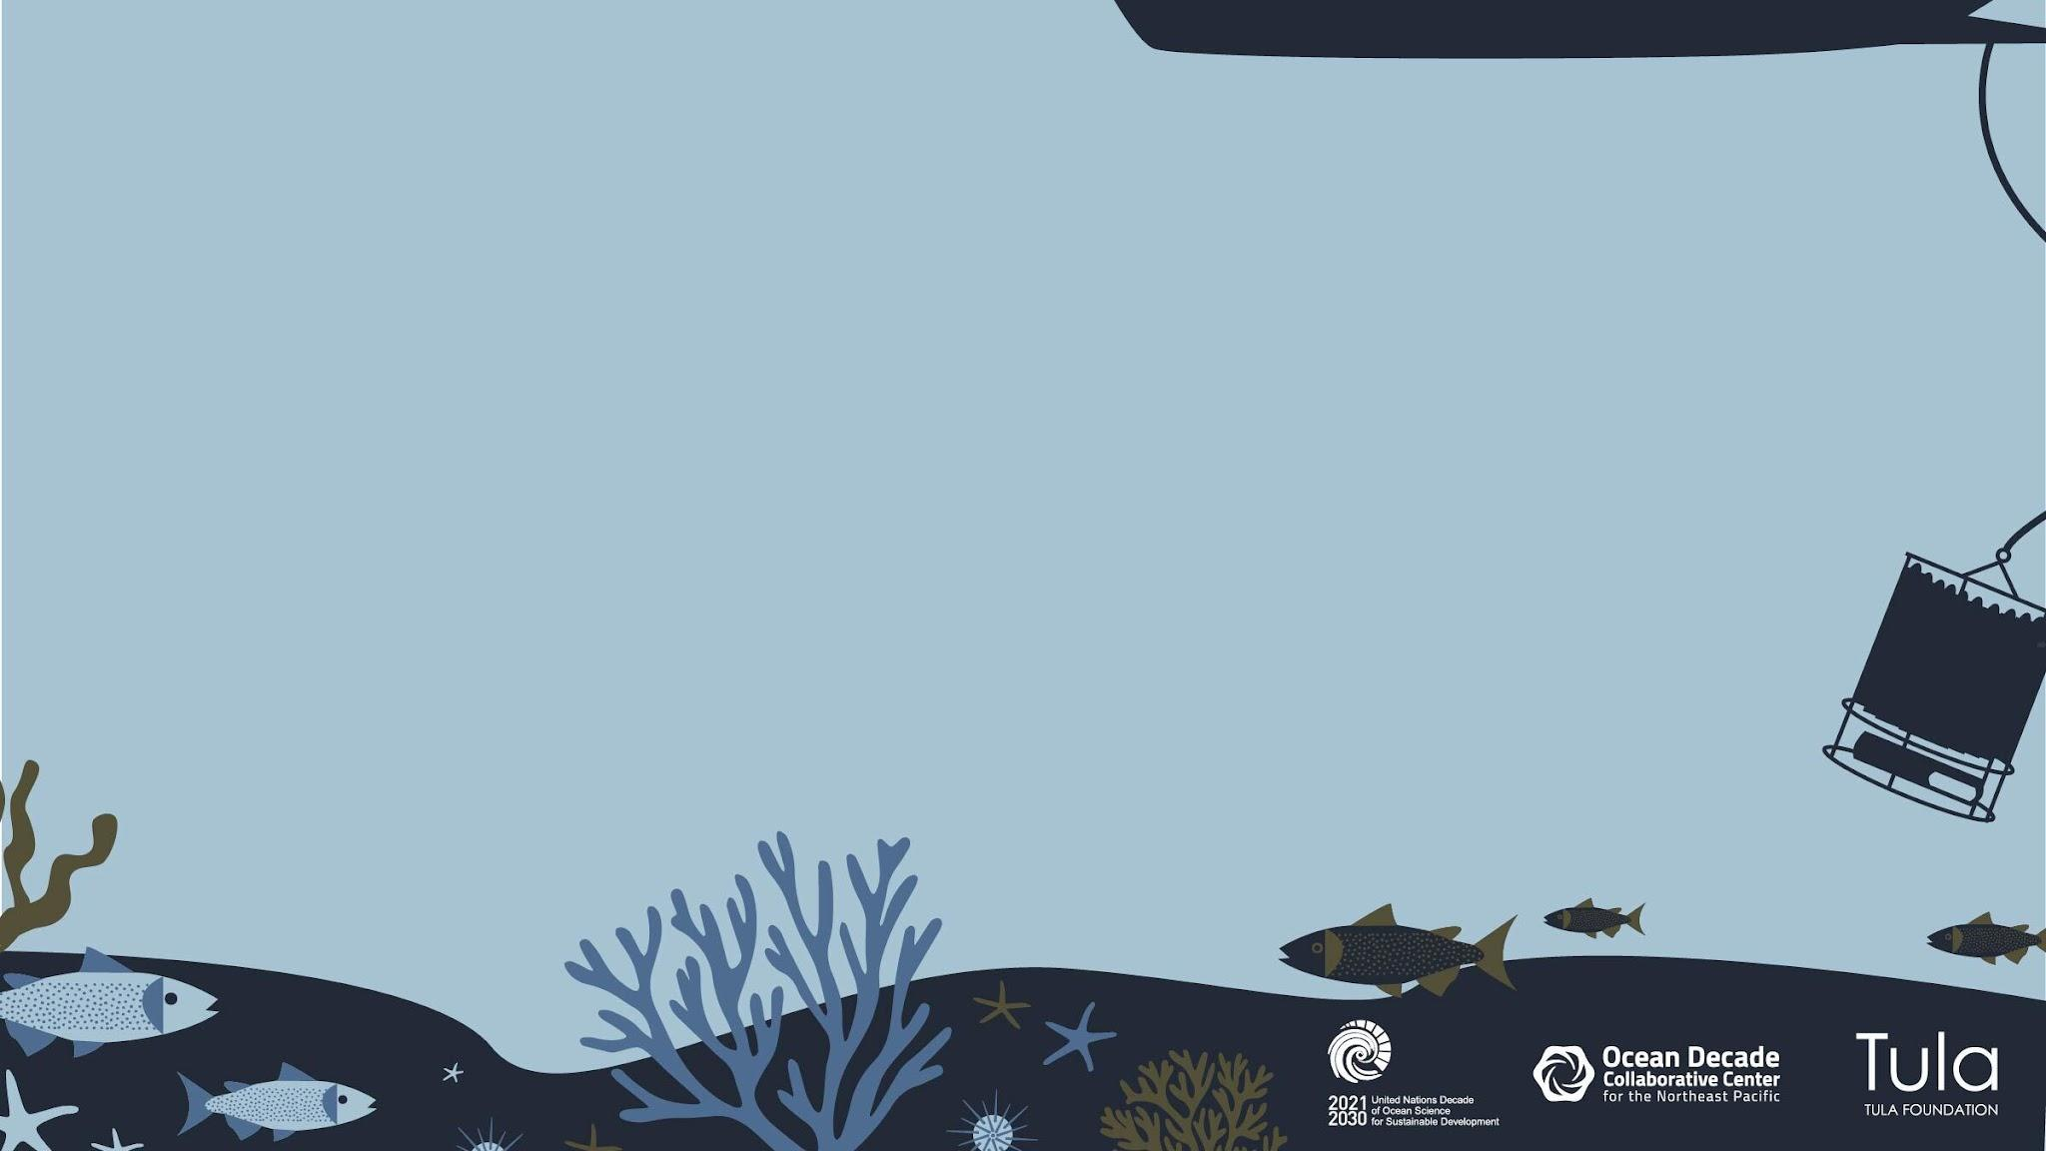
Ocean Decade Collaborative Center for the Northeast Pacific
UNESCO NGO Forum
21 November 2022
Notes:
thank you very much for hosting me today and providnig me an opportunity to give you an update on our Ocean Decade Collaborative Center for the NE Pacific. I am joining you from my home on the Quwetsen traditional territory and the territory of the Hulquiminum speaking peoples of the NE pacific, also known as Vancouver Island, British Columbia in Canada.

Slide 2
From the coast to the deep water and across boundaries and borders, we acknowledge the traditional, ancestral and unceded territories of all the Indigenous peoples that have called the Northeast Pacific region home since time immemorial.
Notes:
Acknowledgement on behalf of the Colalborative Center and the work in our region that

Slide 3

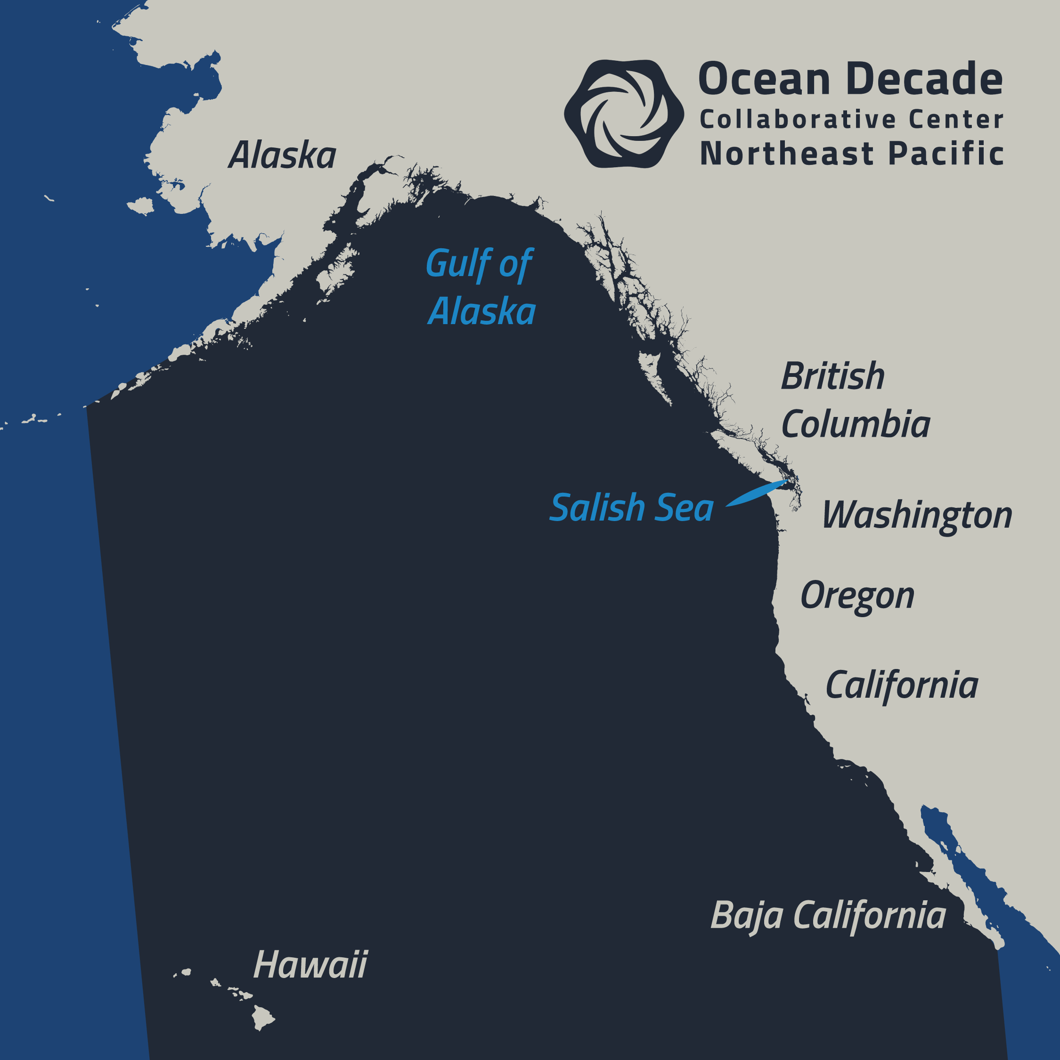

Our aim: To support and facilitate collaborative, co-designed, and co-produced knowledge for solutions to ocean challenges in the NE Pacific region
Oceandecadenortheastpacific.org
oceandecade@tula.org
rebecca.martone@tula.org
Notes:
Today I am here to introduce and provide an update on the Ocean Decade Collaborative Center for the NE Pacific Ocean. We are one of a few Decade Collaborative Centers that are the first to be endorsed by the UN International Oceanographic Commission under UNESCO in support of the Ocean Decade, as of June 2022.
As a REGIONAL collaborative Center, Our aim is to make the Ocean Decade a success in our region by supporting and facilitating collaborative, co-designed, and co-produced knowledge for solutions to challenges in the NE pacific region.
Our region includes the coastal and open ocean off the US and Canadian west coasts, from Alaska to California and everything in between, with extensions to Baja California and Hawaii.
And our regional center aims to tackle all of the challenges and outcomes identified in the Ocean Decade Implementation plan (from climate change to food security to the blue economy)

Slide 4
UN Ocean Decade Coordination
GLOBAL
UN Decade Coordination Unit (IOC)
Decade Advisory Board
NATIONAL
Decade Coordination Offices
Canada = DFO
USA = NOAA/Interagency Working Group
National Decade Committee (NAS)
DECADE COLLABORATIVE CENTERS
Regional
Northeast Pacific (Tula)
Indian Ocean
Western Pacific
Thematic
Ocean Climate Nexus (FIO)
Ocean Climate Solutions and Innovation (Ocean Visions)
Coastal Ecosystem and Community Resilience (Univ Bologna)
Ocean Observing (GOOS)
Ocean Prediction (Mercator Ocean International)
Ocean Data Sharing (IODE)
Notes:
[As Vladimir mentioned] the way the UN Operates is through a centralized Decade Coordination Unit which is part of the Intergovernmental Oceanographic Commission of UNESCO (IOC) The Decade Coordination Unit coordinates the Ocean Decade for the UN at a global scale
They are supported by the Decade Advisory Board with representation from around the world.
DCU then works with other Decentralized Coordination Structures including the Decade Coordination Offices in the member states (US, Canada)
And through Decade Collaborative Centers which are typically run by NGOs and can be either regional in scope, like ours, or thematic in scope (WE ARE A CONTRIBUTION TO THE OCEAN DECADE) SUPPORTED BY THE TULA FOUNDATION

Slide 5




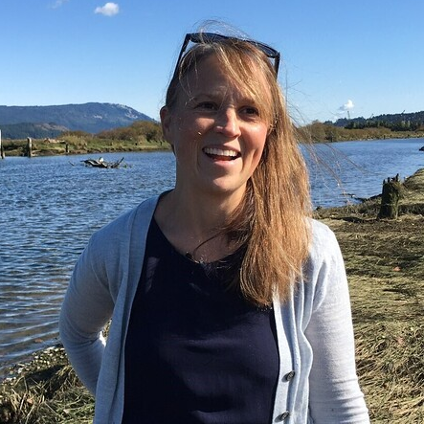
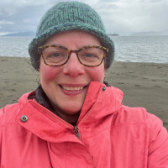
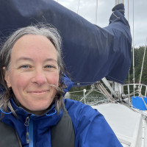
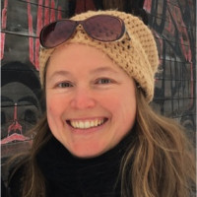


http://tula.org
http://hakai.org
http://quadracentre.org
Notes:
The Ocean Decade collaborative Center for the NE Pacific is a Division of the Tula Foundation. Led by Eric Peterson and Christina Munck, Tula also hosts the Hakai Institute and Quadra Centre for Coastal Dialogue. We at the Ocean Decade Collaborative Center for the NE Pacific are a small team of scientists and boundary spanners with a breadth of experience in collaborative interdisciplinary research, co-designing science to inform solutions, convening and facilitating stakeholders to address complex problems, and ocean education and communications
We work closely with staff across the Tula Foundation, including our administrative staff, Hakai Media and Magazine, and scientific staff from these two other divisions. In particular, we have supported Hakai Institute scientists to get involved in the Ocean Decade, developing Decade Actions for endorsement.

Slide 6
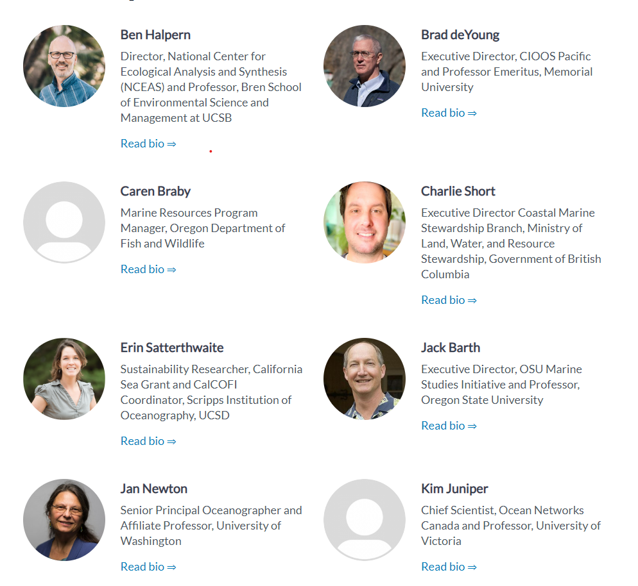
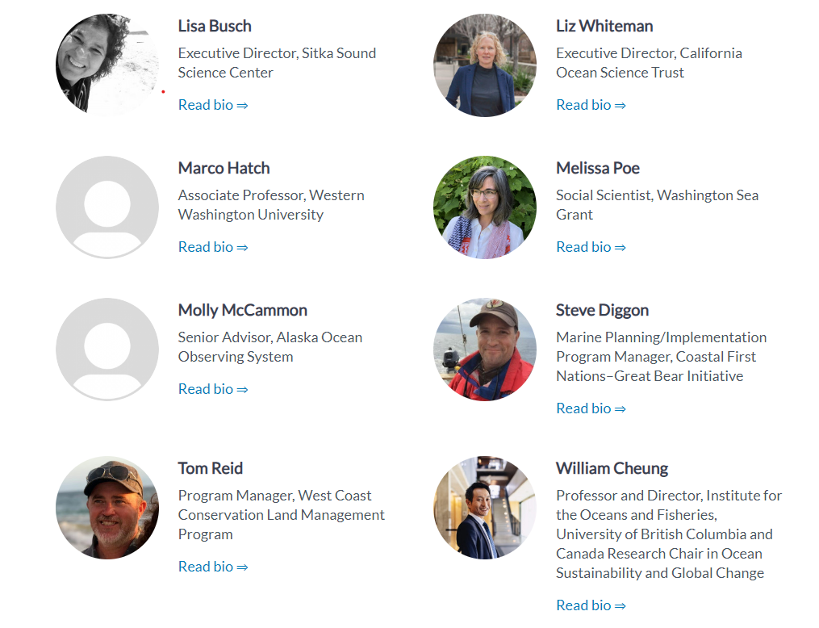
Ocean Decade Collaborative Center NE Pacific
Advisory Committee
Notes:
In addition, we recently developed our Advisory committee with 15 representatives from across a variety of academic institutions, NGOs, crown, state, provincial and Indigenous government agencies, early career and senior professionals, who have a interdisciplinary perspectives and a rich set of experiences bridging knowledge and decision making and working with communities in our region. This diverse set of Ocean People will help advise on priorities, strategic plan, and our workplan and roadmap for the Decade

Slide 7
Ocean Decade Collaborative Center NE Pacific
Our work:
Support and coordinate across Programmes, Projects, and Contributions
Catalyze new Decade Actions
Facilitate knowledge co-production and support stakeholder engagement
Foster Indigenous leadership and participation in the Ocean Decade
Enhance capacity exchange, access to, and impacts of ocean science and knowledge
Amplify Decade Actions to build broad public awareness of the Ocean Decade
Mobilize resources to support Decade Actions
Notes:
As a collaborative center we
Support and coordinate Decade actions and Catalyze new ones
We work to support stakeholder and rightsholder engagement and facilitate knowledge co-production towards innovative evidence-based solutions that serve the needs of communities and weave in multiple ways of knowing
Foster Indigenous-led conservation and management and knowledge that supports Indigenous community priorities
Enhance capacity exchange, access to, and impacts of ocean science and knowledge
Amplify Decade Actions to build awareness
And MObilize Resources, both in kind and financial, to help support Decade Actions

Slide 8
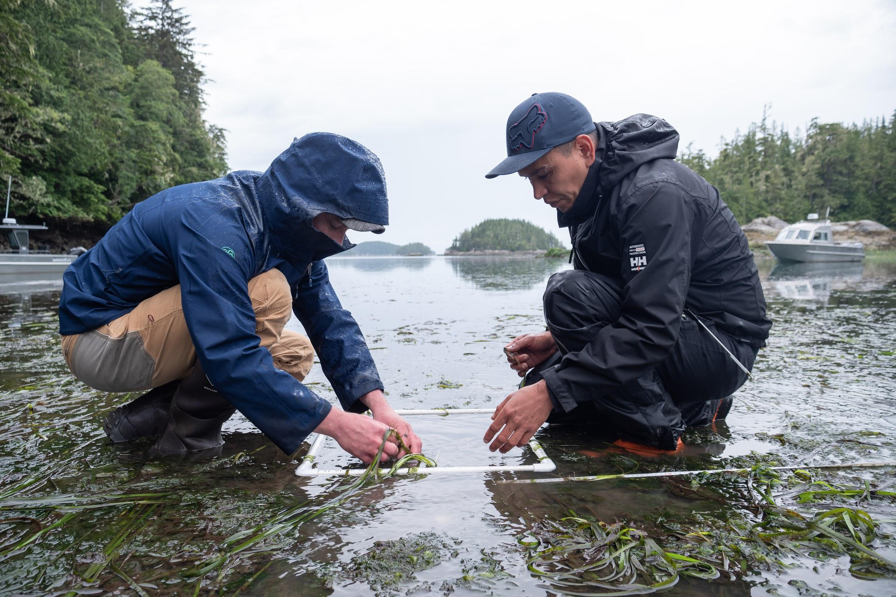
Engagement & Outreach
Developing and strengthening relationships with knowledge holders, rightsholders, and “stakeholders” in Northeast Pacific region
Developing mechanisms to support stakeholder participation within DCC NEP activities and supported Decade Actions
  Participating in and co-leading workshops and dialogues
  Connecting scientists, industry, community members, and decisionmakers
  Providing support for and development of webinars, symposia and events at conferences
Notes:
The bulk of our work centers on
Developing and strengthening relationships with scientists, Indigenous knowledge holders, rightsholders and stakeholders in Northeast Pacific region
Developing mechanisms to support stakeholder participation within DCC NEP activities and supported Decade Actions
Participated in and co-led workshops and dialogues
Co-designing Applied Ocean Models to Support Communities in the NE Pacific (DITTO)
COAST Talks Seminar
Providing support for and development of webinars, symposia and events at conferences
Salish Sea Ecosystem 2022 Conference
IMPAC5 Conference 2023
Coastal Zone Canada 2023 Conference

Slide 9
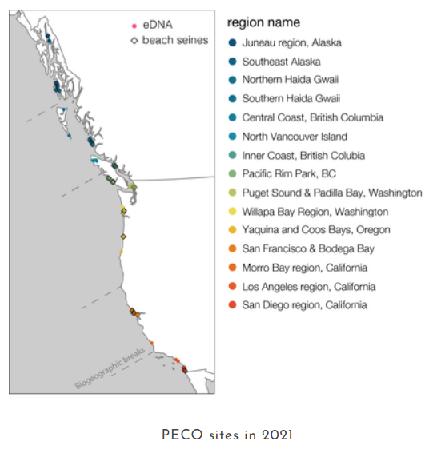
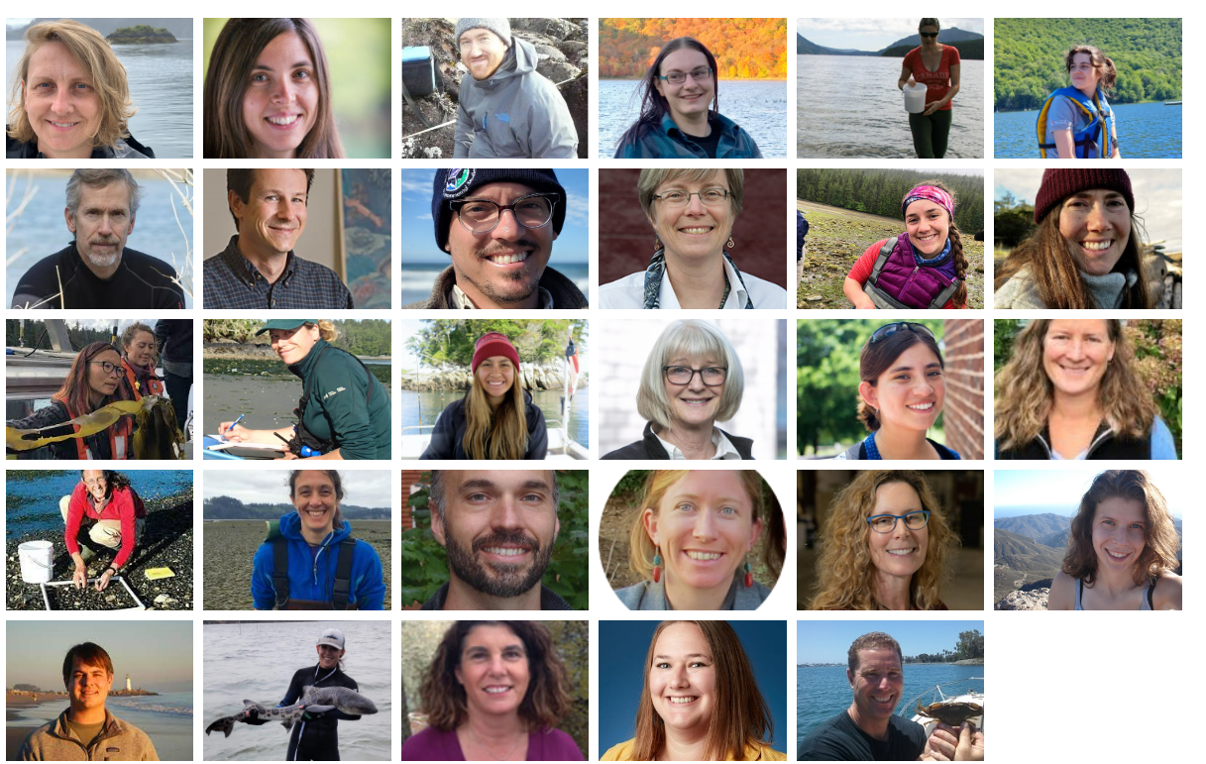
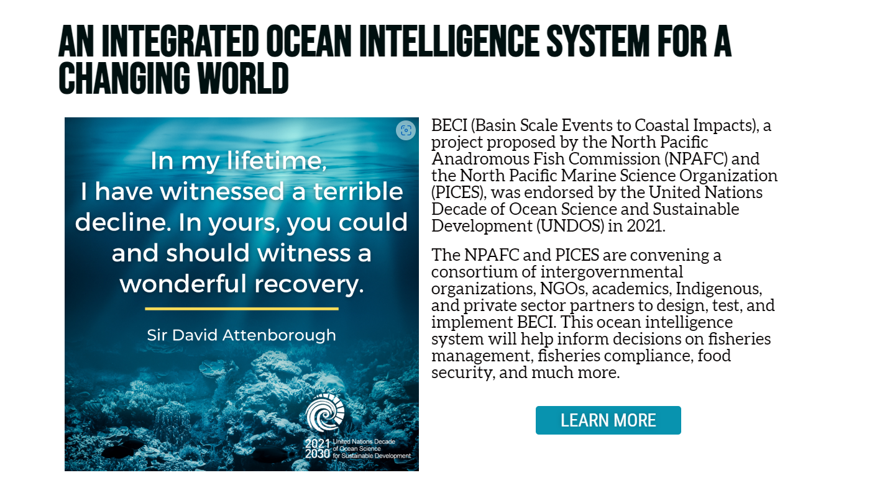
Supporting Endorsed Decade Actions in NE Pacific
Amplifying work and outcomes
Identifying collaboration opportunities
Providing connections to global Programmes and other Projects
Facilitating dialogues and identifying knowledge gaps and opportunities
Examples:
OBON programme endorsed projects:
Pacific eDNA Coastal Observatory;
Hakai Institute Ocean Biomolecular Observing Network
Examples:
Regional Projects in NE Pacific:
  Basin Scale Events to Coastal Impacts (BECI)
  Marine Plan Partnership (MaPP)
Notes:
We also support endorsed projects and programmes in the NE Pacific
We do this by
amplifying their work and outcomes through our extensive network and communication channels
Helping to engage knowledge holders, scientists, students, community members, industry members and other stakeholders
Bringing together similar projects and topics to identify knowledge gaps and collaboration opportunities
Guiding groups through endorsement process, advising on project planning and coordination and facilitating dialogues
PROBABLY SKIP:
For example, we support the NE Pacific Biodiversity Action Network Project (affiliated with Marine Life 2030): guided through endorsement process, supporting development of project steering committee, advising on project planning and coordination, facilitated first meeting of steering committee.
Basin Events to Coastal Impacts Project (no Programme attachment at endorsement): advising on project planning and coordination, connecting to decade programmes as needed to support science plan development, provided facilitation and convening advice for workshops
Pacific eDNA Coastal Observatory and the HI OBON project -

Slide 10
Fostering Indigenous Leadership and Participation
Centering on Indigenous priorities and elevating Indigenous voices is a priority
Global efforts being led by the UN DCU through their Indigenous and Local Knowledge Framework
Support active endorsed projects in NE Pacific
  Advancing Indigenous Partnerships in Ocean Science for Sustainability (ONC)
  Marine Plan Partnership for NE Pacific
  Community engaged Ocean Science in Canada (Canadian Commission for UNESCO)
  First Nations – Trusted Crowd-Sourced Bathymetry & Capacity Building in British Columbia, (CIDCO)
Many academic institutions, global programmes, government initiatives that are looking to engage Indigenous communities (~50 projects in region)
Notes:
Our work is centered on co-production and co-design of knowledge to meet the needs of communities; We want to elevate Indigenous voices and acknowledge the importance of decolonization and harms that have been done in the past and are continuing today -and we aim to be transformational in our region
We work to support the UN’s efforts through UNDRIP and the Indigenous and Local Knowledge Framework of the Ocean Decade
Working to support the active endorsed projects in our region
Including those listed in slide
Note that there are many academic institutions, global programmes, government initiatives and that this can actually be overwhelming and emphasizes the importance of coordination

Slide 11
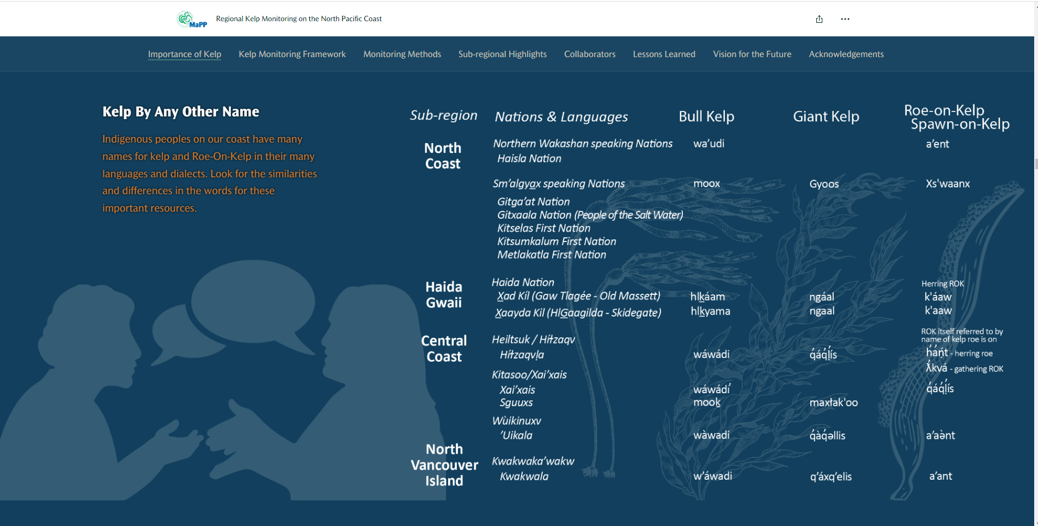
Indigenous-led Initiatives in the Ocean Decade:
E.g. Marine Plan Partnership
https://storymaps.arcgis.com/stories/78945b1d95ec4b9fab5142670088174f
Notes:
One of the projects endorsed under the Ocean Decade is the Marine Plan Partnership for the NE Pacific - this is a collaboration between 17 First Nations in Haida Gwaii, the North, Central coasts, and North Vancouver Island implementing regional and subregional marine plans
One example of work under the MaPP project, is the regional kelp monitoring project, described here in a story map. The project is bringing together First Nation guardians, the Province of BC, and external collaborators to monitor kelp to inform Indigenous-led stewardship, including kelp as a key habitat for other species and directly for kelp harvest management. In addition, the project highlights Indigenous names for Kelp and how they have been used by FNs since time immemorial. This highlights one way that the Indigenous Language Decade could be woven into the Ocean Decade and vice versa.

Slide 12
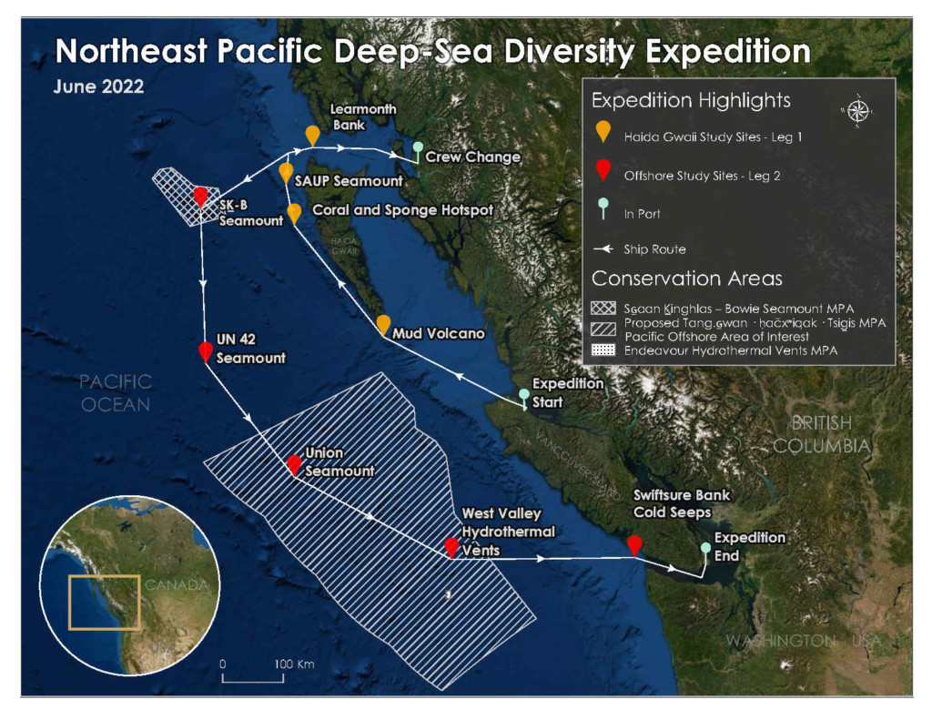
Indigenous-led Initiatives in the Ocean Decade:
E.g. NE Pacific Deep Sea Diversity Expedition
Partners: Fisheries and Oceans Canada, the Council of the Haida Nation, the Nuu-chah-nulth Tribal Council, and Ocean Networks Canada
Lead PIs: Cherisse Du Preez, Chelsea Stanley, Tammy Norgard (Fisheries and Oceans Canada)
Location: Northeast Pacific Ocean
Dates: 7th June to 28th June 2022
Northeast Pacific Deep-Sea Diversity Expedition (oceannetworks.ca)
Notes:
Another Indigenous-led initiative is the NE Pacific Deep Sea Diversity Expedition which is an endorsed Activity and is connected to the Challenger 150 programme, focused on deep sea biodiversity science for management. This work was led by the Council of the Haida Nation, the Nuuchahnulth Tribal council, Ocean Networks Canada and Fisheries and Oceans Canada
The focus of the three-week expedition was to discover, explore, and monitor deep-sea ecosystems within several existing and proposed Marine Protected Areas (MPAs) while sharing the joy of discovery of the incredible life and wonders hidden far below the waves, including seamounts, hydrothermal vents, and cold seeps that are globally rare biodiversity hotspots. The science co-created by these partners will contribute to a better understanding of these remarkable and fragile ecosystems.
THis project also included Mapping and naming uncharted areas using Indigenous-language

Slide 13
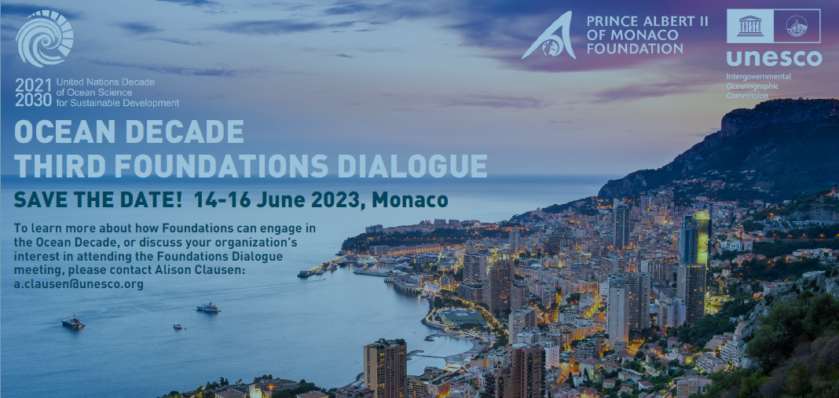
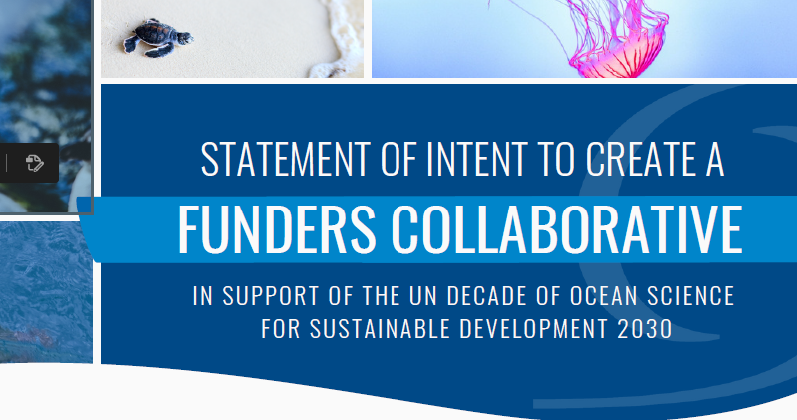
Resource Mobilization
Develop mechanisms and opportunities for Tula to mobilize resources for Decade Actions
  Establishing Tula USA
  Foundations Dialogue
  Funders Collaborative
Recruit funders and donors to support the Ocean Decade
Track and communicate available funding opportunities for regional partners to support Decade Actions
Notes:
Last but not least, we are working to mobilize resources in the Ocean Decade, such as
Working to recruit funders and donors as well as Industry partners
Tracking and communicating available funding opportunities

Slide 14
Thank you, Merci, Huy ch q’u
Our aim: To support and facilitate collaborative, co-designed, and co-produced knowledge for solutions to ocean challenges in the NE Pacific region
oceandecadenortheastpacific.org
oceandecade@tula.org
rebecca.martone@tula.org
Notes:
Thank you all so much for your attention and the invitation to present to you today. Encourage you to go to our website and sign up for our newsletter!
And do not hesitate to connect with me directly to discuss ways we can better work together.
HI-Ch-K-ah

