Slide 1
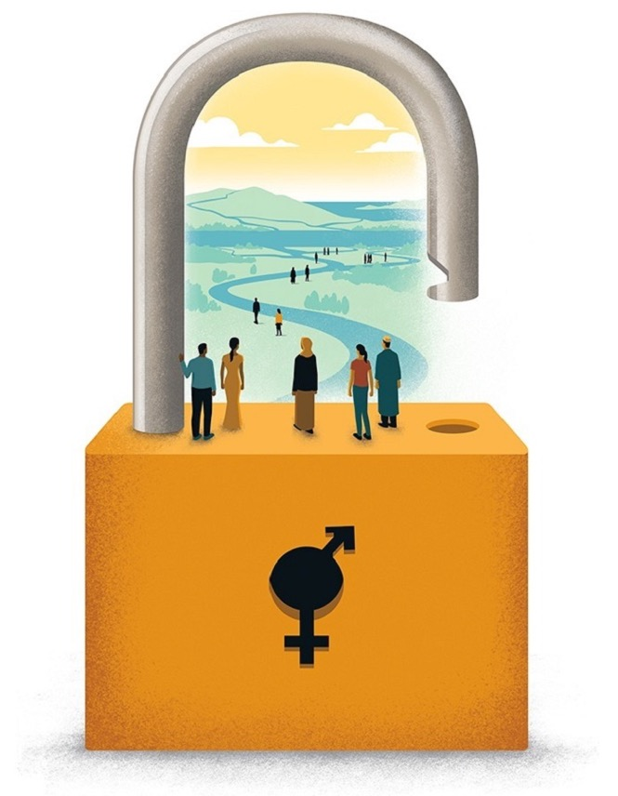
Webinar Science – Technology – Innovation and Entrepreneurship in support of the SDGs
WATER, WOMEN, SCIENCE AND POLICY
GENDER-TRANSFORMATIVE POLICIES FOR CLIMATE RESILIENCE AND SUSTAINABLE DEVELOPMENT
Rount Table II – May 24, 2022
Laura Imburgia
Senior Water and Gender Programme Specialist
lv.Imburgia@unesco.org
UNESCO World Water Assessment Programme

Slide 2

WATER CRISIS, CLIMATE CRISIS AND AND GENDER INEQUALITY
→ WATER INSECURITY EXACERBATES GENDER INEQUALITIES
Gender inequalities at all levels:
  unequal access to water, land, credit, training
  disparities in representation and participation
Globally,
1 in 3 scientist is a women*
Globally,
2 in 10 jobs in the water sector are held by women**
Globally,
14.9% of water managers are women**
→ BOLD, AMBITIOUS AND URGENT ACTION IS NEEDED
*UNESCO data
**World Bank data

Slide 3
TRANSFORMATIVE ACTIONS TO ACCELERATE GENDER EQUALITY IN THE WATER DOMAIN
More opportunities exist today for gender-responsive water and climate policies than existed 25 years ago but there is still a long way to go
Achieving gender equality means involving more women –more diverse groups of women- in policymaking and serious commitments by policymakers and water institutions
One of the key areas is promoting education and training for girls and women in information, technology and STEM
Policymaking should take into account the special needs of women in climate-induced water disasters and building climate resilience and sustainable livelihoods

Slide 4
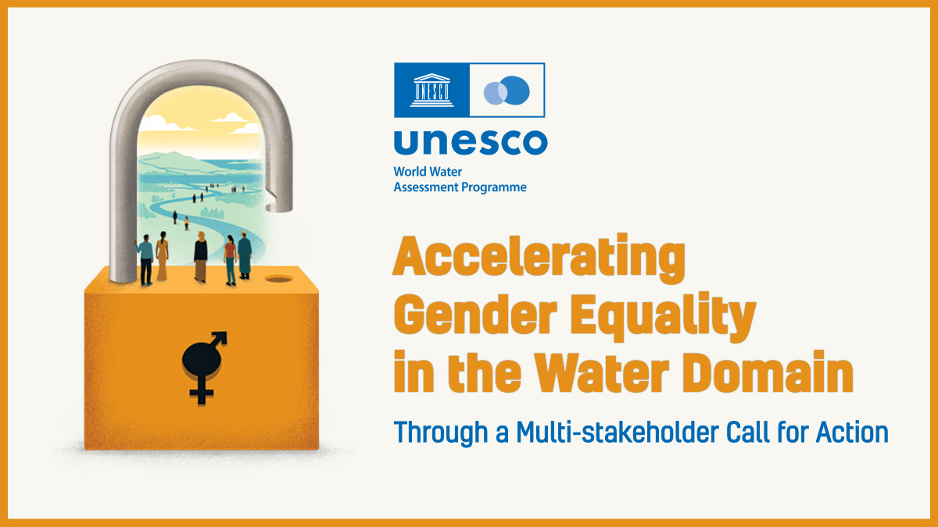
TRANSFORMATIVE ACTIONS TO ACCELERATE GENDER EQUALITY IN THE WATER DOMAIN
A CALL FOR ACTION
ACCELERATING GENDER EQUALITY IN THE WATER DOMAIN: THE WAY FORWARD
Notes:
Taking account of these issues, UNESCO WWAP together with a multi-stakeholder coalition decided to develop a wide-scale global policy and practice initiative: “A Call for Action for Accelerating gender equality in the water domain”.
This initiative is aligned to the UNESCO’s Gender Equality Priority. The multi-stakeholder coalition is composed by Member States institutions, UN agencies, international and regional organizations, NGOs, and civil society. The Initiative was launched last year at the World Water Week and will last until the completion of the 2030 Agenda for Sustainable Development.
The Call addresses governments, private sector, financers to commit concrete and transformative actions.

Slide 5
POSITION PAPER WITH CONCRETE RECOMMENDATIONS FOR ACTION
FIVE KEY AREAS FOR ACTION – POSITION PAPER
ACT upon principles of gender-equal funding;
PRIORITIZE the collection of sex-disaggregated data;
NARROW the gap between policy and practice by:
-UPHOLDING women’s water rights;
- DEVELOPING gender-transformative strategies and policies
FOSTER women's leadership beyond participation;
COUNTER negative gender norms / stereotypes / taboos
bit.ly/AcceleratingGenderEquality (EN, FR, SP)
ACCELERATING GENDER EQUALITY IN THE WATER DOMAIN: THE WAY FORWARD

Slide 6
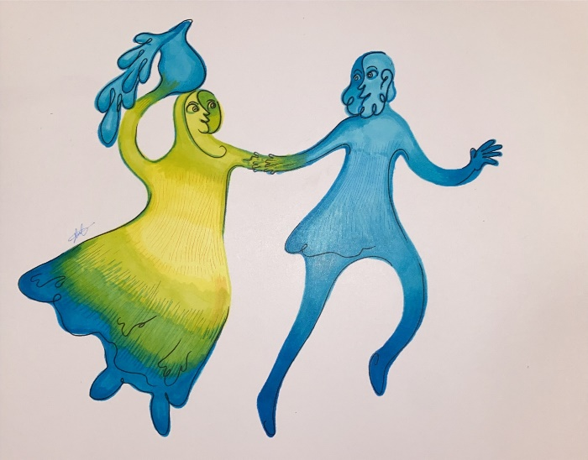
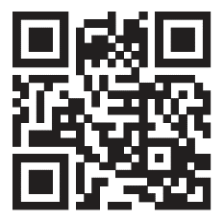
Call for Action: UNION OF THE GLOBAL COMMUNITY – THE MULTI-STAKEHOLDER COALITION
Member States institutions, UN Agencies, international and regional organizations, NGOs, ODAs, private sector and civil society.
The Coalition is supported so far by:
140 individual members
14 Member States
Argentina, Brazil, Costa Rica, the Czech Republic, Indonesia, Italy, Ivory Coast, Mexico, the Netherlands, Nigeria, the Republic of Korea, Slovenia, Spain, Tajikistan
Regional organizations:
The African Ministers’ Council on Water (AMCOW), UN-Economic Comission for Latin America and the Caribbean (ECLAC)
Open to new members - Expressions of interest can be sent to: waterandgendercallforaction@unesco.org
ACCELERATING GENDER EQUALITY IN THE WATER DOMAIN: THE WAY FORWARD

Slide 7
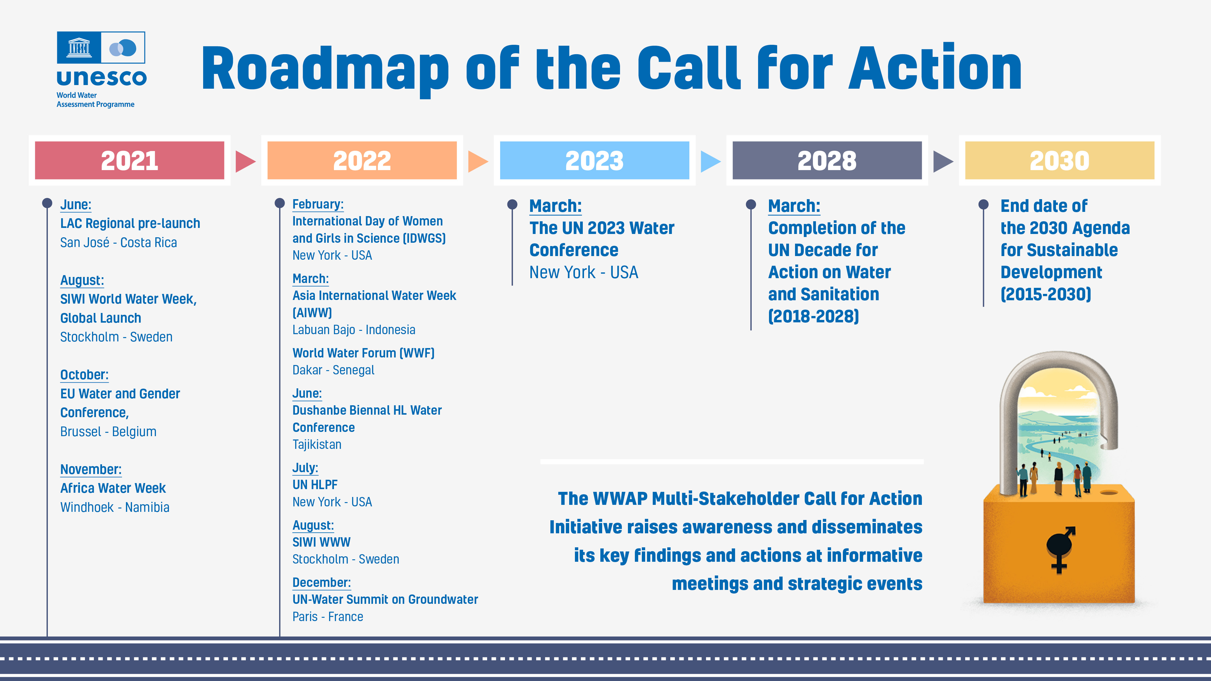
ACCELERATING GENDER EQUALITY IN THE WATER DOMAIN: THE WAY FORWARD

Slide 8
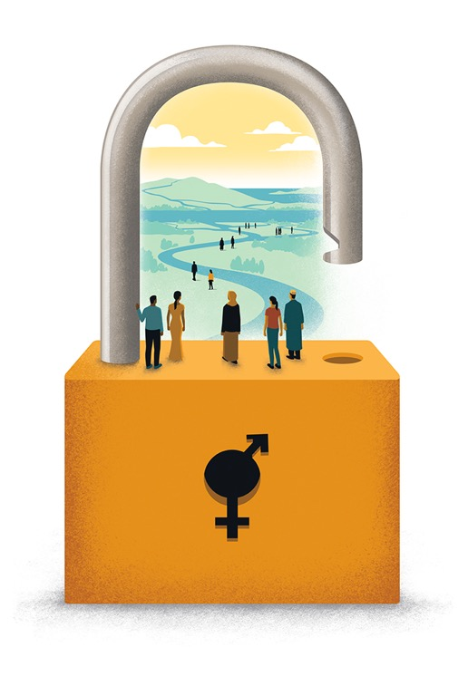

THE CALL FOR ACTION INITIATIVE
UNESCO WWAP and the Multi-Stakeholder Coalition
JOIN THE CALL:
waterandgendercallforaction@unesco.org
lv.imburgia@unesco.org
@UNESCOWWAP
bit.ly/AcceleratingGenderEquality

