Slide 1

AFWA or the network’s view on the role of STEM, education, vocational training, mentoring
By
Leticia Ackun (PhD)

Slide 2
Women‘s Participation: A Challenge and Opportunity
Women (and girls) are most affected by poor water and sanitation but are under-represented in key decision-making positions and in the sector broadly as reported by a 2018-2019 World Bank study.
In 64 water utilities women representation was
    Workers 18%
    Engineers & Managers 23%
    32% of utilities had no female Engineers
    12% of utilities had no female Managers

Slide 3
Why are women so under-represented in WASH?
Attraction challenges: Gender Roles marked through social norms; Divisions of labor; STEM; limited role models
Recruitment challenges: Discriminatory hiring processes and targeting candidates
Retention Challenges: Work life balance; family friendly policies; sexual harassment, work facilities
Advancement Challenges: Training; mentorship opportunities; leadership opportunities

Slide 4
What Can be done to address these challenges?
ATTRACTION
RECRUITMENT
RETENTION
ADVANCEMENT
  Set up networks to change the narrative on women in WASH
  Create a platform for women working in WASH
  Identify and promote girls in WASH
  Identify and support women WASH entrepreneurs
  Promote girls TVET/STEM training in WASH
  Undertake baseline on women in WASH to Understand their needs for growth in the sector
  Use findings to inform action and policy within and outside the network
  Implement mentoring program for women and girls
  Enhance visibility of women in international and national fora

Slide 5
The Imperative for Increasing Women‘s Professional Involvement in WASH
Women benefit from better jobs and incomes which in turn benefits households and communities
Greater organizational outcomes due to gender diversity and expanded skills sets leading to greater innovation
Greater customer satisfaction due to improved considerations of the needs of female customers
Greater gender equality contributing to economic advancement – It could add $316b to Africa’s GDP by 2025

Slide 6
What Should Networks be Aiming to Achieve?
More women in leadership roles in WASH through personal and group effort
Women led WASH businesses increasing and growing through access to finance and technical support
More women and girls attending WASH related trainings
Women led WASH activities at community level
Greater visibility of women at local and international levels to enhance their participation in policy and technical design

Slide 7
Some activities carried out by the Women’s Network
Capacity building of members in different fields
Advocacy / community outreach programmes
Participation in initiatives for the girl child/partnership with schools
Proposals for funding
Mentorship and coaching
Commemoration of international and sector day celebration

Slide 8
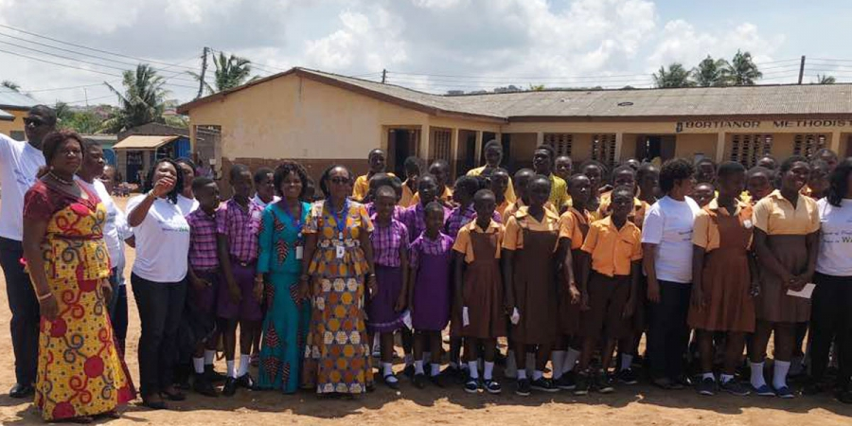
Advocacy / community outreach programmes in schools

Slide 9

Thank you

