Slide 1
Moving GRC from Geneva to Jakarta
PHYLLIS DRUCKER | SR. CONSULTANT | 954.649.4770
Copyright © 2017 ComplianceNow, LLC

Slide 2


Geneva to Jakarta …
“If you’re still running Geneva GRC and planning on upgrading to Jakarta, be prepared for a bit of culture shock.”
Copyright © 2017 ComplianceNow, LLC

Slide 3

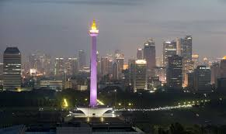
Geneva to Jakarta …
Geneva
Jakarta
While Geneva and Jakarta, like their namesake cities, have a common infrastructure (e.g., buildings, streets, and people), they have very different cultures and speak different languages.
Copyright © 2017 ComplianceNow, LLC

Slide 4
Geneva to Jakarta …
To get to Jakarta, you can bypass Helsinki and Istanbul, the two releases that immediately followed Geneva
But in Helsinki, everything changed.
And both Istanbul and Jakarta are based on Helsinki, not Geneva.
Copyright © 2017 ComplianceNow, LLC

Slide 5

Geneva to Jakarta …
“With the Helsinki release, ServiceNow didn’t just upgrade the GRC application, they totally redesigned it from the ground up.”
Copyright © 2017 ComplianceNow, LLC

Slide 6


Geneva to Jakarta …
The redesign represents an evolutionary leap in GRC.
GRC before Helsinki
GRC after Helsinki
Everything changed.
Everything got better.
Nothing got easier.
Copyright © 2017 ComplianceNow, LLC

Slide 7
Geneva to Jakarta …
What Changed?
Helsinki, Istanbul, Jakarta
New GRC Model
Geneva
Old GRC Model
Copyright © 2017 ComplianceNow, LLC

Slide 8
Large Scale Changes

Slide 9
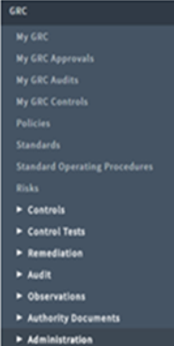
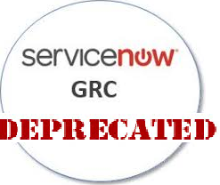
Geneva to Jakarta …
With the Release of Helsinki, the GRC Application was Deprecated …
Copyright © 2017 ComplianceNow, LLC

Slide 10
Geneva to Jakarta …
… And Replaced by Three Totally New Applications
Copyright © 2017 ComplianceNow, LLC

Slide 11
Geneva to Jakarta …
… that are no longer Free
Geneva
Jakarta
Policy & Compliance Subscription
$$$
ServiceNow
Base Subscription
(included GRC)
$$$$
ServiceNow
Base Subscription
$$$$
Risk Management Subscription
$$$
Audit Management Subscription
$$$
Copyright © 2017 ComplianceNow, LLC

Slide 12
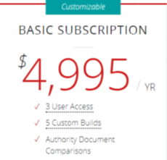
Geneva to Jakarta …
… and Neither is the UCF
Before Helsinki, you could access the Unified Compliance Framework from within the GRC application, browse the available compliance frameworks, and download the authority documents, citations, and controls you needed – all for free.
After Helsinki, you now need to subscribe to the UCF.
  Basic subscription: $4,995 per year
  Additional builds: $99 each
  Additional users: $99 each
  Custom Compliance Template: $5,000 each.
Note: Please check with your UCF rep for current pricing.
Copyright © 2017 ComplianceNow, LLC

Slide 13
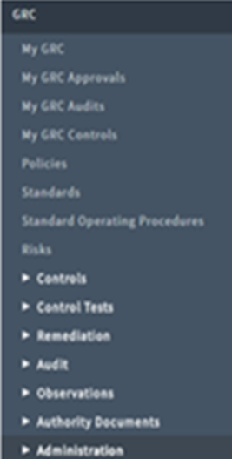
Geneva to Jakarta …
Most of the Old Familiar Modules were Deleted …
 | The “My GRC” reporting modules are gone. Replaced by a Compliance Overview Dashboard and a Policy Overview Dashboard.
 | The Policies, Standards, and Standard Operating Procedures modules are gone. Replaced by a new Policies and Procedures module.
 | Risks is gone. It was split out into its own application.
 | Controls are still there but have been totally redefined.
 | Control Tests have been replaced by “Indicators.”
 | Audits is gone. It was split out into its own application.
 | Authority documents are still there.
 | The Administration modules have totally changed.
Copyright © 2017 ComplianceNow, LLC

Slide 14
Geneva to Jakarta …
… or Redesigned and Replaced by New Modules
… that have different features than the old.
Copyright © 2017 ComplianceNow, LLC

Slide 15
Geneva to Jakarta …
… and have Different Application Scopes
Application scoping restricts access to application files and data
Attestations
Planned Task
Task
Authority Documents
Citations
Controls
Policies
Policy Statements
Profiles
Profile Types
Profile Classes
Indicators
Indicator Templates
Indicator Tasks
Issues
Global Scope
Policy & Compliance Scope
GRC Profiles Scope
Copyright © 2017 ComplianceNow, LLC

Slide 16
Geneva to Jakarta …
The Single GRC Application became a Suite of Applications
Before Helsinki
After Helsinki
Audit
UCF
Compliance
Risk
GRC
GRC (or IT GRC) Application
GRC-Related Applications Suite
Copyright © 2017 ComplianceNow, LLC

Slide 17
Geneva to Jakarta …
… that Continues to Expand with Each New Release
Helsinki
Istanbul
Jakarta
Audit
UCF
Compliance
Risk
Audit
Workbench
PA Integration
Compliance
Risk
Vendor Risk
SIG Questionnaire
UCF
Audit
Workbench
PA Integration
Compliance
Risk
UCF
Copyright © 2017 ComplianceNow, LLC

Slide 18
Control Level Changes

Slide 19

Geneva to Jakarta …
“The concept of a control was totally redefined.”
Copyright © 2017 ComplianceNow, LLC

Slide 20
Geneva to Jakarta …
A Control is now defined as the “Application of a Policy Statement to a Profile.”
Copyright © 2017 ComplianceNow, LLC

Slide 21
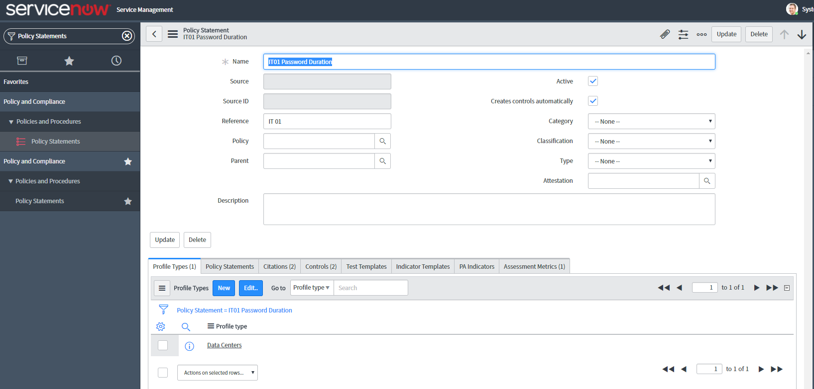

Geneva to Jakarta …
“Policy Statements are What You Previously Knew as Controls.”
Copyright © 2017 ComplianceNow, LLC

Slide 22

Geneva to Jakarta …
“If you import content from the UCF, the Controls come in as Policy Statements”
Copyright © 2017 ComplianceNow, LLC

Slide 23
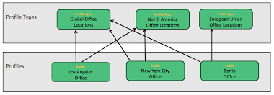
Geneva to Jakarta …
Profiles are Records that make up a Profile Type
Copyright © 2017 ComplianceNow, LLC

Slide 24
Geneva to Jakarta …
… and Profile Types are at the Hub of the GRC Applications
Profile Types
Risk
Compliance
Audit
Copyright © 2017 ComplianceNow, LLC

Slide 25

Geneva to Jakarta …
Attestations were Added
Attestations are surveys that allow you to confirm that a control is in place prior to monitoring it.
Copyright © 2017 ComplianceNow, LLC

Slide 26
Geneva to Jakarta …
Control Tests became Indicators
… and focus switched from control testing to control monitoring.
Copyright © 2017 ComplianceNow, LLC

Slide 27
Geneva to Jakarta …
Remediations and Observations were Combined into Issues
… that are now handled in the same way.
Copyright © 2017 ComplianceNow, LLC

Slide 28
Geneva to Jakarta …
The Language Changed and Broke with Common Industry Usage
Translating the New ServiceNow GRC Terminology
When You See … | Think …
Policy Statements | “Framework controls” or “control objectives”
Profile | “Record in Table”
Profile Types | “Records returned by filtering a table”
Indicators | “Test Generators” that spawn control tests.
Indicator Tasks | “Control Tests.”
Issues | “Failed Control Tests.”
Control | “Something to be monitored by an indicator.” Totally new concept.
Copyright © 2017 ComplianceNow, LLC

Slide 29
Making the Move

Slide 30
Geneva to Jakarta …
“ServiceNow provides a Migration Tool … but Not Everything Migrates.”
What Migrates
Authority Documents
Citations
Policies
Controls
Risk Definitions
Risks
Control Test Definitions
Risk Criteria Thresholds
What Doesn’t
Audit Instances
Audit Definitions
Control Tests
Conditions
Requirements
Activities
Control Test Sample Data
Scope
Observations
Remediations
Copyright © 2017 ComplianceNow, LLC

Slide 31
Geneva to Jakarta …
… Even with the tool, the migration requires a significant level of effort
“It takes between one and two months to complete the entire migration process.”
-- ServiceNow HI Portal Response --
Copyright © 2017 ComplianceNow, LLC
Notes:
It takes anything between 1-2 months for the entire migration process. This activity includes following steps: 1) Understanding differences between legacy and current GRC modules 2) Understanding and creating profiles and profile type structure 3) Identifying control and profile relationships 4) Migrating risks, policies, controls, authority documents, citations etc. using migration utility 5) Migrating Control test definitions to indicator templates for creating manual indicators using migration utility 6) Coming up with custom scripts for other migrations if they are not available as part of out of the box migration utility 7) Migrating all legacy custom fields into new GRC modules 8) Once all the data is migrated, mapping all the right permissions/roles with all your custom roles and groups (if any) There might be other activities involved based on how the customer has set up the legacy system.
Source: ServiceNow Community HI Portal Response: https://community.servicenow.com/thread/276034?q=migrating%20GRC%20from

Slide 32

Geneva to Jakarta …
But it’s Worth the Effort
Once you migrate your control environment into the new GRC model, ServiceNow greatly reduces the day-to-day burden and cost of managing that environment. For example, say you have a hundred servers that need to be compliant with an established requirement. ServiceNow allows you to group those servers into a Profile Type that automatically generates and manages the controls required to monitor those servers. Then, when you retire a server or add a server, ServiceNow automatically retires or adds the related controls and indicators. You don’t have to do it manually. Similarly, the new model enhances automated evidence collection allowing you to more easily prove compliance, shorten audits, and lower audit costs. While setting everything up in the new model takes more work, once set up, managing your compliance processes becomes a lot easier.
Copyright © 2017 ComplianceNow, LLC

Slide 33
Wrap Up

Slide 34

Geneva to Jakarta …
“We hope this short overview helps you better prepare for the journey ahead.”
User-Centric Growth Platform To Power The Modernize Enterprise
Copyright © 2017 ComplianceNow, LLC

Slide 35
Geneva to Jakarta …
If there is anything we can do to help, please let us know.
“At ComplianceNow, we have both the expertise and experience to help move your Internal Control environment and compliance processes from Geneva to Jakarta in a matter of weeks, not months. I invite you to contact me directly at MikeDeAndrea@ComplianceNowLLC.com to explore how we can best serve you.”
Mike DeAndrea, Owner
ComplianceNow, LLC
Copyright © 2017 ComplianceNow, LLC

Slide 36

Contact …
Mike DeAndrea
ComplianceNow, LLC
MikeDeAndrea@ComplianceNowLLC.com
www.ComplianceNowLLC.com
User-Centric Growth Platform To Power The Modernize Enterprise
Copyright © 2017 ComplianceNow, LLC

Slide 37
Disclaimers …
All images included in this presentation were downloaded from the Internet and are believed to be in the Public Domain. If you are the owner of any of these images and wish to have them removed or proper credit given, please contact ComplianceNow at www.ComplianceNowLLC.com.
All tradenames and product names mentioned in this presentation are the trademarks of their respective owners.
ComplianceNow is a trademark of ComplianceNow, LLC.
User-Centric Growth Platform To Power The Modernize Enterprise
Copyright © 2017 ComplianceNow, LLC

