Slide 1

General Data Protection Regulation
A Quick Look at Data Subject Rights
PHYLLIS DRUCKER | SR. CONSULTANT | 954.649.4770
Presented by
Mike DeAndrea, GRCP, CSA, CSOE, CICA
www.mdeandrea.com
Mike DeAndrea
Notes:
Make sure we’re recording. So let me set the stage for what I’m going to be talking about today.
Today, I’m going to focus on the ServiceNow GRC applications, mainly on what it takes to build out a system of internal controls using the Policy and Compliance application.

Slide 2

General Data Protection Regulation
The GDPR is all about providing data subjects visibility into how their personal data is being used and processed.
What information are you holding on me?
Why are you holding it?
How are you using it?
Who are you sharing it with?
Notes:
The GDPR is all about personal data transparency.

Slide 3

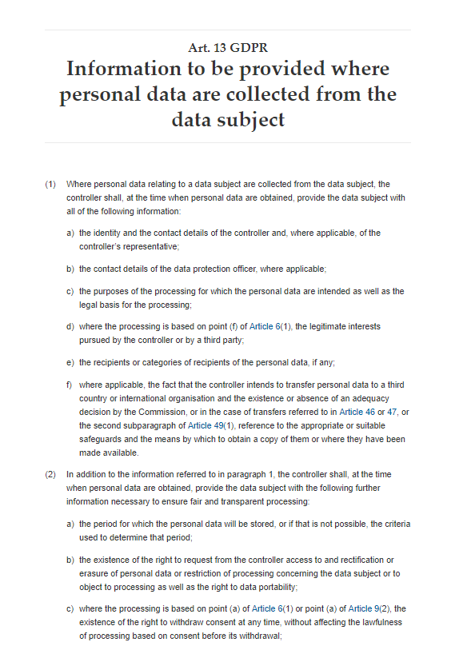
Right to be Informed
The GDPR gives me the right to be informed at the time my personal data is obtained who is collecting it, why they are collecting it, how it will be used, and who it will be shared with.

Slide 4
GDPR
Article 15
Right to Access
The GDPR gives me the right to access whatever data you have on me.

Slide 5
GDPR
Article 16
Right to Rectification
The GDPR gives me the right to request changes to my data to correct or update the information.

Slide 6
GDPR
Article 17
Right to Erasure
The GDPR allows me to request that you delete my data, typically at the end of a customer relationship. (Depends on retention schedules and retention periods in line with other applicable laws.)

Slide 7
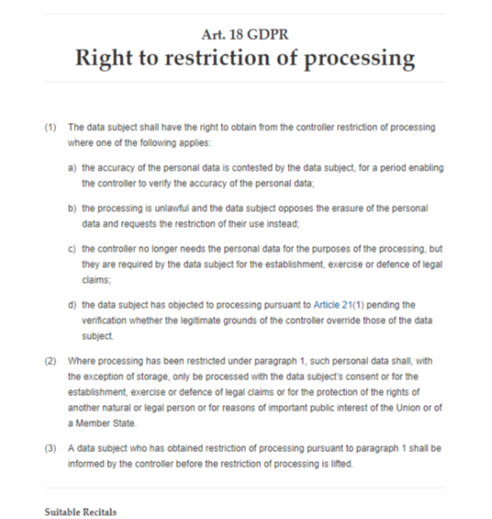
GDPR
Article 18
Right to Restriction
The GDPR gives me the right to request that my data not be used in processing. The data can be held in limbo (not erased), which means the processor can hold my data but can’t use it.

Slide 8
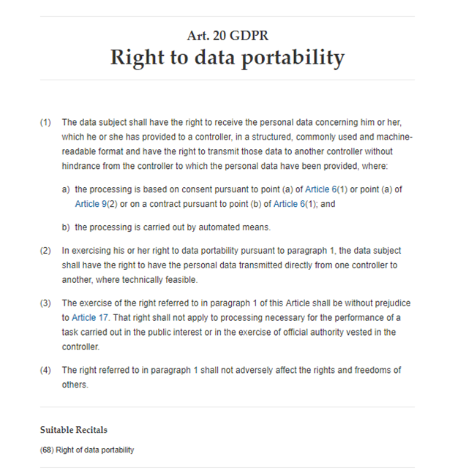
GDPR
Article 20
Right to Data Portability
The GDPR gives me the right to ask that my personal data be transferred in machine-readable electronic format back to me or to another processor.

Slide 9
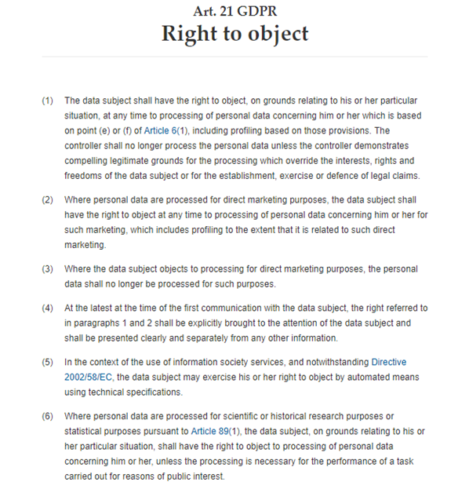
GDPR
Article 21
Right to Object
The GDPR gives me the right to object to processing my data.

Slide 10
GDPR
Article 22
Right to Object to AP
The GDPR gives me the right to object to a decision about me being made based on automated processing since automated processing often doesn’t take into consideration my unique circumstances.

Slide 11
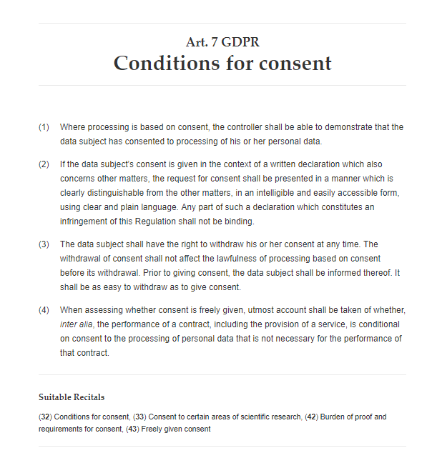
GDPR
Article 7
Right to Withdraw Consent
The GDPR gives me the right to withdraw my consent even if given previously.

Slide 12
Thank You
Mike DeAndrea
GRC Business Consultant
760.636.6430
mdeandrea@mdeandrea.com
Visit us online at: www.mdeandrea.com

