Slide 1

JUNIOR ORDER OF MELCHIZEDEK
RITES OF PASSAGE PROGRAM
Sponsored by the Ecumenical Center for Black Church Studies

Slide 2
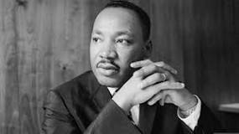
Order of Melchizedek
The Peaceful Warrior
1A) Defining Role of Warrior
1B) Defining Concept of Peace/non-violence
1C) Introduction of Dr. King as the Peaceful Warrior
1D) TODAY’S LESSON
2. History of Warrior as Protector of Community: Exploring Warrior in various global cultural context. Examples of Warriors for Civil Rights.
3. Contemporary Warrior: Identifying Warriors in Our Community Today. How do they work within the system to make change?
4. Living Warriors: Community Leader As Guest Speaker: Personal Testimony on Life as Warrior for a Cause using Non-violence.
5. Future Warrior: Using what we have learned to Build the Beloved Community
6. Student Projects: Exploring Class Projects for Sharing
7. Student Projects: Group Sharing of Class Projects
8. Graduation: Student Awards of Completion

Slide 3
DEFINNNG:
The Peaceful Warrior
Role of Warrior
Peace/non-violence
1.
2.
3.
1.
2.
3.

Slide 4
DEFINNNG:
The Peaceful Warrior
Role of Warrior
Peace/non-violence
1. Protector/Defender
2. Brave/Courage
3. Skillful Fighter
1. Love
2. Harmony
3. Interconnection

Slide 5
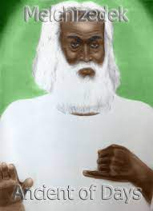
Melchizedek Hebrews 7:1-3
This “Melchizedek, king of Salem, priest of the Most High God, … His name, in the first place, means “KING OF RIGHTEOUSNESS”; next, he is also king of Salem, that is, “KING OF PEACE.” Without father, without mother, without genealogy, having neither beginning of days nor end of life but resembling the Son of God, he remains a priest forever.

Slide 6
King David and Jesus are
ORDER OF MELCHIZEDIK Members
Psalm 110: 1 & 4 (David)
Hebrews 5: 5-6 (Jesus)
¹The Lord says to my lord,
“Sit at my right hand
until I make your enemies your footstool.”
⁴The Lord has sworn and will not change his mind,
“You are a priest forever according to the order of Melchizedek.”
⁵ So also Christ did not glorify himself in becoming a high priest but was appointed by^{[a]} the one who said to him, “You are my Son; today I have begotten you”;
⁶ as he says also in another place, “You are a priest forever,
according to the order of Melchizedek.”

Slide 7
Rev. Dr. Martin Luther King, Jr. is is a Members of the ORDER OF MELCHIZEDIK
KING MELCHIZEDEK
1. Priest Of The Most High God
2. King Of Righteousness
3. King Of Peace
REV. DR. MARTIN L. KING
Known for promoting freedom through non-violence and advocating for civil rights.
In 1964, he won the Nobel Peace Price for combating racial inequality through non-violent resistance.

Slide 8
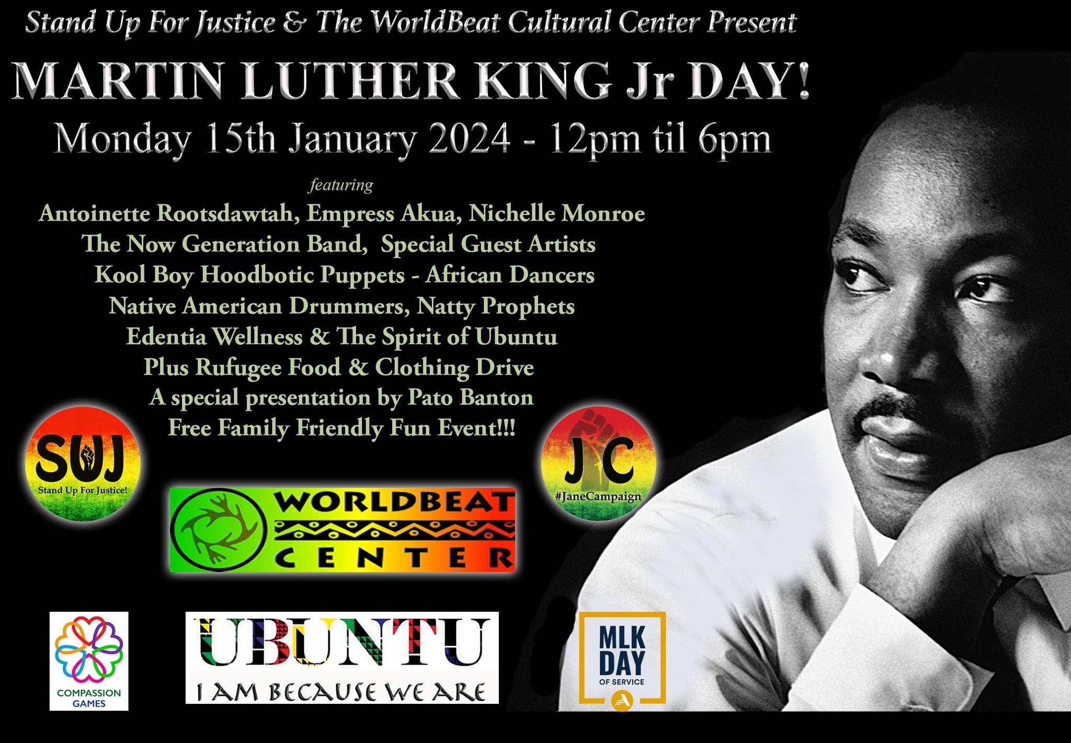

Slide 9
TODAY’S LESSON
1. Take notes of important points made during the lesson. Also note any questions you may have about the lesson.
2. Each week during the review you will have an opportunity to share your take away from the previous week or ask questions about the presentation.
3. Your final assignment in the class is to do a presentation on you idea of the Peaceful Warrior.
4. Everyone who completes the assignment will be gifted appropriately by by Elders at the Term Celebration.

Slide 10
Xe:The fire is the eternal flame of God.
Concentric circles: greatness, charisma, leadership
Colors of Africa:
Black: spiritual energy and maturity
Red: sacrificial rites and bloodshed but also spiritual and political moods.
Green: growth – both spiritual growth, and also relating to the land, harvest, vegetation and crops.
***************************************************
OATH OF THE ORDER OF MELCHIZEDEK
HEBREW 5:5-6
Neither did Christ presume to set himself up as high priest but was set apart by the One who said to him, “You are my Son; today I celebrate you!”
In another place, God declares, “You’re a priest forever in the order of Melchizedek.”

Slide 11
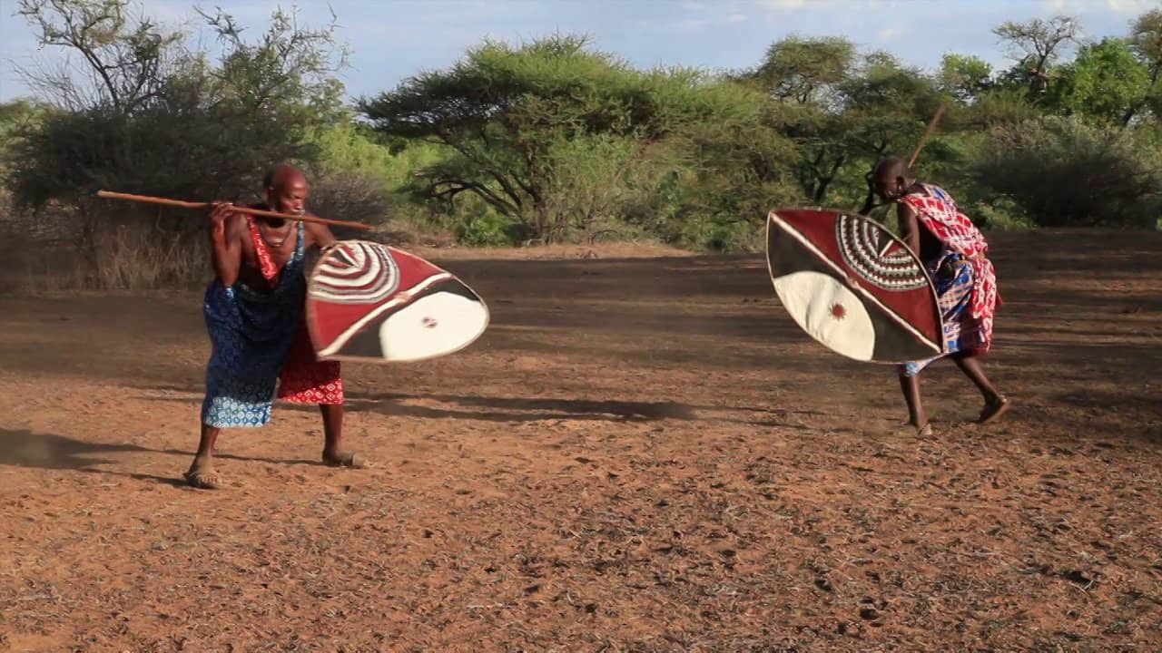

A warrior is one who is
Introduced to their tribal practices and customs. A Warrior is not Gender specific. The warrior is prepared to fight for and protect our connection to the divine, ourselves, and our community. A Peaceful warrior utilizes self-defense, self-discipline psycho-physical stamina, and fitness--in preparation for the life journey. By being Introduced to cultural practices, the lessons inculcate self-determination, perseverance, readiness, and preparedness to fight and protect.
AKOBEN: “WAR HORN”
VIGILIANCE*WARINESS*ALERTNESS
“A HORN IS USED TO SIGNIFY THE COMMENCEMENT OF A BATTLE, A CALL TO ARMS TO DEFEND YOUR COMMUNITY. A SYMBOL OF AWARENESS OF YOUR CHALLENGERS AND A READINESS TO CONFRONT THE. LASTLY, A CALLING TOGETHER TO TACKLE A COMMUNAL CHALLENGE.

Slide 12

The Inner Workings of a Warrior..
The ram will challenge any adversary, but also submits to slaughter. Perhaps a more modern translation could be the ram has the power and strength of purpose to face any challenge, but has the wisdom to understand when an encounter is not a threat and can be responded to with humility. Those with strength who understand their weaknesses can become even stronger. It is not with physical strength we win battles, but with our humility and wisdom.
Isaiah: 11:2
The Spirit of the Lord will rest on Him. The Spirit of Wisdom and understanding; the Spirit of advice and power; the Spirit of knowledge and AWE
The Spirit/Holy Spirit dwells in each warrior to produce:
Confidence: to conquer Fear, Doubt, and Low Esteem To know though we can not see.
Hope: when faced with adversity that all is well and you are protected
Guide: for Righteous Decision making
Trust: in God, yourself, and the community

Slide 13

In all circumstances a warrior is wise to Rely on peace to apply their principles, practices, and customs in preparation for life’s adventures…

Slide 14

Peaceful Warrior as a protector amid chaos…
ALL FORMS OF MENTAL
PSYCHOLOGICAL WARFARE: FEAR & DOUBT

Slide 15
DO
FEAR
LOW ESTEEM negative thoughts harmful people arrogance procrastination guilt shame..
Leaving many to fear they are not good enough, unworthy, or fundamentally flawed. However, through faith in oneself, these feelings and behaviors can be overcome by creating new habits and breaking free from some of the patterns the enemy will try to create to hold you back.
*What is Doubt?
Feeling of uncertainty- unsureness, indecision, hesitation, distrust, mistrust.
*What is fear?
Fear arises with the threat of harm, either physical, emotional, or psychological, real or imagined.
*What is low-esteem?
Impacts how you feel about and treat yourself—it can also play a role in how you allow others to treat you. It can affect your motivation to go after the things you want in life and your ability to develop healthy, supportive relationships.

Slide 16
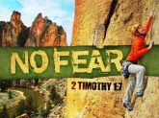
Marvel Studios' Black Panther - Official Trailer (youtube.com)
What does a Warrior look like?
2 Timothy 1:7
“For God has not given us a spirit of fear and timidity, but of power, love, and self-discipline.”

Slide 17
A Warrior is willing to Guide and Be Guided
As a Guide:
will allow you to make conscious and better decisions.
will allow you to be aware of the tools to use in when faced with adverse situations.
Say no to things that can harm yourself or others.
Set realistic goals.
Stay motivated even when circumstances do not turn out the way I thought they should.

Slide 18
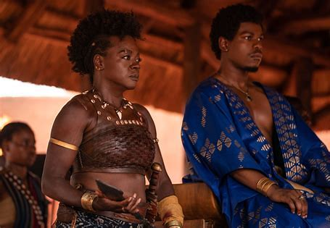
Warriors promote high-esteem and confidence not “arrogance.”
Warrior has confidence:
You are worthy* Asking for assistance when needed.
You are enough: *Never comparing myself to others, but acknowledging and appreciating gifts in others.”
You deserve to believe in yourself.
The Divine Creator has placed within each of us a measure of Faith to produce great works, make great accomplishments, build up the community, Be an example of the Divine Creator.
Warrior has no use for arrogance:
Arrogance is pride, ego-driven, conceited, Hubris, or less frequently, hybris, which describes a personality quality of extreme or excessive pride or dangerous overconfidence, often in combination with arrogance. The term "arrogance" comes from the Latin adrogare, meaning to feel that one has a right to demand certain attitudes and behaviors from others.

Slide 19

Nyame Nti
"by God's grace"
As a Warrior:
TRUSTS GOD
TRUSTS YOURSELF
TRUST OTHERS
“symbol of faith and trust in God”
"This stalk is depicted as the staff of life in many cultures. It symbolizes to the Akan that food is a basis of life and that they could not survive if not for the food that God has placed here on Earth for their nourishment. "

Slide 20
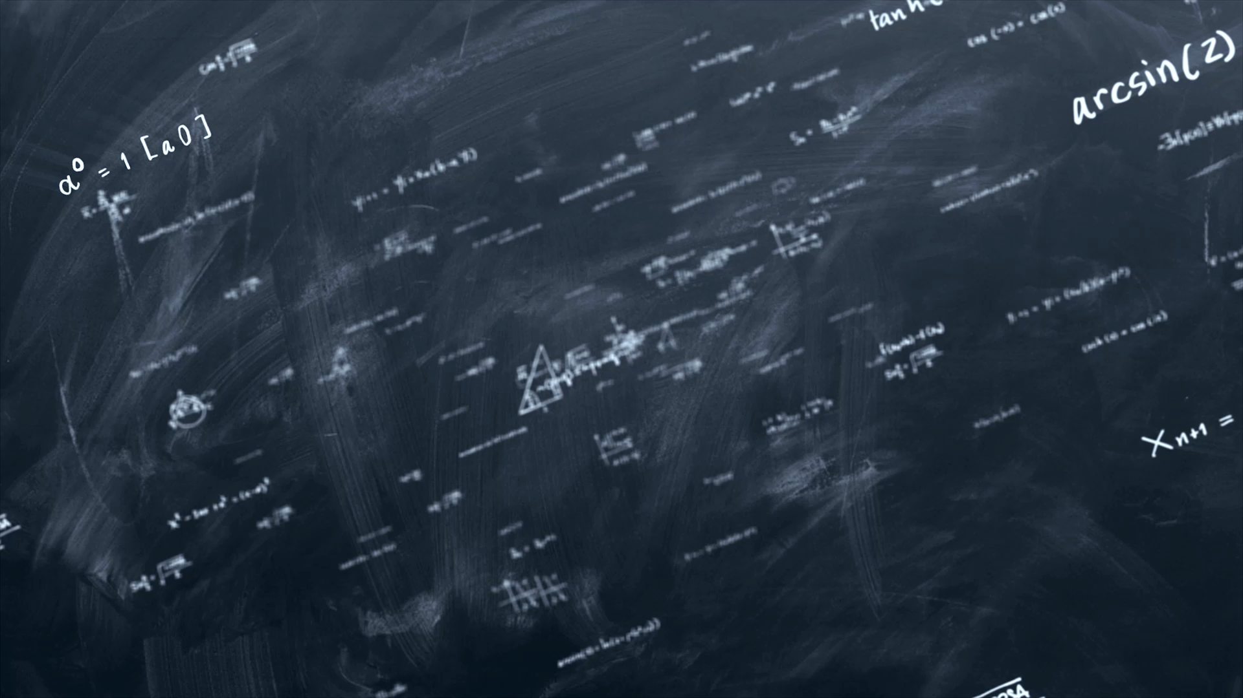
Formula for Warrior
God’s Wisdom…Will…Manifestation

Slide 21
Warrior Tools
Formula’s to consider:
*I AM Statements of Affirmation to increase your value and beliefs.
*Keep a Gratitude Journal to remind you to be grateful.
*Volunteer Your Time and Gifts to Others.
*Participate hobbies to help increase skills and talents.
*Read daily proverbs and/or inspirational quotes that help preserve your Integrity-Truth-Peace
*Pray and meditate for at least 5 mins a day to reconnect to the Divine through Christ, by simply taking deep breaths. To Stop_ Calm_Relax_Heal.

Slide 22

“Nyame Nwu Na Mawu”
“God won’t die for me to die.”
It is a symbol expressing the immortality of the human soul, expressing faith in God to preserve one’s soul.
As a Warrior under the Order of Melchizedek,
1. to lead a life of Integrity-Truth-Peace (Non-Violence)
2. Connect with the Spirit as a Tool to seek God in every situation, believe and trust in Self and Community
3. As a shield to defend/protect from character attacks
4. Increase Hope and Provide Evidence to yourself and to others who you truly are

Slide 23

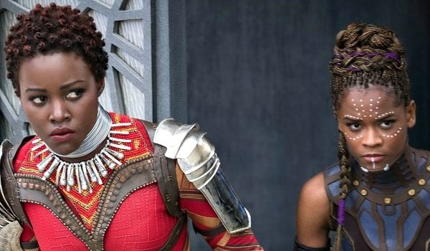
Warriors for us today are your Priests, Bishops, Minsters, Guru’s, Teachers, Poets, Authors, Song Writers, Environmentalist, Humanitarians, Sages, all people great and small present in our day which incorporate the faith traditions of the past that promote truth, integrity, peace and faith, to ensure our present day resembles the authenticity, honor and pluralism, and reverence due to God the Creator, found in our Divine Self, and instilled in community.
A Warriors Notes of God: The earth is wide but Nyame is chief. The order that Nyame has settled, living man cannot subvert. All people are Nyame offspring. No one is the offspring of the earth. No teaches forging to a smith’s son. If he knows it, it is Nyame who taught him. The hawk say’s “All that Nyame did is good.” No one points out Nyame to a Child. When a fowl drinks water it shows it to Nyame. There is no way around Nyame destiny. If a living man knocks over your cup, Nyame will refill it. Unless we die of Nyame, let living man kill you and you will nor perish. To save fraud, Nyame gave each person a name. If you tell Nyame, Tell the wind. Could Nyame die, I would also die. When the world make Nyame it burden, no one becomes humpback.
Funtunfunefu-Denkeymefunefu
Represents Siamese crocodiles
Symbol of unity in Diversity.
Can you identify any significant/relevant Warriors in your life ?
What would they look like?
How could a Warrior utilize their skills, knowledge and character to protect, value in God, themselves and community.

Slide 24
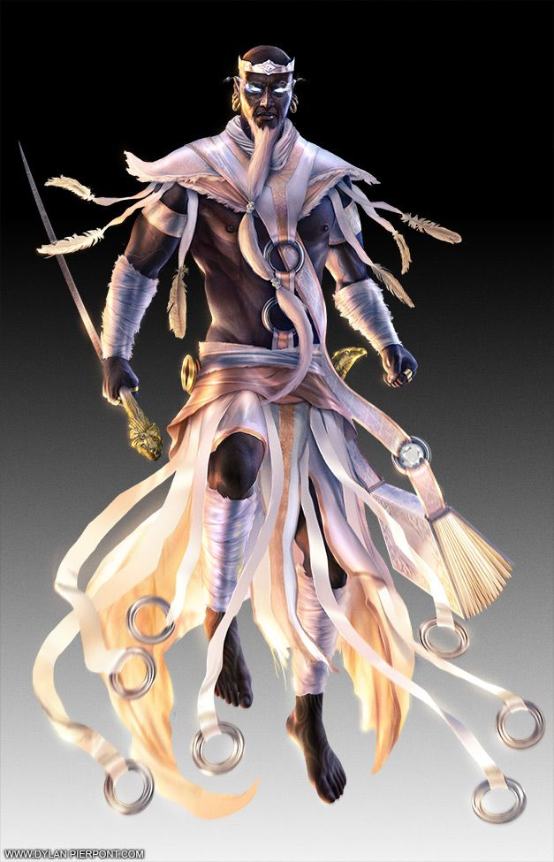
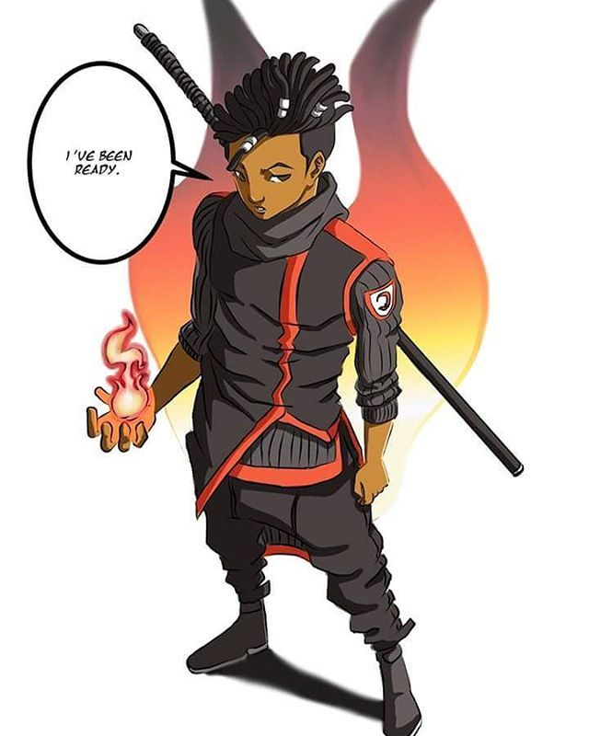
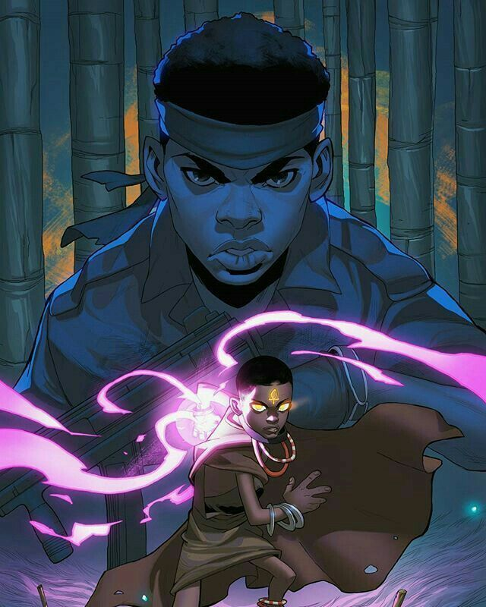
The Ashanti have a special handshake, in which you hold your left hand out to shake hands. This comes from the Ashanti's explanation that the left hand holds the shield, and the right hand holds the spears. So, in order to show your trust in someone, you put down your shield and therefore have your left hand free. What are some ways you can show trust/ having faith in someone?

Slide 25
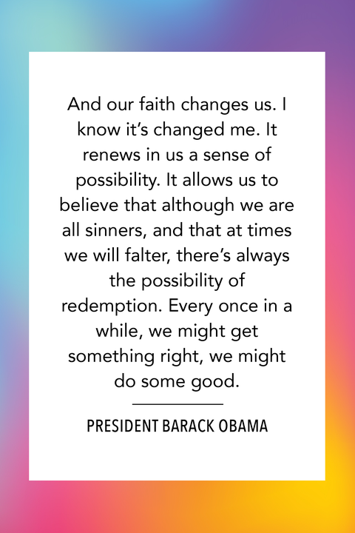
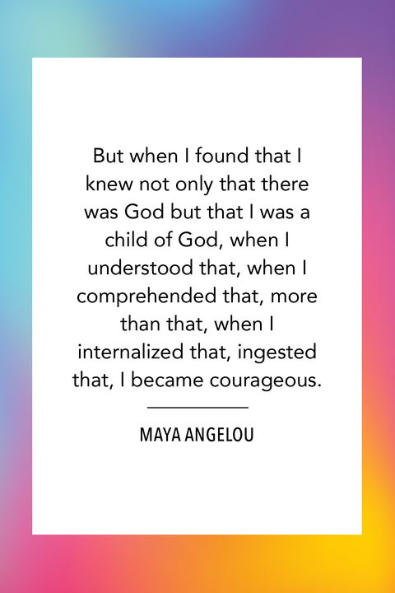
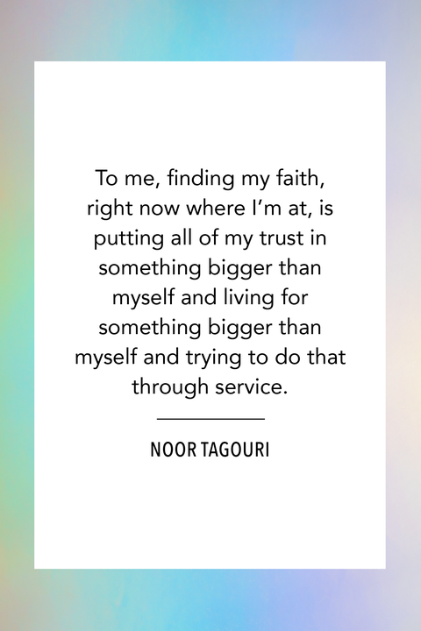
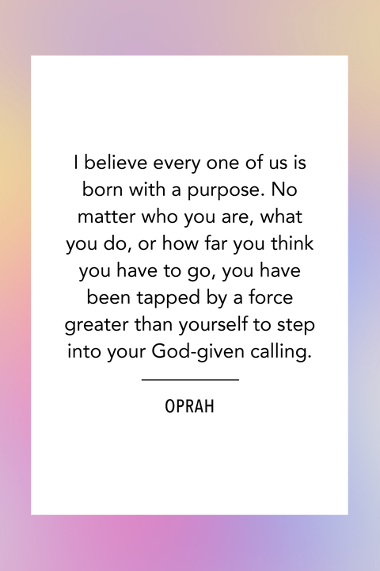
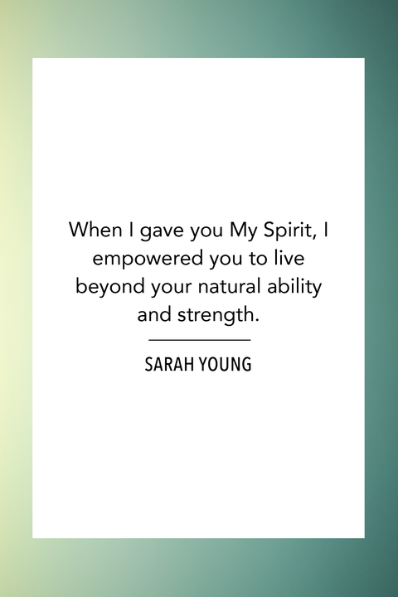

Slide 26
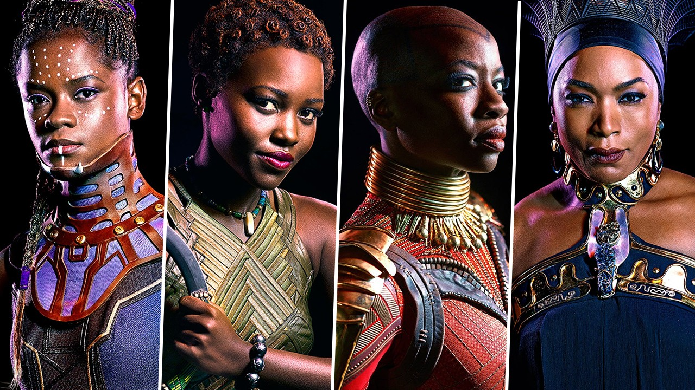
Rites of Passage: Sani Mgbanwe
“Guide”
Personal: Memorize and Recite 7 “I AM” statements. Find a Spiritual Mentor
Emotional: Learn techniques to balance emotions and feelings.
Spiritual: Begin spiritual practices of meditation and prayer to connect w/Divine
Mental: Learn methods and develop modalities to enhance focus and mindfulness
Social: Encourage/Invite others to experience the principles of JOM
Political: As a Guide, Join the Co-horts of Peace, Truth, Honesty, Integrity to invoke spirit of Unity and Support from the Ancestors
Economic: Be informative on ways faith in God, Self and Community will lead to success.
Historical: Learn how to apply the principles of Sankofa by creating a “Tree of Origin”
Cultural: Create and/or encourage spaces that incorporate African traditions which focus of wholeness and wellness in the community
Physical: Actively involved in any form of “Art”-Martial Arts, Dance, Drumming, Nature oriented, which will promote oneness with Divine, Self and Community

Slide 27
THE ARMOR OF GOD => BELOVED COMMUNITY OR KINGDOM LIVING
Rev. Dr. Martin Luther King, Jr. is a forerunner to the Age of Melchizedek. The character traits that constitute the “Beloved Community” are those listed in the The Order of King Melchizedek’s Armor of God (Remember Melchizedek is King of Righteousness and Peace):
1. Truth/honesty 2. Righteousness/Integrity 3. Peace/non-violence 4. Faith 5. Servant-Leader (Helmet of Salvation) 6. Mystic Healer (Sword/Word)
JOM MOTTO: Knowing the Past, informs the Present, which influences OUR Future moment in time.

Slide 28
JOM MOTTO:
Knowing the Past, informs the Present, which influences Our Future moment in time.

Slide 29
JOM VISION:
Seeking Truth,
with Integrity,
to establish a World of Peace,
through Faith.

Slide 30
AFRICAN CULTURAL VALUES
1. Griot – History Story Teller, often in song (S.R.O.M.)
2. Scribe: an educated note taker, also a teacher. (2022)
3. Warrior: the defender of community and culture. (2023)
4. Teacher: one who gives or shares knowledge. (2024)
5. Leader: one who provides guidance through example. (2025)
6. Healer: One who heals physically, emotionally, psychologically and spiritually. (S.R.O.M.)

Slide 31
SCHEDULE FOR A ONE HOUR CLASS
MEDITATION: Quite Settling (1-3 minutes)
OATH OF THE ORDER: Hebrews 5:5-6 (Memorized and shared) (1 minute)
⁵So also Christ did not glorify himself in becoming a high priest, but was appointed by the one who said to him, “You are my Child, today I have begotten you”; ⁶ as he says also in another place, “You are a priest forever, according to the order of Melchizedek.”
WEEKLY DISCUSSION: Who was Melchizedek? Why is the program named Jr. OM? (At least 5 minutes per week. Should be done more often and longer when deemed appropriate.)
DISCIPLINE CHECK (10 minutes)
Homework Check: (use discretion in reporting method)
Physical Exercise Check: (Are you staying active and healthy?)
LESSON FOR DAY (35 minutes)
Session 2 Theme: Warrior within the Family
CLOSING MEDITATION (1-3 minutes)
REPEAT OATH IN CLOSING (1 minute)

Slide 32
SCHEDULE FOR A ONE HOUR CLASS
MEDITATION: Quite Settling (1-3 minutes)
OATH OF THE ORDER: Hebrews 5:5-6 (Memorized and shared) (1 minute)
⁵So also Christ did not glorify himself in becoming a high priest, but was appointed by the one who said to him, “You are my Child, today I have begotten you”; ⁶ as he says also in another place, “You are a priest forever, according to the order of Melchizedek.”
WEEKLY DISCUSSION: Who was Melchizedek? Why is the program named Jr. OM? (At least 5 minutes per week. Should be done more often and longer when deemed appropriate.)
DISCIPLINE CHECK (10 minutes)
Homework Check: (use discretion in reporting method)
Physical Exercise Check: (Are you staying active and healthy?)
LESSON FOR DAY (35 minutes)
Session 3 Theme: Warrior within the Community
CLOSING MEDITATION (1-3 minutes)
REPEAT OATH IN CLOSING (1 minute)

Slide 33
Full Order of Melchizedek
JR. OM RITES OF PASSAGE
OM SACRED ORDER
Truth: Honesty
Righteousness: Integrity
Peace: Nonviolence
Faith – Faith
The Jr. Order of Melchizedek ROP program focuses on the transitional period from youth to young adulthood. The Jr. Order of Melchizedek (JOM) program combines Biblical principles with traditional African social roles and values (7th – 12th Grades)
Helmet- High Priest - One learns to serve the Community. Because one’s character has been built, primary concerns for others becomes one’s responsibility.
Sword-Ma’at - Maat. Goddess of truth, justice, wisdom, the stars, law, morality, order, harmony, the seasons, and cosmic balance. Maat was both the goddess and the personification of truth and justice. Her ostrich feather represents truth. OM MASTER

