Slide 1
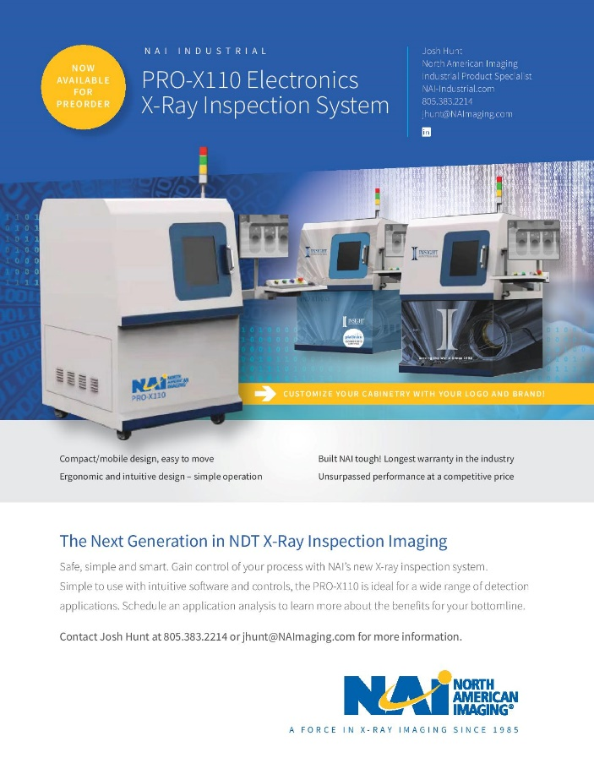
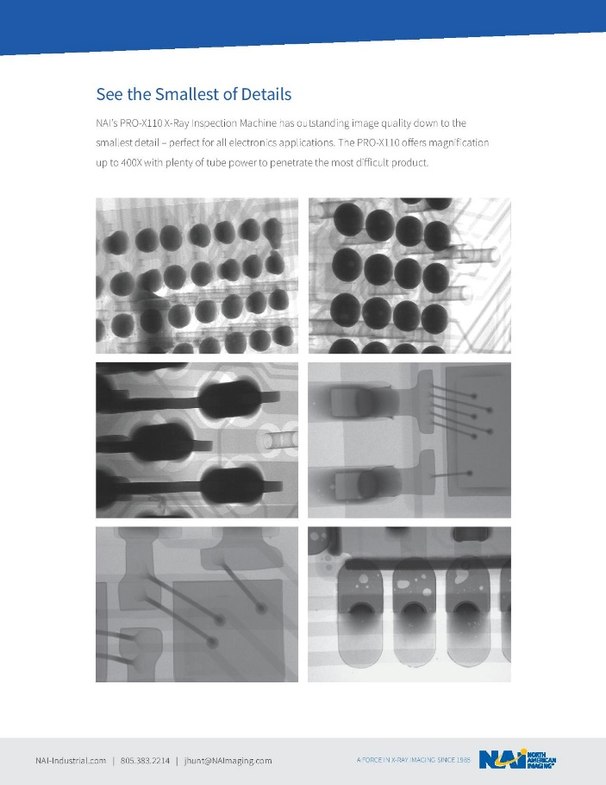
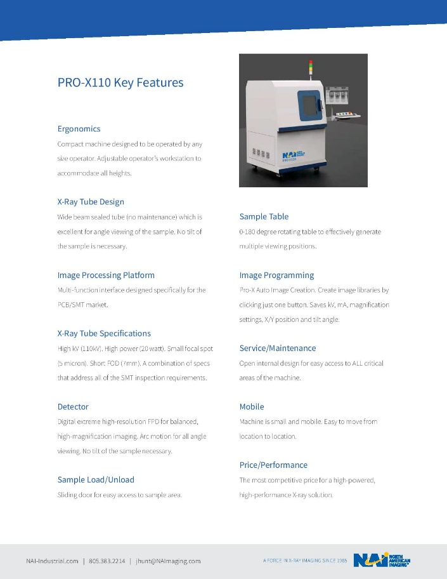
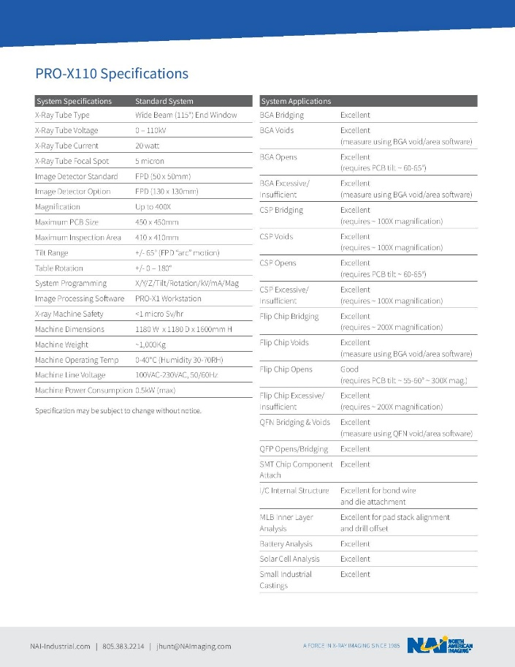
PRO-X110 SYSTEM OVERVIEW
www.naimaging.com / www.rucousallc.com

Slide 2
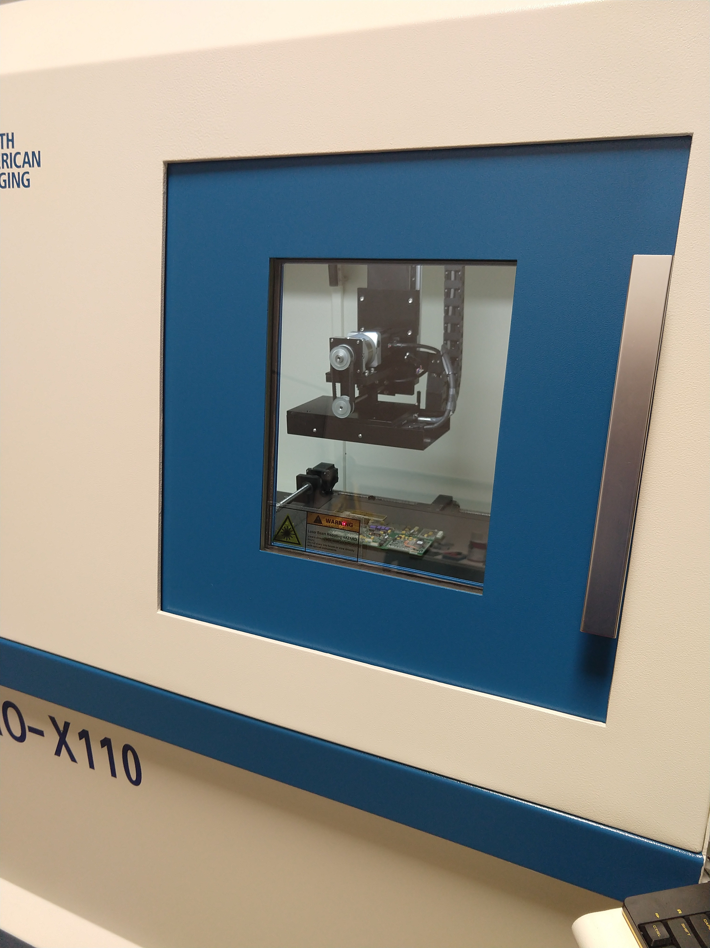
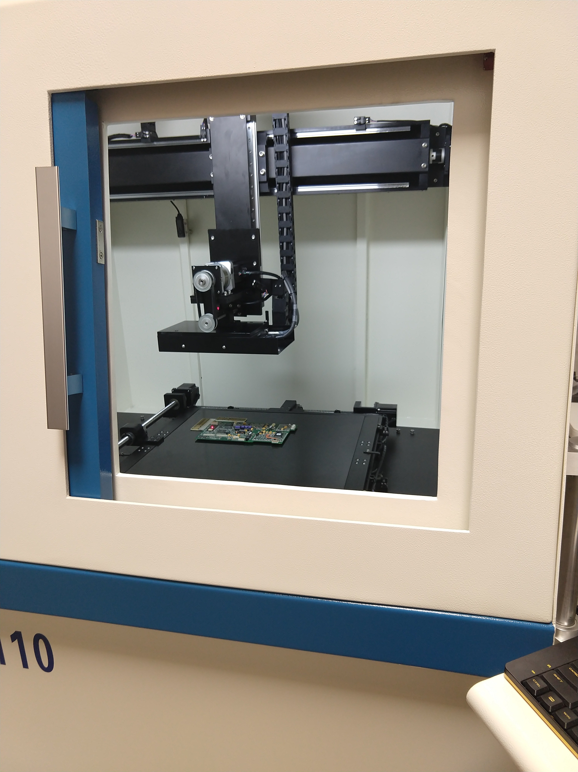
PRO-X110 SYSTEM OVERVIEW
PRO-X110 Sample entry door
PRO-X110 FPD and table
www.naimaging.com / www.rucousallc.com

Slide 3
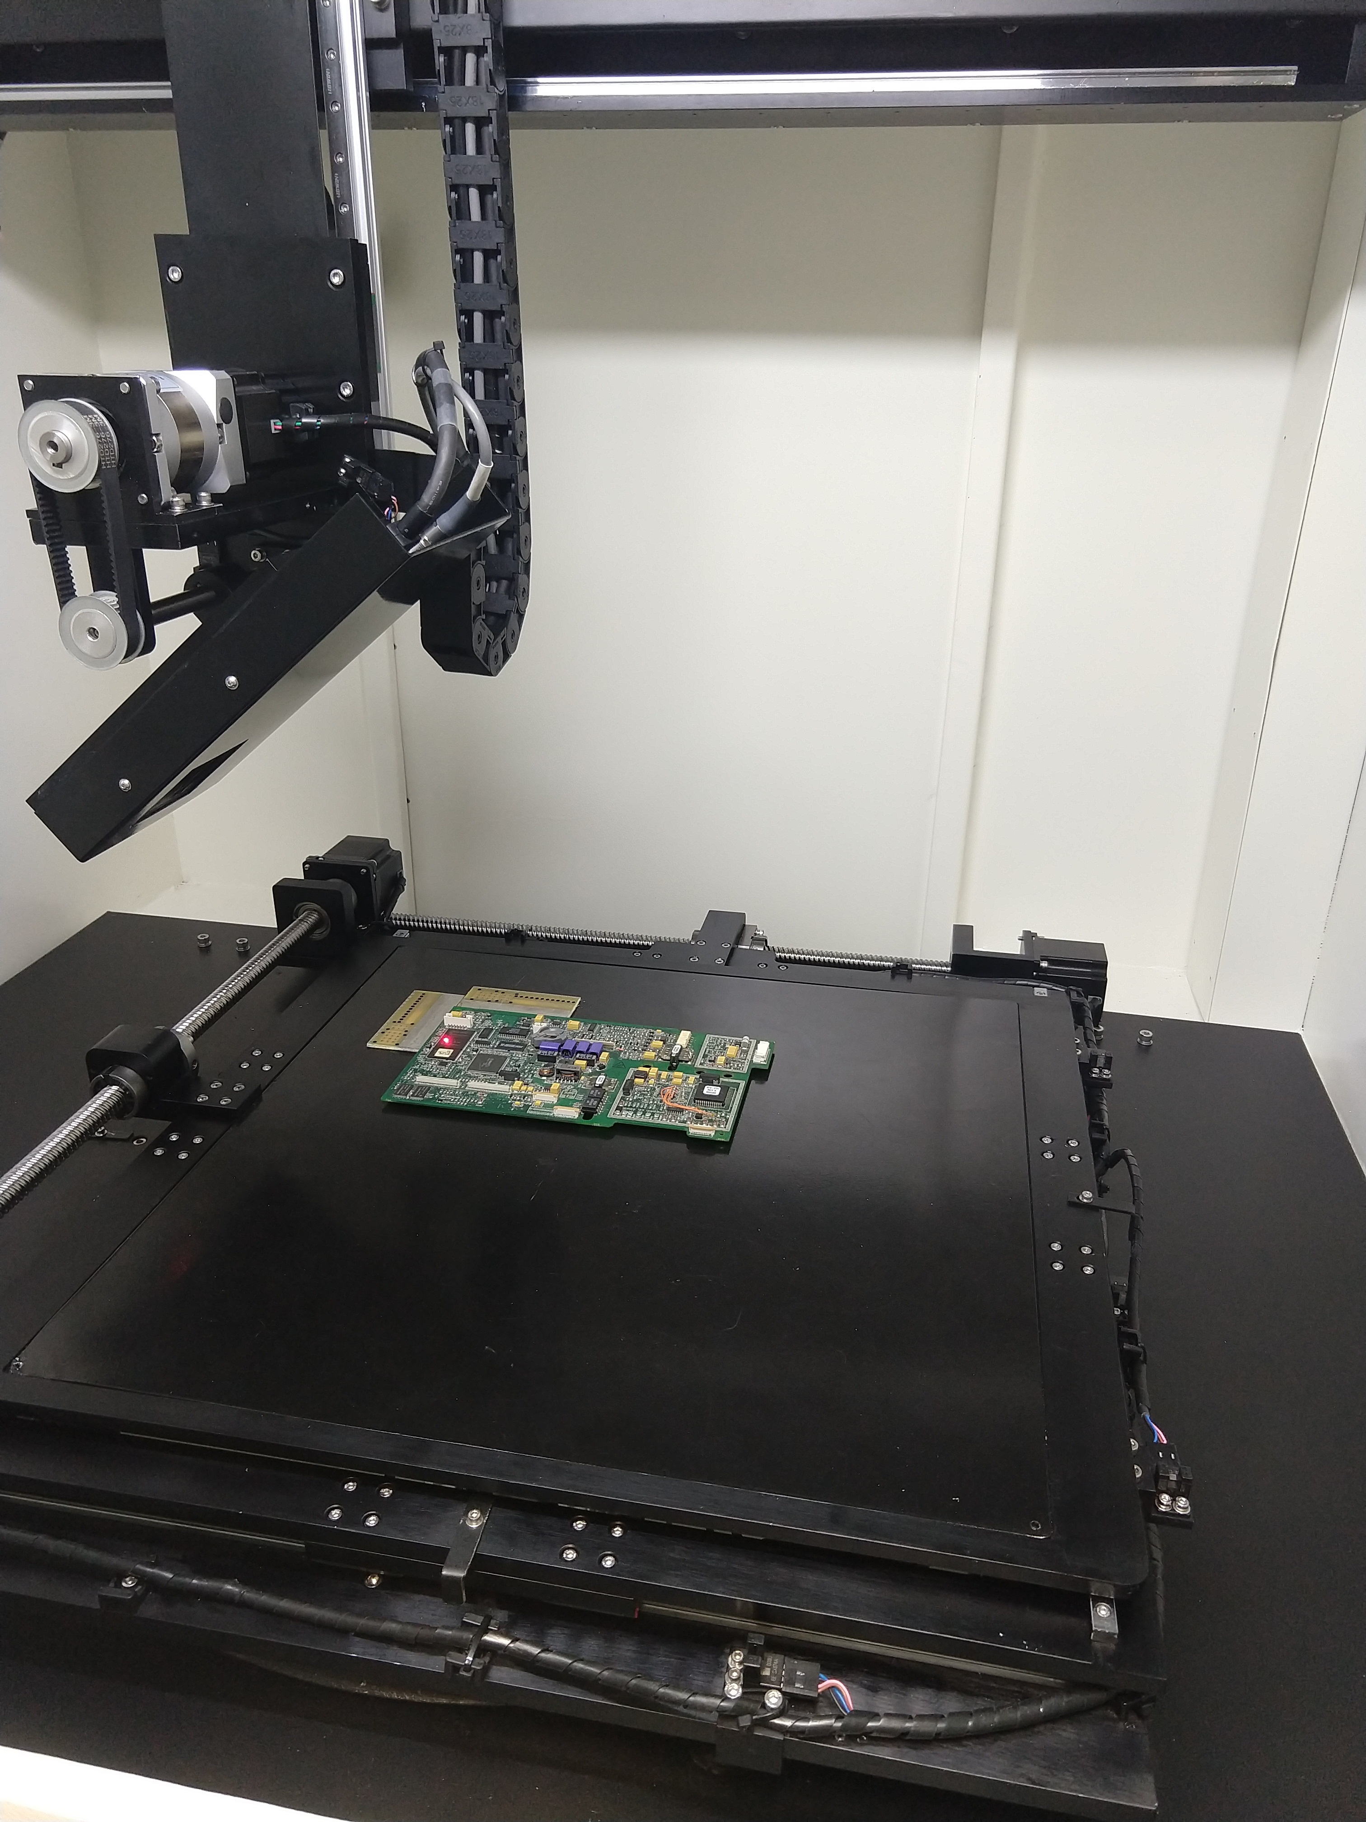
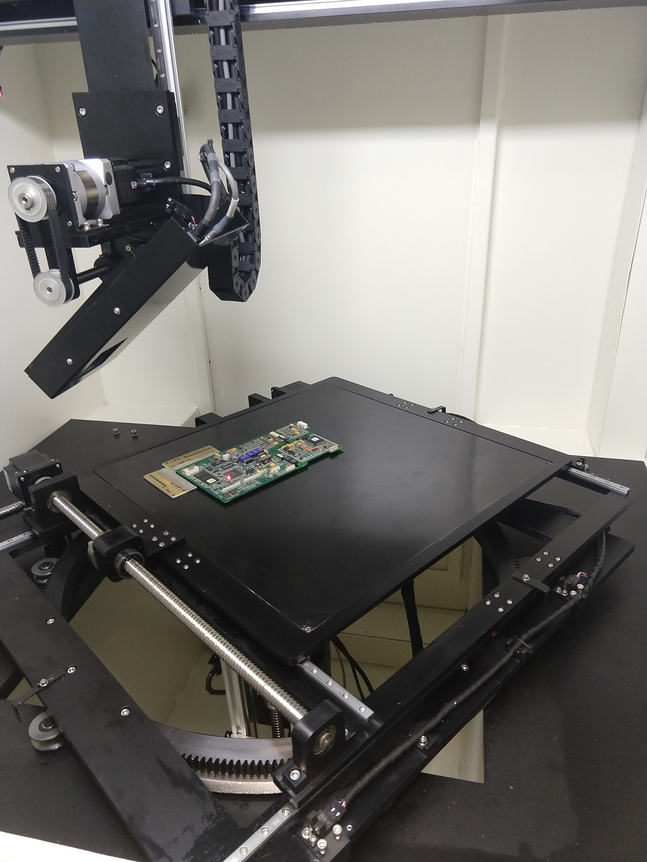
PRO-X110 SYSTEM OVERVIEW
PRO-X110 FPD Tilt
0 – 65 Degrees
PRO-X110 Table Rotation
0 – 180 Degrees
www.naimaging.com / www.rucousallc.com

Slide 4
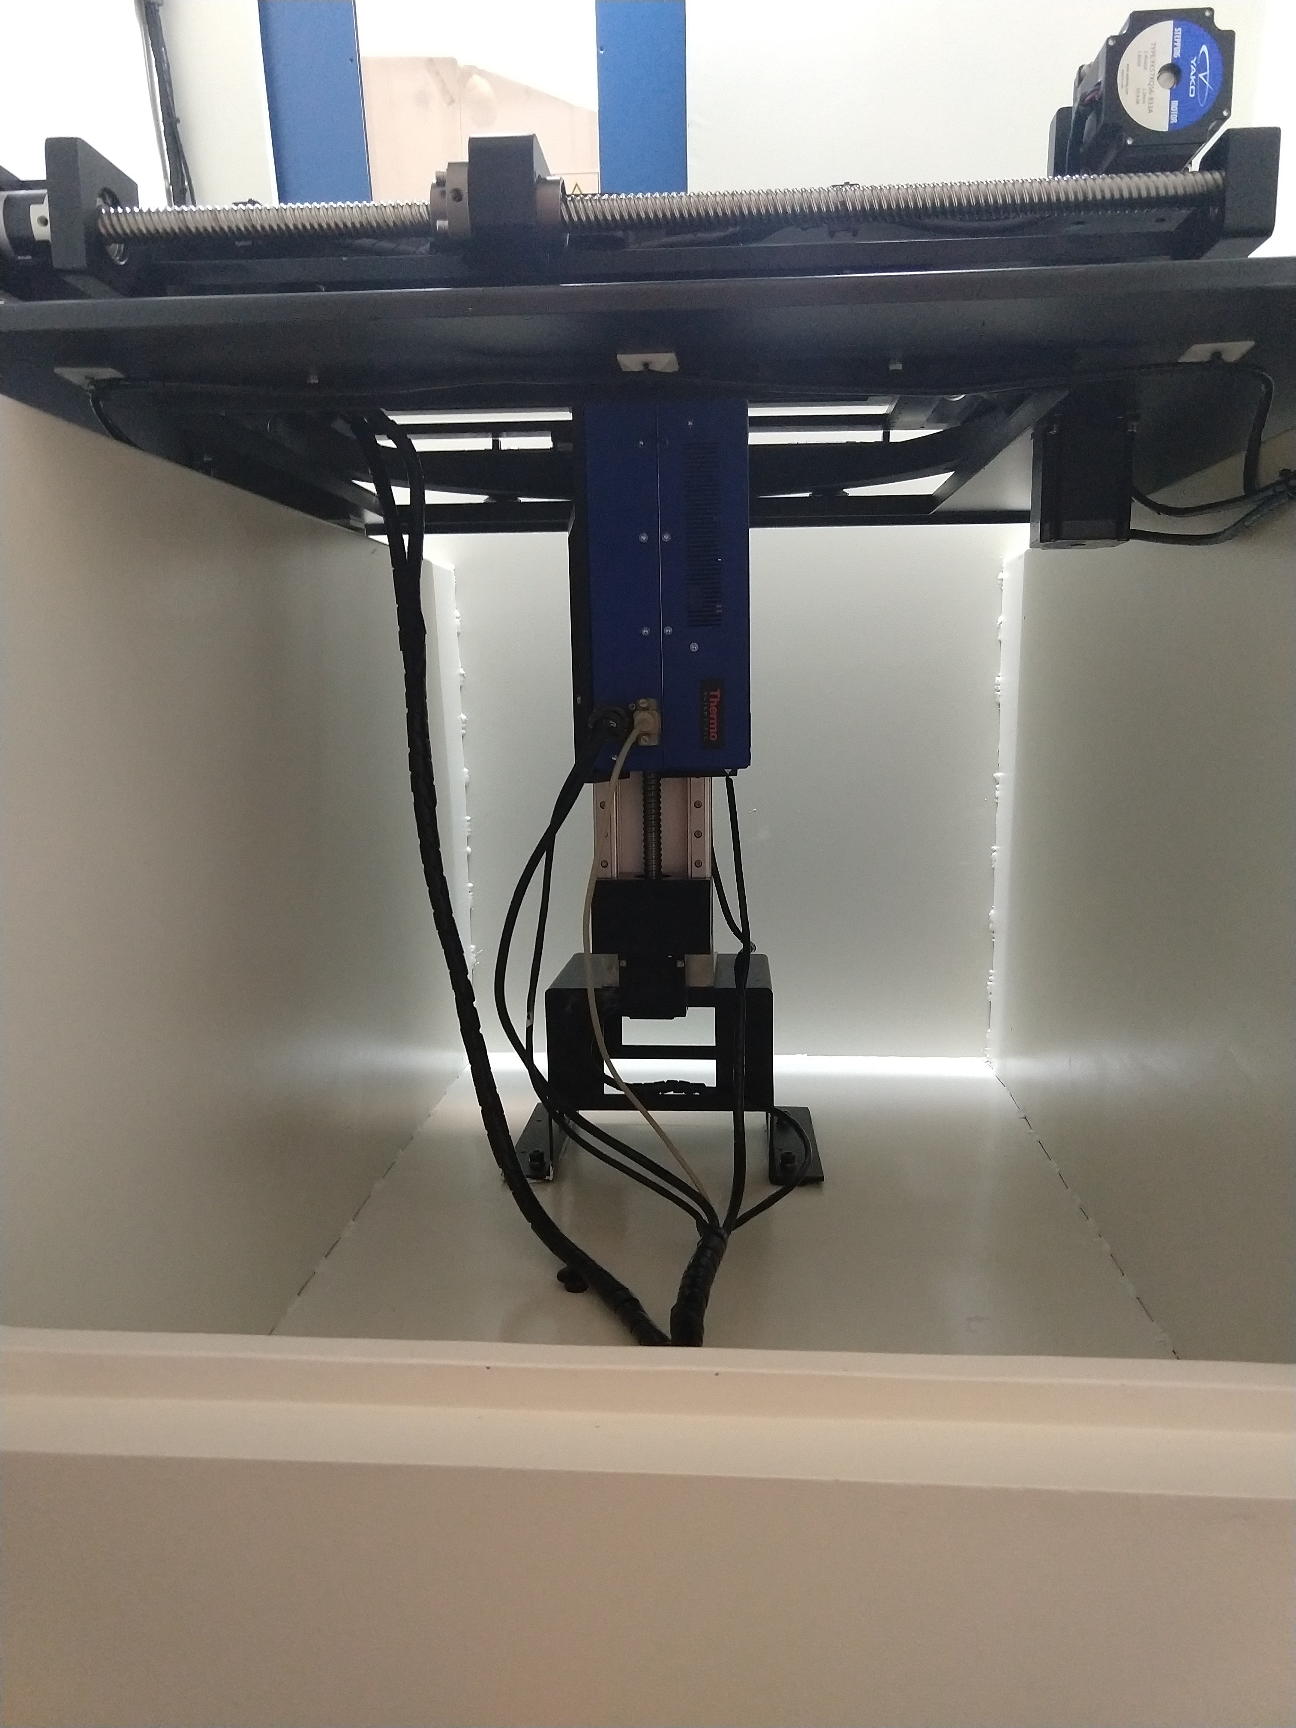
PRO-X110 SYSTEM OVERVIEW
PRO-X110 Rear Door Access
FPD
Table
Interlocks
X-ray Tube
PRO-X110
Table
Table Motors
X-ray Tube
www.naimaging.com / www.rucousallc.com

Slide 5
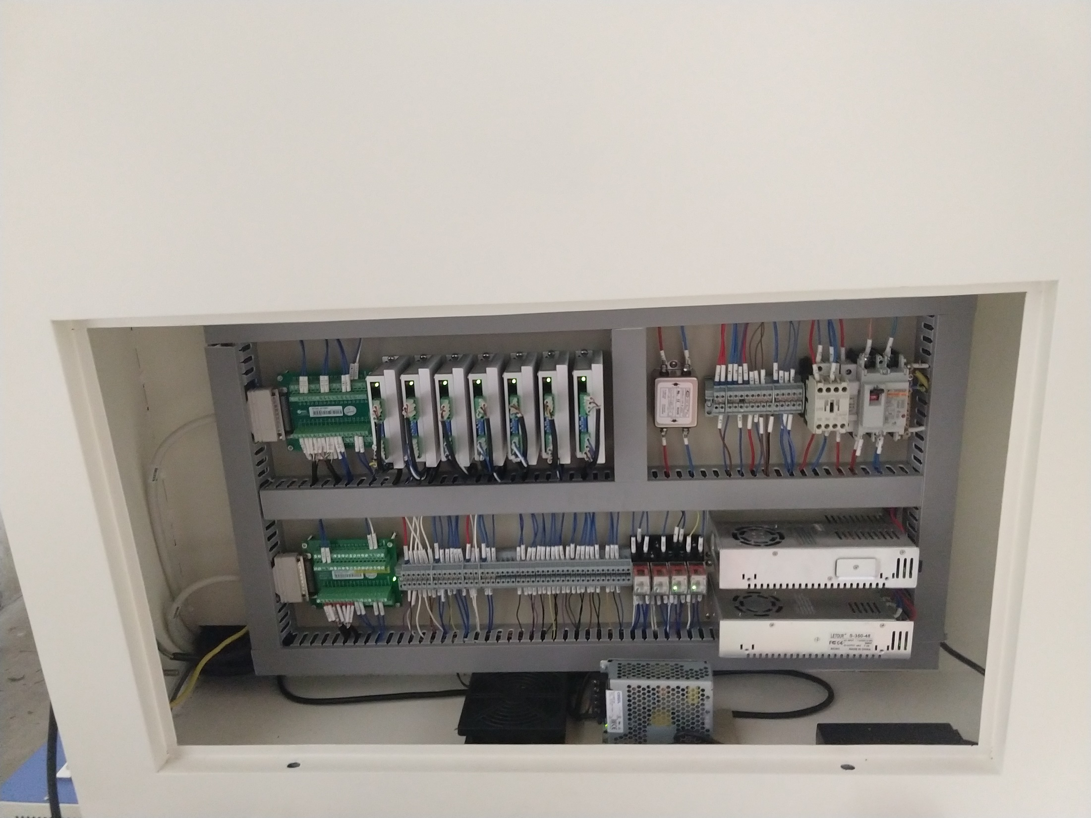
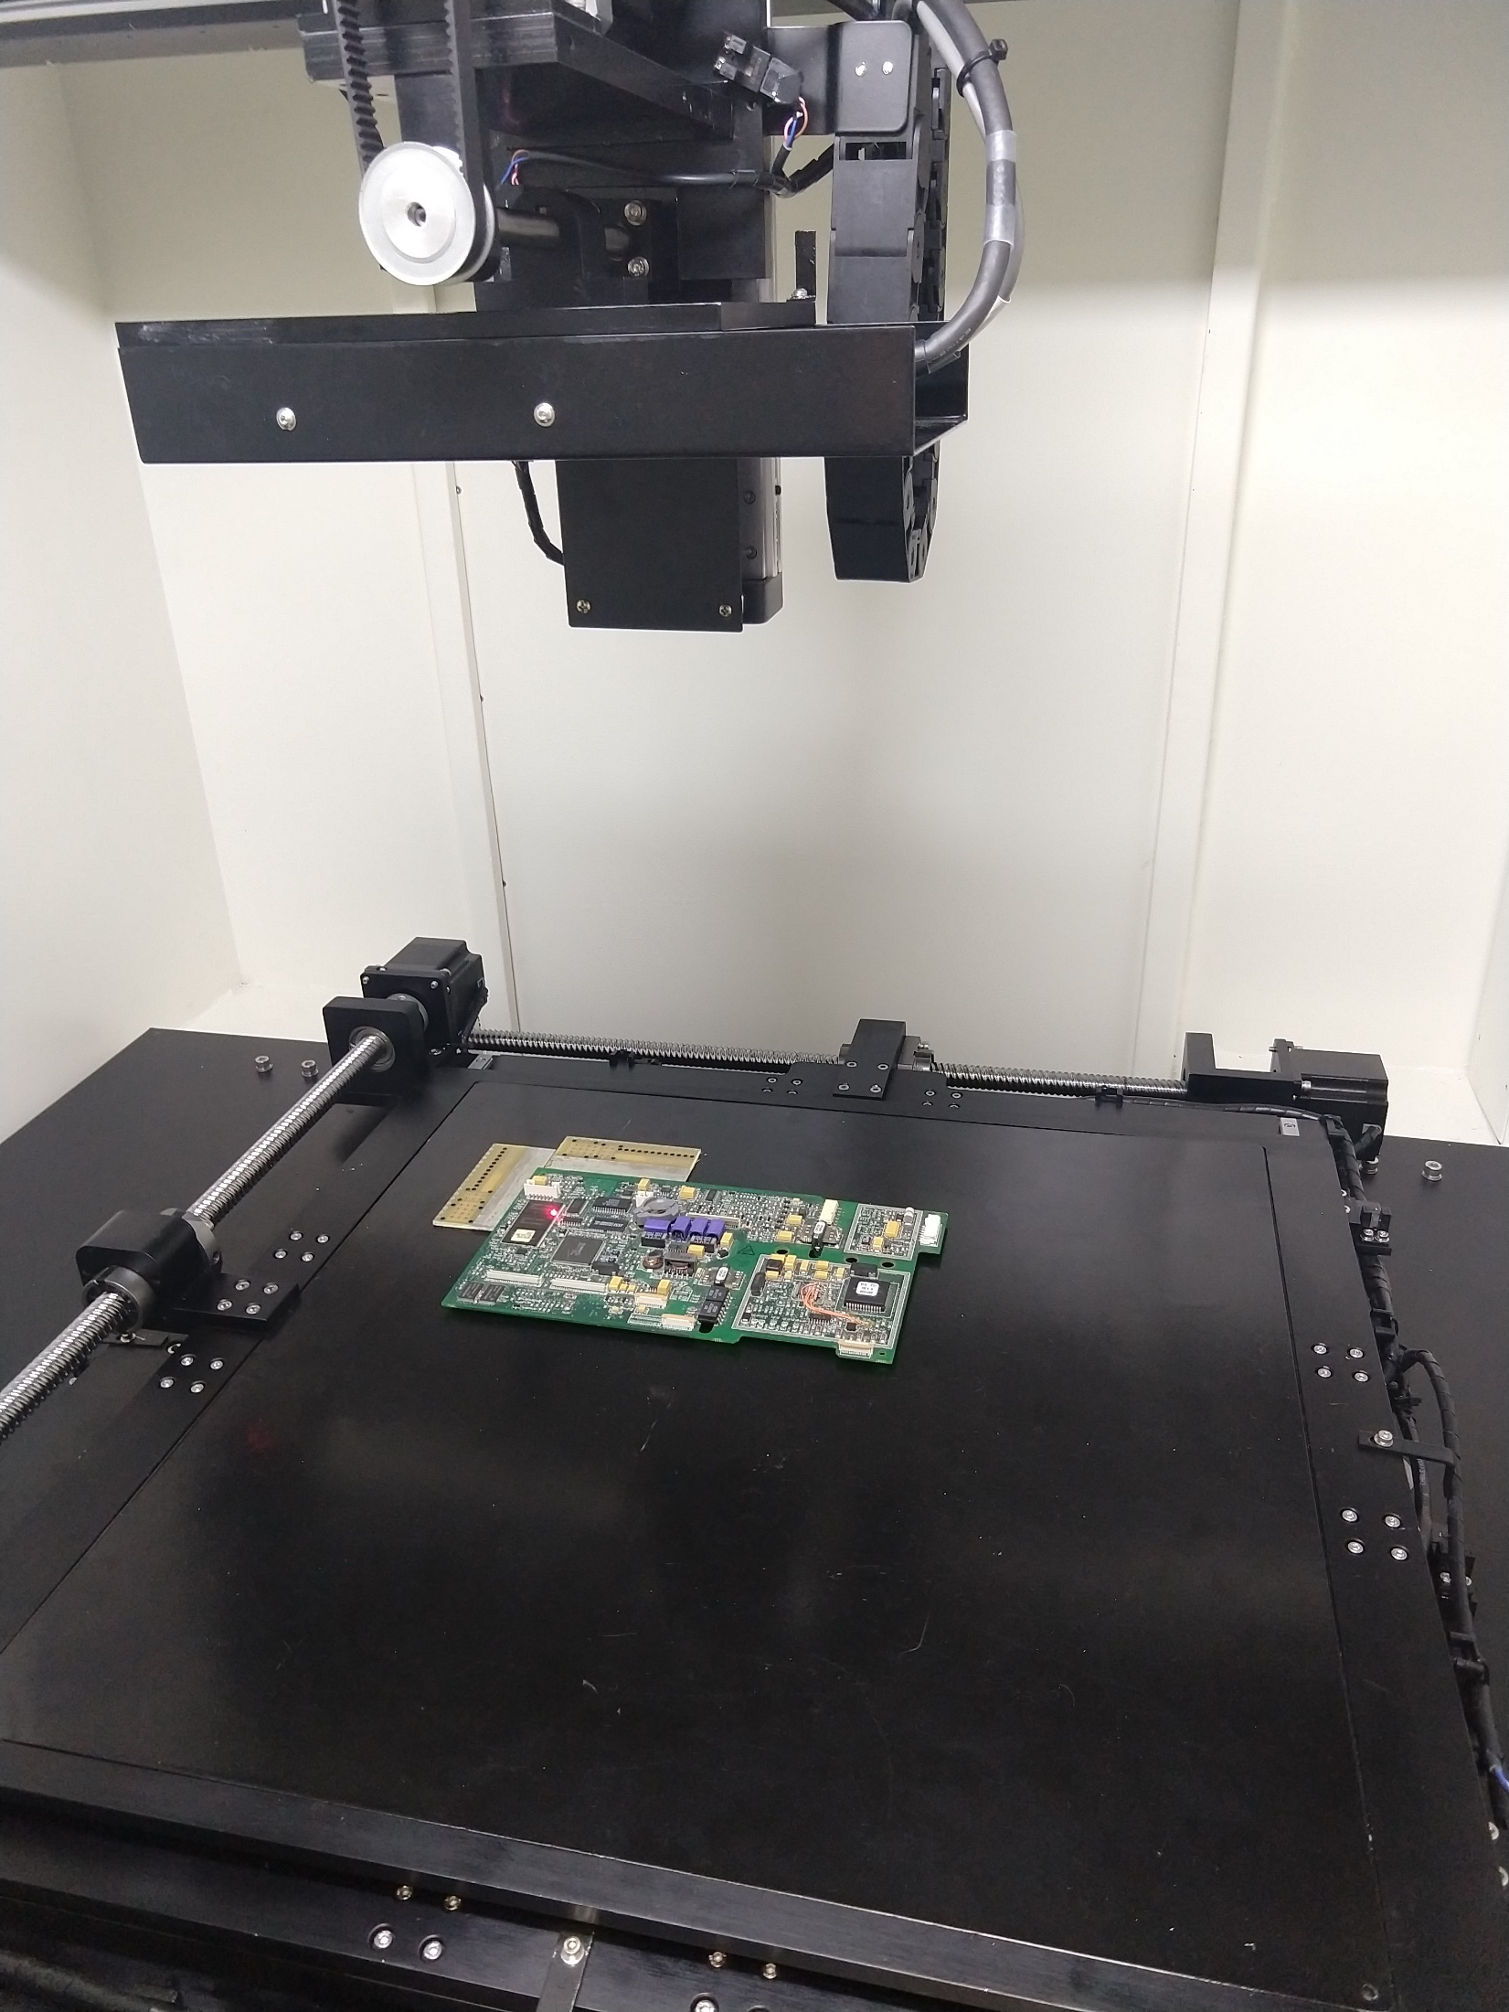
PRO-X110 SYSTEM OVERVIEW
PRO-X110
FPD Z Axis Motion = 500mm
PRO-X110
Electrical Control Access
www.naimaging.com / www.rucousallc.com

Slide 6
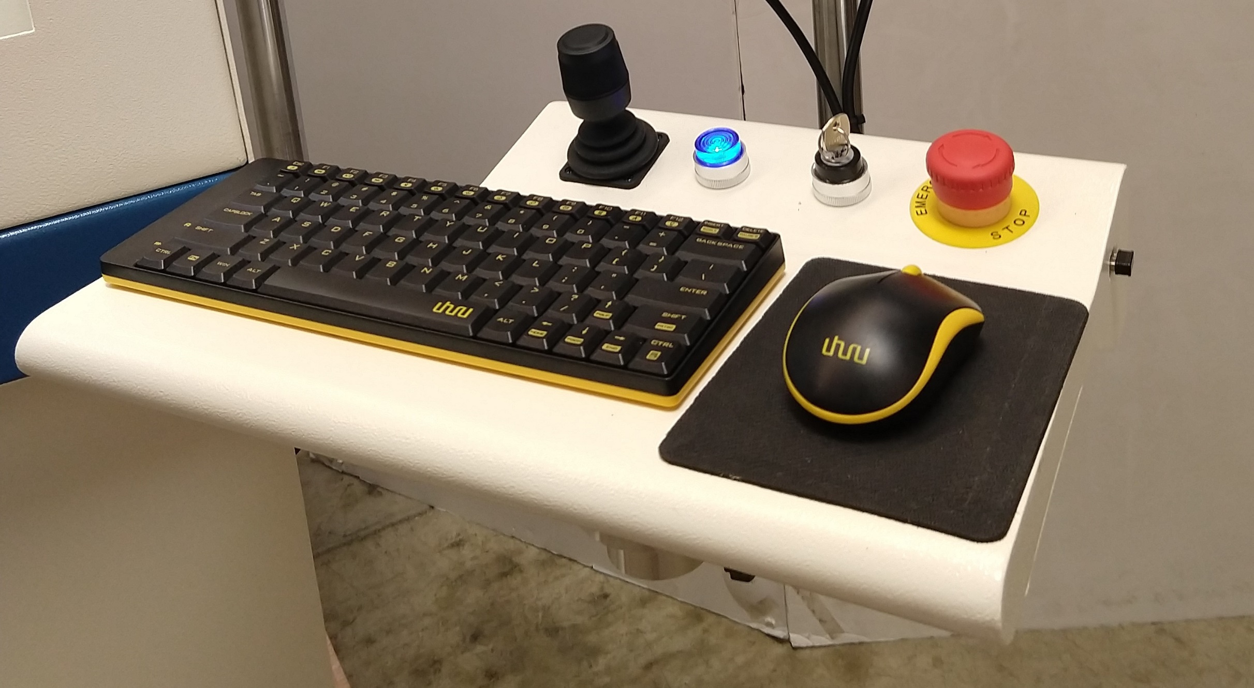
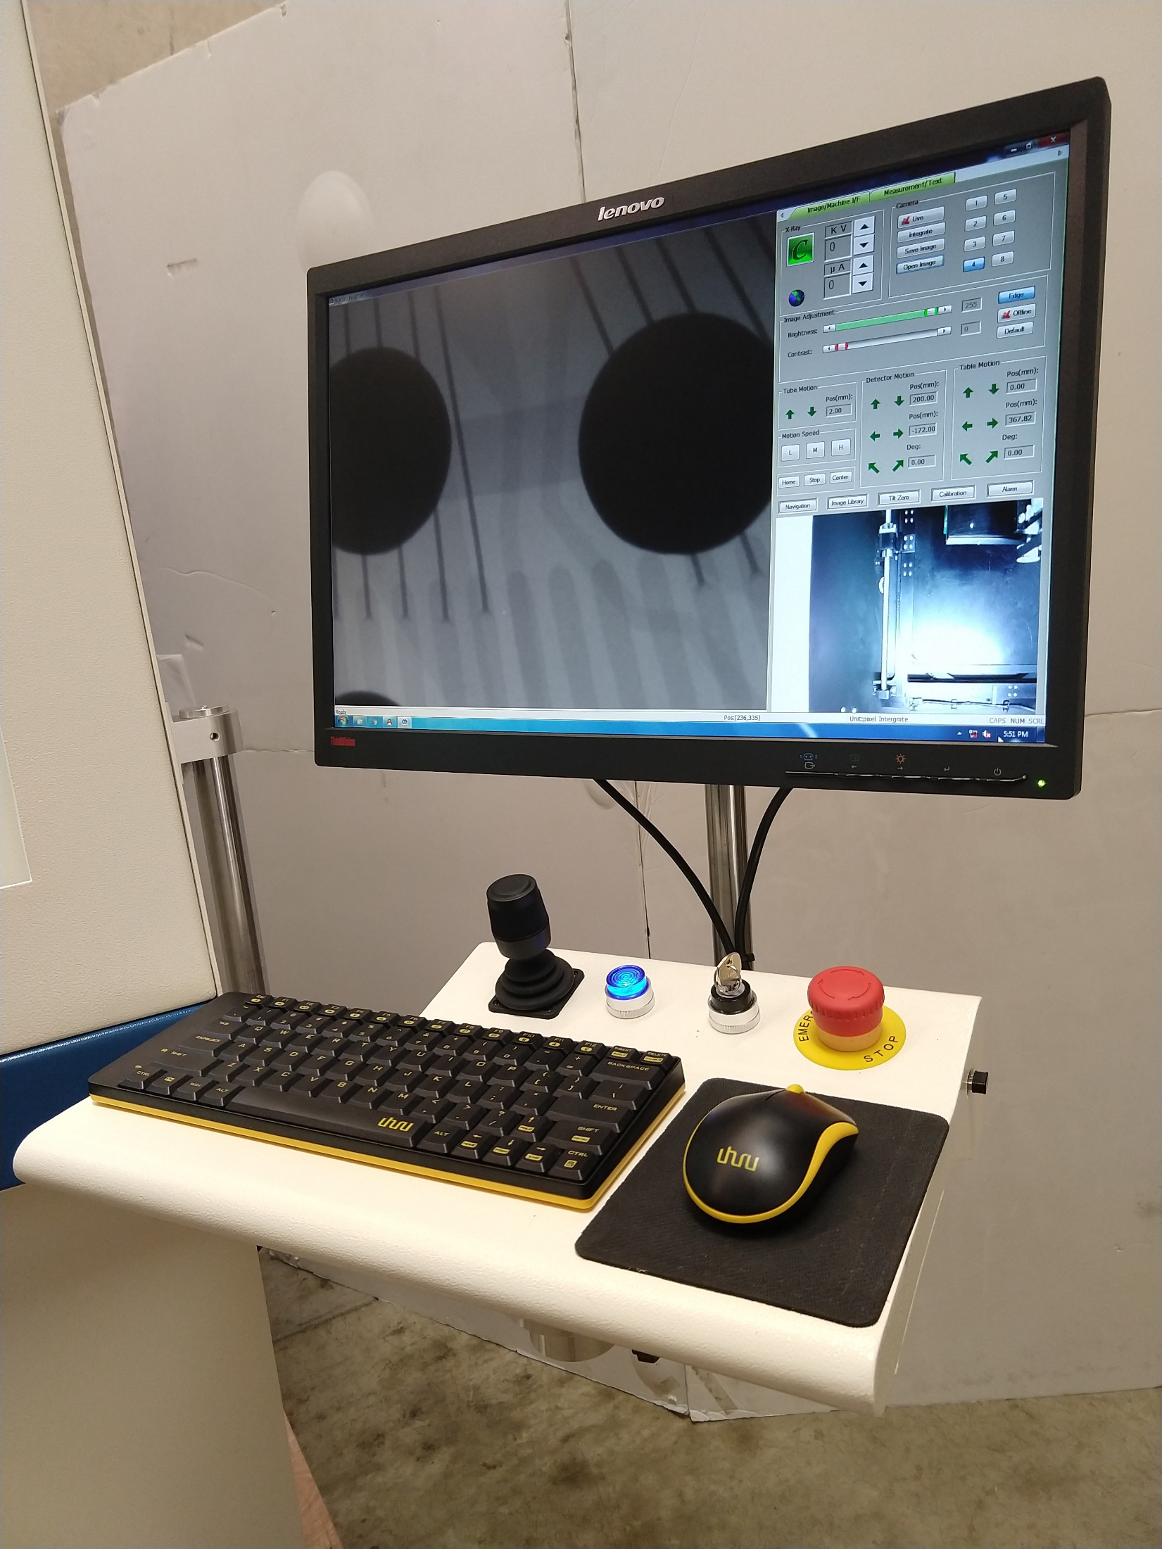
PRO-X110 SYSTEM OVERVIEW
PRO-X110
Operator Control Panel
Joystick, Computer On/Off Power On Key, E-Stop, Keyboard and Mouse
USB Port
PRO-X110
Operator Workstation
Monitor and Controls
www.naimaging.com / www.rucousallc.com

Slide 7
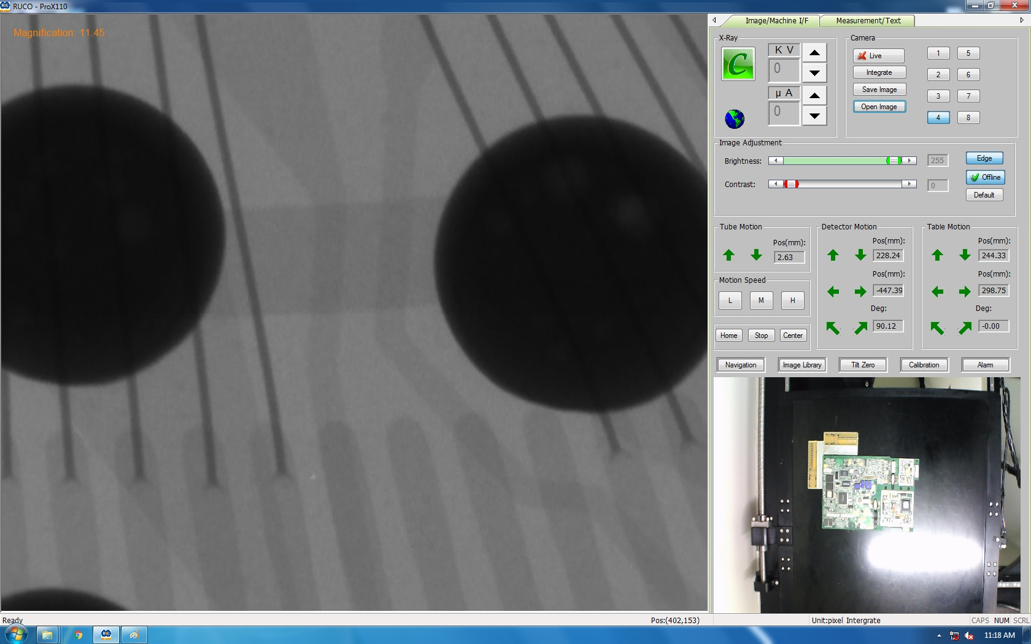
PRO-X110 SOFTWARE OVERVIEW
PRO-X110
Page One Software
Section One
kV, mA, Live Image, Integrate, Save/Open Image
Frame Average
Section Two
Brightness/Contrast
Edge Enhancement
Section Three (Motion Controls)
X-ray Tube Z Axis
Detector Z/X/Rotation
Table X/Y/rotation
Speed Controls L/M/H
Home/Center Position
Section Four
Navigation (point and click for position)
Image Library (save system parameters for specific types of devices; kV, mA, mag)
System Calibration Interface
Alarm Report
www.naimaging.com / www.rucousallc.com

Slide 8
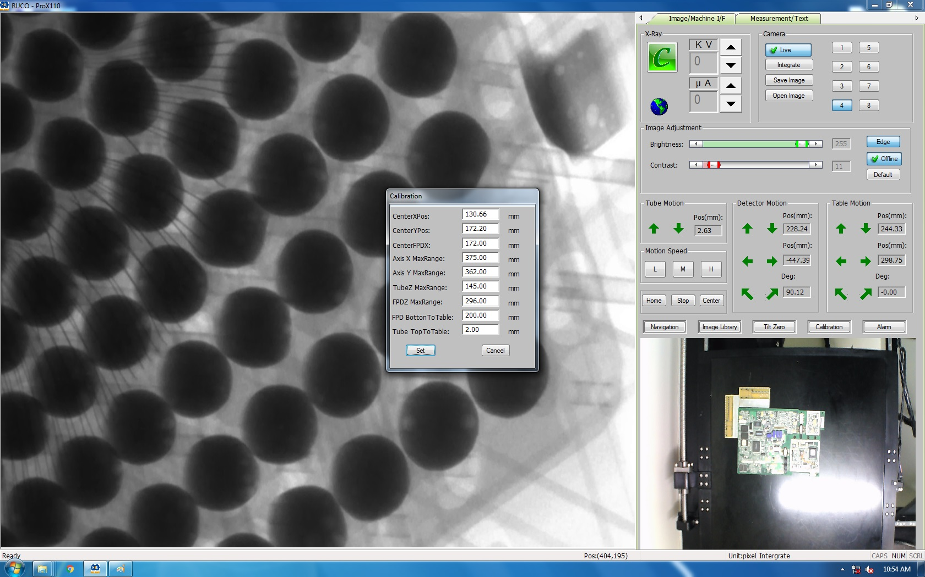
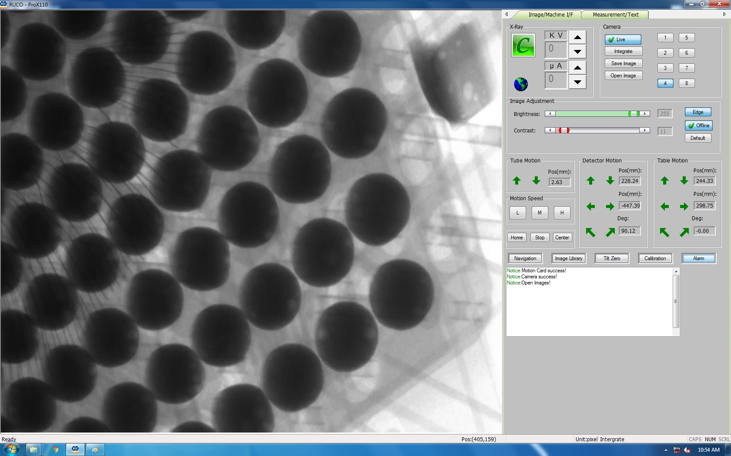
PRO-X110 SOFTWARE OVERVIEW
PRO-X110
Page One Software
Calibration (machine settings)
Alarm Report (system interface)
www.naimaging.com / www.rucousallc.com

Slide 9
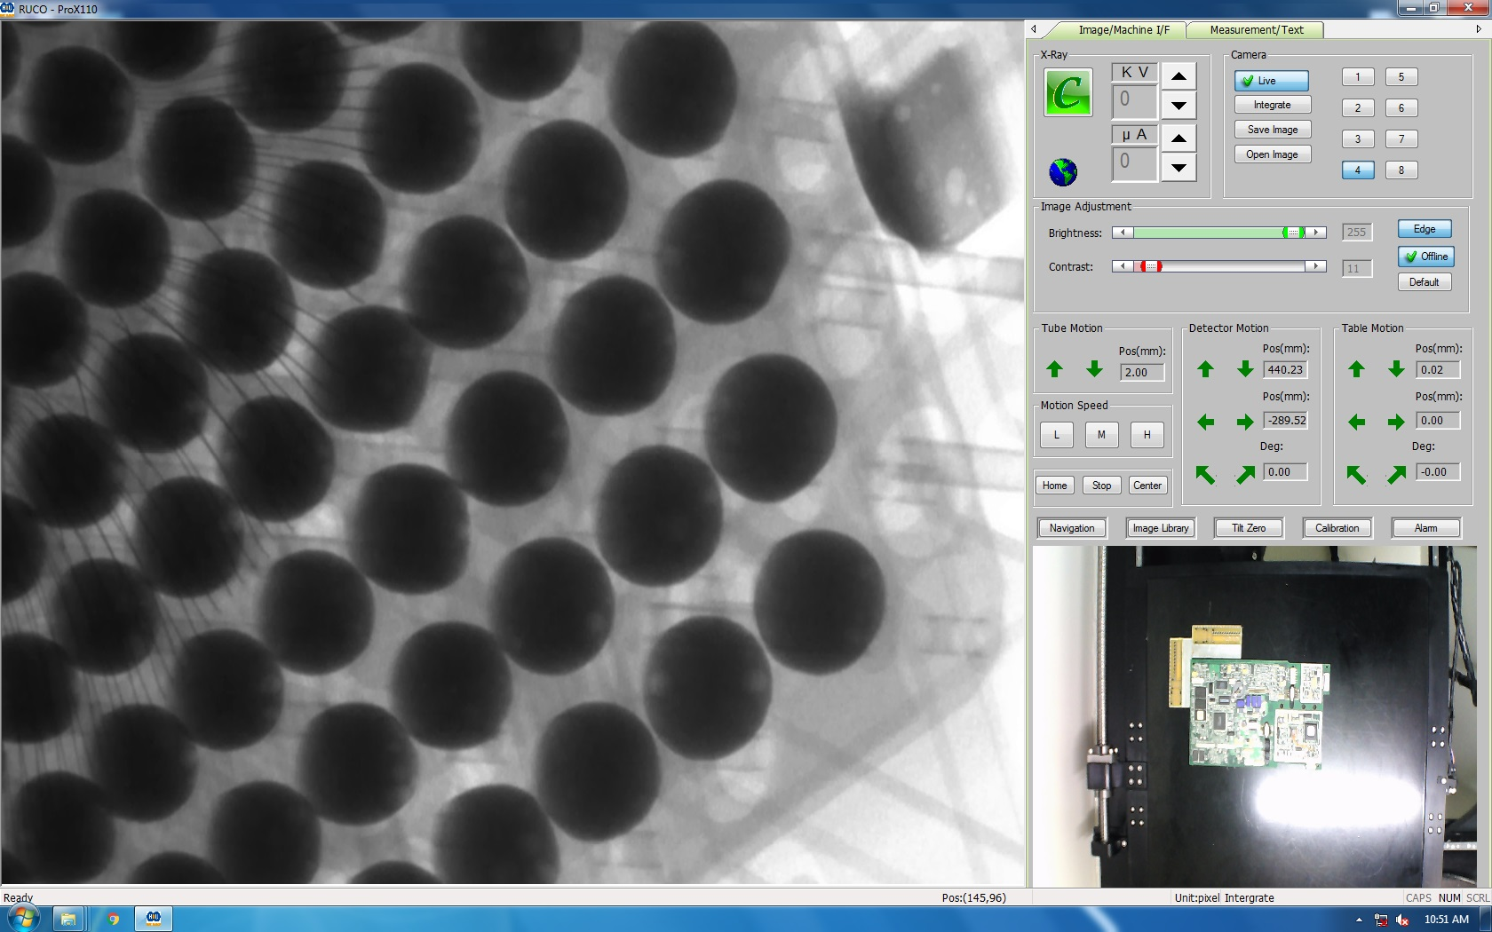
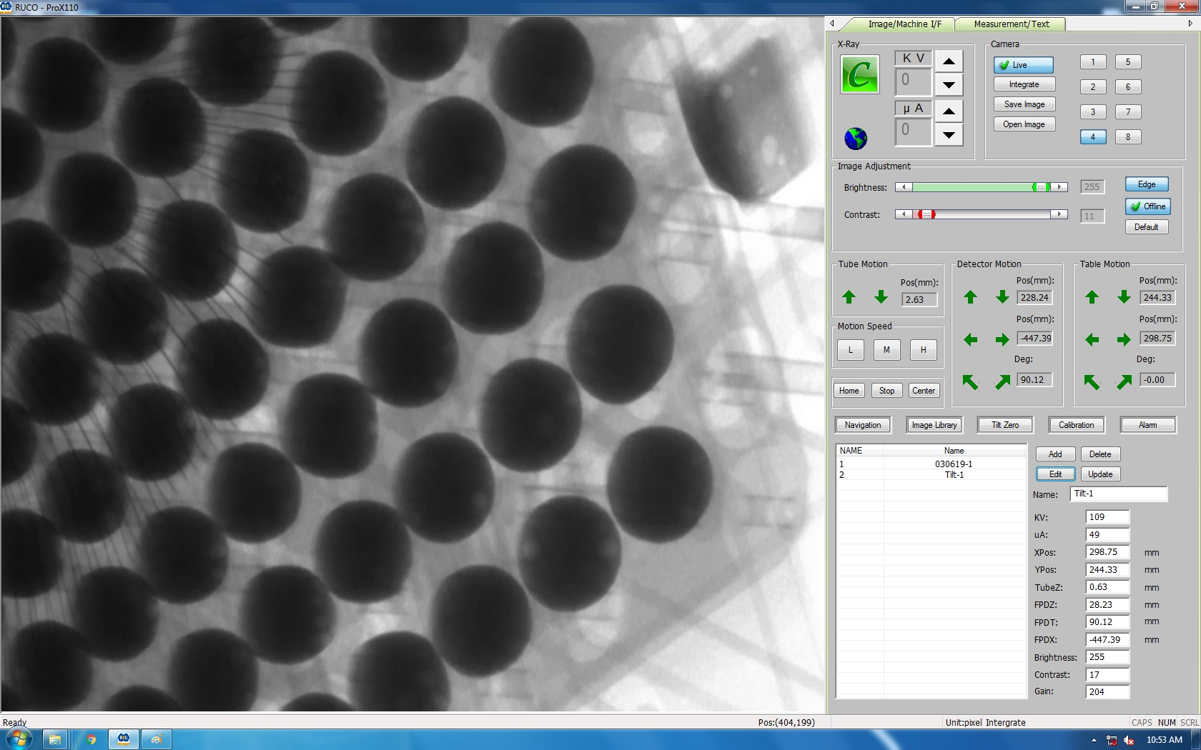
PRO-X110 SOFTWARE OVERVIEW
PRO-X110
Page One Software
Navigation (optical camera point and click for sample position)
Image Library (create label, save kV, mA, magnification settings for different types of devices)
Recall at any time to eliminate need to manually enter kV, mA, magnification
www.naimaging.com / www.rucousallc.com

Slide 10
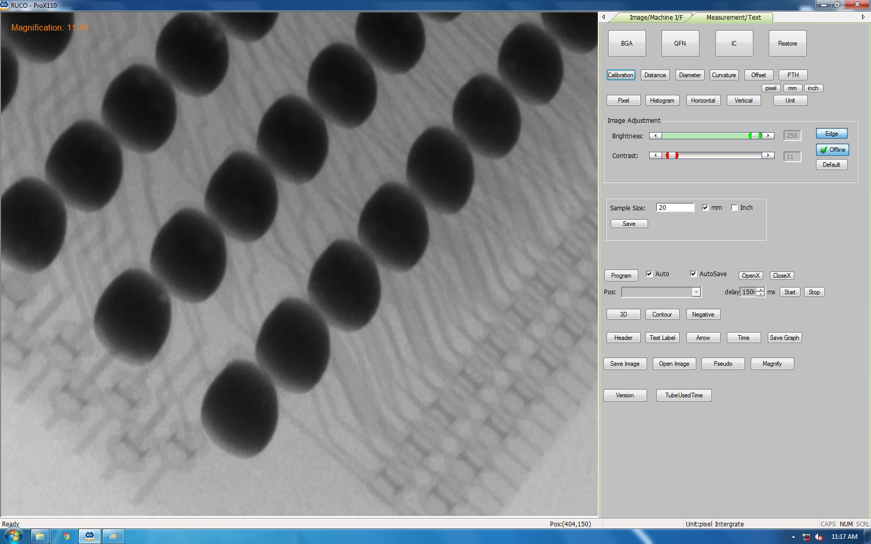
PRO-X110 SOFTWARE OVERVIEW
PRO-X110
Page Two Software
Section One
BGA, QFN, IC Analysis
Measurements; Distance, Diameter, Curvature, Offset, PTH
Other Analysis; Pixel, Histogram, Vertical/Horizontal Slice, Unit of Measure
Section Two
Brightness/Contrast Adjustment
Edge Enhancement
Calibration Table
Section Three
Inspection Program Creation
3D, Contour Relief, Negative Image
Text, Arrow, Time Stamp
Save/Open Image, Pseudo Color, Digital Magnification
Software Version, Elapsed Time
www.naimaging.com / www.rucousallc.com

Slide 11
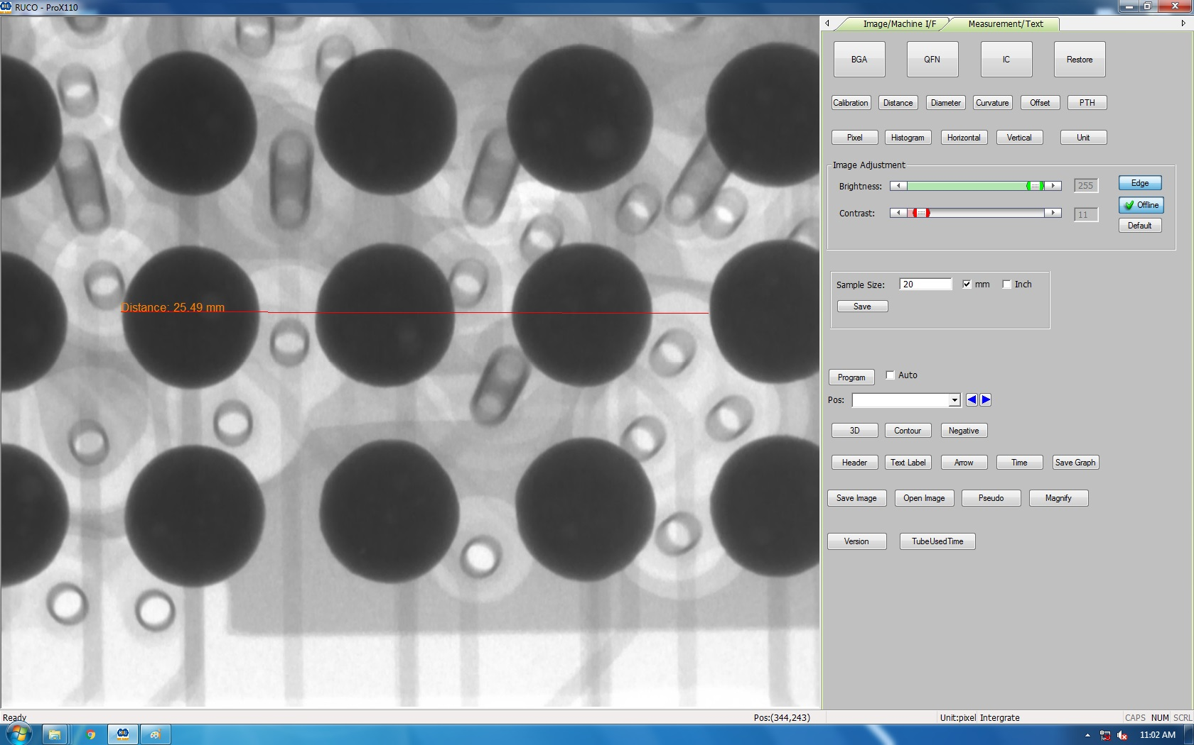
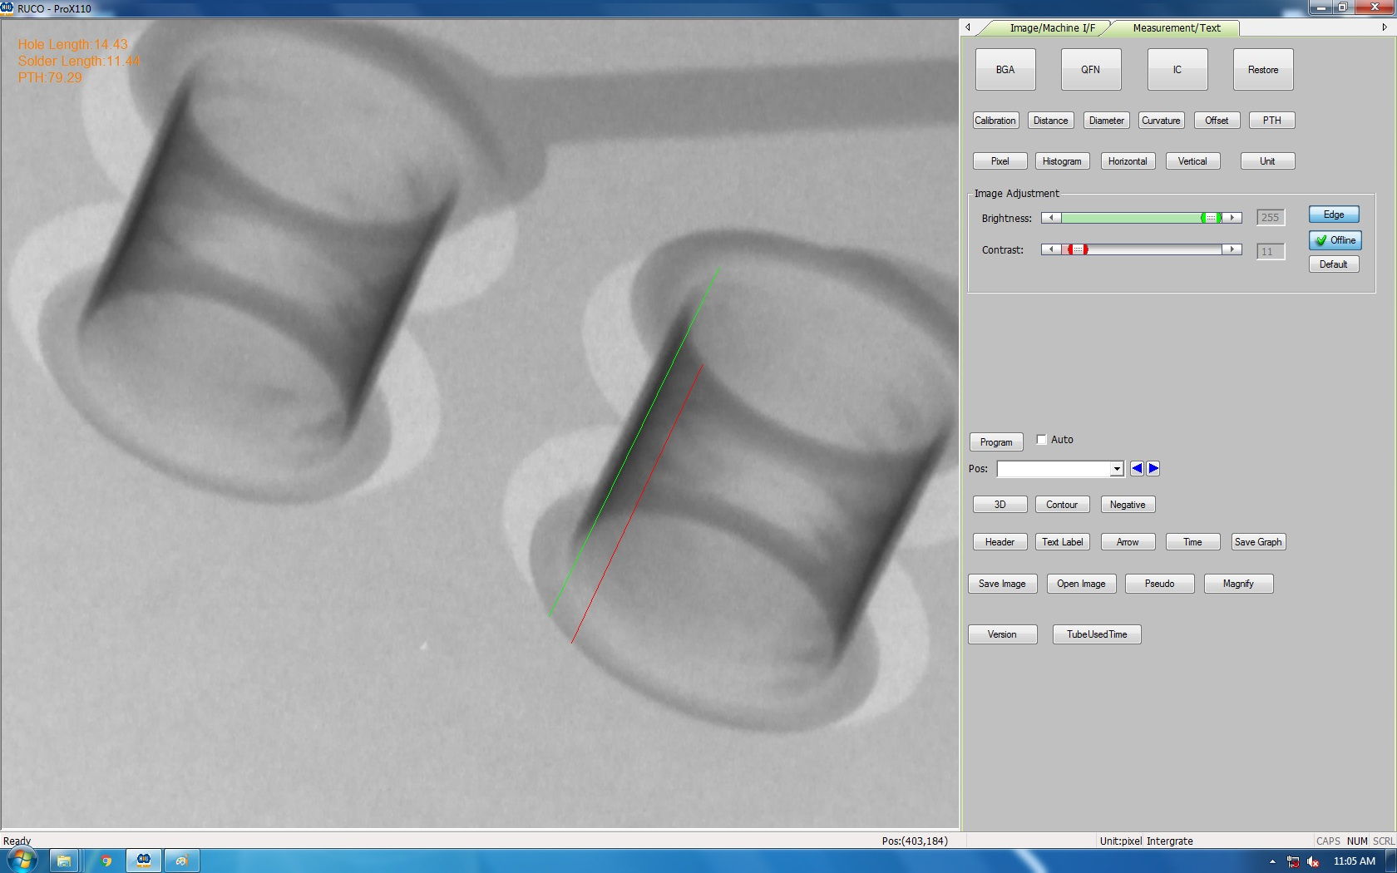
PRO-X110 SOFTWARE OVERVIEW
PRO-X110
Page Two Software
Distance; Point to Point Measurement
PTH; Plated Thru Hole Measurement
www.naimaging.com / www.rucousallc.com

Slide 12
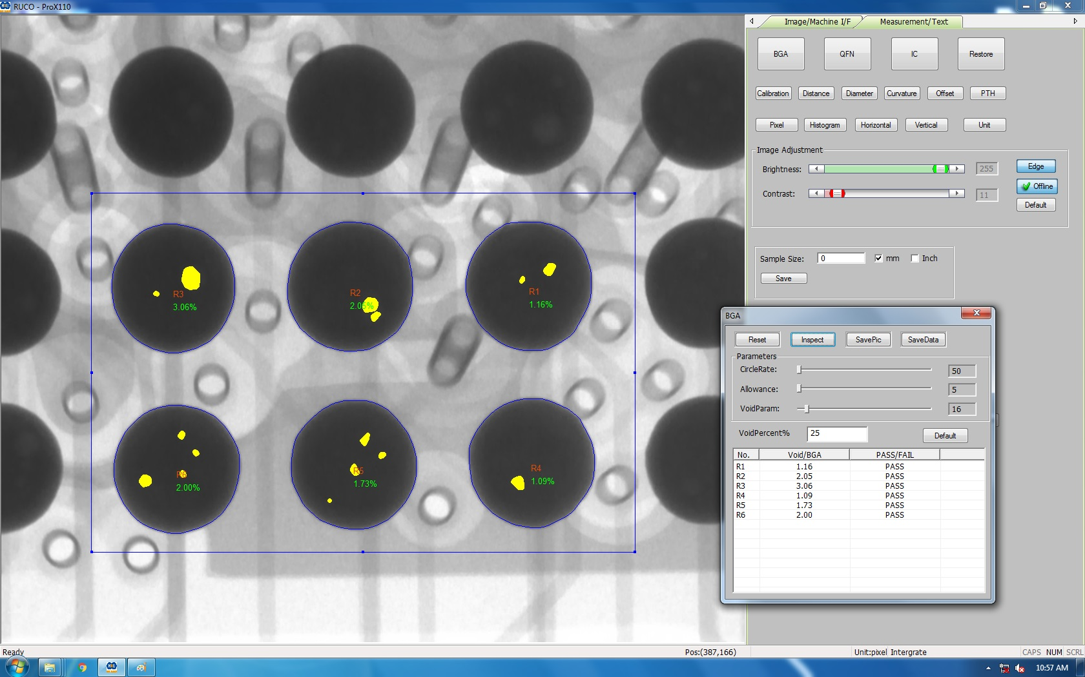
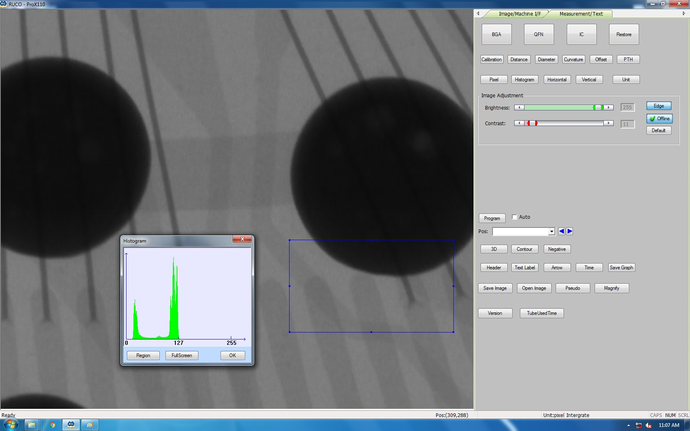
PRO-X110 SOFTWARE OVERVIEW
PRO-X110
Page Two Software
BGA; BGA Void Analysis
Histogram; ROI or Full Screen Analysis
www.naimaging.com / www.rucousallc.com

Slide 13
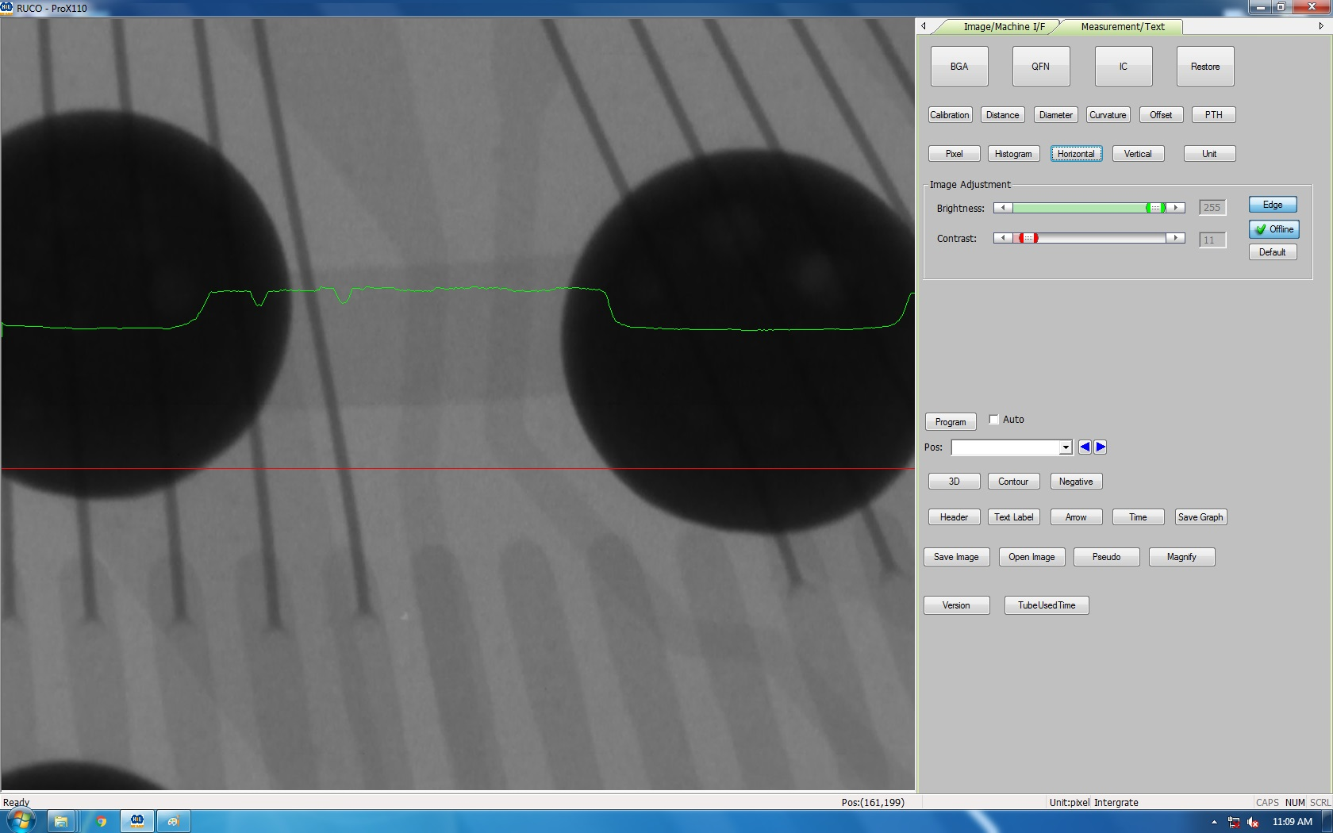
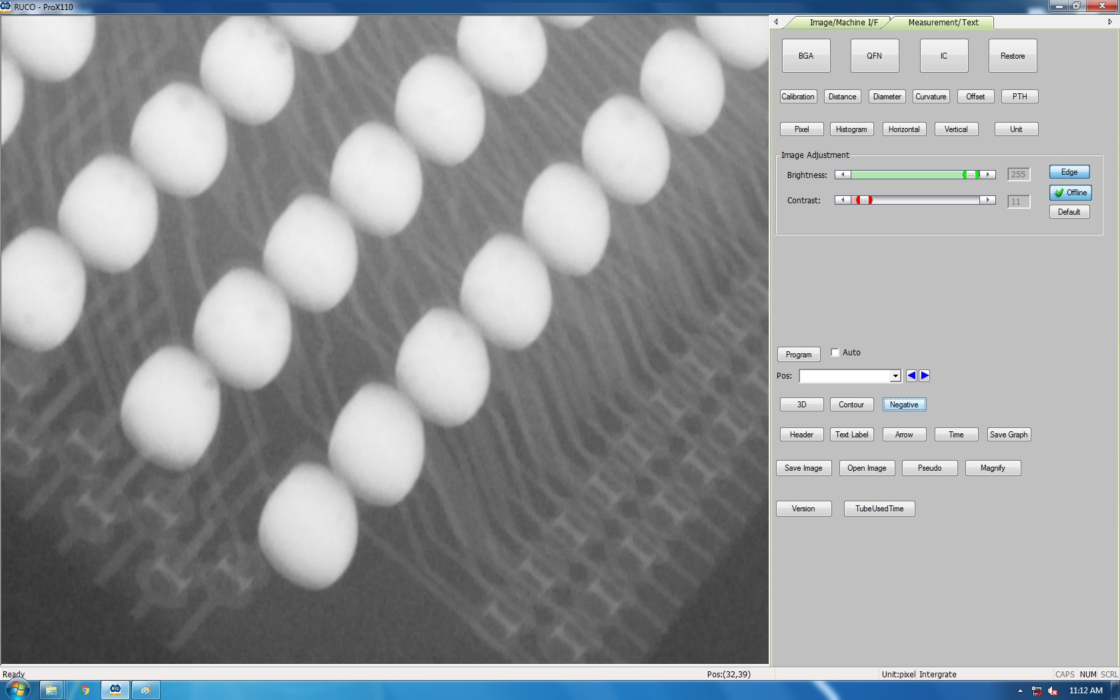
PRO-X110 SOFTWARE OVERVIEW
PRO-X110
Page Two Software
Horizontal/Vertical Slice; Grey Scale Slice Mapping
Negative Image; Image Reversal from Positive Image
www.naimaging.com / www.rucousallc.com

Slide 14
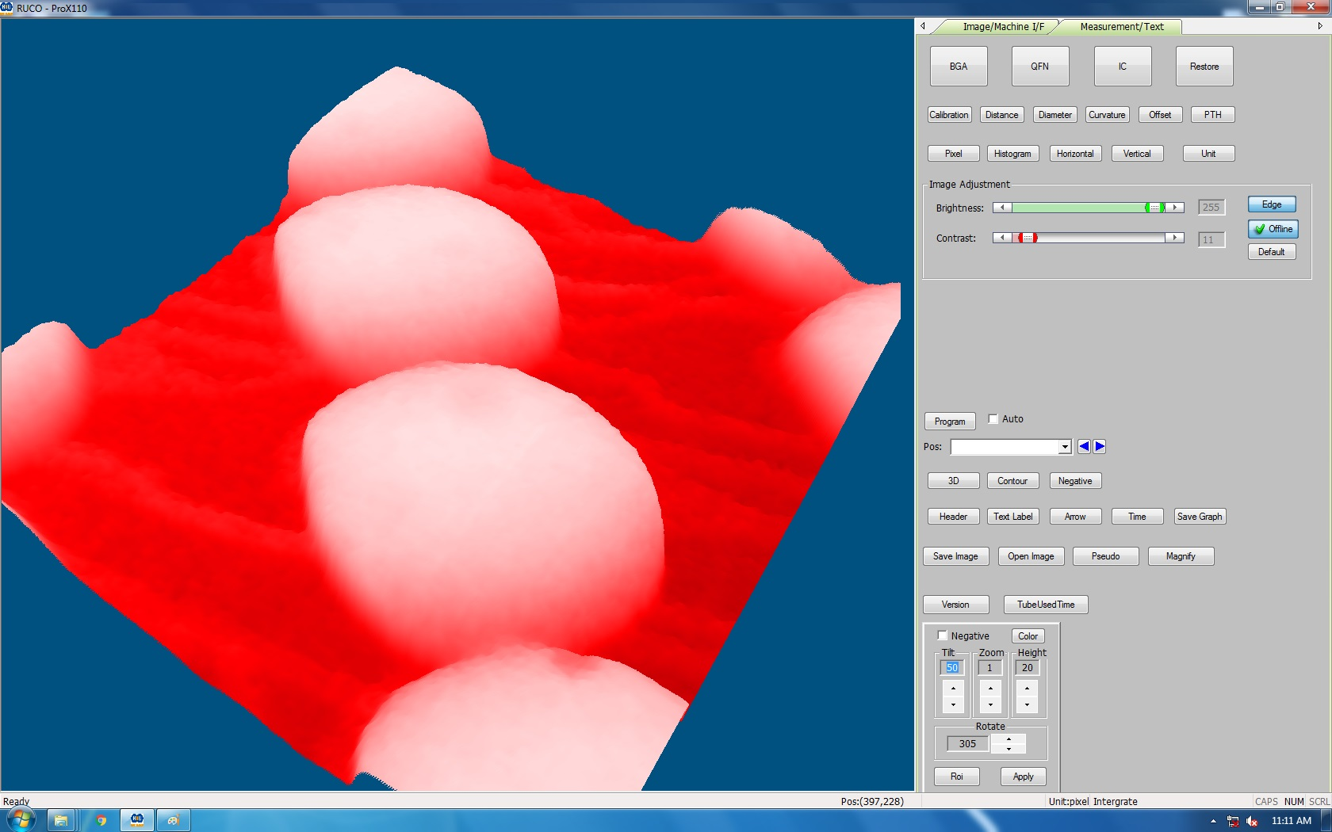
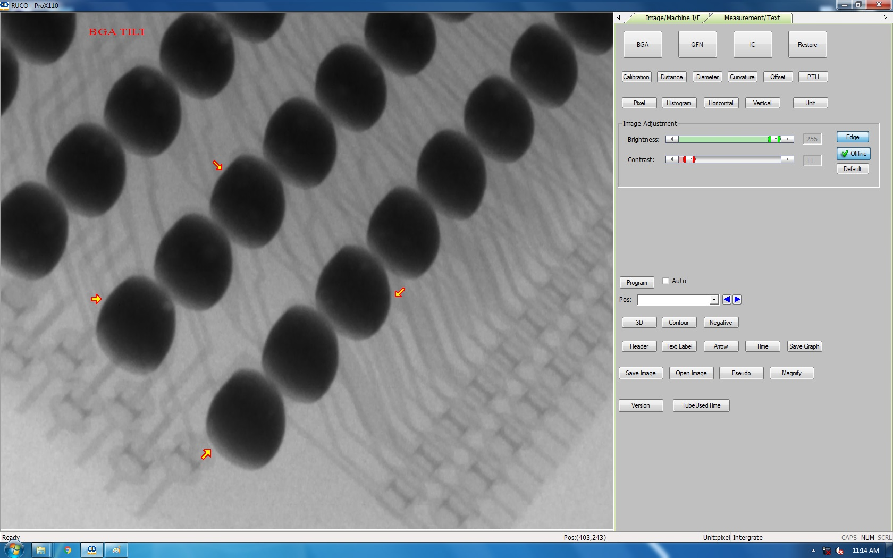
PRO-X110 SOFTWARE OVERVIEW
PRO-X110
Page Two Software
3D; 3D Topographical Rendering (ROI of Full Screen)
Text/Arrows; Text Label and Arrow Markers
www.naimaging.com / www.rucousallc.com

Slide 15
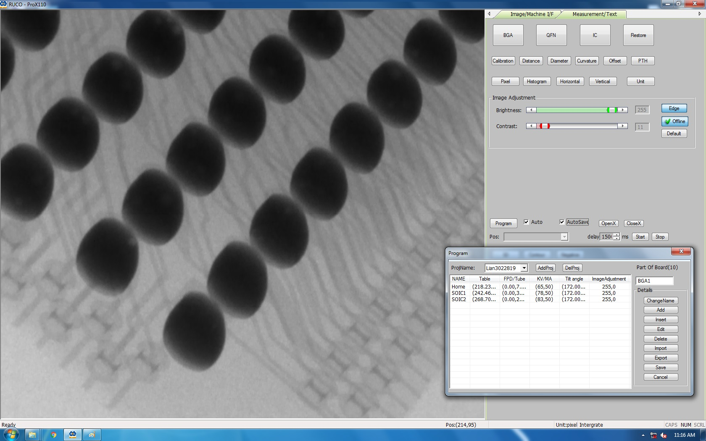
PRO-X110 SOFTWARE OVERVIEW
PRO-X110
Page Two Software
Inspection Program Function
Set Up/Label Locations to be Inspected
Move to Each Location and Save
Enter Inspection Dwell Time for Each Location
Automatically Save All Images Inspected
Port to Project Folder
Unlimited Number of Programs
www.naimaging.com / www.rucousallc.com

