Slide 1
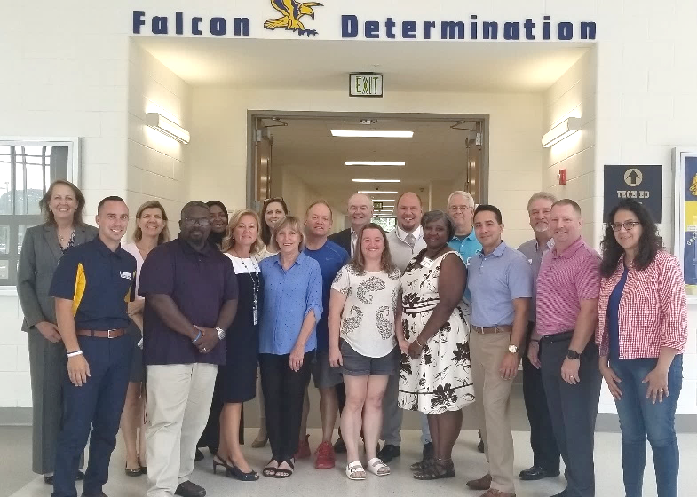
SPHS Business Advisory Board 2019-2020
Officers:
Tom McGinn- President
Kirk Lynn- Vice President
Melanie Wood-Treasurer
Sue Gallagher- Secretary
Committee Chairs:
Jim Cleveland- Website
Mock Interviews/ Career Conversations- Nancy Jackson/ JoAnne Brack
Financial Literacy- Kirk Lynn/ Alice Lukas/James Henson /JoAnne Brack
Marketing- Melanie Wood
6 monthly meetings, (1 virtual) 109 attendees, 163.5 hours
70 members

Slide 2
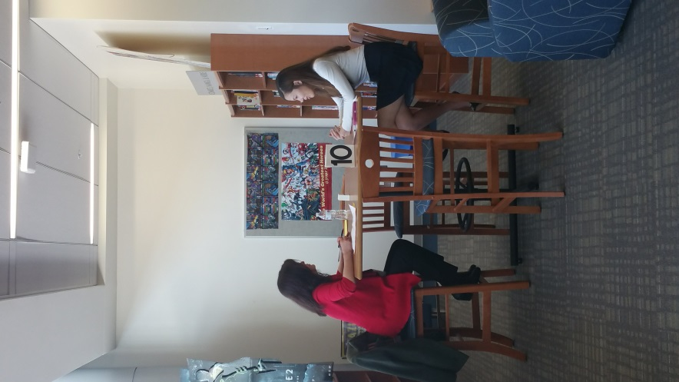
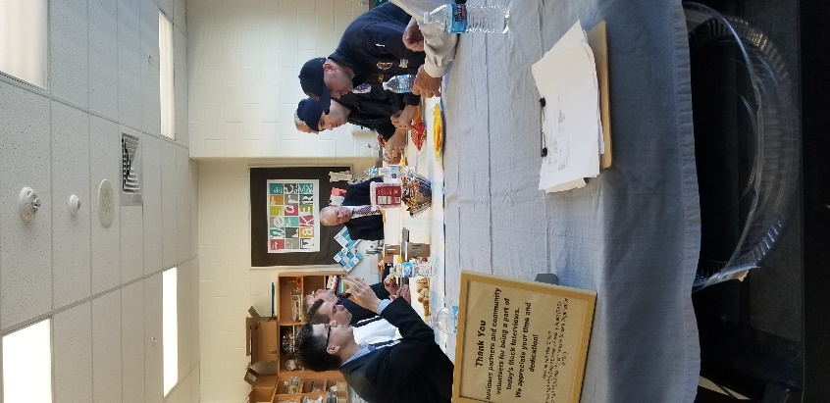
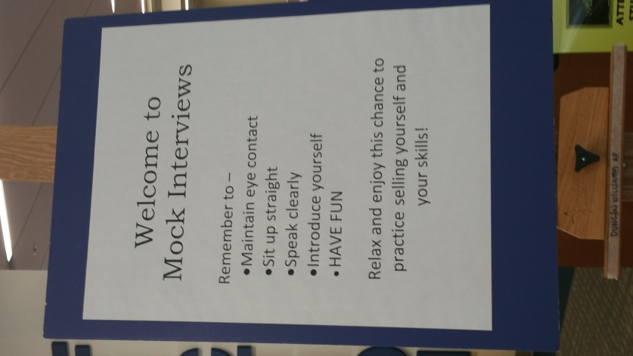
Mock interviews & Career Conversations

Slide 3
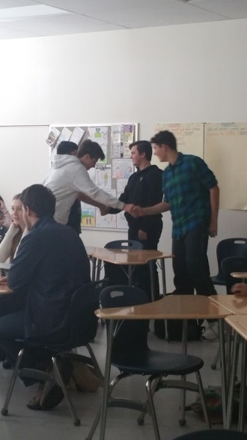
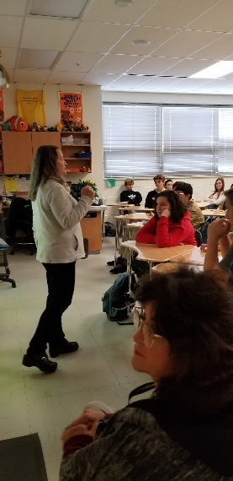
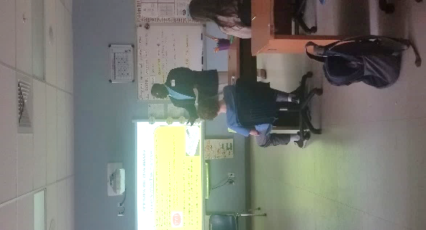
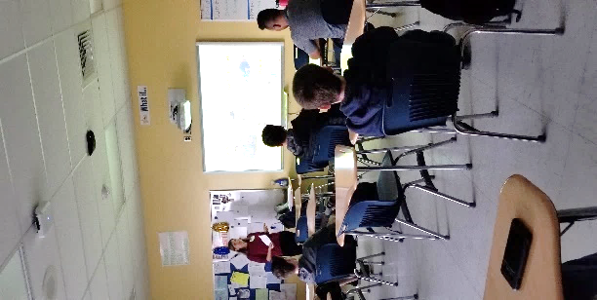
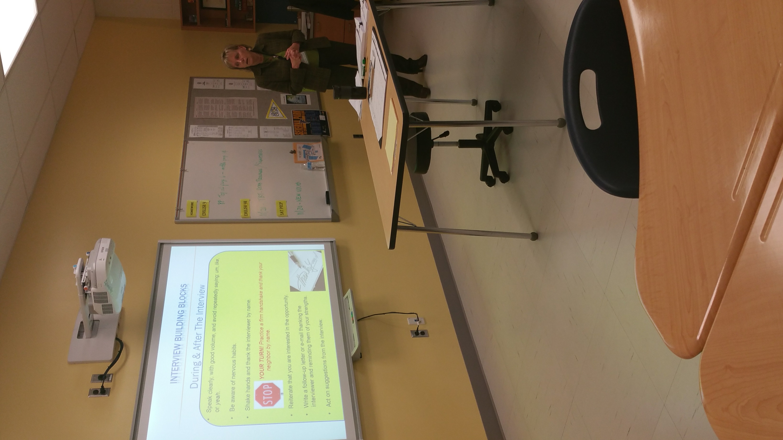
SPHS Business Advisory Board 2019-2020
Mock Interview advisory: November 22, 2019
Focus: Interviewing preparedness and resume writing
20 business partners facilitated 11th grade advisories. (497 students, 40 volunteer hours)
Updated PowerPoint with more student engagement

Slide 4
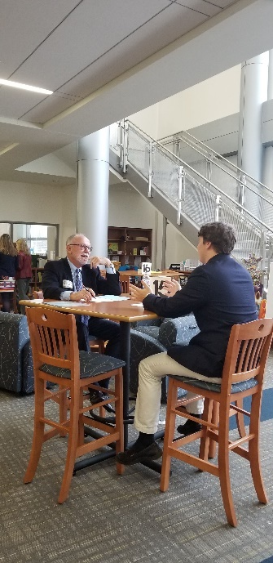
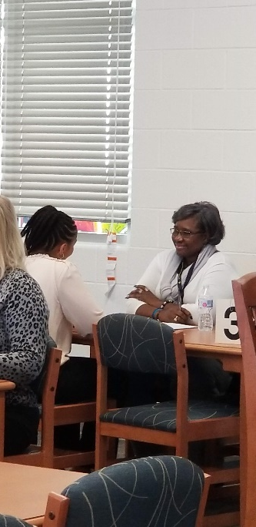
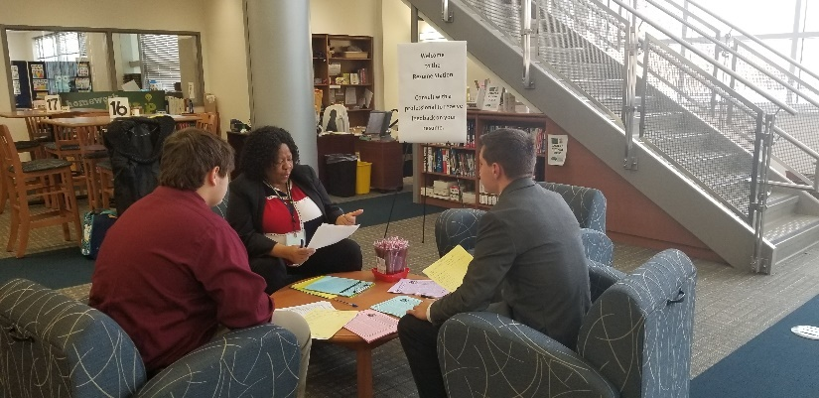
SPHS Business Advisory Board 2019-2020
Mock interviews/Career Conversations: Dec 2-6 2019
Focus: interviewing skills, career awareness, resume, soft skills
244 volunteers (366 volunteer hours) 5 English teachers, 497 students
Technical careers
Resume Doctors each period

Slide 5
Mock interviews & Career Conversations

Slide 6
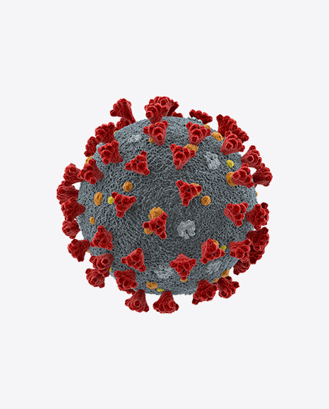
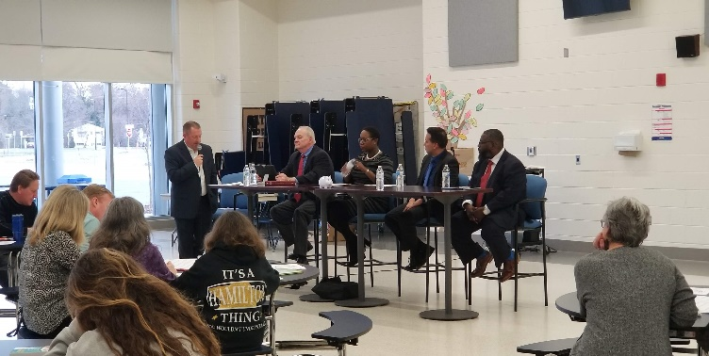
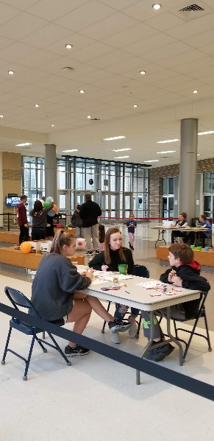
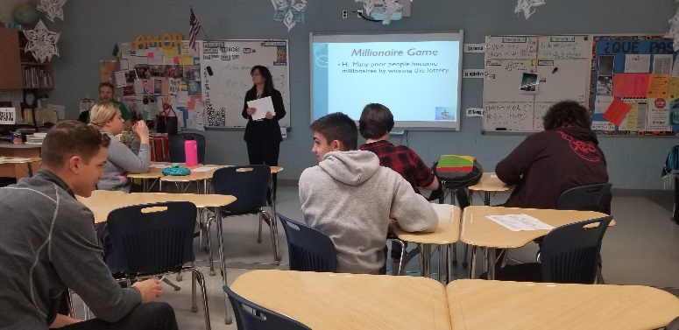
SPHS Business Advisory Board 2019-2020
Financial Literacy Week March 23-27, 2020
Money grows on skills Not Trees
All Week : Trivia Questions of the Day, Tee shirts for faculty
February 18- Video promo kick off/Budget advisories
March 18- Reality Fair-(Sponsored by SECU) 160 students
Monday 23– Video kick off
Wednesday 25 - Parent Night
Thursday 26- Credit Unions Reps at all Lunches
Friday 27– Financial Literacy Advisories
140 planning hours
Cancelled

Slide 7
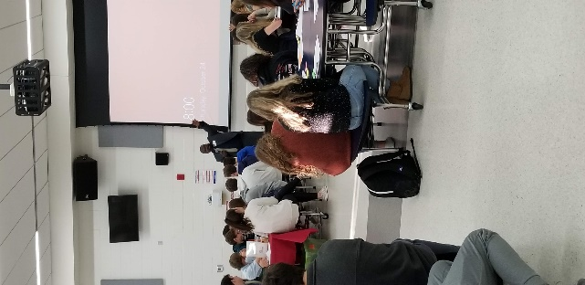
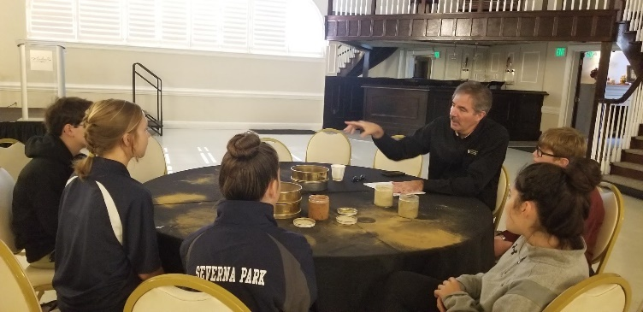
SPHS Business Advisory Board 2019-2020
Continued development of guest speakers series list for faculty (year-long)
Focus: matching teacher needs with field experts
70 in data bank 40 different topics
Sample topics presented to classes:
Health & Drug Ed, Stock Market, Media Productions, Business Management, Entrepreneurship, Employment, Speech & Debate, Leadership, Human Resources, Government, Business Credit, Patents, Brand & Image Creation, Forensics, Technology, Biology, Culinary, Financial Literacy, Non-Profits, Law Enforcement Careers, Cyber Security, Corporate Responsibility, Invasive species, Ballistics, logistics

Slide 8
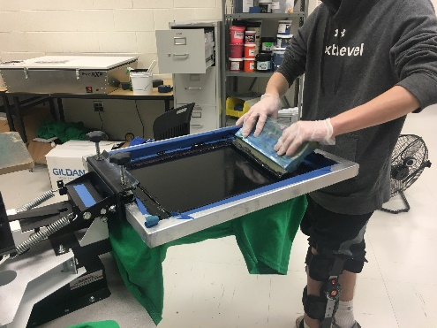
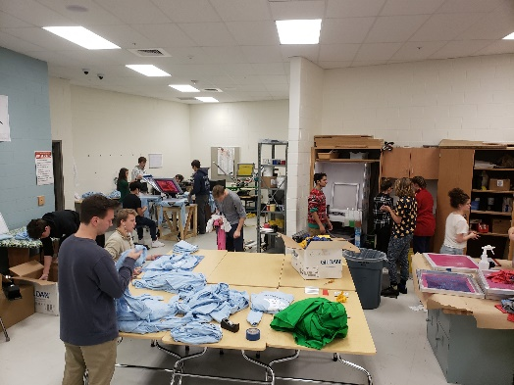
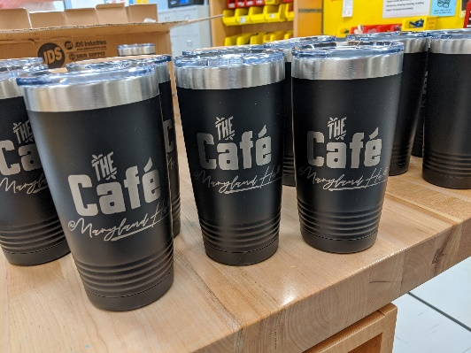
SPHS Business Advisory Board 2019-2020
Co-curricular support (year-long)
Project Lead The Way
STAR
Chick-fil-A Leader Academy
Diamond Challenge
SpCustoms $2000 profit & over 2000 tee shirts printed & expanded laser engraving

Slide 9
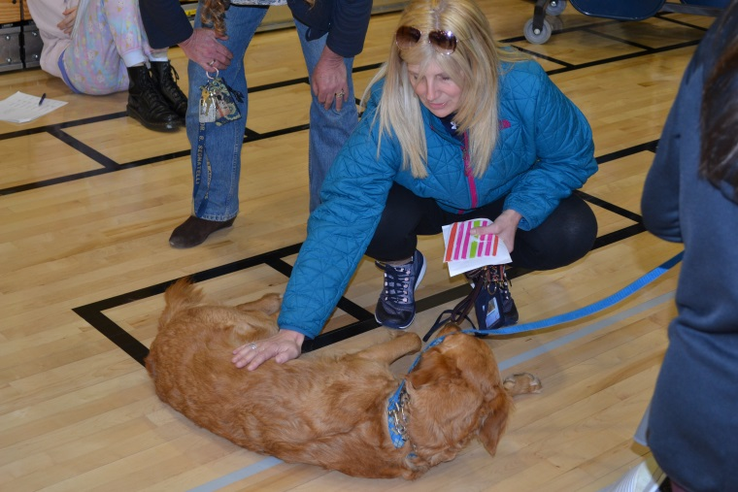
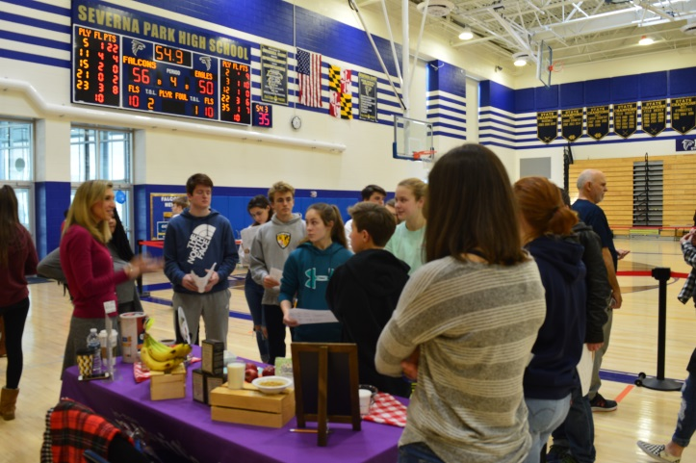
SPHS Business Advisory Board 2019-2020
Signature
Entrepreneurial Fair- Oct. 24, 2019 (277 students, 18 presenters, 72 Hours)
Including student entrepreneurs- Ellie Heath
Healthy Teen Choices Fair-Feb. 6, 2020 (500 students, 21 presenters, 147 hours)
Explorations Course- feedback for Explorations final pitches (18 hours)

Slide 10
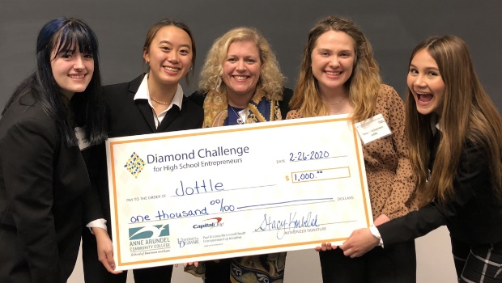
SPHS Business Advisory Board 2019-2020
Diamond Challenge AACC Pitch site Champions: Team Jottle
Teagan Schumann (10th), Amanda Vu (12th), Yasmeen Hembree (12th) and Ali Rohrs (12th)

Slide 11
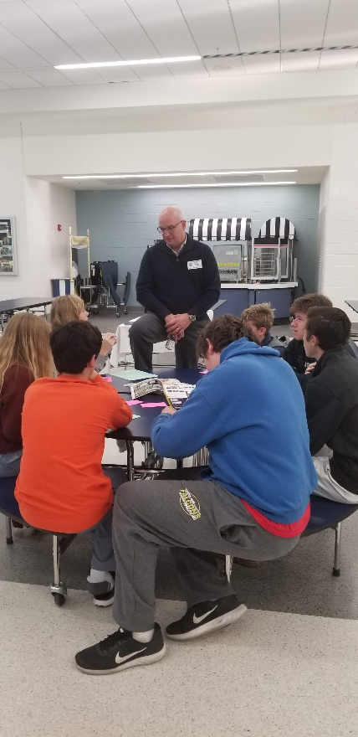
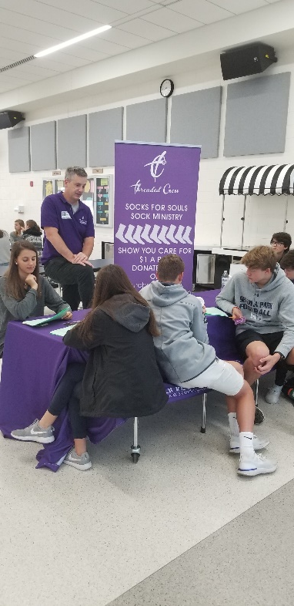
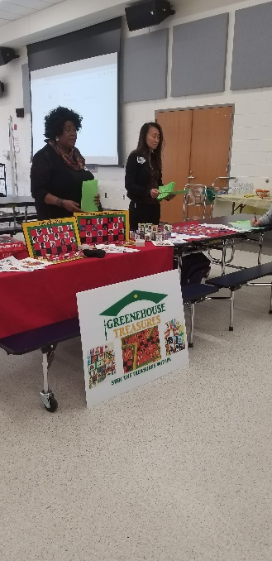
Entrepreneur Fair

Slide 12
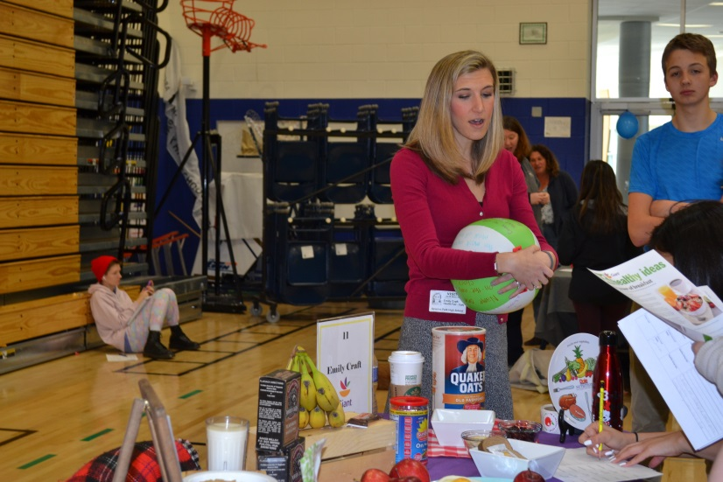
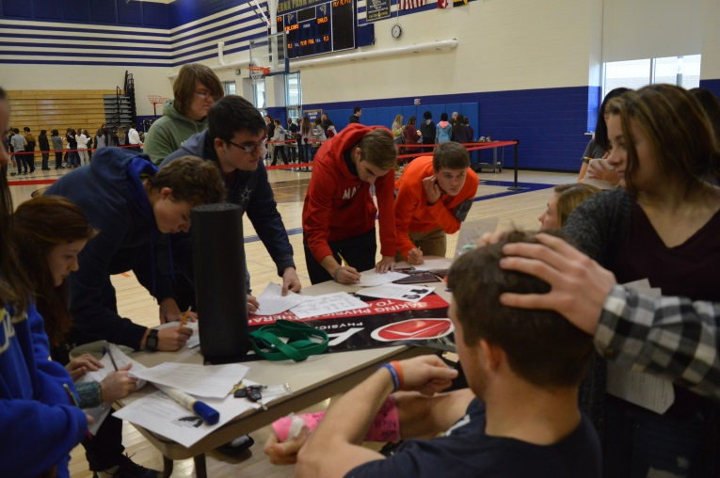
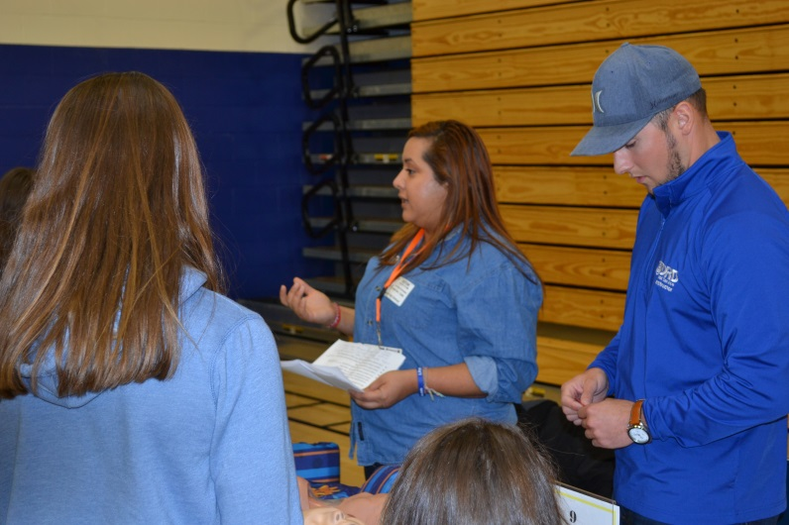
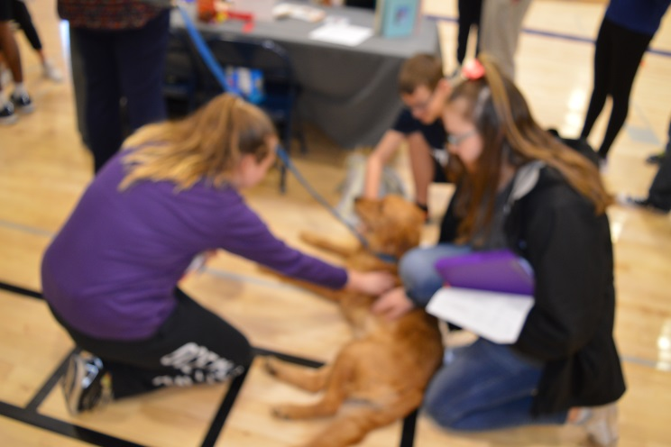
Health Fair

Slide 13
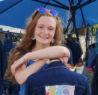
SPHS Business Advisory Board 2019-2020
AACPS support-21st Century Education Foundation
SPHS Business Partner of the Year: Edward Knox
Celebrated Signature Student: Ellie Heath
Three Blue Bunnies

Slide 14
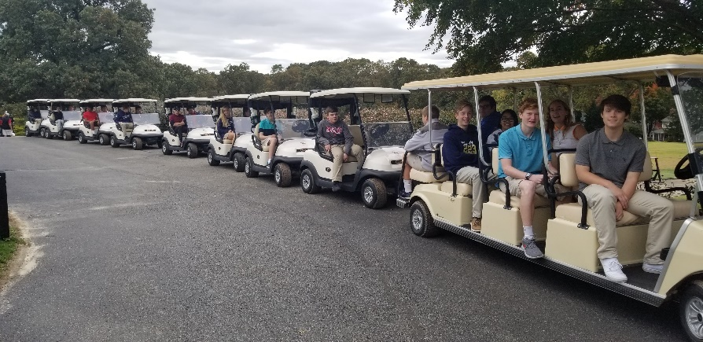
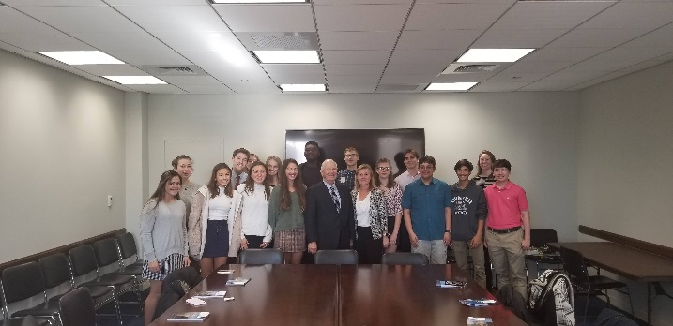
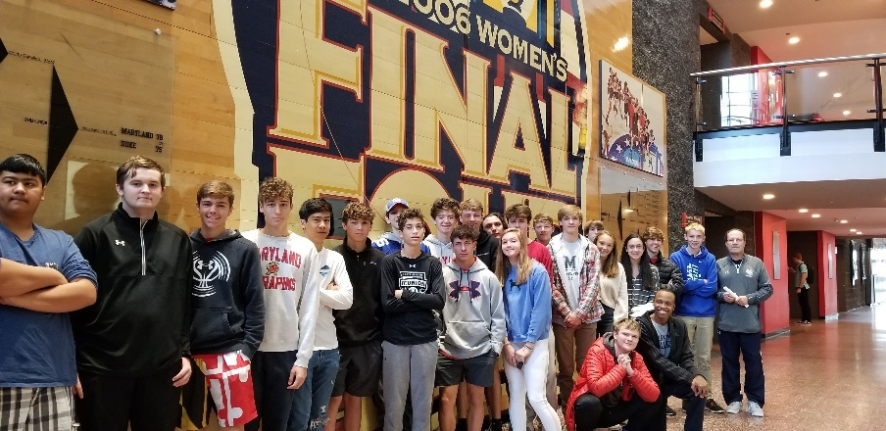
Thank you for
Your support!
946.5 hours x $25.43=
$24,069.50

