Slide 1
Developing Academic Interventions for Students Receiving Tier III or Special Education
Gary L. Cates, Ph.D.
Illinois State University
www.garycates.net

Slide 2
What are your biggest challenge(s) with individualized academic assessment and intervention?
Write down the answer to this question for each of the following areas:
Reading
Written Expression
Math

Slide 3
Evaluate
(Curriculum Based Evaluation)
Tier 3 & SPED
Assess
(Curriculum Based Assessment)
Tier 2
Measure
(Curriculum Based Measurement)
Tier I

Slide 4
What are your Current Practices?
Please briefly answer the following questions:
  What data do you collect at the Universal Level?
  What Interventions do you currently have available at the Universal Level?
  What data do you collect at Tier 2?
  What Interventions do you currently have available?
  What data do you collect at Tier 3?
  What Interventions do you currently have available?

Slide 5
1. Screen for Academic Skill Deficit
2. Confirm Academic Skill Deficit
3. Analyze Available Data
4. Develop a Hypothesis
5. Test the Hypothesis
6. Develop a Goal
7. Develop Intervention
7. Implement Intervention
7. Evaluate & Troubleshoot Intervention

Slide 6
7 Big Questions
 | Question Being asked
Question 1. | Is there a potential skill deficiency?
Question 2. | Is there a Real deficiency?
Question 3. | What Pattern(s) of Responding is observed?
Question 4. | Under what conditions is skill deficiency present?
Question 5. | Is the above hypothesis supported when tested?
Question 6. | Where do we want the student's performance to be and by when?
Question 7. | Is the Intervention Effective?

Slide 7
Step 1:
Screen for ASD-R
Curriculum Based Measurement (CBM)
Step 2:
Confirm ASD-R
Curriculum Based Assessment
(CBA)
Steps 3, 4, and 5
Diagnosing Specific ASD
Curriculum Based Evaluation
(CBE)
Multiple Domain Analysis
(Broad Band Assessment)
Single Domain Error Analysis
Universal Screening Measures

Slide 8
Step 1 Generic Example:
Is there a potential deficit?
 | Fall Raw Score Performance | Percentile Rank
Target Student | 42 | 8th
Peers | 107 | 50th
Using a universal screening measure (e.g., AIMS Web Dibbles, Easy CBM, etc. )for a general skill area (i.e., reading, math, written expression, spelling)

Slide 9
Step 2 Generic Example:
Is there a real deficit?
 | Percentile Rank
Domain 1 | 8th
Domain 2 | 27th
Domain 3 | 34th
Domain 4 | 10th
Domain 5 | 44th
Using an academic achievement test (e.g., WRMT, KEY-Math, TOWL, TOWS etc. )for a general skill area (i.e., reading, math, written expression, spelling)

Slide 10
Step 3 Generic Example:
Analyze existing data?
 | Percentile Rank
Domain 1 | 8th
Domain 2 | 27th
Domain 3 | 34th
Domain 4 | 10th
Domain 5 | 44th
Analyze error patterns within the identified deficit areas

Slide 11
Step 4 Generic Example:
Develop a Hypothesis
 | Percentile Rank
Domain 1 | 8th
Domain 2 | 27th
Domain 3 | 34th
Domain 4 | 10th
Domain 5 | 44th
What is contributing to the students performance?
1. Font 2. Regrouping 3. Silent e 4. Understanding Comma usage

Slide 12
Step 5 Generic Example:
Test Hypothesis
 | Percentile Rank
Domain 1 | 8th
Domain 2 | 27th
Domain 3 | 34th
Domain 4 | 10th
Domain 5 | 44th
Construct a test for the hypothesis within the domains
Probes with different font, Probes that that require regrouping, Flash cards of Words with and without Silent E, probes that require understanding of commas

Slide 13
Step 6 Generic Example:
Develop a Goal
 | Fall Raw Score Performance | Percentile Rank
Target Student | 42 | 8th
Peers | 107 | 50th
Returning to USM: Set a goal that includes level of performance, conditions, and timeline.
Given a probe, Gary will be able to complete 10 items with 90% accuracy within 15 minutes by October 15th.

Slide 14
Step 7 Generic Example:
Intervention Development, Implementation, and Evaluation
Matching Domain/Skill with the intervention?
Intervention Fidelity/Integrity checked?
Data graphed?
Goal set: Level of performance, date, conditions?

Slide 15
Understanding Learning through the Instructional Hierarchy
Stages of Learning Require Different Approaches

Slide 16
Acquisition
Demonstration
Modeling
Fluency
Drill
Generalization
Discrimination Training
Differentiation Training
Prompting
Cuing
Reinforcement
Adaptation
Problem Solving
Simulations

Slide 17
Accuracy at 90% or higher?
No
Use Procedures that include Demonstration, Modeling and/or Prompting
Yes
Fluency at desired level?
No
Drill and/or Provide Incentive
Yes
Skill happening in New environments/situations?
No
Provide Practice in new situations/environments
Yes
Skill being used in conjunction with other skills?
No
provide simulations and encourage problem-solving with the skill
Yes
Congratulations!

Slide 18
Application to Reading

Slide 19
Big 5 Areas of Reading
Phonemic Awareness
Alphabetic principle
Fluency
Vocabulary
Comprehension

Slide 20
Early Literacy Intervention Principles
Exposure of letters, letter sounds etc.
  Essentially building Alphabetic Principle
  demonstration and modeling prompting and cuing
Repeated Practice of acquired skills learned through exposure
  Discrimination Training/Differentiation
FUN!
Must train the exceptions!

Slide 21
Early Literacy Interventions
Flash Card Drills with incentives
Letter/Sound Bingo
Around the world
Chess Clock competitions
Color by Letter

Slide 22
Reading Accuracy
Percent of words read correctly
Dependent upon sub skills:
  Sight words
  Phonics
  Context
Affected by word difficulty

Slide 23
Reading Accuracy Interventions
Word Supply – Demonstration (Acquisition)
Sentence Repeat – Repeated Practice (Generalization)
Error Drill – Repeated Practice (Fluency)

Slide 24
Reading Fluency
Accuracy Rate: Number of correct words read per minute
Affected by Accuracy

Slide 25
Fluency Building Interventions
Repeated Reading – Repeated Practice
Listening Passage Preview – Modeling/Demonstration
Paired Reading – Modeling with support fading

Slide 26
Reading Comprehension
Reading Difficulty
Background Knowledge
“Motivation” (i.e. level of reinforcement)
Interest in the topic
Passage Length

Slide 27
Measuring Reading Comprehension
Multiple Choice
True/False
Fill in the blank
Essay
CLOZE
MAZE
Retell
Question Rate/Frequency

Slide 28
Reading Comprehension Interventions
TELLS
POSSE
Vocabulary Preview
Question Preview
Click or Clunk
Question Interspersal

Slide 29
Tying it all Together
Reading Example

Slide 30
Academic Intervention Consultation Service (AICS) Process
Referral resulting in 8 week admission
2 times per week for 50 minutes
½ hour parent interview ½ hour initial assessment time
AIMSWeb Maze, ORF, TELS
Woodcock Reading Mastery Test
3 Full Reading Passages (AimsWeb or Jamestown Series)
Accuracy Protocol, Fluency Protocol, Comprehension Protocol
  Alternative: Early Literacy Skill Development
  Additional: Exceptions training

Slide 31
Step 1 Reading Example: Is there a potential deficit?
MAZE | MAZE Correct | Percentile Rank | Percent Accuracy
Trial 1 | 17 | 57 – 62 | 100%
Trial 2 | 17 | 57 – 62 | 100%
Trial 3 | 14 | 39 – 44 | 100%
R-CBM | Words Read Correctly (WWC) | Percentile Rank | Percent Accuracy
Trial 1 | 81 | 22 – 23 | 96%
Trial 2 | 78 | 20 – 21 | 97%
Trial 3 | 78 | 20 – 21 | 98%

Slide 32
Step 2 WRMT: Is there a real deficit?
Composite/Subtest | Standard Score | Percentile Rank | Confidence Interval | Description
Total Reading | 105 | 63 | 100 – 110 | Average
Listening Comprehension | 117 | 87 | 106 – 128 | Above Average
Oral Reading Fluency | 84 | 14 | 75 – 93 | Below Average
Basic Skills | 103 | 58 | 96 – 110 | Average
Word Identification | 97 | 42 | 88 – 106 | Average
Word Attack | 109 | 73 | 100 – 118 | Average
Reading Comprehension | 118 | 88 | 111 – 125 | Above Average
Word Comprehension | 116 | 86 | 109 – 123 | Above Average
Passage Comprehension | 117 | 87 | 106 – 128 | Above Average

Slide 33
Step 3 Reading Example: Analyze existing data
Omissions, Pauses, Insertions, Substitutions (Circle all that apply)
Does not know letter sounds or letters _______________________
Long vowel short vowel discrimination
Does not blend diagraphs
Does not demonstrate basic rules
Rule exception violations
Self Corrections: ____Percent of Self Corrections that:
Change meaning ______ Do not Change meaning _____
Other (Describe):

Slide 34
Step 3 Reading Example: Analyze existing data
Omissions, Pauses, Insertions, Substitutions (Circle all that apply)
Does not know letter sounds or letters ___None___________
Long vowel short vowel discrimination E U A
Does not blend diagraphs None
Does not demonstrate basic rules N/A
Rule exception violations __gh, ph__
Self Corrections: 20 Percent of Errors are Self Corrections that:
Change meaning ___5% Do not Change meaning __95%
Other (Describe):

Slide 35
Step 4 Reading: Develop a Hypothesis
When reading orally, Gary often pauses or substitutes words and self-corrects his reading errors. 5% of the time these errors change meaning of the reading. Many of his substitutions are related to long and short vowel sounds.
Hypothesis: Gary’s reading fluency is low because: The rate of pauses or substituting that result in self correction is too high. His substitutions are due to insufficient instruction in short and long vowel sounds
If we drop the instructional reading level this rate should improve.

Slide 36
Step 5 Reading Example: Test Hypothesis
Omissions, Pauses, Insertions, Substitutions (Circle all that apply)
Does not know letter sounds or letters ___N/A___________
Long vowel short vowel discrimination N/A
Does not blend diagraphs N/A
Does not demonstrate basic rules N/A
Rule exception violations __N/A
Self Corrections: 1 Percent of Self Corrections that:
Change meaning ___0 Do not Change meaning __100%
Other (Describe):

Slide 37
Step 5: Testing Hypothesis by decreasing Grade Level
Probe | Score
R-CBM | Words Read Correctly (WWC) | Percent Accuracy
Trial 1 | 102 | 96%
Trial 2 | 107 | 97%
Trial 3 | 105 | 98%

Slide 38
Step 6 Reading Example: Develop a Goal
Given a grade level reading probe, Gary will be able to read at or above the 25th percentile with 95% accuracy by the next bench marking period.
Given a grade level reading probe, Gary’s accuracy levels in substations and pauses will increase to 95% by the next bench marking period.

Slide 39
Step 7 Reading Example: Intervention Development
The intervention MUST Match the Domain/Skill Deficiency
  Vocabulary Review
    Acquisition of words: Demonstration
  Error Drill
    Acquisition of words: Demonstration
  Direct Instruction in “A” “E” and “U” vowel sounds in isolation
    Acquisition of Skills: Demonstration
  Direct Instruction in “gh” and “ph” in isolation
    Discrimination Training

Slide 40
Brief Experimental Analysis of Academic Responding: Fluency

Slide 41
Experimental Analysis of Academic Responding: Accuracy

Slide 42
Direct Instruction long E

Slide 43
Direct Instruction silent e

Slide 44
Direct Instruction on Long A

Slide 45
Direct Instruction: ph

Slide 46
Direct Instruction: gh

Slide 47
Reading Comprehension: What about it?

Slide 48
What Makes up a Good Math Curriculum?
Numbers & Operations with Procedural Fluency
Algebra
Geometry
Measurement
Data Analysis
Statistics, & Probability
National Council of Teachers of Mathematics²

Slide 49
What Makes up Good Math Instructional Practices
Institute of Educational Sciences: National Center for Education Evaluation and Regional Assistance http://www.rti4success.org/images/stories/tieredInstruction/rti_math_pg_042109.pdf ³
8 Recommendations

Slide 50
Other TIER II Math Interventions
Program GRADE LEVELS
Fast Math 2 and up
Mastering Math Facts 2 and up
Math Facts in a Flash 1-6
Peer Assisted Learning Strategies (PALS) K-6
First Grade Small Group Tutoring 1
Connecting Math Concepts K-8
Corrective Mathematics 1-6
Knowing Mathematics 4-6
Navigator 1-8
Voyager Mathematics (Vmath) 3-8
iSucceed Math 3-8
Accelerated Math 1-12
Hot Math K-3
Pirate Math 2-5
Go Solve Word Problems 3-8
Math Steps K-7
Number Worlds PreK-8

Slide 51
Tying it all Together
Math Example

Slide 52
Academic Intervention Consultation Service (AICS) Process
Referral resulting in 8 week admission
2 times per week for 50 minutes
½ hour parent interview ½ hour initial assessment time
AIMSWeb TENS, Math-CAP, Math COMP
Key-Math
Self Constructed/Downloaded probes
Fill the gaps through Consistent direct instruction

Slide 53
Step 1: Is there a potential Deficit?
Probe | Problems Attempted/ Problems Presented | Percent Accuracy | Percentile Rank
Math Computation | 15/40 | 87% | 18th
Math Concepts and Applications | 12/28 | 67% | 23rd
16 year old male
Home Schooled
Taking ACT soon!
Mom wants accommodations – suspects learning disability he works slow

Slide 54
Step 2 Math Example is there a real deficit?
Subtest/Area | Percentile Rank
Total Test | 39
Basic Concepts | 37
Numeration | 37
Algebra | 50
Geometry | 11
Measurement | 18
Data Analysis and Probability | 37
Operations | 53
Mental Computation and Estimation | 50
Addition and Subtraction | 75
Multiplication and Division | 37
Applications | 42
Foundations of Problem Solving | 50
Applied Problem Solving | 37

Slide 55
Step 2 Math Example is there a real deficit?
Subtest/Area | Percentile Rank
Total Test | 39
Basic Concepts | 37
Numeration | 37
Algebra | 50
Geometry | 11
Measurement | 18
Data Analysis and Probability | 37
Operations | 53
Mental Computation and Estimation | 50
Addition and Subtraction | 75
Multiplication and Division | 37
Applications | 42
Foundations of Problem Solving | 50
Applied Problem Solving | 37

Slide 56
Step 3 Math Example: Analyze existing data
Look for error patterns for the domains below the 25th Percentile:
Measurement:
Clocks, money, rulers, thermometers etc.
Geometry:
Shapes, volume, area, circumference, other formulas, basic theorems, etc.
Work Rate: Very slow. Key math took 2 hours.

Slide 57
Step 4 Math: Develop a Hypothesis
When doing math, Gary often skips or inaccurately responds to items involving basic geometry and measurement (radius, circumference, finding area, finding perimeter, volume, and angle theorems)
Hypothesis 1: Gary’s math performance in class is low because: he has not acquired some basic geometric and measurement concepts/skills.
If we provide direct instruction in these areas his performance should improve.
Hypothesis 2: Gary’s math performance is low because he works too slowly (i.e., not demonstrating fluent responding).

Slide 58
Step 5 Math Example: Test Hypothesis
We administer probes (5 problems of each type) dealing specifically with the error patterns we discover.
We determine if he is below 80% in any of the areas.
We conspicuously time his performance and compare to norms.

Slide 59
Step 5: Testing Hypothesis by administering probes
Probe | Score
Clocks | Problems Correct (not timed) | Percent Accuracy
Money | 5 | 100
Rulers | 5 | 100
Thermometers | 5 | 100
Shape | 5 | 100
Volume | 3 | 60
Area | 4 | 80
Circumfence | 4 | 80
Calculating Angles | 0 | 0

Slide 60
Step 6 Math Example: Develop a Goal
Given a [SPECIFY PROBE HERE] probe, Gary will be able to complete with 95% accuracy by [SPECIFY DATE HERE].

Slide 61
Step 7 Math Example: Intervention Development
The intervention MUST Match the Domain/Skill Deficiency
Volume
- Acquisition: Demonstration/Modeling/Prompting
Calculating Angles
- Acquisition: Demonstration/Modeling/Prompting
General: 1. Used Chapter Tests as “Pre Assessment”
2. Constructed 3 Problems for “next day” and Provided DI
3. Repeated process until 100% mastery once
Explicit timing: See graphs next slides

Slide 62
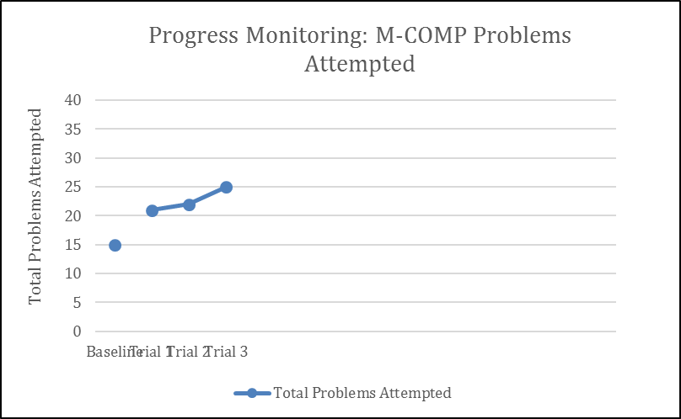

Slide 63
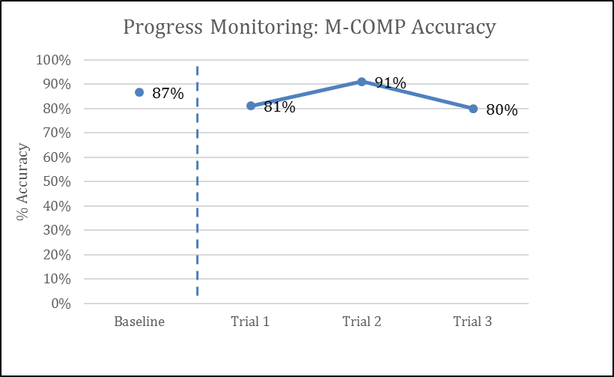

Slide 64
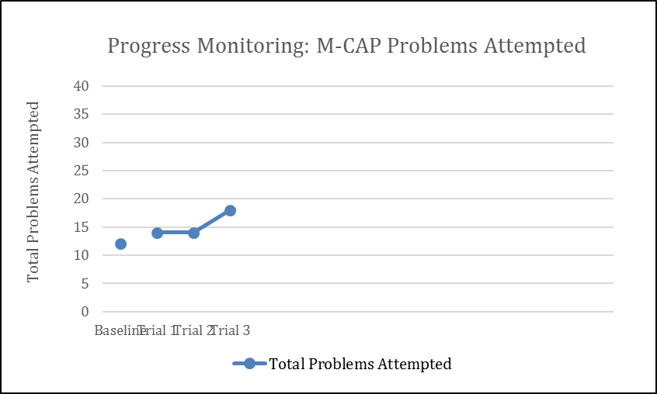

Slide 65
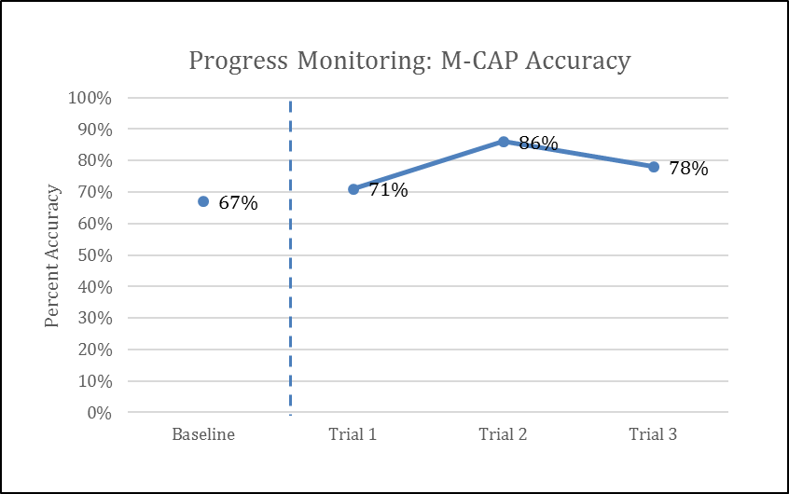

Slide 66
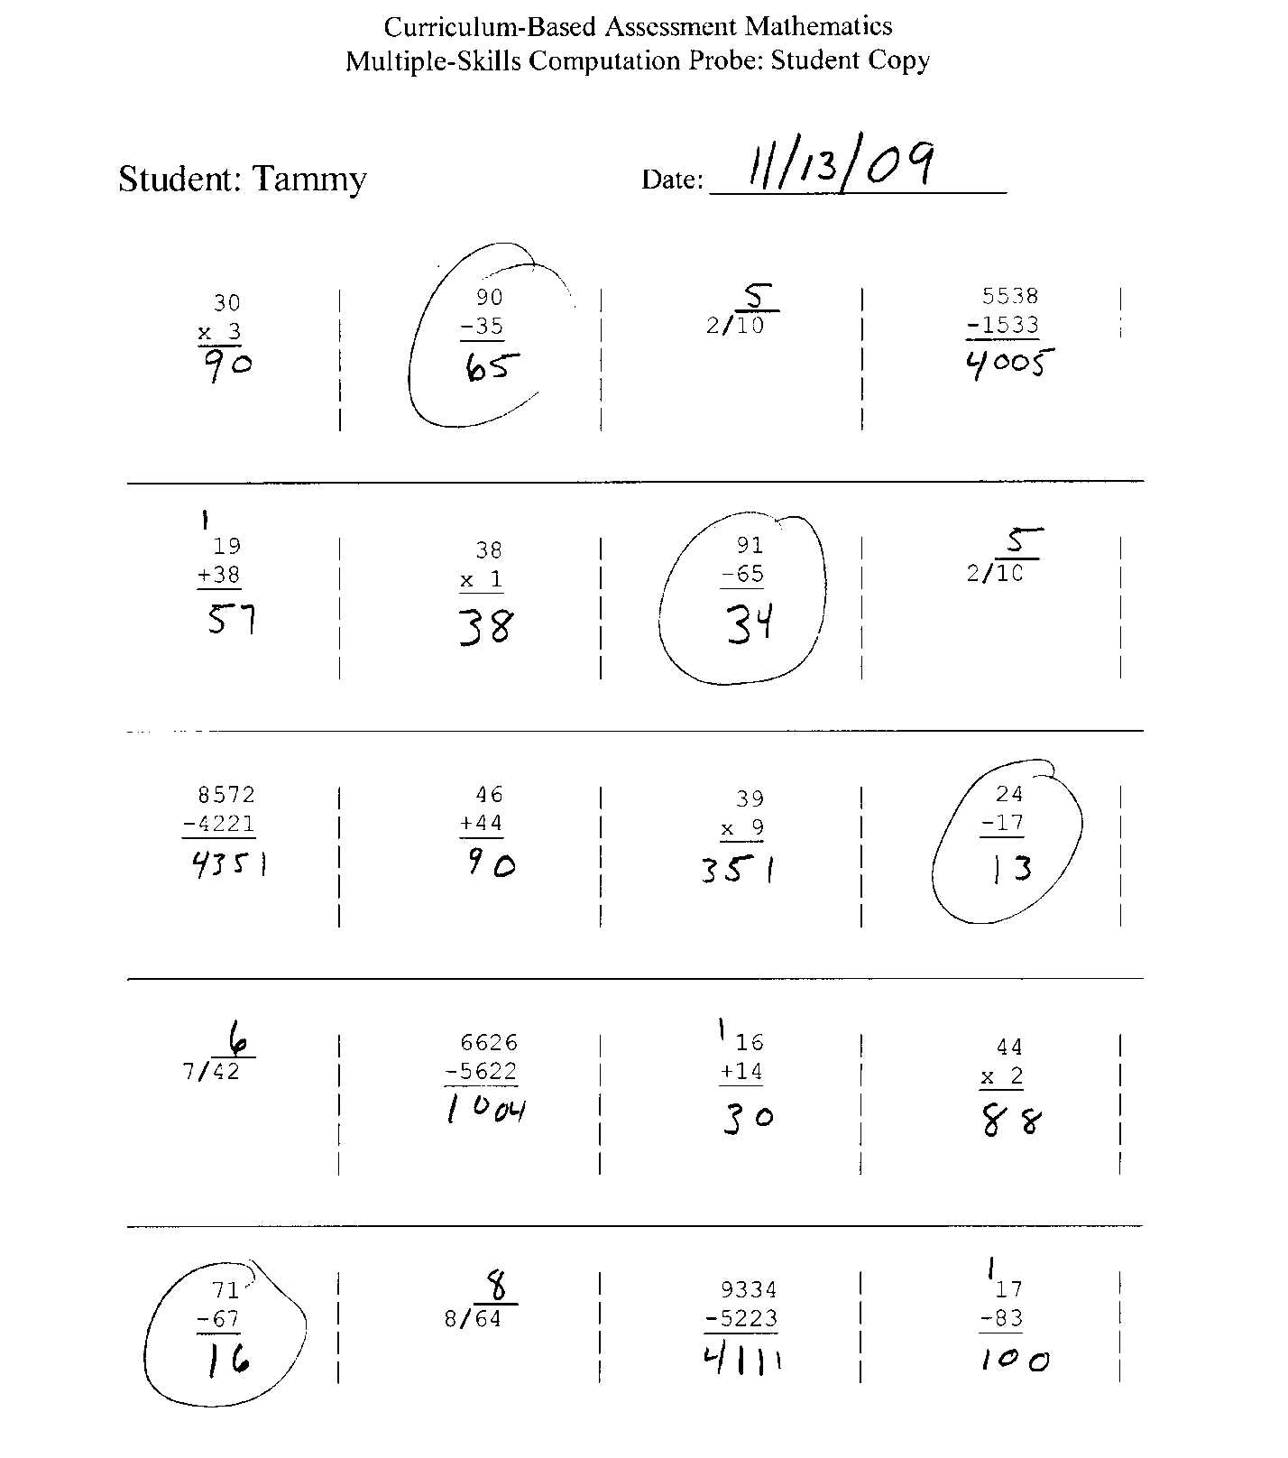
1. What seems to be
the problem?
2. What should the
intervention target?
3. Describe something a
teacher could do to target
this problem.
4. Do you have to buy
an expensive program
just for Tammy?

Slide 67
What Makes up a Good Writing Instruction – Elementary Students?
Provide daily time for students to write - Minimal
Teach Students to use the writing process – STRONG!
  Plan (POW) Draft Share Edit Revise (COPS)
Teach Student to become fluent with handwriting, typing, word processing, sentence construction, and spelling. - Moderate
Create an engaged community of writers - Minimal
Institute of Educational Sciences:
National Center for Educational Research and Regional Assistance

Slide 68
What Makes up a Good Writing Instruction – Secondary Students?
Explicitly teach variety of writing strategies
Use Model – Practice – Reflect cycle
Integrate writing with reading and cue them to writing features.
Use assessment of student writing to inform instruction
Institute of Educational Sciences:
National Center for Educational Research and Regional Assistance

Slide 69
Writing Intervention
Writing rubrics by grade level (See online rubrics)
Look for error types and focus on one or two at a time
Hamburger
POW-TREE
  Pick topic
  Organize (TREE) = Topic, Reasons, Explain, End
  Write
COPS
  FANBOYS

Slide 70
Tying it all Together
Math Example

Slide 71
Academic Intervention Consultation Service (AICS) Process
Referral resulting in 8 week admission
2 times per week for 50 minutes
½ hour parent interview ½ hour initial assessment time
AIMSWeb Story Starters (student choice)
TOWL
Self Constructed Probes (Commas, DOL, etc.)
Fill the gaps through Consistent direct instruction

Slide 72
Step 1: Is there a potential Deficit?
Story Starter | Percentile Rank
Correct writing sequence | 31
Total words written | 22
10 year old male
5th Grade
Taking ACT soon!
Mom wants accommodations – suspects learning disability he works slow

Slide 73
Step 2 Writing Example is there a real deficit?
Subtest | Percentile Rank | Scaled Score | Descriptive Term
Vocabulary | 84 | 13 | Above average
Spelling | 84 | 13 | Above average
Punctuation | 95 | 15 | Superior
Logical Sentences | 75 | 12 | Average
Sentence Combining | 99 | 18 | Very Superior
Contextual Conventions | 50 | 10 | Average
Story Composition | 95 | 15 | Superior
Composite Score
Contrived Writing | 97 | 128 | Superior
Spontaneous writing | 86 | 116 | Above average
Overall Writing | 96 | 126 | Superior

Slide 74
Step 3 Writing Example: Analyze existing data
Look for error patterns for the domains below the 25th Percentile:

Slide 75
Step 2 Writing Example is there a real deficit?
Subtest | Percentile Rank | Scaled Score | Descriptive Term
Vocabulary | 84 | 13 | Above average
Spelling | 84 | 13 | Above average
Punctuation | 95 | 15 | Superior
Logical Sentences | 75 | 12 | Average
Sentence Combining | 99 | 18 | Very Superior
Contextual Conventions | 50 | 10 | Average
Story Composition | 95 | 15 | Superior
Composite Score
Contrived Writing | 97 | 128 | Superior
Spontaneous writing | 86 | 116 | Above average
Overall Writing | 96 | 126 | Superior

Slide 76
Step 4 Writing: Develop a Hypothesis
Hypothesis: Gary’s writing performance in class is low because: insufficient reinforcement for writing more is provided.
If we provide direct instruction in these areas his performance should improve.

Slide 77
Step 5 Writing Example: Test Hypothesis
We administer probes dealing specifically with the error patterns we discover.
We determine if he is below 90% in any of the areas or 25th percentile.

Slide 78
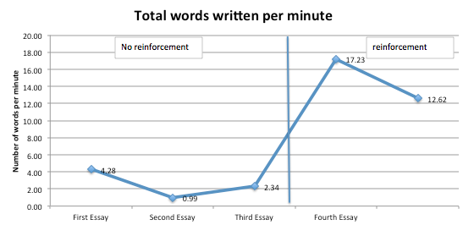
Step 5: Testing Hypothesis by administering probes

Slide 79
Step 4 Writing: Develop a Hypothesis
Hypothesis: Gary’s writing performance in class is low because: transitions are lacking and paragraph construction is poor.
If we provide direct instruction in these areas his performance should improve.

Slide 80
Step 5 Writing Example: Test Hypothesis
We administer probes dealing specifically with the error patterns we discover.
We determine if he is below 90% in any of the areas or 25th percentile.

Slide 81
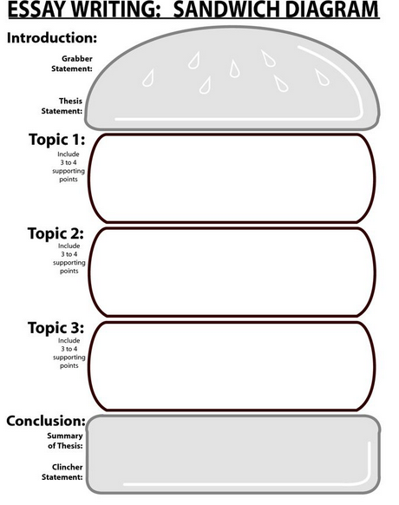

Slide 82
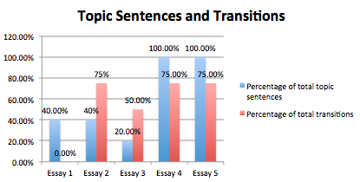

Slide 83
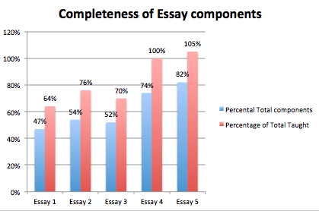

Slide 84
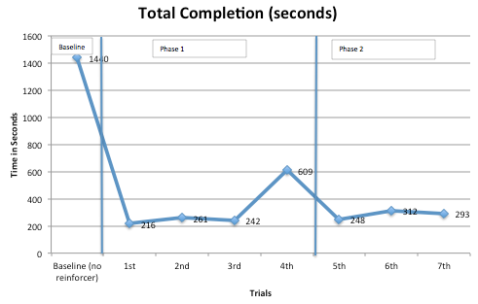

Slide 85
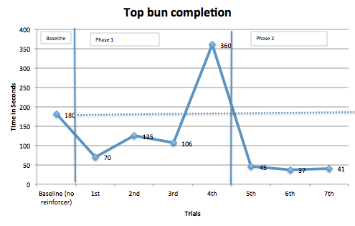

Slide 86
Step 6 Writing Example: Develop a Goal
Given a [SPECIFY PROBE HERE] probe, Gary will be able to complete with 95% accuracy by [SPECIFY DATE HERE].

Slide 87
Step 7 Writing Example: Intervention Development
The intervention MUST Match the Domain/Skill Deficiency
COPS
POW-TREE
Hamburger/Sandwich

Slide 88

Questions?
Gary Cates
garycates@garycates.net
www.garycates.net

