Slide 1

Conducting Meaningful Functional Behavior Assessment
Gary L. Cates, Ph.D.
Illinois State University

Slide 2

Typical Hypotheses
Group Example
What are common hypotheses for:
  Not completing homework?
  Talking out during class?
  Out of Seat?
  Inappropriate Touching of others?
Notes:
Could either do the first one as a group then have them do the other three as a table. You could walk around and write some of their ideas on an overhead.
Or you could do all of this as a group activity.

Slide 3
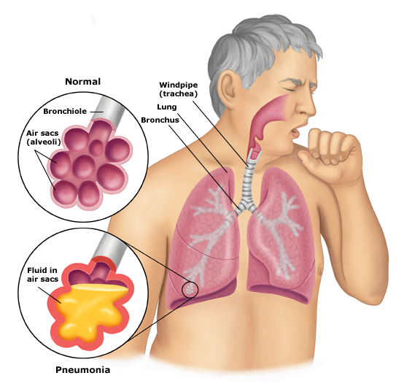


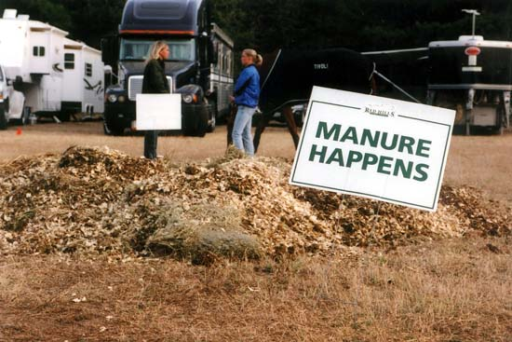
Introduction, Pneumonia, Manure, and Scientific Practices

Slide 4
To be successful in implementing Effective Behavioral Interventions you need to:
Have a conceptual frameworks for what behavior REALLY is
Be focused on the variables that you can immediately change

Slide 5
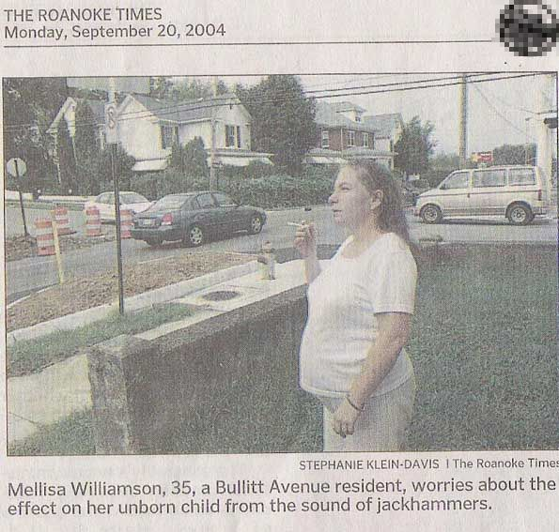

Slide 6
Behavioral Function as a Framework for Understanding Behavior
Determining what the antecedents and consequences are for a given behavior
Focuses on what is maintaining the behavior not the cause!

Slide 7
What you must keep in mind
All behavior has a function
We are trying to identify the function
We may NOT be circular in your logic
Weare not looking for “underlying causes”
We don’t treat behavior that a dead person can do.

Slide 8
4 General Functions of Behavior: To Get Something or To Ger out of Something
Tangible Reinforcement: Food, Stickers, Toys,
Social Reinforcement: Teacher or Peer
Escape/Avoidance: Get out of or terminate something "aversive"
Sensory Reinforcement: Visual, auditory primarily (Touch, smell)

Slide 9
Typical Hypotheses
Group Example
What are common hypotheses for:
  Not completing homework?
  Talking out during class?
  Inappropriate touching of others?
  Poor math test scores?
Notes:
Could either do the first one as a group then have them do the other three as a table. You could walk around and write some of their ideas on an overhead.
Or you could do all of this as a group activity.

Slide 10
Approaches to Functional Assessment
Questionnaire:
  Have others tell you what happens
Observational Assessment:
  Watch and describe A-B-C’s
Experimental Functional Analysis: Do a test of hypothesis
 I usually do a bit of all three of the above

Slide 11
Example of Functional Analysis: Talking out in class
Potential Function Test Condition
Tangible R+ Access Contingent upon talking out
Attention Reprimand Contingent upon talking out
Escape Contingent upon talking out after demand
Self-Stimulation Leave isolated in room
Control Condition Play with attention and no demands

Slide 12
What is the primary function of Behavior?

Slide 13
A More Applied Classroom Example
Teacher & Student Behavior affect each other

Slide 16
Functional Behavior Assessment

Slide 17
Needed Data for FBA
Record Review: ODR/Teacher Nominations
ABC Log
Frequency Recording
Interview
Tier II Data: Fidelity & Graph
Direct Behavioral Observation
Quarterly Teacher Tabulation Form*
Experimental Analysis if Necessary

Slide 18
Office Discipline Referrals
Good as a stand-alone screening tool for externalizing behavior problems
Also good for analyzing school wide data

Slide 19
Office Discipline Referral Form
Student: | Grade: | Referring Staff:
Date of Referral: | Time of Behavior:
Location Classroom # ____ Hallway Cafeteria Library Bathroom ____ Bus Open Yard In Front of School Parking Lot Other (please ID) | External Behavior Abusive language Physical contact Sexual Language toward peer or adult Lying Cheating Vandalism Smoking Truant from Class Other (please ID) |  | Internalizing Behavior Note: For internalizing referrals send form, but do not send student to the office unless necessary. Does not talk with peers Excessively shy/withdrawn Avoid social interaction Appears fearful in non threatening situations Fails to assert self Unresponsive to social situations Doesn’t participate in social activities Other (please ID)
Antecedent | Behavior |  | Consequence

Slide 20
Teacher Nominations
(Top 3 but up to 5)
Student | Internalizing | Externalizing
Gary | X | X
Mark | X
Craig | X
Ben |  | X
Meg
Gwen |  | X
Corroborate with ODR
Follow up with Rating Scale/Diagnostic Tool

Slide 21
Confirming Teacher Nominations with Other Data
Teacher, Parent, and Student Rating Scales
  BASC
  CBCL (Achenbach)
  SSBD

Slide 22
Standard Protocol
Check in – Checkout, Check and connect, Social Skills Curriculum

Slide 23
Daily Report Card
Date _________________
Teacher___________________________ Student__________________
0 = No 1= Yes
Total Points = Today ________% Goal ________%
Points Possible = 32
Parent’s signature _______________________________________________________
 | Be Safe | Be Respectful | Be Ready |  | Teacher Initials
 | Keep hands, feet, and objects to self | Use kinds words and actions | Follow directions | Have Needed Materials
Reading | 0 1 | 0 1 | 0 1 | 0 1
Recess | 0 1 | 0 1 | 0 1 | 0 1
Math | 0 1 | 0 1 | 0 1 | 0 1
Lunch | 0 1 | 0 1 | 0 1 | 0 1
Social Studies | 0 1 | 0 1 | 0 1 | 0 1
Recess | 0 1 | 0 1 | 0 1 | 0 1
Language Arts | 0 1 | 0 1 | 0 1 | 0 1
Science | 0 1 | 0 1 | 0 1 | 0 1
Comments:

Slide 25


Implementing with Fidelity
It does not have to be scary
It must be done however

Slide 27
Student | MAZE | ORF | F&P | Teacher | ISAT | Total | Tier
Example: Gary Cates | 2 | 3 | 1 | 2 | 2 | 10 | 2
Mark | 2 | 1 | 2 | 1 | 1
Renee | 1 | 1 | 1 | 1 | 1
Karla | 2 | 3 | 3 | 1 | 1
Adena | 2 | 2 | 2 | 1 | 1
Brenda | 1 | 1 | 2 | 3 | 1
1=25-99th percentile
2= 11th-24th Percentile
3 = 1-10th Percentile

Slide 28
Purpose of Needed Data for FBA
Data Source
Purpose
Record Review
ABC Log
Frequency Recording
Interview
Tier II Data
Direct Behavioral Observation
Quarterly Teacher Tabulation Form
Experimental Analysis
History of the problem
generate hypothesis
When and Severity
Build Rapport, Hypothesis
Assess Fidelity and Standard Protocol
Norms & baseline
Educational Impact
Confirm Function

Slide 29
Enter the School Psychologist
You can now do your job

Slide 30
Individual Problem-Solving Meeting
Teacher comes with
  Quarterly teacher data tabulation form
  Tier II intervention description and graph
  Tier II Fidelity checklist completed
School Psychologist/Case Manager Comes with
  ABC Log
  Frequency/Rate Logs
  Direct Observation Data

Slide 31
Individualized Behavioral
Assessment & Intervention
Functional Behavior Assessment
Positive Social Skill Development focused
This is Tier III

Slide 32
Prior to Observations
Do a record review: Consider ICEL
Do a teacher interview: Keep it brief
  Have an operational definition of the behavior

Slide 33
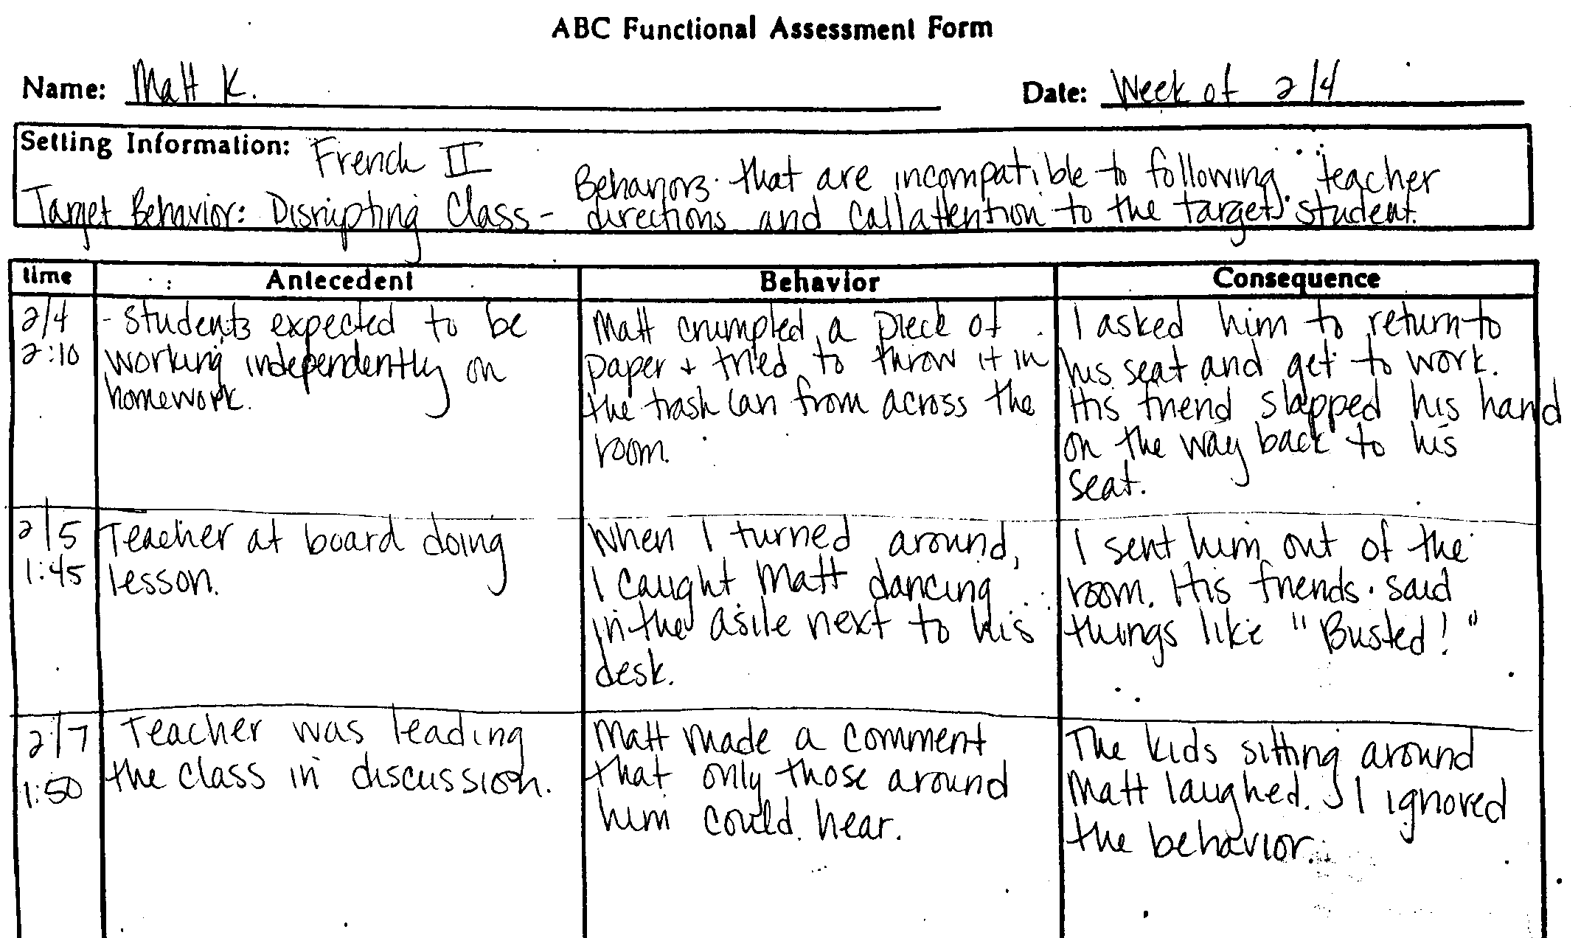
Notes:
This is an example of an ABC that was documented each time the target behavior occurred. It is important in this situation to clearly define the target behavior.
Ask the audience what patterns they see.

Slide 34
1. What patterns do you see here? 2. What is the likely function of behavior?

Slide 35
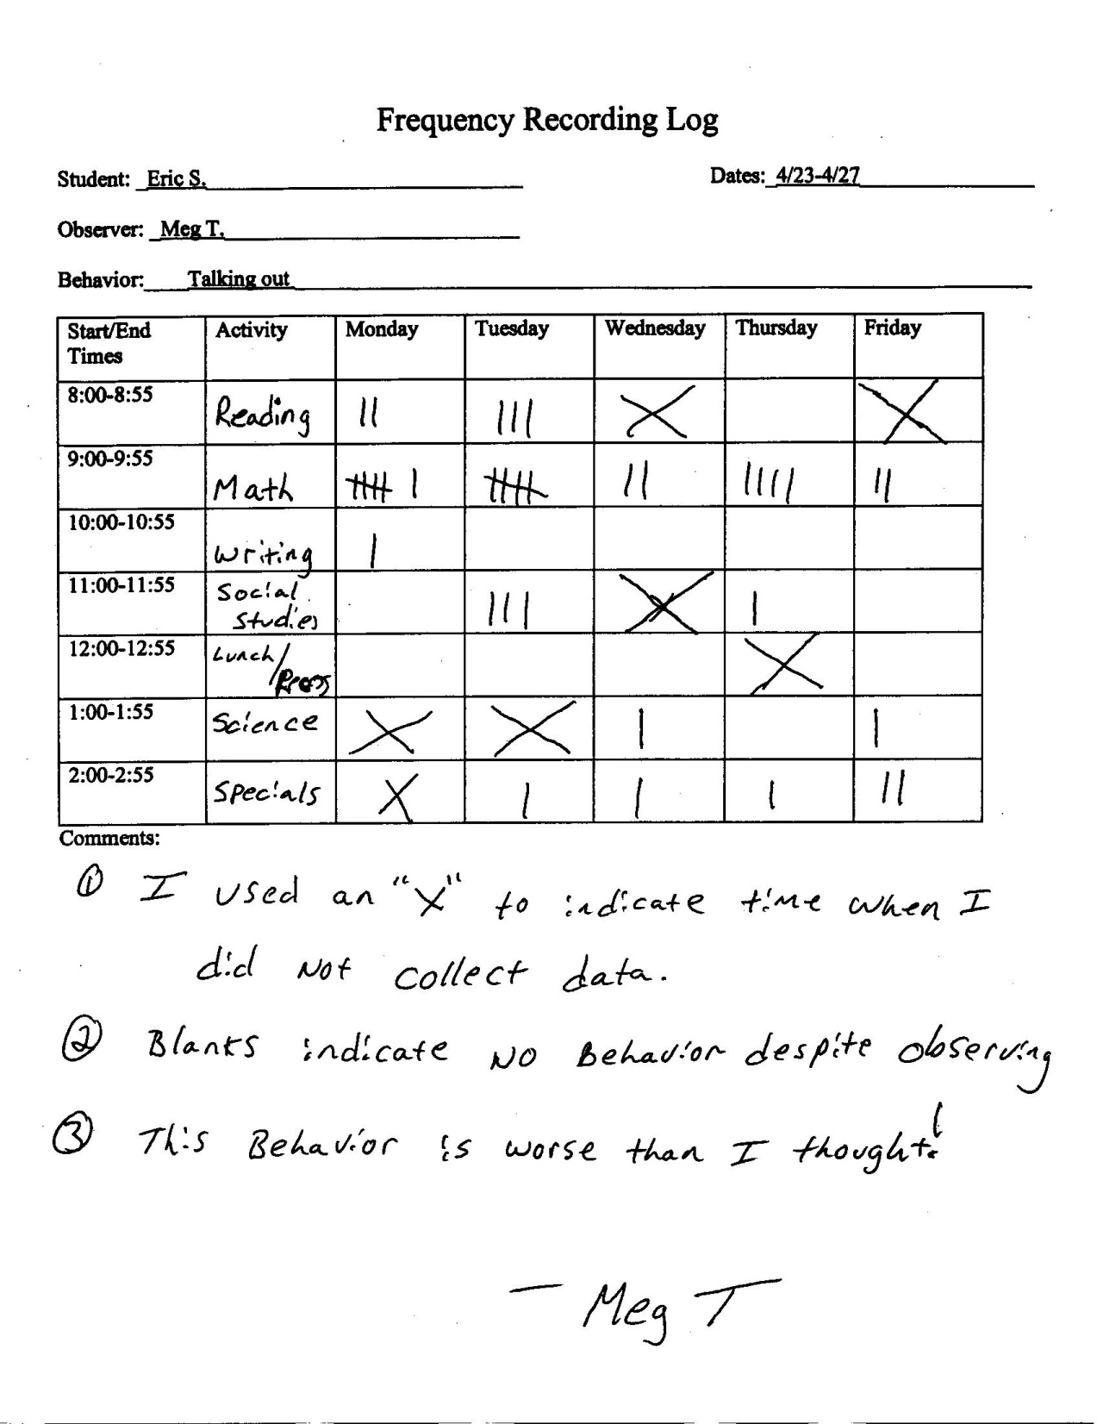
What day does the behavior most often occur? What day is it least likely to occur?
What time of day does the behavior most often occur? Least often?
When should someone come to visit if they wanted to witness the behavior?
Note: It is just as important to look
at when the behavior occurs
as it is to look at when it doesn’t.

Slide 36
What can you get from this?
Are all of these behaviors severe enough to warrant individualized intervention?

Slide 37
Types of Systematic Direct
Behavioral Observation Recording
Partial
Whole
Momentary
Duration
Frequency
Rate
Set Interval Width
Set Interval N

Slide 38
So now what?
Intervention that matches function
Identify alternative behavior
Consider schedule of Reinforcement
Implement with integrity
Graph Data
Analyze Data
Change/tweak when necessary

Slide 39
Small Group Work Time!
Pulling it all together

Slide 40
Teaming up
Please get into groups of four.
Delineate who will play the role of
  a) Teacher
  b) A support personnel #1
  c) Principal
  d) Another support personnel #2
With those four you also need to identify
  Team facilitator
  Team timekeeper
  Team Process Specialist
  Team note taker

Slide 41
Case Problem Solving Time
Everyone will be given a case along with other materials that we will refer to as handout packet 2.
We are going to handout this packet piece by piece as if you were obtaining data.
We are going to work this case from start (planning the assessment) to finish (Planning an intervention)

Slide 42
Steps to Conducting FBA
Review existing information
Develop data collection plan
Analyze data
Formulate a potential hypothesis
Develop an intervention plan based on hypothesized function

Slide 43
Step 1: Review Existing Information
You are to review the case information in front of you with other people around you. This is your “home team”.
You are to come up with a preliminary hypothesized function within the next 5 minutes.
Notes:
Hand out the Initial Referral forms.

Slide 44
Step 2: Case Assessment Planning
With your team determine:
What data you need to collect
When to collect it (or how you will determine when to collect it)
What those data might tell you
Caution: The data you ask for are the data you will get. You will get one piece of data at a time in the order you ask for it.
Notes:
Handout the case management form.

Slide 45
Step 3: Data analysis 1
Analyze the data you have received.
What have you learned from these data?
Were these the “right” data to collect first? If yes, why? If no, why not?
What is your current hypothesized function? Has it changed from your preliminary hypothesized function?
What do you do next? You may change your original order of data collection now.
Notes:
Handout the first piced of data that each team asks for.

Slide 46
Step 3: Data analysis 2
Analyze the data you have received.
What have you learned from these data?
Do you think you asked for the right data? Why or why not?
What is your current hypothesized function? Has it changed from your preliminary hypothesized function?
What do you do next? You may change your original order of data collection now.
Notes:
Handout second data source requested.

Slide 47
Step 3: Data analysis 3
Analyze the data you have received.
What have you learned from these data?
What is your current hypothesized function? Has it changed from your preliminary hypothesized function?
Notes:
Handout third data source requested.

Slide 48
Step 4: Develop a working Hypothesis
Based on the data you have collected state your functional hypothesis in behavioral terms. Write it down.

Slide 49
Step 5: Develop an Intervention Plan
Using the Intervention Articulation Form with your team develop a behavioral intervention plan. (Note taker this your job)
We will share these plans with another group.
Notes:
Handout the Intervention Articulation Form

Slide 50
Jigsaw Time
It is time to send your Facilitator off to another group (An away team).
He/she will describe to another group
  Your hypothesized function and
  Your intervention plan
While your facilitator is gone you will:
  Listen to a new FBA and Intervention
  Provide insights and input into how to tweak their plan based on the away teams hypothesized function.

Slide 51
Reporting back to your Home Team
Facilitators will share with you what they learned while away.
Team members will share with the facilitator what they learned from their “away” facilitators.
  Were hypothesized functions the same?
  How different were your interventions?

Slide 52

Questions?
Gary Cates
garycates@garycates.net
www.garycates.net

