Slide 1
A Response to Intervention Model in Mathematics
Gary L. Cates, Ph.D.
garycates@garycates.net

Slide 2
Today’s Agenda
Provide overview of RTI as it relates to Math
8 Recommendations for Solid Math Instruction
Analyzing Tier I Data
Universal Screening
Tier II Diagnostics & Intervention
Tier III Evaluation & Intervention

Slide 3
Discussion/Activity I
What have you accomplished with regard to implementation of RTI in math in your district/building(s)?
What are you currently struggling with in regards to implementation of RTI in Math in your district/building(s)?

Slide 4
My 3 Talking Points About RTI
RTI is an overall integrated system of service delivery focused on ALL students.
Data-based decision making will be the driving force in the conceptualization, development, implementation, and evaluation of the RTI process.
Alignment of curriculum with state standards is critical

Slide 5
The RtI Process
Navigation Map to Data-Based Decision Making

Slide 6
Universal Screening Measures
Standard Educational Diagnostic Tool
Tier II Standard Protocol Instruction
Progress Monitoring
Tier III Individualized Instruction
Progress Monitoring
Special Education
Entitlement
Progress Monitoring
Universal Core Curriculum
Individualized Diagnostic Assessment
Identification of Students At-Risk

Slide 7
4 points of Understanding for A Comprehensive Tiered System of Support In Mathematics
Call it whatever you want and you don’t have to have a triangle

Slide 8
Tier 3
Individualized Intervention 5%
Tier 2
Standard Protocol 15%
Tier 1
Universal Instruction 80%
POU 1: Tiers are not mutually Exclusive
From One Another

Slide 9
Example of 3-Tier Level Interventions
Math
Tier I
Tier 2
Tier 3
Time
60
90
120
Curricular Focus
5 areas
Less than 5
2 or less
Core
+
Supplemental
+
Intensive
Core
+
Supplemental
Curricular Breadth
Core
Frequency of Progress Monitoring
3X Yearly or greater
Monthly or greater
Weekly

Slide 10
Universal Instruction
(Tier I) During Fall
Full Standard Protocol (Tier II)
During winter
Full Individualized Intervention (Tier III) Never utilized because not needed
Less Intensive Standard Protocol (Tier II) in spring because adequate progress was being made.
POU 3:
Students may be at a specific tier level
for various amounts of time
POU 2: Tiers are not places, but are points

Slide 11
Universal Instruction
(Tier I) All Students
All Students getting Everyday Math
Full Standard Protocol (Tier II)
Some Students getting:
1. Think Fast
2. PALS-Math
3. Number Worlds
Full Individualized Intervention (Tier III)
Individually Tailored methods:
1. Assignments
2. feedback
3. Motivation
4. Time
5. Materials
6. Arrangement
POU 4: Different things can happen with
different kids at the same tier level

Slide 12
Math and RTI is and is not like Reading and RTI
Number and Math Concepts
Addition & Subtraction
Word Problems
Multiplication/Division
Whole Numbers/ Fractions
Algebra & Geometry

Slide 13
TIER I
Core Instruction and Screening

Slide 14
Tier I Curriculum and Instruction
Provided to all students
  Is effective for most (e.g. 80%) students
    Effectiveness determined by high stakes test performance (or other global outcome measure; ISAT, PSAE, ACT¹)

Slide 15
What Makes up a Good Math Curriculum?
Numbers & Operations with Procedural Fluency
Algebra
Geometry & Measurement
Data Analysis, Statistics, & Probability
National Council of Teachers of Mathematics²

Slide 16
What Makes up Good Math Instructional Practices
Institute of Educational Sciences: National Center for Education Evaluation and Regional Assistance http://www.rti4success.org/images/stories/tieredInstruction/rti_math_pg_042109.pdf ³
8 Recommendations

Slide 17
Recommendation 1:
Screen all students to identify those at risk for potential math difficulties and provide interventions to students who are at risk.

Slide 18
Recommendation 2:
Instructional materials for students receiving interventions should focus intensely on in-depth treatment of whole numbers in K-5, and on rational numbers in 4-8.

Slide 19
Recommendation 3:
Instruction during intervention should be explicit and systematic (i.e., providing models of proficient problem solving, verbalization of thought processes, guided practice, corrective feedback, and frequent cumulative review).

Slide 20
Recommendation 4:
Interventions should include instruction on solving word problems that is based on common underlying structures

Slide 21
Recommendation 5:
Intervention materials should include opportunities for students to work with visual representations of math ideas/Interventionists should be proficient before using them.

Slide 22
Recommendation 6:
Interventions at all grade levels should devote about 10 minutes in each session to building fluent retrieval of basic facts.

Slide 23
Recommendation 7:
Monitor progress of students receiving Tier 2 and 3, as well as borderline students.

Slide 24
Recommendation 8:
Include motivational strategies in Tier 2 and 3 interventions.

Slide 25
Examples of Solid Core Curriculum: What Works Clearinghouse⁴
Elementary
  Odyssey Math
  Everyday Math
Middle School
  I Can Learn: Pre-algebra & Algebra
  Cognitive Tutor
  Expert Mathematician
High School
  Core + Mathematics

Slide 26
Instruction Should Map Onto ISAT, PSAE, ACT
Does it?
If not, then you are not going to do well on your major outcome measures
Instructional Planning Forms can Be helpful

Slide 28
Academic Engaged Time
Behavior and Learning are not mutually exclusive.
The largest predictor of student success
75% as a rule of thumb
Collecting at the class level for all students may be effective.

Slide 29
Class Wide Behavioral Observation Form
Teacher _____________________________________ Date: _________________
School: ______________________________________ Time: __________________
Observer: ____________________________________
Subject/Activity: _______________________________
Behavior(s) | Definitions
Behavior 1: Academic Engaged Time (AET) | Student appropriately responding to teacher and/or lesson
Behavior 2: Inappropriate Socialization (IS) | Student socializing in a manner inconsistent with intended learning
Behavior 3: Inappropriate Motor Behavior (IMB) | Student engaging in behavior incompatible with learning other than socialization (e.g. out of seat, fidgeting, staring out window etc.)
 | Behavior | 1 | 2 | 3 | 4 | 5 | 6 | 7 | 8 | 9 | 10 | 11 | 12 | 13 | 14 | 15 | 16 | 17 | 18 | 19 | 20
1 | AET
2 | IS
3 | IMB
 | Behavior | 21 | 22 | 23 | 24 | 25 | 26 | 27 | 28 | 29 | 30 | 31 | 32 | 33 | 34 | 35 | 36 | 37 | 38 | 39 | 40
1 | AET
2 | IS
3 | IMB
 | Behavior | 41 | 42 | 43 | 44 | 45 | 46 | 47 | 48 | 49 | 50 | 51 | 52 | 53 | 54 | 55 | 56 | 57 | 58 | 59 | 60
1 | AET
2 | IS
3 | IMB
 | Behavior | 61 | 62 | 63 | 64 | 65 | 66 | 67 | 68 | 69 | 70 | 71 | 72 | 73 | 74 | 75 | 76 | 77 | 78 | 79 | 80
1 | AET
2 | IS
3 | IMB
 | Behavior | 81 | 82 | 83 | 84 | 85 | 86 | 87 | 88 | 89 | 90 | 91 | 92 | 93 | 14 | 95 | 96 | 97 | 98 | 99 | 100
1 | AET
2 | IS
3 | IMB

Slide 30
Tier I Assessment: Screening
All students administered a screening 3 times per year.
Allows for identification of students at-risk for falling behind
Can help in facilitating preventative intervention service delivery

Slide 31
DO NOT CONFUSE WITH DIAGNOSTIC TESTING!
Brief administration (within minutes)
Brief Scoring
Simple to understand
Sensitive to changes in performance
Allows for repeated measurement (alternate forms)
Predicts high stakes performance

Slide 33
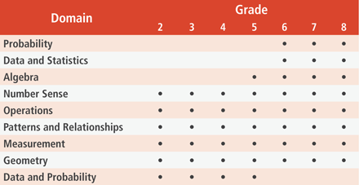
An Example of Tier I Screening Measures
AIMSweb Mathematics Computation & Applications⁵

Slide 34
Examples of Tier I Screening Measures
Easy CBM⁶
  Based on name
Domain | K | 1 | 2 | 3 | 4 | 5 | 6 | 7 | 8
Number & Operation | * | * | * | * | * | * | * | * | *
Geometry | * | * |  | * |  | * |  | * | *
Algebra | * | * | * | * | * | * | * | * | *
Measurement | * |  | * |  | * | *
Data Analysis |  |  |  |  |  |  |  |  | *

Slide 35
Discussion/Activity II
How well is your universal curriculum meeting the needs for all students
What Screening measures do you currently have in place for math?
How well do they stack up against the definition of “Screener”?
  Most importantly do they predict ISAT, ACT, PSAE?

Slide 36
TIER II
Supplemental Instruction and Diagnostic Assessment

Slide 37
Tier II Assessment:
Broad based Diagnostic Tool
Administered to students who were identified as at-risk on the screening tool.
  Requires more time and resources to administer than the screener.
  Helps identify general area of weakness
  Can be done by whomever is adequately trained
Reduces need to do more lengthy assessment with every child.
Helps identify the “right” children

Slide 38
MAP ⁷
MAP does not fit the definition of “screener”
It is used for diagnostic benchmarking
Provides strengths & Weakness analysis of student performance
Aligned with State Standards

Slide 39
ACUITY⁸
Grades 3-8
Provides Reports
Linked to State Standards
Predictive Measures: 3 per year
Diagnostic Measures: Find Domains
Custom: Make your own questions and share

Slide 40
Tier II Curriculum and Instruction
Provided to students who are at-risk on screener AND identified with diagnostic tool.
  Is provide to small number of students (e.g. 15%)
  Is provided in addition to Tier I service.
Is scripted and provided in small group (i.e. fewer kids get it) format.
Can be provided by anyone adequately trained
Is Scientifically based

Slide 41
Examples of TIER II Interventions
PALS Math
iPass/iLearn
Study Island
Number Worlds
Vmath (Voyager)
Accelerated Math
Mclass Math

Slide 42
Other TIER II Math Interventions
Program GRADE LEVELS
Fastt Math 2 and up
Mastering Math Facts 2 and up
Math Facts in a Flash 1-6
Peer Assisted Learning Strategies (PALS) K-6
First Grade Small Group Tutoring 1
Connecting Math Concepts K-8
Corrective Mathematics 1-6
Knowing Mathematics 4-6
Navigator 1-8
Voyager Mathematics (Vmath) 3-8
iSucceed Math 3-8
Accelerated Math 1-12
Hot Math K-3
Pirate Math 2-5
Go Solve Word Problems 3-8
Math Steps K-7
Number Worlds PreK-8

Slide 43
Activity III
What standard protocol interventions do you have in place?
Are they scientifically based?
How long do they take to administer?
How do you know if they are working?

Slide 44
TIER III
Individualized Instruction and Curriculum Based Evaluation

Slide 45
Tier III Curriculum and Instruction
Provided to students who do not make adequate progress with TIER II level of support
  Is provide to small number of students (e.g. 5%)
Is provided to 1 or 2 students at a time.
Is provided in addition to Tier I & Tier II
Is evidenced based
Can be provided by anyone adequately trained.

Slide 46
Tier III Assessment:
Curriculum Based Evaluation⁹
Administered to students who are not making adequate progress with TIER II intervention
  Requires more time and resources to administer than the screener and diagnostic tool
  Utilizes individualized evaluation procedures using students own curriculum to isolate specific problem areas.

Slide 47
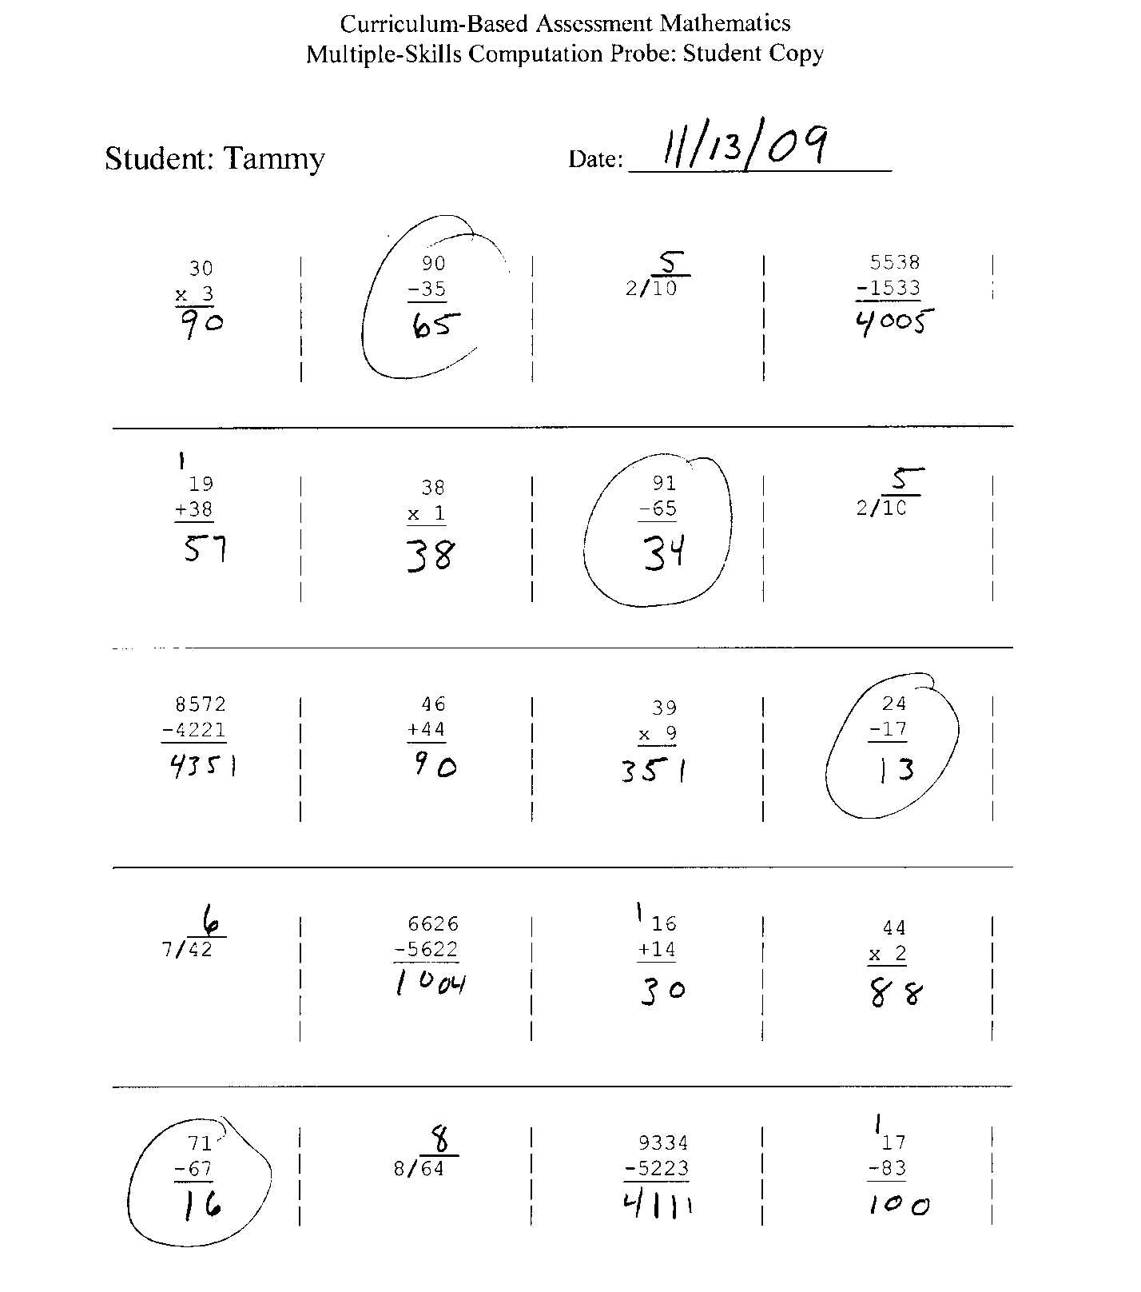
1. What seems to be
the problem?
2. What should the
intervention target?
3. Describe something a
teacher could do to target
this problem.
4. Do you have to buy
an expensive program
just for Tammy?

Slide 48
Activity IV
What types of interventions are you putting into places for individual students with problems in math?
How do you develop these?
Are they evidenced based?
How do you know if they are working?

Slide 49
Special Education Entitlement
Comprehensive Evaluation

Slide 50
Criteria - Illinois
Not Achieving Adequately: Age or state level standards AND
Not improving sufficient progress AND
Educational Needs significantly different
Exclusionary Criteria
  Hearing, vision, cognitive, emotional, cultural, disadvantage, Limited English

Slide 51
Documentation
Scientifically Based Instruction
Integrity of instruction
Progress monitoring linked to areas of deficit
Intervention delivered for a sufficient amount of time

Slide 53
Review Assessment

Slide 54
Universal Screening
Standard Educational Diagnostic Assessment
Individualized Diagnostic Assessment
Grade Level Instructional Planning Form
Analysis of High Stakes Testing Data

Slide 55
Review Intervention

Slide 56
Core Curriculum
Standard Protocol
Individualized

Slide 57
Thinking Differently and Facilitating Others to Do the Same
AYP Applies to ALL Students
Think Prevention ALWAYS!
  Saves headaches later
Make Decisions with data ONLY!
  Best practices in assessment and intervention
TIERS are not places EVER!
  Level of support
Services are dynamic
  Intensity and type of service can be different for any student
Authentic assessment links to and informs interventions in the most direct way

Slide 58

Questions

Slide 59
References & Resources
Assessment in Illinois
http://www.isbe.state.il.us/assessment/default.htm
National Council of Teachers of Mathematics http://www.nctm.org/standards/content.aspx?id=23273
Institute of Educational Sciences: National Center for Education Evaluation and Regional Assistance http://www.rti4success.org/images/stories/tieredInstruction/rti_math_pg_042109.pdf
What Works Clearinghouse
http://www.whatworksclearinghouse.org
AIMSweb Math Computation & Applications http://www.aimsweb.com/measures-2/math-concepts--cbm/
EasyCBM
http://easycbm.com/index.php
MAP http://www.nwea.org/products-services/computer-based-adaptive-assessments/map
ACUITY: http://www.acuityforschools.com/tour/index.html
Howell, K. W. Nolet, V. (2000). Curriculum-Based Evaluation: Teaching and Decision Making (3rd Ed.). Wadsworth: Belmont, CA.

