Slide 1
CJTennis coaching
A Simplified Guide to Grips – Devised by Curtis Austin

Slide 2
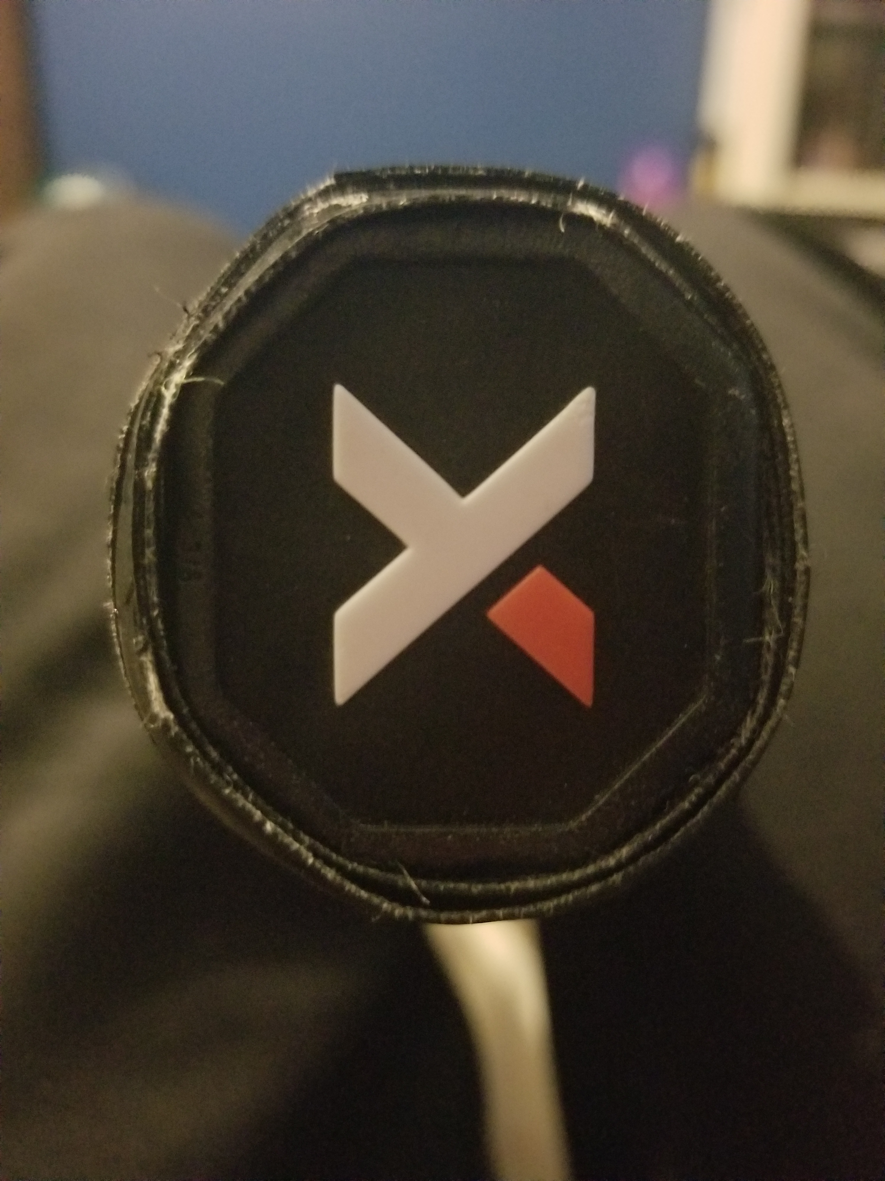
Understanding Bevels
1
8
2
7
3
The best reference point to find a grip is by seeing which bevel the base knuckle of the index finger is on.
The picture here shows the butt cap of a racket, with the corresponding bevel numbers.
6
4
5

Slide 3
Serve/ Volley/ Slice/ Overhead Grip
There is one grip for all of these shots, and back in the days of wooden rackets this was the universal grip for nearly every shot:
- Continental Grip

Slide 4
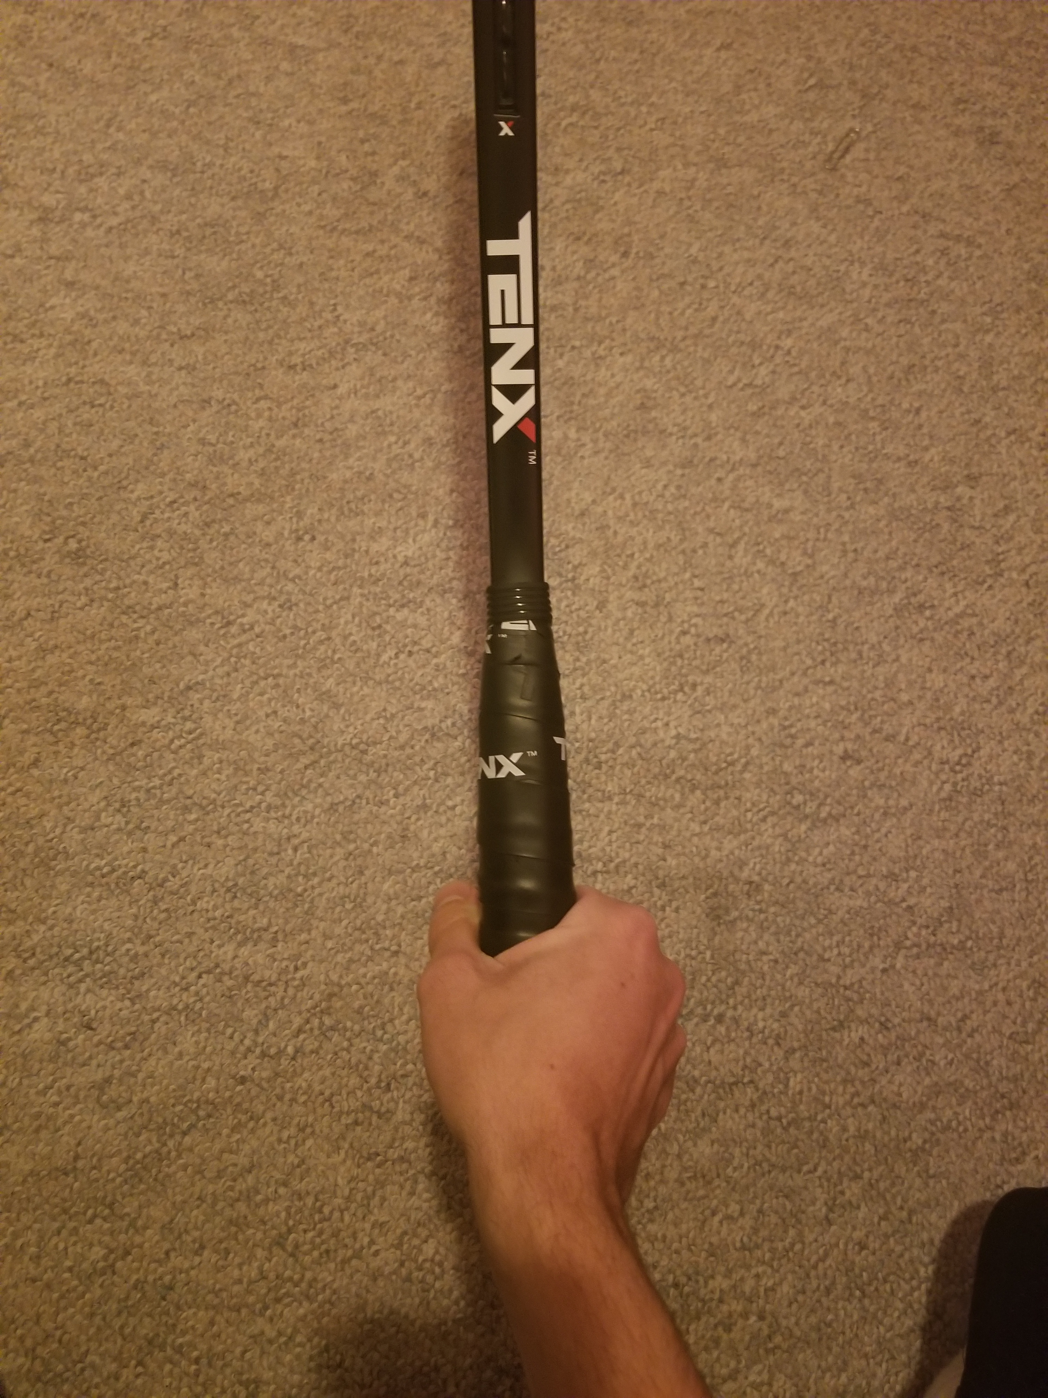
Continental Grip
To find the grip, put the base knuckle of the index finger on Bevel #1. The V formed by the thumb and forefinger are on top of the handle.
Continental is used for a multitude of strokes, most commonly serves and volleys, but also overheads and slices.

Slide 5
Continental Grip
Advantages
Allows for pronation on Serves and Overheads.
Provides an Open Racket Face for Volleys, as well as the same grip for F/H and B/H.
Low Strike Zone for Groundstrokes so good for Defensive pick ups.
Limitations
Topspin is extremely hard to achieve, so low net clearance needed to keep the ball flat and in play, meaning a lower margin for error.

Slide 6
Forehand Grips
There are 3 forehand grips that will be covered in this section, they are as follows:
- Eastern Forehand Grip
- Semi-Western Forehand Grip
- Western Forehand Grip
Each grip has a different strike zone, the higher the contact point the more topspin that can be applied, as the swing path takes the racket more up the back of the ball.

Slide 7
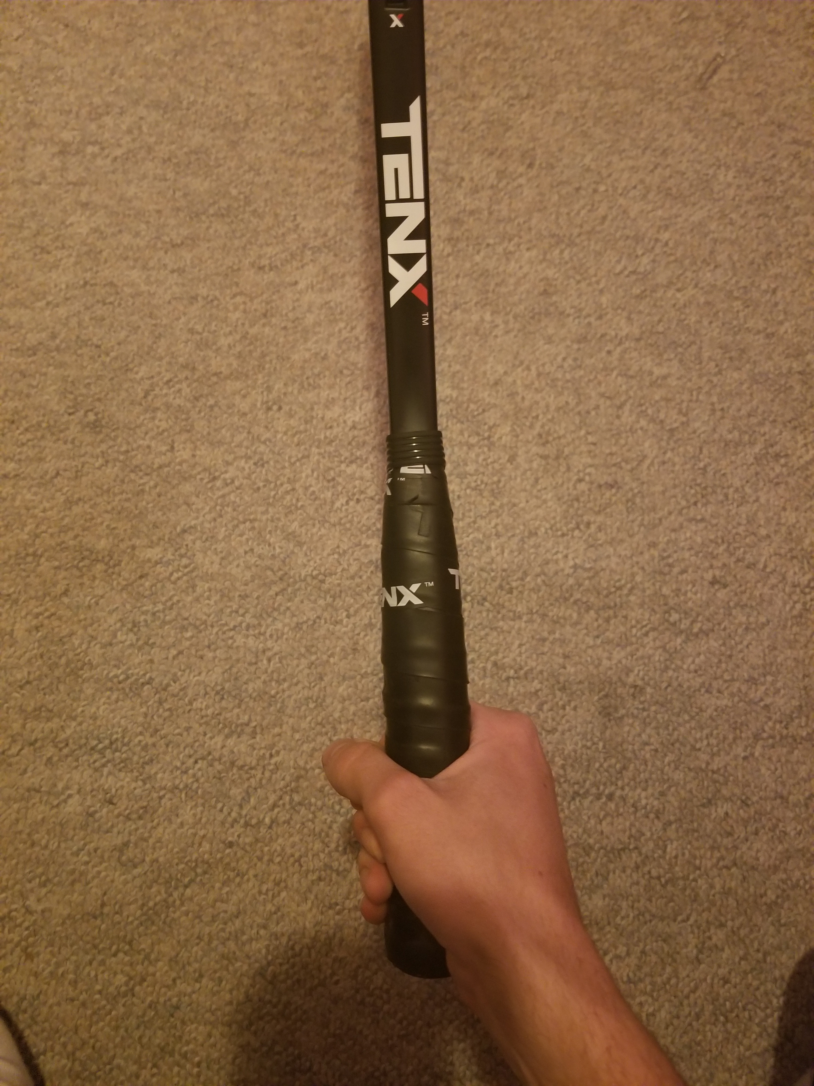
Eastern Forehand Grip
To find the grip, turn the hand clockwise from Continental grip, the base knuckle of the index finger moves by one bevel to bevel #2.
This grip is sometimes called the ‘Shaking Hands Grip’.
The Strike Zone is around waist height.

Slide 8
Eastern Forehand Grip
Advantages
Ideal for Beginners because of its versatility, can be used to generate power, great for flat strokes, and a little topspin.
Easier grip change from Continental and Backhand grips.
Limitations
Difficult to return high bouncing balls as the strike zone is waist height.
Low margin for error as it is not easy to generate much topspin, often meaning that net clearance is low.

Slide 9
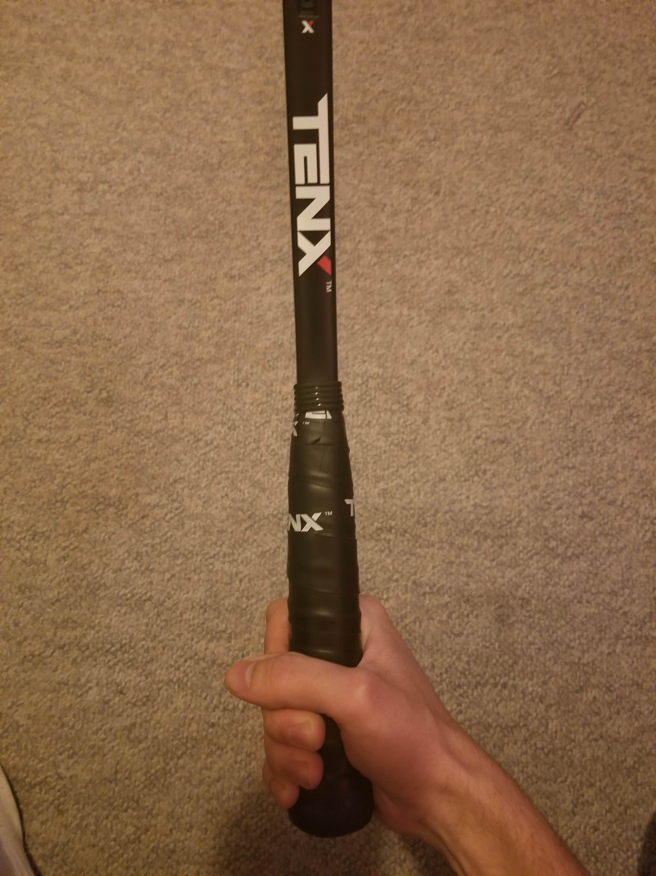
Semi-Western Forehand Grip
To find the grip, turn the hand clockwise from Eastern Forehand grip, the base knuckle of the index finger moves by one bevel to bevel #3.
The Strike Zone is between waist and shoulder height.
This is the best grip for a mixture of speed and topspin.

Slide 10
Semi-Western Forehand Grip
Advantages
Higher margin for error, as lots of topspin can be applied for more net clearance and control.
Strike zone is higher, so it is possible to hit aggressive balls with topspin from high bouncing balls.
Limitations
Lower balls are harder to return as the racket face is naturally closed.
A large change of grip from Continental, making players too uncomfortable to approach the net.

Slide 11
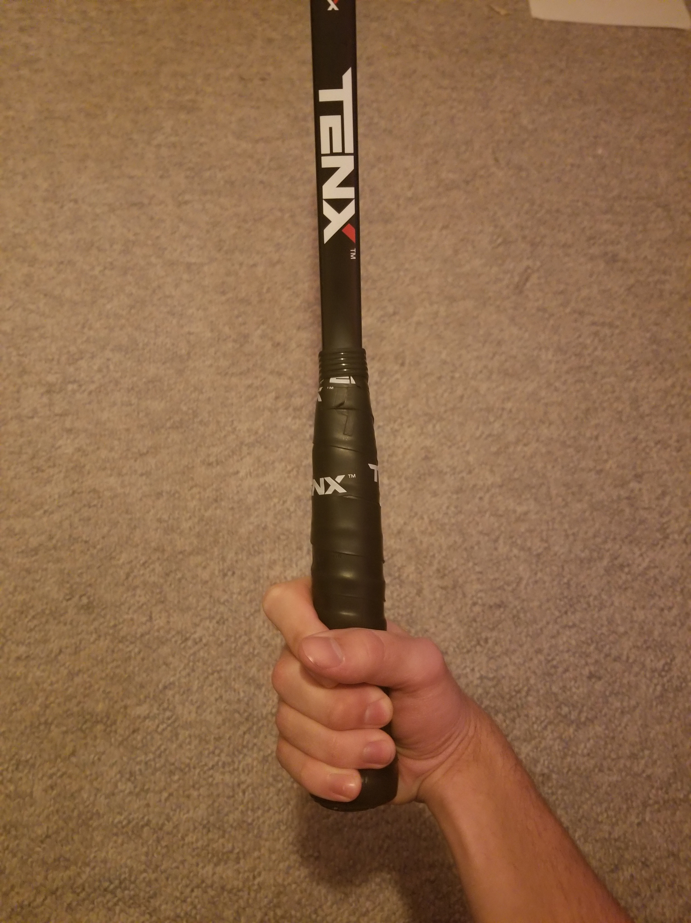
Western Forehand Grip
To find the grip, turn the hand clockwise from Semi-Western Forehand grip, the base knuckle of the index finger moves by one bevel to bevel #4.
The Strike Zone is around shoulder height.
This grip can be used to achieve extreme topspin, however this is at the expense of power.

Slide 12
Western Forehand Grip
Advantages
Extreme amounts of topspin can be applied, allowing for very high net clearance, and a bounce that pushes the opponent back behind the baseline.
High strike zone making high bouncing balls easier to handle.
Limitations
Huge amounts of racket speed are needed to generate enough power and spin to hit an effective deep ball.
Very hard to hit a flatter stroke as the racket path is up the back of the ball.
The racket face is very closed, so it is extremely hard to hit low bouncing balls.

Slide 13
Backhand Grips
There are 3 different backhand grips that will be covered in this section, they are as follows:
- Two Handed Backhand Grip
- Eastern Backhand Grip
- Extreme Backhand Grip
Two Handed Backhands often give more stability and power, whereas One Handed Backhands can help generate more topspin, as well as offering more reach.

Slide 14
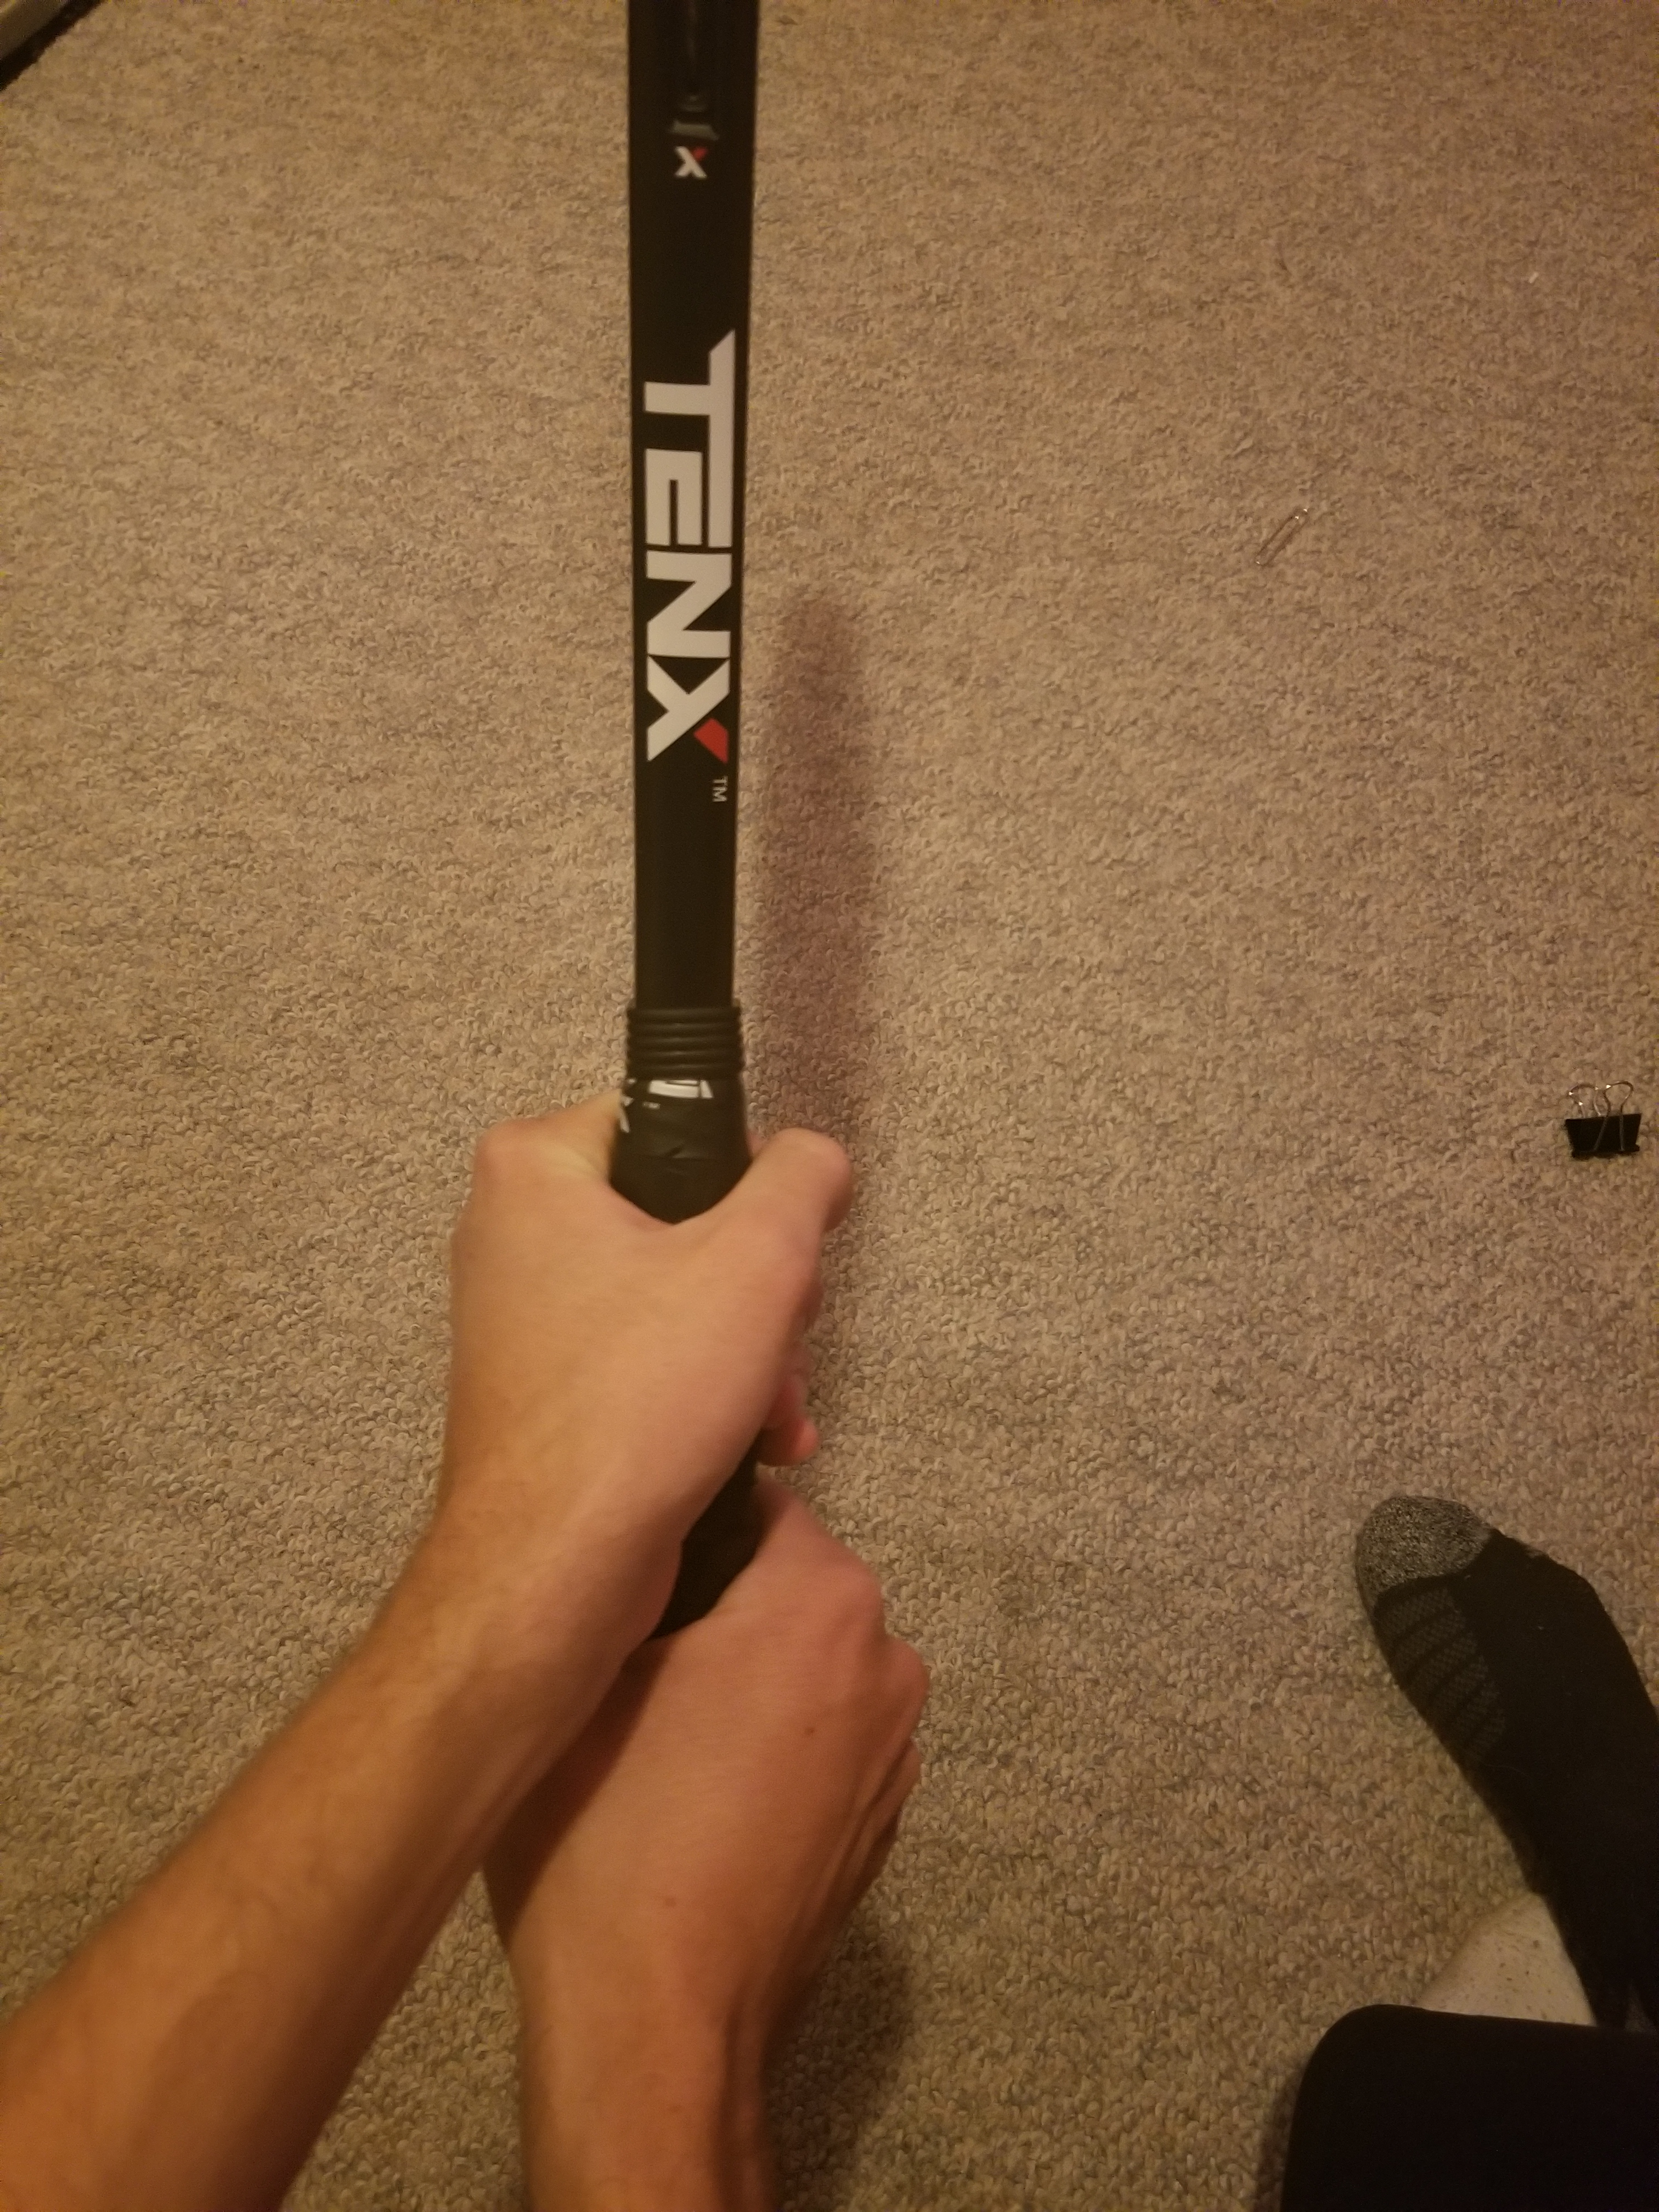
Two Handed Backhand Grip
The dominant hand is at the bottom using Continental grip, with the non-dominant hand on top using either a Semi-Western or Eastern Forehand grip.
This grip gives the player good stability on the backhand wing.
The Strike Zone is usually around waist height.
A good mixture of topspin and power can be generated.

Slide 15
Two Handed Backhand Grip
Advantages
Great for both flat and topspin strokes, from both lower and higher shoulder height balls.
Compact, with power coming from rotation.
Limitations
Reach is very limited, making very wide balls tough to return.
May be uncomfortable with B/H strokes requiring one hand, like volleys and slices.

Slide 16
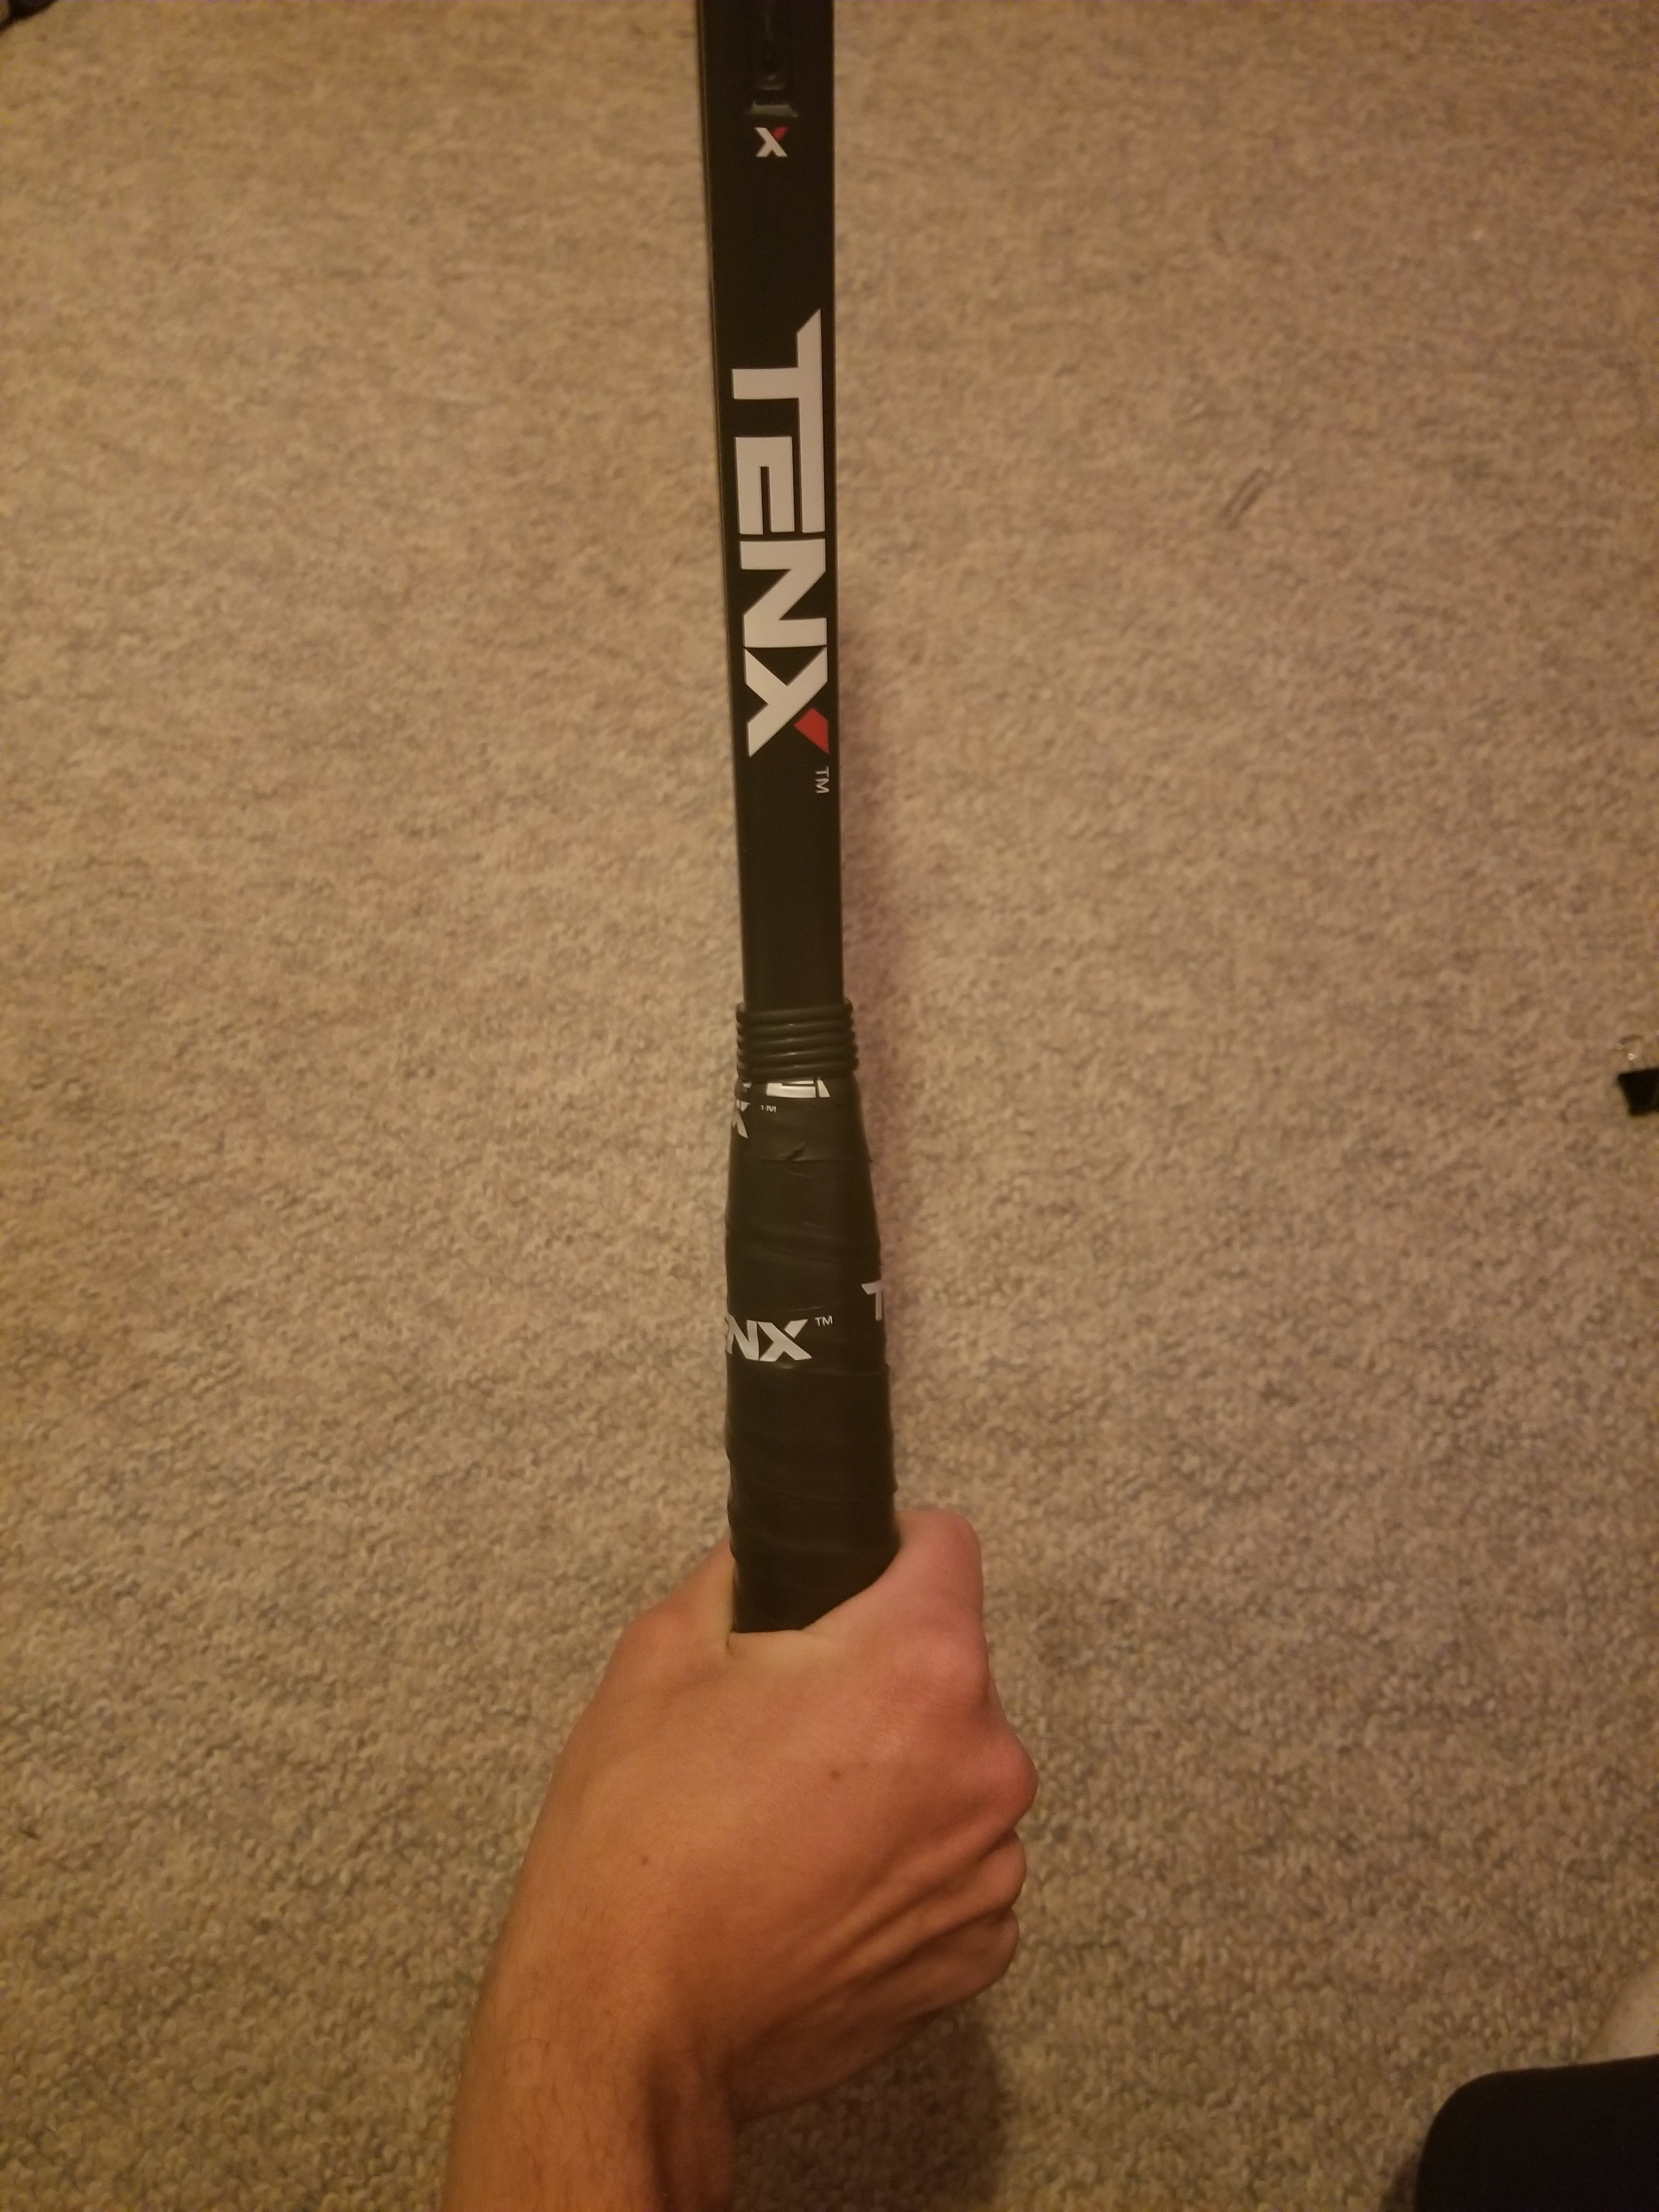
Eastern Backhand Grip
To find the grip, turn the hand anticlockwise from Continental grip, the base knuckle of the index finger moves by one bevel to bevel #8.
The Strike Zone is between waist and shoulder height.
This One Handed Backhand grip is useful to achieve a flat shot, and can be hit with power.

Slide 17
Eastern Backhand Grip
Advantages
Very similar to the Eastern Forehand, it is equally good for both flat and topspin shots.
Close to Continental so an easy transition after the serve, and when approaching the net.
Limitations
Difficult to hit with controlled topspin from a very high ball, resulting in lots of defensive slices.

Slide 18
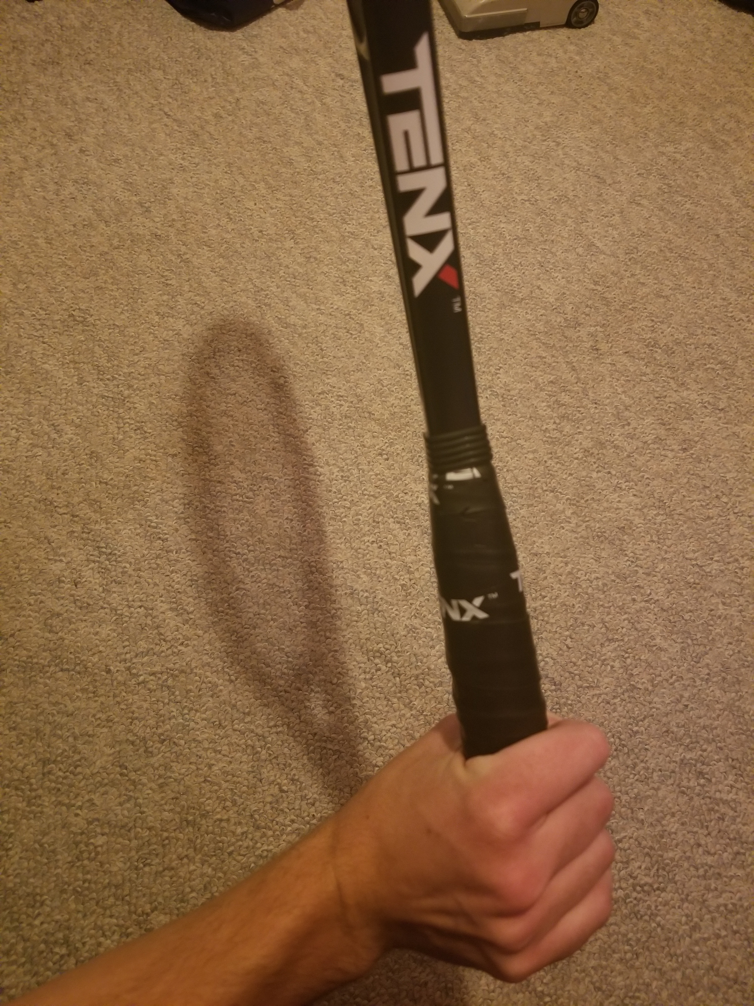
Extreme Eastern Backhand Grip
To find the grip, turn the hand anticlockwise from Eastern Backhand grip, the base knuckle of the index finger moves by one bevel to bevel #7.
The Strike Zone is around shoulder height.
This grip is very seldom used, because it requires huge amounts of strength in the wrist.
This grip is used to produce very heavy topspin, at the expense of power.

Slide 19
Extreme Eastern Backhand Grip
Advantages
Great for hitting topspin strokes from high bouncing balls, as the strike zone is high.
Immense topspin produced, great for keeping the opponent behind the baseline.
Limitations
Lots of racket speed is needed, so swings are longer, this can be an issue on faster courts.
The racket face is very closed, so it is extremely hard to hit low bouncing balls.
A large grip change from Continental, making players too uncomfortable to approach the net.

Slide 20
Thanks for reading, cjtennis coaching www.cjtenniscoaching.ca

