Slide 1
Systamatic LLC
Dr. Oswald Cartwright
Oswald.Cartwright.Com

Slide 2
You Can’t Quit and You Can’t Get Out the Game

Slide 3
The Premise/Interactive
Life is Hard
Life is Fun/Crucible Events
You Don’t Always Get What You Want (Show Chart)
Enjoy and Appreciate the Gifts, Opportunities, and Successes
Ready For the Downturns in Life, Stagnation, Seemingly No Progress
Appreciate the Small Things
Crucible Events (Life Changing) Can Alter Your Life, Path, Choices

Slide 4
The Game of Life-Why Play The Game
You Don’t Have A Choice
It’s About Security
It’s About Power to Control Your Life
It’s About the Money
It’s About Taking Care of Your Family
It’s About Having the Things You Want In Life
It’s About Your Legacy
It’s About Retirement
It’s About Having Fun

Slide 5
The Game of Life
People Can Be Malicious
Sometimes They Don’t Know What They Are Doing
Sometimes it’s Related to the Competition They Are Just In the Way
  Mash Them
  Embarrass Them Casually
  Give Them Enough Room where They Can Fail
  But Don’t Rub It In
  When They Do Fail Help Them
Competition Is A Natural Attribute

Slide 6
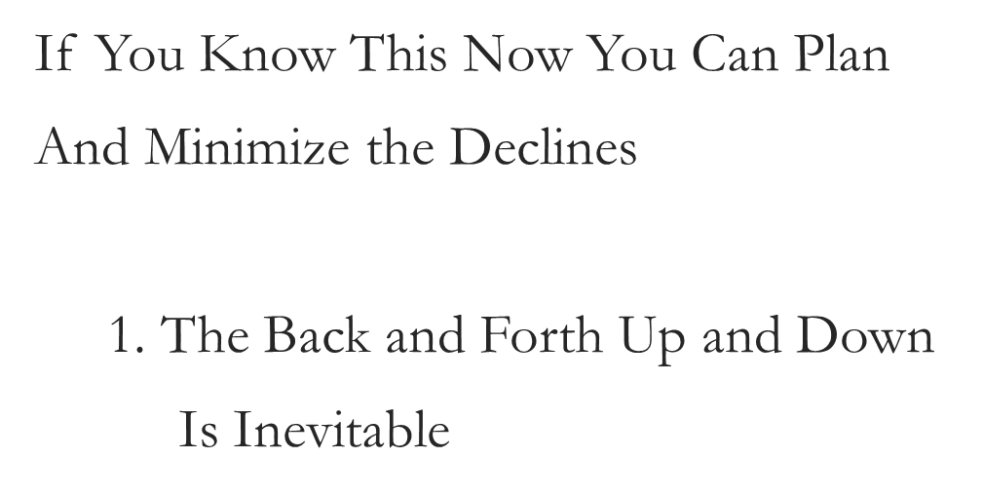
The Game of Life

Slide 7
The Point
    Where Are You Going
    Relentless
    Manage Self
    Courage
    Extreme Focus
    Preparation
    Execution

Slide 8
Tools
Be Aware of the Competition
Counterpunch
Crazy Boss
Conversation Choices/Favor Town
Buy In
Influencer
Buck Up Suck Up
Laws of Success

Slide 9
The Premise
Q1
Getting Started
Q5
Fight to Become
Q9
Parents and Kids
New Job/Money
New Home
New Car
Kids Are Maturing
Taking Care of Parents
Hard Work/More Responsibility
Long Hours
Q2
Q6
Becoming/Succeeding
Q10
Retirement
Finding Your Way.
Advance Degree
Thinking About Family/Fun/Travel
Advanced Responsibility
Family Maturing
We Made It
It’s Our Time
Not the End
Inevitable
Best Health Possible
Food, Exercise, Medication
Q3
Q7
Q11
A Plan
Accomplishments
Failing Health
Execute the Plan
Thinking About Your First Property
Mentoring
Enjoying
Growth/Maturing
Q12
Q4
Personal Accomplishment
Q8
Maintenance
Pass Away
Family
Fun
Maturing
Ourselves
Accomplishments
Assets
This Is The End
Your Legacy Lives On

Slide 10

Cycle of Life-What We Think
Years

Slide 11
Cycle of Life-What Happens
Success/Happiniess
Years

Slide 12
Five Stages of Decline
Denial
Irrelevance
Salvation
Arrogance
Pursuit of More
Years

Slide 13
Cycle of Life-With Reality and Planning
Success
Years

Slide 14
Games People Play
Sabotage You
Define For You What They Want For You
Pull You Down
Distract You
Make You Feel Bad
Remind You of Your Failures/Disappointments
Compete With You (Rodney)
Isolate You
Make You Feel Incompetent

Slide 15
Games People Play
My Mommy Said “it’s a War” Between You and Life
I Definitely Counterpunch
Create Hell to Create Peace
  Basically Intimidation
  It’s A War
  It’s A Street Fight
  Deal With Clowns On the Street Like A Clown On the Street
  Bully Boss or Employee Go At The and Go At Them Hard
Sometimes You Have to Make People Uncomfortable With You or Make them Comfortable Then Light Them Up/Expose Them
  Little Boys On The Metro
  Teenage Girls On the Metro

Slide 16
Games People Play
Remember It’s Not True
  True North/What Do You Want For You
  If They Are Right (If You Feel You Could Be Doing Better)
    Go To Work
Pivot to Something New (Federal to Entrepreneurship)
  You Have to Prepare For the End Anyway
Pivot to a New Organization
Change Your Network
Don’t Look Back Don’t Give Up
The Competition

Slide 17
Competition Defined
Drive
  Initiative-A Tendency That Prompts Action
  Independent-Of Purpose With An Outcome
Desire
  Directed-At A Particular Goal
  Expectation-The Outcome (Believe)
Determination
  Developing Competence
  Gaining Satisfaction
  Striving Alone

Slide 18
Competition
The Competition Wants What You Want
The Competition is Not Actually Competitive
Competition Sees You As A Blocker To Their Goals
Just Want to Block You-Misery Loves Company
  You Are One of Us Actually I Am Not
Look Out For Meaningless Assignments/Dead In Jobs
Use Secondary Ignorance
  You Running a Game On Me Actually I am Running A Game On You
    Metro Guy

Slide 19
Competition
Adventure
Avoid Disaster/Embarrassment
Success
Surprises
Spontaneity
Feeling of Success Avoiding Defeat

Slide 20
Competition
All Around You
Whether You Like It or Not
Human Nature
Compete Not Necessarily Against Others (piano)
Play The Course (Me Against the Course)
  Your Life is Your Life and My Life is My Life I Can’t Worry About Your Blessings
You and Your Goals (That’s How You Measure Yourself)

Slide 21
Competition
Watch Out for The Competitive Boss, Family Member, Friend, Co-Worker
Watch Out For the Non-Competitive
  Can’t Really Play
  Have the Uniform On
  Can’t Get A Hit to Save Their Life
  Softball Story
  I Just Practiced Hard, Self Improved, and Then Executed

Slide 22
Competition
Embrace It/It Could Be A Goal To Reach For
Use It To Your Advantage
Don’t Compete Because Your Goals Are Your Goals
Competition Attacks You-Fight Back With the Counterpunch
Know Exactly How Competitive You Are (Kevin)
  This Is Where the Fight Starts
  Then Think About What People Are Feeling About You (EI)
    Jealous, Uneasy, Behind, Inadequate

Slide 23
Competition
Winning
  Defined By You
  Aggression Not Hostility
    Really Don’t Care About the Opposition
  Don’t Expect A Break Go Get It
  Always Be Cool-Avoid the Angry African American Bias
  Lack of Control Impairs Your Ability to Perform Effectively
  Knowing How To Effectively Counterpunch in Important

Slide 24
Counter Punch
Don’t Have to Initiate But You Can Respond (linda)
Know When Enough is Enough
Sense of When Too Much is Too Much
No Tears (that’s too far)
Fake Tears You Still Won

Slide 25
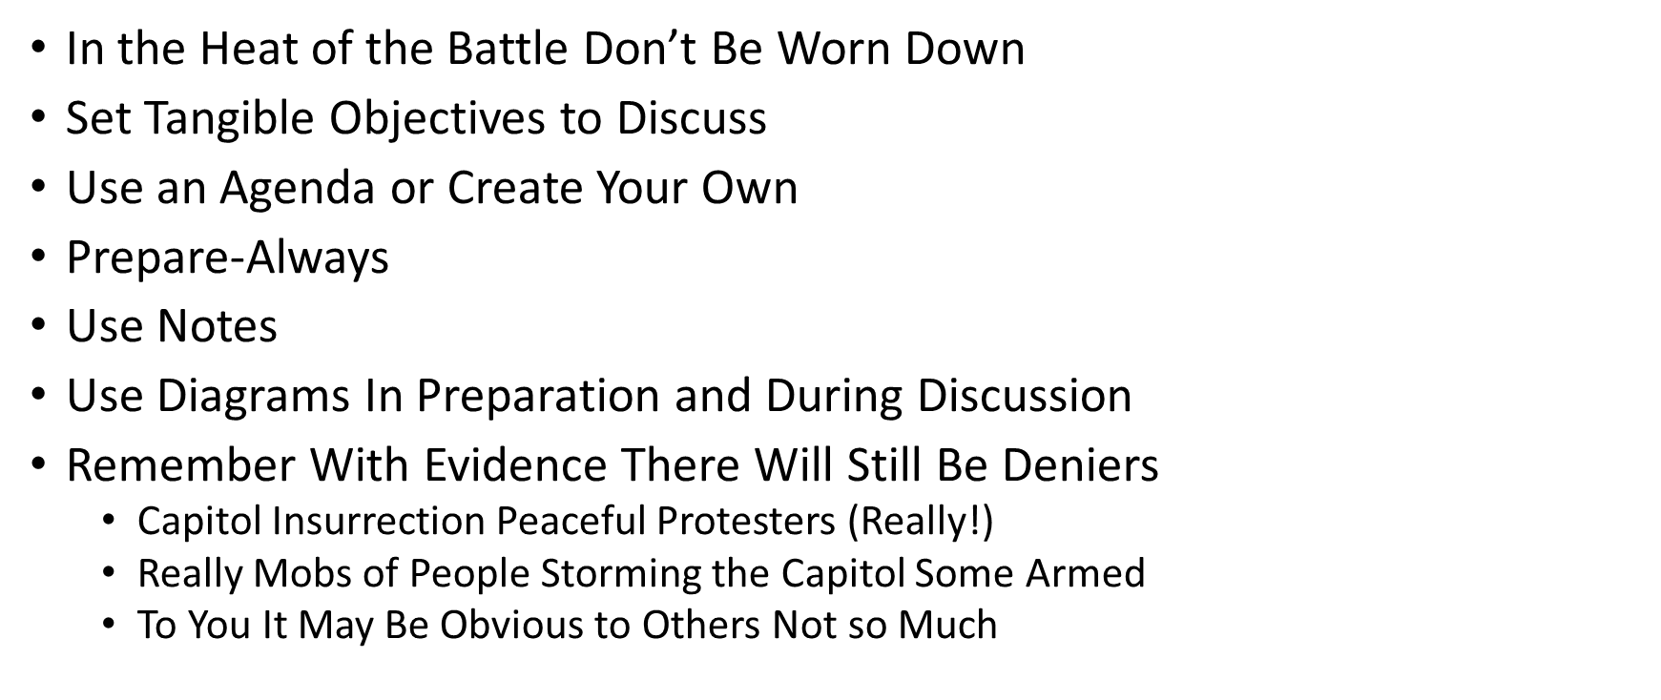
Questions To Counter Punch

Slide 26
Counter Punch
Anchoring
  Did You Have A Good Day today versus How was Your Day? (Answer in the Question)
Bully Man and Woman
  Bully In the Alley-Hit them With A Brick
  Growing In The Alley in DC
Sometimes the Answer is No
  SCJ Kentanji Jackson Brown on When A Child Is Conceived
    No as in No I am not going to answer that question

Slide 27
Counter Punch
Clarify With Easier Examples
Try and Figure Out If People Have a Baseline of At Least of What You Are Talking About
  Background In Procurements
  No Background Use Simpler Examples
Sometimes the Answer is OK and Just Move On
Listen Carefully and Listen Fully

Slide 28
Counter Punch
Be Open to Suggestions and Recommendations
You Are Right (Except When They Took Your Money)
Know What You Are Talking About and Answers to Your Questions
  Before You Ask Them
Know When You Have Won the Argument/Discussion or Battle
  This Is What You Will Hear
  Remember Some People Enjoy the Debate-You Have to Also
  That’s Enough
  Let’s Table That
  Silence

Slide 29
Harvard Case Method Diagnosing
Problem
Causing the Problem
Evidence
Solutions (Short and Long Term)
Risks
Director’s Brief
Then I Need to Know How To Respond

Slide 30
Exactly What To Say
I Don’t Have Time
It’s the Wrong Time
I Don’t Have the Money Right Now
Avoid A Loss
  My Mommy and Her Hair

Slide 31
Exactly What To Say
Just One More Thing
Working on the Lesser Objective
  Start On The Bigger Objective to Get to The Smaller Objective
Have A Primary and A Secondary Objective -Pivot if Necessary
Just Ignore It
If I Can Will You
Before You Make Up Your Mind
Use Peer Pressure

Slide 32
Exactly What To Say/Peer Pressure
Most People
  Others
  Confidence(Peer Pressure Creates A Sense of Confidence)
  Others Success
  Angie’s List, Yelp, Pictures, References
  Review, Details, Engage Other People
  Tiger Woods/Cars in Movies/Competition
Is That Enough
  Anchor Into A Possession and then Say Is That Enough
    Will You Buy It At $45,000 (Car)

Slide 33
I'm Not Sure This Is For You
              Relieves Pressure
              Gives Them An Opportunity to Think It Through
              Everyone Is Offering Something Today Only
              A Decision Needs to Be Made Now
              A Best and Final
              Then You Have the Crazy Boss or Crazy Anybody
              Family, Friends, Business Dealings, Church

Slide 34
Crazy Boss
The White Horse (Michael)
The Lofty Talk
I Am the Greatest Gift
No Results
Extended Periods of Non-Performance
Bragging About Former Positions
Look At Actual Capability

Slide 35
Crazy Boss
Watch Them Try to Manage Everything
  Fall Behind
  Isolated Staff
  Contractors
  They Were Too Slow
  Total Fiasco
  Watch Turnover
Encouraging People To Leave
One on One (Michael) WW III (life Had Already Prepared Me)

Slide 36
Crazy Boss
Don’t Assume The Person In the Job Can Do the Job
  Bragging About Who They No-The Past
Don’t Assume Lofty Talk Is Correlated With Capability, Performance, or Results
Look Out for What Tactically You Have to Do to Accomplish the Objective
What Are the Satisfying Criteria

Slide 37
Crazy Boss
People Will Put their Head In the Sand
Make Them Respond
Drive the Discussions Vehemently
Counterpunch Effectively
Easier Just to Ignore It (the Boss)

Slide 38
Crazy Boss
Call Them Out With The Counterpunch
  If Not They Will Keep Doing It
    Asking Your Neighbor to Not Block Your Driveway
  Be Serious, Firm, and Direct, Hurt Their Feelings (Gently)
    Yes They will retaliate-well it’s a war now engage them directly

Slide 39
Crazy Boss
Throw You Under The Bus To Save Themselves
If They Try That Publicly (little Boss-Big Boss Don’t Do It)
  Counter Punch Them Immediately/Expect Them To Defend and to Retaliate
  Attacking Someone That’s Protected-Consequence Maybe That’s The End
  Make Them Not Want to Do That Again
  Proof In the Pudding/ The Director’s Will Get It
  Expect Their Friends to Rescue Them
    Harvard Guy From Alabama

Slide 40
Crazy Boss
Try and Help Them
  Sean “I don’t Need Your Help” Well You Do
  Failed (Watch Him Cry Leaving the Office (No Weapon)
Look For A Detail
Be Mobile
Take Advantage of Opportunities In the Chaos
Create Your Own Opportunities

Slide 41
Disagreeing With the Boss
Validate or Re-Articulate the Original Point
Don’t Make Judgements
  Tell A Story
  Opinions-Use Facts

Slide 42
Disagreeing With the Boss
Be Realistic About Risks and Stay Calm
Not Speaking Up
  Of Speaking Up
Decide Whether To Wait
  Form An Army
  Timing Is Everything
Identify A Shared Goal-The Manager’s Priority
Ask Permission to Disagree
Now We Can Focus On The Secret Handshake The Politics of the Office

Slide 43
The Secret Hand Shake
  Identify the Relevant Players, Get to Know Them, Talk to Them, Socialize With Them
  PUURR
    Pause, Understand, Reflect, Re-Interpret (Alternative), Re-Direct
  Identify Objections & Deal With Them Early
  Find Ways to Give Credit
  Balancing Act
    Does My Solution Resolve Senior Management Problems
    Who Looks Good or Bad
    Can You Re-shape A Solution That Actually Meets the Organization’s Needs.

Slide 44
The Secret Hand Shake
  Confident But Don’t Overdo It
  Perceptions Are More Powerful Than Reality (45)
  Grooming
  Office or Office Space
  Voice
  Slow Down
  Fit Your Actions to the Times-Culture and Do you Fit

Slide 45
The Secret Hand Shake
  Know the Game
  Anticipate Moves
  Ten Steps Ahead of Them
  Become An Expert
  Remember There Are Few Opportunities and A Great Deal of Competition
  How Do You Stand Apart/Compete

Slide 46
The Secret Hand Shake
  Compliment Someone Who Expects You To Attack (Rivals)
  Art of the Successful Counterpunch (Punch Back But Subtly)
  Faint Praise
  People Have Reactions
    Competition

Slide 47
The Secret Hand Shake
  Questions They Have
  Is This Person Smart
  Will They Make Me Look Bad
  Will They Be Promoted Before Me
  Does the Director/Manager Like Them

Slide 48
Secret Handshake
  What’s In It For Them
  Asking For Something
  Does My Proposal Respond To Senior Management’s Concerns
  Who Looks Good?
  Who Look’s Bad?
  Who’s An Ally or Not?
  Reshape Your Ideas Into the Needs, Desires, and Concern of Others
  Now Buy In

Slide 49
Buy In
  Ways People Kill Your Ideas
    Fear Mongering
      Raising Doubts
      Undesirable Act
      Frightening Consequences

Slide 50
Buy In
    Other(s)
      Money-We Can’t Afford It
      Exaggerating the Problem
      Your Proposal Goes to Far-Over Kill
      It Won’t Work Here
      Idea Is Un-inspiring
      Not Enough Preparation Homework

Slide 51
Buy In
    Let Them Attack You
      Do Your Homework-Cite Examples and Sources
      Get Peoples Attention With Your Opening Remarks

Slide 52
Buy In
      Simple
      Common Sense Avoid Complex Arguments
      Show Respect
      Self-Confidence

Slide 53
Influencer
  Harness Peer Pressure
    Compare Behaviors,
    Identify Differences in What’s Expected
    Identify Results Oriented Behavior
  Design Rewards and Demand Accountability
    Fair, Equitable, Discussed Up Front, Administered In a Timely Fashion
  Create A Village
    Formal and Informal leaders Encourage Vital Behaviors and Confront Negative Behaviors
    Look For Real Time Feedback
    Changing Minds
      Has to Be Achievable

Slide 54
Buck Up Suck Up
What Do You Do When You Have Made A Mistake
  Address It Quickly
  Explain Why It Happened
  Discuss What You Are Doing About It
  Talk About How You Have Prevented That From Happening Again
  Say Subtly That It Will Never Happen Again
  Better to Give Me A Chance to Fix It Than Not
  Make It Safe For People to Talk to You

Slide 55
Buck Up Suck Up
Acknowledge
Move to Your Point
Come Back to Their Point and Answer the Question
Listen I understand that is a Problem and then the Pivot
Survey The Land-Literally (Conduct Formal and Informal Surveys) Of Issues Then Talk (With Research As A Foundation and Support).
Talk In Threes (Use Three Good Examples)
Stay Strong and Unwavering
Stay On Point Give the Same Answer Over and Over

Slide 56
Laws of Success-Tolerance
  Patience
  Understanding
  Seek To Understand and Then Understood
  Crucial Conversation
  Negotiation
  Watch Out For Anchoring
  Respect Other’s Position/Views/Perspective (You Don’t Have to Agree)
    But You Have to Get the Job Done
  Analyze Your Prejudices and Biases

Slide 57
Laws of Success-Failure
  Temporary Defeat
  Allows You to Get Better
  Strength Grows Out of Resistance (No Pain No Gain)
  Set Backs
  Turning Points
  Crucible Events
  My Story

Slide 58
Laws of Success-Substitution
    Something Good Will Happen To Replace A Failure or Disappointment
    Fire Makes Iron
    No Struggle No Growth
    Create Stretch Goals
    Try It/Try Something
    Test It
    Use Small Increments

Slide 59
You Can’t Quit and You Can’t Get Out the Game
    Games People Play
    Cycle of Life
    Competition
    Counterpunch
    Crazy Boss
    Buy In
    Influencer

Slide 60
You Can’t Quit and You Can’t Get Out the Game
    Organize Yourself
    Take Action
    Be Responsible, Assess, and then Revise
    Now Play The Game

Slide 61
References
          Buy In- John Carter
          Crucial Conversations -Kerry Patterson
          Influencer- Joseph Grenny
          Secret Handshake- Kathleen Reardon
          Winning The Psychology of Competition-Walker
          Games Mother Never Taught You
          Laws of Success-Napoleon Hill
          Exactly What To Say Jones

Slide 62
Biography
Dr. Cartwright is the President and Owner of Systamatic LLC a Program and Project Management Company. With 37 years of Federal Service and 11 years as an Adjunct Faculty Dr. Cartwright is an expert in Strategic Management, Program and Project Management, Information System Design, Development and also Financial Management. Dr. Cartwright is a Harvard University Kennedy School Senior Executive Fellow and holds dual Doctoral degrees in Information Systems and Management from the University of Sarasota, the Master of Business Administration from Florida Tech and dual Bachelor degrees in Business and Health Care Administration from Towson University. Dr. Cartwright’s is a graduate of George Washington University’s Senior Executive Development Program, a Project Management Professional (PMP) and a certified Business Relationship Manager (BRM). His interests include playing the Piano and Remodeling Houses.
Oswaldcartwright.com (301) 437-6128

