Slide 1
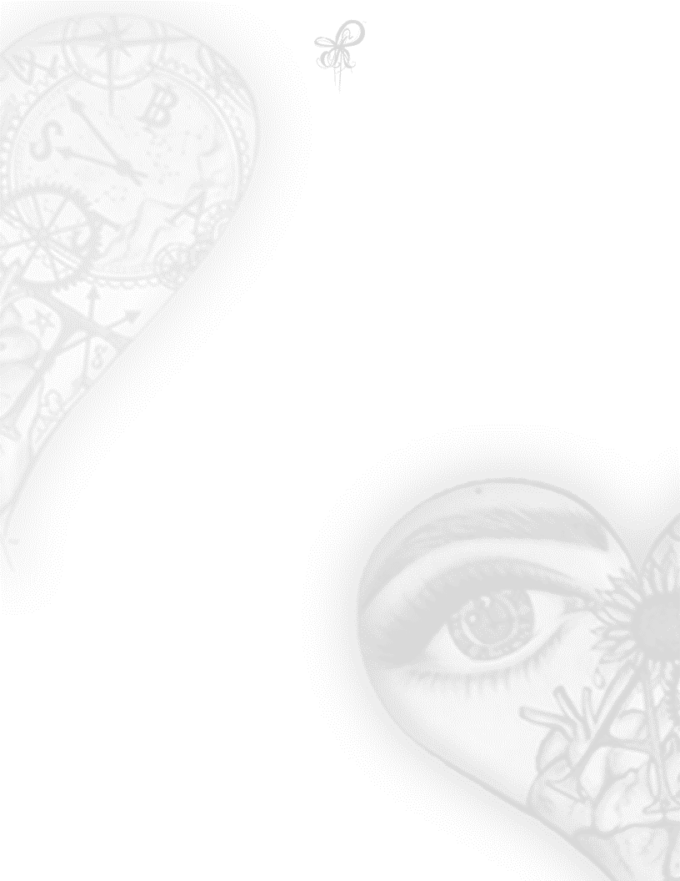
Colorless World
She was born
Into a colorless world with horns
From a heaven where beautiful rainbows adorn
She was raised
In a world that mourns
From the crimes
Where innocent beauty is worn
On the faces of men
From the females whose clothes
They’ve viciously torn
She grew
Into a beautiful rose with thorns
Rides a stallion with a unicorn horn
Guided by the shielded powers
Gifted to her as a newborn
She’s not a woman scorned
but you’ve been warned
#347-1ASP ACILÉGNA SAZARRET

