Slide 1
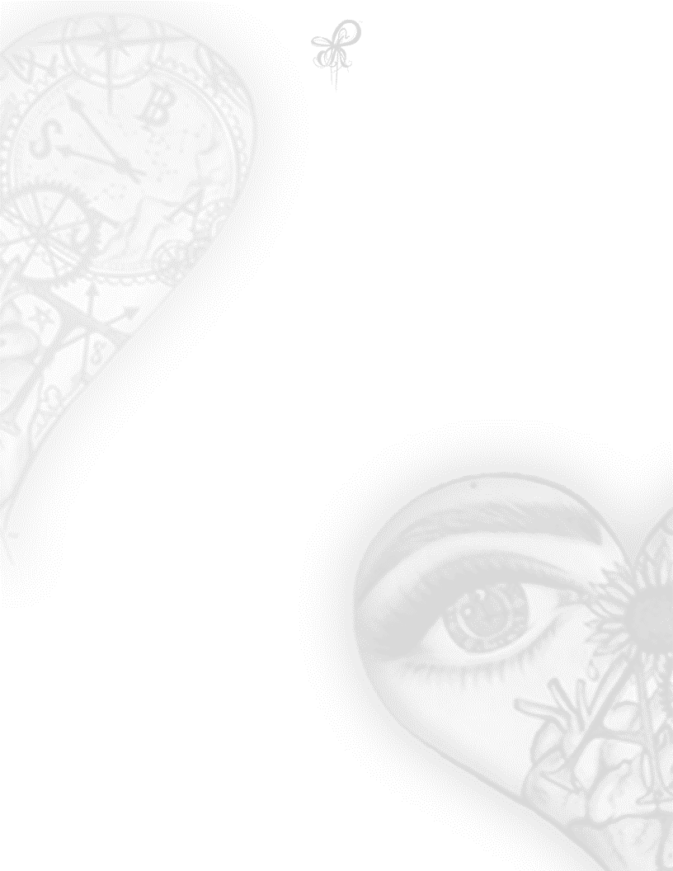
Guts Of Evil
The Devil guides
Their human eyes
To find luscious prey
Who do you trust
When the guts of evil
Have human cravings
at nights and the lights of day
Women are turned into ragdolls
Forced to play in a human dollhouse
They’re made small
With the tricks designed
By the lovers of human trafficking
So that evil can stand tall
Robbers of human innocence
Married to cannibals
They eat the flesh of innocent minds
Of fresh blood, they have wined and dined
Filthy humans whom live in a pigsty
A dirty shanty, they shamelessly deny
#353-1ASP ACILÉGNA SAZARRET

