Slide 1
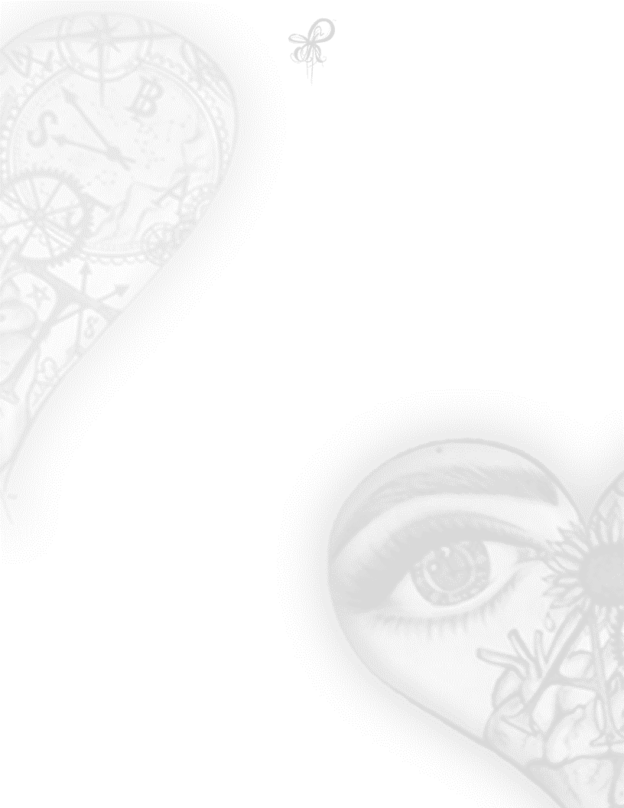
She’s Worth More
Eternal love,
To her- he swore
At a very young age,
he got her knocked up
He promised
The moon and the stars
But he kept her locked up
She’s worth more!
More than humiliation
More than a slap
To the face and a whip to the back
Leaving her beat and sore
All promises broke
At the gifts of the beatings she wore
and he thought she’d adore
She’s worth more!
#346-1ASP ACILÉGNA SAZARRET

