Slide 1
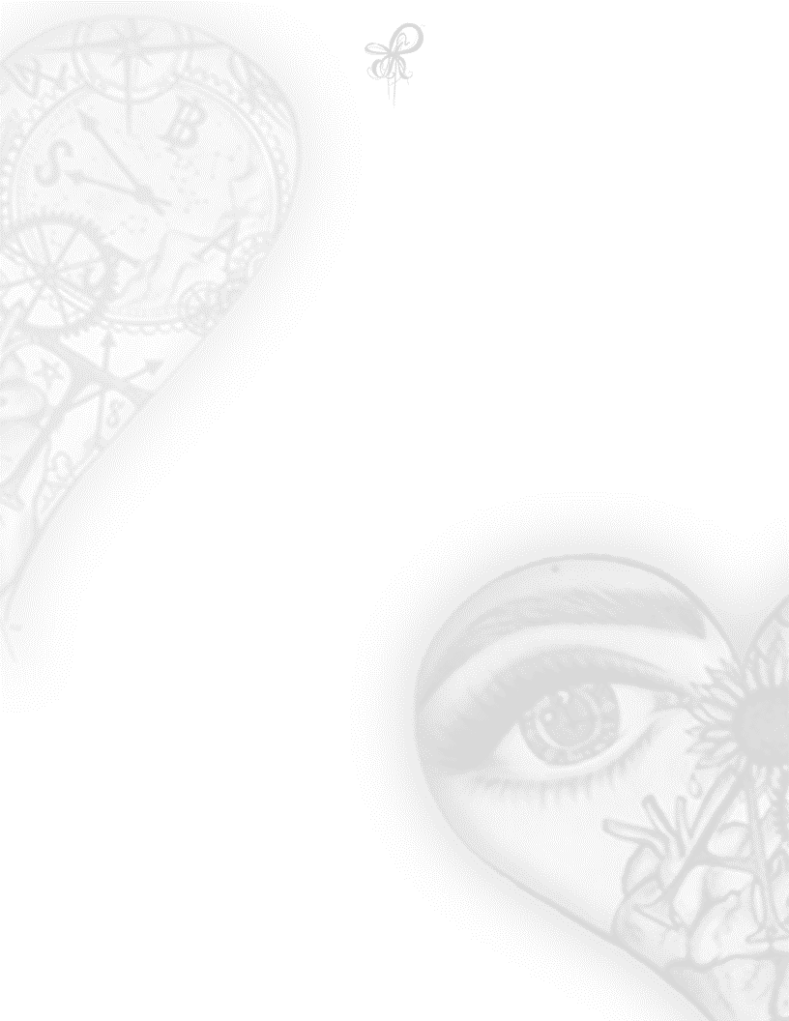
Silhouette
I withdraw stacks
To place on the tables
I let you call the shots
You love to turn heads
So our love, I want to test
Gambling my love
Is the game I play best
Tell me-
Are you willing to place bets
Would your eyes spin
on a ride of Russian roulette
with my silhouette
Tell me-
Are we like Romeo and Juliette
Would you too, die of poison shots
If you thought me to be dead
#345-1ASP ACILÉGNA SAZARRET

