Slide 1
Palm Beach Baseball Umpire Assn.
The Electronic Rules Book

Slide 2
Returning members can use their old hard copy
Rules Book and make sure they have noted any new
rule changes for current year.
Rules Books can be purchased from
NFHS for $10 + shipping.
In the future NFHS will not be printing Rules Books.

Slide 3
The NFHS has released the NFHS Rules App, which is available via iTunes and Google Play. The NFHS Rules App contains quizzes for all NFHS sports.
THE APP IS FREE.
One way to study for the exam is to utilize the NFHS free app quizzes.

Slide 4
The FHSAA Rules Exam will not have
‘trick’ questions but word for word
straight from the Rules Book, questions
are from the NFHS.

Slide 5
Finding electronic books on nfhs site
ARBITER SIGN-IN:
CLICK ON
NFHS CENTRAL HUB
CLICK ON PUBLICATIONS TAB
CLICK ON THE SPORT
CLICK ON LINK
2018 NFHS Baseball Rules Book

Slide 6
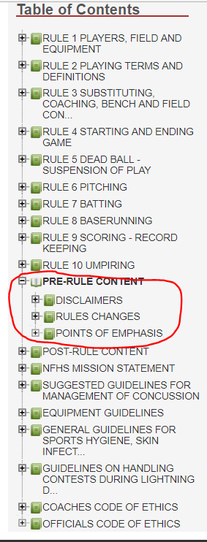
The ‘Rules’ are listed first in
Electronic Table of Contents.
‘Rules Changes’ and ‘Points of Emphasis’ are found under PRE-RULE CONTENT.

Slide 7
if needed, Use the search box.

Slide 8
After searching a word or group of words
a list of rules/penalties appears containing the ‘search’
To find exact location of the ‘search’ within this list, you would then need to use ‘Ctrl F’ on the computer.

Slide 9
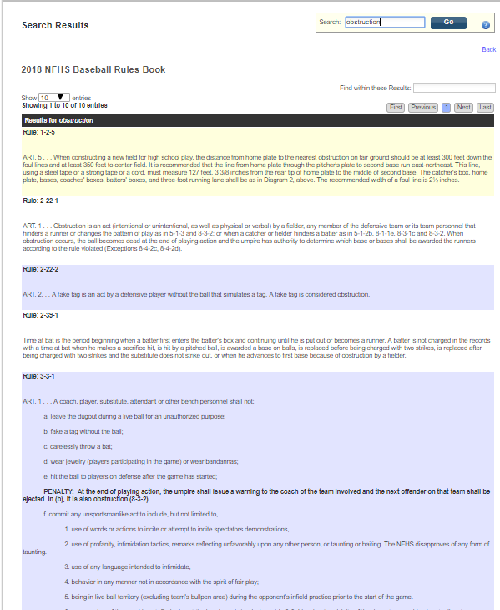
All the rules/penalties that contain
‘obstruction’ appears but the word
‘obstruction’ is not highlighted.

Slide 10
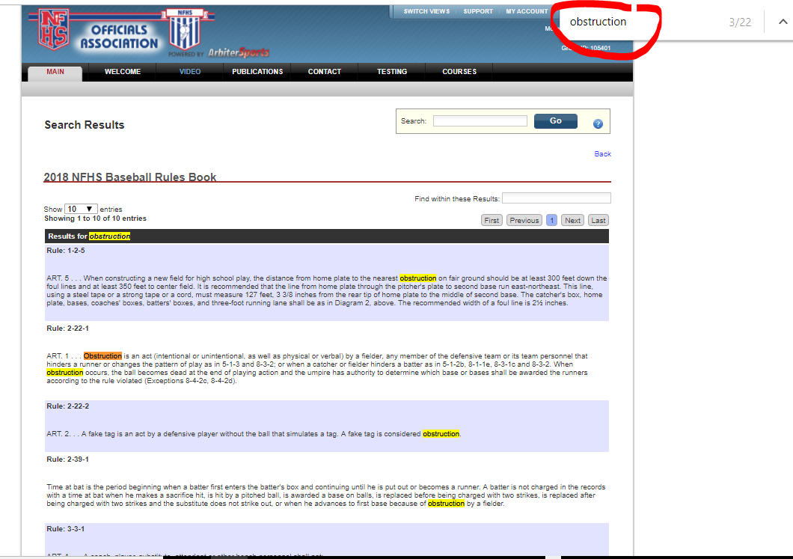
Use ‘Ctrl F’ on your
computer and another
search box will appear.
Type ‘obstruction’ and all
will be highlighted.
(Hold ‘Ctrl’ key down as
you hit the ‘F’ key)

Slide 11
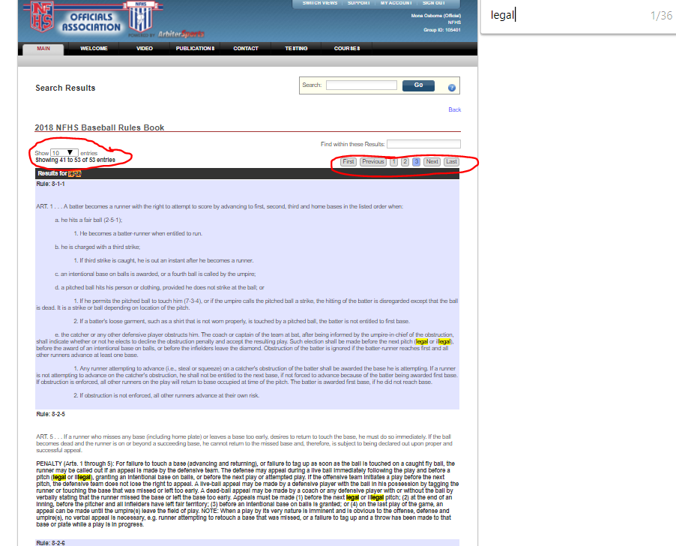
Be sure to check the top or bottom of the page after you run a ‘search’ in case a word is in the book more than can be listed on one page. In this example the word ‘legal’ comes up 53 times and there are at
least 3 pages of listings. If there are more than 3 pages the extra pages will show as you click succeeding ones.

