Slide 1
Game Assignment Program

Slide 2
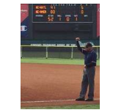
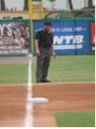
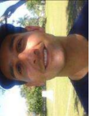
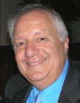
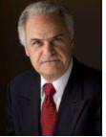
PICTURE IN ARBITER
You are required to upload a photo in Arbiter. Let Mona know if you cannot and she will do for you at a meeting.
Top row are not good examples. Bottom row is. Should not be in uniform,
wearing sun glasses, hats or writing on clothing. Torso or Head shot (shoulders & up) are best.
Be sure picture uploads correctly, not sideways. First two photos can’t tell who they are.

Slide 3
LEARNING ARBITER
If you are new to Arbiter don’t wait for the last minute to learn how to use it. It will be helpful to go in and browse around…try different options on your calendar and travel limits for example.

Slide 4
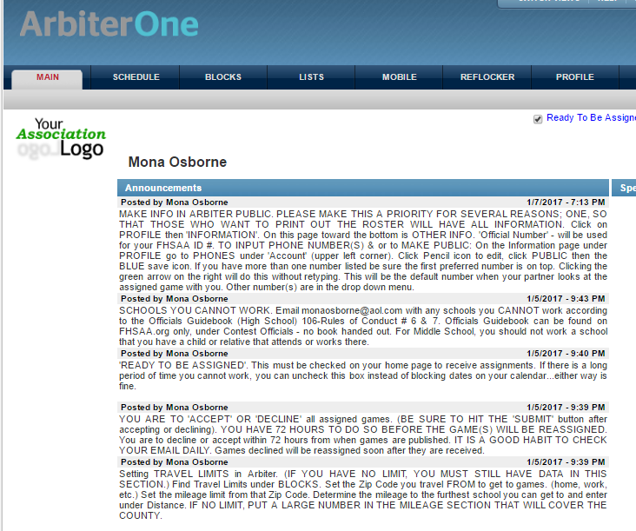
ANNOUNCEMENTS
Read the ‘Announcements’ on MAIN page for additional information.

Slide 5
TRAVEL
Must fill out Travel Limits info. Click on ‘Blocks’ then ‘Travel Limits’.
In the example above: Official travels from home to games Tues-Sat. Home Zip Code was entered – 33406 then Distance of 50 miles. Tuesday through Saturday was checked off and APPLY was clicked to enter this info.
On Mondays the official is in Ft. Lauderdale and the Zip Code for there is entered. From there the official can only make a game within 20 miles and that is entered. Monday is checked and APPLY clicked to enter this info.

Slide 6
TRAVEL
Travel Limits for a DAY apply to every DAY throughout your calendar.
Example: If you have a limit just one time and say it was a Tuesday,
restriction will apply to ALL Tuesdays. It is best for a ‘one time’ situation to use the
calendar’s time blocks. (Slides 6-10)

Slide 7
TRAVEL
Using your Travel Limits, ARBITER CALCULATES
you ARRIVING 30 minutes before Game Time.
Example: Even if you have an unlimited Travel Limit (a large # like 100 to cover the county) and you are coming from your job in Boca (Boca Zip Code should be posted) and you are blocked to 6:00…you will NOT show available for a 7:00 game in Jupiter. Arbiter calculates 45 min to travel to Jupiter from Boca…arriving at 6:45.

Slide 8
CALENDAR
You are required to keep your calendar up to date with any blocks you may have. (Partial time of day(s) or entire day(s) that you cannot work.) This is usually a continual process with most officials because family events , work related issues, etc. happen after blocks are created; other blocks may come up or a blocked day may become open…making you available.
ALL DAYS by default are OPEN until you make a change with BLOCKS.

Slide 9
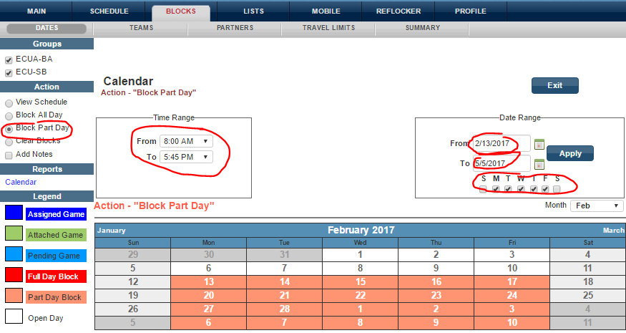
CALENDAR- Partial Day(s) Blocked
EXAMPLE above shows blocked from 8AM – 5:45 M-F. You can’t work games earlier than 7:00. Arbiter calculates you arriving at 6:30. You will show available for any school within 45 min of zip code entered in Travel Limits.
Click on Block Part Day – choose Time Range you CAN’T work then
the Date Range; click off each day affected then hit APPLY. All days within the Date Range
you selected will turn Orange which represents a partial block.

Slide 10
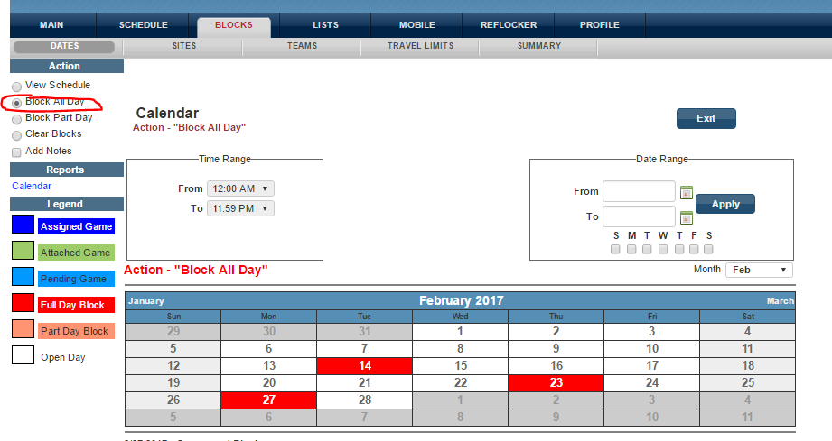
CALENDAR- Full Day(s) Blocked
You can block full days individually or use the date range. To block individually, click
BLOCK ALL DAY then DOUBLE CLICK the day(s). No ‘Time Range’ is necessary, it will
Default to 12AM-11:59PM.

Slide 11
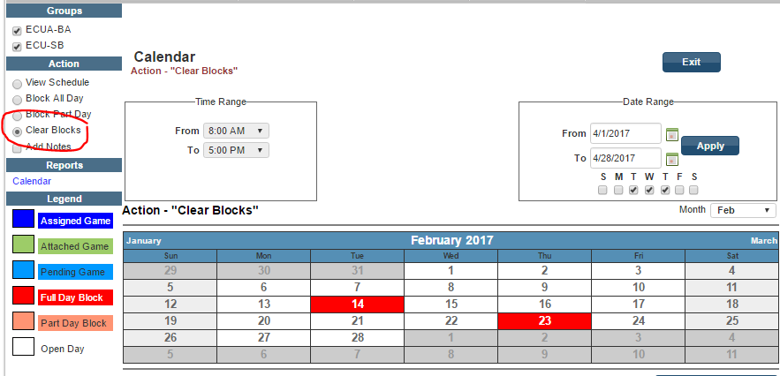
CALENDAR- Clear Blocks
To CLEAR BLOCK(S), check ‘Clear Blocks’ then double click the day.

Slide 12
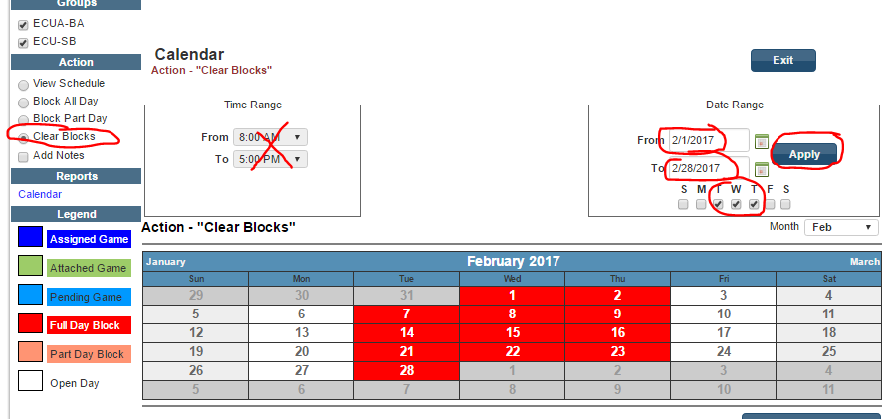
CALENDAR – Clear Blocks
If there are a lot of blocks to clear you can put in the date range and mark the days of the week and hit APPLY - all games will unblock at once.

Slide 13
You will receive an email when you get a new assignment and also a reminder email
three days before each game. CHECK EMAILS OFTEN.

Slide 14
Options to View Schedule and Events
Above is example of the different choices under the filter DATE. GROUP filter will
give choice if you are in more than one group/sport. INCLUDE filter has choice of
GAMES or EVENTS or ALL. (see page 16 of the Member Packet about Events).
DON’T FORGET TO HIT ‘APPLY’ WHEN CHANGING FILTERS.

Slide 15
ACCEPTING OR DECLINING A GAME
Check Accept of Decline and then SUBMIT

Slide 16
DECLINING A GAME

Slide 17
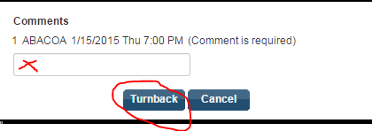
TURNING BACK A GAME
OPTION WILL NOT APPEAR IF WITHIN 72 HOURS.
Call Mona within 48 hours. DAY OF, Call Yetta.
Turnback Assignment
Type ‘reason’, work, etc. (‘personal’ is acceptable), then be sure to click Turnback.

Slide 18
SCHEDULE
Your schedule on Arbiter can be printed out.
Printing it out throughout the season is useful to keep track of when you are paid for a game.
You can print out according to the DATE RANGE you put in.
Example: After each week, you can print out just for that week. Or print out the next week of games for reference of upcoming games.

Slide 19
PARTNER’S INFO #1 Click on Game Number
Schedule of Randy Benhart. Click on the Game Number (435) to see partner’s info.
Note: Randy is the Plate Umpire (PU). Game is at American Heritage (SITE) which is the
HOME team. (Sometimes a team plays at a park. Rarely may play at opponent’s field
because of specific situation.) Important to note the SITE and DATE & TIME.

Slide 20
PARTNER’S INFO #2
After clicking on the game number (435) the partner’s CONTACT information shows.
Clicking on the partner’s name brings up his contact info and address (see next slide).
Protocol is that the PLATE partner contacts his partner AT LEAST 2 days before game
day. IF BASE UMPIRE does not hear from the plate umpire by that time, he is to make
contact no later than day before.
THIS PROCEDURE ENSURES THAT BOTH UMPIRES SHOW UP!

Slide 21
PARTNER’S INFO #3 Click on partner’s name
After clicking partner’s NAME their address shows.
This is useful if the Plate umpire (who is responsible for bringing the PAY SHEET) wants to
fill out the sheet before arriving at the game. (More info next slide about filling out the
Pay Sheet.)
Either partner may bring a pay sheet, but that should be part of the conversation when
confirming the game. Other information to confirm - time of arrival, where partners will
park/meet, shirt color to be worn.

Slide 22
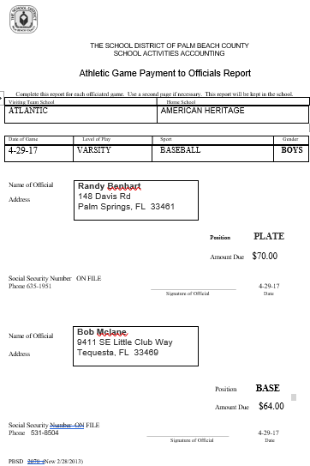
Pay Sheet #1 Sample: Filled out.
Notes:
Copy paste address for pay sheet.

Slide 23
Pay Sheet #2
Be sure TOP portion is filled out correctly.
Notes:
Copy paste address for pay sheet.

Slide 24
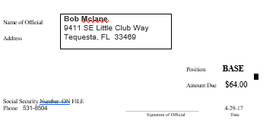
Pay Sheet #3
You can COPY AND PASTE partner’s info to the Word Document of a Pay Sheet.
Pay Sheets are on our web site www.palmbeachbaseballumpires.com
Notes:
Copy paste address for pay sheet.

Slide 25
Pay Sheet #4
PAY SHEETS on the web site are in two formats: Word Doc and PDF.
Pay sheet can be downloaded and kept on your computer.
The WORD Doc is for those that want to type the info in. (Only the signature CANNOT be typed…EACH OFFICIAL MUST SIGN).
Notes:
Copy paste address for pay sheet.

Slide 26
Pay Sheet #5
Suggestion if TYPING info to Pay Sheet.
1. Make Personal Sheets partially filled out; one for JV and one for V and keep on computer and print extras (#5 next page)
a. Fill out LEVEL of Play, SPORT and GENDER.
b. Pre-fill with your info as Plate and one as Base official for each level.
Notes:
Copy paste address for pay sheet.

Slide 27
Pay Sheet #5
Suggestion if TYPING info to Pay Sheet.
3. When you get an assignment and you are bringing the pay sheet then Copy & Paste partner’s info into the box of the Word Doc.
4. YOU SHOULD KEEP BLANKS AND/OR PREFILLED COPIES IN YOUR VEHICLE FOR POSSIBLE LAST MINUTE PARTNER CHANGE OR IN CASE PARTNER FORGETS TO BRING.
5. It is the responsibility for the Plate umpire to bring a pay sheet…but the base umpire can confirm they will bring for the crew.
Notes:
Copy paste address for pay sheet.

Slide 28
SITE
Clicking on Site will bring up the address.
CLICKING ON THE ADDRESS WILL BRING UP GOOGLE MAPS
Notes:
Palm Springs, comes up Lake Worth. Map is correct.

Slide 29
MASTER SCHEDULE To View ALL Games in Arbiter.
IF A SLOT IS BLANK IT IS BECAUSE AN OFFICIAL HAS NOT ACCEPTED OR IT
HAS NOT YET BEEN ASSIGNED.

Slide 30
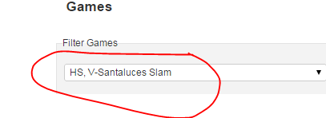
MASTER SCHEDULE
Examples
Filter:
Santaluces PRE-SEASON
Filter:
Santaluces SLAM

Slide 31
EVENTS #1
EVENTS - will be posted in Arbiter. Events can be meetings, practice games, anything besides a Game Assignment. You should accept an EVENT if necessary.
Events in Arbiter are NOT game assignments and will be listed as an EVENT on your schedule.
Practice Games are NOT assigned games and will be listed as an EVENT.

Slide 32
EVENTS #2
An Event may be an announcement and may not need to be ACCEPTED.
If you are required to Accept or Decline an Event –
that request will be posted in the Details of the EVENT.

