Slide 1
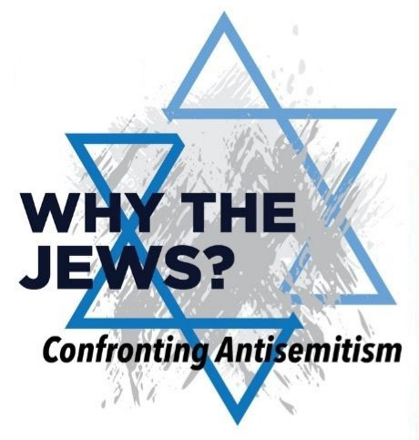
Being a Light Amid Growing Antisemitism
Rabbi Dr. Joshua Brumbach

Slide 2
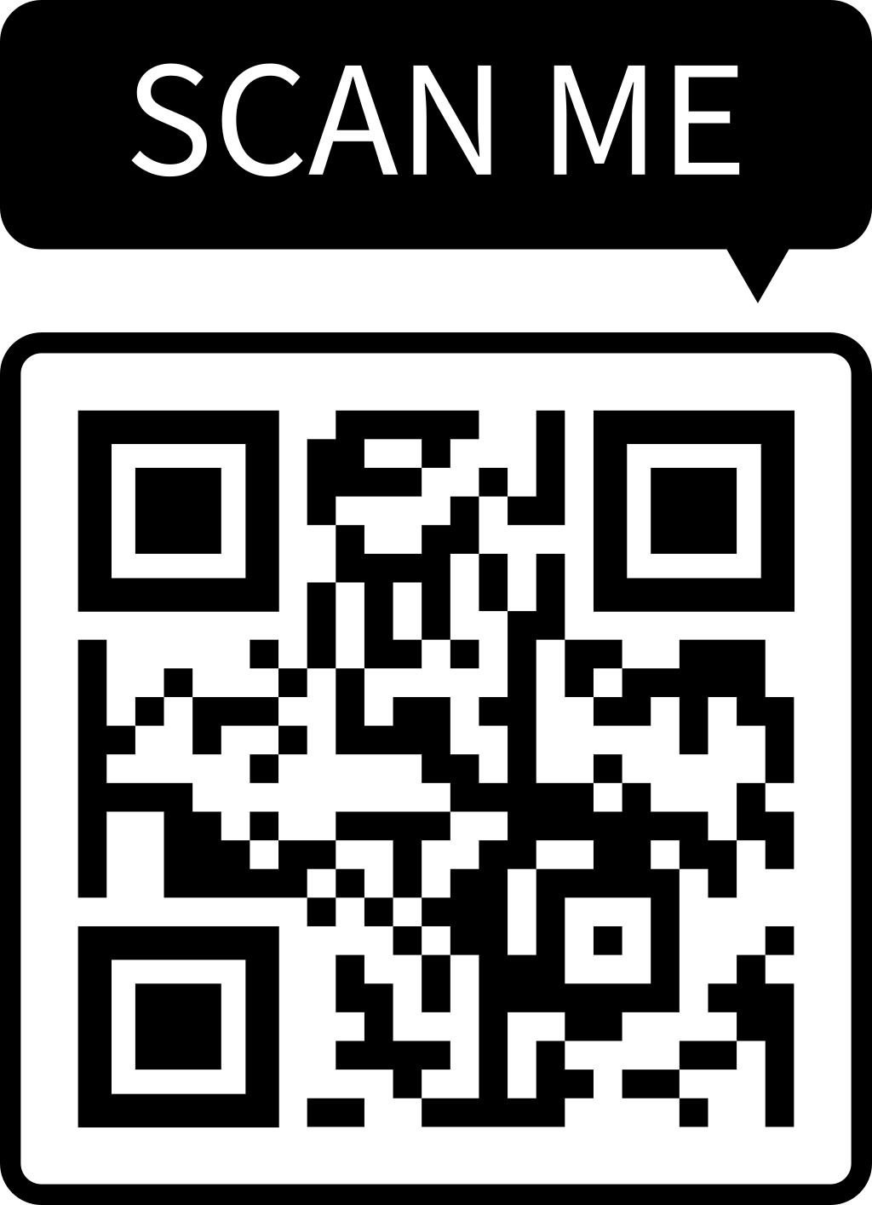
https://joshuabrumbach.com/event-handouts

Slide 3
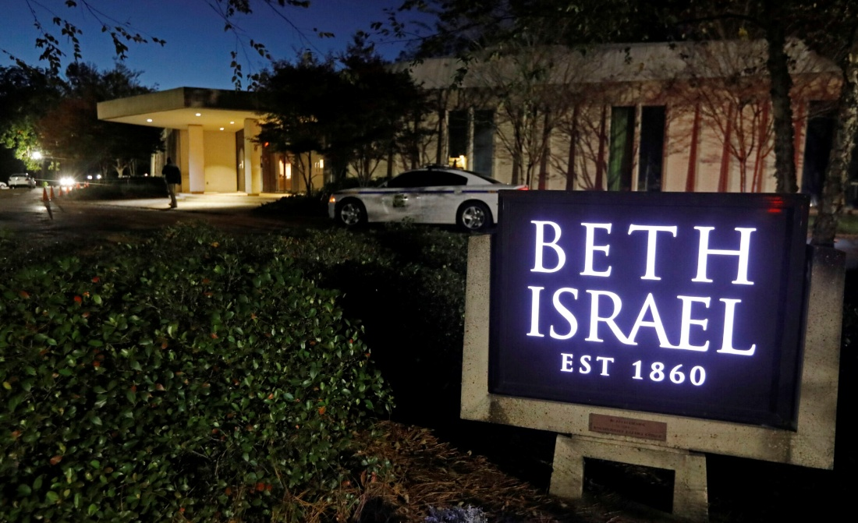
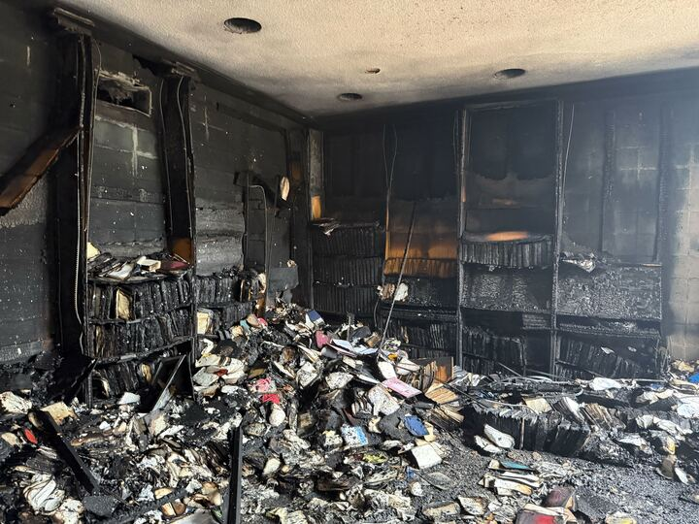

Slide 4
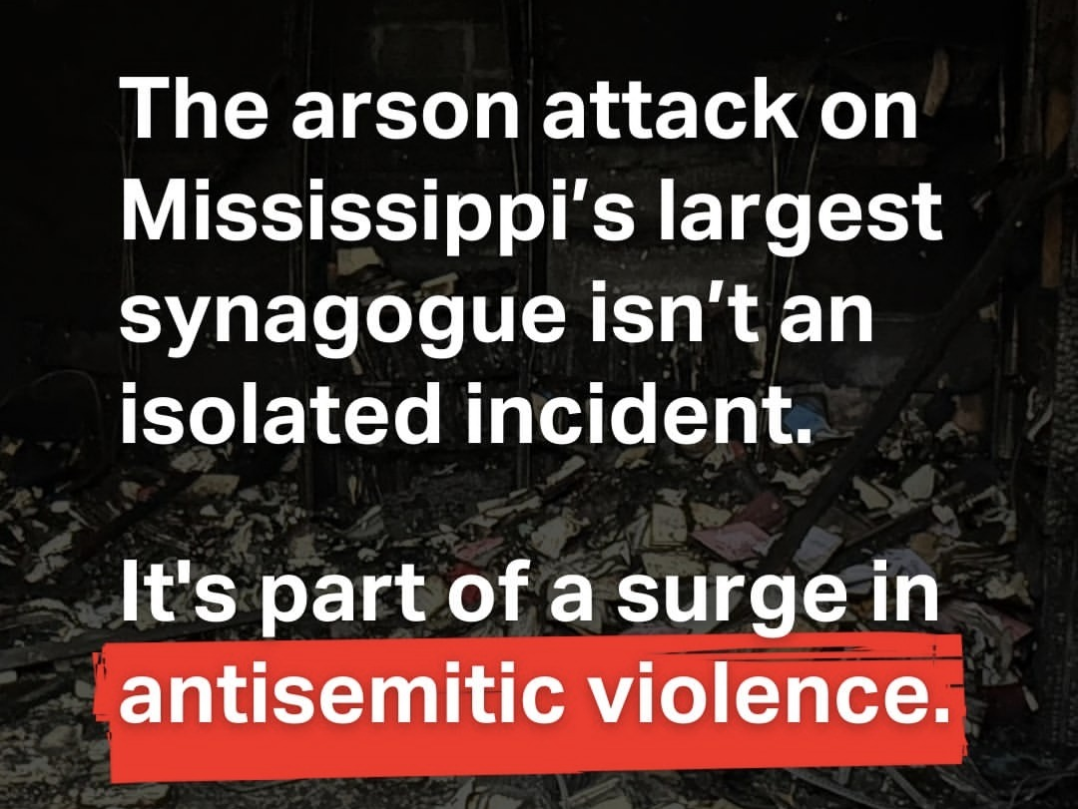

Slide 5
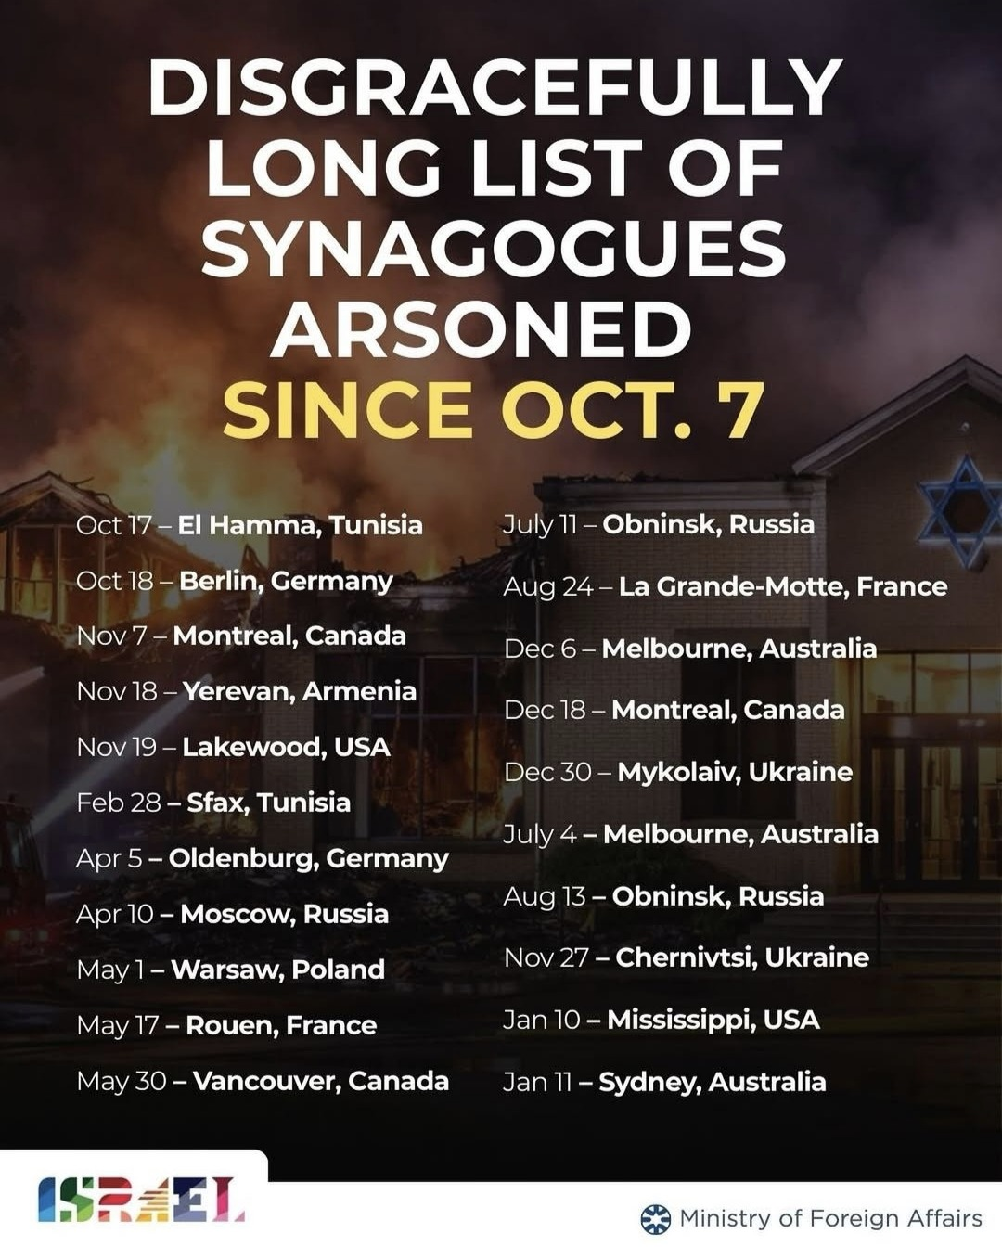

Slide 6
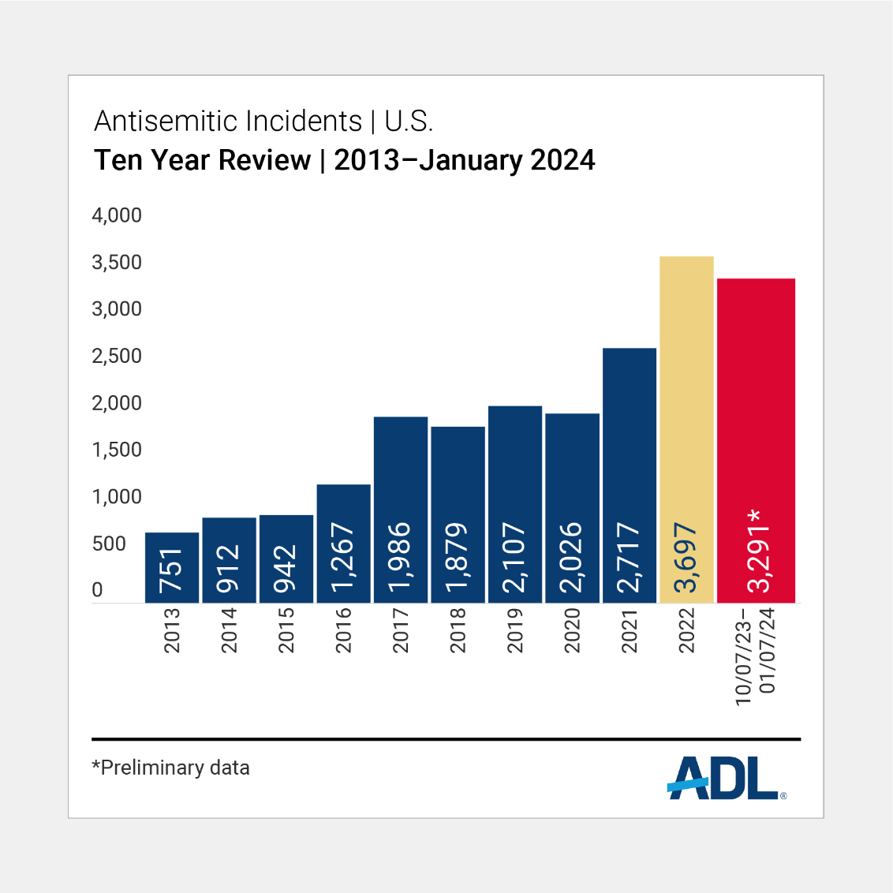

Slide 7
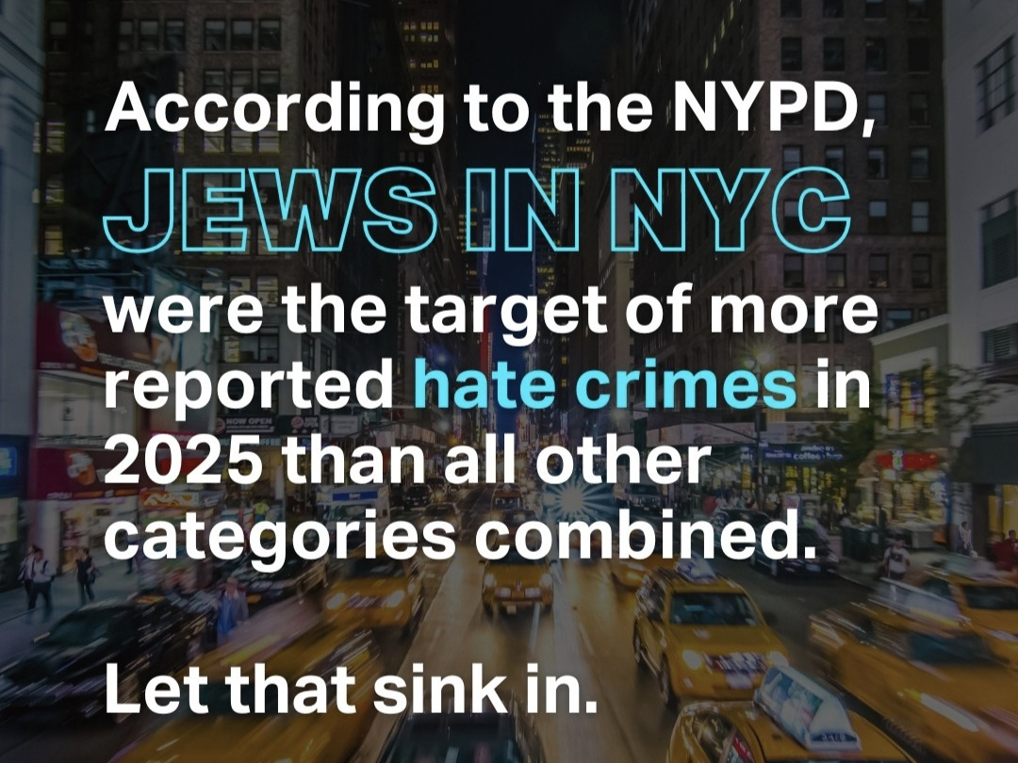

Slide 8
New Antisemitism =
  A new form of antisemitism that often manifests as anti-Zionism.

Slide 9
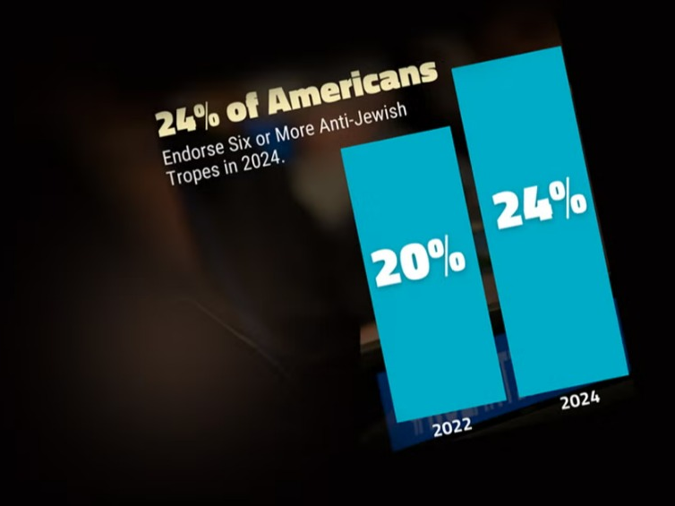

Slide 10
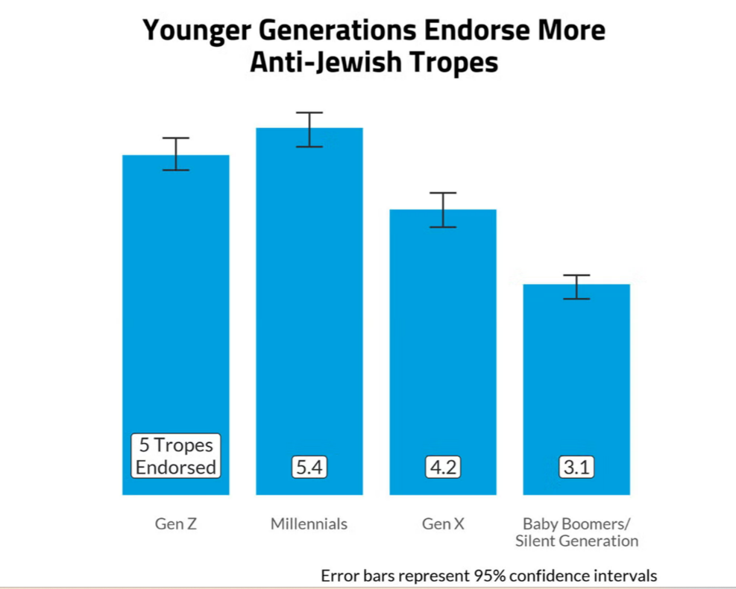

Slide 11

ANTISEMITISM
ON THE POLITICAL LEFT

Slide 12
“Sophisticated Antisemitism”
  Antisemitism on the
  Political Left is packaged in progressive language, masking its antisemitism.
    It pretends to be the opposite of what it actually is.

Slide 13
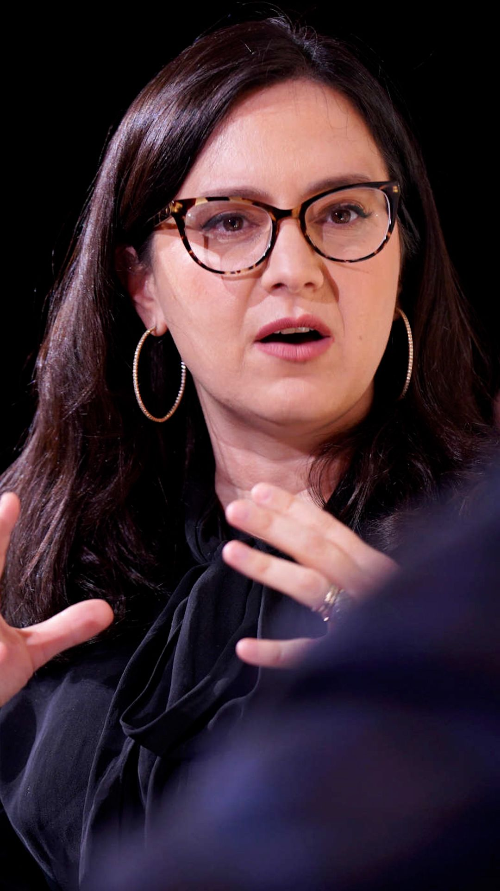
Bari Weiss
“anti-Semitism that originates on the left is a far more subtle and sophisticated enterprise. It’s typically camouflaged in language familiar to Jewish tongues and ears: the language of social justice and anti-racism, of equality and liberation.”

Slide 14
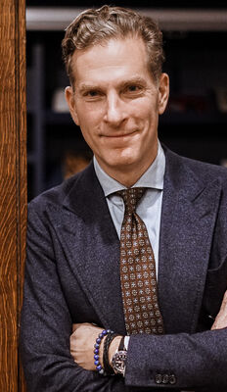
Noah Feldman
“The core of this new antisemitism lies in the idea that Jews are not a historically oppressed people seeking self-preservation but instead oppressors: imperialists, colonialists, and even white supremacists. This view preserves vestiges of the trope that Jews exercise vast power. It creatively updates that narrative to contemporary circumstances and current cultural preoccupations with the nature of power and injustice.”

Slide 15
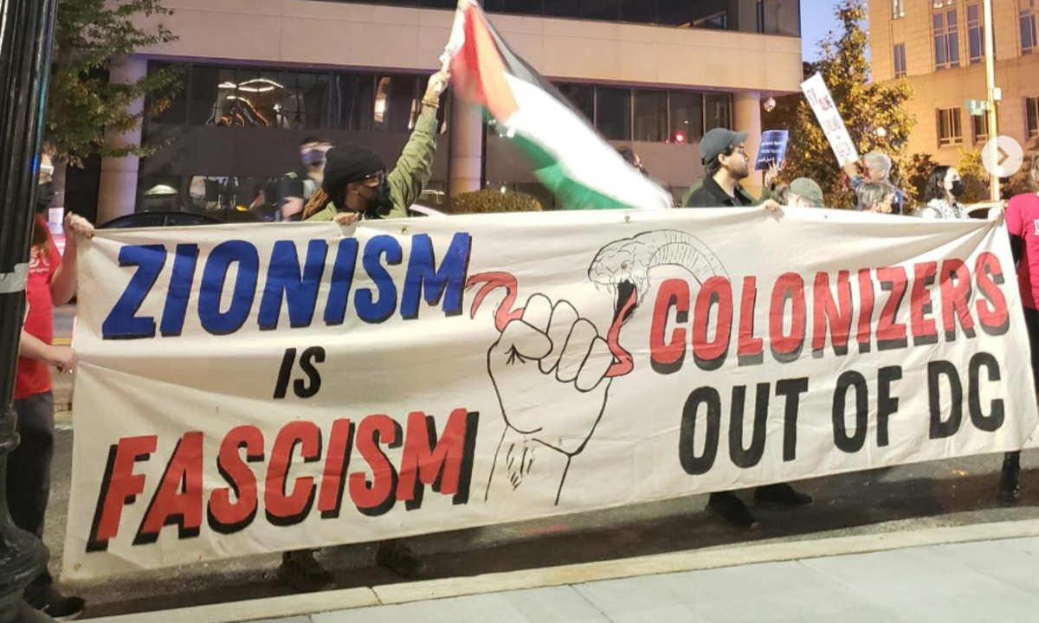

Slide 16
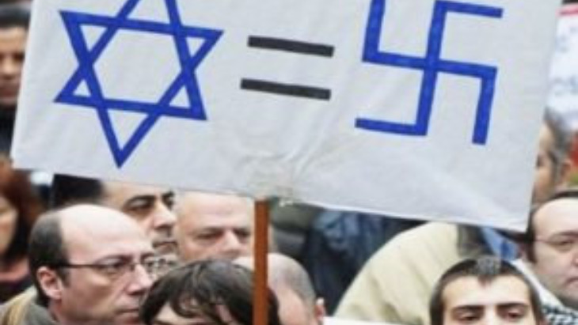

Slide 17


1963

Slide 18
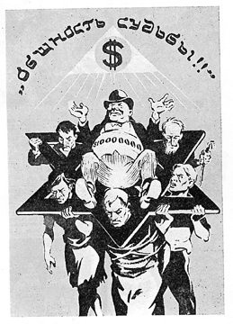
"the existence of a universal Jewish conspiracy involving Judaism, Jewish bankers, Zionism, and Western capitalism"

Slide 19
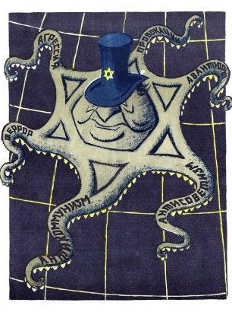
KGB Brochure:
Criminal Alliance of Zionism and Nazism
“Zionists have colluded in genocide against the Slavs, Jews and some other people of Europe.”
1985

Slide 20
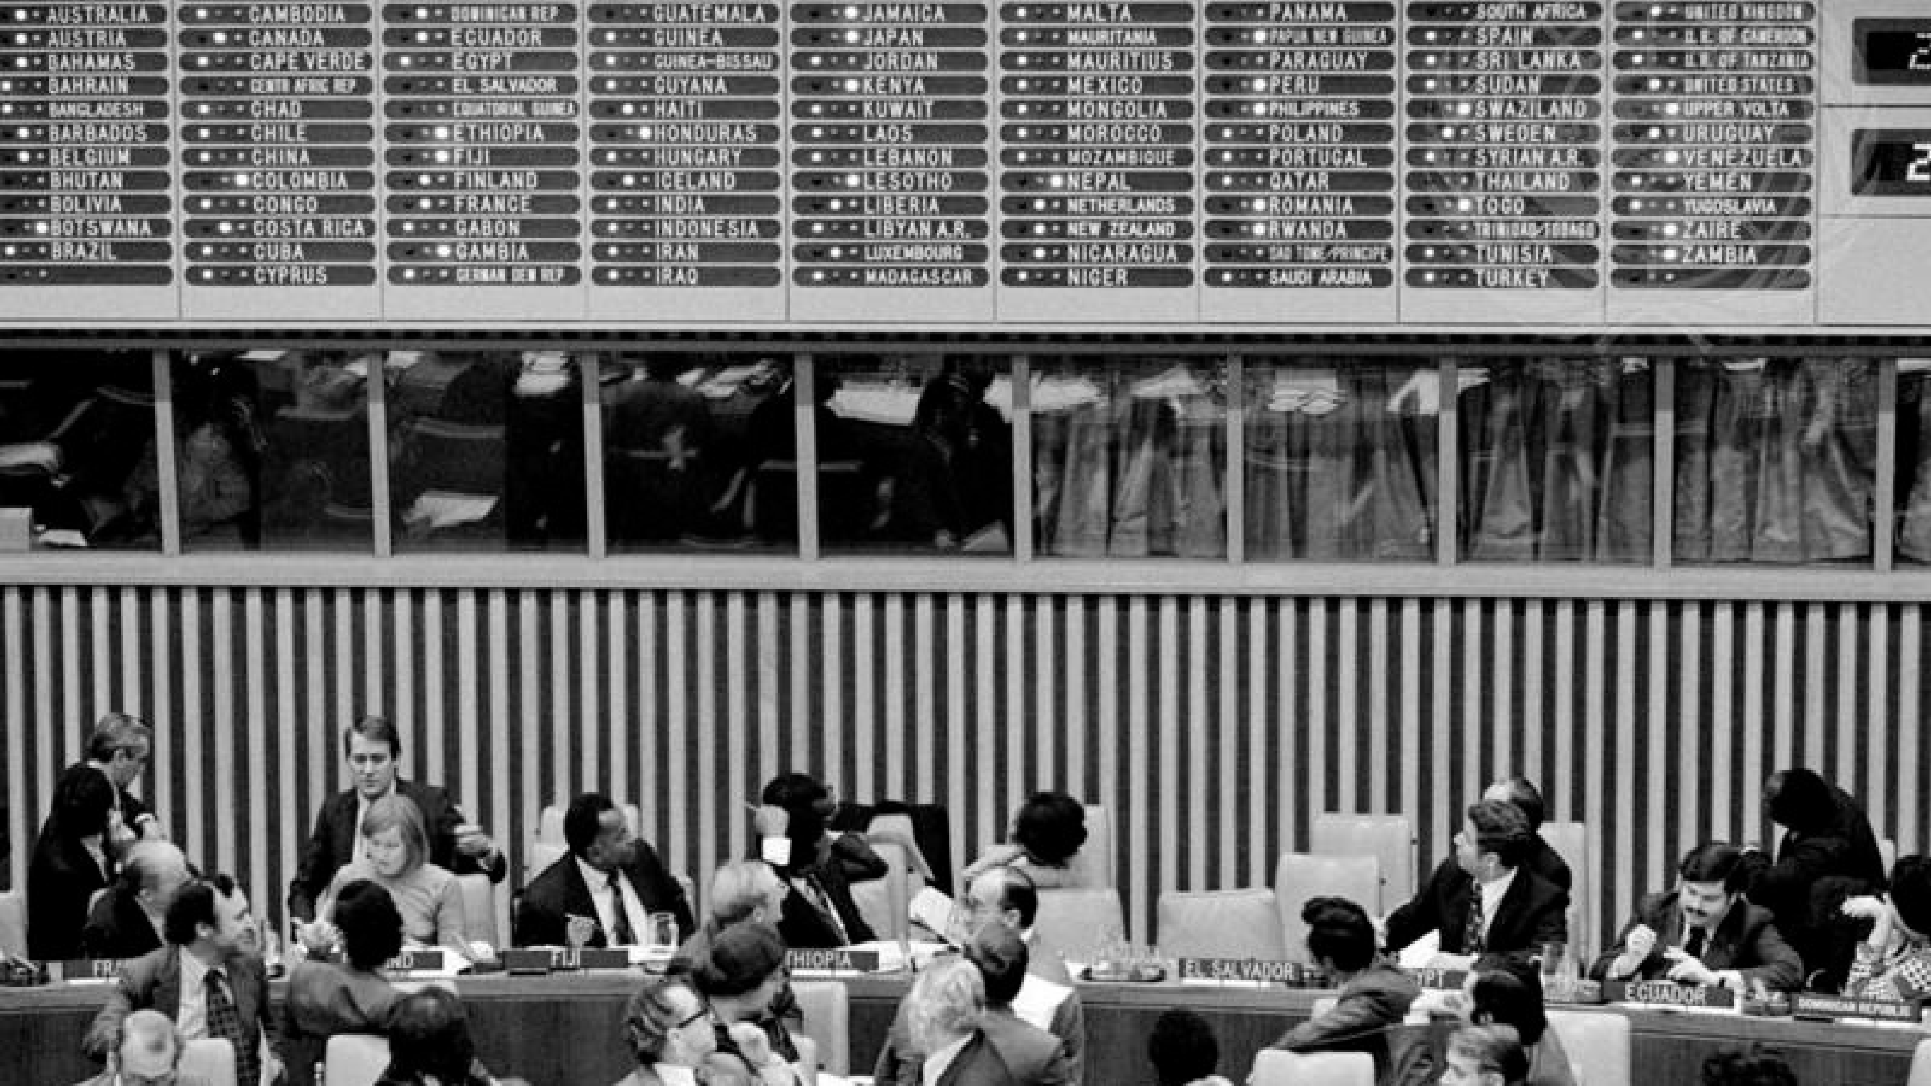
1975 - Zionism is “Racism”

Slide 21
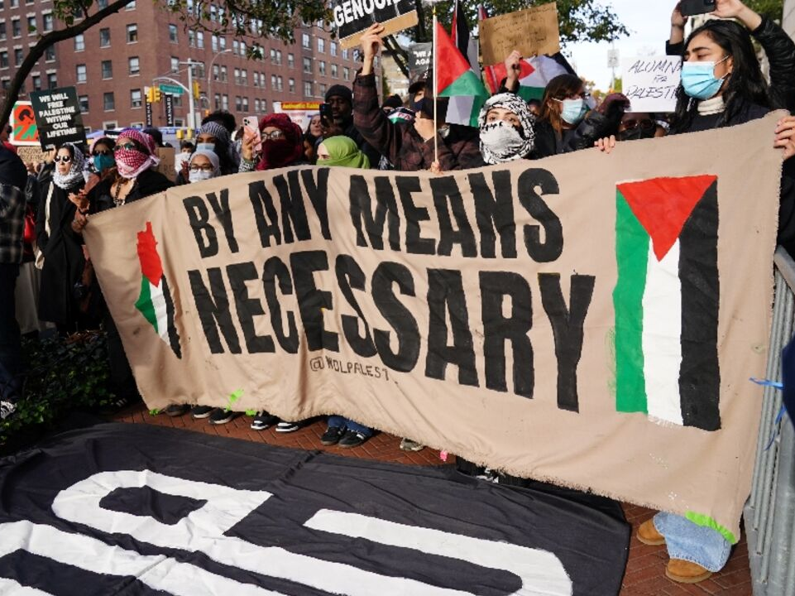

Slide 22
ANTISEMITISM
ON THE POLITICAL RIGHT

Slide 23
“Old-Skool Antisemitism”
  = Jews Have Too Much Power

Slide 24
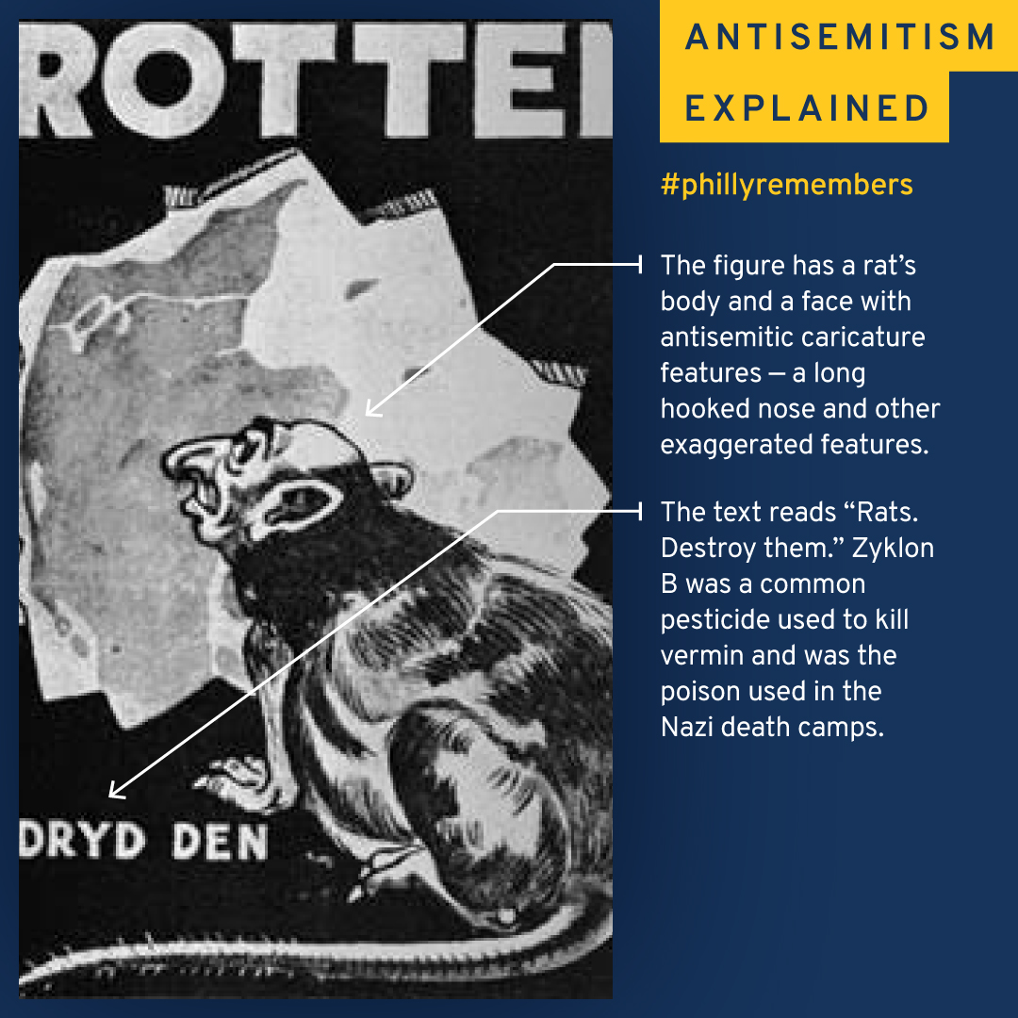

Slide 25
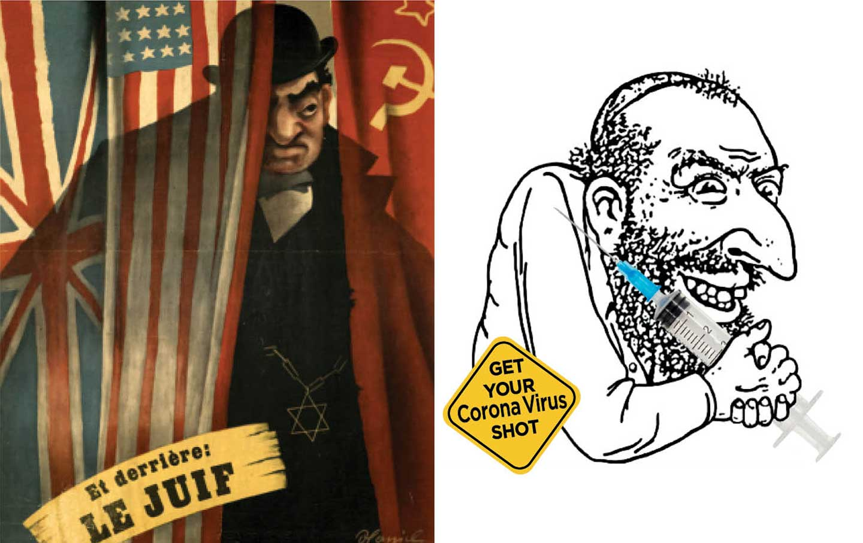

Slide 26


Slide 27
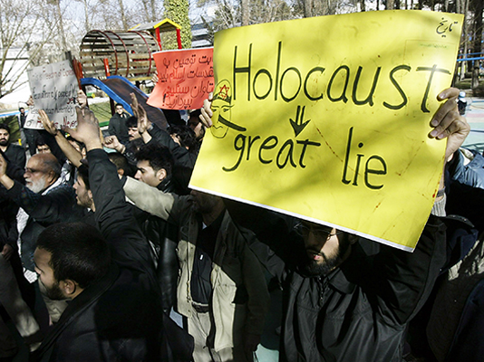

Slide 28


Slide 29
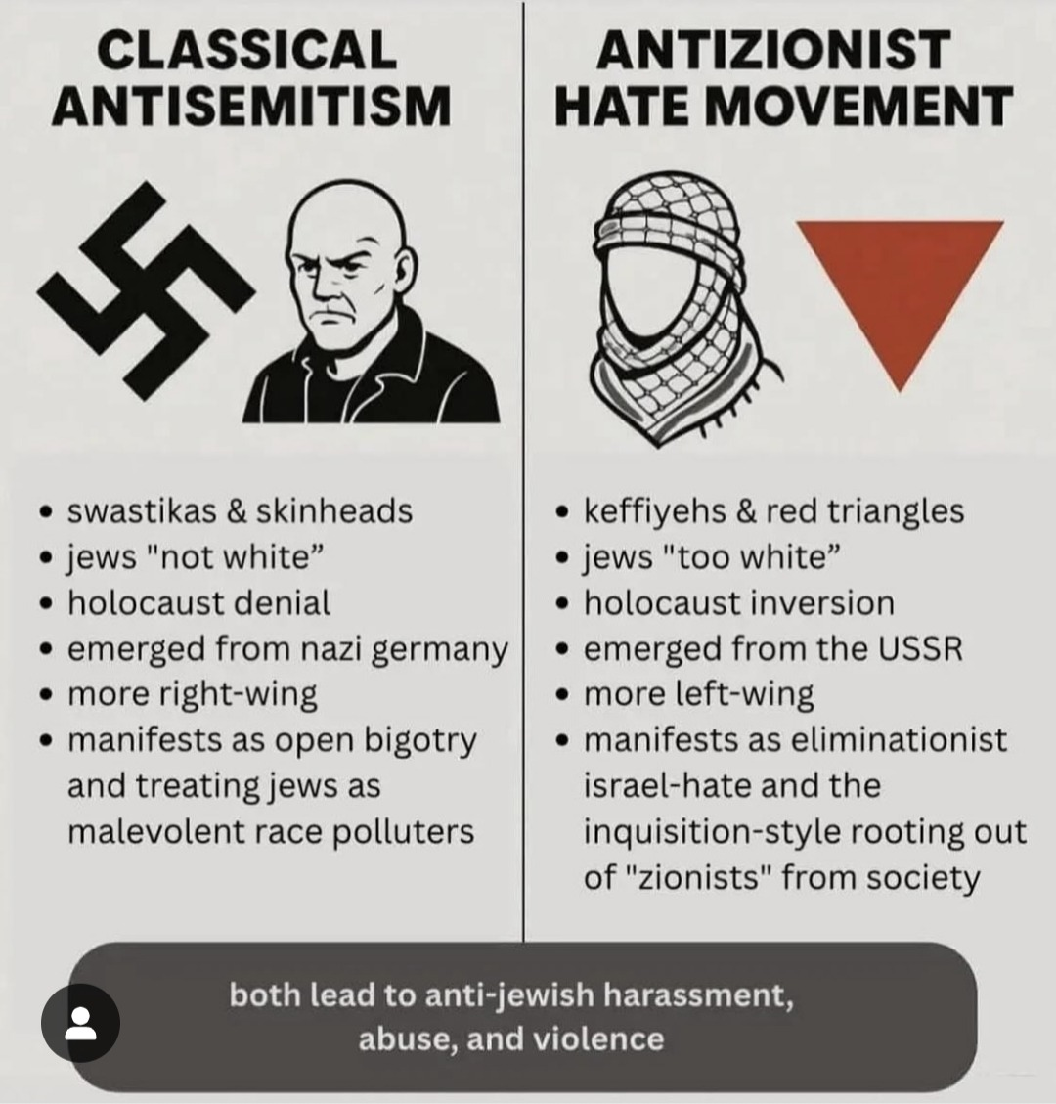

Slide 30
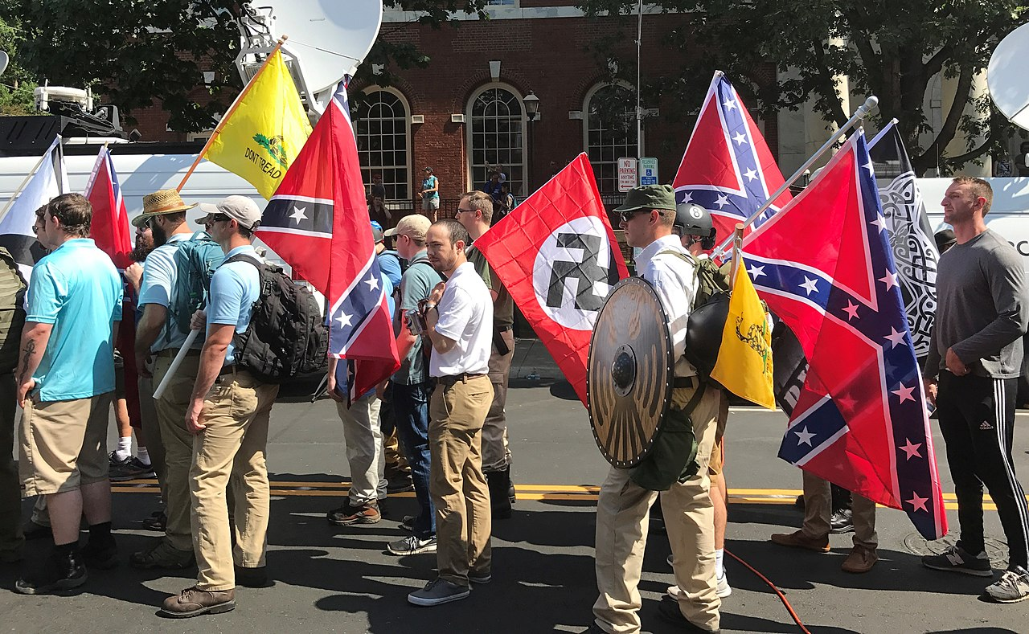
Unite the Right Rally
Charlottesville, VA – Aug. 2017

Slide 31
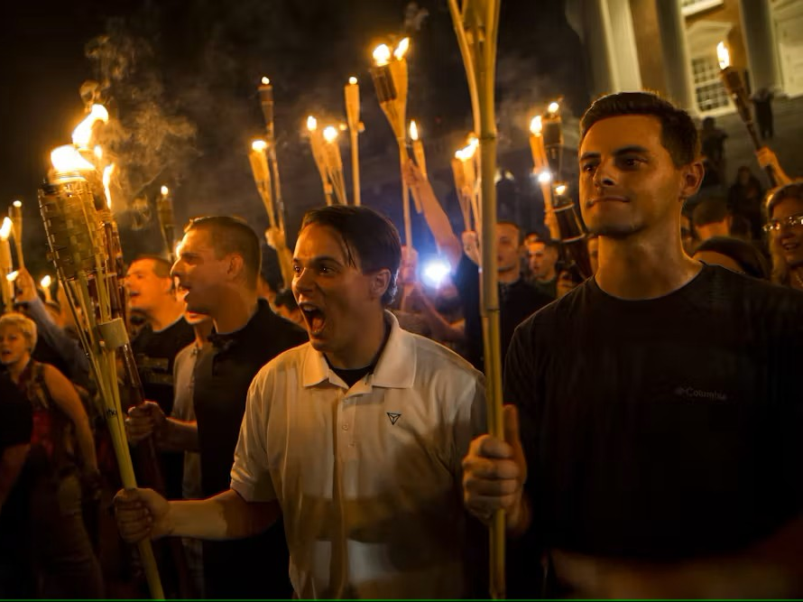

Slide 32
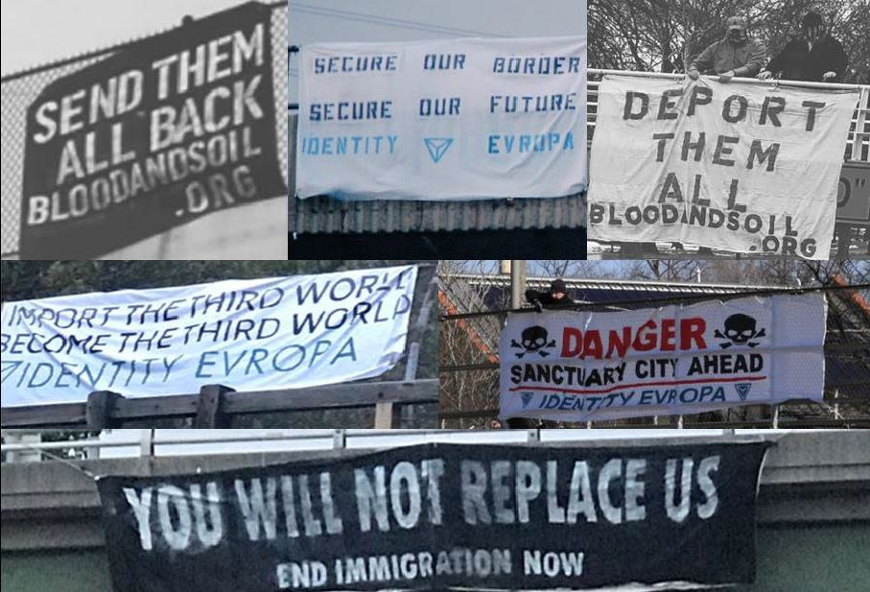

Slide 33
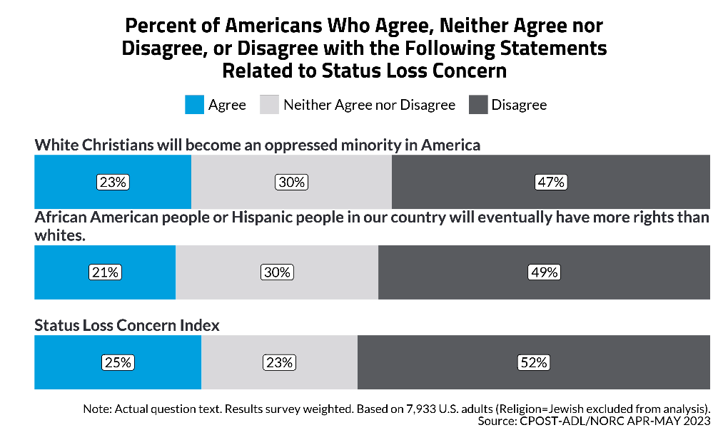

Slide 34

Pepe the Frog

Slide 35


Slide 36


Slide 37
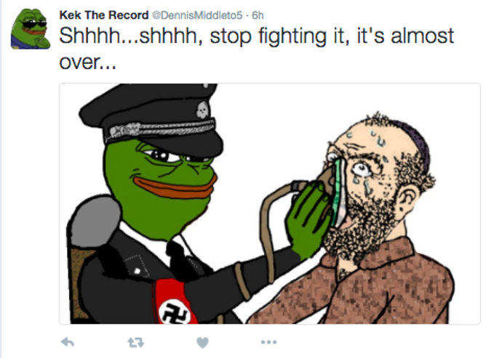

Slide 38


Slide 39


Slide 40
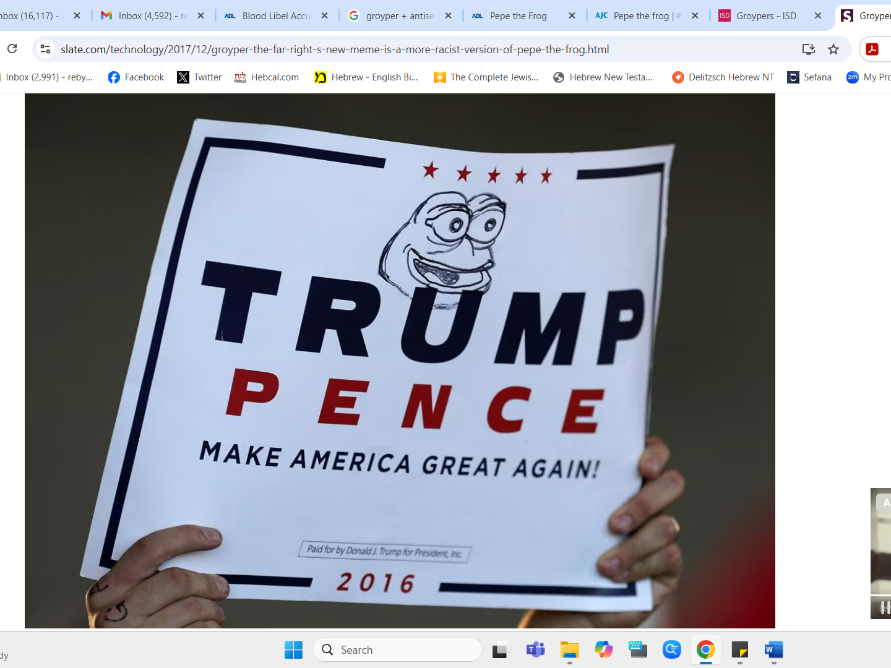

Slide 41


Slide 42
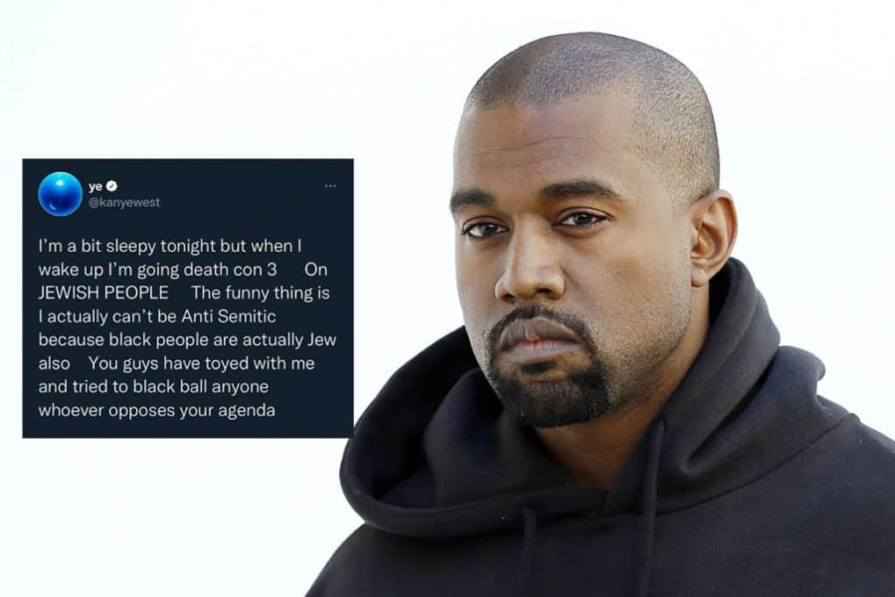

Slide 43
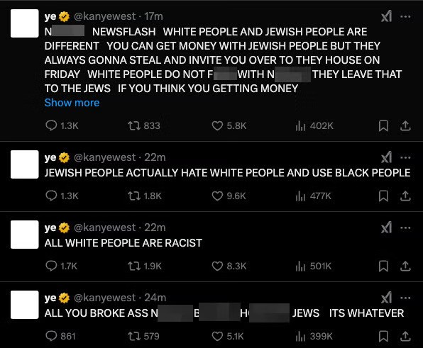

Slide 44


Slide 45
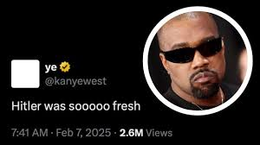

Slide 46
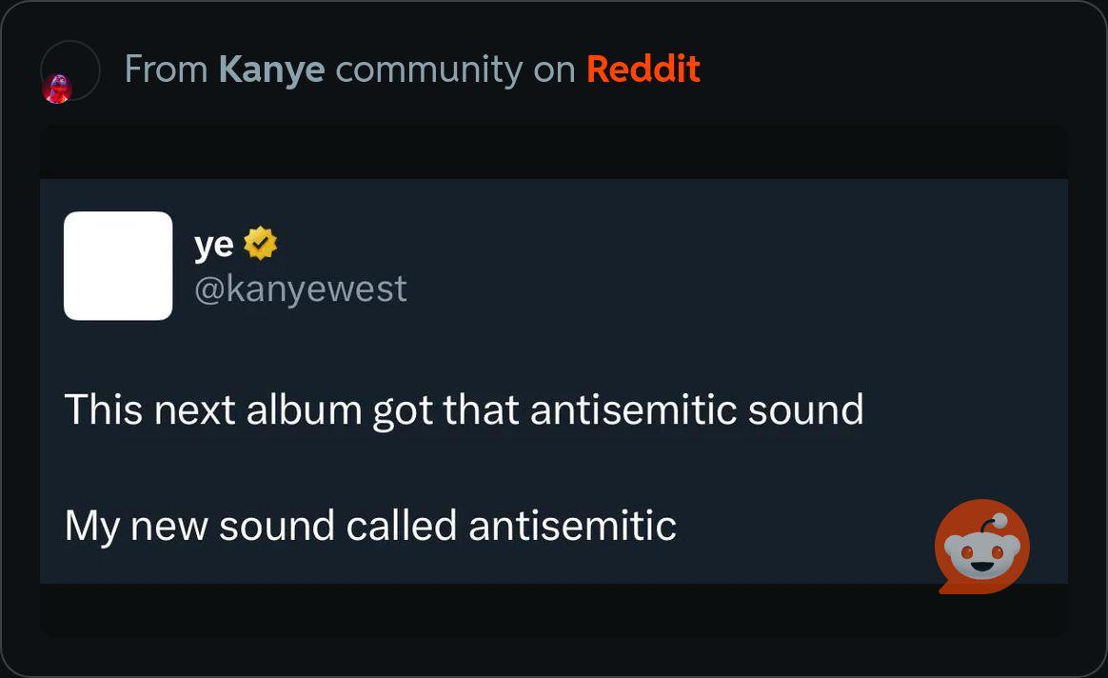

Slide 47
ANTI-ZIONISM
AND ANTISEMITISM
ON COLLEGE CAMPUSES

Slide 48
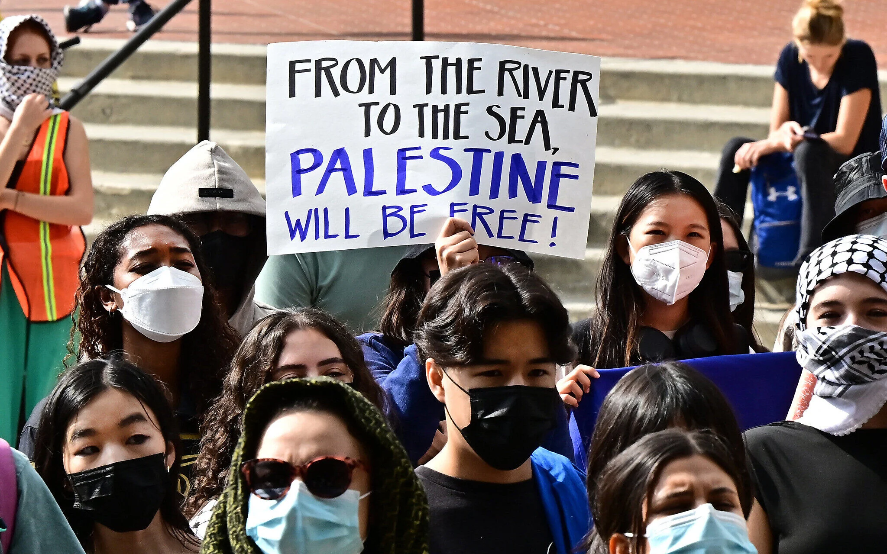

Slide 49
2023-2024 ADL Annual Report on
Anti-Israel Activism on U.S. campuses
2,637 anti-Israel incidents of assault, vandalism, harassment, protests/actions and divestment resolutions between June 1, 2023, and May 31, 2024.
A staggering 628% increase in those categories compared to the same period in 2022-2023.
This marks the highest number ever documented by ADL.

Slide 50
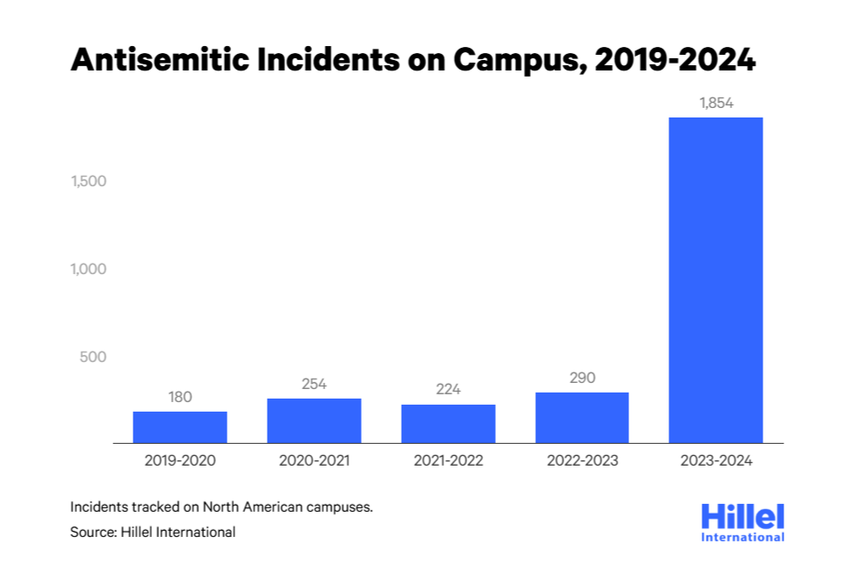

Slide 51
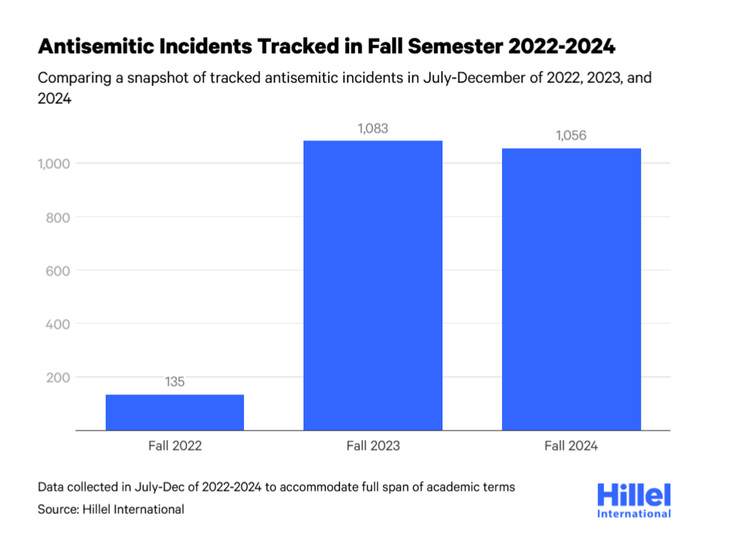

Slide 52
ORIGINS OF ANTI-ZIONISM AND ANTISEMITISM ON COLLEGE CAMPUSES

Slide 53
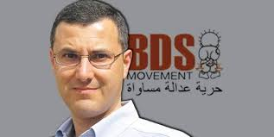

Slide 54
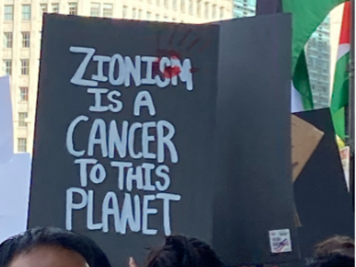

Slide 55
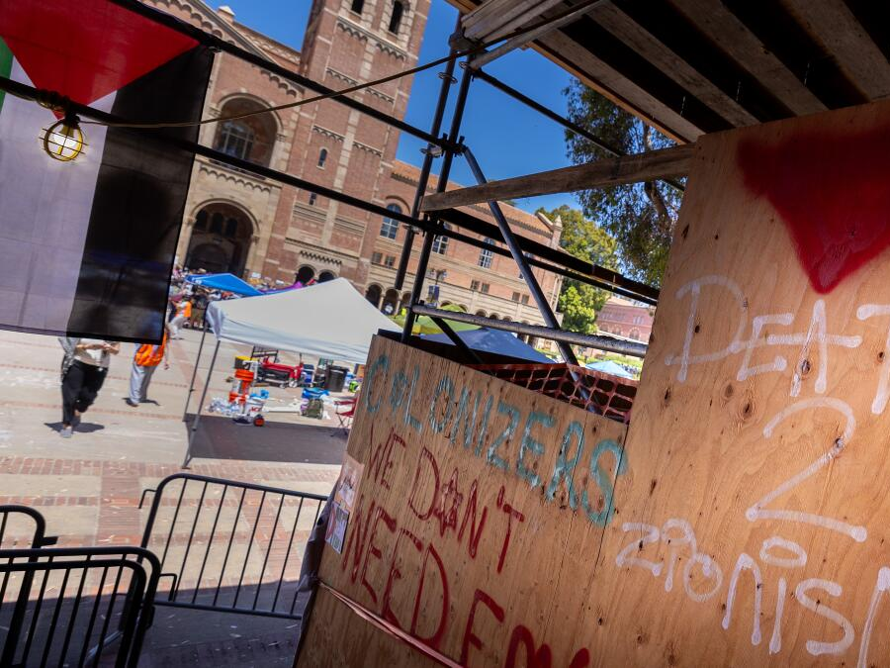

Slide 56
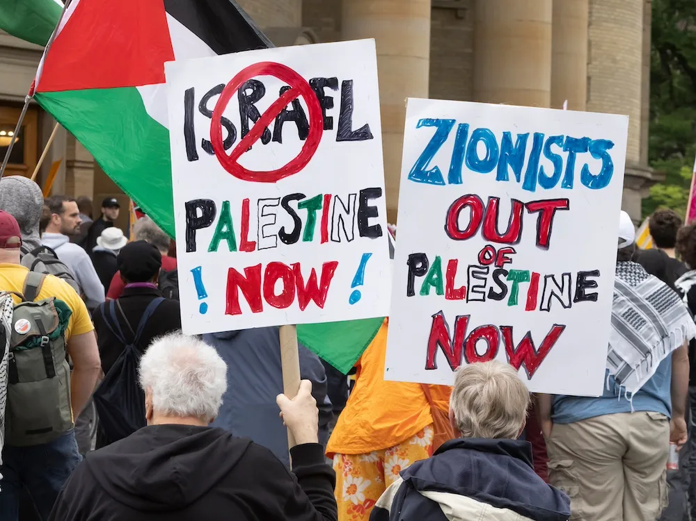

Slide 57
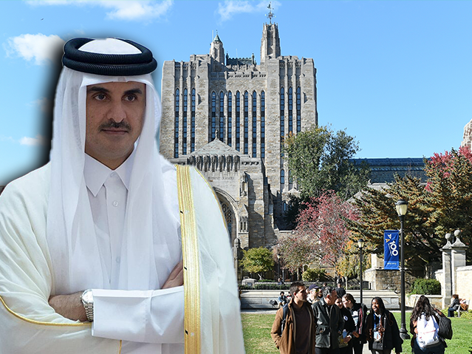

Slide 58
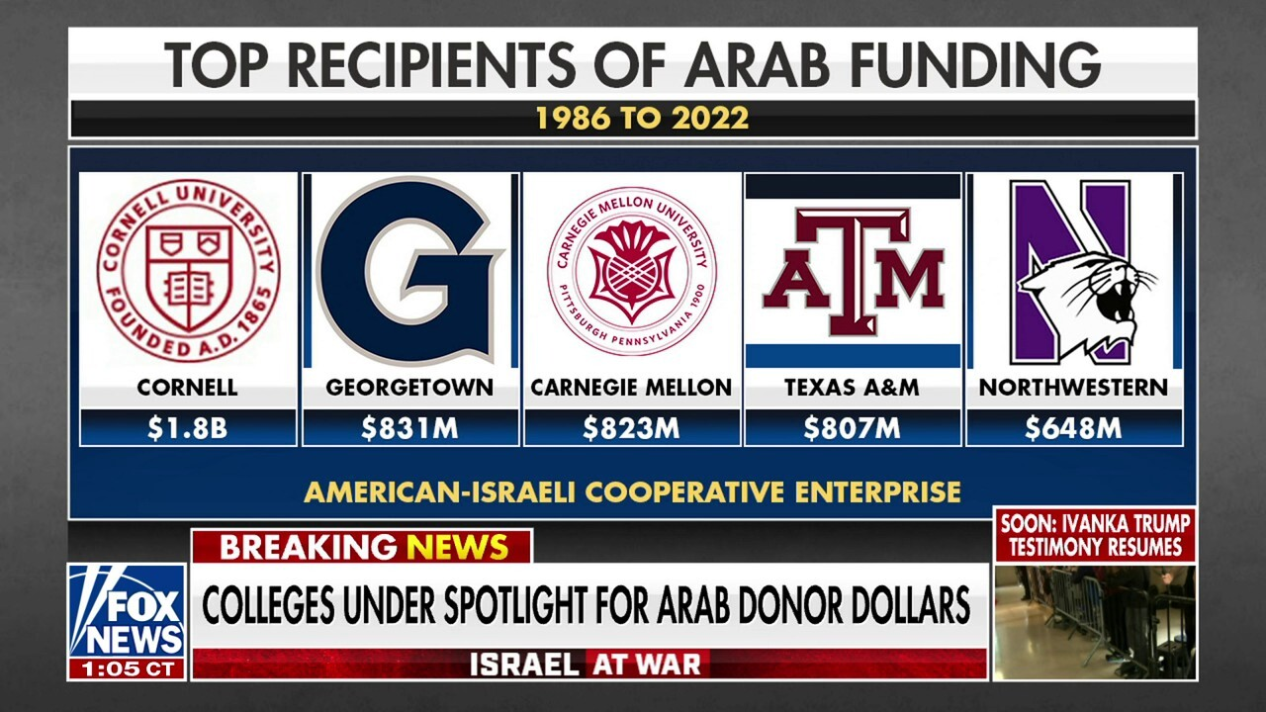

Slide 59
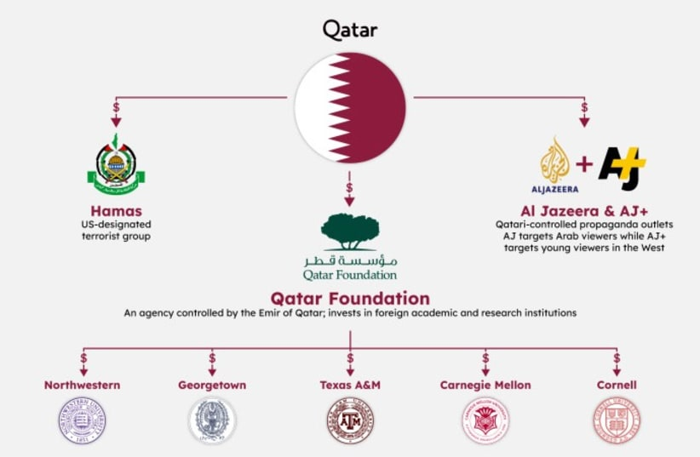

Slide 60
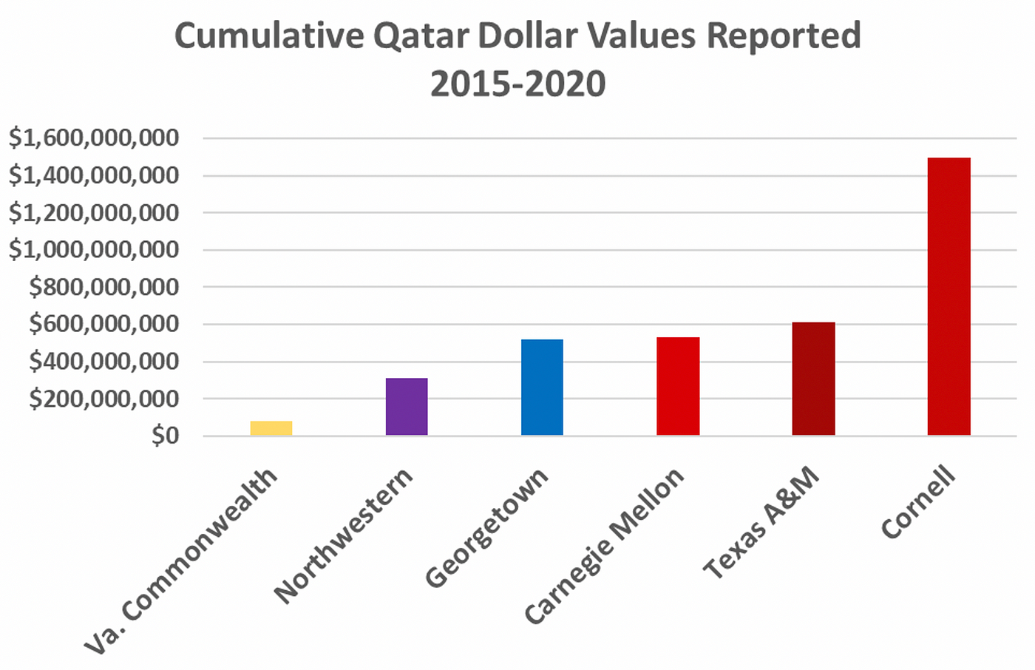

Slide 61
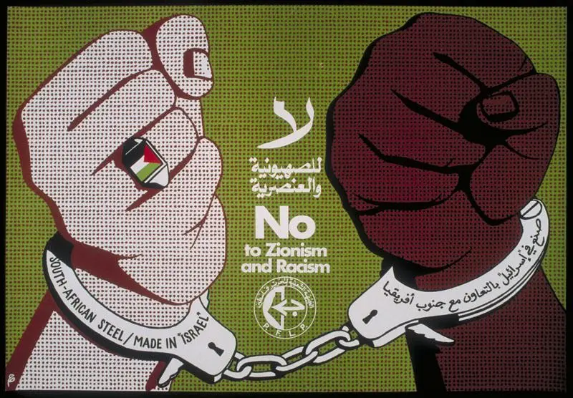

Slide 62
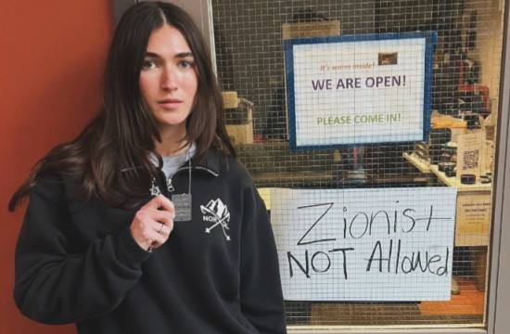

Slide 63
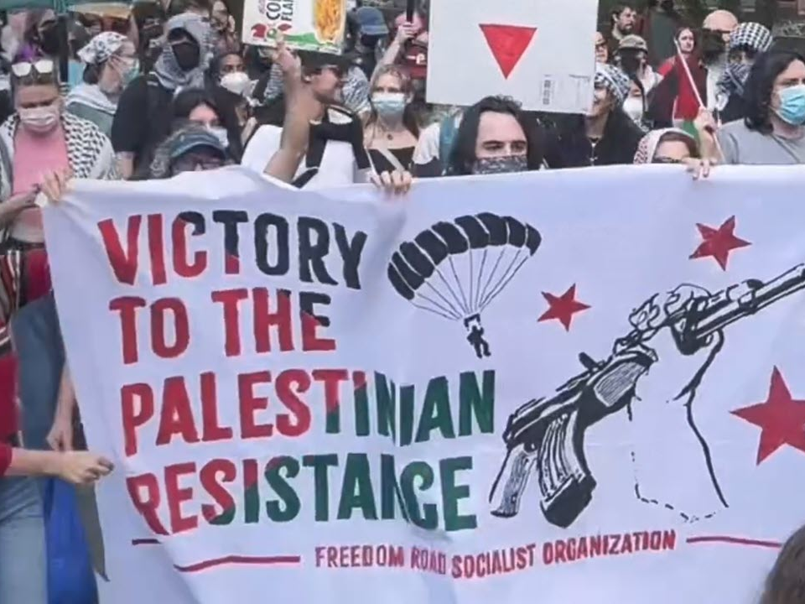

Slide 64
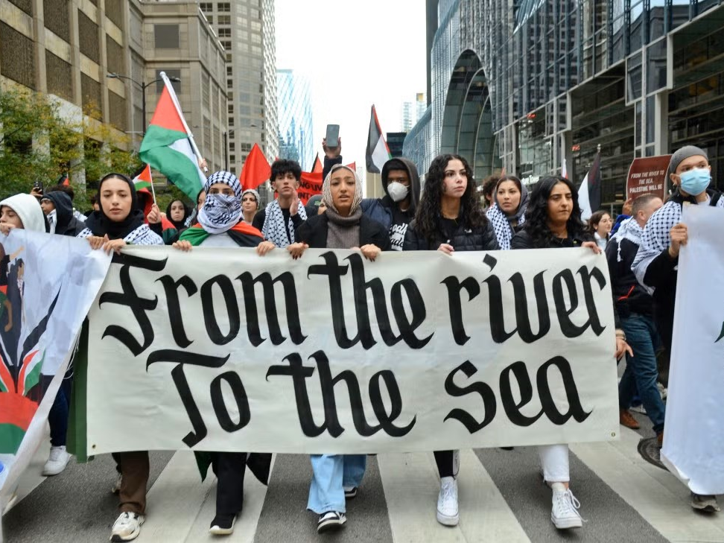

Slide 65
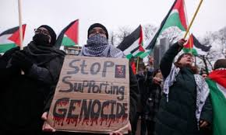

Slide 66
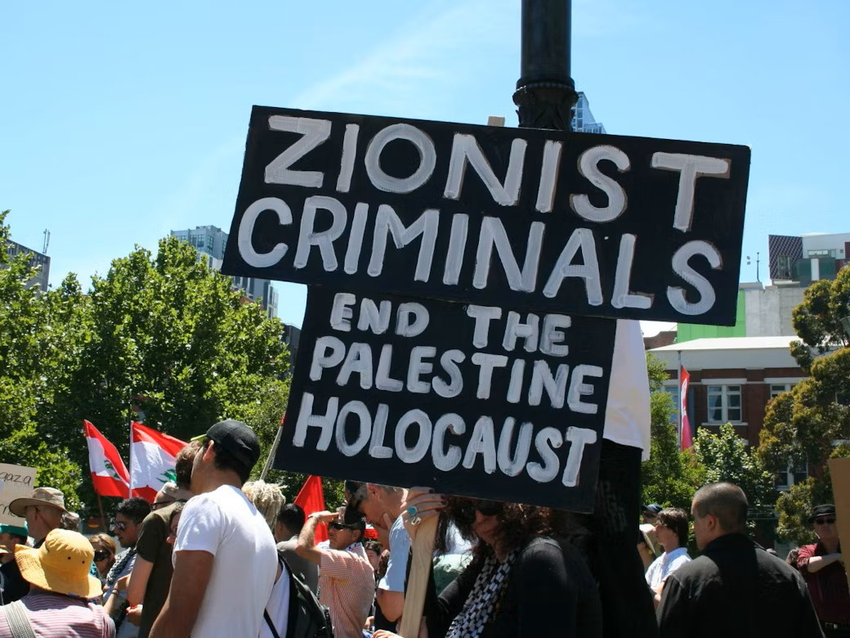

Slide 67
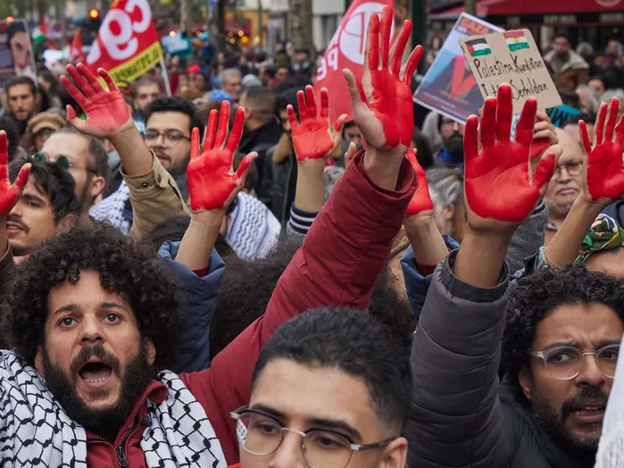

Slide 68


Slide 69

Palestinian Abdel Aziz Salha shows off his bloody hands following the killing of two Israeli soldiers in the West Bank town of Ramallah in 2000.

Slide 70


Slide 72


Slide 73

BEING A LIGHT
AND A PROPHETIC VOICE

Slide 74
For God has not given us a spirit of fear,
but of love, power, and a sound mind.
(2 Timothy 1:7)

Slide 75


Slide 76
7 Things You Can Do
Reach out and meet with local pastors.

Slide 77
7 Things You Can Do
Contact your local Christian radio station and speak with the manager, specifically share your concerns and ask if they would be open to an interview on the issue.

Slide 78
7 Things You Can Do
In your sermons, specifically address verses and passages within Scripture that are often weaponized against Jews.

Slide 79
7 Things You Can Do
Equip and mobilize the Gentiles in our congregations to serve as ambassadors for the Jewish people.

Slide 80
7 Things You Can Do
Find out what is happening locally and get involved.

Slide 81
7 Things You Can Do
Reach out to local rabbis, or your local Board of Rabbis, to share your concerns:
  “I realize we have had our differences, but rising antisemitism affects all of us … whether you like it or not, we’re in this together.”

Slide 82
7 Things You Can Do
Pray!
  Pray against growing antisemitism
  Pray for a spirit of peace, healing, conviction, and reconciliation.

Slide 83
כִּ֣י אִם־הַחֲרֵ֣שׁ תַּחֲרִ֘ישִׁי֮ בָּעֵ֣ת הַזֹּאת֒ רֶ֣וַח וְהַצָּלָ֞ה יַעֲמ֤וֹד לַיְּהוּדִים֙ מִמָּק֣וֹם אַחֵ֔ר
וְאַ֥תְּ וּבֵית־אָבִ֖יךְ תֹּאבֵ֑דוּ וּמִ֣י יוֹדֵ֔עַ אִם־לְעֵ֣ת כָּזֹ֔את הִגַּ֖עַתְּ לַמַּלְכֽוּת׃
On the contrary, if you keep silent in this crisis, relief and deliverance will come to the Jews from another quarter, while you and your father’s house will perish. And who knows, perhaps you have attained your royal position for just such a crisis.”
(Esther 4:14, JPS)

Slide 84
https://joshuabrumbach.com/event-handouts

Slide 85
Rabbi Dr. Joshua Brumbach
rebyosh@simchatyisrael.org
(203) 932-9929

