Slide 1
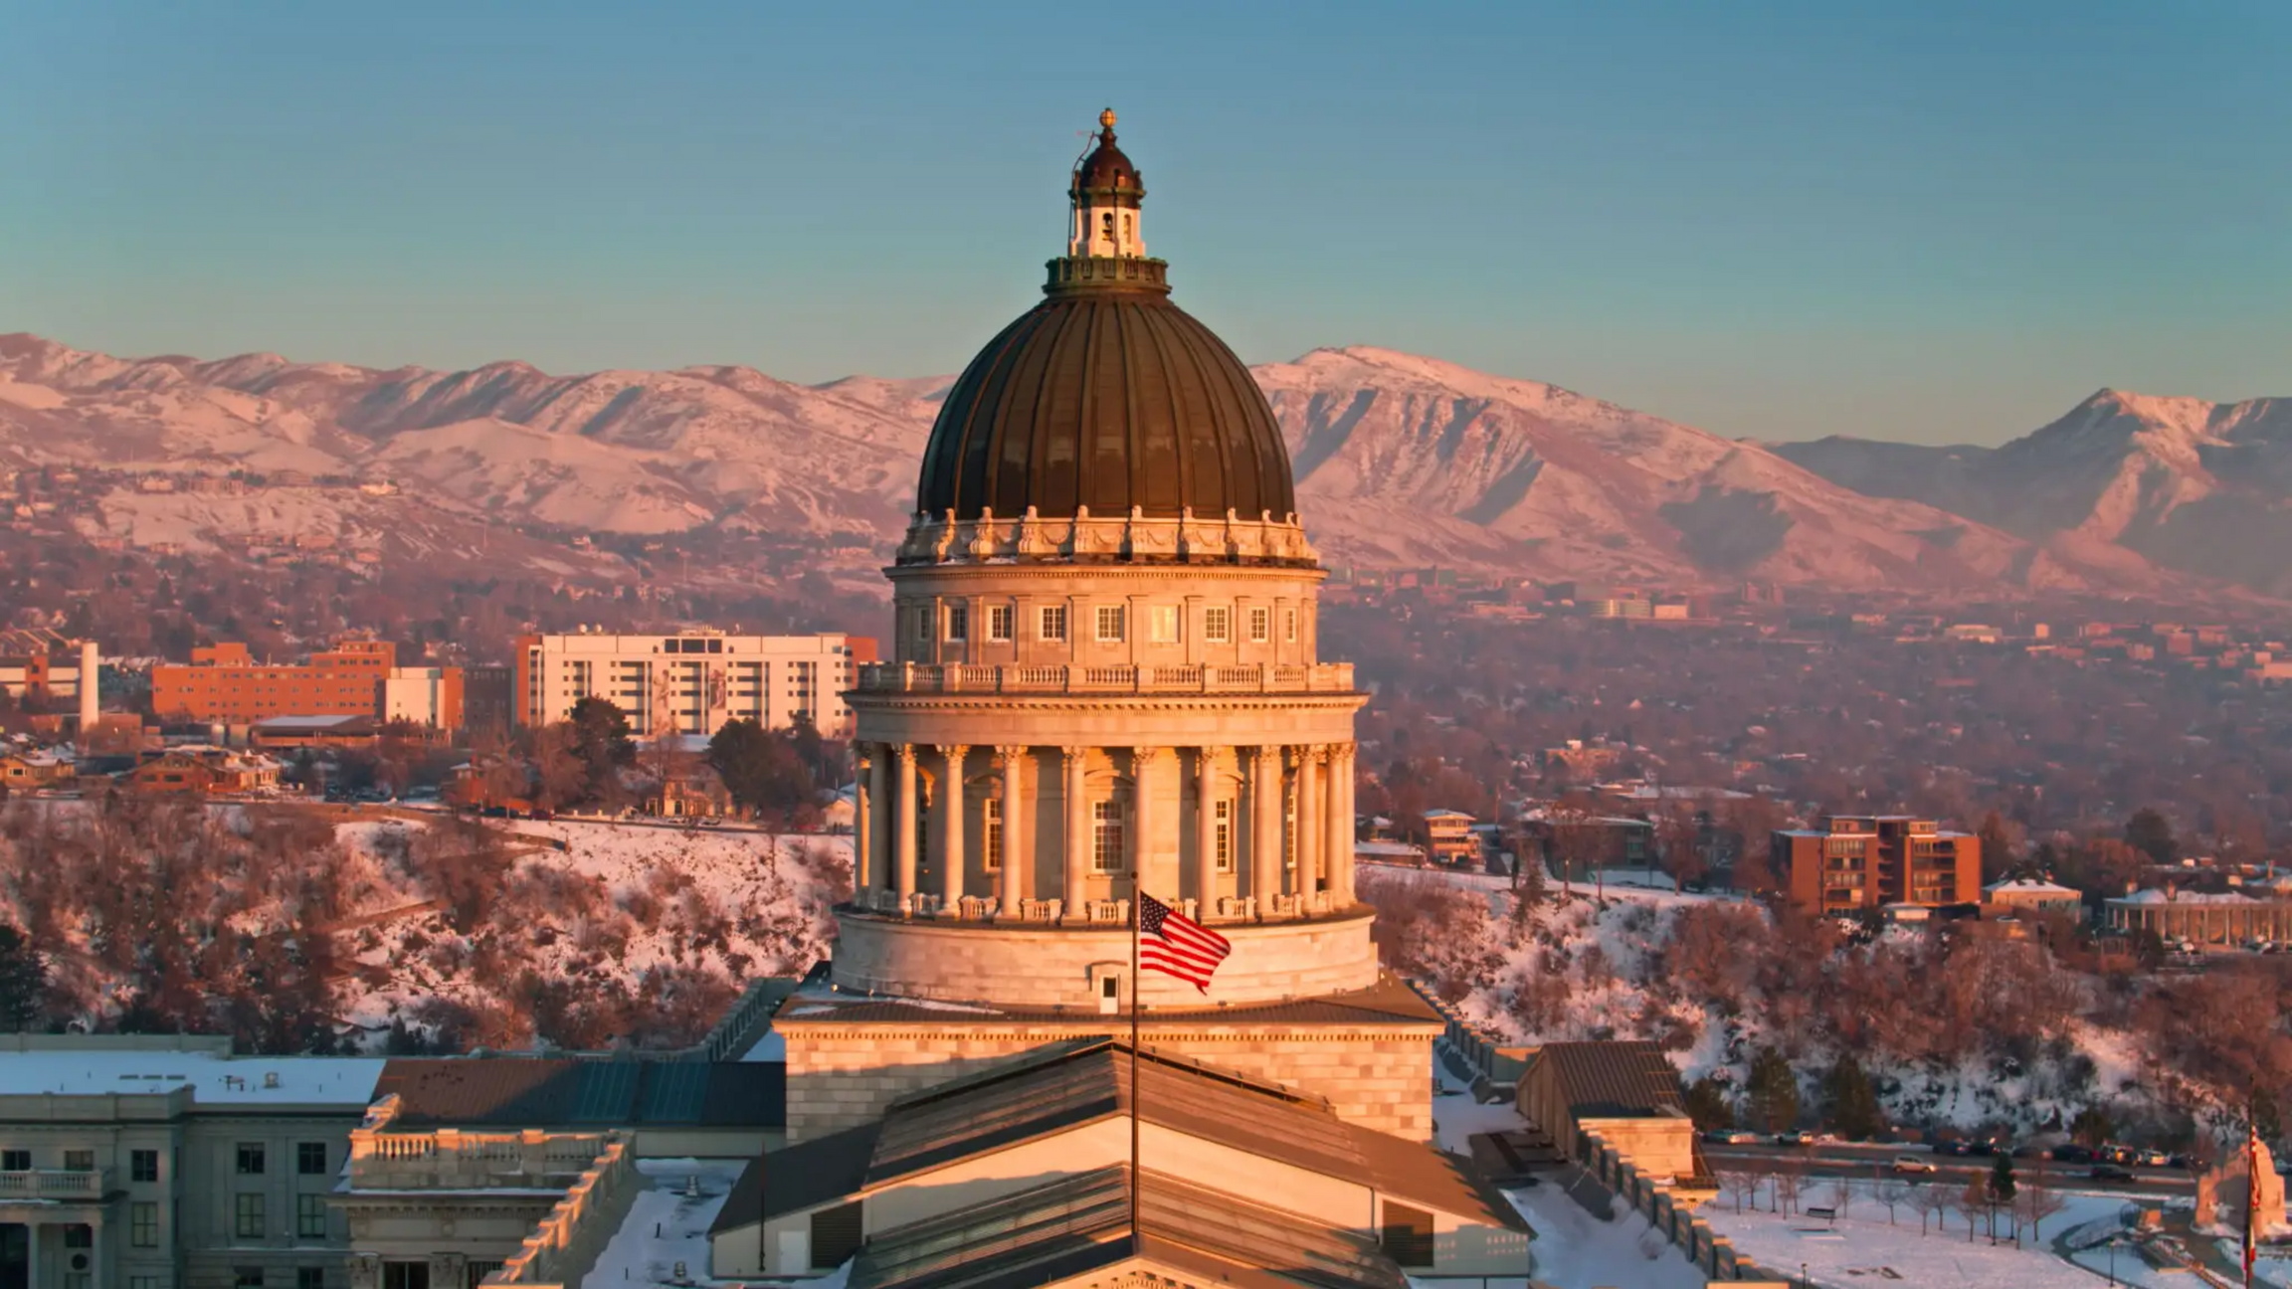






UTRSOL
Board of Directors Meeting
Utah for Rational Sex Offense Laws
Notes:
Thank you for attending Utah for Rational Sex Offense Laws' first meeting. Our organization's acronym is UTRSOL with no other pronunciation.
We are supported by member organizations
1. Justice By Objectives
2. NCACR National Coalition Against Conviction Registries
3. Restorative Action Alliance
4. ACSOL Alliance for Constitutional Sex Offense Laws
For those who are not familiar with these organizations, I'll briefly outline them.
Justice By Objectives is dedicated to supporting individuals and families navigating the criminal justice system, particularly incarceration.
NCACR National Coalition Against Conviction Registries
connects diverse organizations to share ideas and resources on sex offense policies throughout the country.
Restorative Action Alliance believes that through education, litigation and legislative advocacy, Restorative Action Alliance helps build safer communities which invest in primary prevention of sexual harm, meaningfully hold those accountable who cause harm, and safeguard the civil liberties of all.
ACSOL Alliance for Constitutional Sex Offense Laws
is a nonprofit civil rights, legal reform, and support organization, based in Sacramento, California. It provides news, resources, events, and support for registrants and their families affected by sex offense laws.

Slide 2
AGENDA
  Governing Docs: By-Laws and Articles of Incorporation
  Road Map: Strategic Plan 2025
  501(c)(3): Aftermath Alliance Foundation
  501(c)(4): UTRSOL
  Aftermath Alliance: Fearless Support Group
  Reentry Resource Fair
  UTRSOL Meeting 2: General Assembly
  Calendar of Events
  Resources: Housing and Employment
UTRSOL
Utah for Rational Sex Offense Laws

Slide 3
Governing Docs
BY-LAWS AND ARTICLES OF INCORPORATION
UTRSOL
Utah for Rational Sex Offense Laws

Slide 4
BY-LAWS AND ARTICLES OF INCORPORATION
April 30
May 18
June 2
June 9
June 16
By-Laws completed
Articles of Incorporation completed
Articles submitted to Utah Department of Commerce
Articles approved/denied
  Find a bank, open a business account
    America First Credit Union
    Mountain America Credit Union
  Submit for 501(c)(3)
  IRS Form 990-EZ
UTRSOL
Utah for Rational Sex Offense Laws

Slide 5
Road Map
STRATEGIC PLAN 2025
UTRSOL
Utah for Rational Sex Offense Laws

Slide 6
ROAD MAP: STRATEGIC PLAN 2025
Legislative Arm
Membership Arm
Organizational Collaboration
AfterMath Alliance
My Survivor Voice Podcast
Objective 1
Objective 2
Objective 3
Objective 4
Objective 5
a. Provide input and support to SOMAC
b. Collaborate with legislatures on proposed bills
c. Pursue risk-based registry assessments, three
d. tiered system, and reduced public view of registry
a. Provide Monthly Newsletters
b. Provide support and advocacy
c. Engage members to increase volunteers
a. Partner with Utah Department of Corrections (UDC)
b. Collaborate with Expungement Advocacies
c. Establish dialogue with Victim Advocacies
d. Coordinate with Adult Probation and Parole (AP&P)
a. (Fearless Groups) Support Group for collateral victims (family, friends)
a. Create a podcast for victims, collateral victims, and those on the registry to provide the public with their stories.
UTRSOL
Utah for Rational Sex Offense Laws

Slide 7
ROAD MAP: STRATEGIC PLAN 2025
Research Alignment
Legal Advisory Arm
Strategic Plan 2025
Objective 6
Objective 7
a. Educate members on State and Federal Laws
b. Keep current on Peer Reviewed Articles
c. Understand Recidivism Assessments (Static-99R,
d. Stable-2007, VASOR, SOSERA, SOTIPS)
a. Provide litigation against Utah sex offense Laws
b. Establish a working group of attorneys to execute litigation plan
c. Formulate UTRSOL Legal Working Group (ULWG)
  Legislative Arm
  Membership Arm
  Organizational Collaboration
  AfterMath Alliance (Fearless Groups)
  My Survivor Voice Podcast
  Research Alignment
  Legal Advisory Arm (Civil Rights)
UTRSOL
Utah for Rational Sex Offense Laws

Slide 8
  ORGANIZATIONAL COLLABORATION (29)
Utah Organizations
National Organizations
Government Departments
  *Justice By Objectives
  *Clean Slate Utah
  *Utah Prisoner Advocate Network (UPAN)
  +No More Victims nonprofit
  +Suncrest Counseling
  Alpha Counseling
  Utah Association of Criminal Defense Lawyers (UACDL)
  Utah Women & Leadership Project (UWLP)
  Utah Coalition Against Sexual Assault (UCASA)
  RASA Legal
  Utah Psychological Association
  New Directions
  Salt Lake Legal Defender Association
  +Utah Support Advocates for Recovery Awareness (USARA)
  *Alliance for Constitutional Sex Offense Laws (ASCOL)
  *United Voices for Sex Offense Reform (UV4SOR)
  *National Coalition Against Conviction Registries (NCACR)
  *Women Against Registry (WAR)
  *Restorative Action Alliance
  *Amplified Voices Podcast
  National Association for Rational Sexual Offense Laws (NARSOL)
  +Utah Department of Corrections (UDC)
  +Adult Probation and Parole (AP&P)
  +Davis County Sheriff's Department
  +Davis County Board of Commissioners
  *Sex Offense Management Advisory Committee (SOMAC)
  Utah Commission on Criminal and Juvenile Justice (CCJJ)
  Legislatures and staff
UTRSOL
Utah for Rational Sex Offense Laws

Slide 9
501(c)(3)
AFTERMATH ALLIANCE FOUNDATION
UTRSOL
Utah for Rational Sex Offense Laws

Slide 10
AFTERMATH ALLIANCE FOUNDATION 501(C)(3)
2. Membership Arm
4. AfterMath Alliance (Fearless Group)
5. My Survivor Voice Podcast
6. Research Alignment
Utah State Nonprofits
  *Utah Prisoner Advocate Network (UPAN)
  *Justice By Objectives
  *Clean Slate Utah
  RASA Legal
  National Association for Rational Sexual Offense Laws (NARSOL)
  Suncrest Counseling
  Alpha Counseling
  Utah Support Advocates for Recovery Awareness (USARA)
  Utah Women & Leadership Project (UWLP)
UTRSOL Research Action Committee
  Utah Psychological Association
  New Directions
UTRSOL
Utah for Rational Sex Offense Laws

Slide 11
UTRSOL RESEARCH Action Committee (URAC)
  As a civilian component that is not attached to the legislature, this committee would be the alternate side of the Sex Offense Management Advisory Committee (SOMAC), interacting and collaborating with them to provide research, facts, statistics, and experience in their role to provide the legislature with better approaches to the registry. As a civilian arm of this movement, we could interact with the public in a way that SOMAC, as part of the legislature, required to be non-partisan, cannot.
  With the number of bills pushed out during the January-March legislative sessions, the committee would function as a check and balance against bills that may be pushed out that would greatly affect the registry population and its collateral victims. As a body of professionals, this committee would have more weight with the legislatures and the public as well as with the news media when the case arises that they pursue an emotional based argument.
  As a body of professionals that does not have a criminal background, it would give UTRSOL additional legitimacy with the public and legislative bodies we intend to engage with. Having mental health professionals either on our board, working with our support group, or on this committee establishes us in an additional way as legitimate after we have incorporated as an official entity in Utah.
UTRSOL
Utah for Rational Sex Offense Laws

Slide 12
501(c)(4)
UTRSOL
UTRSOL
Utah for Rational Sex Offense Laws

Slide 13
UTRSOL 501(C)(4)
3. Organizational Collaboration
7. Legal Advisory Arm (Civil Rights)
1. Legislative Arm
Utah Government
  Utah Department of Corrections (UDC)
  Adult Probation and Parole (AP&P)
  Davis County Sheriff's Department
  Davis County Board of Commissioners
  Sex Offense Management Advisory Committee (SOMAC)
  Utah Commission on Criminal and Juvenile Justice (CCJJ)
  Legislatures and staff
Utah State Nonprofits
  Utah Coalition Against Sexual Assault (UCASA)
National Organizations
  *Women Against Registry (WAR)
  *Restorative Action Alliance
  *Amplified Voices Podcast
  *United Voices for Sex Offense Reform (UV4SOR)
  *National Coalition Against Conviction Registries (NCACR)
  No More Victims nonprofit
UTRSOL Legal Working Group
Utah State Nonprofits
  Utah Association of Criminal Defense Lawyers (UACDL)
  Utah Psychological Association
  Salt Lake Legal Defender Association
National Organizations
  *Alliance for Constitutional Sex Offense Laws (ASCOL)
UTRSOL
Utah for Rational Sex Offense Laws

Slide 14
UTRSOL LEGAL WORKING GROUP (Ulwg)
  UTRSOL needs the involvement of attorneys within our organization to execute one part of our goals and objectives.
  Our organization also needs attorneys to sit in on our Board of Directors to establish more legitimacy and credibility with the public and legislative bodies we intend to engage with. At the current moment, UTRSOL will be pursing incorporation within the next few weeks to become a legal entity in the state of Utah. We intend to move forward with nonprofit 501(c)(3) status in the near term and then 501(c)(4) status later this year or early part of next (for the purpose of lobbying the legislature).
  When UTRSOL becomes a 501(c)(4) nonprofit, we intend that members of the Working Group also stand in as the Board of Directors for the future organization which will retain the Utah for Rational Sex Offense Laws (UTRSOL) organization name. The 501(c)(3) will form it's own Board of Directors and will hold the name of it's support Group, AfterMath Alliance Foundation.
  This involvement will allow for the coalescence of attorneys throughout the state of Utah to organization to form a more cohesive voice in the desire and attempt to change the registry laws across the state.
UTRSOL
Utah for Rational Sex Offense Laws

Slide 15
Aftermath Alliance
FEARLESS SUPPORT GROUP
JUNE 14, 2025
UTRSOL
Utah for Rational Sex Offense Laws

Slide 16
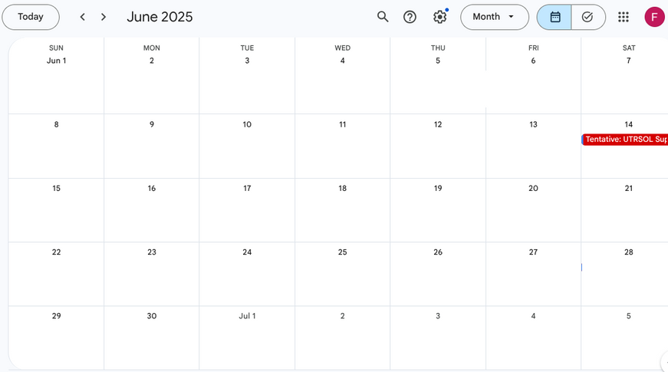
MEETING DATE
Proposed Date June 14, 2025
6 PM to 7:30 PM
Facilitator
  We will need to search for a mental health professional facilitator who would be interested in this support group.
UTRSOL
Utah for Rational Sex Offense Laws

Slide 17
Reentry Resource Fair
UTAH STATE CAPITAL
JUNE 25, 2025
10 AM - 5 PM
UTRSOL
Utah for Rational Sex Offense Laws

Slide 18
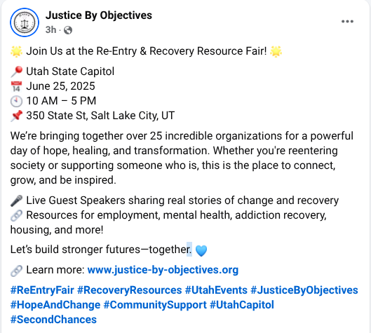

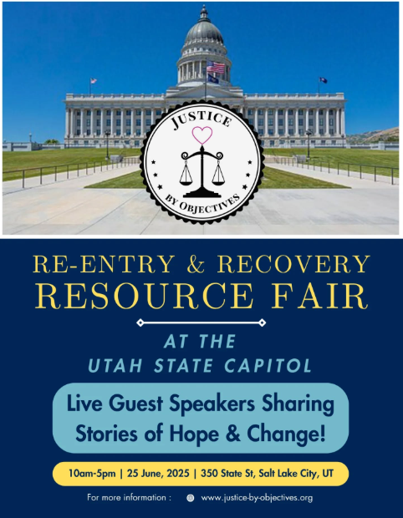
OVERVIEW
UTRSOL
Utah for Rational Sex Offense Laws

Slide 19
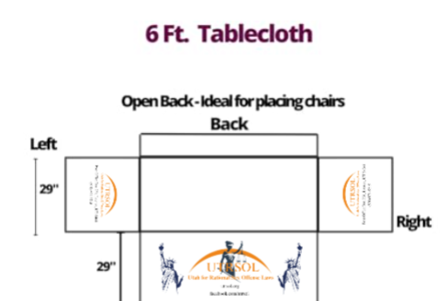


TABLE CLOTH
Center
Left
Right
UTRSOL
Utah for Rational Sex Offense Laws

Slide 20

BUSINESS CARDS
Front
Back
UTRSOL
Utah for Rational Sex Offense Laws

Slide 21
UTRSOL Meeting 2
GENERAL ASSEMBLY
JUNE 28, 2025
UTRSOL
Utah for Rational Sex Offense Laws

Slide 22
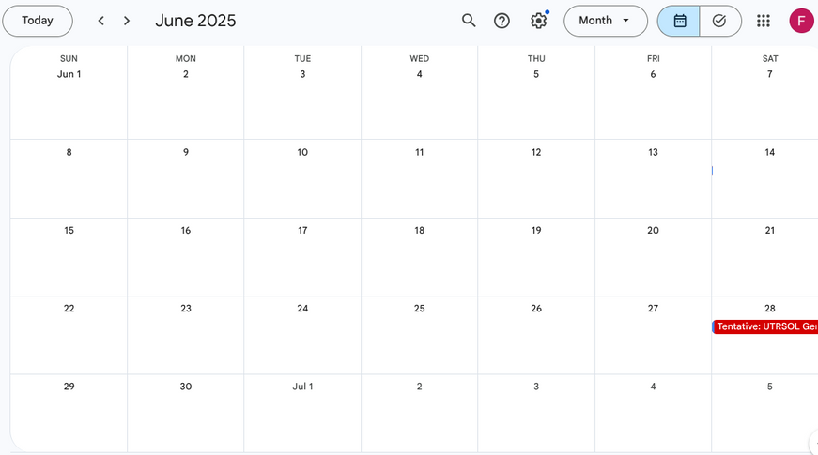
MEETING DATE
Proposed Date June 28, 2025
6 PM to 7:30 PM
UTRSOL
Utah for Rational Sex Offense Laws

Slide 23
Calendar of Events
UTRSOL
Utah for Rational Sex Offense Laws

Slide 24
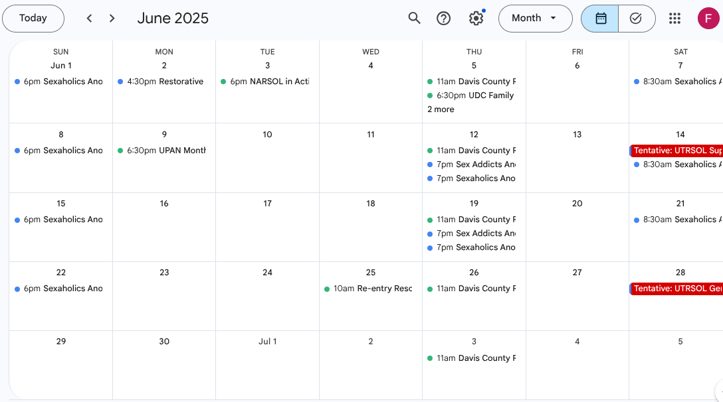
JUNE 2025
UTRSOL
Utah for Rational Sex Offense Laws

Slide 25
Resources
HOUSING AND EMPLOYMENT
UTRSOL
Utah for Rational Sex Offense Laws

Slide 26
Join us in the movement.
UTRSOL
Utah for Rational Sex Offense Laws

Slide 27
The Urgency of Now
THANK YOU!
UTRSOL
Utah for Rational Sex Offense Laws

Slide 28
UTRSOL
Board of Directors Meeting
Utah for Rational Sex Offense Laws
Notes:
Thank you for attending Utah for Rational Sex Offense Laws' first meeting. Our organization's acronym is UTRSOL with no other pronunciation.
We are supported by member organizations
1. Justice By Objectives
2. NCACR National Coalition Against Conviction Registries
3. Restorative Action Alliance
4. ACSOL Alliance for Constitutional Sex Offense Laws
For those who are not familiar with these organizations, I'll briefly outline them.
Justice By Objectives is dedicated to supporting individuals and families navigating the criminal justice system, particularly incarceration.
NCACR National Coalition Against Conviction Registries
connects diverse organizations to share ideas and resources on sex offense policies throughout the country.
Restorative Action Alliance believes that through education, litigation and legislative advocacy, Restorative Action Alliance helps build safer communities which invest in primary prevention of sexual harm, meaningfully hold those accountable who cause harm, and safeguard the civil liberties of all.
ACSOL Alliance for Constitutional Sex Offense Laws
is a nonprofit civil rights, legal reform, and support organization, based in Sacramento, California. It provides news, resources, events, and support for registrants and their families affected by sex offense laws.

