Slide 1
Notes:
Brings balance to the body’s energies, promoting optimal health and well-being, while supporting our own profound healing capacity

Slide 2
36 breath daily reset (meditation) for your mind, body and soul 2-5 minutes each finger, thumb, palm & back of hand

Slide 3
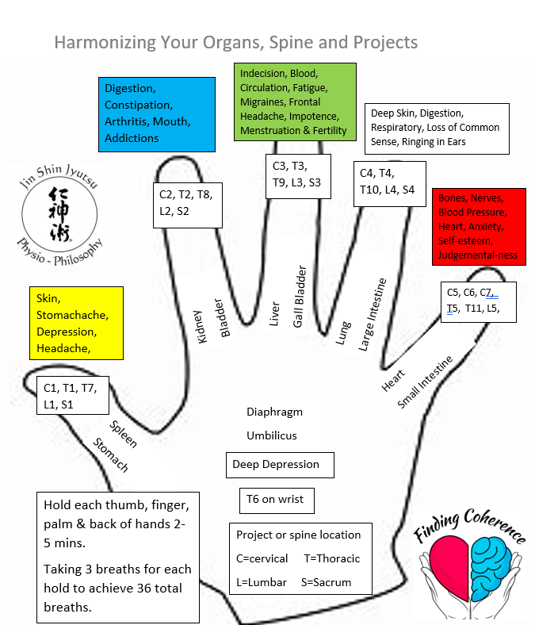

Slide 4
Thumb: Attitude: Worry/Obsessing Helps Stomach & Spleen Skin surface 3 deep breaths to bring Contentment back into harmony
Notes:
Fear of the Future-incapacity to digest our thoughts & emotions

Slide 5
Index Finger: Attitude: Fear/Anxiety Helps Bladder & Kidney Blood Essence 3 deep breaths to bring Balance back into harmony
Notes:
Fear of survival

Slide 6
Middle Finger: Attitude: Anger/Frustration Impatience Helps Gall Bladder & Liver Muscle 3 deep breaths to bring Joy back into harmony
Notes:
Fear “the world (other people) will not make me happy.

Slide 7
Ring Finger: Attitude: Sadness/Grief/loneliness Helps Large Intestine & Lung Deep Skin 3 deep breaths to bring Gratitude back into harmony
Notes:
Fear “I can’t be happy again.” Most dangerous- Can kill you!

Slide 8
Little Finger: Attitude: Trying too hard/Pretense/Stage fright Helps Small Intestine & Heart Skeleton 3 deep breaths to bring Serenity back into harmony
Notes:
Fear “I cannot be what I want to be” or “I can’t fulfill the others want of me.”

Slide 9
Palm: Attitude: Depression Helps Umbilicus & Diaphragm 3 deep breaths to bring back Source of Life back into harmony

Slide 10
Back of Hand: 3 deep breaths to bring Peace back into Harmony

Slide 11
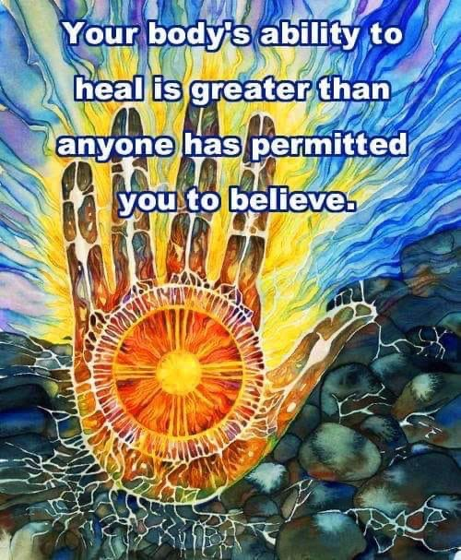

Slide 12
