Slide 1
[DATE]
Parent Intro Meeting
TEAM PICUTRE

Slide 2
Tonight’s
Agenda
Coach’s Introduction
Coaching Philosophy
Team Roster
Team Roles
Team Schedule
Team Budget
Uniforms & Equipment
Social Media
TEAM PICUTRE

Slide 3
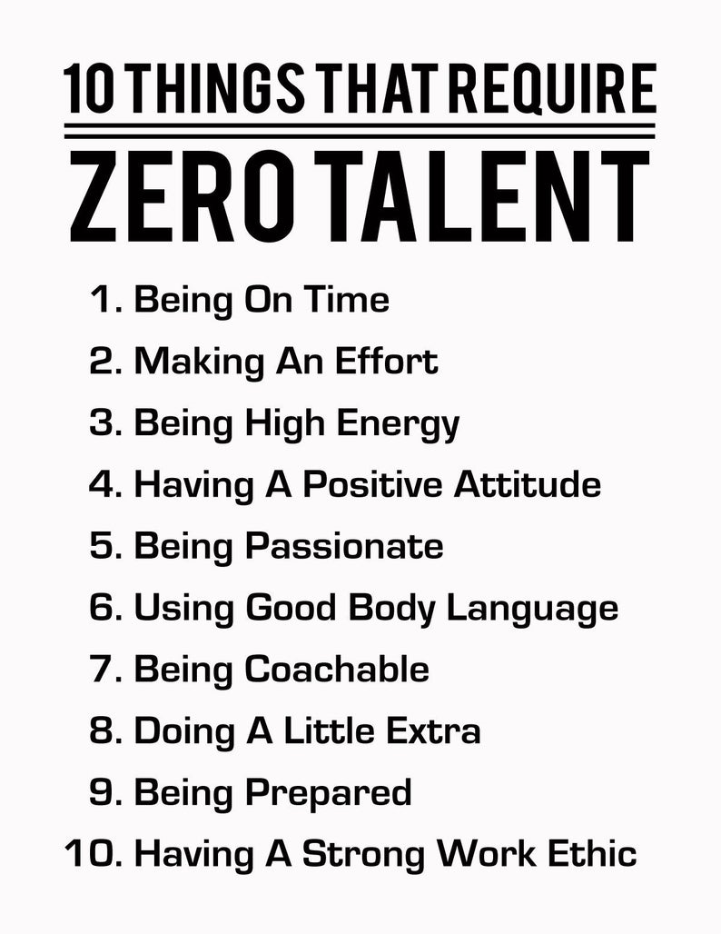

Slide 4
About Your Coach…
INFO ABOUT YOU

Slide 5
COACH BACKGROUND
NCCP Toolbox [YOUR #]
INFO ABOUT YOU

Slide 6
COACHING PHILOSOPHY
Our ‘3 Rules’
Customize with your ways of working…
Having FUN!
LEARN every shift, every period, every ice time
SUPPORT start together, finish together, always

Slide 7
HAVE FUN
We will develop interpersonal skills, confidence, leadership skills, character and a passion for hockey – all disguised as FUN!
TEAM PICUTRE

Slide 8
LEARN
Practice, hard work, resilience and intensity are necessary to obtain results. We will encourage the girls to push their comfort level and develop their leadership skills on and off the ice
TEAM PICUTRE
“If you want good things to happen to you, you need to work for it”

Slide 9
SUPPORT
We will build friendships, SUPPORT one another and foster teamwork that will transfer into a strong sense of belonging and contributing to something bigger than ourselves.
TEAM PICUTRE
ONE TEAM WITH 17 PLAYERS…

Slide 10
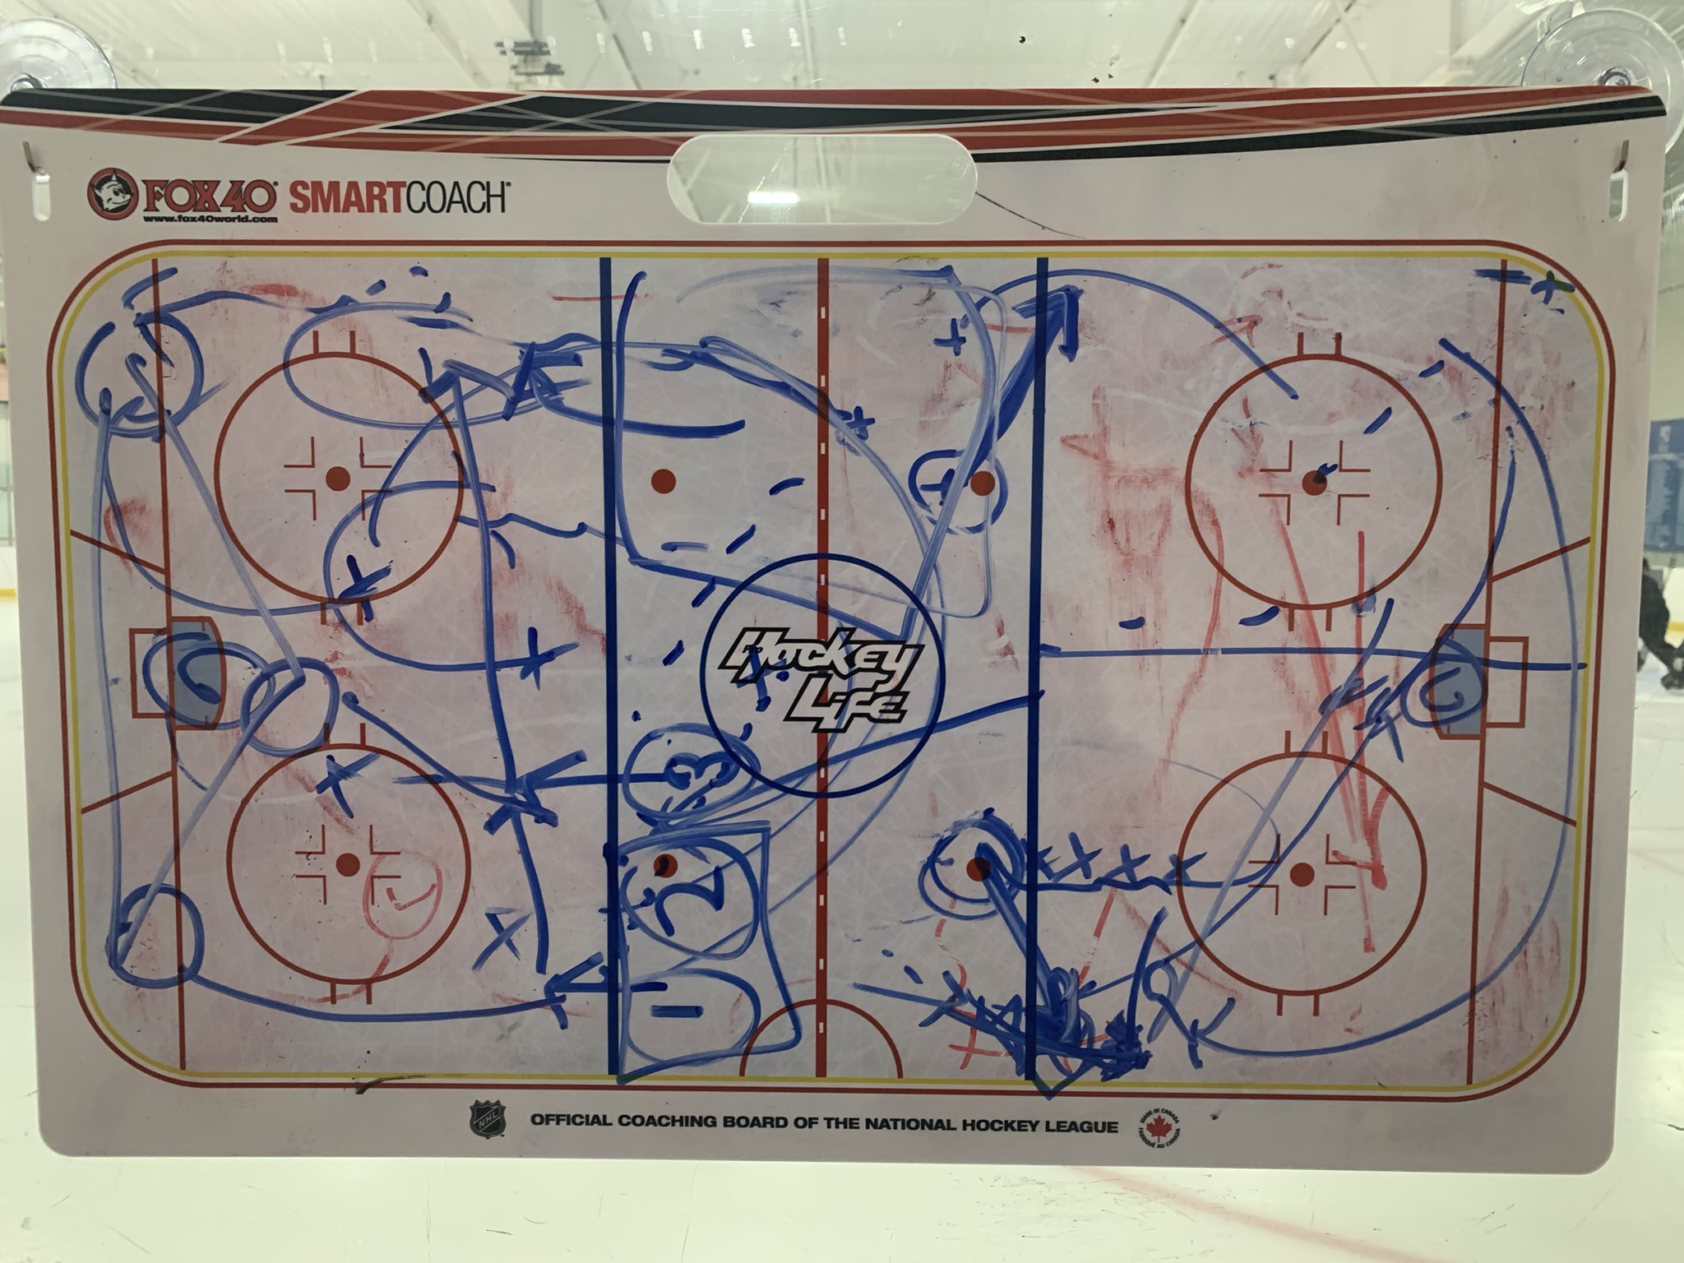
MY EXPECTATIONS
  BE ON TIME:
  Practices: Dressed and ready to go
  on ice when Zamboni comes on
  Games: 1 hour before game start time
  BE PRESENT:
  Participate in team events and activities
  Listen to coaches and act on feedback
  BE RESPECTFUL:
  Full commitment and dedication to the crest on your chest, your teammates, coaches and staff

Slide 11
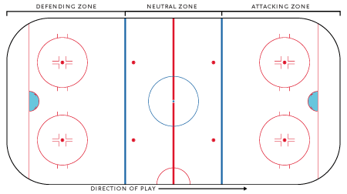
TEAM APPROACH / SYSTEM
DEFENSIVE ZONE | NEUTRAL ZONE | OFFENSIVE ZONE
RIGID
Play your position
Find an outlet
Protect the house
CREATIVE
Play your position
Wide passing
Broader coverage
FUN ZONE!
Know your role!
F1,F2,F3
Aggressive D Hinge
Moving Triangles
Use the D
Shoot to Score!

Slide 12
COACHING STYLE
Direct & Loud: Usually the same handful of things…
Consistent: play the system and reinforce good habits…
Who’s in front? | Get it out!
Challenge her! | Far side!
Use the D! | Get back / cover!
Update with items important to you…
Shoot to Score! | No Muffins!
Believe in yourself! | Quick shifts!
Strong breakouts! | Nobody in front!

Slide 13
REMEMBER…
THEY WILL MAKE MISTAKES. Our intention is to teach resiliency and build confidence.
WE ARE A TEAM. Must start together and finish together. Players and parents are expected to support the team at all times. We are in this together.
THIS IS ABOUT LEADERSHIP: Through practice and game situations they will build confidence & learn to trust in their decisions and develop leadership skills crucial to driving practical decision making

Slide 14
FAIRPLAY
FAIRPLAY is the intent and expectation
WE WILL SHORTENT THE BENCH in certain instances:
  Disciplinary measures (this is really the only recourse we have)
    RECALL: Be ON TIME, Be PRESENT, Be RESPECTFUL
  To extend our playing time in a tournament or LLHFL season
CONCERNS?
  Respect the 24 Hour Rule
  NOBODY approaches the bench / staff / parents during a game

Slide 15
WHAT YOU SHOULD
EXPECT FROM ME…
Communication: open, honest, upfront – always!
  1 on 1 meetings: two or more scheduled during the year with your daughter and you present
  Focus on development, what is working, what is not.
  On ice feedback: corrective action where required, celebrate success and achievement (2 deep rule)
Prompt Feedback to your inquiries
  I am available anytime at [YOUR PHONE NUMBER]
  If you have not heard back in 24 hours reach out again
  If you have a grievance please follow 24 Hour Rule

Slide 16
TEAM ROSTER
Forwards | Defence | Goalies
Juniors | Juniors | Juniors
Seniors | Seniors | Seniors
LIST OF ROSTERED PLAYERS

Slide 17
WE ARE IN THIS TOGETHER!
Running a team such as this requires support and volunteers from all families involved.
TEAM PICUTRE

Slide 18
STAFF
Role |  | Volunteer (Player)
Coaches | Head Coach: [WHO?] Assistant: [WHO?] Assistant: [WHO?] Assistant: [WHO?] | On-Ice: [WHO?] On-Ice: [WHO?] On-Ice: [WHO?]
Training Staff | Head Trainer: [WHO?] | Trainer: [WHO?] Trainer: [WHO?]
Team Manager / Scheduler |  | [WHO?]
Scoring / Statistician |  | [WHO?]
Treasurer |  | [WHO?]
Parent Liaison / Ombudsman |  | [WHO?]
Music |  | [WHO?]
Sponsorship / Fundraising |  | [WHO?]
Tournaments / Social |  | [WHO?]

Slide 19
SEASON SCHEDULE
Monthly Schedule
August | September | October | November | December | January | February to April
Weekly Schedule
Monday | Tuesday | Wednesday | Thursday | Friday | Saturday | Sunday
TBD | TBD | TBD | TBD | TBD | Away Game | Home Game
Intent – 3 to 4 events per week
NOTE: This is indicative and will change
All team events, practices, games, tournaments will be tracked in Teamsnap

Slide 20
PRELIMINARY BUDGET
Total Budget (Current Estimate):
~$X,000
Current Estimated Cost / Family:
~$X,000
Exclusions:
League Registration (~$X)
Other apparel purchases
Payment Schedule:
Installment 1: [DATE] –
Installment 2: [DATE] –
Installment 3: [DATE] –
Installment 4: [DATE] –
Installment 5: [DATE] –
Installment 6: [DATE] -
$X
$X
$X
$X
$X
$X

Slide 21
(League, Tournament & Exhibition Games)
* No other Hornet Items Approved for Games *
UNIFORMS
REP ONLINE STORE PLAYER LINK TO FOLLOW As a reminder, we are required to wear a consistent uniform to all games. Our uniform consists of: [ITEM] [ITEM] [ITEM] [ITEM] [ITEM] Please make sure last names are entered as players want to see them on their jerseys (e.g., GRETZKY not Gretzky, McDAVID or MCDAVID)

Slide 22



ASSOCIATION SOCIAL MEDIA POLICY

Slide 23
THANK YOU!

Slide 24
24 Hour Rule – What is it?
When an issue occurs and a party has a resulting complaint to make or issue to be resolved, they are asked to wait 24 hours, then put the issue in writing and submit it to the appropriate party. Whether this issue is labelled as coaching error, team mate interference, parent conflict or any other of a number of possible situations, it is very important that all parties involved take the full 24 hours to remove or decrease the emotional element so that the actual issue can be resolved quickly, in a civilized manner, and to everyone's satisfaction.
This rule has several purposes:
1) Allows each party involved during an issue to step back and clear the initial emotional elements
2) Provides a clear and concise process for problem resolution
3) Provides a clear understanding of what is expected from all parties involved
4) Promotes direct communication
5) Provides an avenue of fairness and opportunity to every parent, player and coach

