Slide 1
[DATE]
Staff Meeting
TEAM PICTURE

Slide 2
Contents
Season at a Glance
Staff
  Training Staff / Team Moms
  Game / Practice Staff
  Support Staff
Development Curriculum
Practice Strategies
Gameplay Strategies
Statistics – How to Track
Budget / Financial Plan
What’s Next…
TEAM PICTURE

Slide 3
Season Schedule
 | SEPT | OCT | NOV | DEC | JAN | FEB | MAR | APR
Teambuilding
Tournaments
Regular Season
Playoffs
Development Focus | Technical Skills |  | Technical Skills / Tactics |  | Technical / Tactics / Team Play |  | Team Play | Provincials / Tryout Readiness
Feedback | Informal On Ice / As Needed |  |  | Scheduled Session | Informal On Ice / As Needed |  | Scheduled Session | Informal

Slide 4
Training Staff
Trainer Message:
  The “Three Rules”
  Arrival Times
  Changeroom
  Den Moms / Team Moms
  Warmups
Training Staff
  Games: [WHO?]
  Practices: [WHO?]
Team Moms
  Head Team Mom: [WHO?]
  Team Moms: [WHO?]
TEAM PICTURE

Slide 5
Game / Practice Staff
Practices
More coaches the better – all rostered are encouraged to join
More coaches allows for 1:1 instruction and COE
Plans are distributed in advance, reviewed with girls BEFORE ice time
Games
Golden Rule – coaches will NOT be on same door as their kid
Balance out jr and sr parents to align with roster
  Forward Door – [WHO?]
  Defence Door – [WHO?]
  Middle – [WHO?]
  Goalies (between periods) - [WHO?]
Always seek to have 4 coaches on the bench
  Rostered backfill options: [WHO?]

Slide 6
Team Support Staff
Manager – [WHO?]
Treasurer - [WHO?]
Sponsorship / Fundraising - [WHO?]
Music - [WHO?]
Team Instagram - [WHO?]
Social – [WHO?]
Photographer – [WHO?]
Scoring/Stats - [WHO?]

Slide 7
Coaching Curriculum
ASSOCIATION MANDATE OR YOUR OWN PLAN
[FEEDBACK FROM OTHER COACHES – What is your objective for training?]

Slide 8
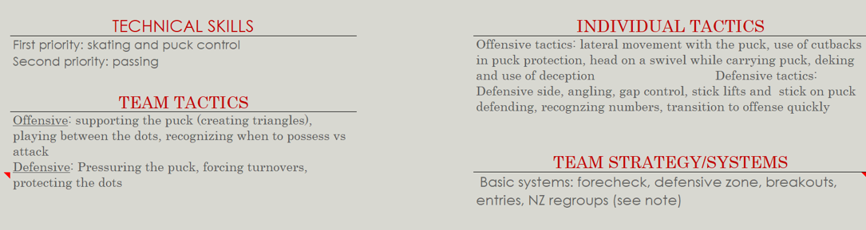
Coaching Curriculum
50%
20%
20%
10%
Drills we use will follow this framework
Early in season there will be HEAVY technical and tactical focus

Slide 9
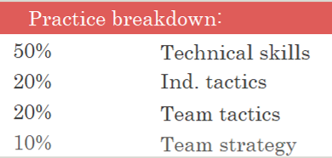
Practice Strategies
General
Girls MUST be ready when Zamboni hits the ice to review plan
Coaches will receive plan in advance
No ‘wasted time’ on the ice
Practices align to Hornets curriculum
Overview
[WHO] will take goalies to warm up
TPS will start most practices – Turns / Pivots / Stops (Technical!)
Don’t typically use a lot of peripheral items – pucks / pylons only
We run stations aligned to development plans / curriculum
Coaches not assigned a station will work on FEEDBACK and COE

Slide 10
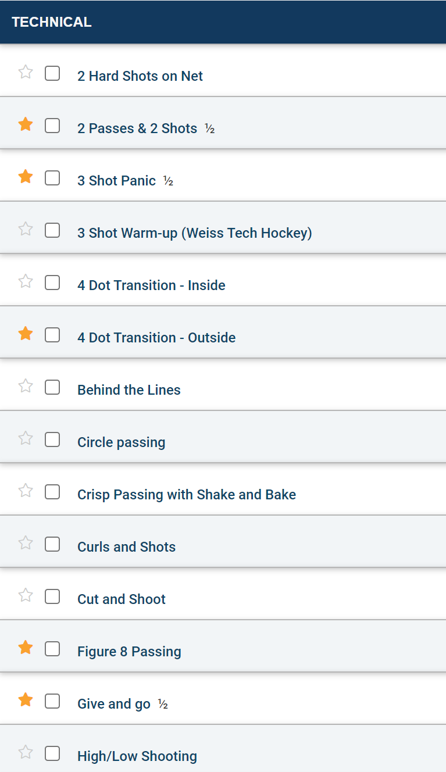
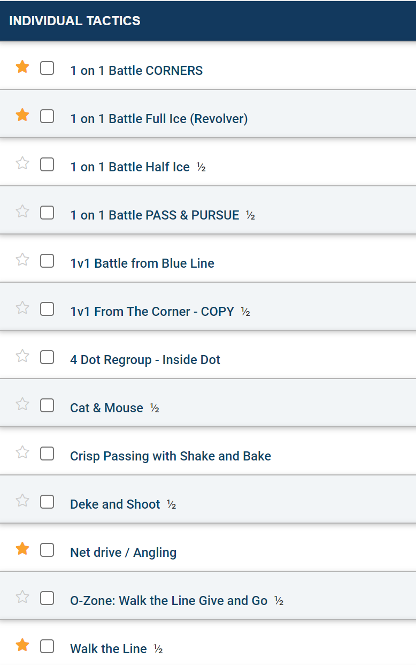
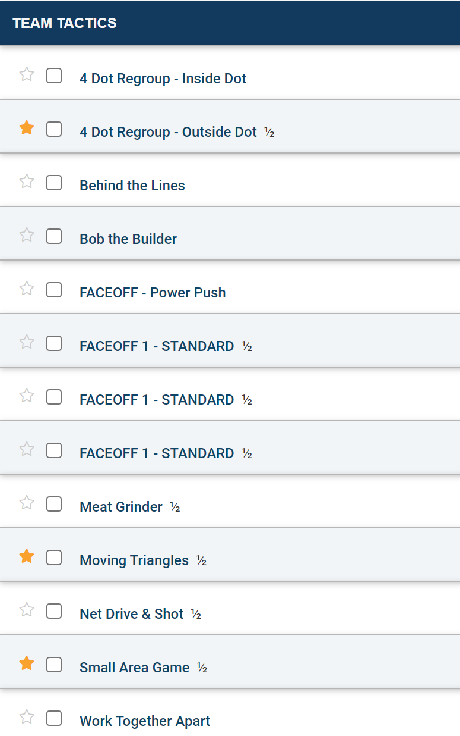
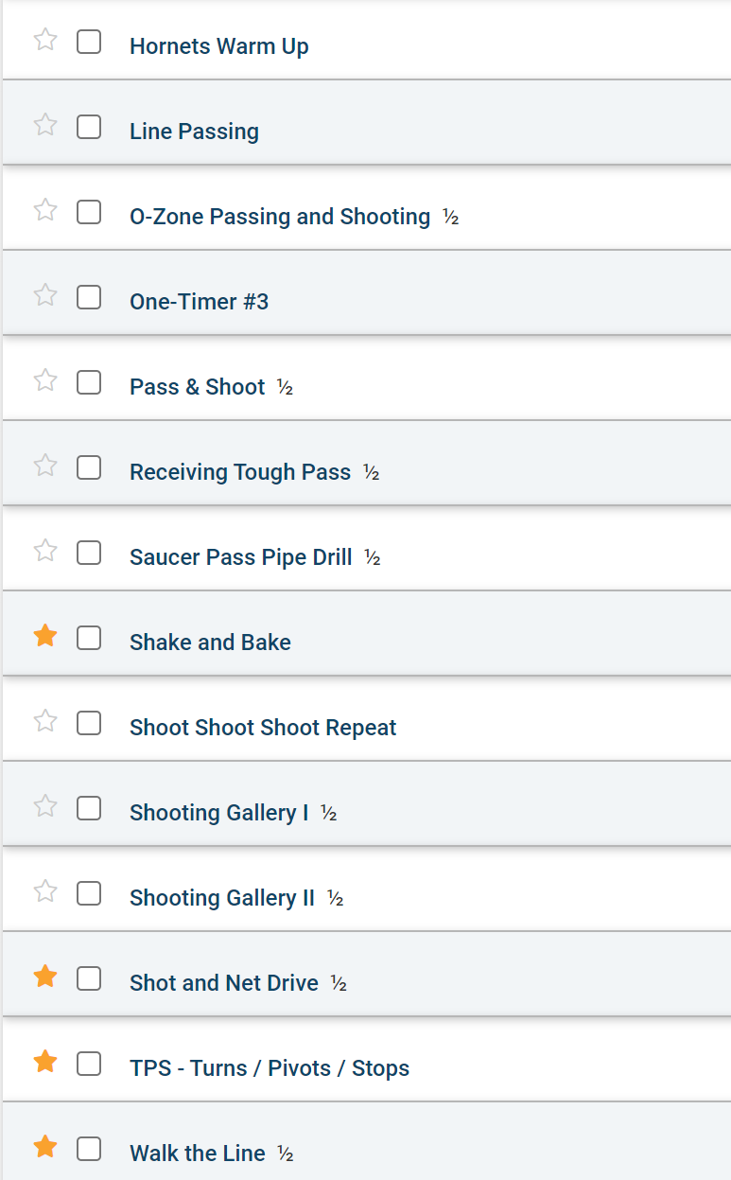
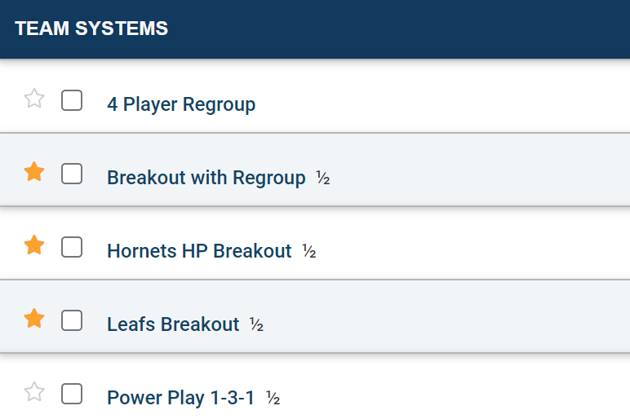
Practice Plans / Drills
Use of stations to promote higher puck touches
Core drills repeated and expanded to build on skill
Practice plans directly aligned to our development curriculum

Slide 11
Gameplay Strategies
“Challenge”
Aggressive, relentless forecheck – shoot, shoot, shoot! / use the D
Attack the puck carrier EVERYWHERE and force errors / turnovers
Will take hinge the D hard and give up odd-girl rush (trust our goalies!)
Use of angles by our D to eliminate threats up the boards
“Pass the Puck”
Leverage the Defence in Fun Zone to tire out / strain opponents
Clean breakouts, do not just dump it up the boards
Use your OPTIONS, no muffins
Carry the puck, make the smart pass, do not throw it away
“Who’s in Front?”
Clear the front of our net, NOBODY has free access to our crease
Hinging in D zone, one D in corner, one clearing the front of the net
ALWAYS someone in front of opposing net when on offence

Slide 12
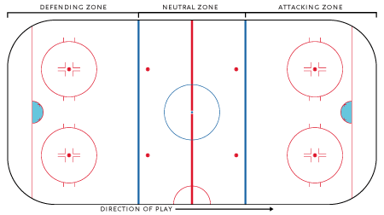
Gameplay Strategies II
DEFENSIVE ZONE | NEUTRAL ZONE | OFFENSIVE ZONE
RIGID
Play your position
Find an outlet
Protect the house
CREATIVE
Play your position
Wide passing
Broader coverage
FUN ZONE!
Know your role!
F1,F2,F3
Aggressive D Hinge
Moving Triangles
Use the D
Shoot to Score!

Slide 13
Statistics
Games
How will you track and by who?

Slide 14
Budget highlights
Budgeting for total costs of ~$XK
  Implies ~$XK per player – but potential to offset with sponsorship and fundraising
Discussion points:
  Bus (currently not planned in budget)
  Fundraising + Sponsorship expectations

Slide 15
High-level budget breakdown
  League Admin $X
  Ice time $X
  Officials $X
  Uniforms $X
  Tournament fees $X
  External Instructors $X
  Equipment and Events $X Training camp etc.
  Contingency $X
  Total $X
  ~ $X / family before fundraising and sponsorship

Slide 16
First Two Weeks at a Glance
WEEK 1
Training
Camp
ADD YOUR SCHEDULE FROM CALENDAR OR TEAM TRACKING APP
WEEK 2
Assess
Player
Roles
WEEK 3
First two weeks we will assess what we have and build from there

