Slide 1




Target Corp. 10 Store Deployment
AR Engagement Kickoff Presentation
Robin L. Mast
PMO

Slide 2

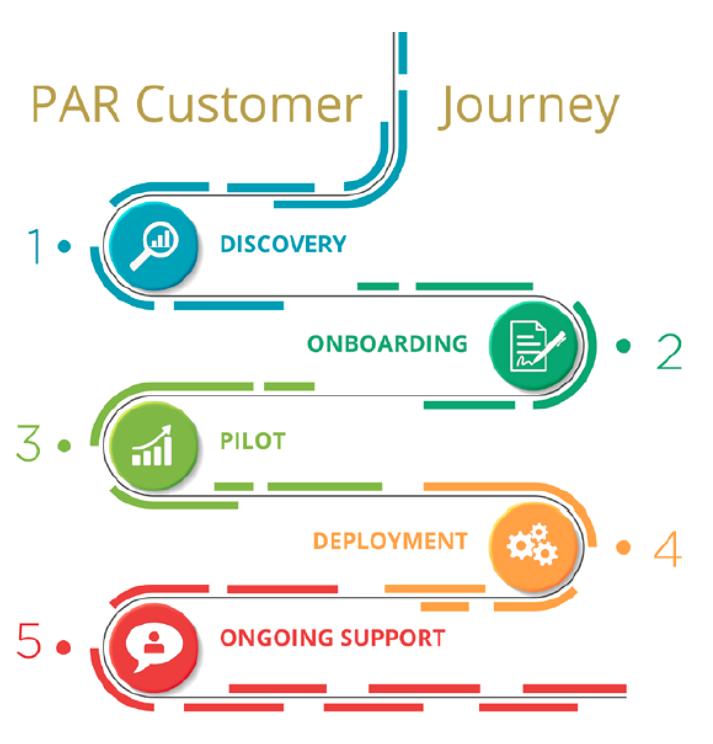
Agenda
AR Customer Journey
Team Introductions
AR’S Onboarding Philosophy
Discuss Journey for Onboarding
Discuss Roles and Responsibilities
Review High Level Schedule
Next Steps: What do we need to accomplish
AR Implementation Services

Slide 3
Clients & AR in attendance
Maureen Brock - Head of Systems Engineering
Ali Zamiri - VP of Business Development
Kellie Harper - Project Manager
Zach Nagel - Implementation Engineer
Helen Carroll - Director of HR
Jean Van Lier - Head of Delivery & Support

Slide 4
AR Implementation Services

Slide 5
AR Onboarding Philosophy
Onboarding and Deployment do not occur in isolation.
Focus on the outcome you want operationally – not how you are used to doing it.
A Change Management plan is essential. Operations representatives must be involved in the project to ensure technology decisions support the goals of the organization at the store level.
Defined roles are essential, including team alignment.
Be engaged! Do your homework, prioritize the Design Sessions.
An understanding of Future Vision is essential for a successful Solution Build and Project Plan.

Slide 6
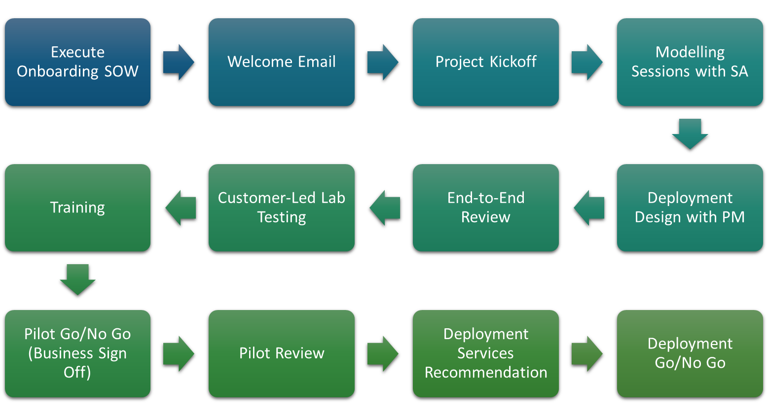
Project Milestones

Slide 7
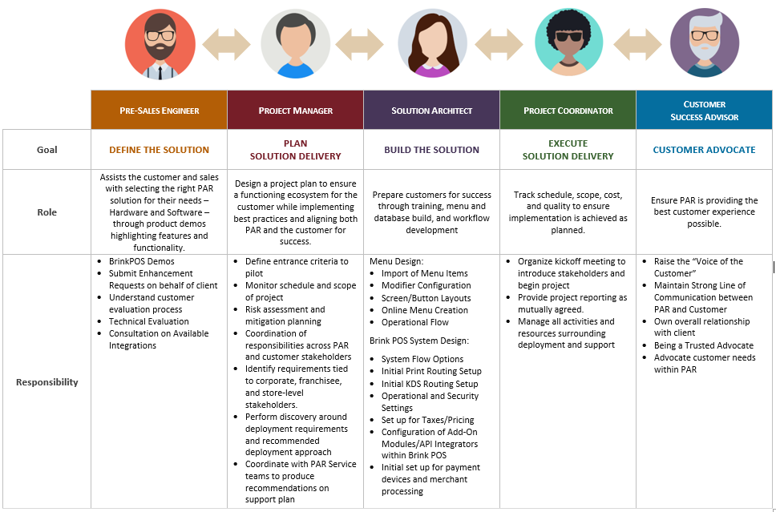
The AR Team

Slide 8
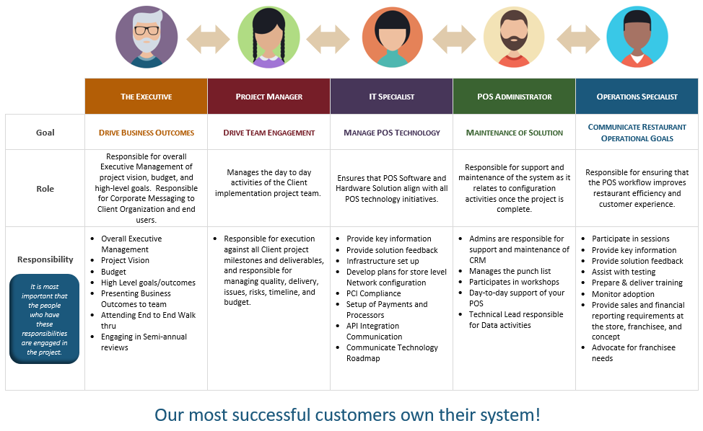
The Customer Team

Slide 9

What key milestones exist today?

Slide 10
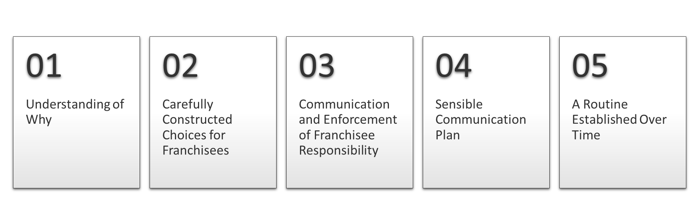
Common Themes of Successful Deployments
AR Excels at Understanding the Nuances of our Client’s Environment and
Adjusting Process and Plans to Meet those Needs and Overcome Unique Challenges

Slide 11
What Drives Project Complexity?
Hardware Solution Details
Multiple solutions available or differing per store requirements
Non-AR Hardware requires validation prior to pilot or deployment
Software Solution Details
One or more integration requiring certification or development in advance of pilot or deployment
Communication Plan
Custom communication plan for Locations
Customer requires frequent reporting on communication of the SER’s
Use of existing peripherals
Multiple weekly meetings to discuss Project status; may include various stakeholders
Support Requirements
AR Implementation Team
Peer-to-Peer Support
Target Internal Help Desk
Support for Non-AR Solution Components
Go-Live Center
Services Required
Database work required to support functionality within existing integration partner
Multiple or High Priority Software Enhancement Requests required for Pilot or Rollout
Deployment Approach
Multi-site pilot event

Slide 12
Project Management Deliverables
Project Plan and Schedule
The AR PMO will work with your team to define and document your schedule, requirements, entrance and exit criteria for each Project Milestone.
Weekly Status Reports
The AR PMO representative assigned to your engagement will provide weekly project tracking to all project stakeholders.
Status Meetings and Deployment Design Sessions
The PM will coordinate status meetings and design sessions for your engagement, which may include external stakeholders and differing AR resources.
At the completion of the Pilot implementation, the AR PM will provide a final deployment plan, which will include an updated issue tracking list and risk assessment.
Deployment Plan with Risk Assessment

Slide 13
How you can help:
AR Tips for A Successful Onboarding
> Assign someone to manage your Onboarding
> Attend Kick Off Call & Site Survey
> Engage in software configuration/Right Store Database
> Prepare site install by making sure the site readiness document and the results from the Site Survey are in fact taken care of if any items on the Site survey needed to be added or fixed.
> Ensure Manager’s and Staff attend training.
> Engage with your new AR Portal.
> Finalize correct store Database configuration you are using from Corporate.
> Actively use AR University for knowledge & Training of staff
> Learn the AR back end & reporting tools.

Slide 14

Thank You all and we look forward to serving you.
Have an Amazing Day

