Slide 1
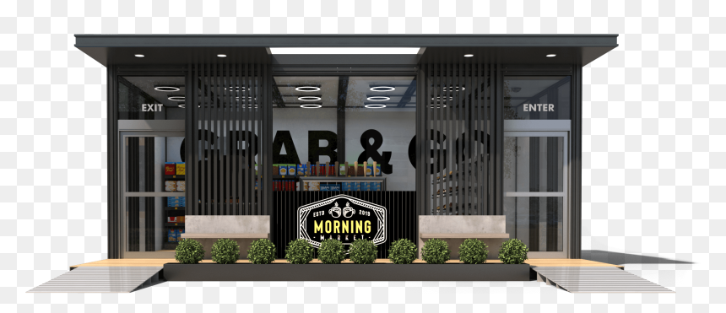
Welcome to Our Onboarding Process
Target Corporation
Robin L. Mast
AR PMO

Slide 2
Onboarding Process
Kick Off Call:
The below task’s is what needs to be accomplished from this call:
Setup Reoccurring Meetings ( How often & Times?)
Need all parties involved with project list of email addresses
Share key documents (list of Store locations, Signed SOW, Product Data (store database) Site Survey Procedures.
Schedule milestones
Risk’s, Actions & Issues currently?
Timeline established (within 6 Months of Project start)
Set up customer with AR University (Online Knowledge)
Provide Site Readiness document
Discuss cabling and networking requirements
Internet Speeds: (15MB Down and 5MB Up)
Grant customer access to the AR Portal
Site Survey is Scheduled (The sooner the better)
Target Specific Technical Implementation Documentation
In order to catch up on this project we need to complete the following: SOW
Risk’s, Actions & Issues: What needs to be addressed Now?
Meet With Sales & Business Development to discuss Project/SOW details:
Create Project /Scope of Work:

Slide 3
Site Survey
Site Survey:
> Confirm site readiness
> Verify cabling and wiring
> Identify hardware location’s
> Test network connectivity
Validate internet speed
Target Database Configuration:
> Store Provisioned
Customer emails support for API's release
AR Foundations Training:
Regional Store Training Plan is created:
> Terminal tour
> Shift management
> Order management
> Payment processing
> Troubleshooting

Slide 4
Store Prep
Store Prep:
Site Survey performed
Database and Product List Completed
> Install Scheduled
> Equipment shipped
> Site Readiness is confirmed
> Networking requirements are in place
Schedule Store Implementation:
> Install Setup all Hardware
> Connect Cameras
> Connect ??
> Configure Terminals as needed
Setup Network
Go Live Support:
> Support Go Live
> Troubleshoot system if needed
> Configure Software if needed
> Handoff to Support / Customer Success

Slide 5
Thank You for allowing us to serve you.
AR onboarding services are flexible to meet the specific needs of your Store’s (Locations). Our team has firsthand knowledge of Our camera-based AI system, Software and will partner with you to get your Store’s up and running with AR as quickly as possible, ensuring that you and your team are setup for long term success.
Our mission is to help empower you to focus on what matters most of which is your Business. Our team will support your Store’s from kickoff to Go live and beyond building a long-lasting partnership with you.

