Slide 1
Network Training BY “ITChefrobin”

Slide 2
Networking Basics

Slide 3
Internet Service Providers
An Internet Service Provider (ISP) provisions any building, allowing users to build networks to connect to the web. We’ll use Comcast in this example
There are loads of ISPs, but typically any building is limited to the providers in their area. Dense urban areas will likely have multiple options, while more rural areas might be restricted to only smaller, local and independent ISPs.
Internet
Service
Provider
(ISP)
Although most big-name ISPs will provide internet that is strong and fast enough for Brink, it’s important to know a customer’s ISP. A local provider may only offer relatively slow speeds due to rural infrastructure

Slide 4
Let’s build a simple network
An Internet Service Provider (ISP) provisions any building, allowing users to build networks to connect to the web. We’ll use Comcast in this example
Internet
Service
Provider
(ISP)

Slide 5
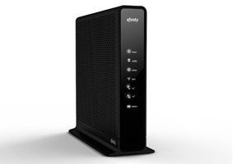
Modems
A modem is the is the physical piece of equipment that allows a user to connect to the ISP. Think of this as the power outlet for internet in a building.
The modem will need to be connected to wherever the ISP has provisioned cables in the building. In restaurants, this is often the back office, basement or IT closet.
ISP
Modem
Modems are usually provided by the ISP. The only real thing to consider as a sales rep regarding modems is where they are in the building.

Slide 6
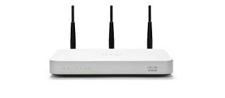
Routers
The router is the piece of equipment that takes internet from the modem, creates a network and “routes” it to devices (like tablets or laptops) to make it accessible.
Routers can create wired or wireless networks that allow devices to access the internet.
ISP
Router
Modem
Different routers will have unique features and abilities. Speed, maximum number of connected devices, wired vs. wireless connection (or both), wireless coverage strength/distance, support tools/analytics, and more are all factors that your choice of router will affect.

Slide 7
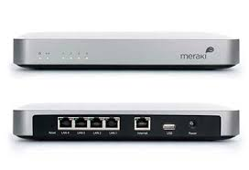
Types of Routers 1
Meraki Z1 Router
Network Type: Wired or Wireless
Wireless Coverage: Approx. 1000 square feet
Maximum # of Connected Devices: Approx. 10 devices
Offers Cloud Analytics and support tools (Toast support remote access and troubleshooting)
4 Ethernet ports for hard wired connections
The Z1 is The essential small deal workhorse. It’s relatively inexpensive, provides strong cloud analytics and creates a wireless network that covers most small spaces. For basic setups with under 10 devices, the Z1 covers all the bases. 3 Year Cloud license included with purchase.

Slide 8
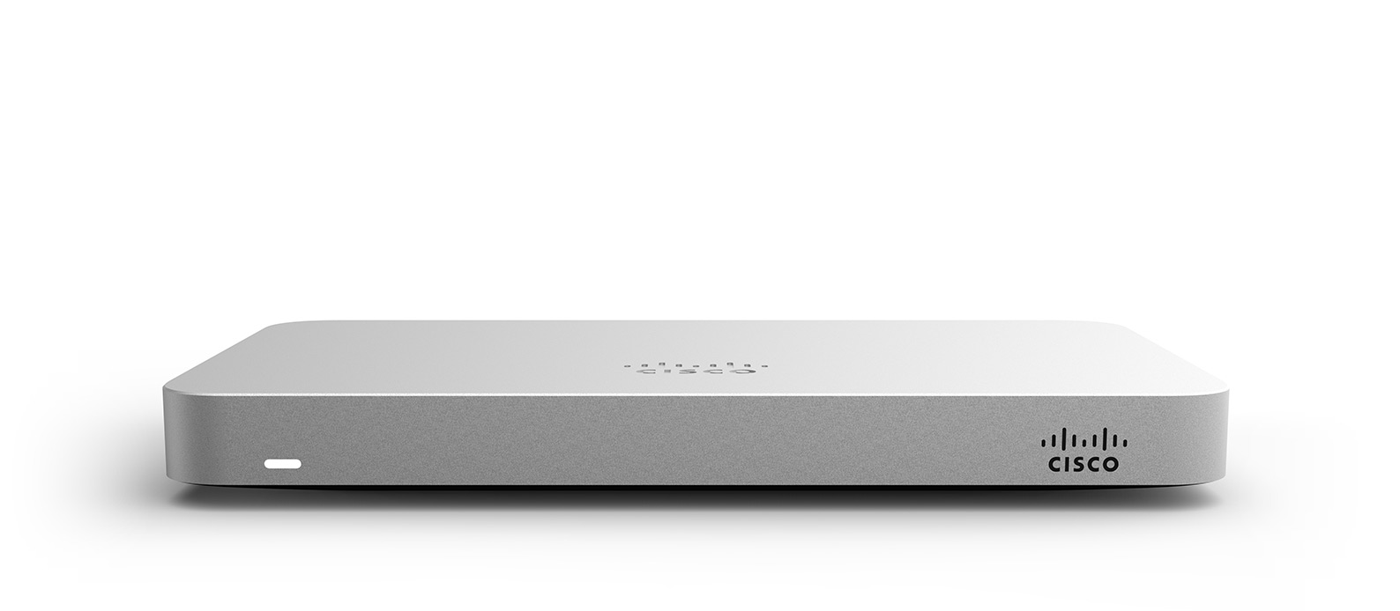
Types of Routers 2
Meraki MX64 Router
Network Type: Wired only
Wireless Coverage: None - requires access points to create Wi-Fi Network
Maximum # of Connected Devices: Approx. 100 devices
Offers Cloud Analytics and support tools (Toast support remote access and troubleshooting)
4 Ethernet ports for hard wired connections
The MX64 is a big step up from the Z1 and covers all setups larger than 10 connected devices. It is a more robust router that is essential for larger installs. It does not create a wireless network on its own, so if your deal needs Wi-Fi (even in a small space), an access point will be necessary. 3 Year Cloud License included with purchase.

Slide 9
Next step… devices!
Now that we know about the differences in the routers, let’s start connecting devices! Let’s pretend we are using a Z1 to start - so that we can hardwire, as well as wirelessly connect devices.
ISP
Router
Modem

Slide 10
Next step… devices!
Let’s start with hardwiring some terminals
Z1
ISP
Modem

Slide 11
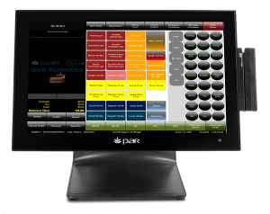
Hardwiring
ISP
Modem
Z1
Terminal 1

Slide 12
Hardwiring
Z1
Terminal 1
ISP
Modem
Terminal 2

Slide 13
Hardwiring
T1
Z1
ISP
Modem
T 3
T2
T 4

Slide 14
Hardwiring
T 1
T 3
Z1
ISP
Modem
T2
!?
T 4
T5

Slide 15
Uh oh...
The Z1 only has 4 ethernet ports, and we have 5 terminals that need to be hardwired.
What happens now?

Slide 16
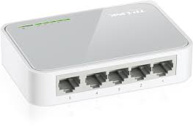
Switches
Here is where switches come in!
A switch is basically a splitter, or power strip for ethernet. We can use a switch to turn 1 port into multiple ports! Simply plug the switch into the router, then plug the terminals into the switch.

Slide 17
Switches
Here is where switches come in!
A switch is basically a splitter, or power strip for ethernet. We can use a switch to turn 1 port into multiple ports! Simply plug the switch into the router, then plug the terminals into the switch.
All hardwired PAR/Brink Terminals, printers and access points (which we’ll cover soon) need to be connected to the router somehow. Depending on the situation, you could need anywhere from 1 to 100 ethernet cables to connect to a single router. Toast has a variety of switches available to cover all possible setups.

Slide 18
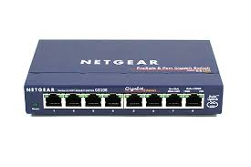
Switches
4-5 Port Switch
8 Port Switch
16 Port Switch
Switches are simple. You just need the correct number of ports covered.
These are the basic switches. Once we cover access point’s we’ll look at more advanced switches.
Pro Tip: Switches also allow you to be more flexible with wiring. If you have 5 terminals upstairs that need to be hardwired, but your modem and router are in the basement, you could use a switch to connect all the terminals upstairs, and only have to run one ethernet cable to the basement, saving a ton of time and energy.

Slide 19
Hardwiring
T 1
T3
Z1
ISP
Modem
T 2
Switch
T5
T 4

Slide 20
Hardwiring
Problem solved!
T1
T 3
Z1
T 2
ISP
Modem
Switch
T 5
T 4

Slide 21
If we add more equipment...
All the same rules apply. Even when the setup starts to look more complicated - it’s just connecting wires and getting them to the router.
T 1
T3
Z1
ISP
Modem
T 2
Switch
T 4
T 5

Slide 22
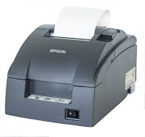
If we add more equipment...
There are endless potential combinations as the # of ports increase.
T3
T 1
Z1
ISP
Modem
Switch
T 2
Kitchen Printers
T5
T4

Slide 23
If we add more equipment...
Add another switch, and connect to the first switch?
T1
T3
Z1
ISP
Modem
Switch
T2
Kitchen Printers
T 4
T 5

Slide 24
If we add more equipment...
Add another switch,
and connect to the router?
T3
T 1
Z1
ISP
Modem
T2
Switch
Kitchen Printers
T5
T 4

Slide 25
If we add more equipment...
Add a bigger switch? 16 Port
T 1
T 3
Z1
T 2
ISP
Modem
Switch
Kitchen Printers
T 4
T5

Slide 26
Just focus on the basics
Networking can seem overwhelming to many people. In reality, the basic rules of networking are quite simple.
Every device needs to connect to the router, if there isn’t space, make some!

Slide 27
Speaking of devices,
Before diving into how wireless works, first let’s make sure we all agree what a “device” is (with regards to networking).

Slide 28
Speaking of devices
Before diving into how wireless works, first let’s make sure we all agree what a “device” is (with regards to networking).
A device is any object connected to the router to access the internet
that has an IP Address.

Slide 29
What’s an IP Address?
Simply put, an
IP address
is the unique identifier for a device that is assigned when it connects to the router. This allows the router to differentiate between devices.

Slide 30
What’s an IP Address?
Simply put, an
IP address
is the unique identifier for a device that is assigned when it connects to the router.
This allows the router to differentiate between devices.
Easy example: Bob and Mary both have tablets in the same room as a router. Bob connects to the router’s wireless network by entering the password. The router assigns Bob’s tablet the IP address - 192.168.1.1 and starts routing internet to the tablet. Bob’s on the web! Mary, however, isn’t on the web, since she hasn’t connected to the network by entering the password. That means the router doesn’t know how to route internet to Mary’s tablet, since it doesn’t have an IP address to send it to.

Slide 31
So, what has an IP address?
The devices with IP addresses
(relevant to Brink, that is)
are:
Tablets (Terminals, Handhelds, KDS - ANY tablet)
Printers
Access Points (which we’ll cover in just a moment)

Slide 32
So, what has an IP address?
The devices with IP addresses (relevant to Brink, that is) are:
Tablets (Terminals, Handhelds, KDS - ANY tablet)
Printers
Access Points (which we’ll cover in just a moment)
So if my restaurant has 2 Terminals, 1 Handheld, 1 Receipt printer, 2 Kitchen printers and 2 Access Points - you could say I have 8 devices with IP addresses that need to connect to the router and access the internet.

Slide 33
Why does this matter?
If you remember the slides on Brink routers, you’ll remember that each router has a maximum number of devices
it can support.

Slide 34
Why does this matter?
If you remember the slides on Brink routers, you’ll remember that each router has a maximum number of devices it can support.
Meraki Z1
Maximum # of Devices: Approx. 10

Slide 35
Why does this matter?
If you remember the slides on Brink routers, you’ll remember that each router has a maximum number of devices it can support.
Meraki Z1
Maximum # of Devices: Approx. 10
Meraki MX64
Maximum # of Devices: Approx. 100
So the number of devices affects our router choice.

Slide 36
Don’t fall for the easy mistake!
Number of Devices
does not equal
Number of Tablets.
A tablet is just one of the
3 types of devices.

Slide 37
Don’t fall for the easy mistake!
Number of Devices
does not equal Number of Tablets.
A tablet is just one of the 3 types of devices.
Common mistake:
“It’s just a simple 6 Terminal setup - a Z1 will be fine”

Slide 38
Don’t fall for the easy mistake!
Number of Devices
does not equal Number of Tablets.
A tablet is just one of the 3 types of devices.
Common mistake:
“It’s just a simple 6 Terminal setup - a Z1 will be fine”
Not necessarily - you need to account for printers and access points as well. If the total number of Tablets + Printers + Access points is ≤ 10, then a Z1 will do. If that total number of devices is > 10, then you will need an MX64.

Slide 39
Now that we all agree,
Let’s dive into wireless. We’ll go back to our original network setup and remove the hardwired terminals to keep things simple.

Slide 40
Wireless
Alright, back to the Z1 Network we set up.
We learned earlier that the Z1 can broadcast a wireless network and cover approx. 1000 square feet. Let’s add some wireless devices!
ISP
Modem
Z1

Slide 41
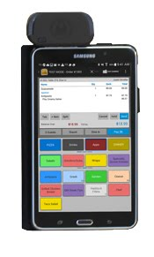
Wireless
Handheld 1
Z1
Modem
ISP

Slide 42
Wireless
Handheld 1
Z1
Handheld 2
ISP
Modem

Slide 43
Wireless
Handheld 1
Handheld 2
ISP
Modem
Z1
Handheld 3

Slide 44
Wireless
Handheld 1
Handheld 2
ISP
Modem
Z1
Handheld 3
Now we’ll look at distance. Let’s outline what 1000 square foot coverage looks like coming from the Z1:

Slide 45
Wireless
Handheld 1
Z1
ISP
Modem
Handheld 2
Handheld 3
Wireless Network Coverage

Slide 46
Wireless
Handheld 3
Handheld 1
Z1
ISP
Modem
Handheld 2
Looks like Handhelds 1 and 2 are covered, but Handheld 3 is outside of the range of the Z1. We’ll need to extend the coverage somehow, or Handheld 3 won’t be able to access the Internet
Wireless Network Coverage

Slide 47
Cue Access Points!
An Access Point
serves as a wireless network extender. Access Points allow us to cover large spaces with
Wi-Fi
so that customers can take advantage of Toast’s wireless solutions.

Slide 48
Cue Access Points!
An Access Point
serves as a wireless network extender. Access Points allow us to cover large spaces with
Wi-Fi
so that customers can take advantage of Brink’s wireless solutions.
Brink offers 3 Access Points to cover all scenarios:

Slide 49
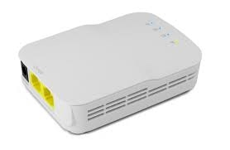
Types of AP’s (1)
Open Mesh Dual Band Access Point
Standard go-to Access Point used in all basic scenarios. These are the least expensive AP’s that are used to easily extend wireless over large or tricky spaces.

Slide 50
Types of AP’s (2)
Open Mesh Dual Band Access Point
Standard go-to Access Point used in all basic scenarios. These are the least expensive AP’s that are used to easily extend wireless over large or tricky spaces.
Each Dual Band will cover approx. 1000 square feet of space in addition to the Z1.
This AP does not have any advanced features.

Slide 51
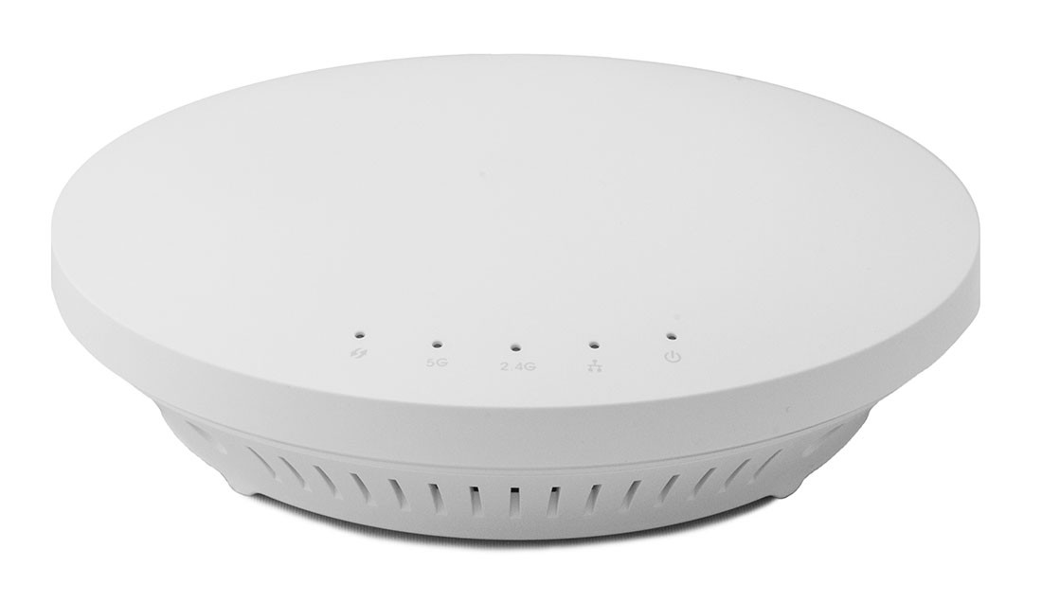
Types of AP’s (3)
Open Mesh MR1750 Access Point
The step up from the Dual Band, the MR1750 covers a slightly larger range and provides some additional features.

Slide 52
Types of AP’s (3)
Open Mesh MR1750 Access Point
The step up from the Dual Band, the MR1750 covers a slightly larger range and provides some additional features.
The MR1750 has cloud analytics & support tools, so as wireless configurations become more complex and demanding, the MR1750’s supportability becomes well worth the very slight price increase from the Dual Band.

Slide 53
Types of AP’s (4)
Meraki MR18 Access Point
The MR18 is the most powerful access point Brink offers, with advanced cloud support tools and an extremely robust network strength.

Slide 54
Types of AP’s (4)
Meraki MR18 Access Point
The MR18 is the most powerful access point Toast offers, with advanced cloud support tools and an extremely robust network strength.
The MR18 is the premium access point, but also comes with a premium price tag. However, any technically demanding setup (heavy reliance on wifi, many handhelds) will need to consider the MR18 for it’s reliability and support tools.

Slide 55
Wireless
Handheld 1
Handheld 3
Z1
ISP
Modem
Handheld 2
Now, let’s use an access point to help get Handheld 3 onto our wireless network.
Wireless Network Coverage

Slide 56
Wireless
Handheld 1
Handheld 3
Z1
ISP
Modem
Handheld 2
Wireless Network Coverage
Thanks Access Point!

Slide 57
What about MX64s?
Remember, although Z1 Routers can broadcast wirelessly (as well as support hardwired connections), the
MX64
does not broadcast wirelessly out of the box.

Slide 58
What about MX64s?
Remember, although Z1 Routers can broadcast wirelessly (as well as support hardwired connections), the MX64 does not broadcast wirelessly out of the box.
If you need an MX64 router for your setup, and need wireless, you just need to add an access point.

Slide 59
MX64
Handheld 1
Handheld 3
Z1
ISP
Modem
Handheld 2
Switch to MX64
Wireless Network Coverage

Slide 60
MX64
Handheld 1
Handheld 2
MX64
ISP
Modem
Handheld 3
Notice we lose our wireless network when switching to the MX64. Let’s add an access point to fix this

Slide 61
MX64
Handheld 1
Handheld 2
ISP
MX64
Modem
Handheld 3

Slide 62
MX64
Handheld 1
Handheld 2
MX64
ISP
Modem
Handheld 3

Slide 63
Basics Recap

Slide 64
What we’ve covered
Basic Hardware
Routers, Switches, Access Points
Internet Basics
ISP, Modems, Hardwired and Wireless connections
Some Specifics
IP addresses, varying combinations, router nuances

Slide 65
Advanced Networking

Slide 66
Let’s pick up where we left off
At the end of Networking Basics training, we covered setting up access points with routers to extend wireless coverage.
There is one thing we overlooked though...

Slide 67
MX64
Handheld 1
Handheld 2
MX64
ISP
Modem
Handheld 3
Here is our last setup, where we added an AP to cover some handhelds. Simple enough! Let’s remove some things to clear up some space.

Slide 68
Our previous setup
We know that the AP needs to be connected to the router to establish an internet connection.
MX64
ISP
Modem
What we didn’t consider, is how that access point is going to be powered. Just like all our other electronics, this AP is going to need power!

Slide 69
Our previous setup
We know that the AP needs to be connected to the router to establish an internet connection.
ISP
Modem
MX64
There we go. Let’s focus on this access point.

Slide 70
Our previous setup
ISP
Modem
MX64
Access points are generally placed where they provide the best coverage. Often this means mounting them to a wall or drop ceiling.

Slide 71
Our previous setup
Access points are generally placed where they provide the best coverage. Often this means mounting them to a wall or drop ceiling.
MX64
ISP
Modem
Unless you get lucky, there probably will not be a power outlet where you happen to need your access point installed.

Slide 72
Our previous setup
Access points are generally placed where they provide the best coverage. Often this means mounting them to a wall or drop ceiling.
Unless you get lucky, there probably will not be a power outlet where you happen to need your access point installed.
MX64
ISP
Modem
That’s where PoE comes in

Slide 73
Power over Ethernet (PoE)
Power over Ethernet
allows you to send electricity through an ethernet cable to power a PoE compatible device.

Slide 74
Power over Ethernet (PoE)
Power over Ethernet
allows you to send electricity through an ethernet cable to power a PoE compatible device.
With PoE equipment, you can turn any ethernet cable into an internet/electric hybrid.

Slide 75
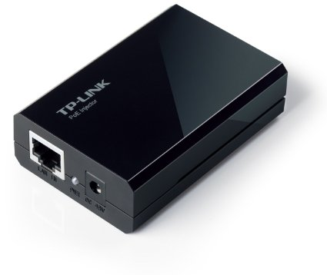
PoE Injector
PoE Injector - for a single device
Plug the router to the injector via ethernet, then plug the injector to the access point via ethernet and plug the injector to an outlet with an adapter.

Slide 76
PoE Injector
PoE Injector - for a single device
Plug the router to the injector via ethernet, then plug the injector to the access point via ethernet and plug the injector to an outlet with an adapter.
In other words, just put a PoE injector in between the router and the access point along the ethernet cable to provide power! This gives you the freedom to place the AP wherever you need, and the PoE will provide power from the source.

Slide 77
How PoE works
Ethernet cable
MX64
AP
PoE

Slide 78
How PoE works
MX64
PoE
Ethernet cable
AP
Connect to outlet
Device is powered!

Slide 79
But what about multiple devices?
Now we know how to handle that tricky access point that needs power. But what if there are multiple access points?
Of course you could just use multiple PoE injectors. In fact for 1, 2 or 3 access points, that is probably your best bet. Once you start to encounter more than a few access points needing PoE, however, having lots of individual PoE injectors all plugged into outlets near the router gets cumbersome, and more difficult to manage

Slide 80
The PoE Switch
Netgear Prosafe 16 Port PoE Switch
PoE + Switch = PoE Switch
Looks just like a regular switch, but every port can be enabled with PoE to accommodate multiple devices!
PoE switches can be used just like a regular switch that also offers PoE. This means you can use a PoE switch for all ethernet devices and provide the necessary APs with electricity.

Slide 81
The PoE Switch
Netgear Prosafe 16 Port PoE Switch
PoE + Switch = PoE Switch
Looks just like a regular switch, but every port can be enabled with PoE to accommodate multiple devices!
PoE switches can be used just like a regular switch that also offers PoE. This means you can use a PoE switch for all ethernet devices, and provide the necessary APs with electricity.

Slide 82
What else?
So now we can build a simple wired network, a simple wireless network, make sure all ethernet ports are accounted for with switches, cover large wireless network areas with access points
AND make sure those Aps
are powered with PoE.

Slide 83
What else?
So now we can build a simple wired network, a simple wireless network, make sure all ethernet ports are accounted for with switches, cover large wireless network areas with access points AND make sure those APs are powered with PoE.
Is there anything else we need to consider
when building these networks?

Slide 84
1 Simple Exception
There is 1 Simple Exception that you should be aware of when building simple networks, and it has to do with running access points in wireless setups.
Let’s go back to a wireless setup with a Z1 and an Open Mesh Access Point

Slide 85
So here we are - this setup has a Z1 broadcasting a wireless network (covering roughly 1,000 square feet), and a single open mesh access point covering another 1,000. Together, they cover all the handhelds, right?
Handheld 1
Z1
Handheld 3
ISP
Modem
Handheld 2

Slide 86
The networks that Z1’s broadcast and the networks that Open Mesh APs broadcast are actually slightly different. Think of them as “speaking different languages”.
You can encounter issues when you allow both to broadcast simultaneously.
Handheld 1
ISP
Modem
Z1
Handheld 3
Handheld 2

Slide 87
If Handheld 3 moved from where it is now (connecting to the Open Mesh AP) into the coverage of the Z1…
It would have to jump from “speaking 1 wireless language to another”. This would cause issues for the tablet, that’s just trying to connect to the internet.
Handheld 1
Handheld 2
Z1
Handheld 3
ISP
Modem
?

Slide 88
This sort of interference can really disrupt the handheld user’s experience. We need to make it easy for the tablet to connect to the internet, so service isn’t interrupted. To do this, we just need to make sure all the devices broadcasting wireless are “speaking the same language”.

Slide 89
If Handheld 3 moved from where it is now (connecting to the Open Mesh AP) into the coverage of the Z1...
Handheld 2
Z1
Handheld 3
ISP
Modem

Slide 90
This sort of interference can really disrupt the handheld user’s experience. We need to make it easy for the tablet to connect to the internet, so service isn’t interrupted. To do this, we just need to make sure all the devices broadcasting wireless are “speaking the same language”.
Since Open Mesh access points all speak the same language, we can build networks with Open Mesh that tablets can wander through without worrying about interference or speaking different languages.

Slide 91
This sort of interference can really disrupt the handheld user’s experience. We need to make it easy for the tablet to connect to the internet, so service isn’t interrupted. To do this, we just need to make sure all the devices broadcasting wireless are “speaking the same language”.
Since Open Mesh access points all speak the same language, we can build networks with Open Mesh that tablets can wander through without worrying about interference or speaking different languages. Just like when you’re roaming on a cell phone, you can move between 2 different towers’ coverage areas without dropping the call - wireless works the same way!
✅

Slide 92
So in our original example, we just have to turn off the Z1 from broadcasting, so our 2nd language isn’t disruptive.
Handheld 1
Z1
Handheld 3
ISP
Modem
Handheld 2

Slide 93
Handheld 1
So in our original example, we just have to turn off the Z1 from broadcasting, so our 2nd language isn’t disruptive.
Handheld 2
Z1
ISP
Modem
Handheld 3

Slide 94
Once the Z1 is not broadcasting, we can add another open mesh access point to broadcast in its place!
Handheld 1
AP
Handheld 2
Z1
Handheld 3
ISP
Modem
AP
Looks like we’re covered!

Slide 95
The “Same Language” Rule
This “same language” rule applies to all wireless networking devices. You can’t mix a Meraki Z1’s signal with an Open Mesh AP’s signal. The same would go for mixing an Open Mesh AP and a Meraki MR18 AP.
Make sure to keep this in mind when adding access points to setups with Z1s. An 1,800 square foot space can’t use a Z1 + an Open Mesh, but rather needs 2 Open Mesh access points.

Slide 96
Advanced Networking

Slide 97
Advanced Recap
What we covered:
PoE (Power over Ethernet)
PoE Injectors
PoE Switches
The Same Language Rule
Mixing Z1 Wireless signals with Open Mesh signals is a NO GO
Wireless devices can move through “Same Language” space without issue

Slide 98
Covering Complex Spaces

Slide 99
Complex Space
So, we have a pretty good understanding of covering spaces with wireless routers and access points using different types of equipment, and the rules that come along with them (POE, switches, POE switches, APs, the “Same Language Rule”, etc.)

Slide 100
Complex Space
So, we have a pretty good understanding of covering spaces with wireless routers and access points using different types of equipment, and the rules that come along with them (POE, switches, POE switches, APs, the “Same Language Rule”, etc.)
When it comes to wireless installs, we know our basic rule of thumb is 1 access point for every 1,000 square feet. But as we all know, not all restaurants are segmented into perfect 1,000 sq. ft bubble shapes to make it easy on our access points...

Slide 101
Complex Space
So, we have a pretty good understanding of covering spaces with wireless routers and access points using different types of equipment, and the rules that come along with them (POE, switches, POE switches, APs, the “Same Language Rule”, etc.)
When it comes to wireless installs, we know our basic rule of thumb is 1 access point for every 1,000 square feet. But as we all know, not all restaurants are segmented into perfect 1,000 sq. ft bubble shapes to make it easy on our access points…
Multiple floors, multiple rooms, extremely large spaces, building materials and intended use are just a few of the many factors considered when building a network

Slide 102
Building Materials
Wireless signals are simple radio waves and behave like them. That means the materials they travel through matter.

Slide 103
Building Materials
Wireless signals are simple radio waves and behave like them. That means the materials they travel through matter.
Simply put - Radio waves do not travel well through metal, brick, or very thick concrete walls or spaces. The worse the material, the weaker the signal

Slide 104
Building Materials
Wireless signals are simple radio waves and behave like them. That means the materials they travel through matter.
Simply put - Radio waves do not travel well through metal, brick, or very thick concrete walls or spaces. The worse the material, the weaker the signal
Glass, thin wood

Slide 105
Building Materials
Wireless signals are simple radio waves and behave like them. That means the materials they travel through matter.
Simply put - Radio waves do not travel well through metal, brick, or very thick concrete walls or spaces. The worse the material, the weaker the signal
Glass, thin wood
Thicker wood, thin concrete

Slide 106
Building Materials
Wireless signals are simple radio waves and behave like them. That means the materials they travel through matter.
Simply put - Radio waves do not travel well through metal, brick, or very thick concrete walls or spaces. The worse the material, the weaker the signal
Glass, thin wood
Thicker wood, thin concrete
Brick, thin metal

Slide 107
Building Materials
Wireless signals are simple radio waves and behave like them. That means the materials they travel through matter.
Simply put - Radio waves do not travel well through metal, brick, or very thick concrete walls or spaces. The worse the material, the weaker the signal
Glass, thin wood
Thicker wood, thin concrete
Brick, thin metal
Thick Metal

Slide 108
Careful with Materials!
Safe to say, don’t expect wireless to travel through brick walls or metal. Metal is very common in kitchens, so if wireless is needed in a kitchen (rare) make sure there is an access point inside the room.

Slide 109
Careful with Materials!
Safe to say, don’t expect wireless to travel through brick walls or metal. Metal is very common in kitchens, so if wireless is needed in a kitchen (rare) make sure there is an access point inside the room.
This may factor into even smaller spaces. Let’s take a 1,400 sq. ft space - if it is just 1 room, you might get by with just 1 source of wireless. If it’s 2 separated rooms, the barrier will impede the signal.

Slide 110
Careful with Materials!
Safe to say, don’t expect wireless to travel through brick walls or metal. Metal is very common in kitchens, so if wireless is needed in a kitchen (rare) make sure there is an access point inside the room.
This may factor into even smaller spaces. Let’s take a 1,400 sq ft space - if it is just 1 room, you might get by with just 1 source of wireless. If it’s 2 separated rooms, the barrier will impede the signal.
1,600 sq ft
*skewed to fit screen: AP range outline would be larger
✅

Slide 111
Careful with Materials!
Safe to say, don’t expect wireless to travel through brick walls or metal. Metal is very common in kitchens, so if wireless is needed in a kitchen (rare) make sure there is an access point inside the room.
This may factor into even smaller spaces. Let’s take a 1,400 sq ft space - if it is just 1 room, you might get by with just 1 source of wireless. If it’s 2 separated rooms, the barrier will impede the signal.
1,600 sq ft
*skewed to fit screen: AP range outline would be larger
?

Slide 112
Careful with Materials!
Safe to say, don’t expect wireless to travel through brick walls or metal. Metal is very common in kitchens, so if wireless is needed in a kitchen (rare) make sure there is an access point inside the room.
This may factor into even smaller spaces. Let’s take a 1,400 sq ft space - if it is just 1 room, you might get by with just 1 source of wireless. If it’s 2 separated rooms, the barrier will impede the signal.
1,600 sq ft
*skewed to fit screen: AP range outline would be larger
✅

Slide 113
Where? The Most Important Question
Let’s look at 2 scenarios: a wired setup (no wireless) and a wireless setup and focus on what is important for each.

Slide 114
Where? The Most Important Question
Let’s look at 2 scenarios: a wired setup (no wireless) and a wireless setup and focus on what is important for each.
Wired: Where are your PAR hardwired Terminals going to be? Are all the necessary terminated wires already run and available?

Slide 115
Where? The Most Important Question
Let’s look at 2 scenarios: a wired setup (no wireless) and a wireless setup and focus on what is important for each.
Wired: Where are your Par hardwired Terminals going to be? Are all the necessary terminated wires already run and available?
Wireless: Where are you planning on using the wireless tablets? Is there wireless coverage available wherever the tablets will be?

Slide 116
Where? The Most Important Question
Where tablets will be used is the most important question, as it influences the entire install. Let’s dive into each scenario again.

Slide 117
Where? The Most Important Question
Where tablets will be used is the most important question, as it influences the entire install. Let’s dive into each scenario again.
Wired:
“Where do you want to use Par Terminals?”
Are you currently using POS terminals in the same places? (existing ethernet wiring setup already available & can be reused)

Slide 118
Where? The Most Important Question
Where tablets will be used is the most important question, as it influences the entire install. Let’s dive into each scenario again.
Wired:
“Where do you want to use Toast Terminals?”
Are you currently using POS terminals in the same places? (existing ethernet wiring setup already available & can be reused)
“Do you want a terminal where you currently do not have a POS terminal installed?” (this may require additional ethernet cable wiring & termination, which is a service PAR typically does not provide)

Slide 119
Where? The Most Important Question
So the key with wired setups is looking where the current POS is being used, ensuring there is ethernet available there, and if there isn’t, that new wiring is addressed. Now let’s look at Wireless
Wireless:
“Where do you want to use your wireless PAR tablets?” (where will access points need to be placed to cover these tablets?)
Is there wiring available to install these access points?
“Are these tablets going to roam/leave a designated space?” (wherever the tablet might be used, coverage is needed. This could be just a single section - or it could mean the entire restaurant)

Slide 120
Where where where?
“Where” can solve tons of problems and avoid unnecessary effort.
10,000 sq. ft space w/ handhelds?
“Where will you use them?” - Answer: “Oh, the handhelds are only used for the beer garden, which is only an 800 sq. ft space near the kitchen”.
Only 1 AP needed. Crisis avoided

Slide 121
Where where where?
“Where” can solve tons of problems and avoid unnecessary effort.
10,000 sq. ft space w/ handhelds?
“Where will you use them?” - Answer: “Oh, the handhelds are only used for the beer garden, which is only an 800 sq. ft space near the kitchen”.
Only 1 AP needed. Crisis avoided
40,000 sq. ft space
“Where are you using PAR?” - Answer: “We are just using hard-wired terminals, and they are just replacing our existing terminals”
No APs or wiring needed. Another crisis avoided

Slide 122
Real Life Example
Let’s look at a real floorplan for a customer who was considering a bunch of hardwired terminals and 3-4 handhelds. Floorplans are always extremely helpful (and sometimes necessary) to collect.

Slide 123
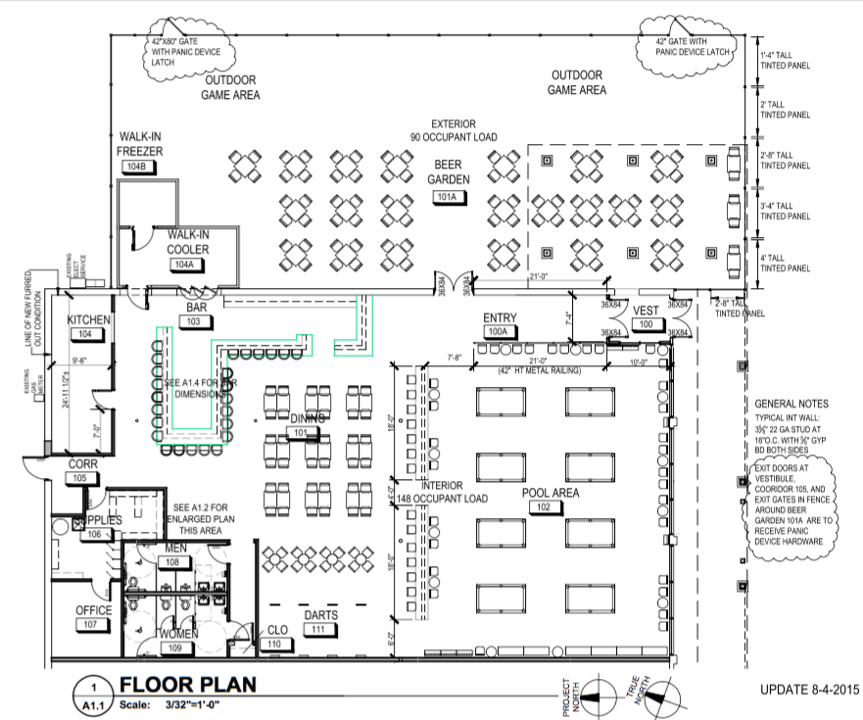
As you can see, this customer has a rather large space with a dining area, bar, a pool area, and outdoor beer garden, as well as some “in between” spaces.
This space is roughly 8,500 square feet

Slide 124
As you can see, this customer has a rather large space with a dining area, bar, a pool area, and outdoor beer garden, as well as some “in between” spaces.
This space is roughly 8,500 square feet
If we just looked at this deal on paper, we would see: 8,500 sq feet and 4 handhelds - which would lead anyone to simply think…

Slide 125
As you can see, this customer has a rather large space with a dining area, bar, a pool area, and outdoor beer garden, as well as some “in between” spaces.
This space is roughly 8,500 square feet
If we just looked at this deal on paper, we would see: 8,500 sq. feet and 4 handhelds - which would lead anyone to simply think…
“This deal needs 8-9 access points”

Slide 126
Yikes! 8-9 access points is a lot and will be a notable expense for the customer. We better make sure that they are all necessary

Slide 127
Yikes! 8-9 access points is a lot and will be a notable expense for the customer. We better make sure that they are all necessary
“Where do you hope to use the handhelds, Mr./Mrs. Customer?”

Slide 128
Yikes! 8-9 access points is a lot, and will be a notable expense for the customer. We better make sure that they are all necessary
“Where do you hope to use the handhelds, Mr./Mrs. Customer?”
“We have the stationary terminals for the bar, beer garden and 1 for the pool area - we were thinking we could use them for the dining area and to help speed up the pool area”
Glad we asked...

Slide 129
Looks like we only need wireless coverage here and here.
This significantly cuts back the networking equipment needs. The dining area totals about 800 sq. ft, and the pool area totals about 1,700 sq. ft.

Slide 130
Looks like we only need wireless coverage here and here.
This significantly cuts back the networking equipment needs. The dining area totals about 800 sq. ft, and the pool area totals about 1,700 sq. ft.
Now we can strategically place our access points to cover the area. Here we can take into account walls/ceilings and existing ethernet cables run.
Let’s look at the relevant materials!

Slide 131
What is this barrier made from?
As we learned, the material may influence how wireless propagates through it, and thus how we set up the network .

Slide 132
What is this barrier made from?
As we learned, the material may influence how wireless propagates through it, and thus how we set up the network .
After asking the customer, it looks like that barrier isn’t a wall, just a low railing to divide the rooms with some cabinets to store electronics and host the stationary POS terminals. That means wireless won’t have much trouble traveling through it!

Slide 133
What is this barrier made out of?
As we learned, the material may influence how wireless propagates through it, and thus how we set up the network .
After asking the customer, it looks like that barrier isn’t a wall, just a low railing to divide the rooms with some cabinets to store electronics and host the stationary POS terminals. That means wireless won’t have much trouble traveling through it!
Also, since there are electronics and stations for their current POS equipment there, this might be an ideal spot to plug in an access point or 2!

Slide 134
Since we can hide them right in the cabinets, let’s put 2 APs along this barrier to cover the dining space as well as some of the pool area!

Slide 135
Since we can hide them right in the cabinets, let’s put 2 APs along this barrier to cover the dining space as well as some of the pool area!
Note: this is a simplified image - it’s not great to have significant overlap between APs - they shouldn’t be too close to each other!

Slide 136
Since we can hide them right in the cabinets, let’s put 2 APs along this barrier to cover the dining space as well as some of the pool area!
Note: this is a simplified image - it’s not great to have significant overlap between APs - they shouldn’t be too close to each other!
Now that the dining room is mostly covered, we should look at the pool area. What’s up with the walls around the perimeter of the pool room?

Slide 137
Looks like these walls are made out of brick, and there aren’t any ethernet cables run through them.
Drilling through brick to run a cable isn’t going to be easy, and running a cable along the wall looks tacky & totally kills the ambiance (right?)
So if we can’t install an access point on the wall, where can we put it to finish covering the space?
Let’s look up!

Slide 138
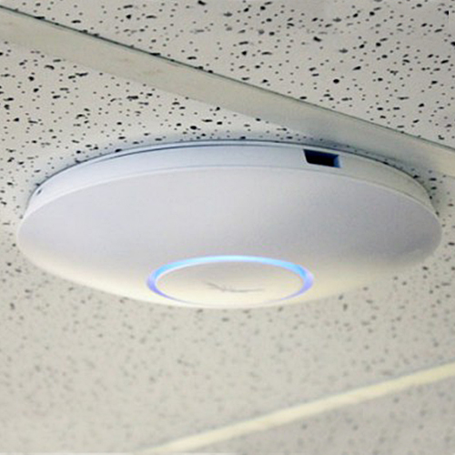
What is the ceiling of the pool room made from?
Looks like it’s a Drop Ceiling! Drop ceilings are ideal for running wires, since you can easily push up the ceiling tiles and move them back into place.
We can have a cable run and place the AP right where it needs to be to cover the space!

Slide 139
Covering Complex Space Recap

Slide 140
Covering Space Recap
What we covered:
Building Materials MATTER!
Metal, Brick and thick Concrete are Wifi killers
Building materials influence how we address an installation (walls, ceilings, barriers, rooms, etc.)
“Where” is the most important question
Where are you using your hardwired tablets
Where are you using your wireless tablets
Site surveys/Floorplans are our friend
Looking at a space specifically helps us avoid unnecessary effort, or concentrate VERY necessary resources towards a tougher project

Slide 141
Congrats! You’ve completed PAR’S Networking Training!

