Slide 1
Stefano Lee, MD

Slide 2
Have you noticed?
More difficulty in seeing your doctor?
Increase in monthly premium and deductible with your insurance?
More time in waiting room?
Less time with your doctor?
Difficulty in communicating to your doctor?
Going to urgent care centers or ER over the weekend?
Getting your medicine or radiology delayed or prevented by your insurance? Prior-authorizations, denials?

Slide 6
What is then Direct Primary Care?
Direct relationship with your doctor, bypassing insurance
Appointment on the same day or next
You can call him almost anytime (I am not an answering machine), reach him by texting, email, or even video chat
Your appointment is between 30 and 60 min as needed
No copay or deductible to worry about

Slide 7
Simple office procedures can be done for free or at low cost
Reduce your visits to urgent care center or ER
Blood works and radiology, even common medications are cheaper
You may cancel it anytime if you are not happy

Slide 8
Pricing comparison 1
Deductible insurance
Harmony family practice
Strep throat visit
Copay: $25
Office visit: $132
Strep test: $39
Total: $196
Based on national averages
Strep throat visit
Copay: none
Office visit: none
Strep test: $10
Total: $10

Slide 9
Pricing comparison 2
Deductible insurance
Harmony family practice
Diabetic visit
Copay: $25
Office visit: $196
Typical labwork: $308
Total: $529
Based on national averages
Diabetic visit
Copay: none
Office visit: none
Typical labwork: $7-15
Total: $7-15

Slide 10
Pricing comparison 3
Deductible insurance
Harmony family practice
Hand laceration visit
Copay: $25
Office visit: $132
Laceration repair: $192
Total: $349
Based on national averages
Hand laceration visit
Copay: none
Office visit: none
Laceration repair: $40
Total: $40

Slide 11
Pricing comparison 4
Deductible insurance
Harmony family practice
40 yo female preventative visit
Copay: none
Office visit: $208
Pap smear: $208
Typical labwork: $352
Total: $768
Based on national averages
40 yo female preventative visit
Copay: none
Office visit: none
Pap smear: $21
Typical labwork: $7-15
Total: $28- 36

Slide 12
Pricing comparison 5
Deductible insurance
Harmony family practice
MRI: $800
Complete metabolic panel: $27
Hemoglobin A1c: $34
TSH: $27
Lisinopril 20 mg x 90: $10
Metformin 500mg x 180: $10
MRI: $270-450
Complete metabolic panel: $7.80
Hemoglobin A1c: $7.25
TSH: $7.50
Lisinopril 20 mg x 100: $2.07
Metformin 500 mg x 1000: $11.75

Slide 13
Scope of practice
Annual health assessments; adults and children
Chronic disease management
Urgent care
Preventative care
Care coordination
General evaluation and management
Weight management
Mental health
Mindfulness therapy
Korean Hand Acupuncture

Slide 14
Procedures we offer with no or low cost
Incision and drainage
Simple laceration repair
Biopsy and lesion removal
Trigger point injection
Joint injection
Toenail removal
EKG
Simple splint and cast
Urinalysis
Rapid Strep test
Rapid flu
Pregnancy test
Other injections (B12, allergy, etc)

Slide 15
Monthly membership pricing
Initial nonrefundable enrollment fee of $50 per adult, or $100 per family
Adult $80 (2nd adult $60, 3rd adult $40)
Children and adolescents up to 18 year-old $20 each.

Slide 16
DPC can also help employees
80-85% of employee health care needs can be met
Catastrophic insurance coverage is still needed (we recommend employees try to purchase a Bronze Plan)
DPC is a health care benefit which can both boost employee morale and aid in retention of valued employees
We offer discount!

Slide 17
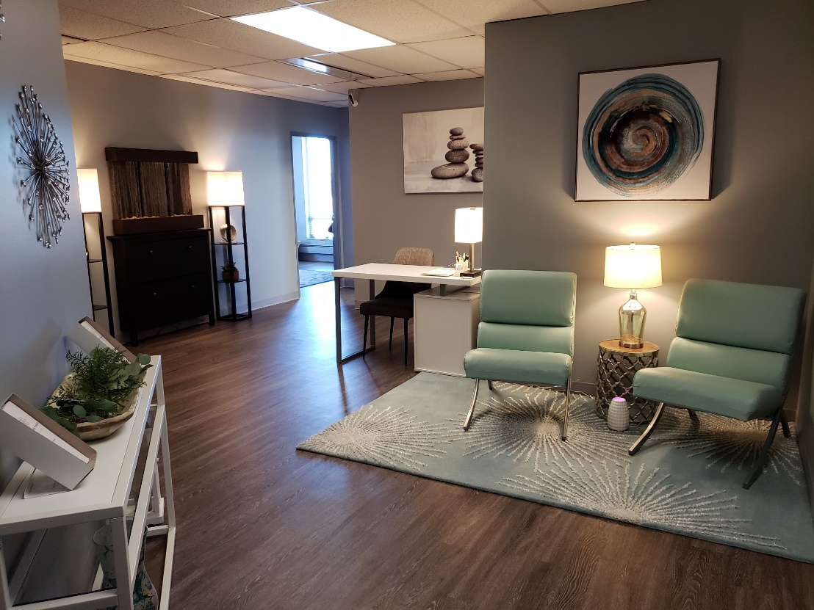
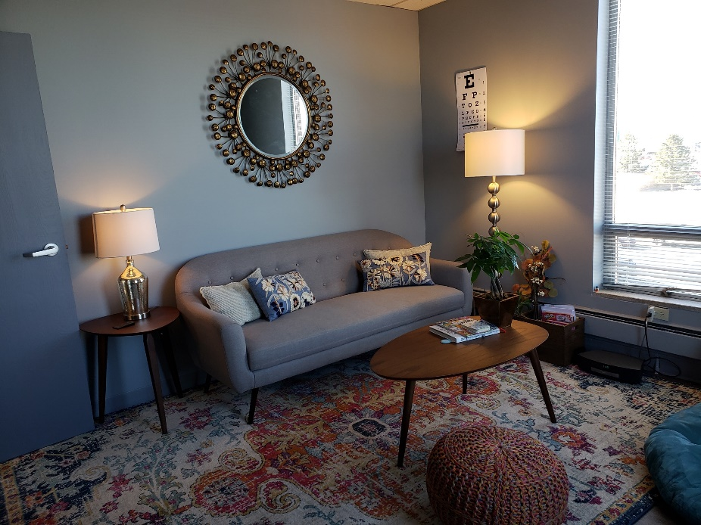

Slide 18
Do I still need an insurance?
Harmony family practice is NOT insurance. We only provide comprehensive primary care
You do not need insurance to become a member
We ALWAYS recommend that you have at least a catastrophic or high deductible insurance plan or healthshare program to cover unexpected events (hospitalizations, surgeries, specialist visits)

Slide 19
I have an insurance, should I still join?
Coverage does NOT always mean CARE.
Better access, convenience, a relationship between you and your doctor, more preventative and wellness care, access to discounted labs, imaging, pathology, and more to come.
Save the amount of your deductible each year
Change to a higher deductible/lower premium plan to save hundreds per year

Slide 20
What about Medicare?
We will see Medicare patients
Although I am opted-out of Medicare, I am still an ordering and referring provider
Medications, labs, imaging and all outside services can still be done through Medicare, if desired
Neither you nor I can seek reimbursement from Medicare for membership fees

