Slide 1
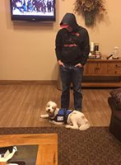
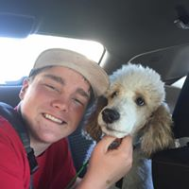
EASTON’S PROJECT
Kemmerer Lions Club 2o18/2019

Slide 2
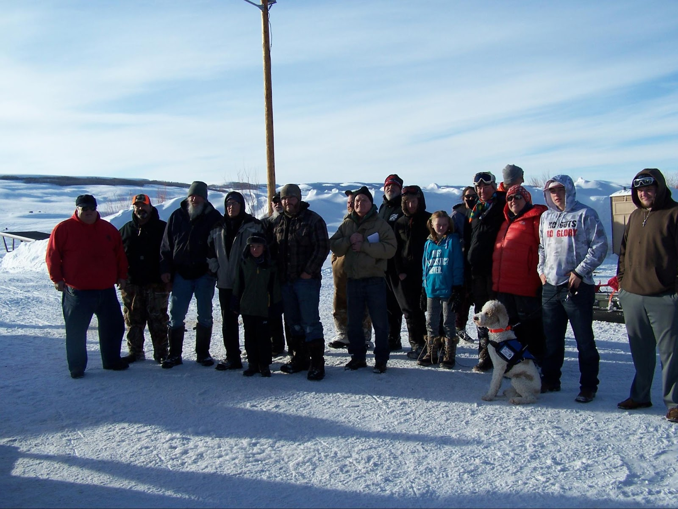
EASTON’S PROJECT CREDITS
KEMMERER LIONS CLUB (KLC)
LIONS OF WYOMING Foundation (LoWF)
STRIKEMASTER
RYDSTROM FAMILY
KEMMERER COMMUNITY

Slide 3
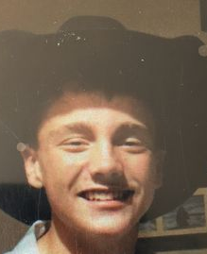
BACKGROUND
In December of 2014, at just 12 years old, Easton was diagnosed with severe Juvenile Diabetes. Easton's condition quickly progressed from frequent monitoring throughout the day and insulin injections to the imperative use of an insulin pump and electronic monitoring device. Easton's condition has, however proven to be even more severe, to the extent that the electronic monitoring equipment does not provide adequate warning in instance where his blood sugar drops precipitously. During these episodes, which can occur as frequently as once a week or more and in as little as 2-3 minutes time, Easton becomes virtually incapacitated (often losing consciousness entirely) and unable to administer the necessary preemptive or corrective measures to avoid a life-threatening situation. Family members and friends have been instrumental in assisting when Easton experiences these life-threatening episodes, but are not always immediately on-hand.

Slide 4
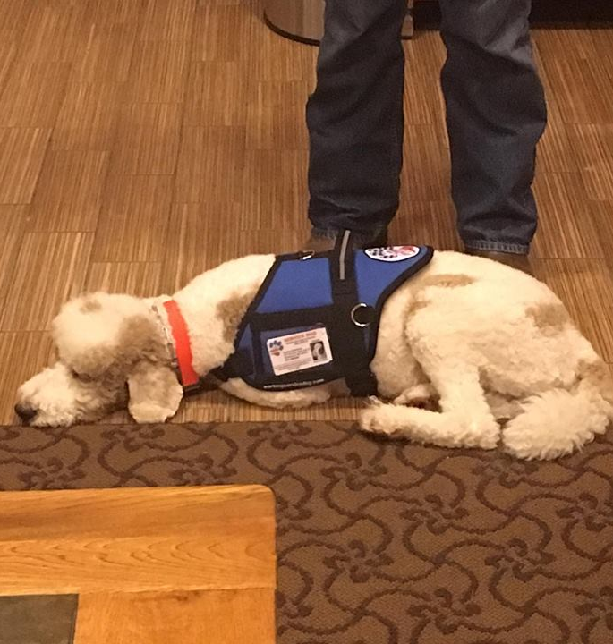
INNOVATIVE OPTIONS
Because Easton's condition can deteriorate so rapidly and unexpectedly (quickly reaching the limitations of the available monitoring technology that the family has employed), a different approach is required to help monitor his physical state, and to preempt these life-threatening events. Through extensive research into available technologies and monitoring options, the family located just a few service providers in the United States, which have begun to train service-dogs to detect and alert at the very early onset of these episodes. Such early detection of these changes in Easton's body allow Easton to personally take corrective measures before his condition becomes so severe that he cannot help himself. In extreme instances, the service animal will seek out and alert others, if Easton himself becomes unresponsive. Where the electronics and medical technology have obviously reached a limitation, this represents the next medically necessary technological advance in the management and treatment of severe cases of diabetes.

Slide 5
AN UNMET NEED
Unfortunately, Easton's medical coverage would not cover the cost of the service animal, given that this is a relatively new approach, and has not been precedented as a common-place service that healthcare coverage is yet obligated to cover. As such, the family bore the entire responsibility for covering the cost of procurement and training of the service animal, which was $15,000.
With Easton’s father working in construction and his mother working full time in the local school system, this represented a financial obligation that the family simply could not meet. Moreover, every day that Easton went without this added level of personal protection, both his short term and long term health were at risk. This is where the KLC became involved.

Slide 6
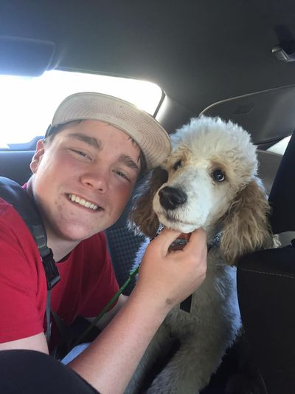
FINANCING EASTON’S PROJECT
Financing began with the Rydstrom family raising $4,500 through their own efforts (i.e. raffles & solicitation of private donations).
The KLC was able to contribute an additional $4,500.
The project was approved by the LoWF for a grant of matching funds to the KLC contribution.
Finally, one of the KLC members was able to obtain a Gas Ice Auger, donated to the KLC by StrikeMaster 100% free of charge. The auger was raffled off in connection with the 2018 KLC Ice Fishing Derby fundraiser event, and netted an additional $3,000.
The total funding raised from these sources was $16,500, providing an additional $1,500 to the family for ancillary expenses (i.e. travel to the training facility in Las Vegas, NV, a part of the training process to introduce Easton to his new companion, Radar.

Slide 7
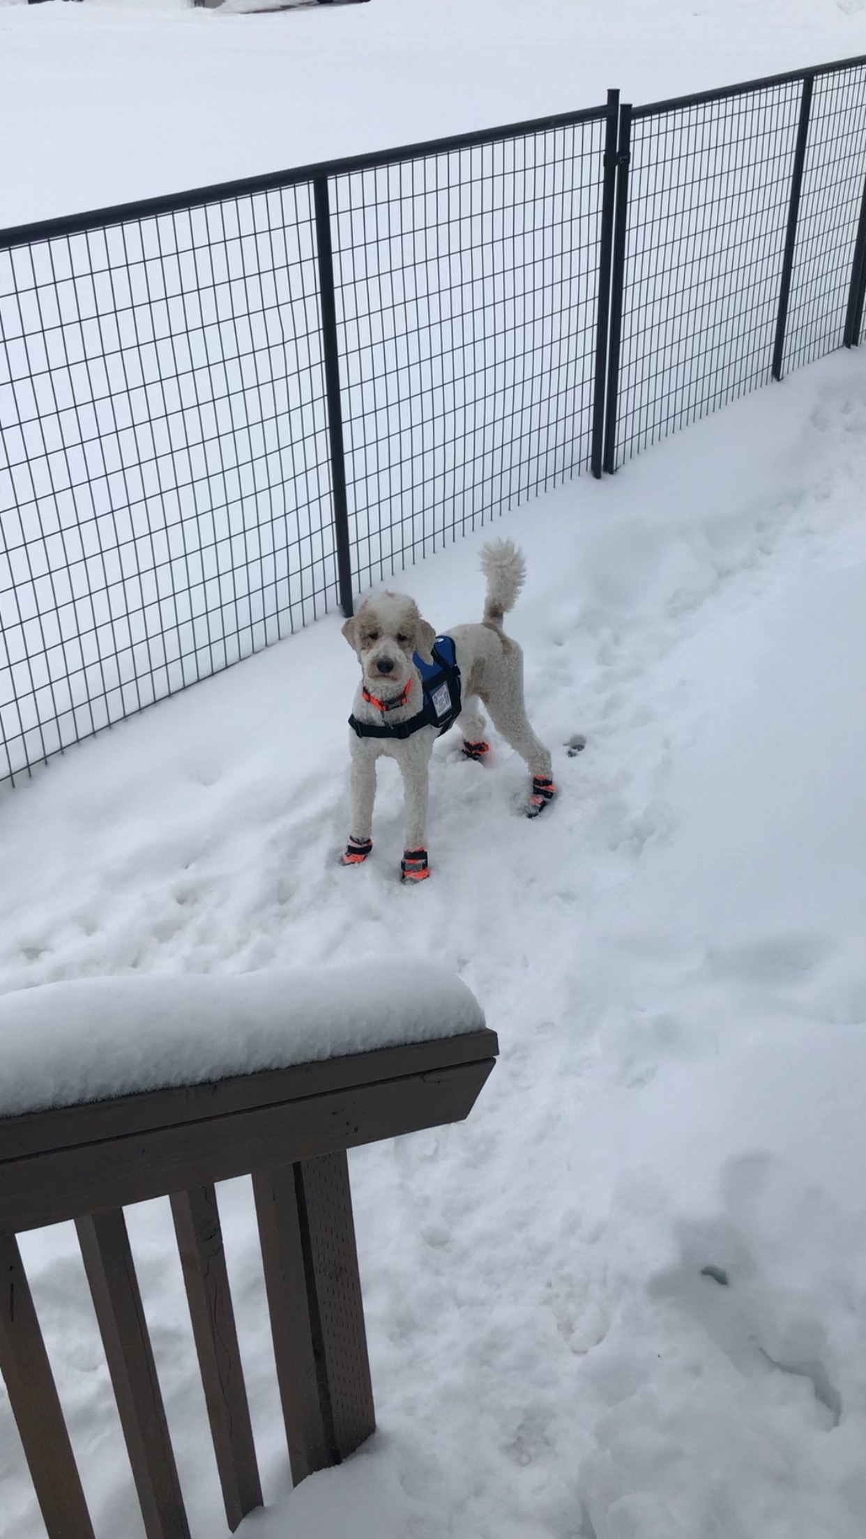
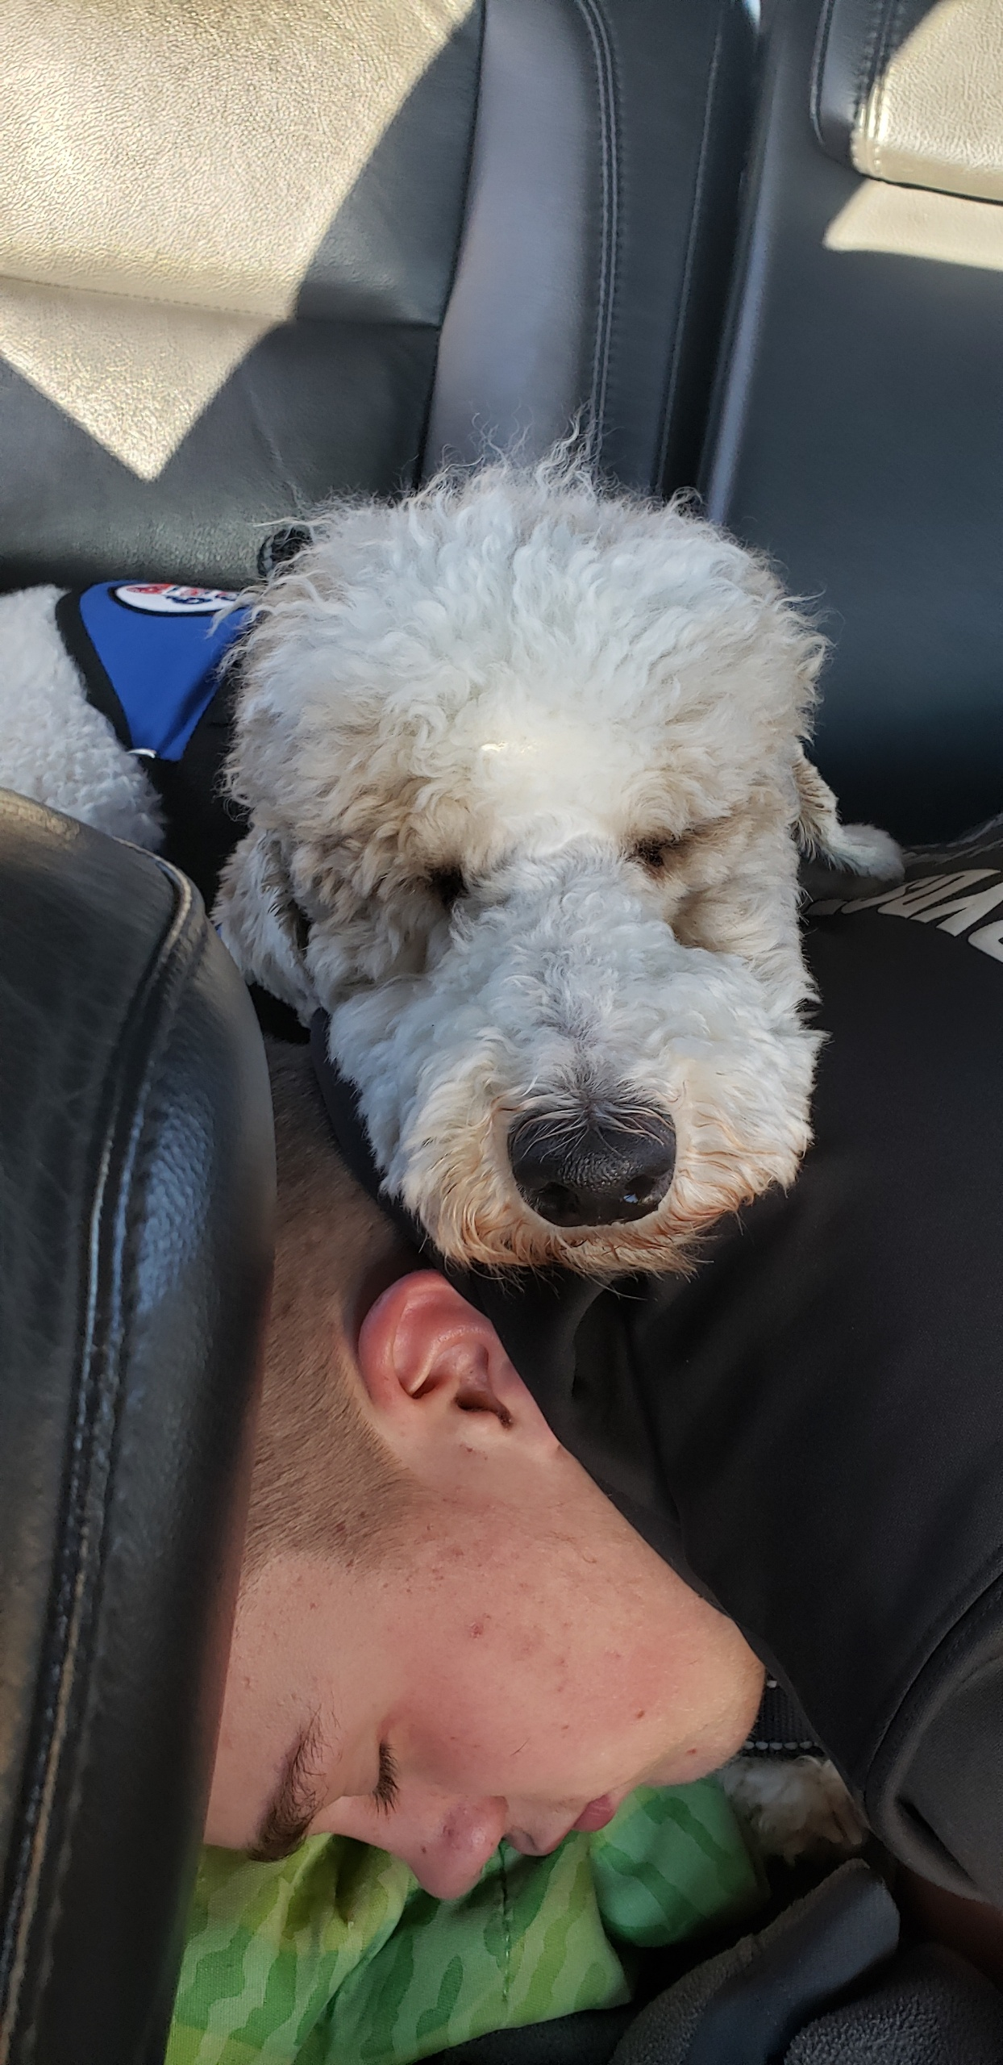
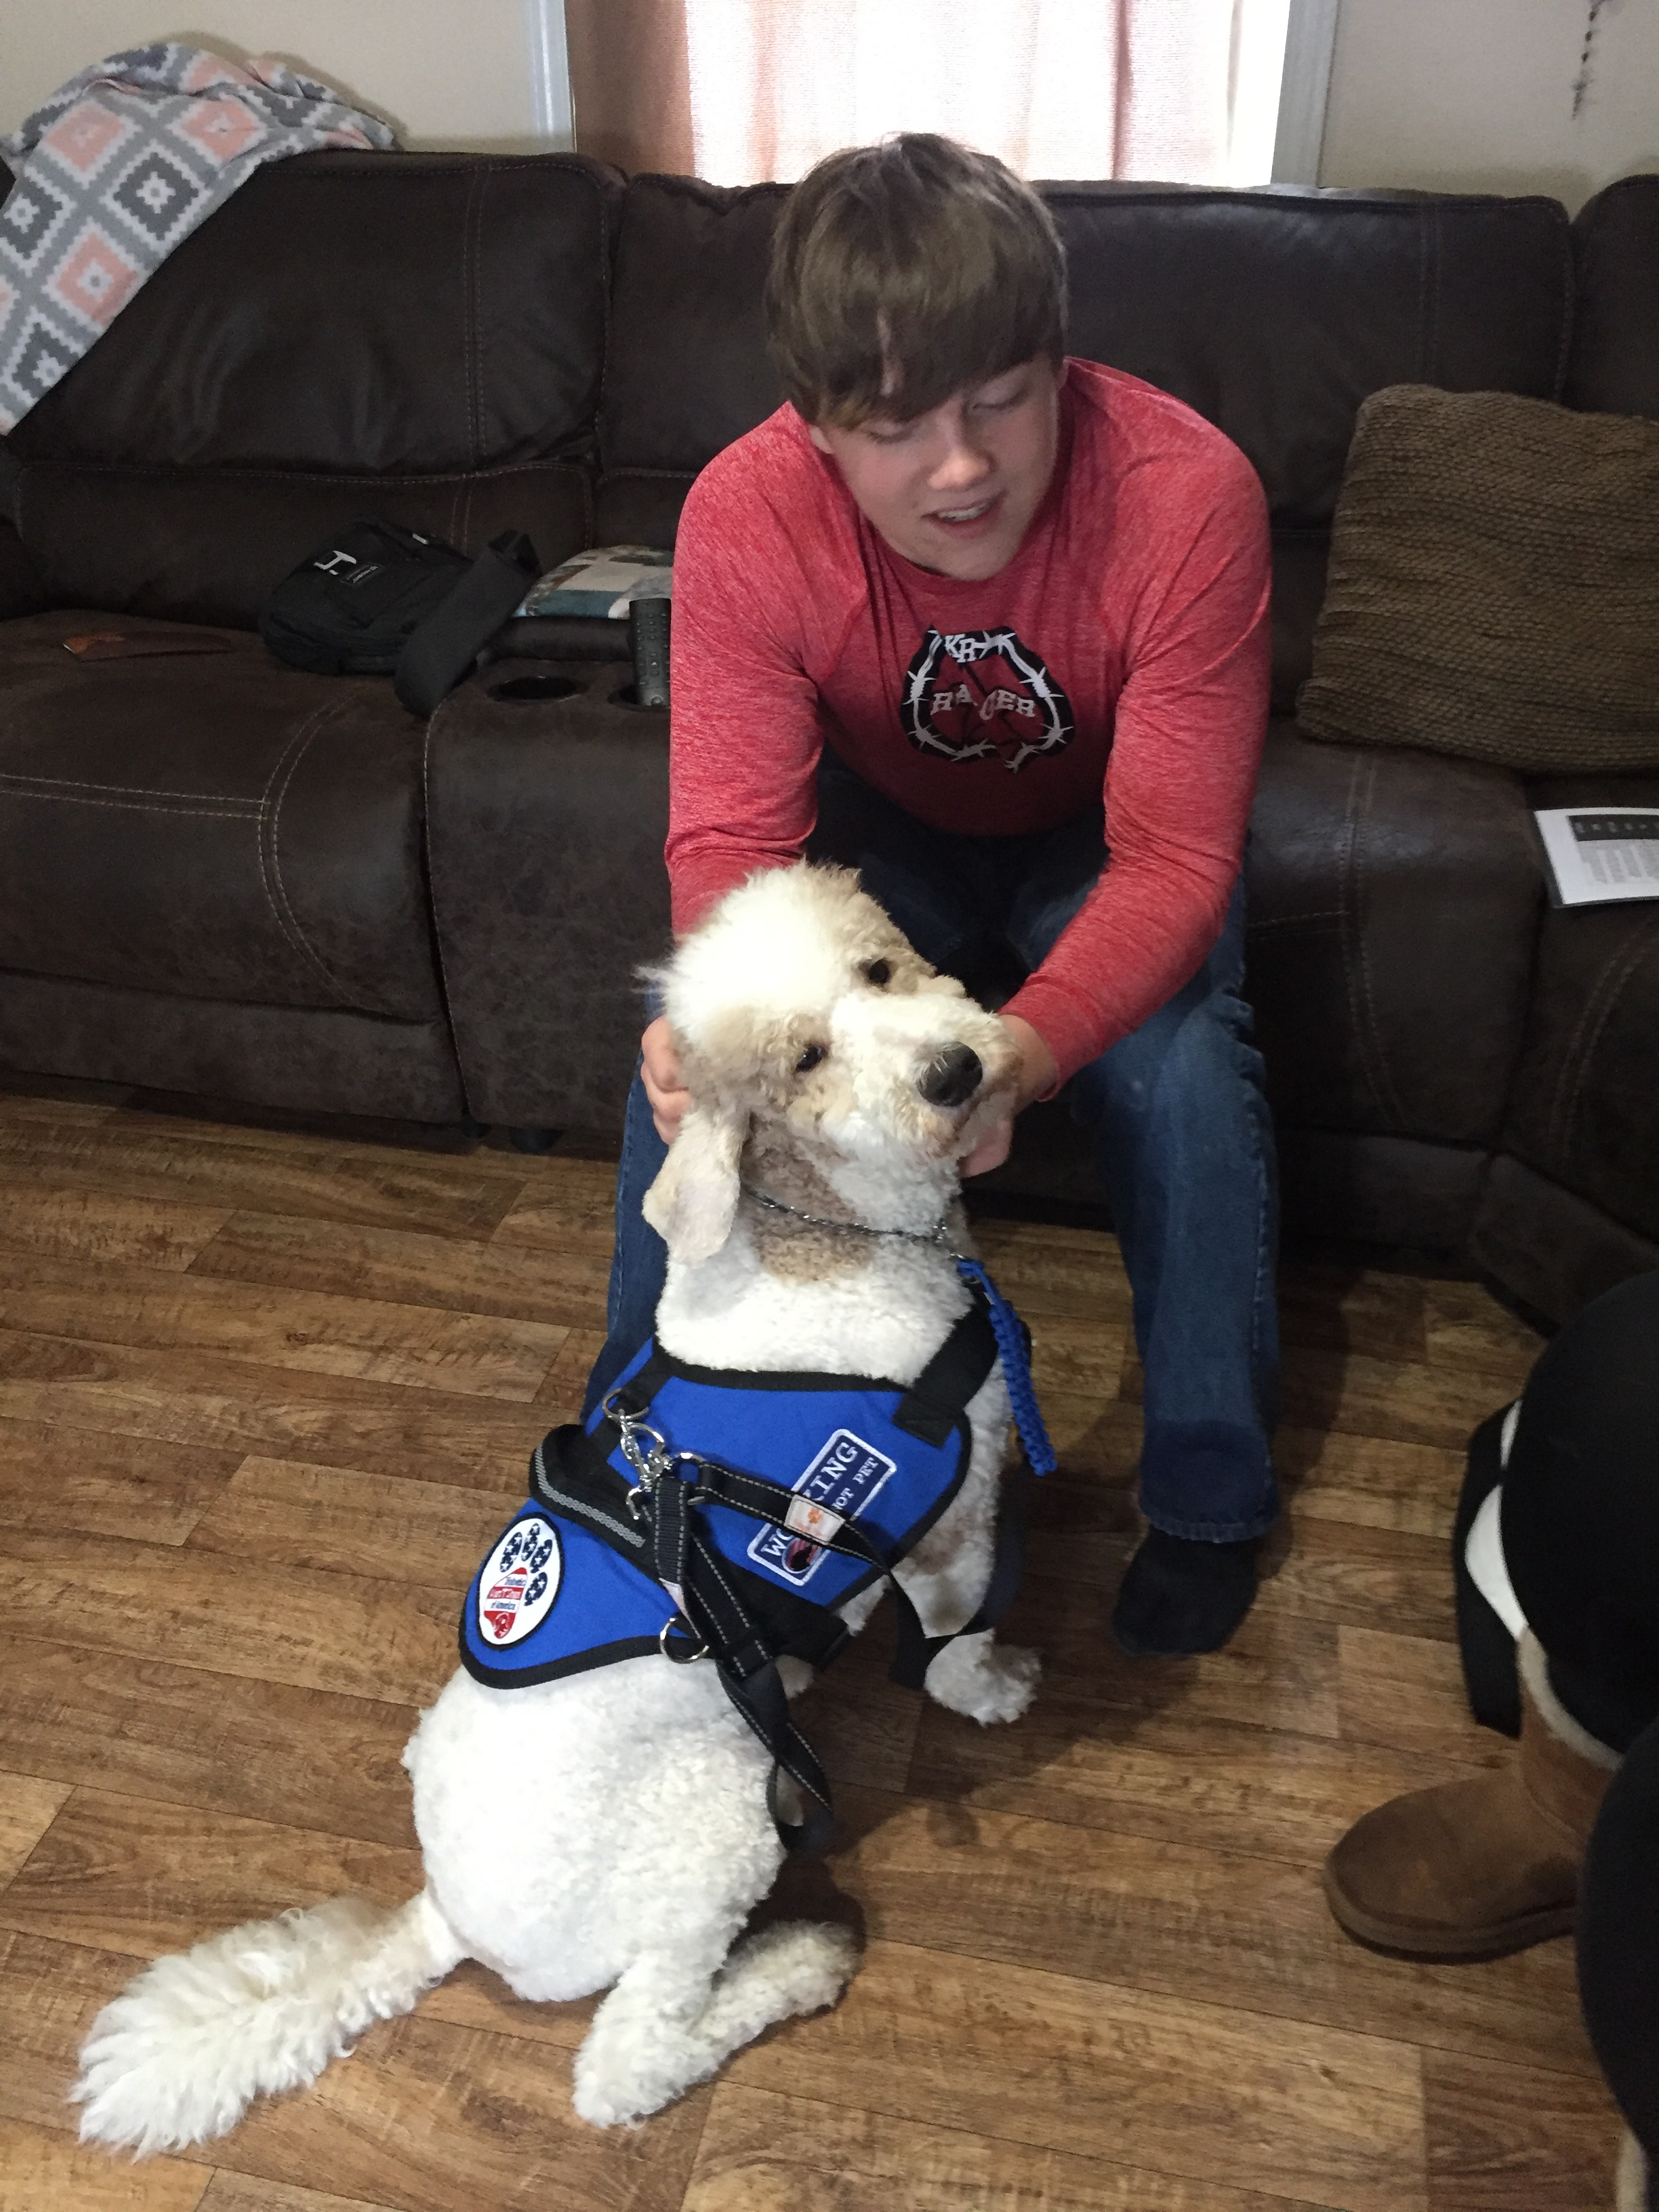
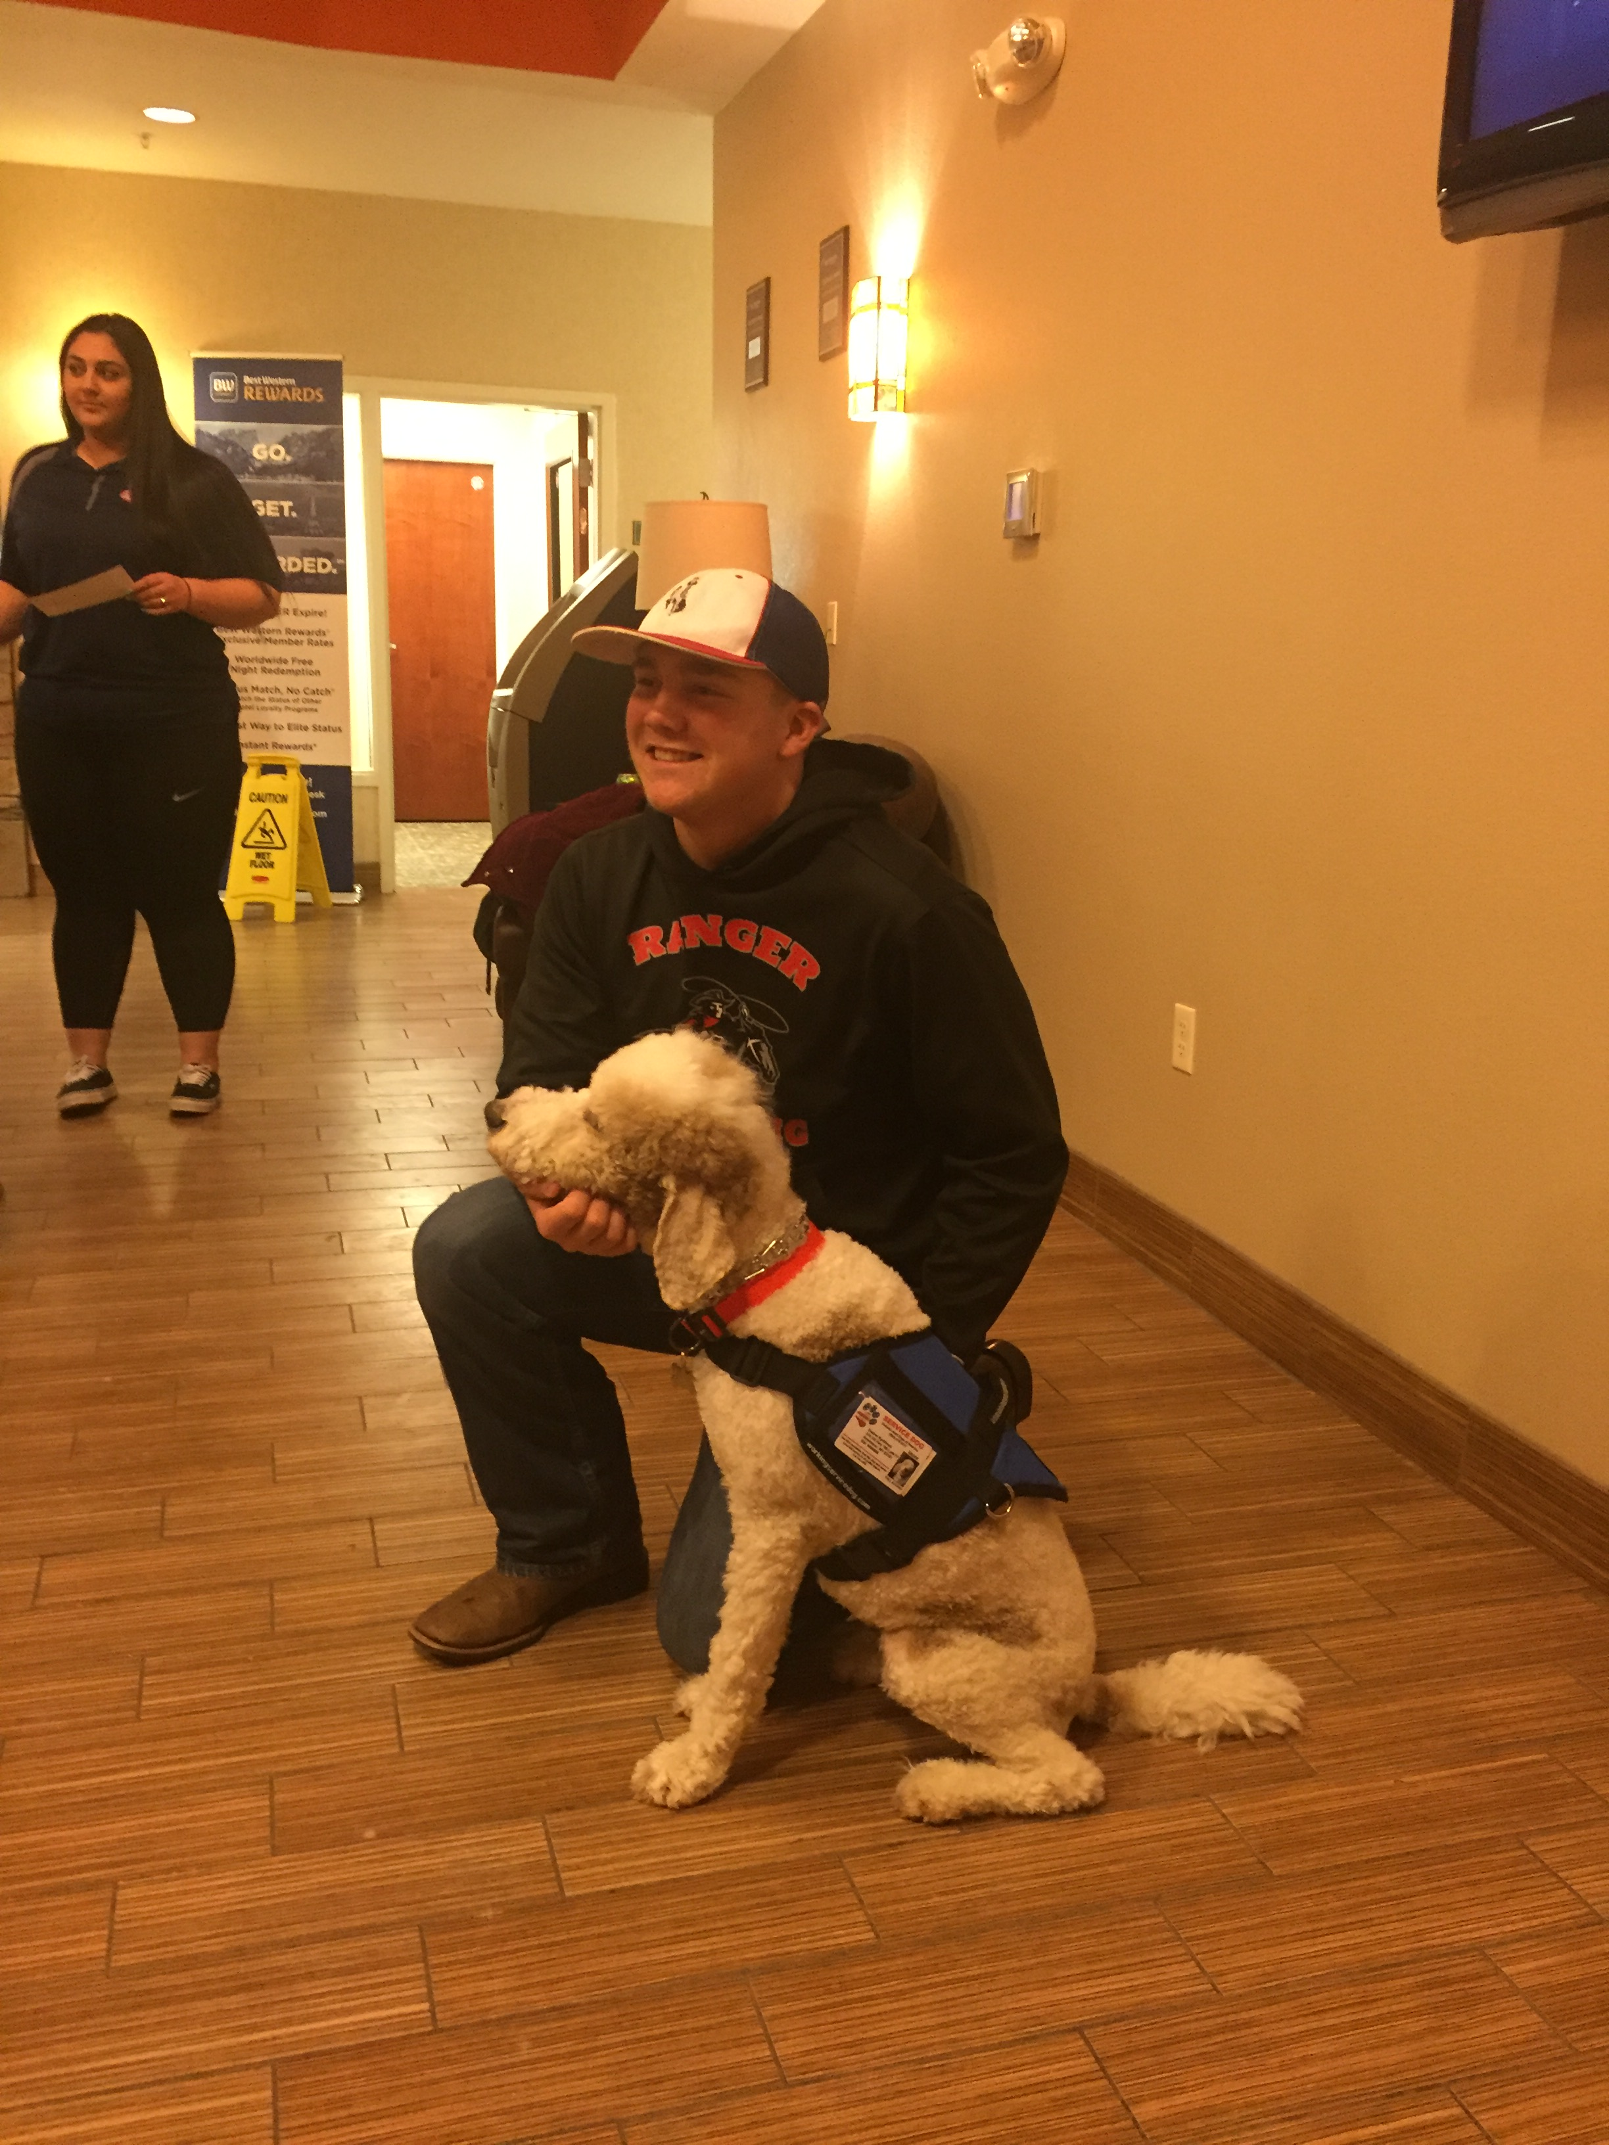
RADAR’S ARRIVAL!
On January 21, 2019, Radar and his trainer arrived in Kemmerer, Wyoming to meet his new family and explore his new home.

Slide 8
RADAR’S ARRIVAL!

Slide 9
RADAR’S ONGOING TRAINING ACTIVITIES

Slide 10
PERFORMING BEYOND EXPECTATION
Since his arrival, Radar has been exceeding the family’s expectations. Immediately upon his arrival, Radar began a vigil not only on Easton but on other members of the family. Easton’s father, Jay, has his own history as a borderline diabetic. Certain changes in Jay’s diet or exercise routine can be problematic. Since his arrival, Radar has alerted on Jay at times, communicating a problem. Upon testing his blood sugar levels, Jay became aware that he was having a high blood sugar-event in each of these instances.

Slide 11
PERFORMING BEYOND EXPECTATION
Recently, Easton and Radar traveled to Big Piney, WY to participate in a Swim Meet event with the school swim team. When swimming, Easton is unable to use monitoring equipment. During the event, Radar is required to be tethered so that he doesn’t interfere with the event. During one of Easton’s events, Radar became agitated and began to bark and howl (activities that are normally discouraged and ones which he wasn’t necessarily trained to do). Thinking that Radar was misbehaving in response to being tied up and away from his companion, Easton’s mother directed Easton to go calm Radar. Once within reach of Easton, Radar began to alert frantically. Upon testing his blood sugar, Easton discovered that the strenuous physical activity had caused his blood sugar to drop to 42. Diabetic patients frequently lose consciousness at 40 or below. Even in the chlorine-filled and humid aquatic environment, Radar was able to perform, exceeding all expectations!

Slide 12
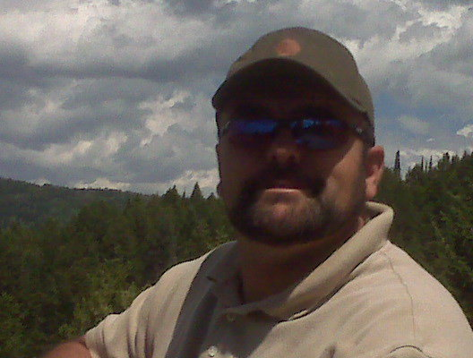
A LIFE-SAVING TOOL FOR OTHERS
Easton and his family have been very open about their situation and this project, with the hope that their experience and success can help others in a similar situation.
To that end, the KLC is happy to provide any information or details on this project. Diabetic Service dogs are relatively new life-saving tool to add another level of vigilance and proactivity in coping with this potentially life-threatening and debilitating disease.
Any questions about this project may be directed to the following contact:
Mark Quinn (Kemmerer Lions Club)
Email: maquinn1@gmail.com
Phone: (307) 723-7680

Slide 13
ANIMAL/TRAINING SERVICE PROVIDER
The provider of the service animal, training, and ongoing support for this projects is Diabetic Alert Dogs of America
5782 Field Breeze Street
Las Vegas, NV 89148
Phone: (800) 975-5177
Web: https://www.diabeticalertdogsofamerica.com/

Slide 14
CONCLUSION – THANK YOU!
This project would not have been possible without the generosity and support of all of the people and organizations involved. The Rydstrom family and the KLC cannot express their collective gratitude for the financial support, creativity, and legwork involved in reaching this life-saving goal.
Most importantly, a young man has a chance to pursue a life of good health, independence, and productivity.
THANK YOU!

