Slide 1
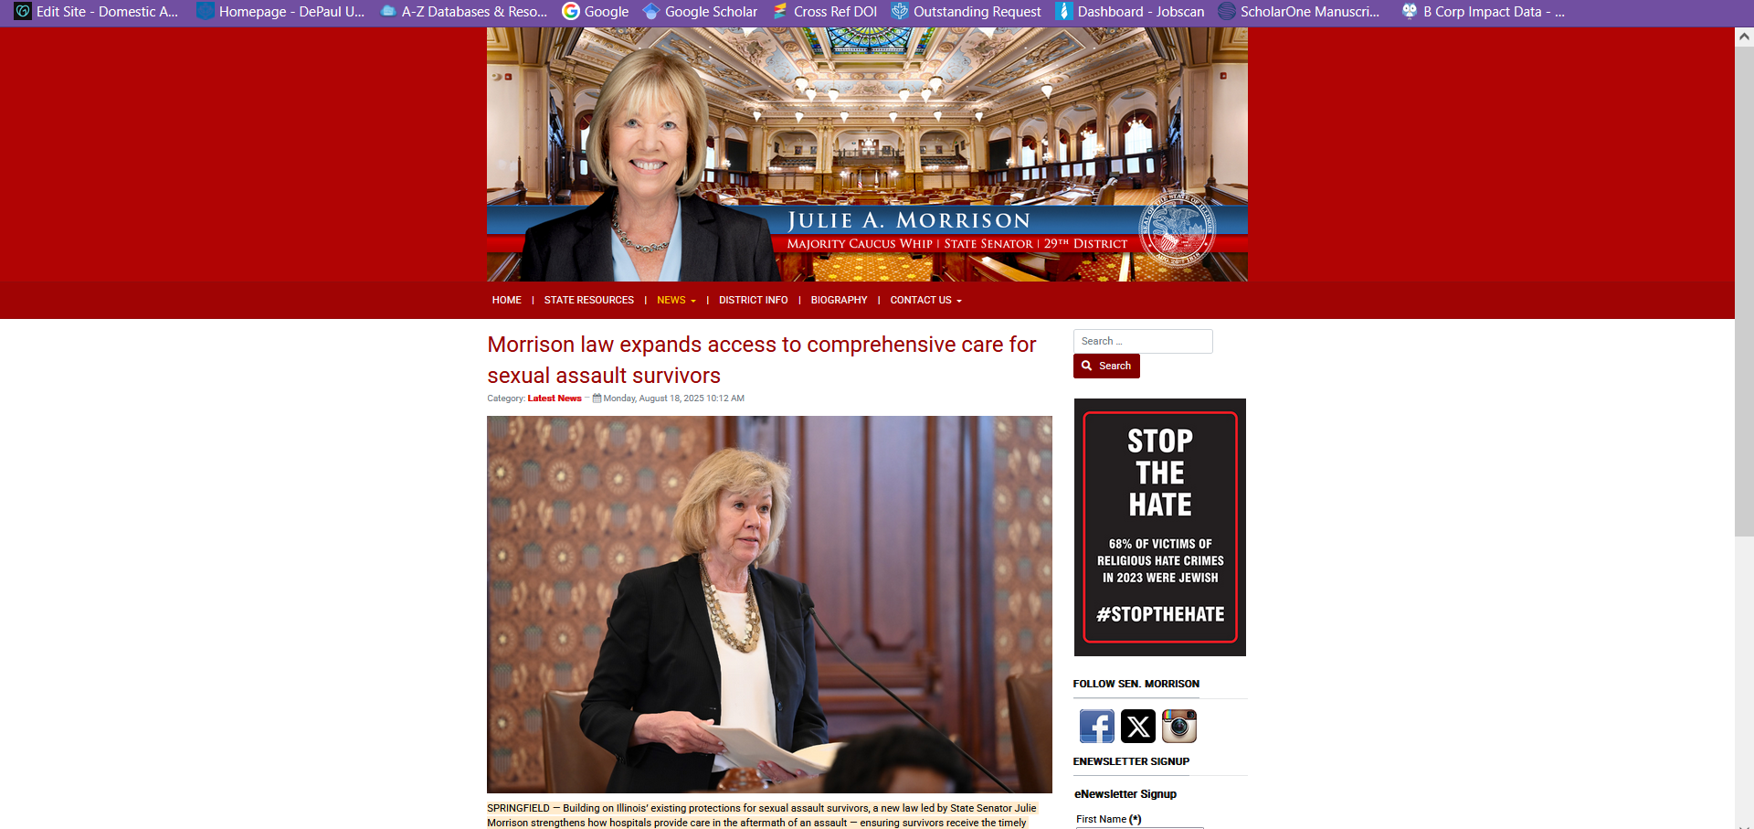
Sen.Morrision Law to Expand Services for Assault Victims

