Slide 1
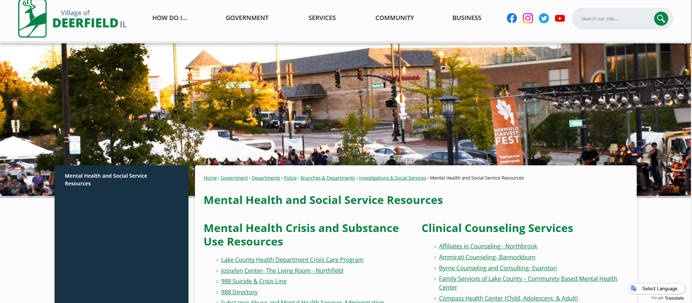
https://www.deerfield.il.us/846/Mental-Health-and-Social-Service-Resourc

