Slide 1
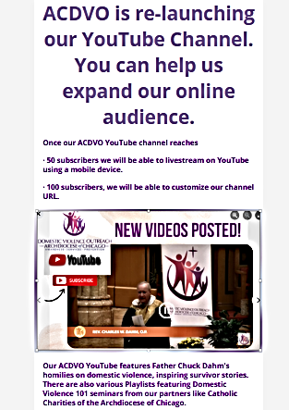

Click this button to go and select the “Subscribe button”.
https://www.youtube.com/channel/UCXBMWQu6dWngvRzAZVRN92w/featured

